Slide 1
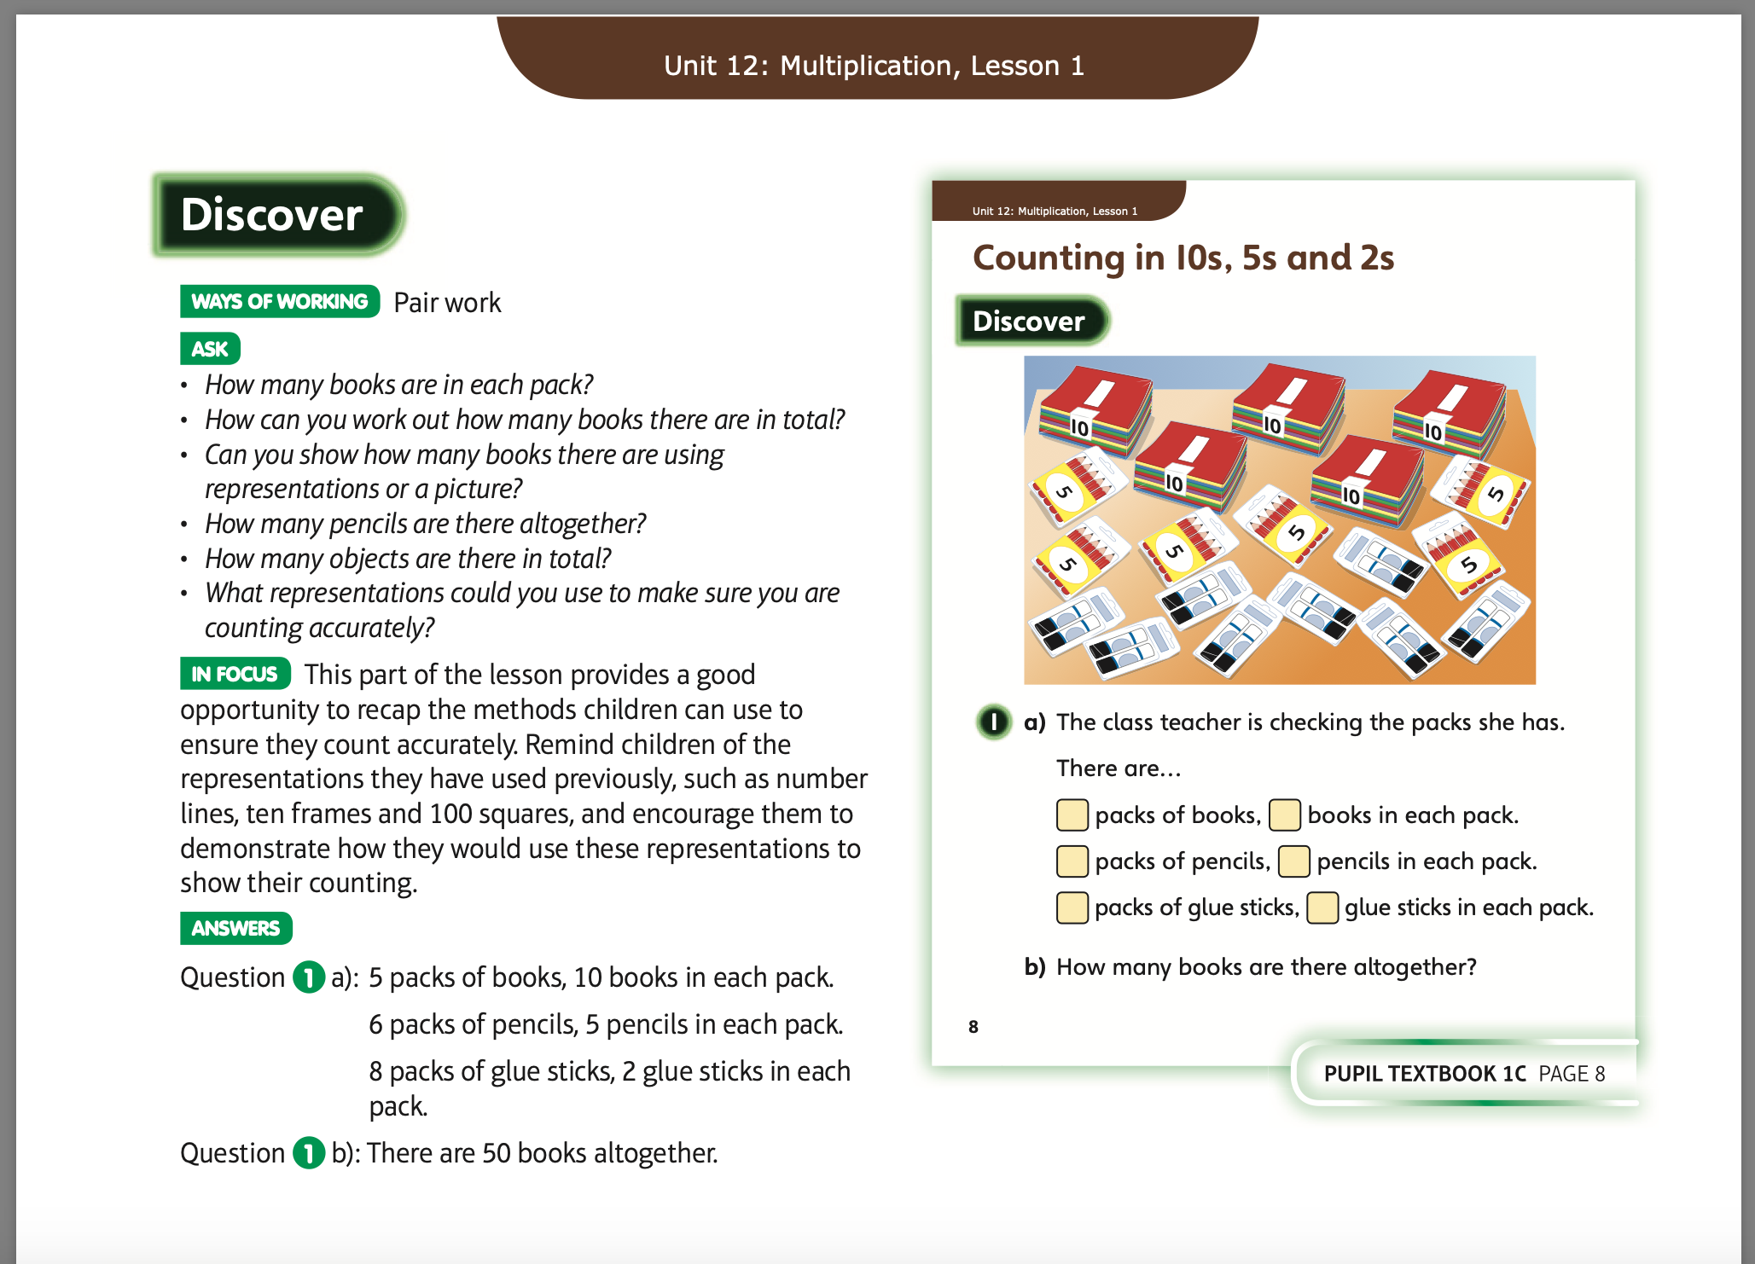
Monday 20.4.20
Have a look at these

Slide 2
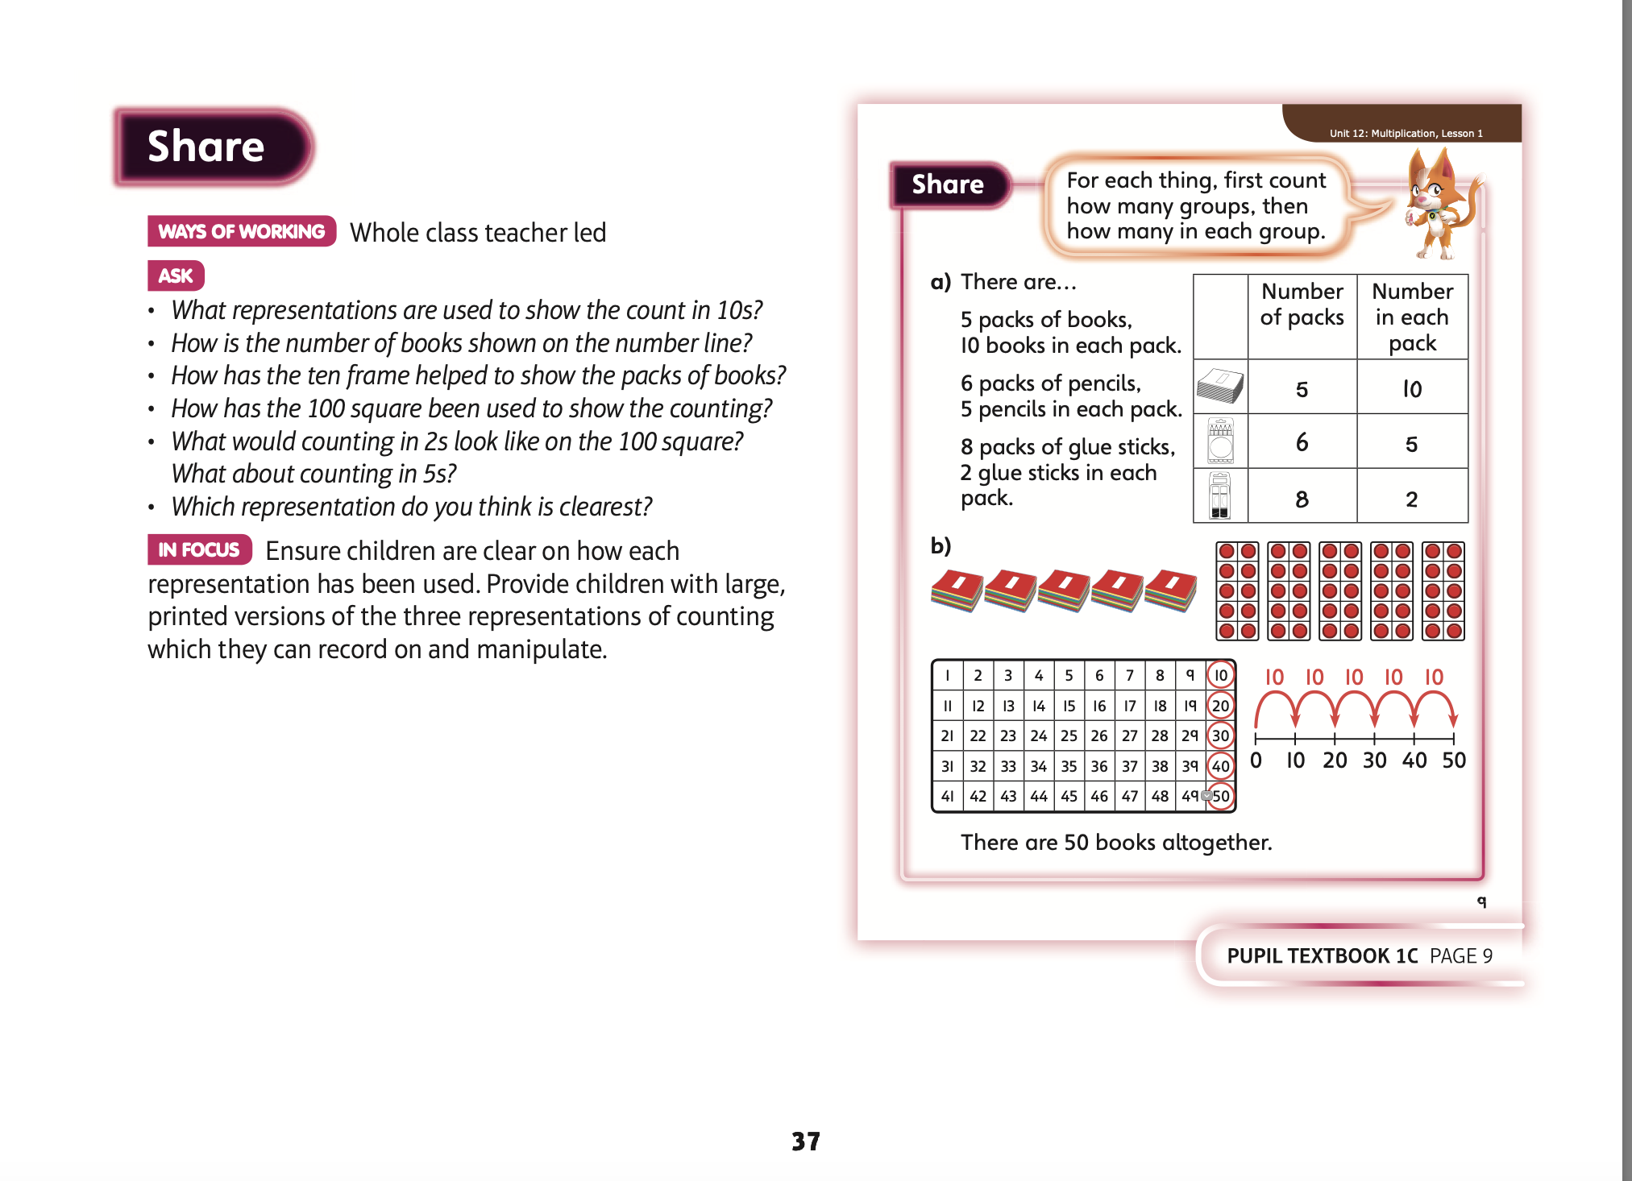
Now complete Unit 12 lesson 1 p 6

Slide 3
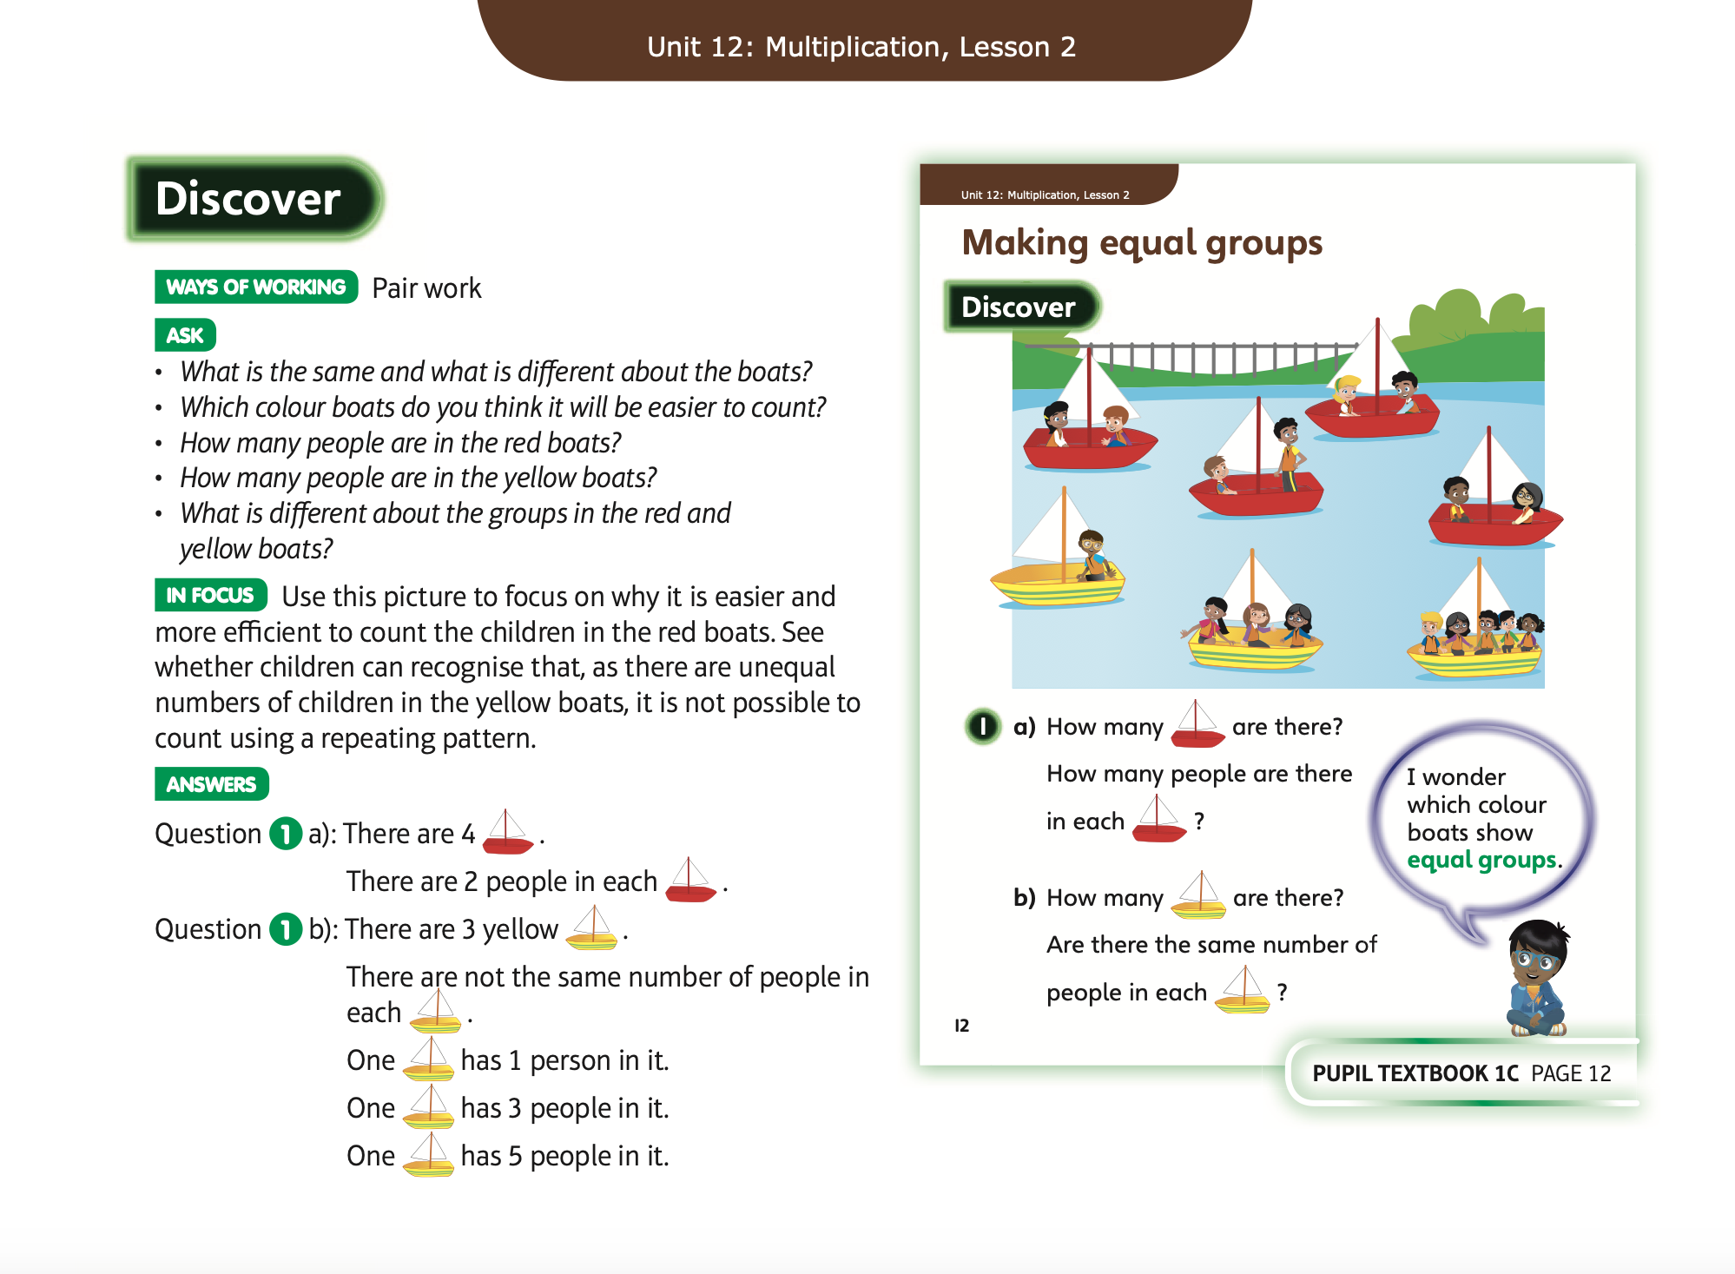
Tuesday 21.4.20
Have a look at these

Slide 4
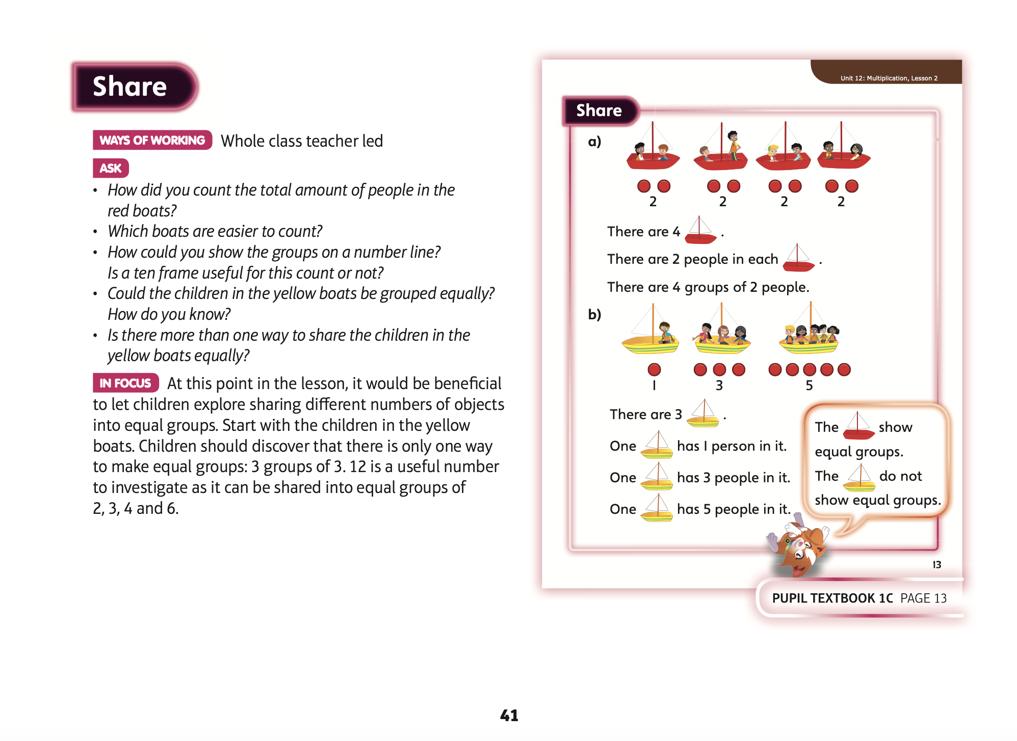
Now complete Unit 12 lesson 2 p 9

Slide 5
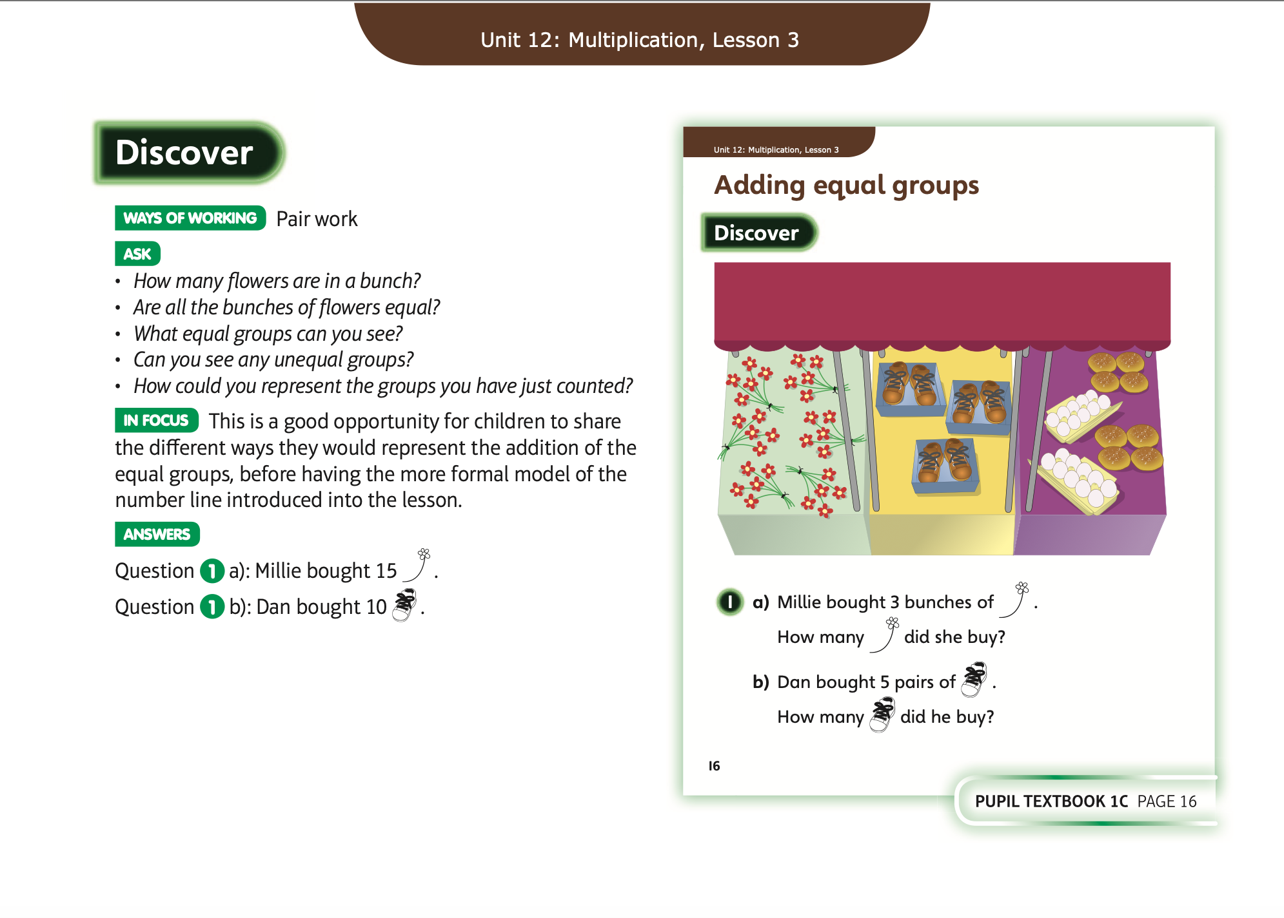
Wednesday 22.4.20
Have a look at these

Slide 6
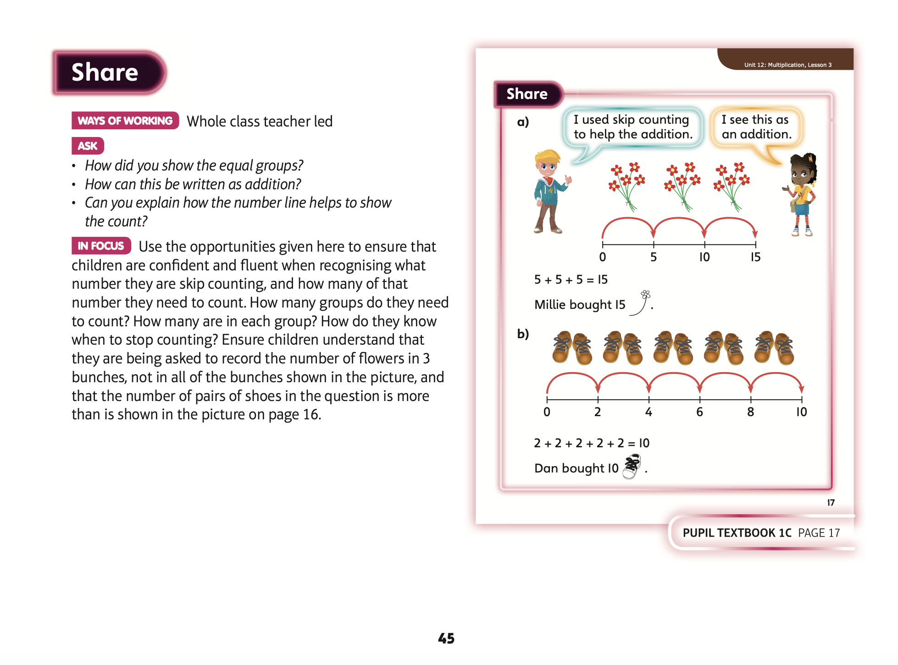
Now complete Unit 12 lesson 3 p 12

Slide 7
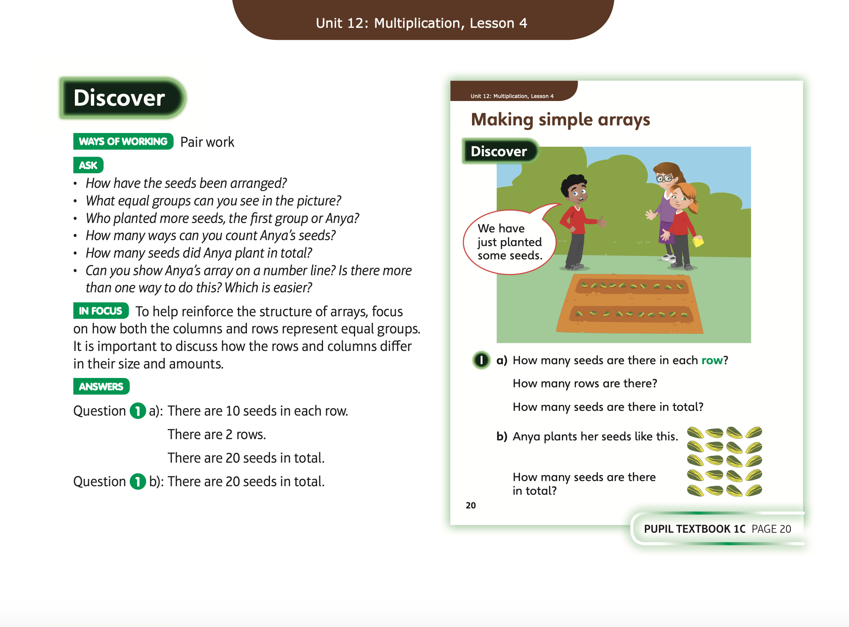
Thursday 23.4.20
Have a look at these

Slide 8
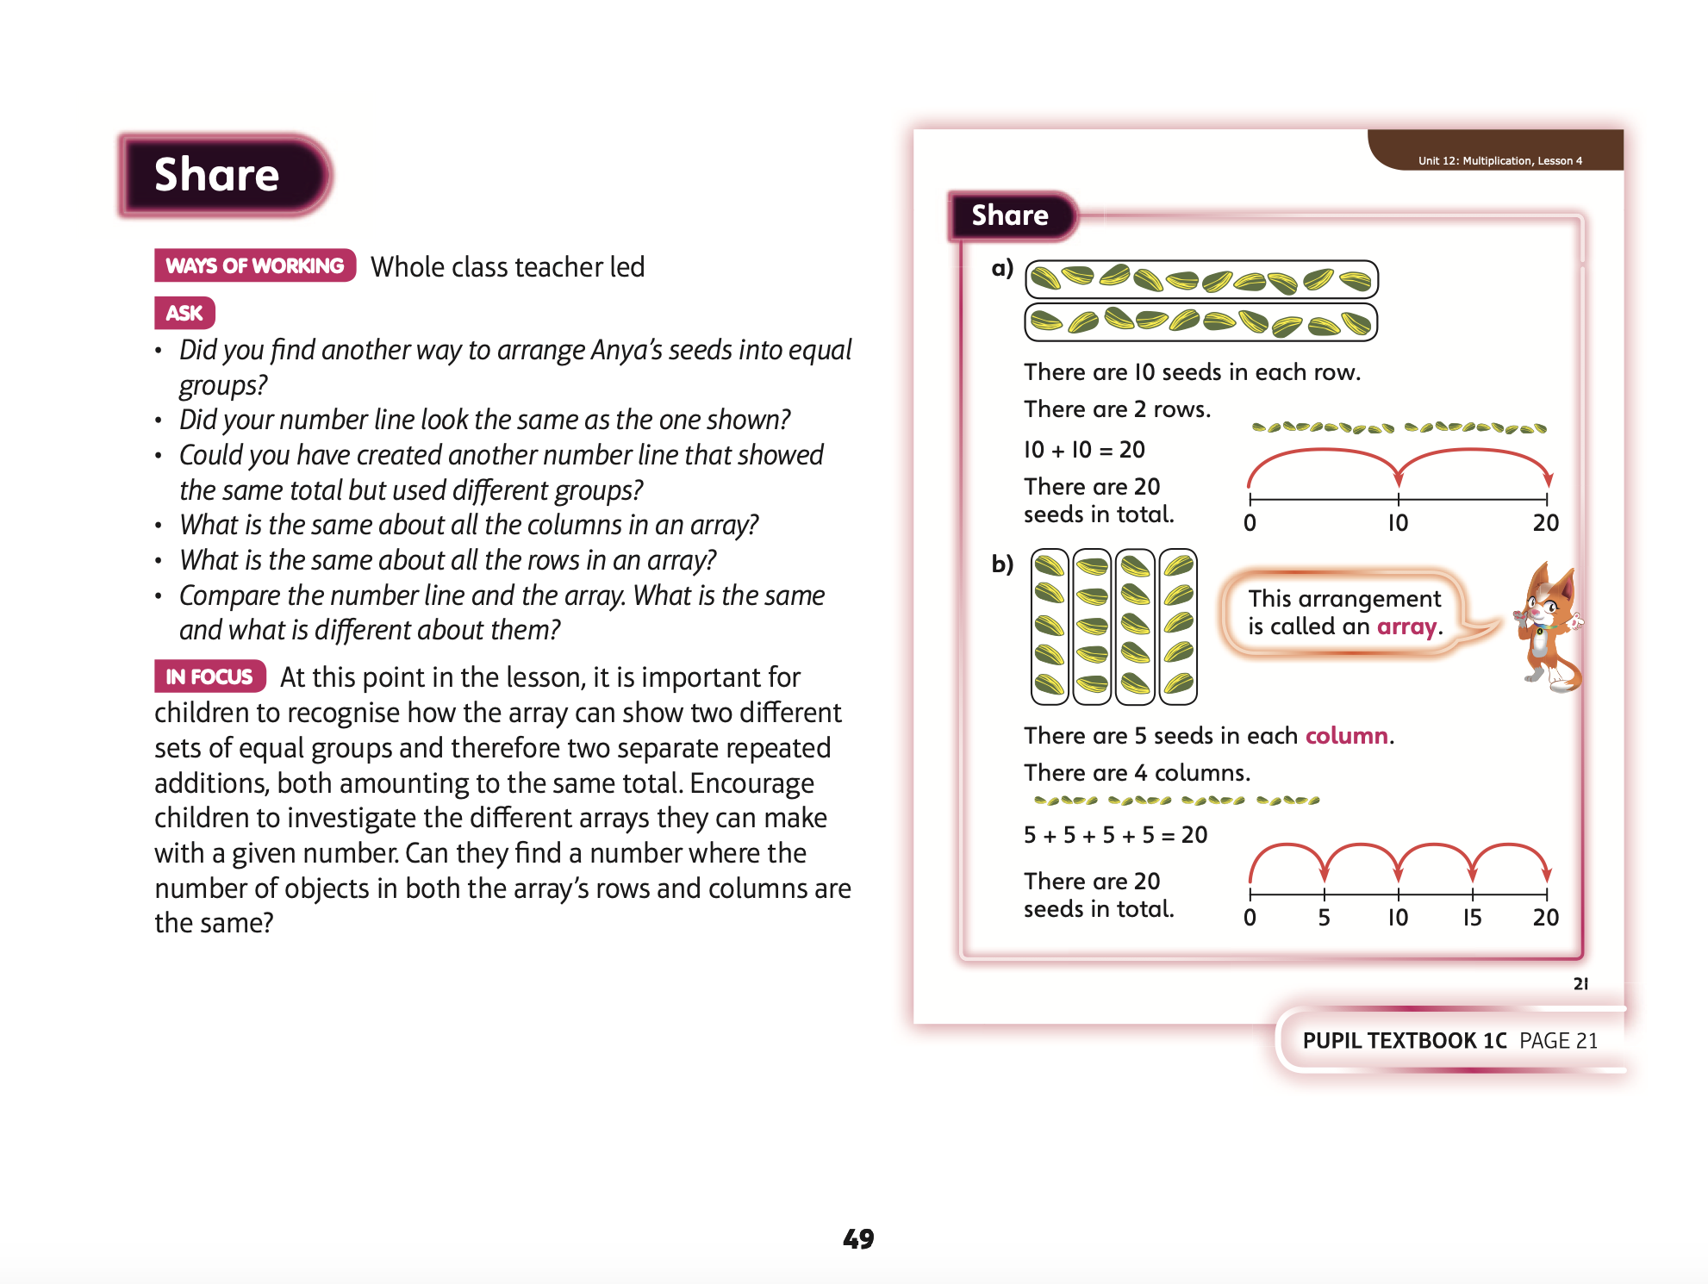
Now complete Unit 12 lesson 4 p 15

Slide 9
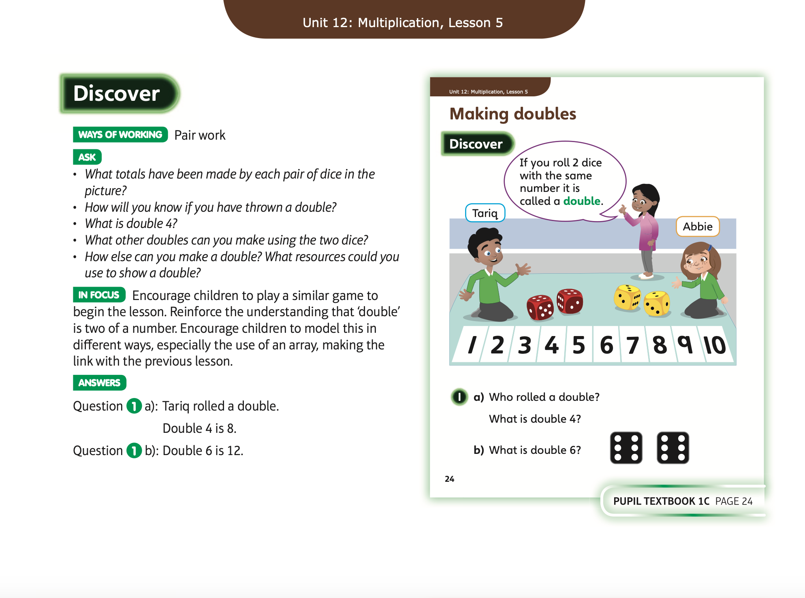
Friday 24.4.20
Have a look at these

Slide 10
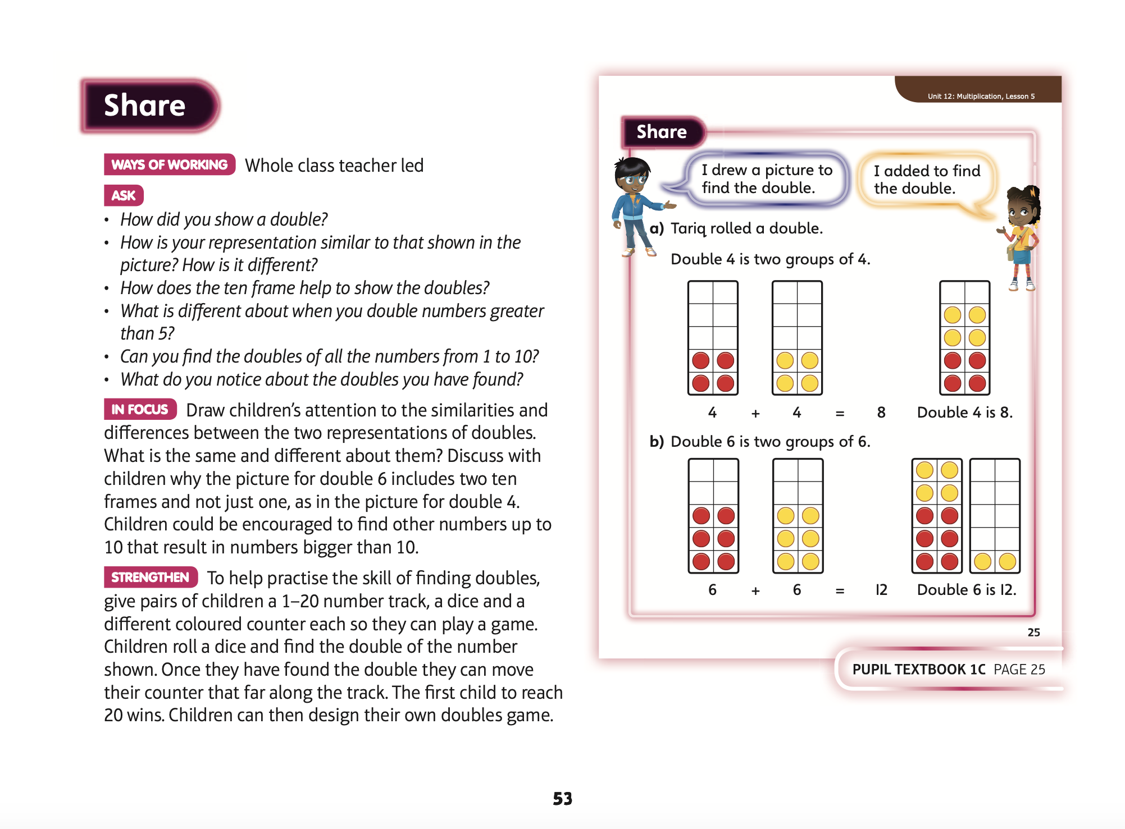
Now complete Unit 12 lesson 5 p 18

