Slide 1
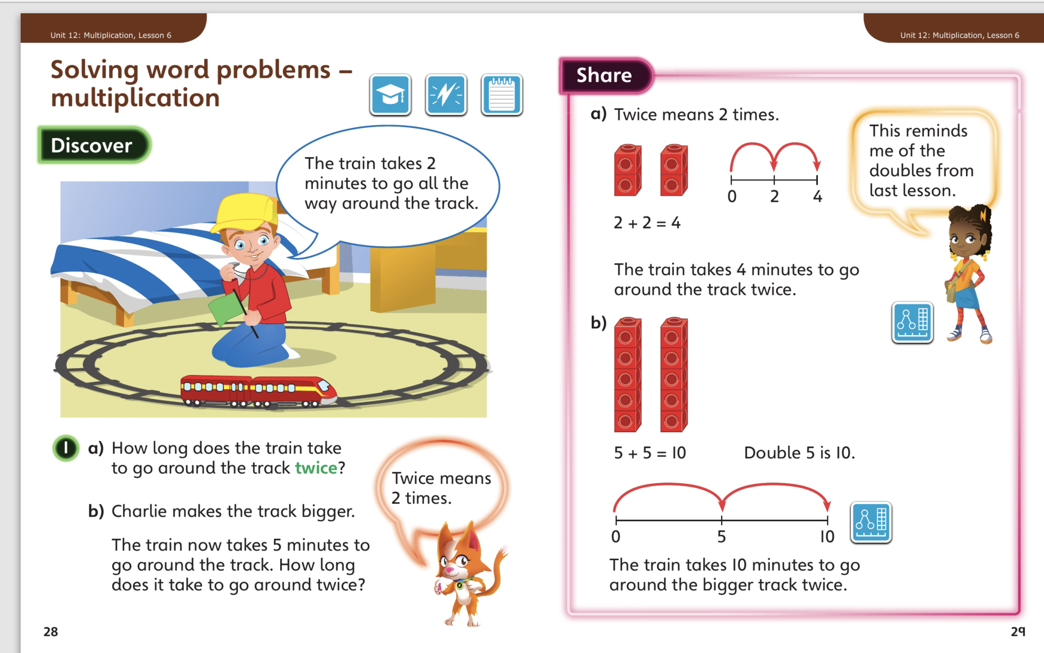
27.4.20 – Share these pages

Slide 2
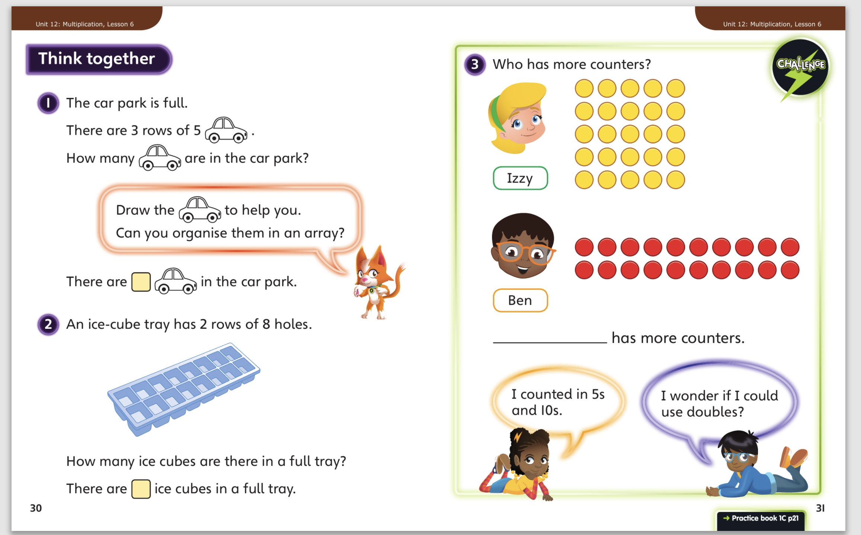
Then complete Unit 12 lesson 6 p21

Slide 3
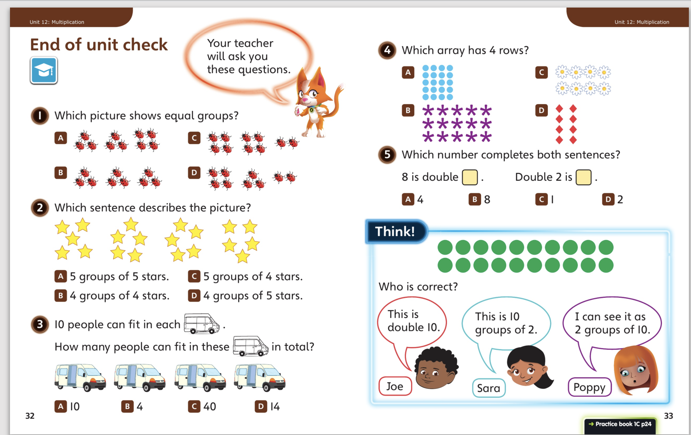
28.4.20 – Share these pages then complete
the end of unit check on p 24

Slide 4
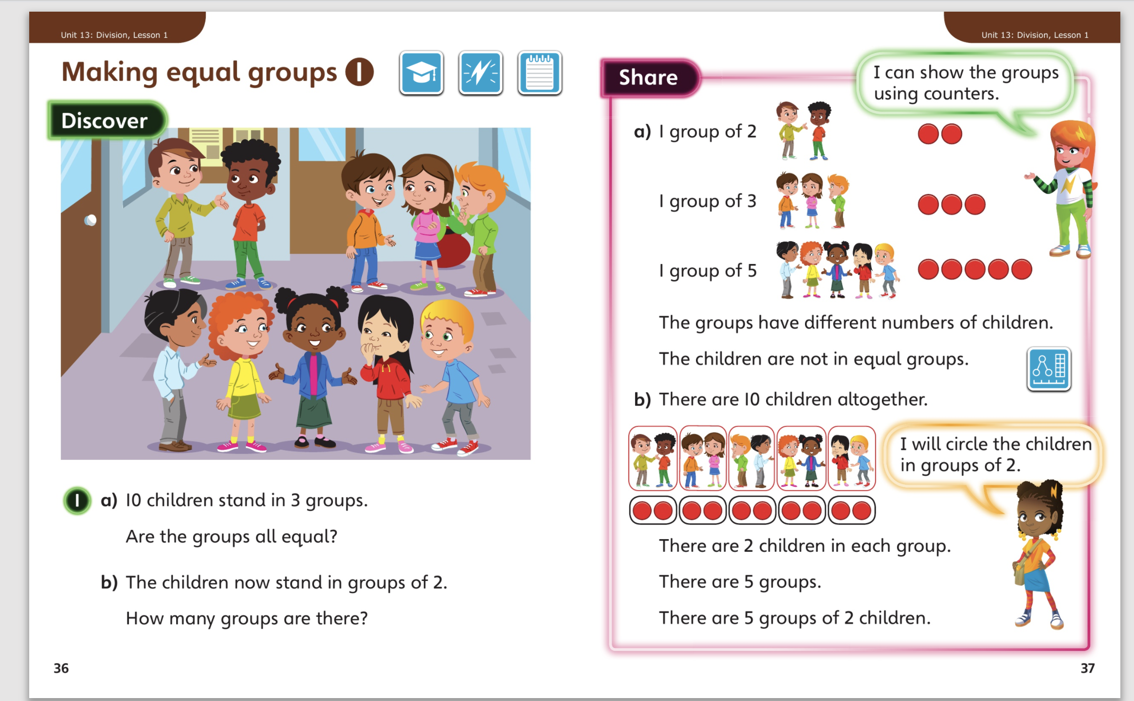
29.4.20 – Share these pages

Slide 5
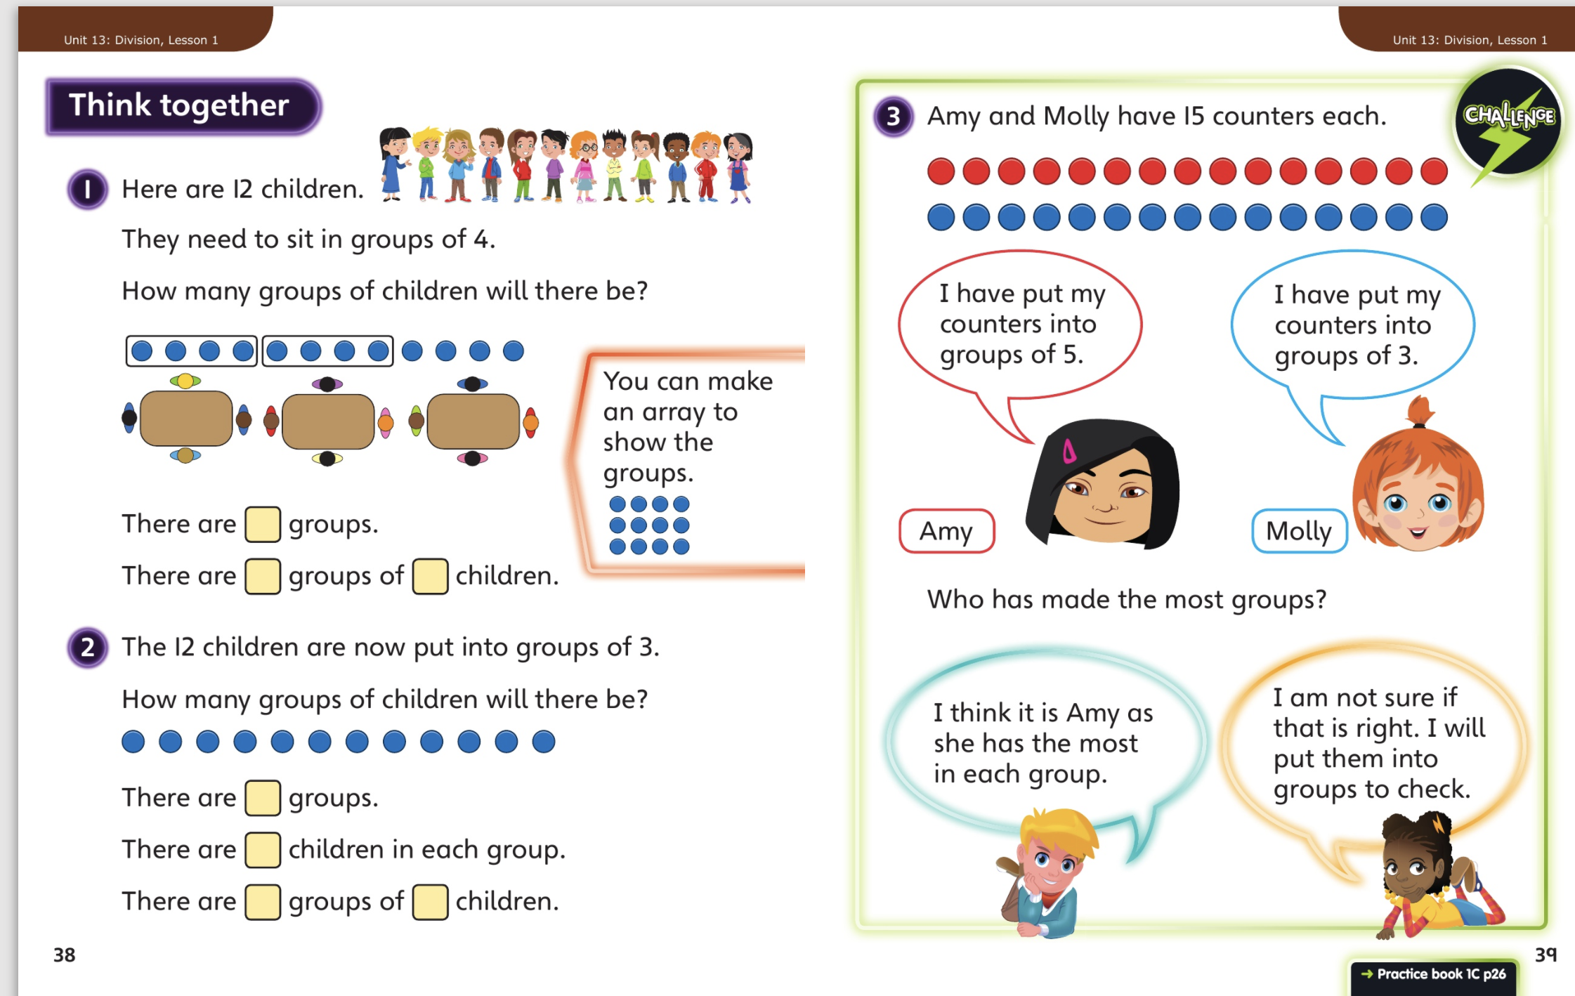
Then complete Unit 13, lesson 1 p 26

Slide 6
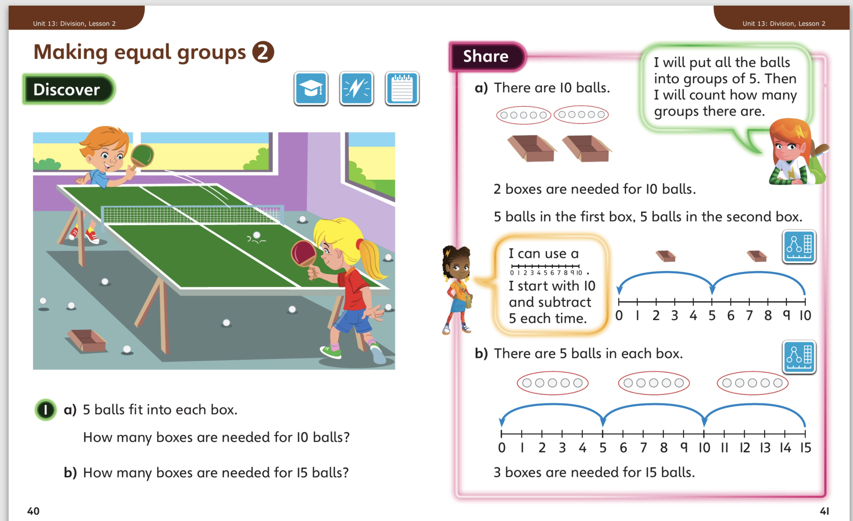
30.4.20 – Share these pages

Slide 7
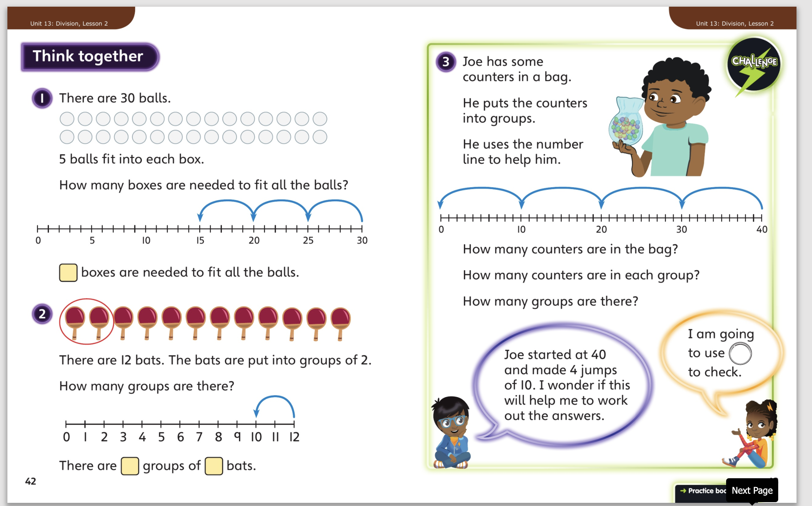
Then complete Unit 13, lesson 2, p29

Slide 8
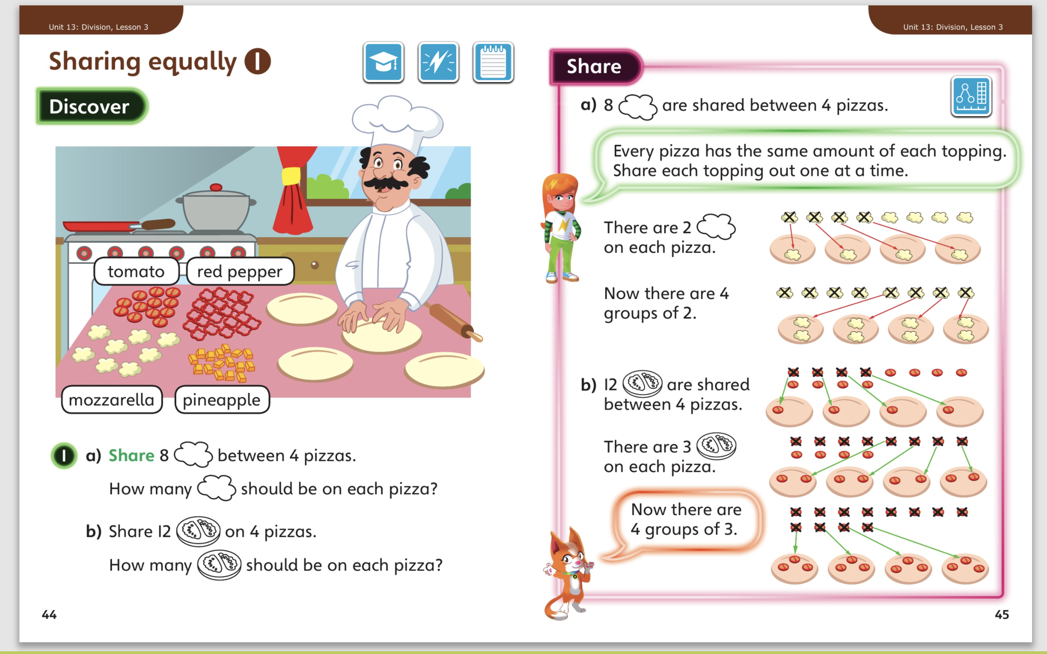
1.5..20 – Share these pages

Slide 9
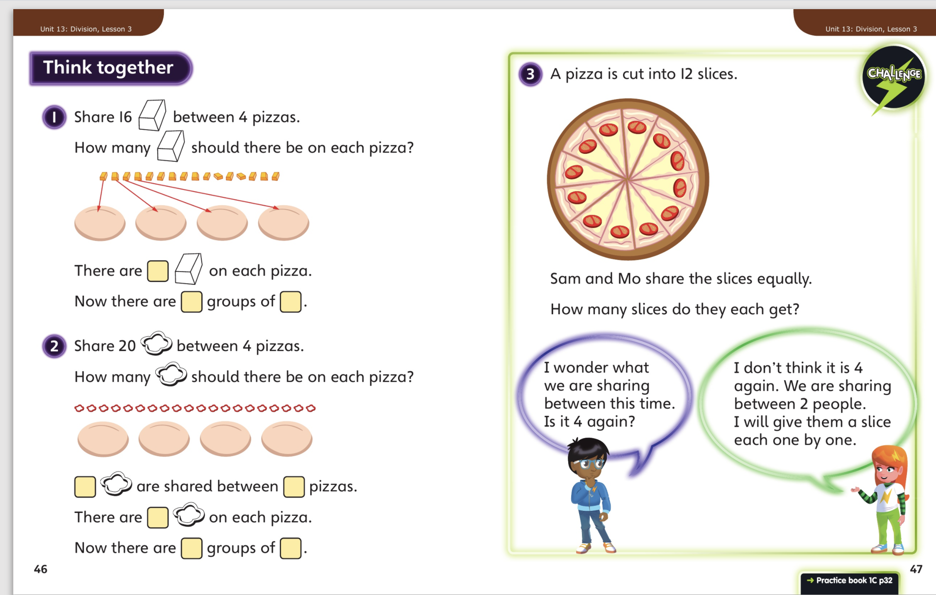
Then complete unit 13, lesson 3, p 32

