Slide 1
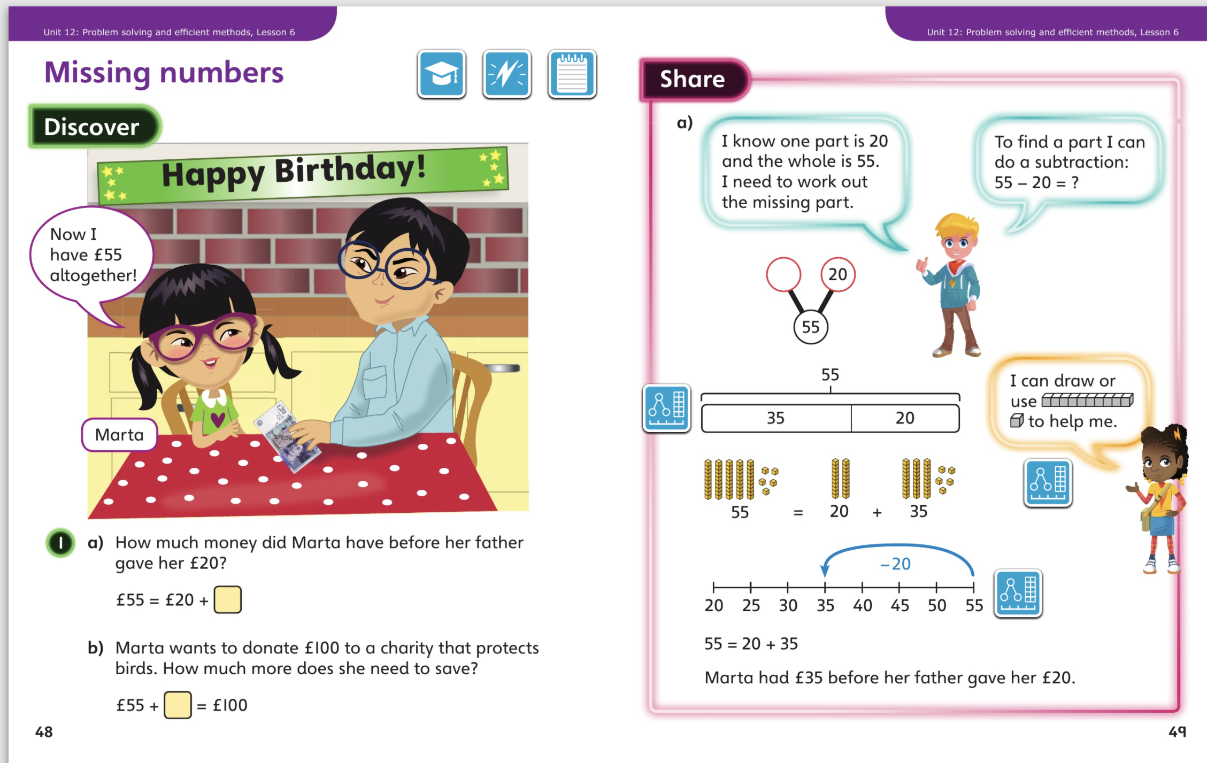

Slide 2
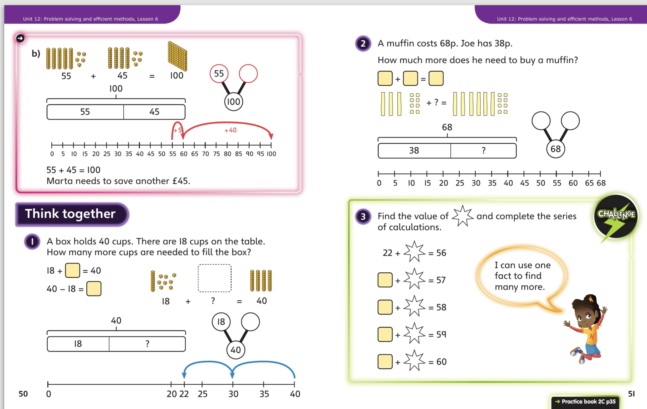
Now complete Unit 12, lesson 6 p35

Slide 3
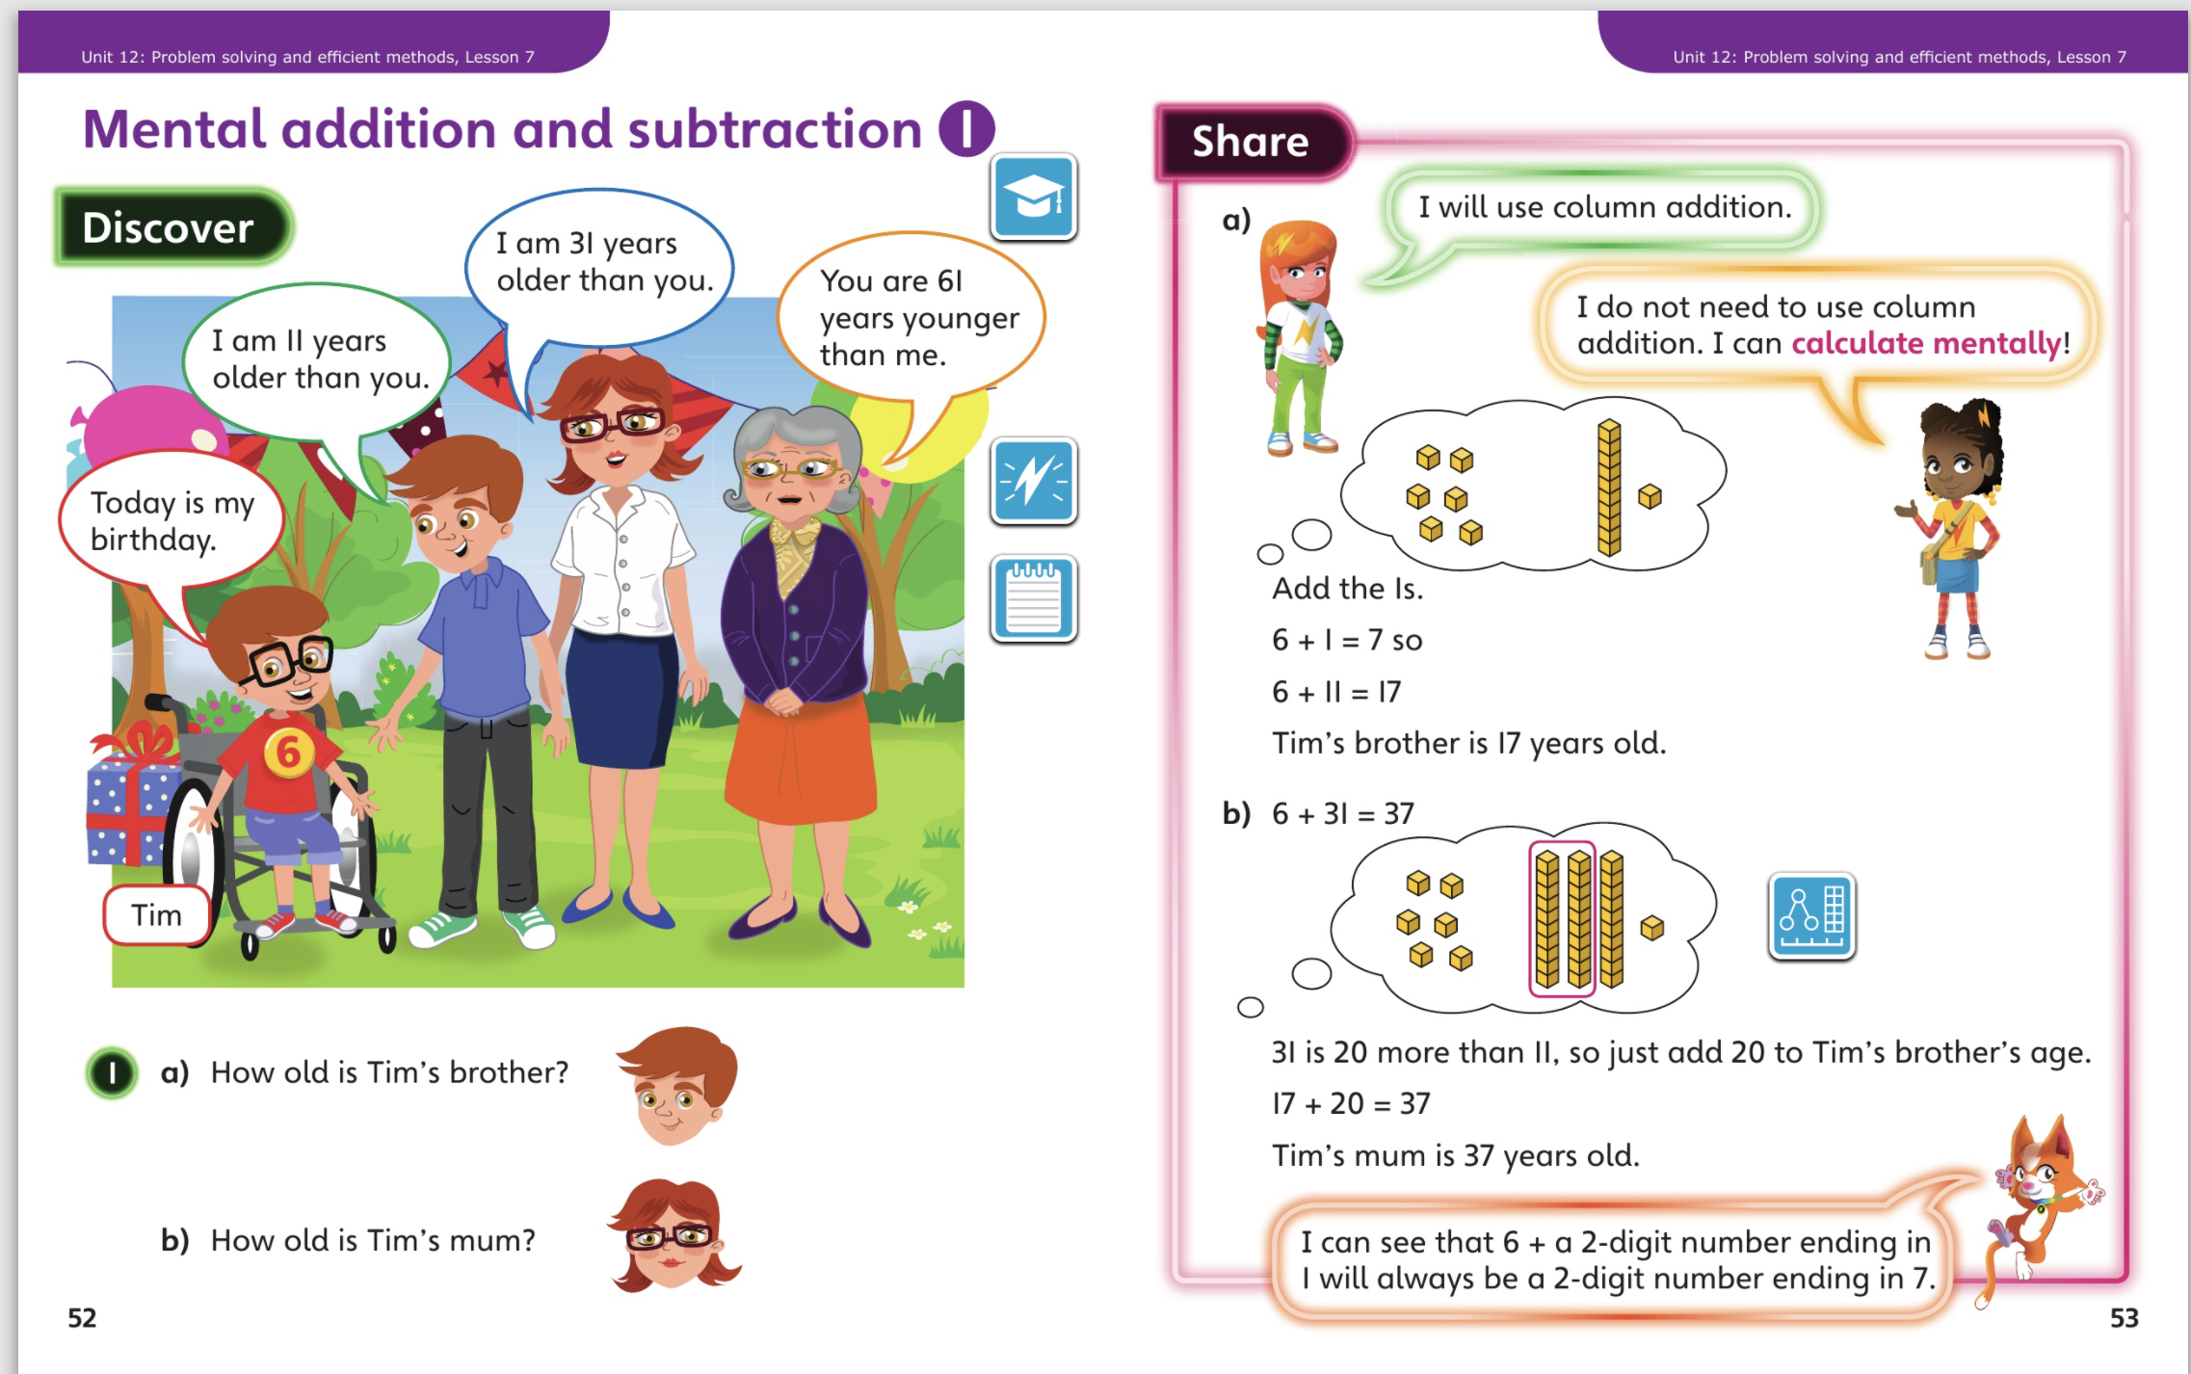
5.5.20 – Share these pages

Slide 4
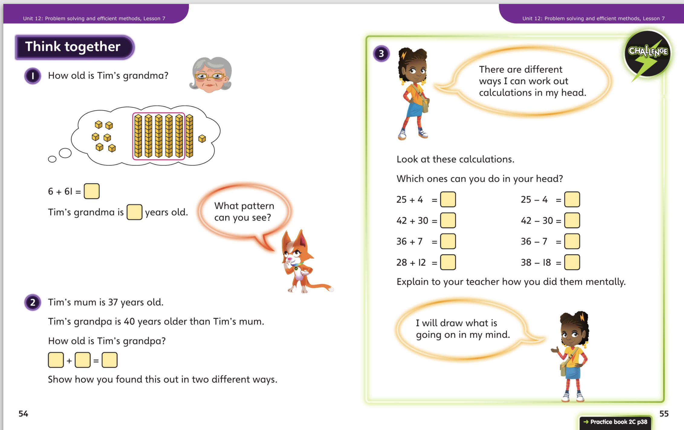
Now complete Unit 12, lesson 7 p38

Slide 5
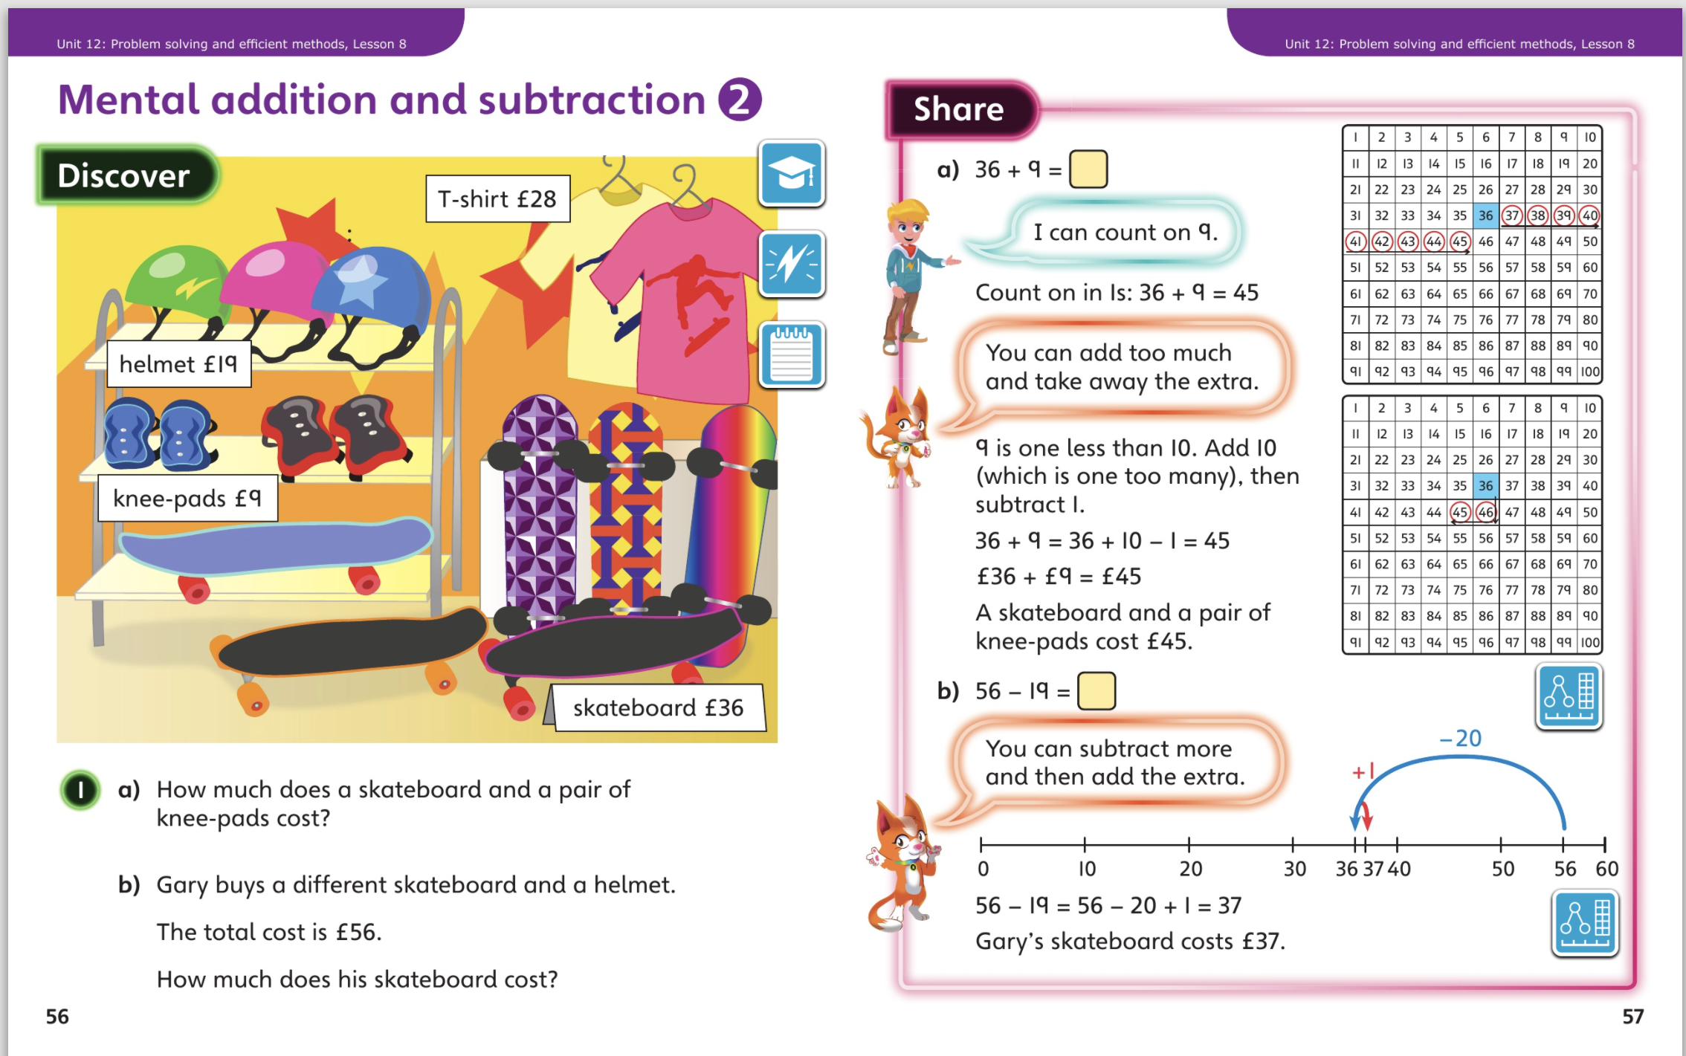
6.5.20 – Share these pages

Slide 6
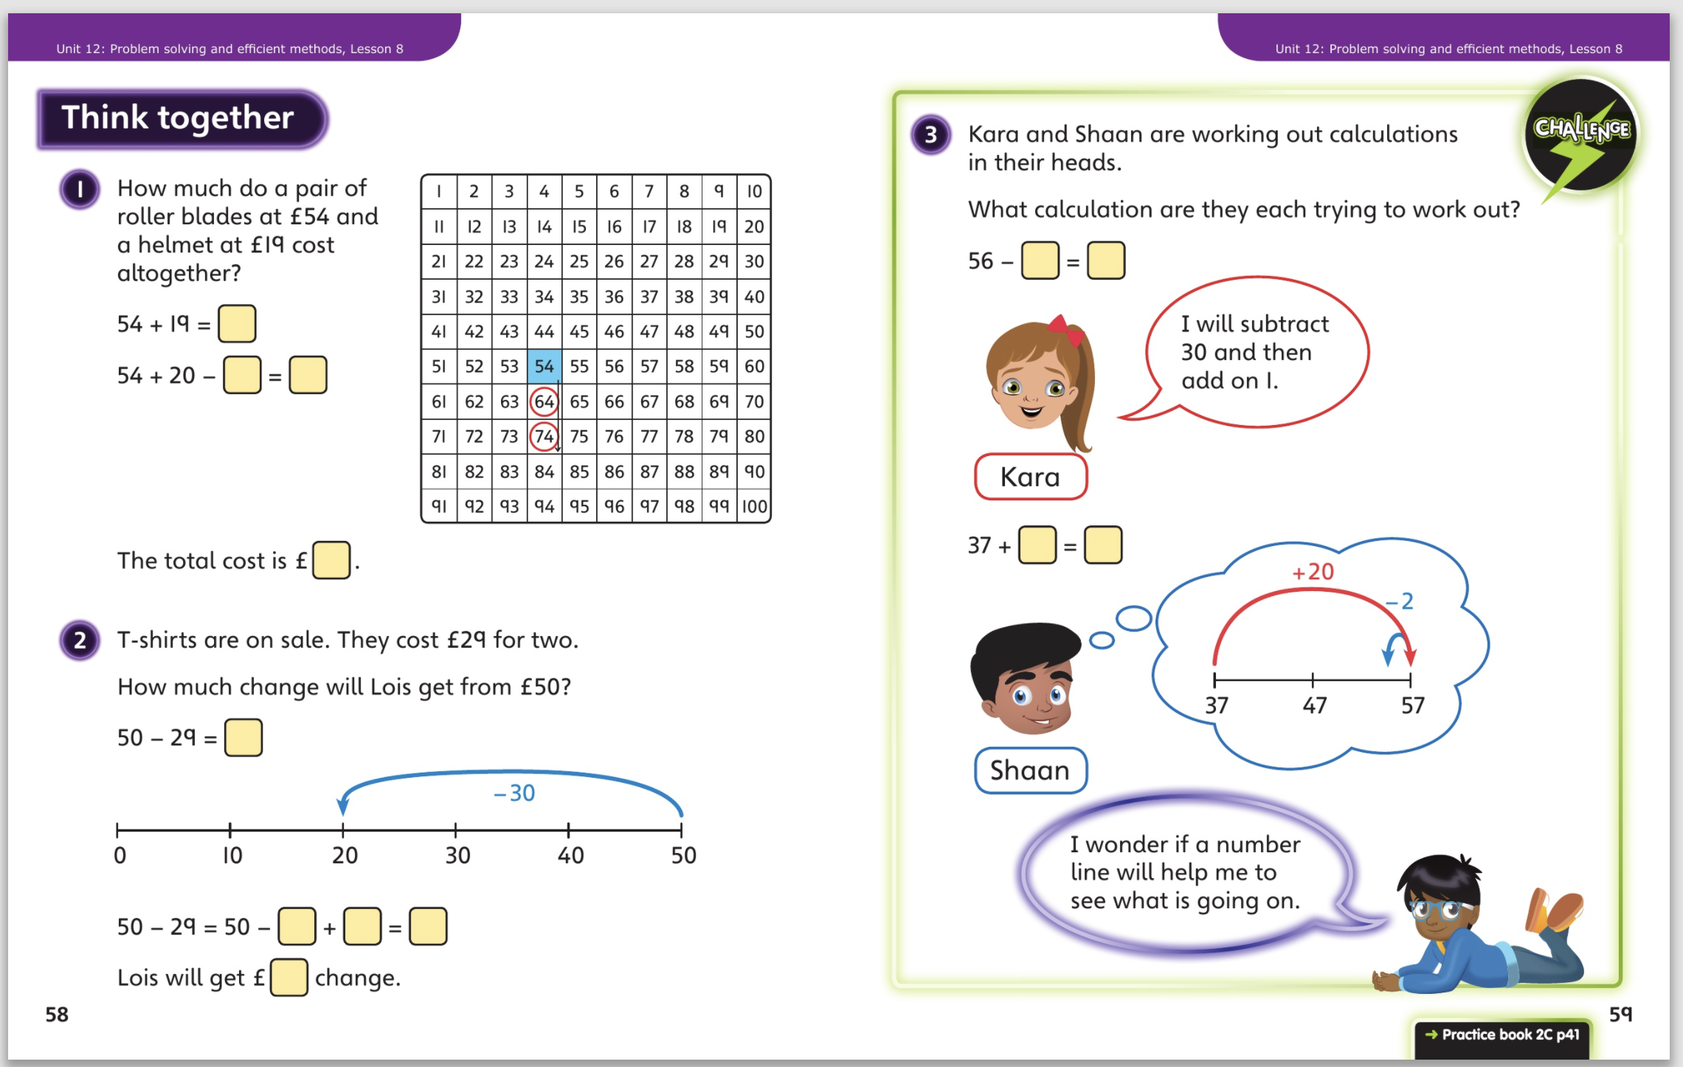
Now complete Unit 12, lesson 8 p41

Slide 7
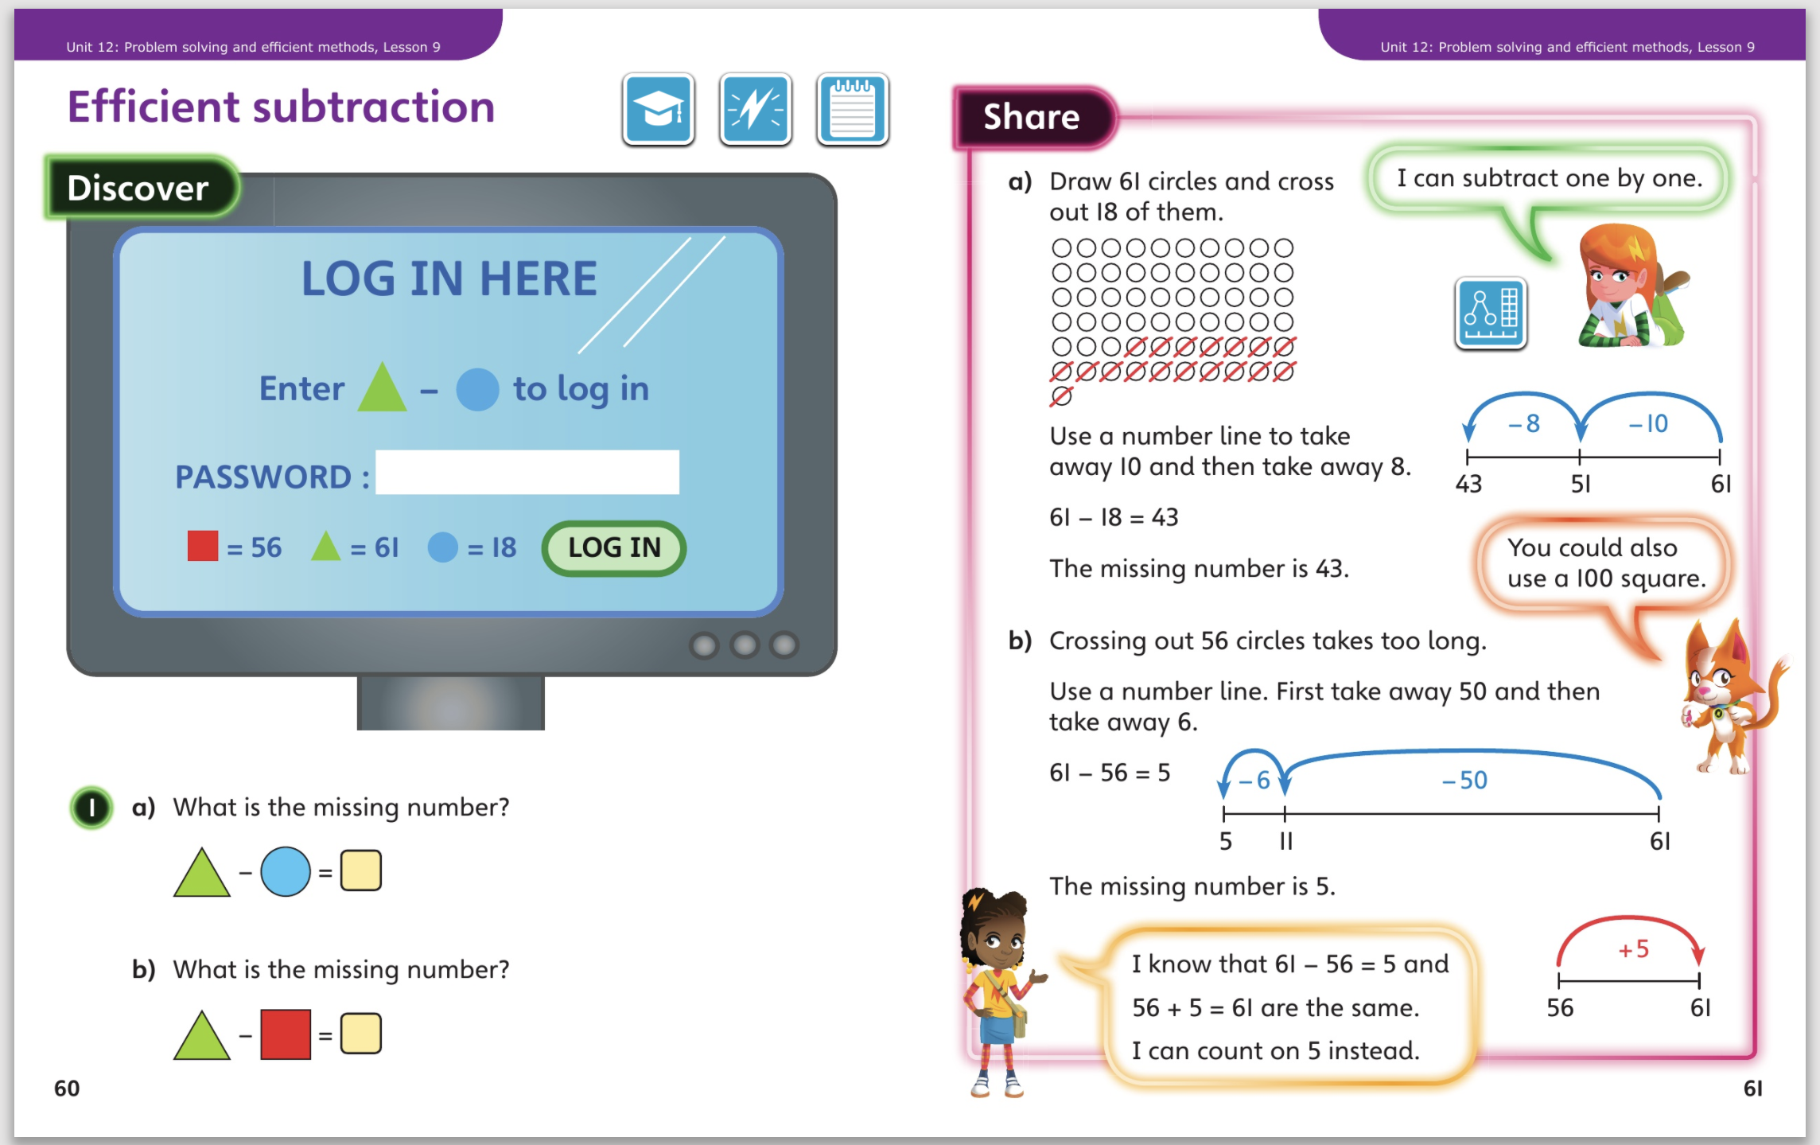
7.5.20 – Share these pages

Slide 8
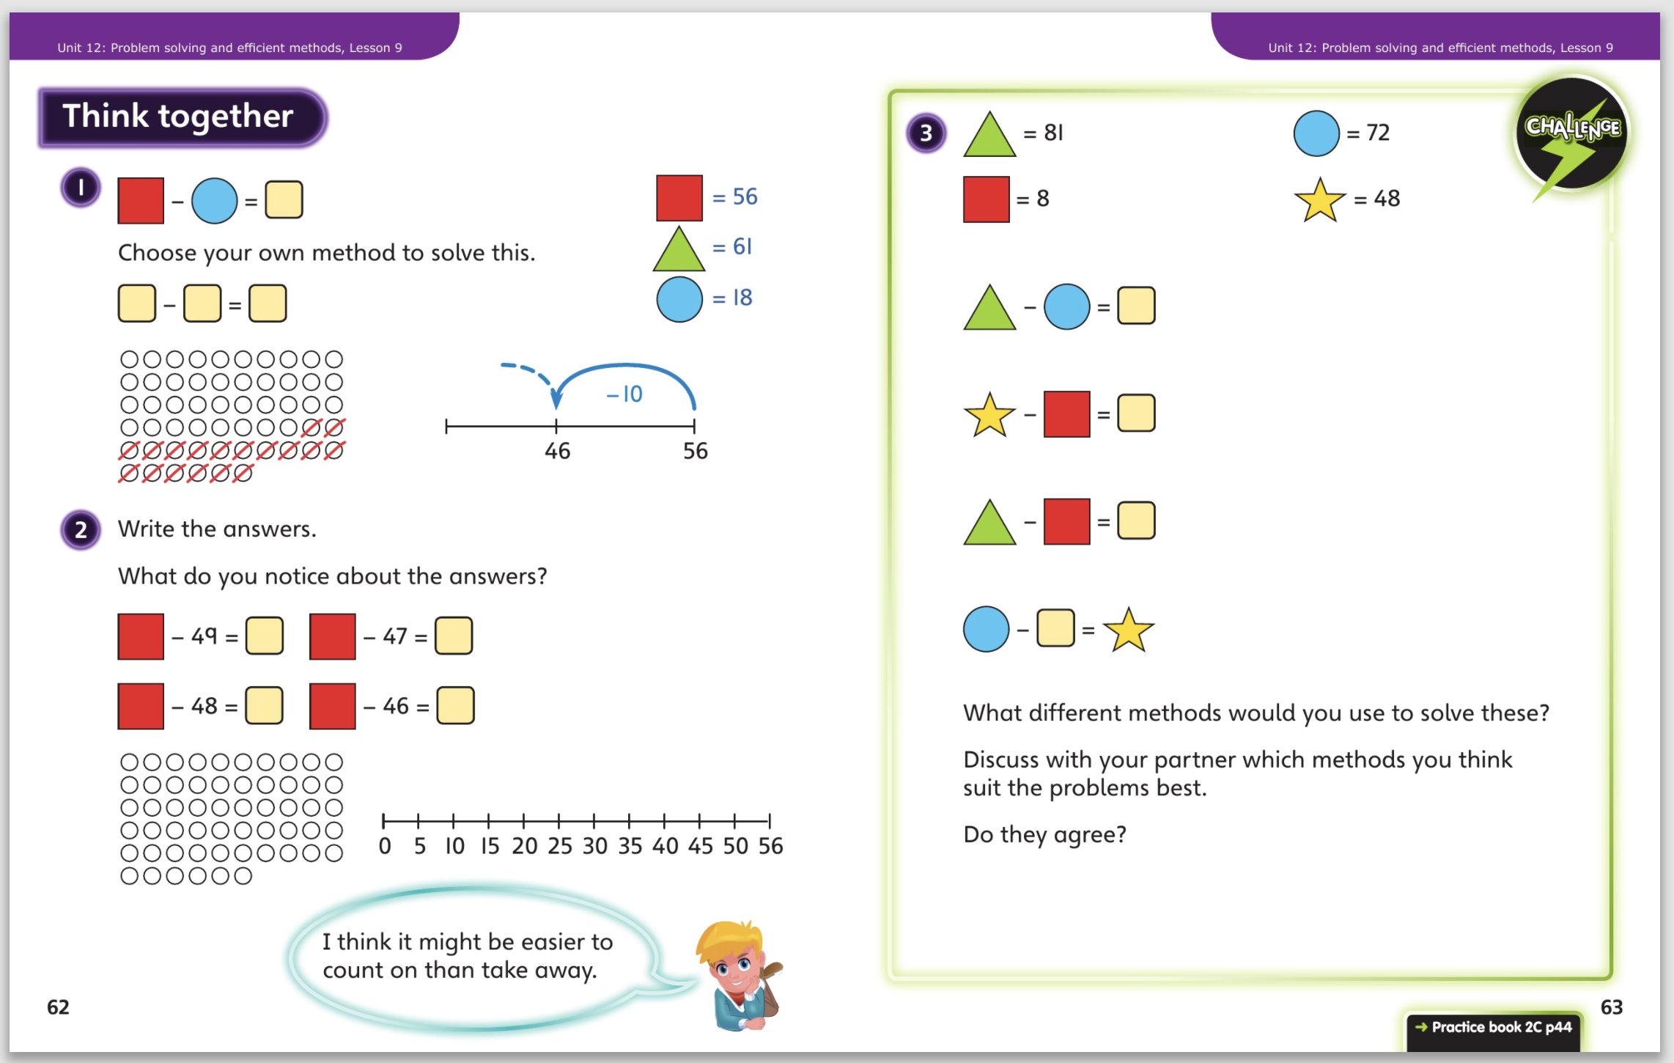
4.5.20 – Share these pages
Now complete Unit 12, lesson 9 p44

