Slide 1
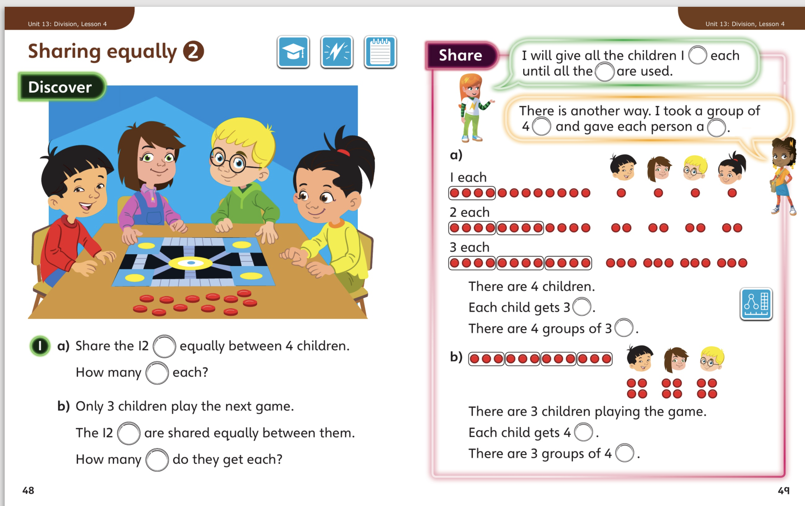
4.5.20 – Share these pages

Slide 2
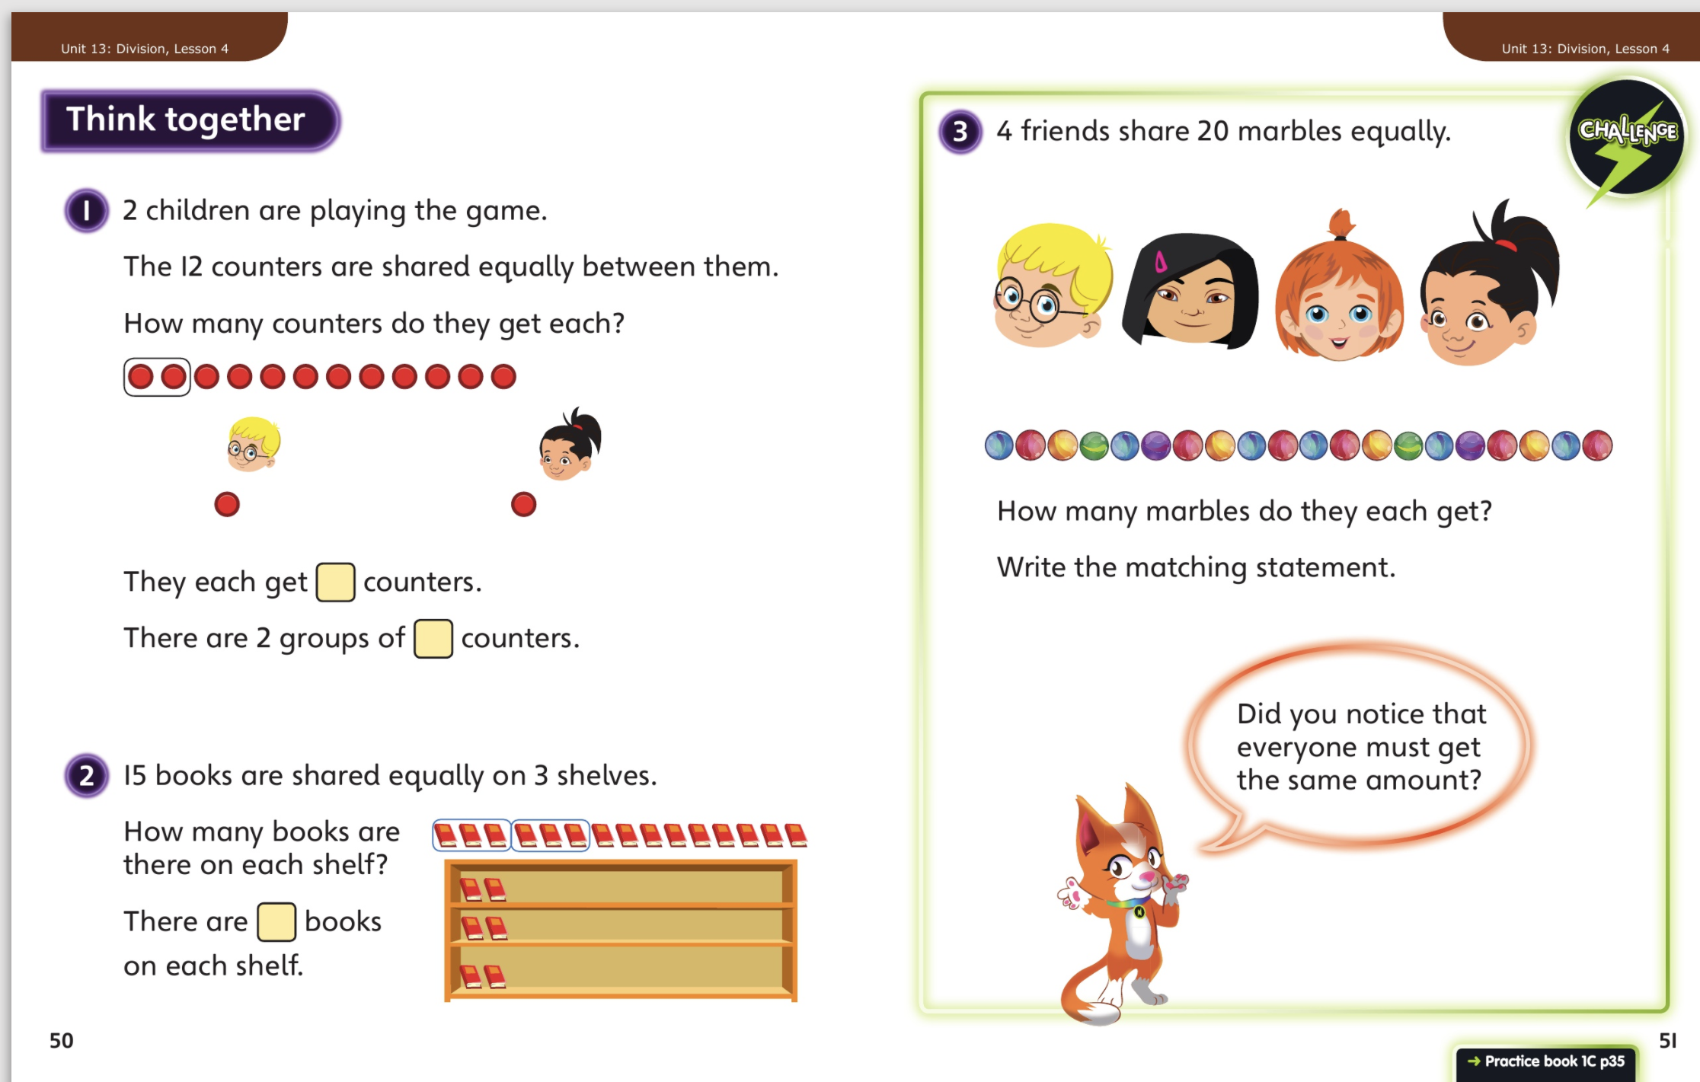
Now complete Unit 13, lesson 4, p 35

Slide 3
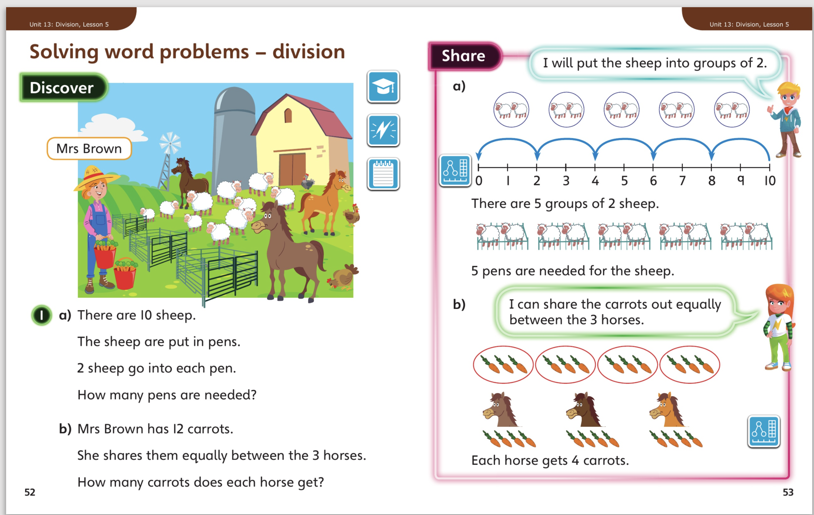
5.5.20 – Share these pages
Now complete Unit 13, lesson 4, p 35

Slide 4
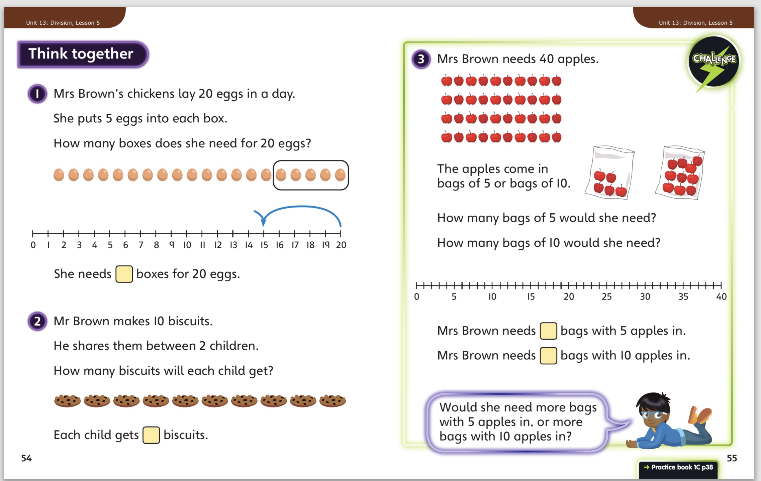
Now complete Unit 13, lesson 5, p 38

Slide 5
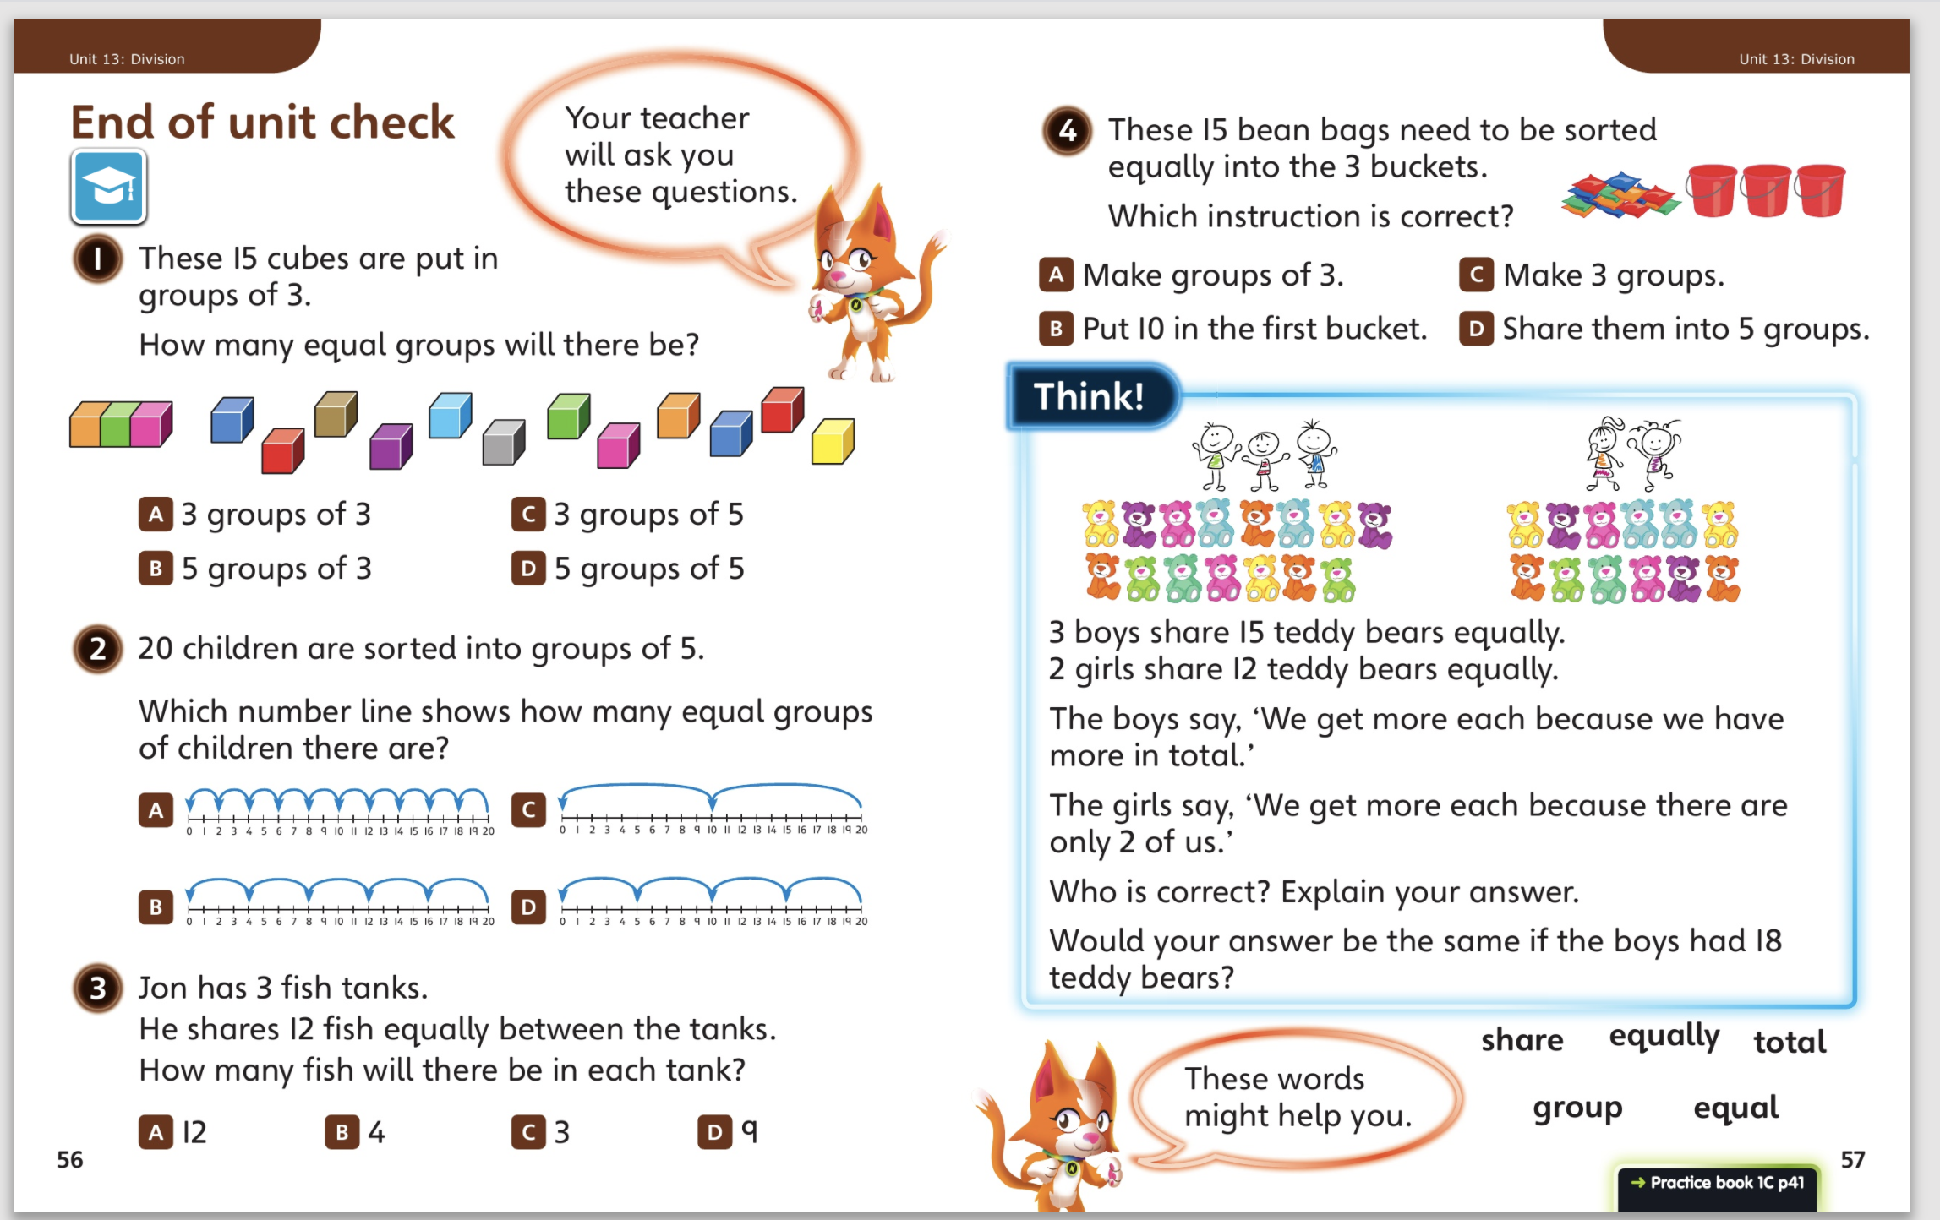
6.5.20 – Share these pages
Now complete the end of unit check p 41

Slide 6
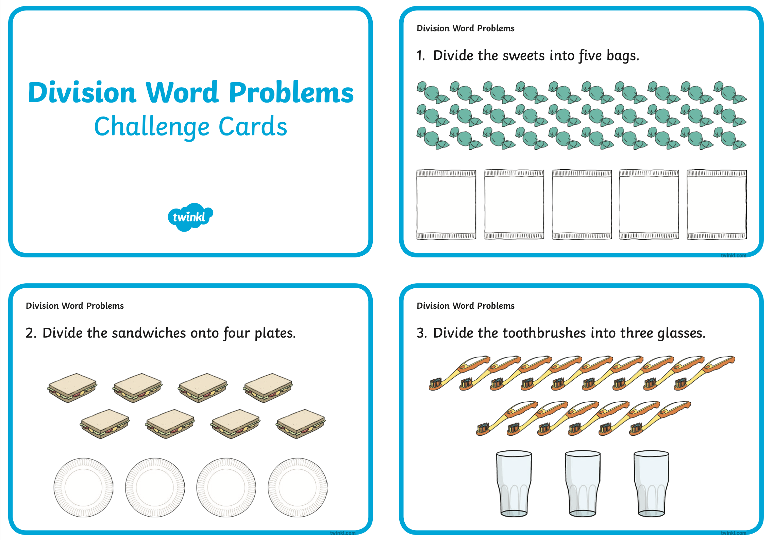
7.5.20 – Have a go at some of these division
word problems before we move onto
our new unit.

Slide 7
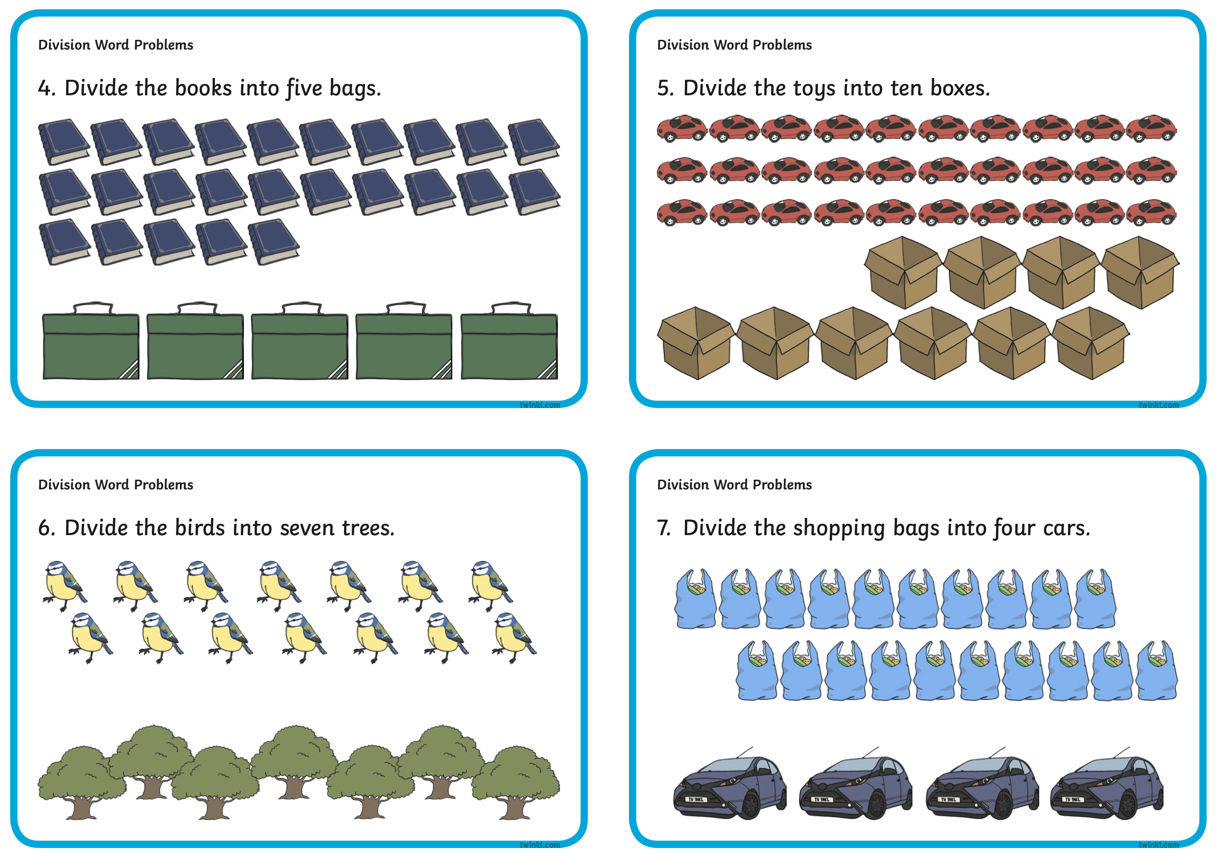

Slide 8


