Slide 1
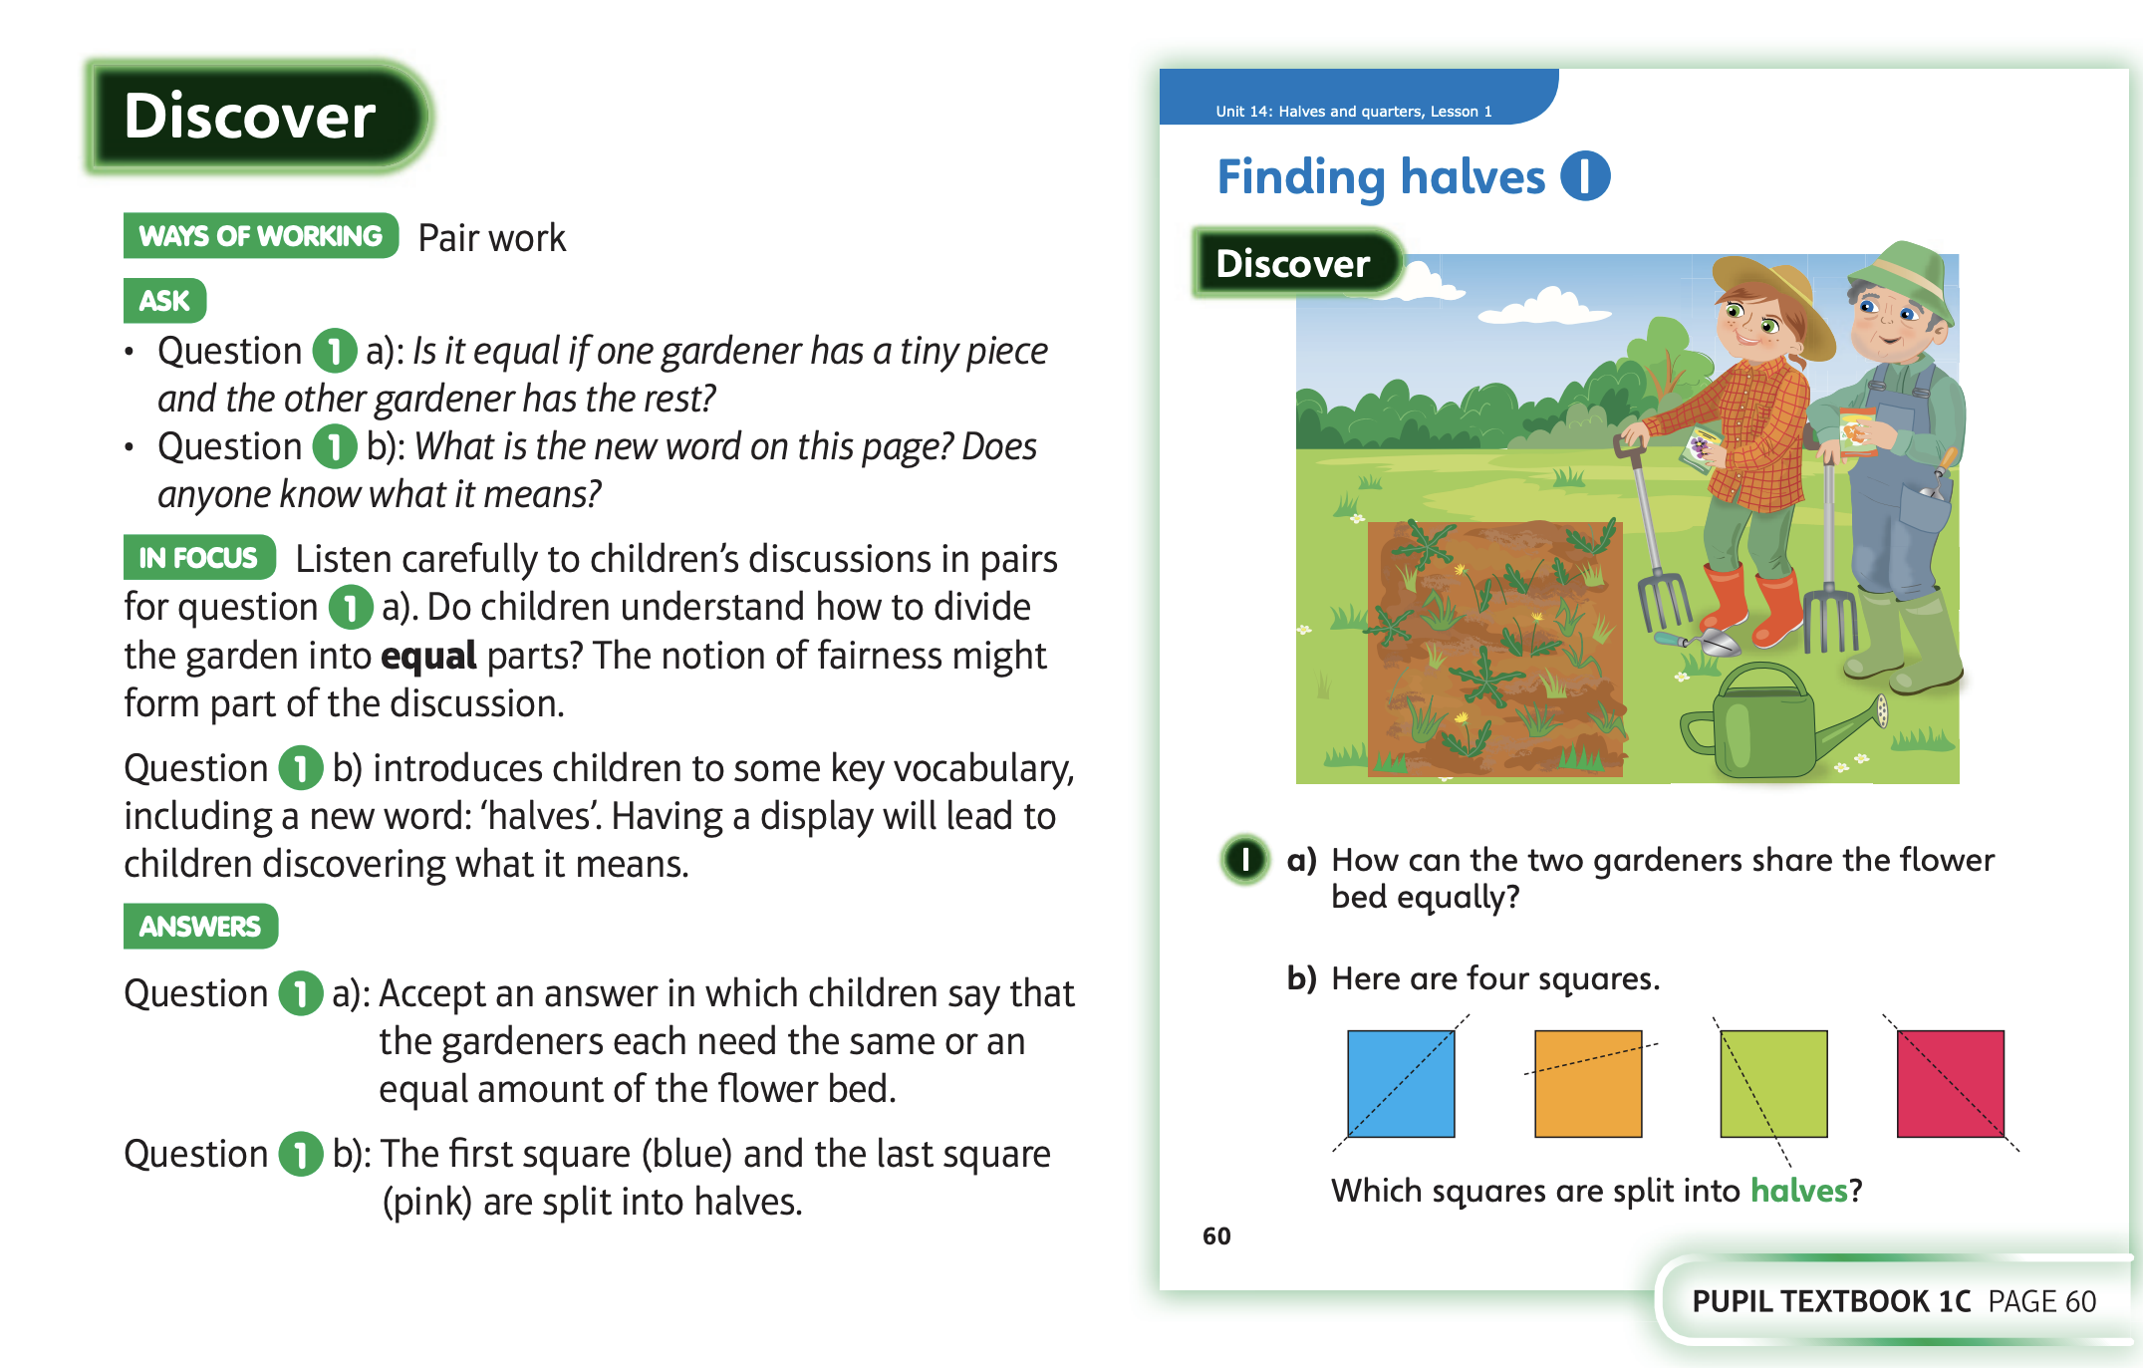
11.5.20 Share these pages

Slide 2
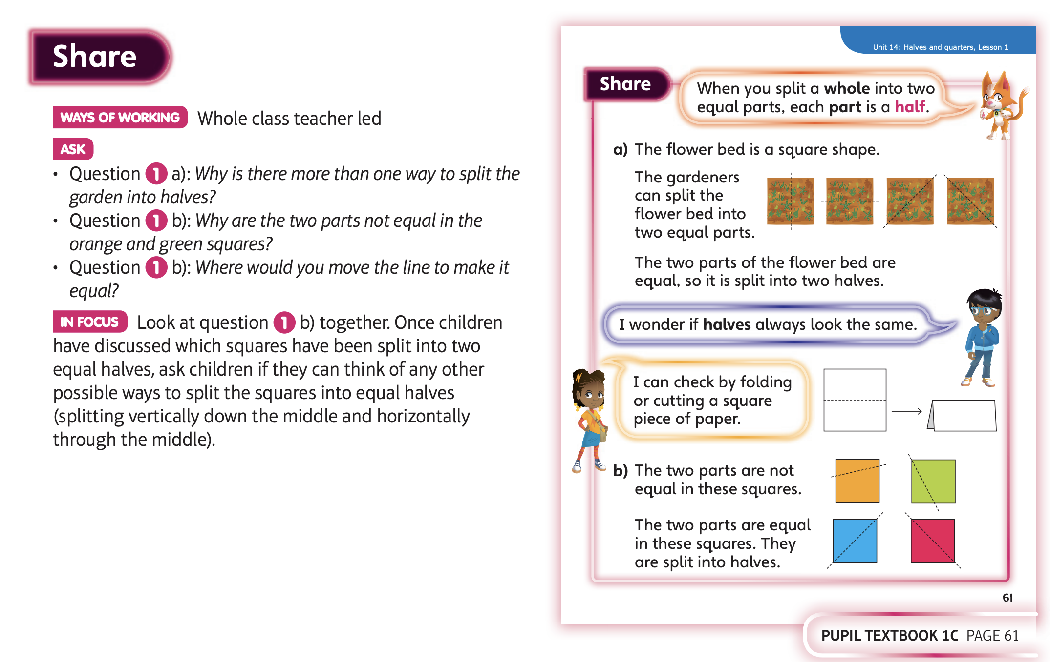

Slide 3
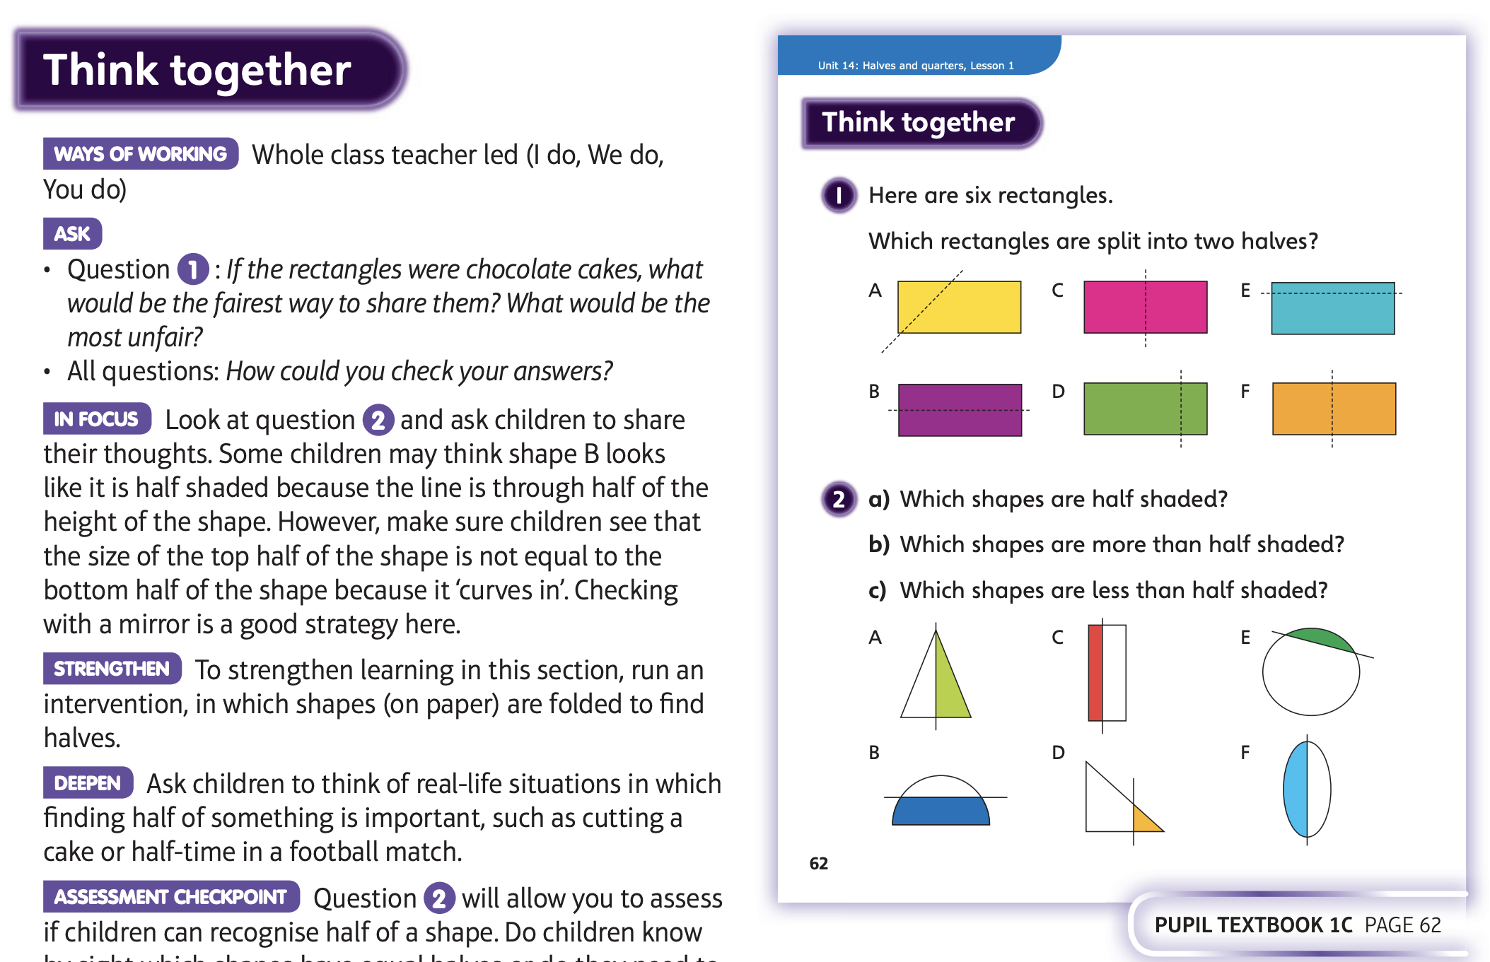
Then complete Unit 14 lesson 1

Slide 4
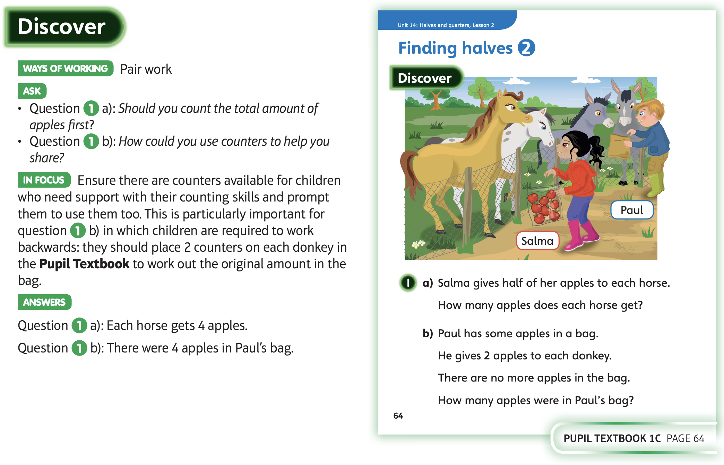
12.5.20 Share these pages

Slide 5
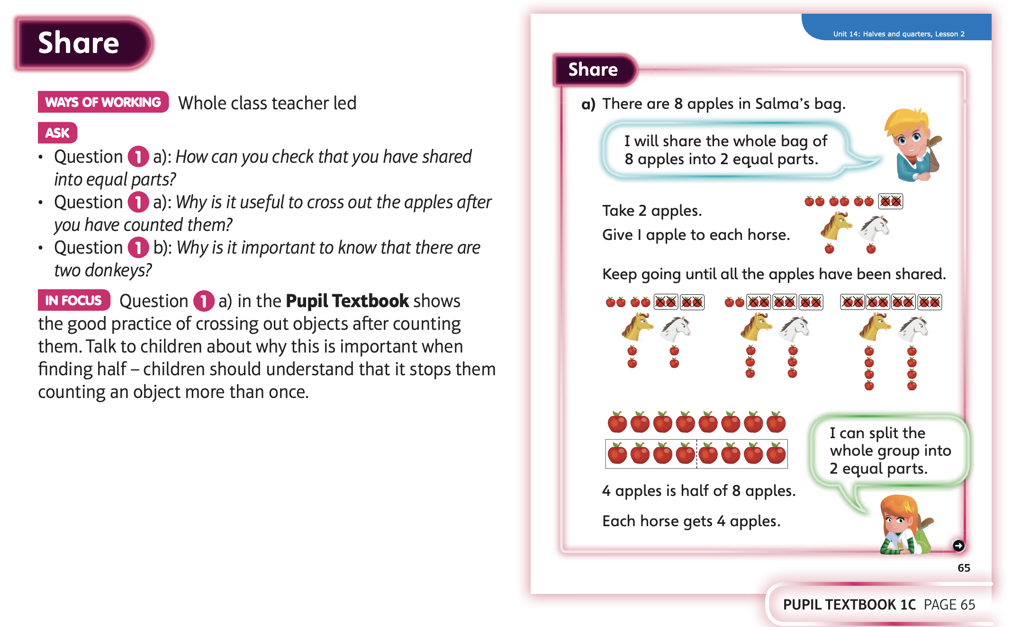

Slide 6
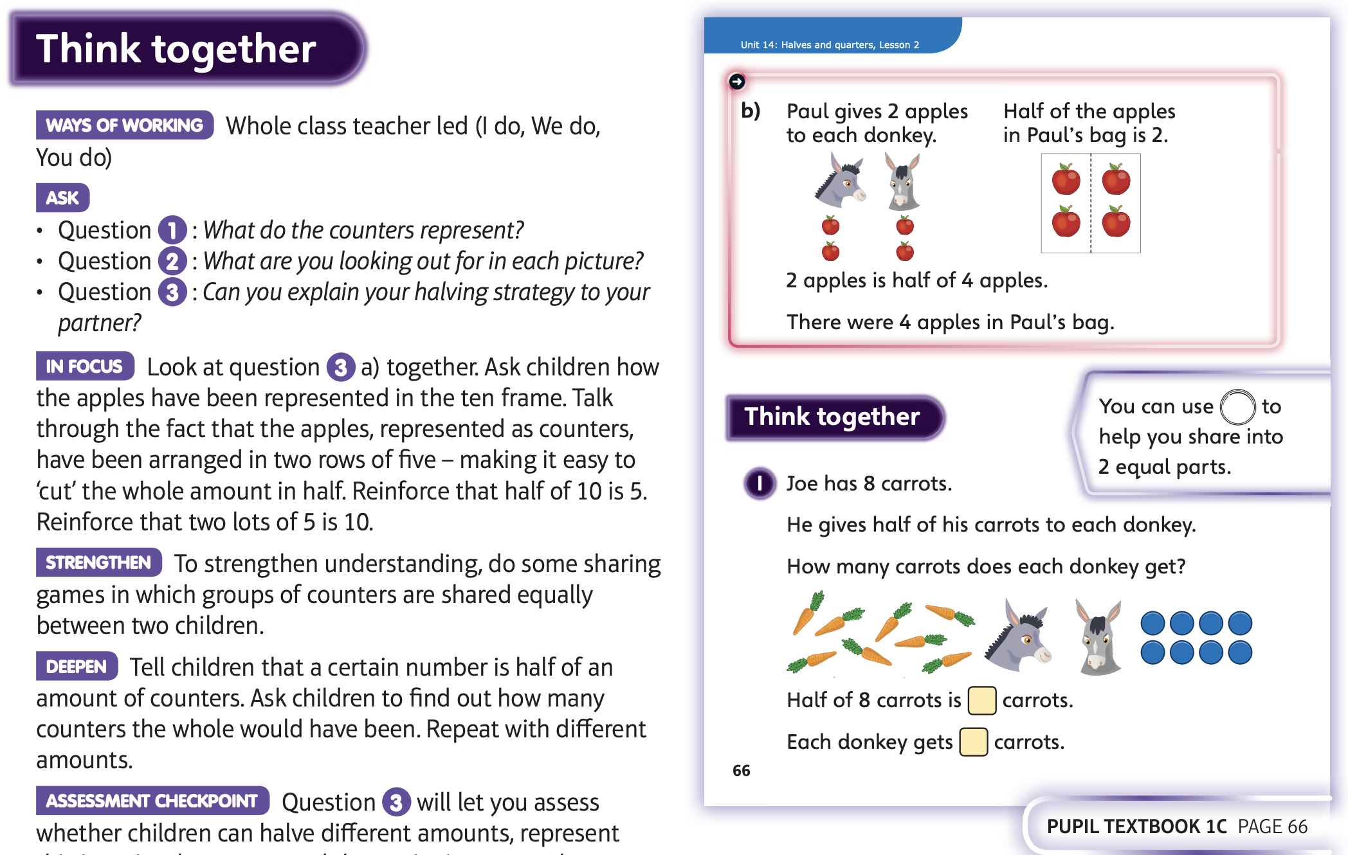
Then complete Unit 14 lesson 2

Slide 7
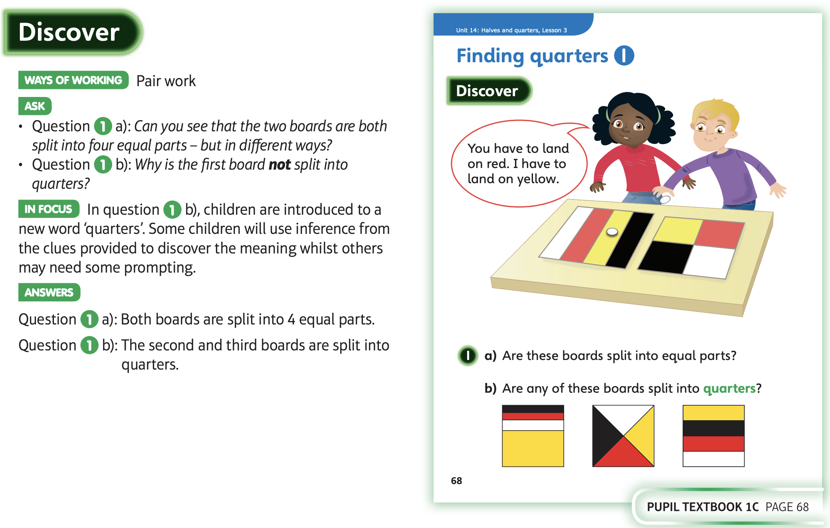
13.5.20 Share these pages

Slide 8
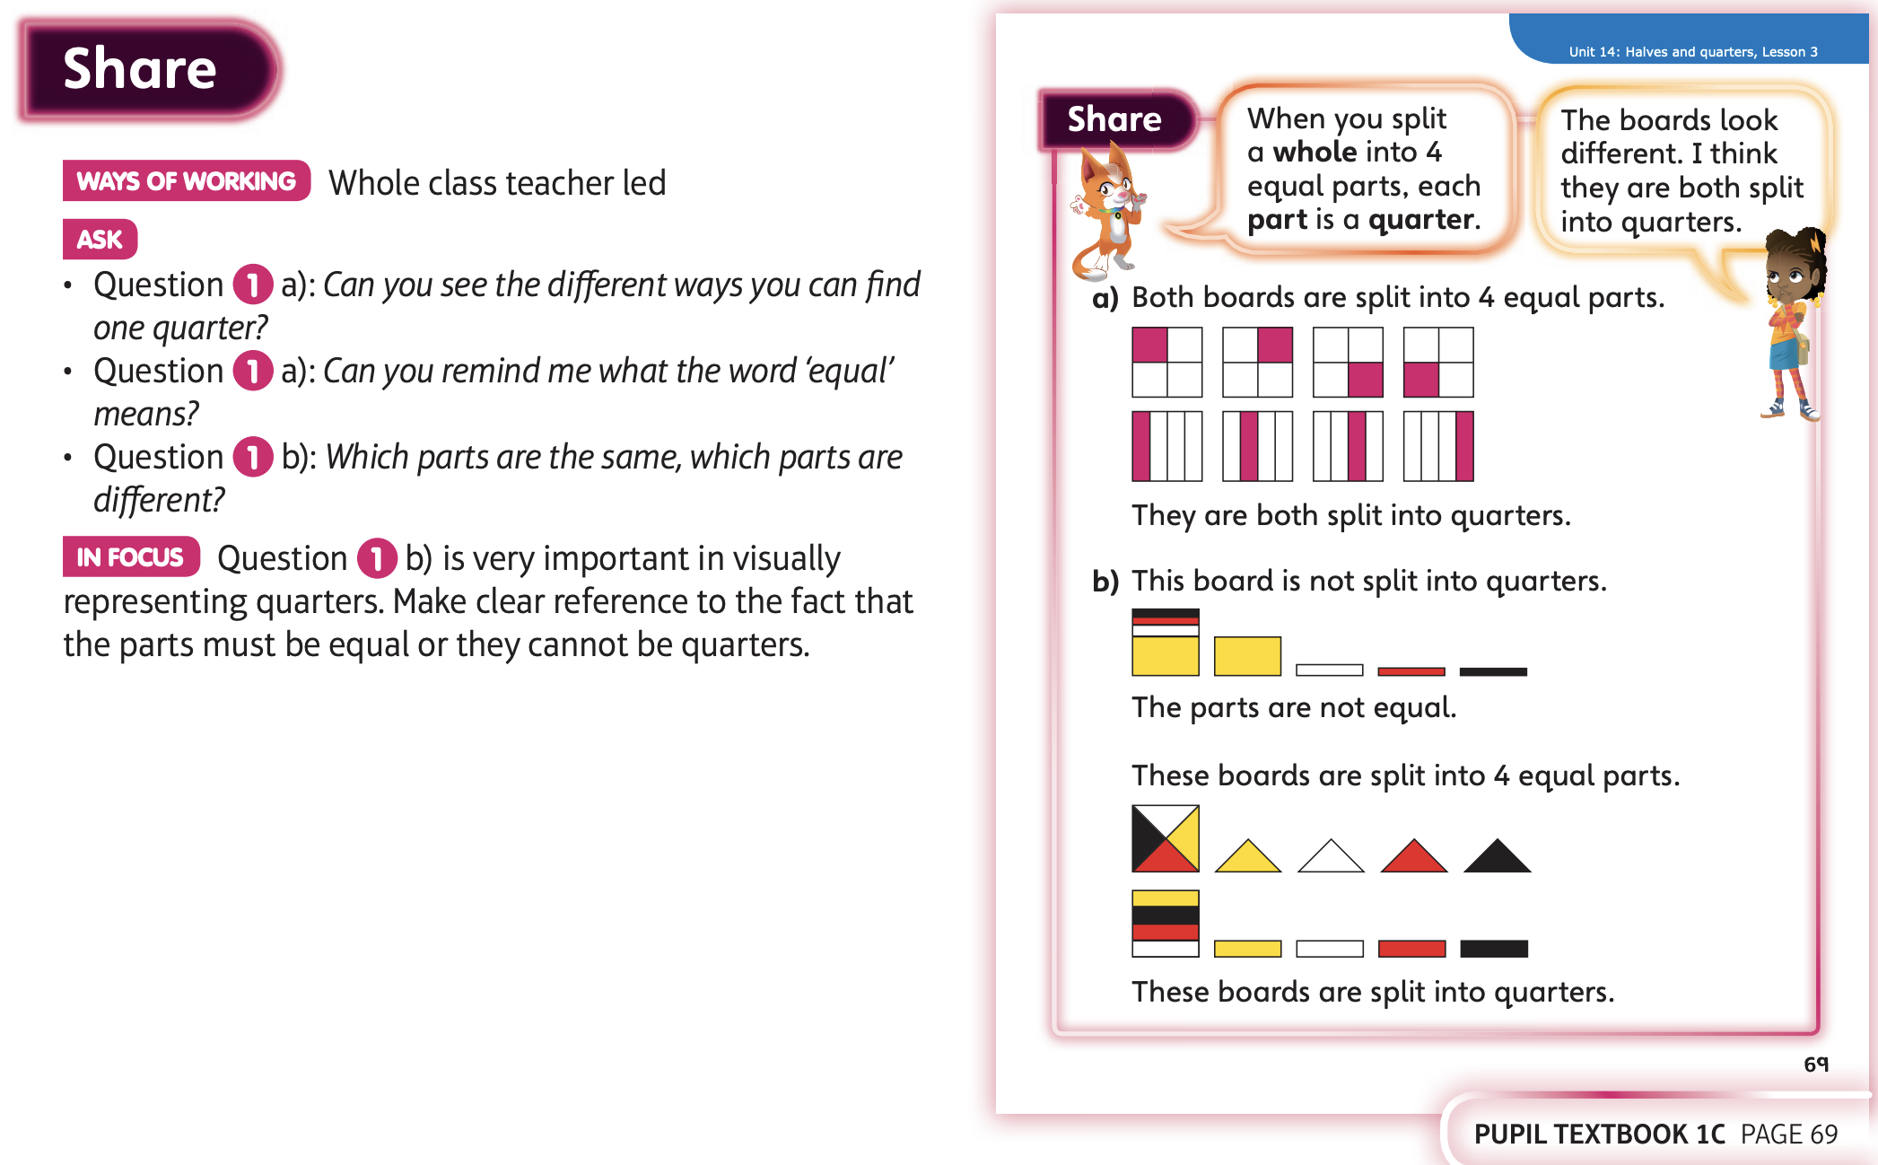

Slide 9
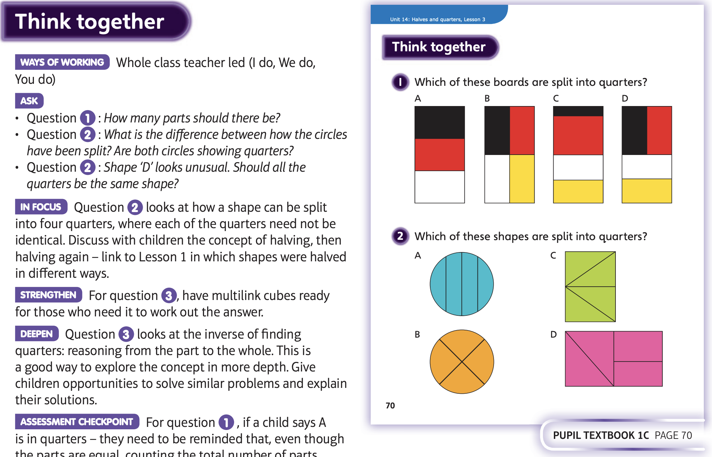
Then complete Unit 14 lesson 3

Slide 10
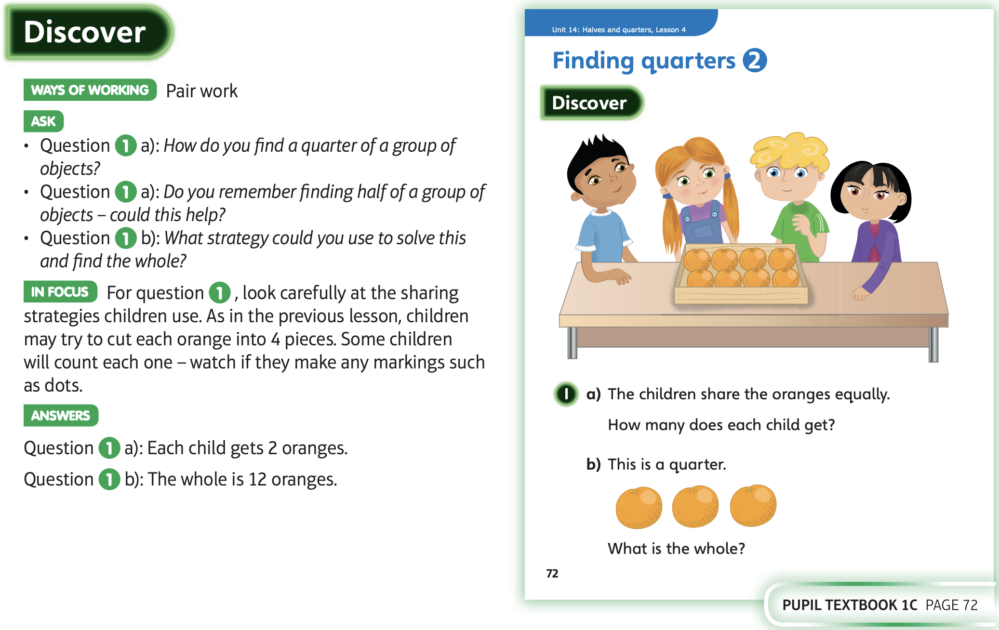
14.5.20 Share these pages

Slide 11
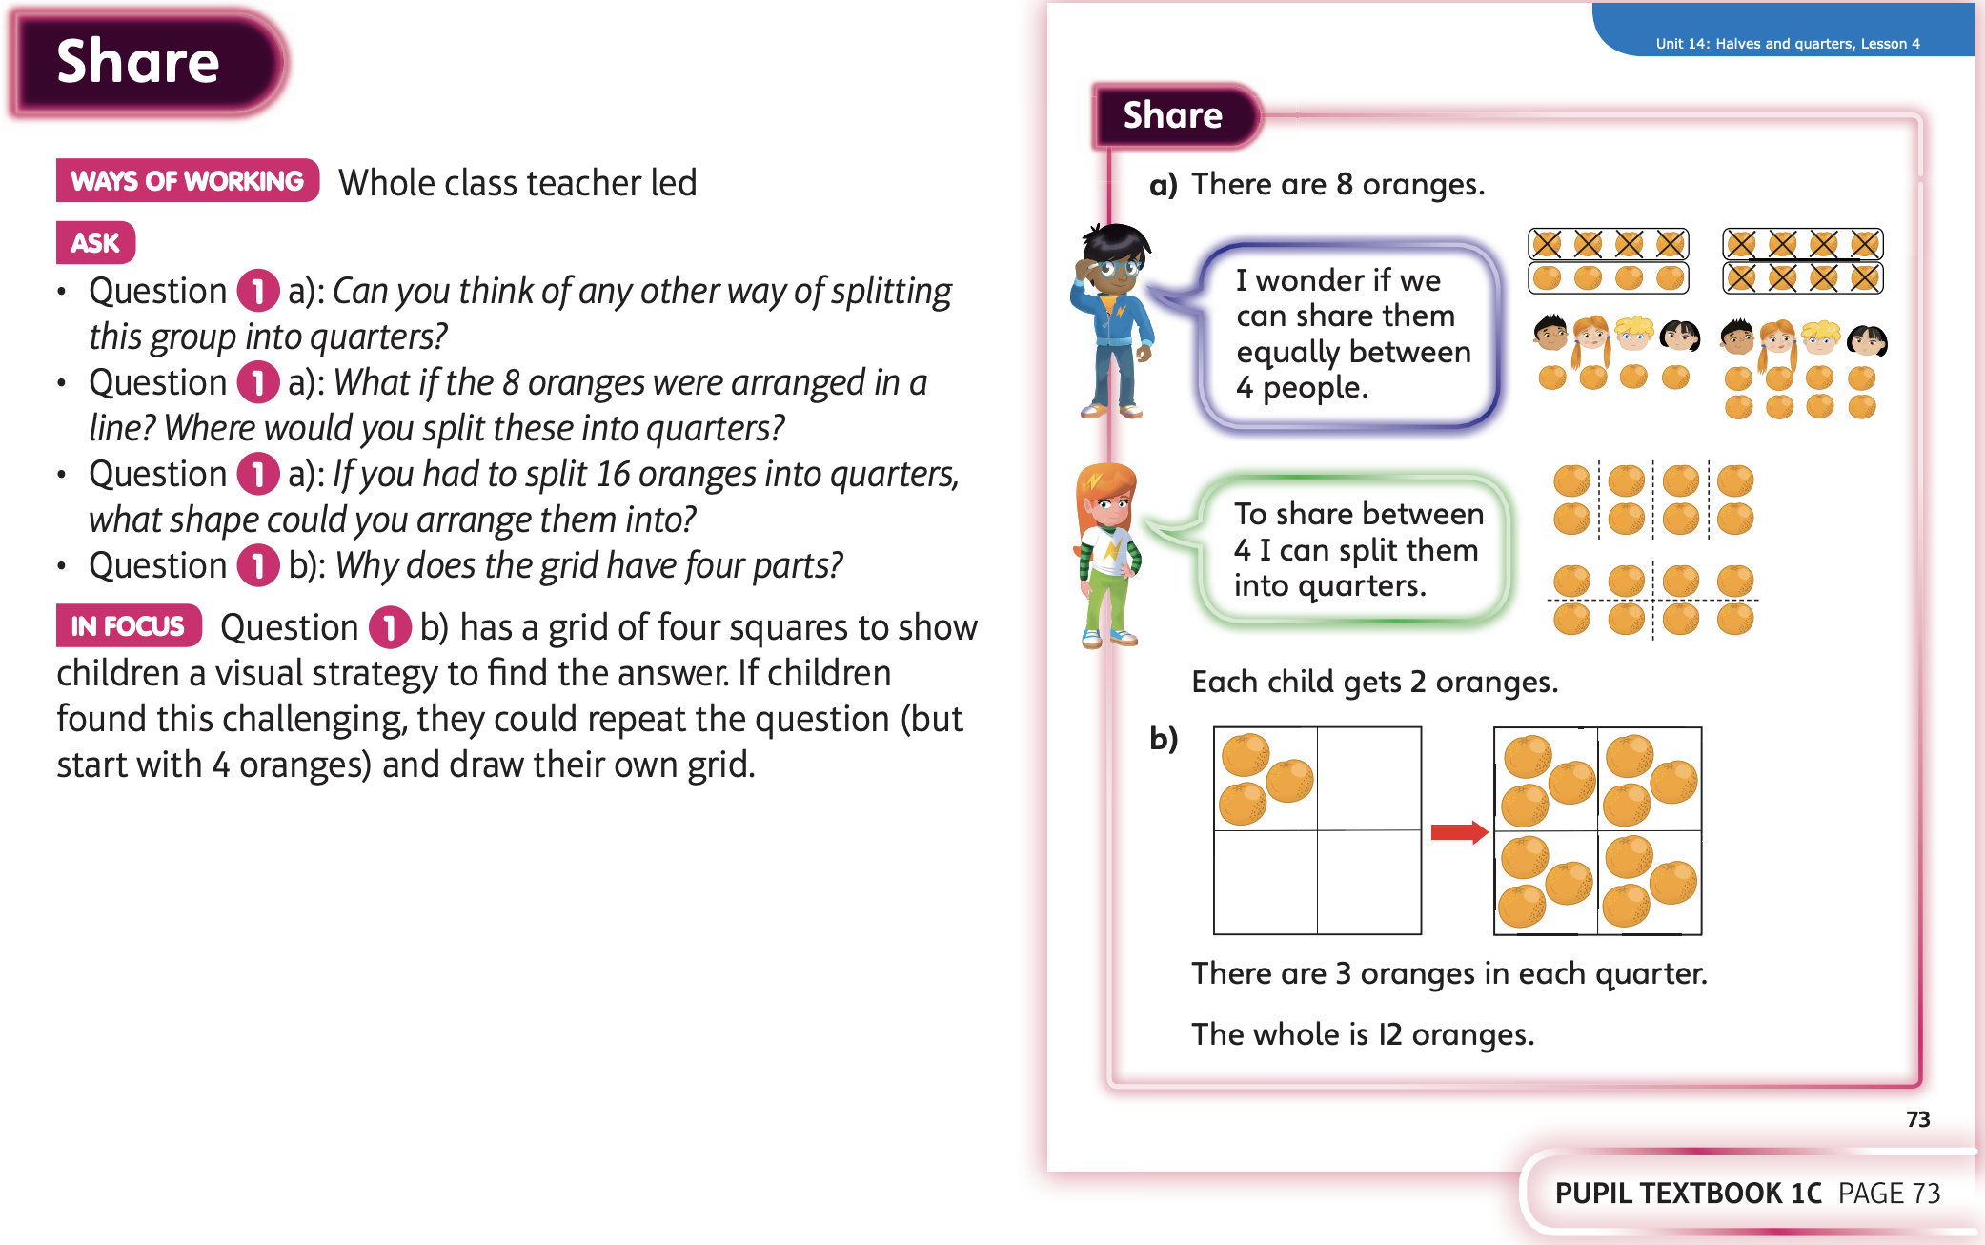

Slide 12
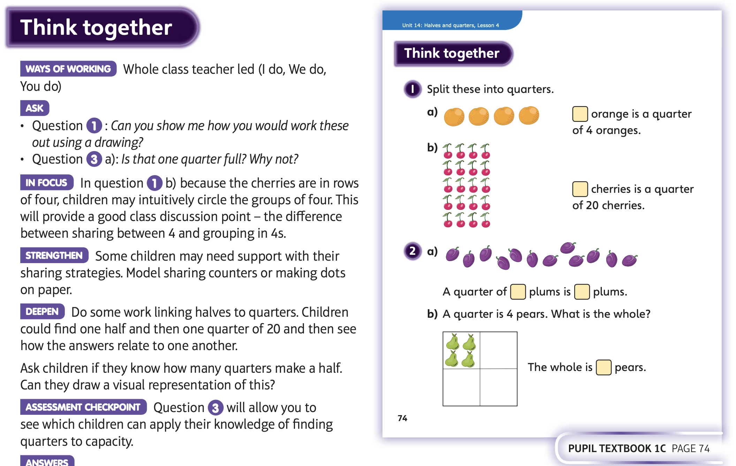
Then complete Unit 14 lesson 4

Slide 13
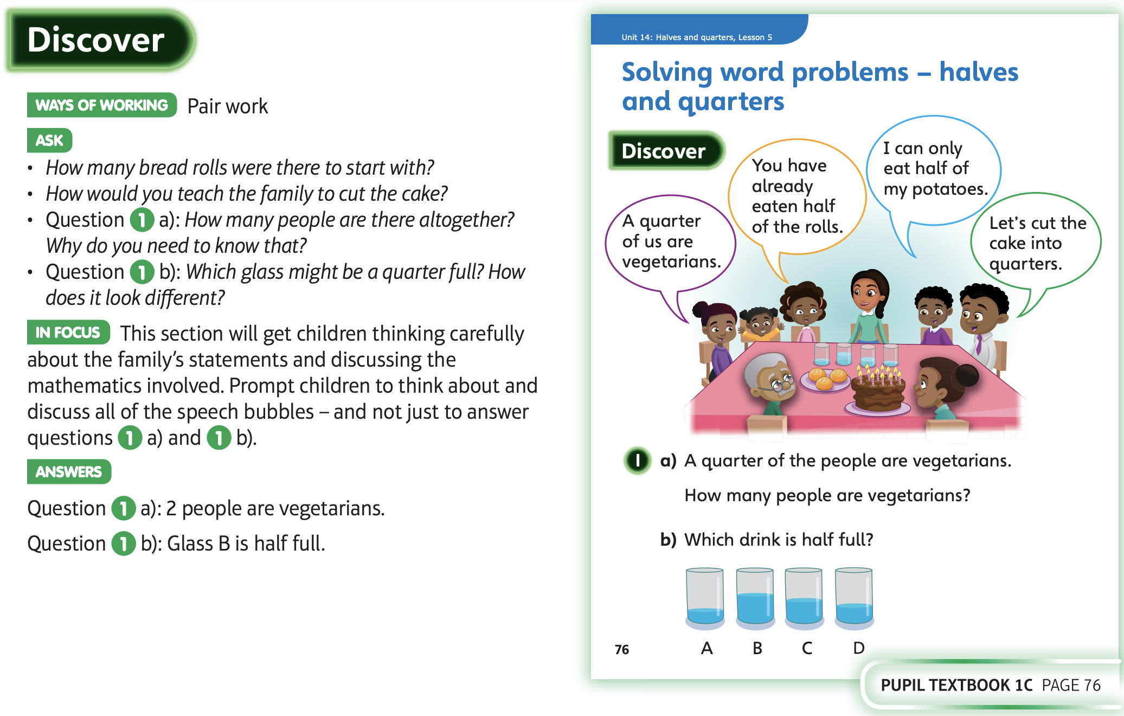
15.5.20 Share these pages

Slide 14
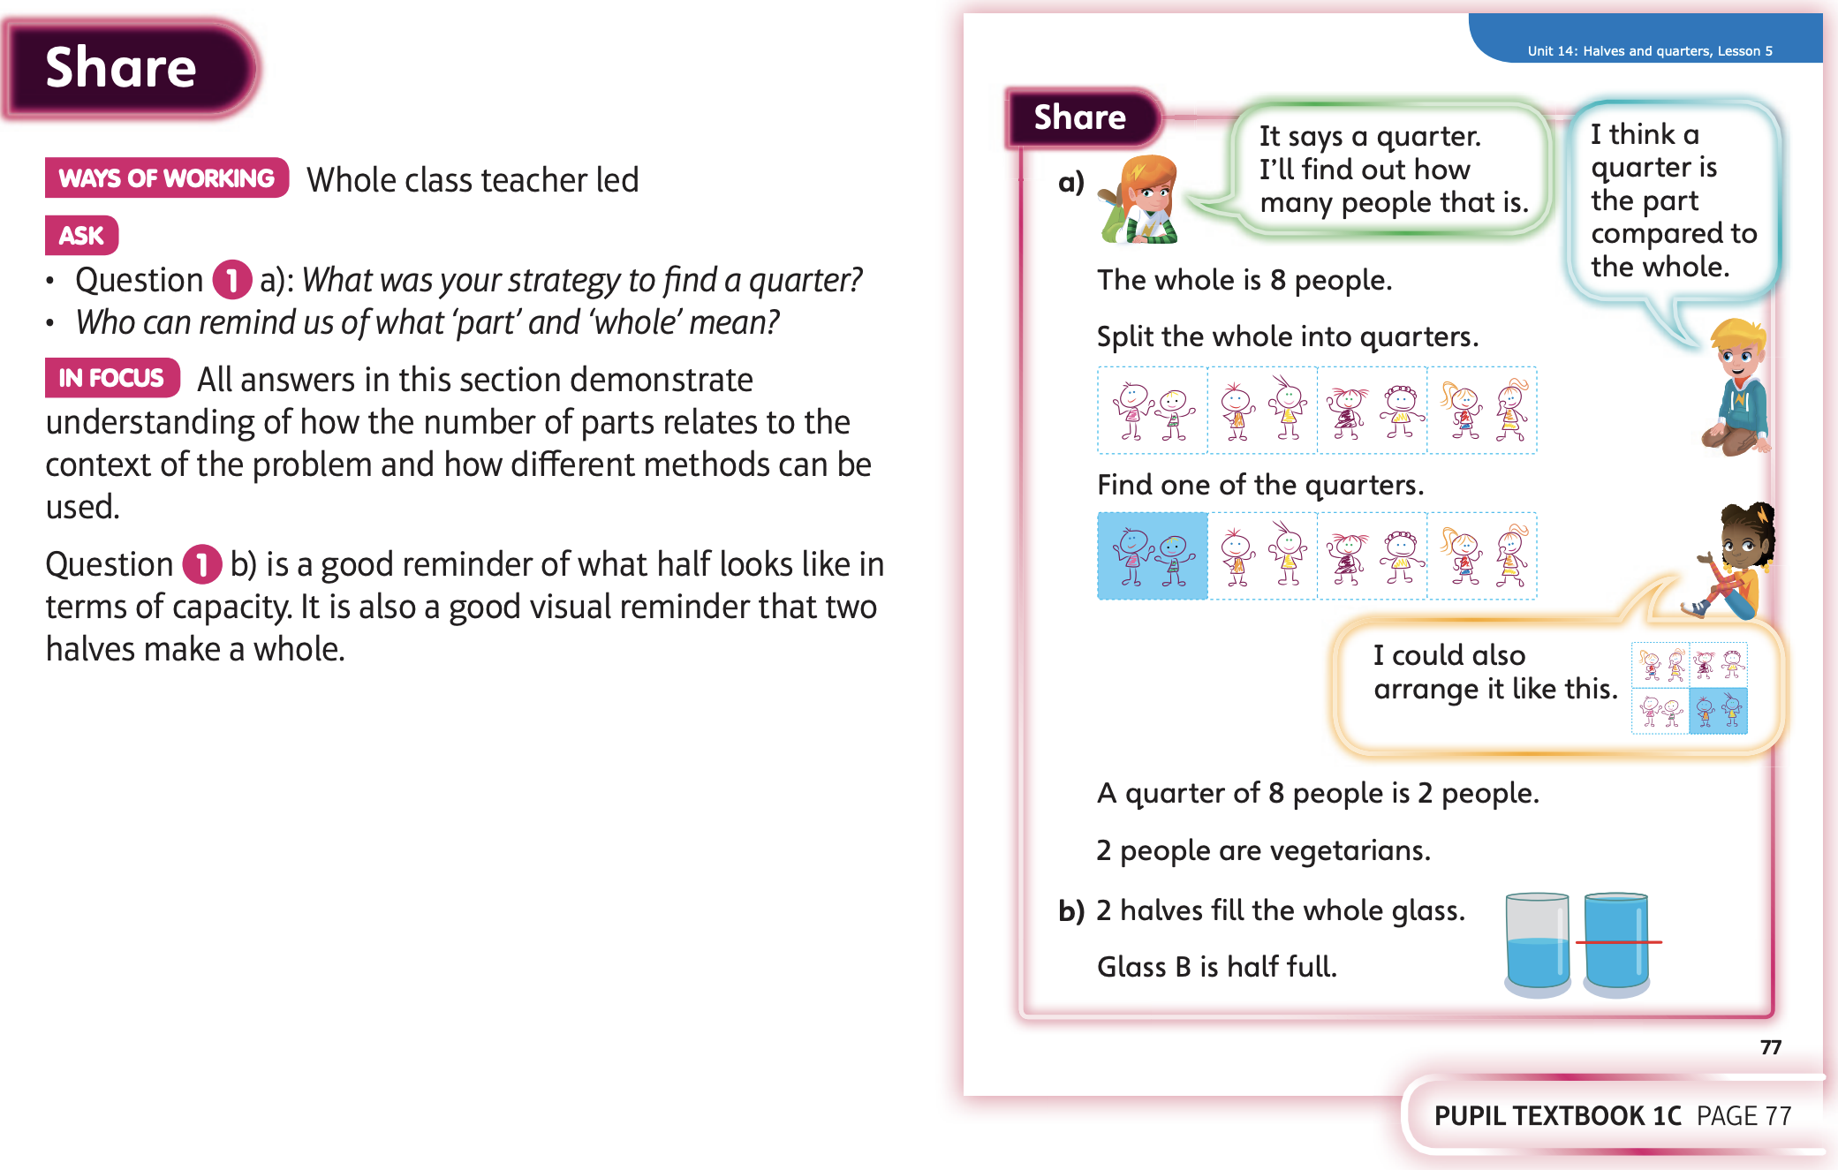

Slide 15
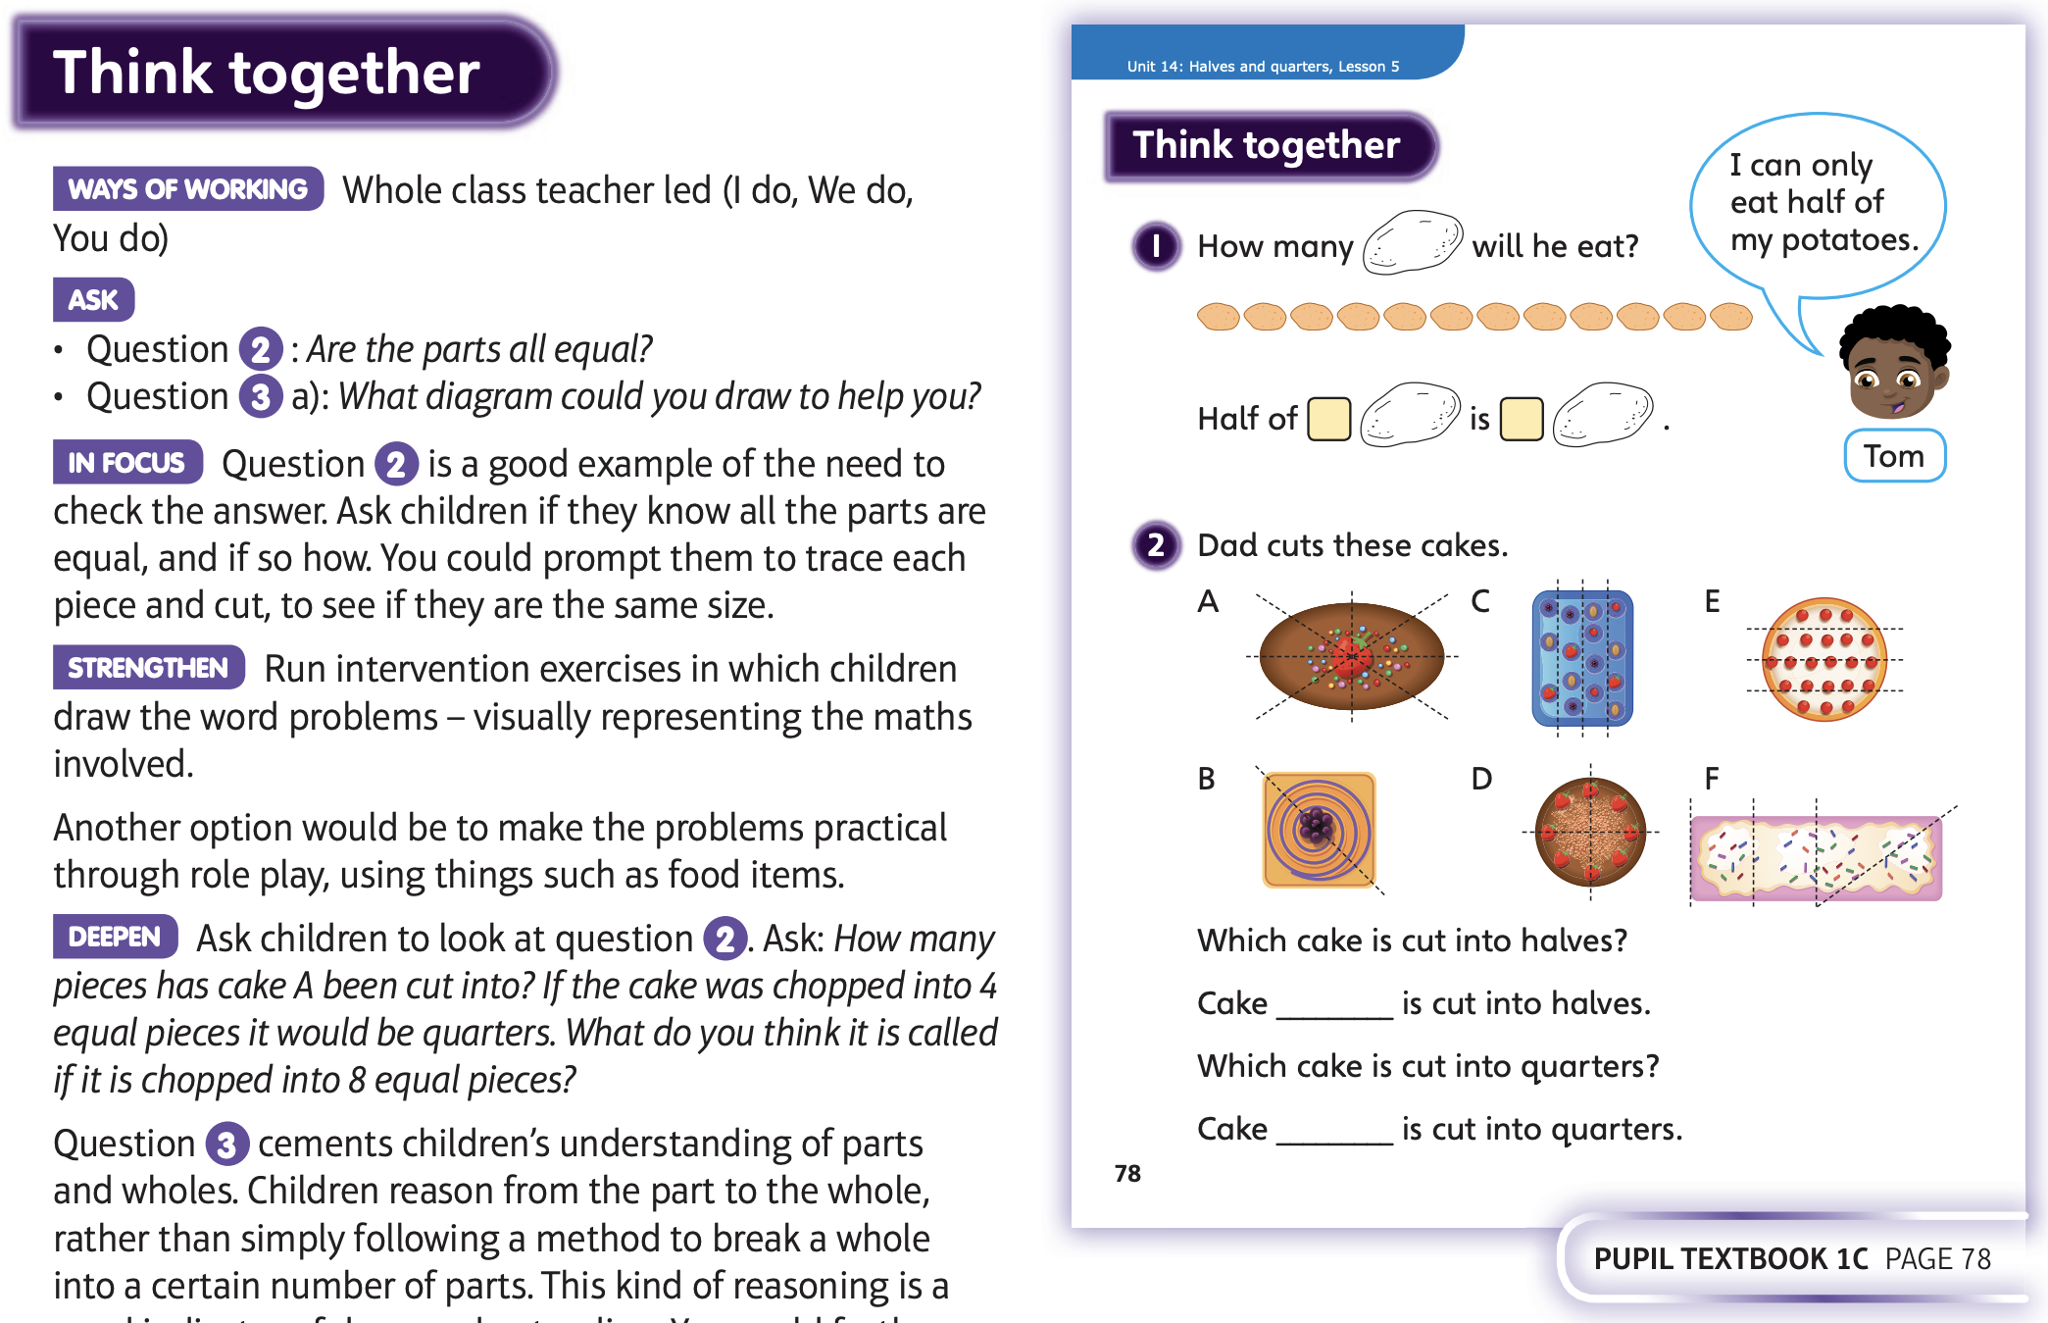
Then complete Unit 14 lesson 5

