Slide 1
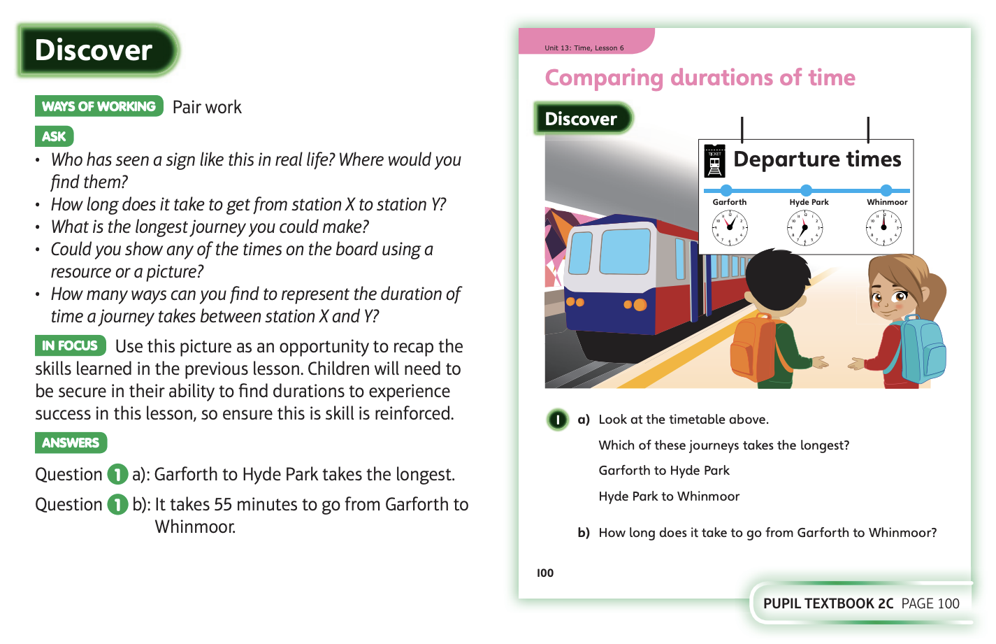
18.5.20 Have a look at these

Slide 2
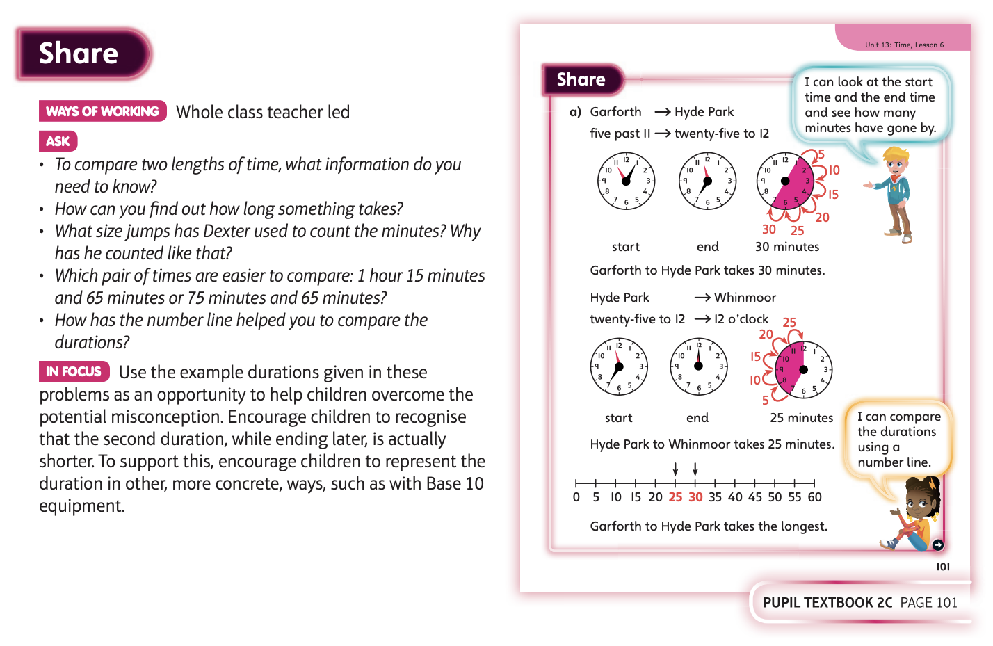

Slide 3
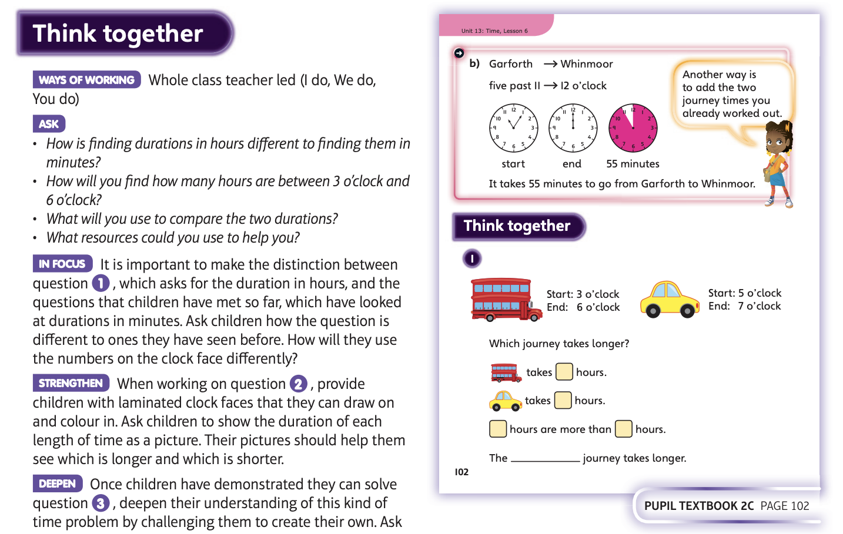
Now complete unit 13, lesson 6

Slide 4
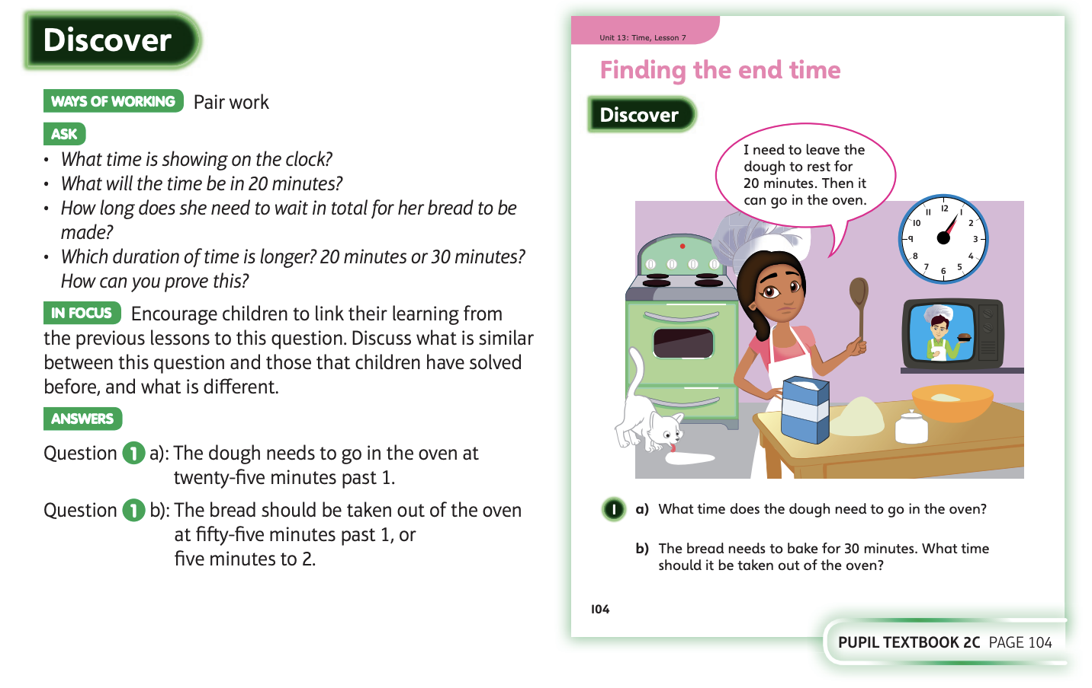
19.5.20 Have a look at these

Slide 5
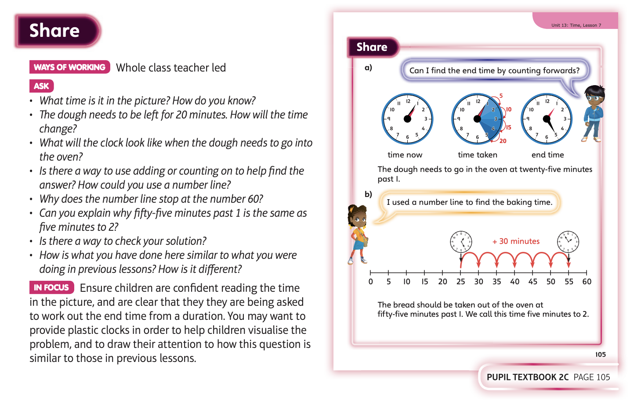

Slide 6
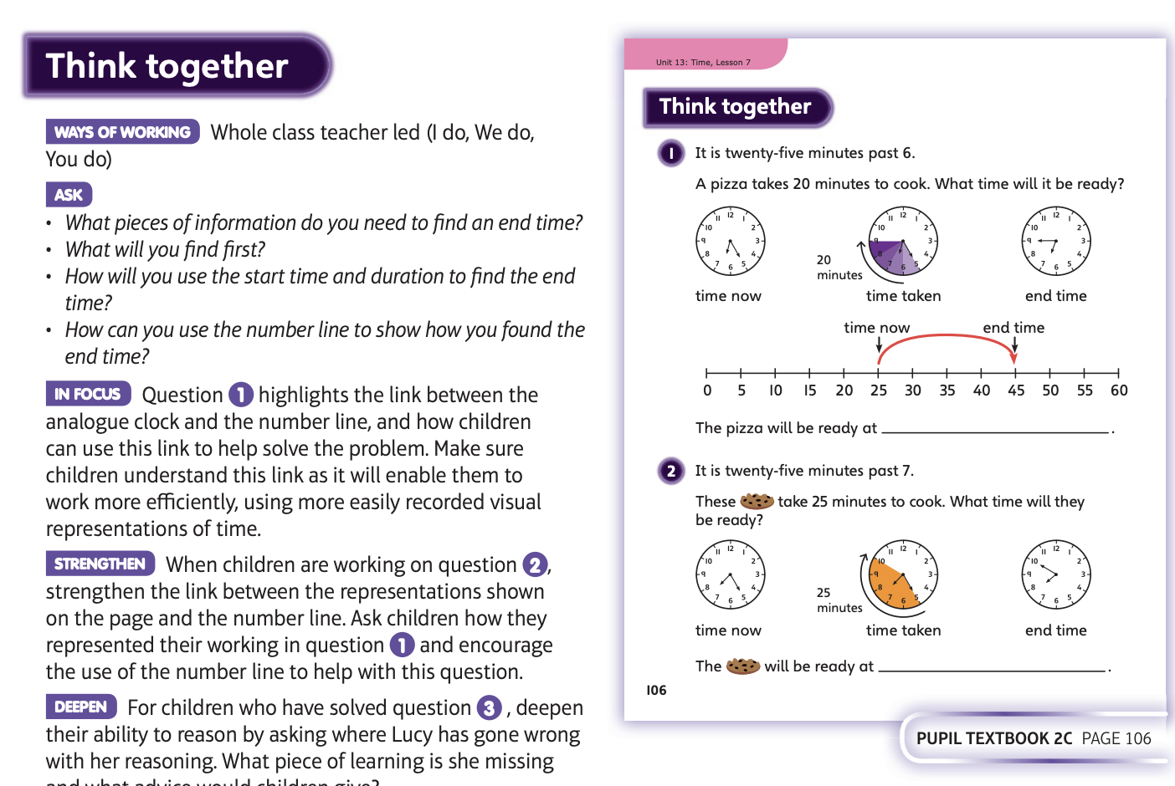
Now complete unit 13, lesson 7

Slide 7
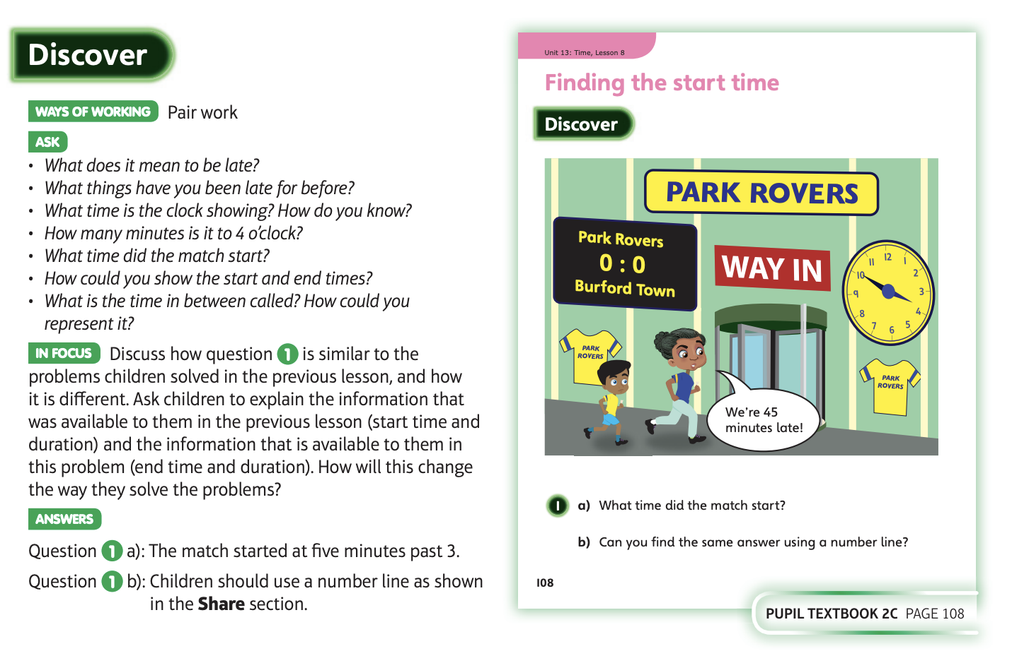
20.5.20 Have a look at these

Slide 8
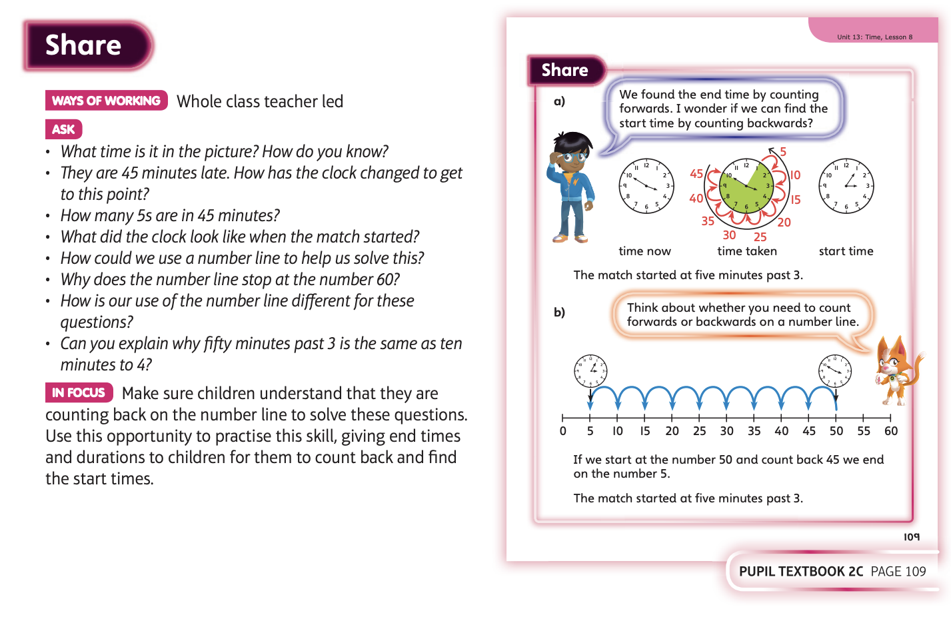

Slide 9
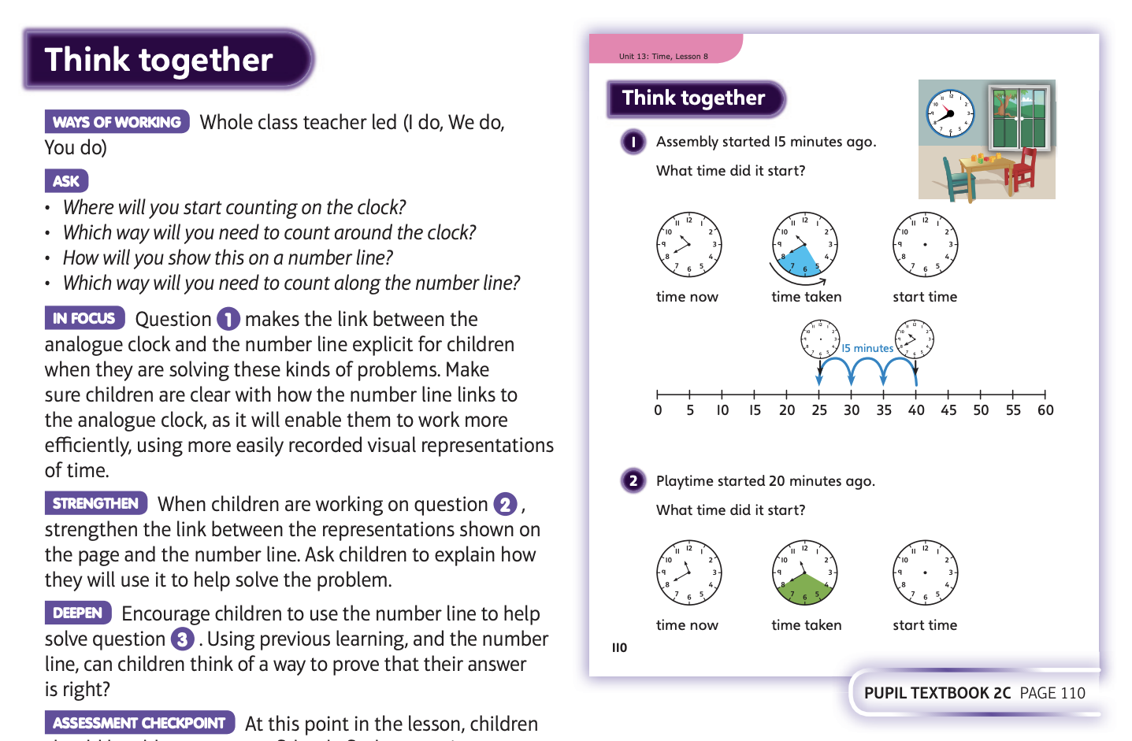
Now complete unit 13, lesson 8

Slide 10
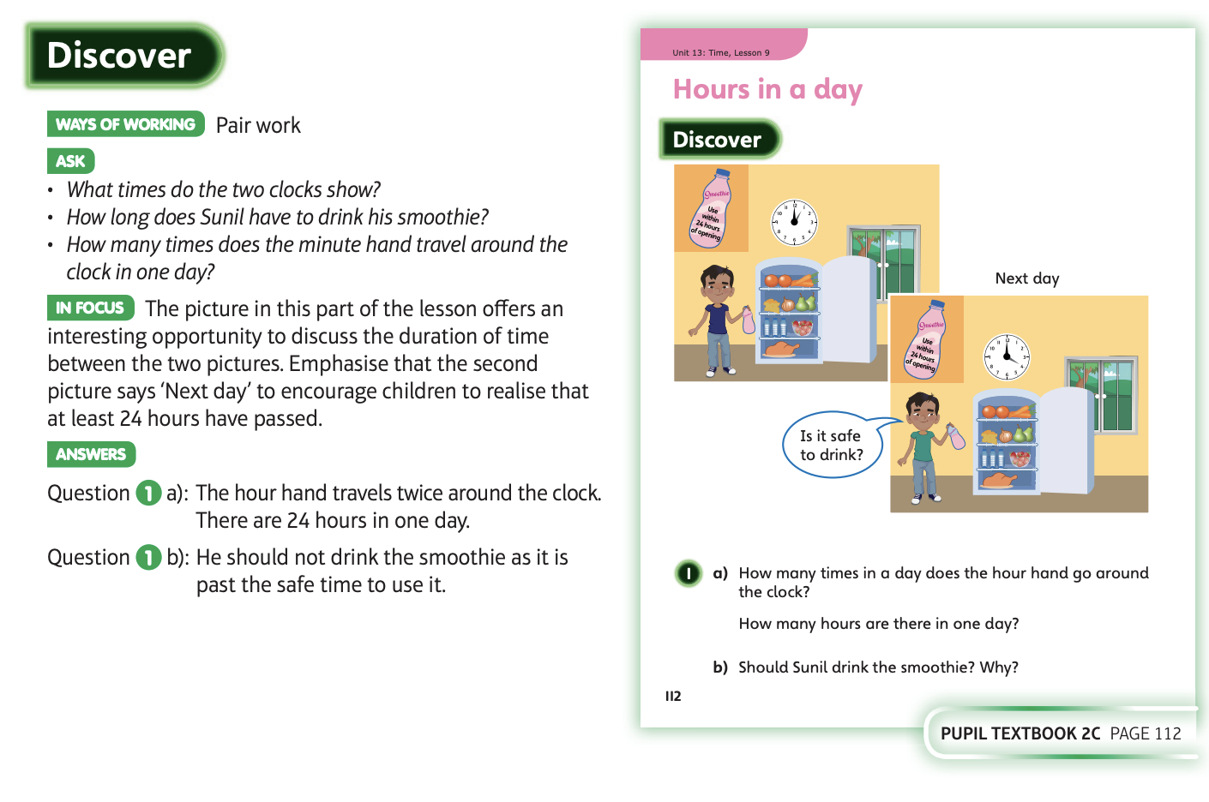
21.5.20 Have a look at these

Slide 11
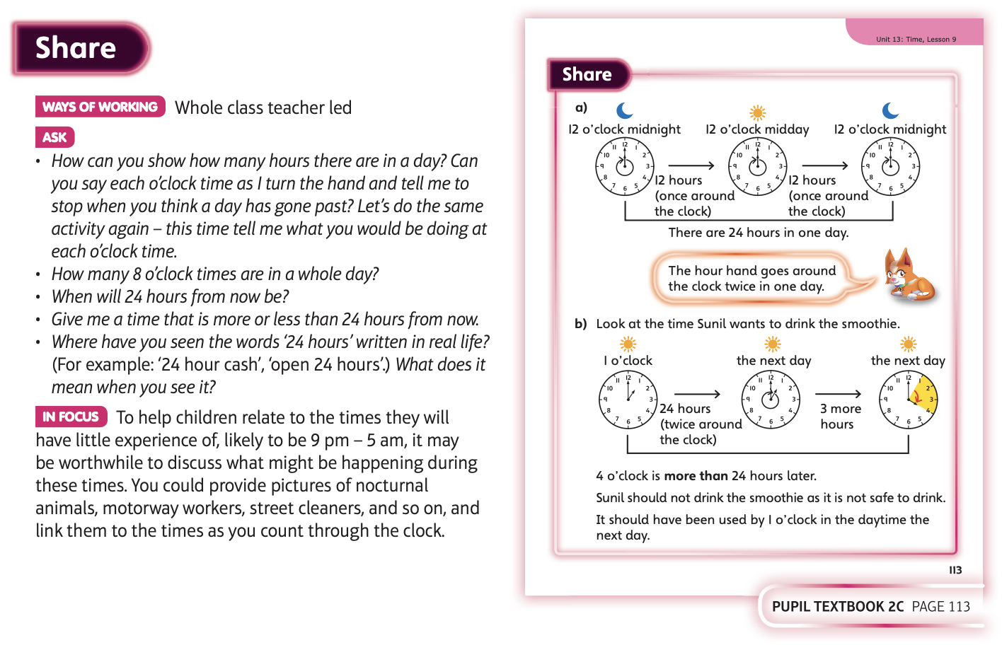

Slide 12
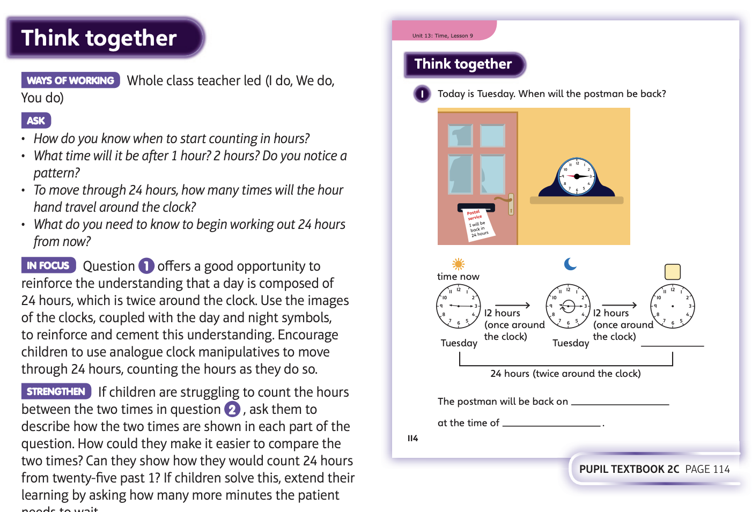
Now complete unit 13, lesson 9

Slide 13
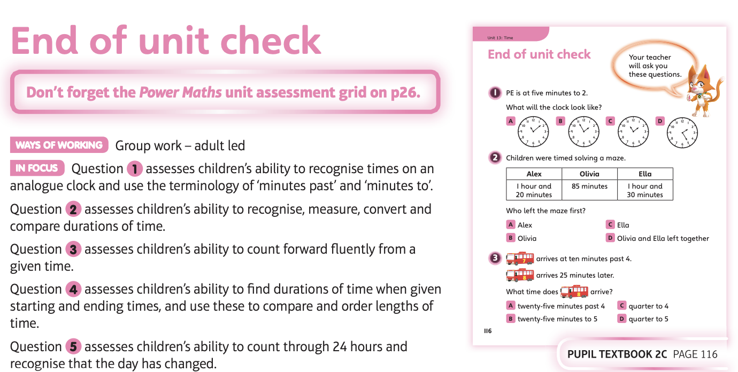
22.5.20 Have a look at these

Slide 14
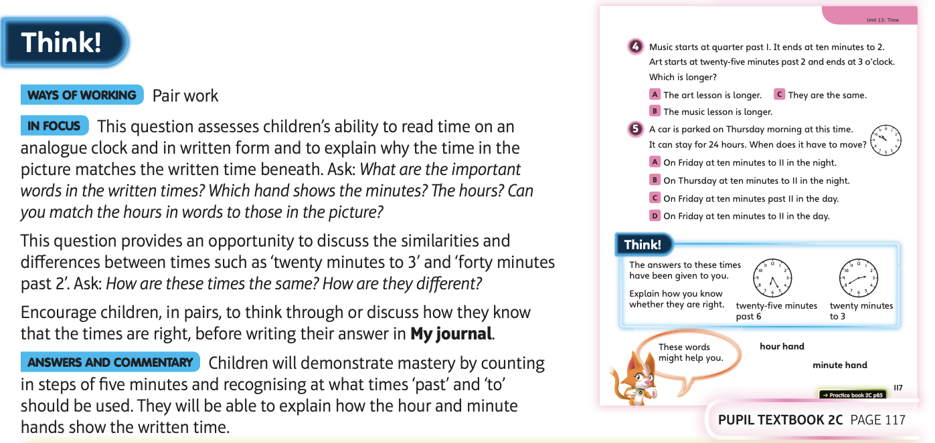
No complete the end of unit check

