Slide 1
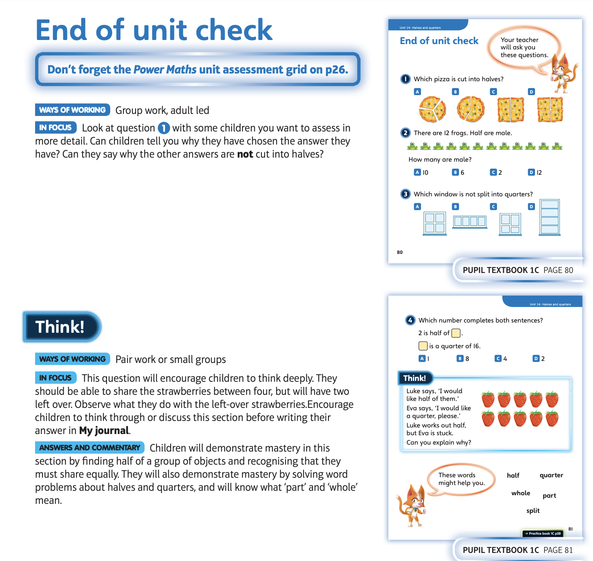
18.5.20 Have a look at these
Then complete the end of unit check

Slide 2
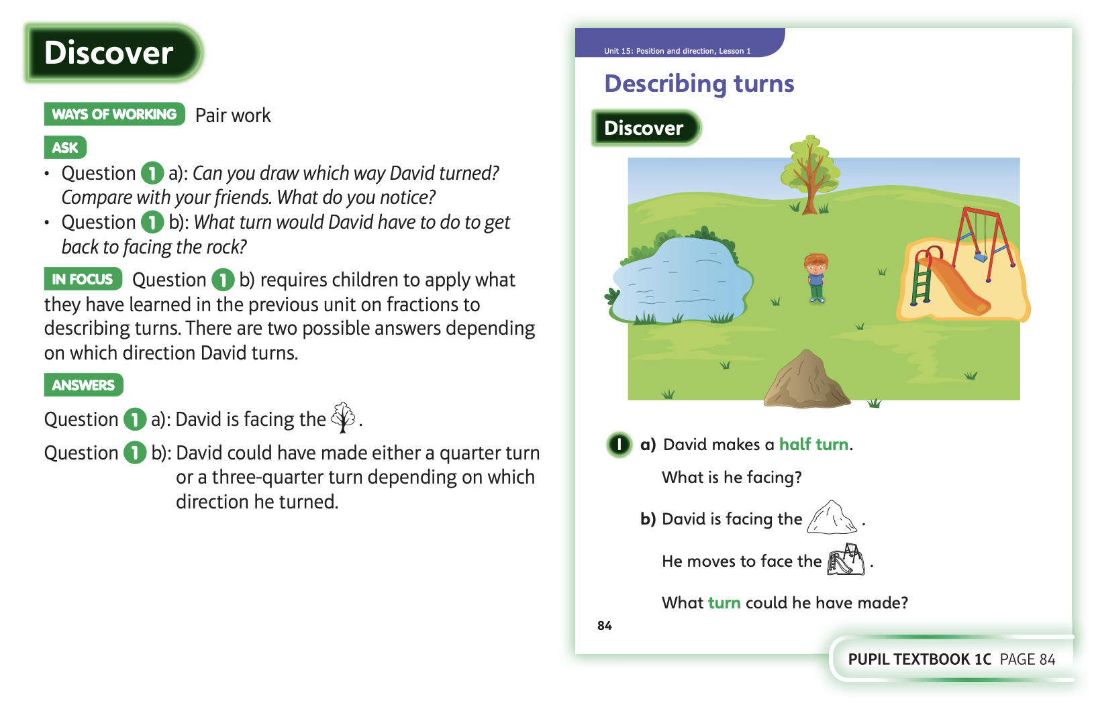
19.5.20 Have a look at these

Slide 3
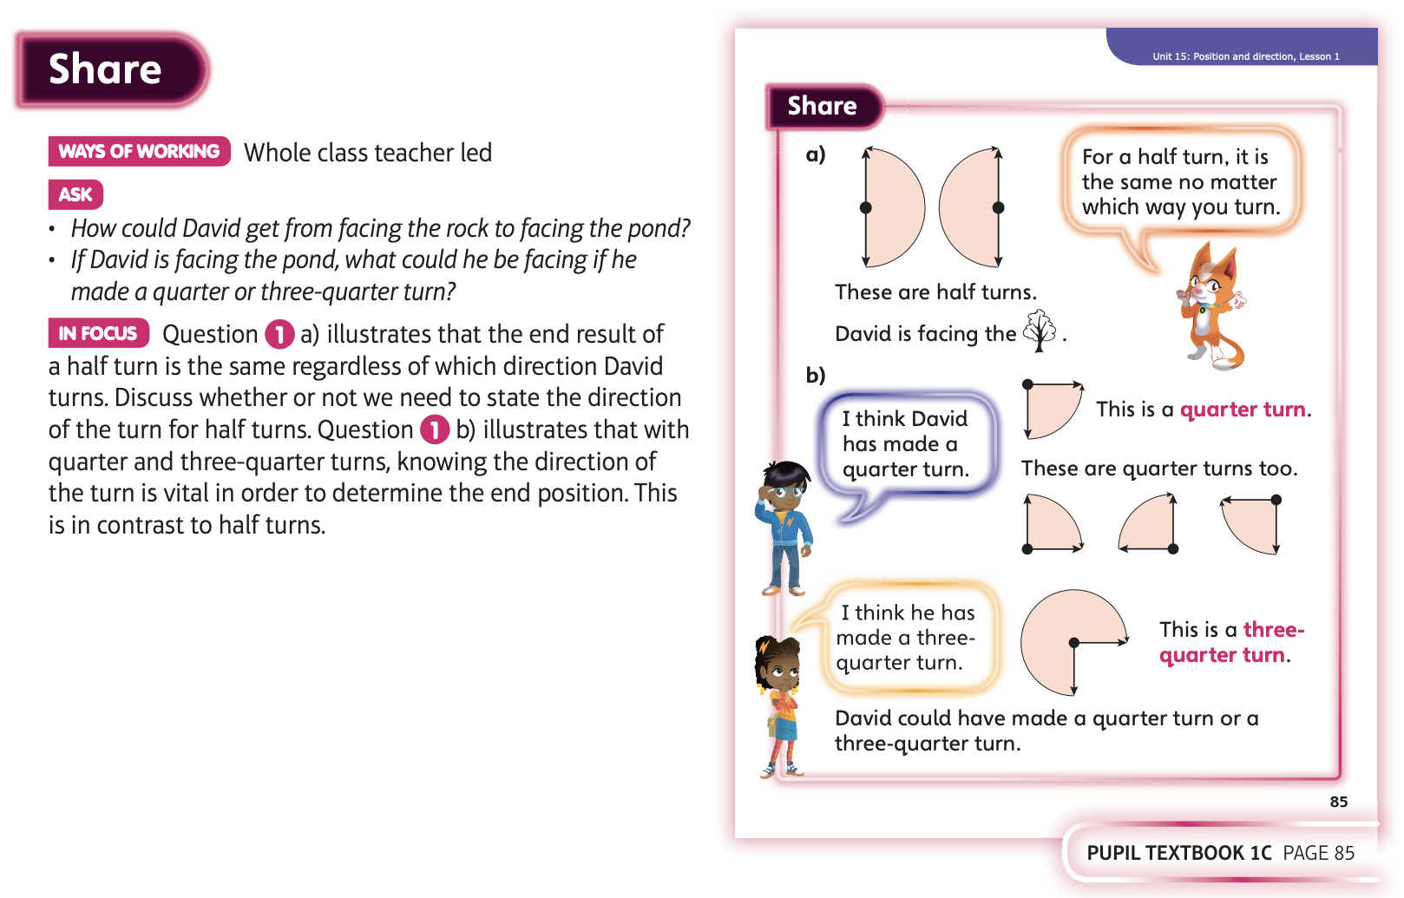
19.5.20 Have a look at these

Slide 4
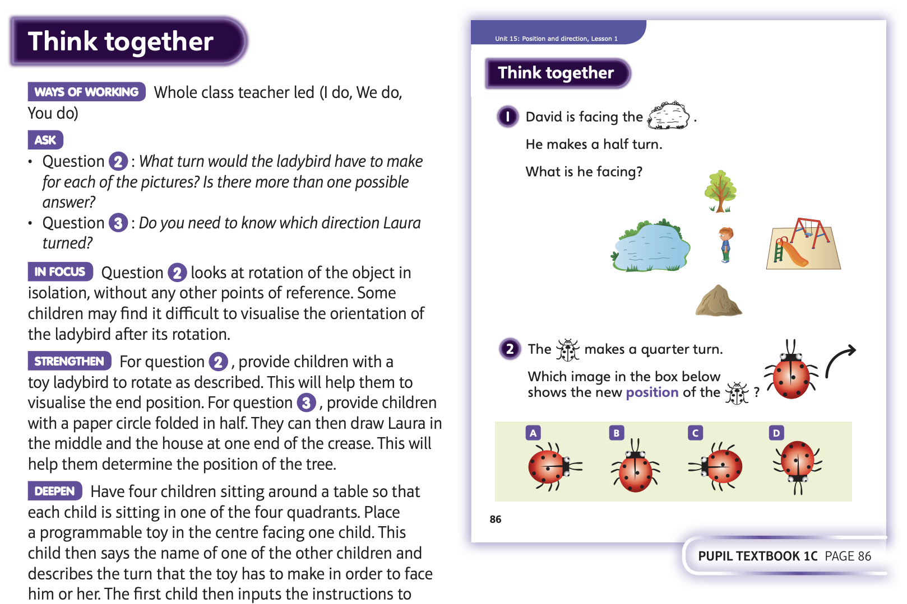
19.5.20 Have a look at these
Then complete Unit 15, lesson 1

Slide 5
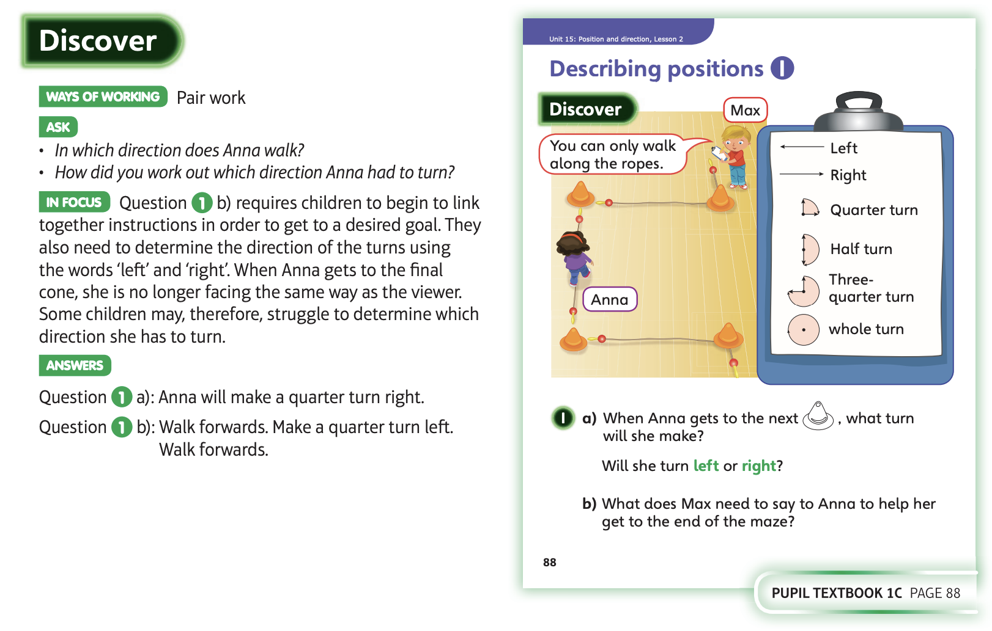
20.5.20 Have a look at these

Slide 6
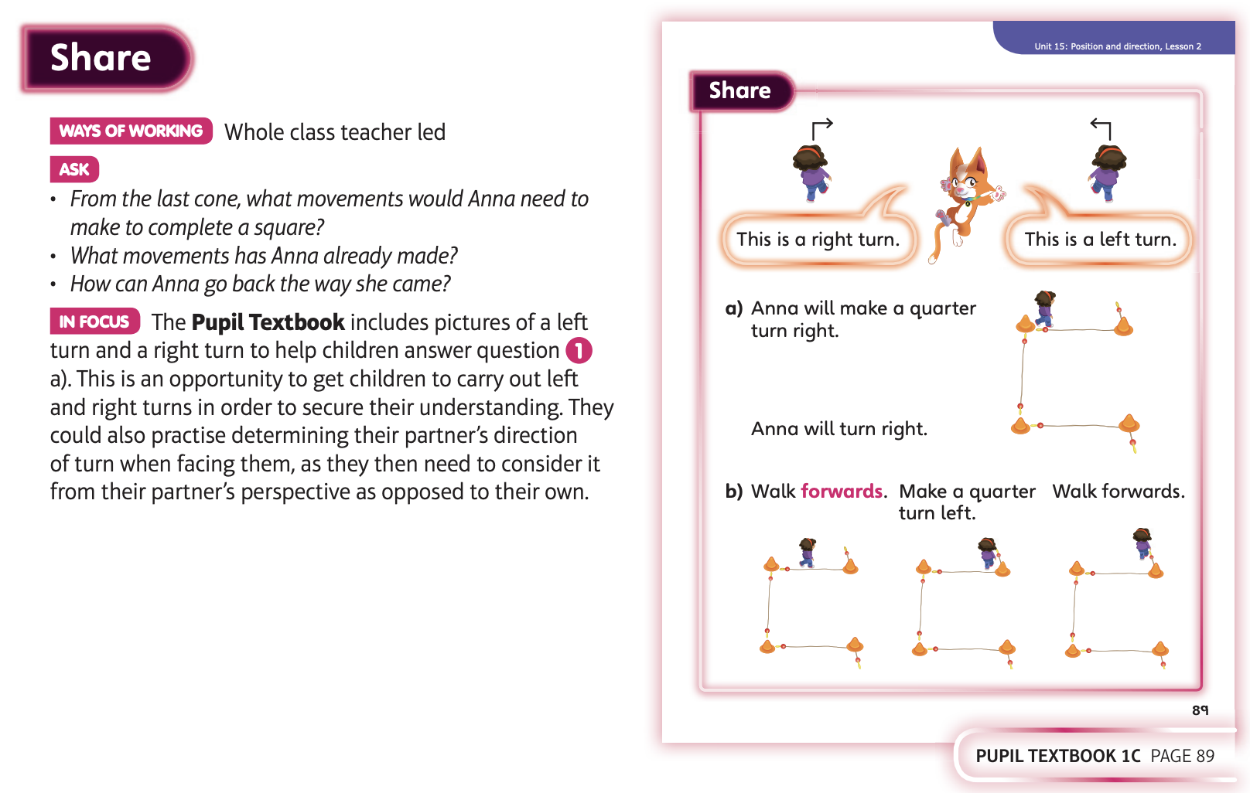
20.5.20 Have a look at these

Slide 7
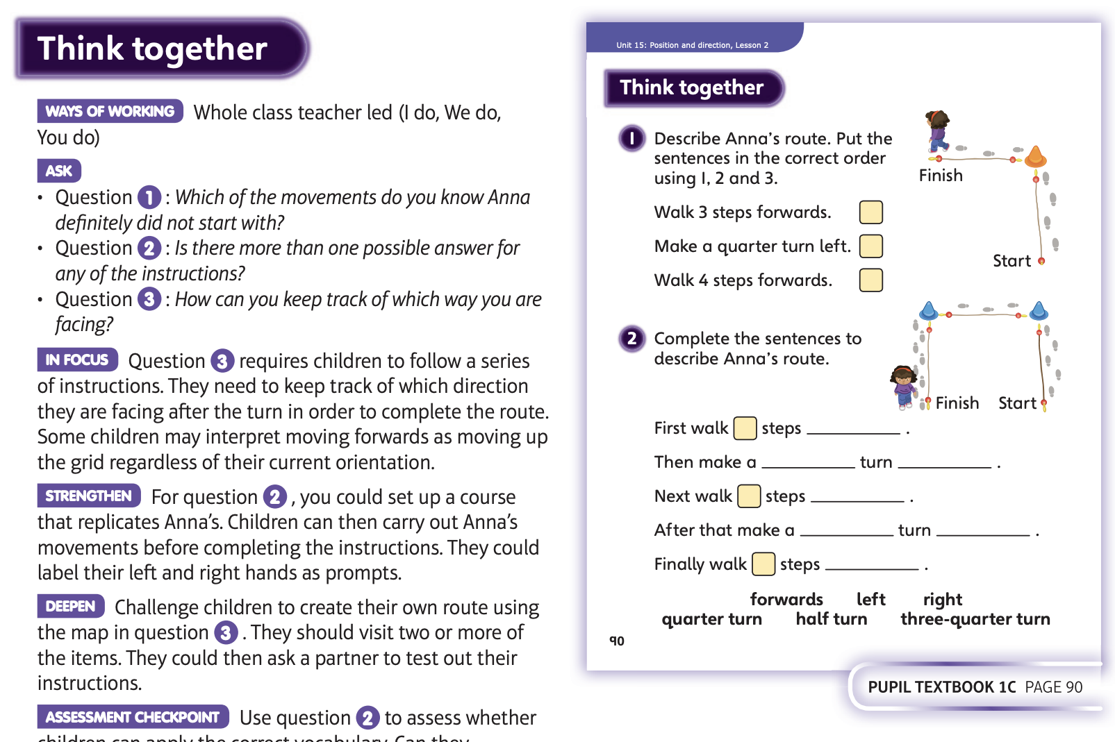
20.5.20 Have a look at these
Then complete Unit 15, lesson 2

Slide 8
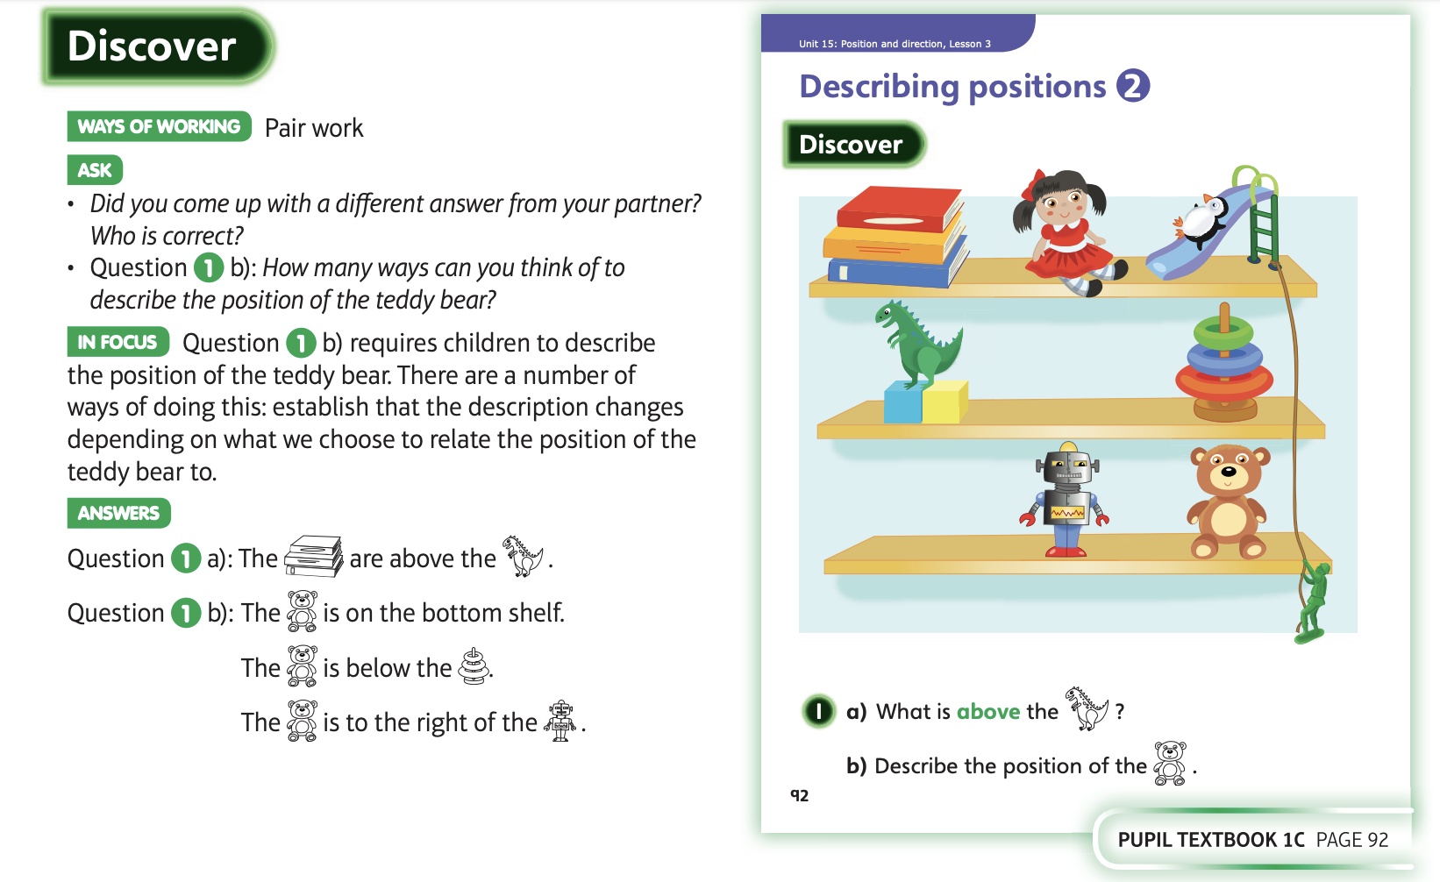
21.5.20 Have a look at these

Slide 9
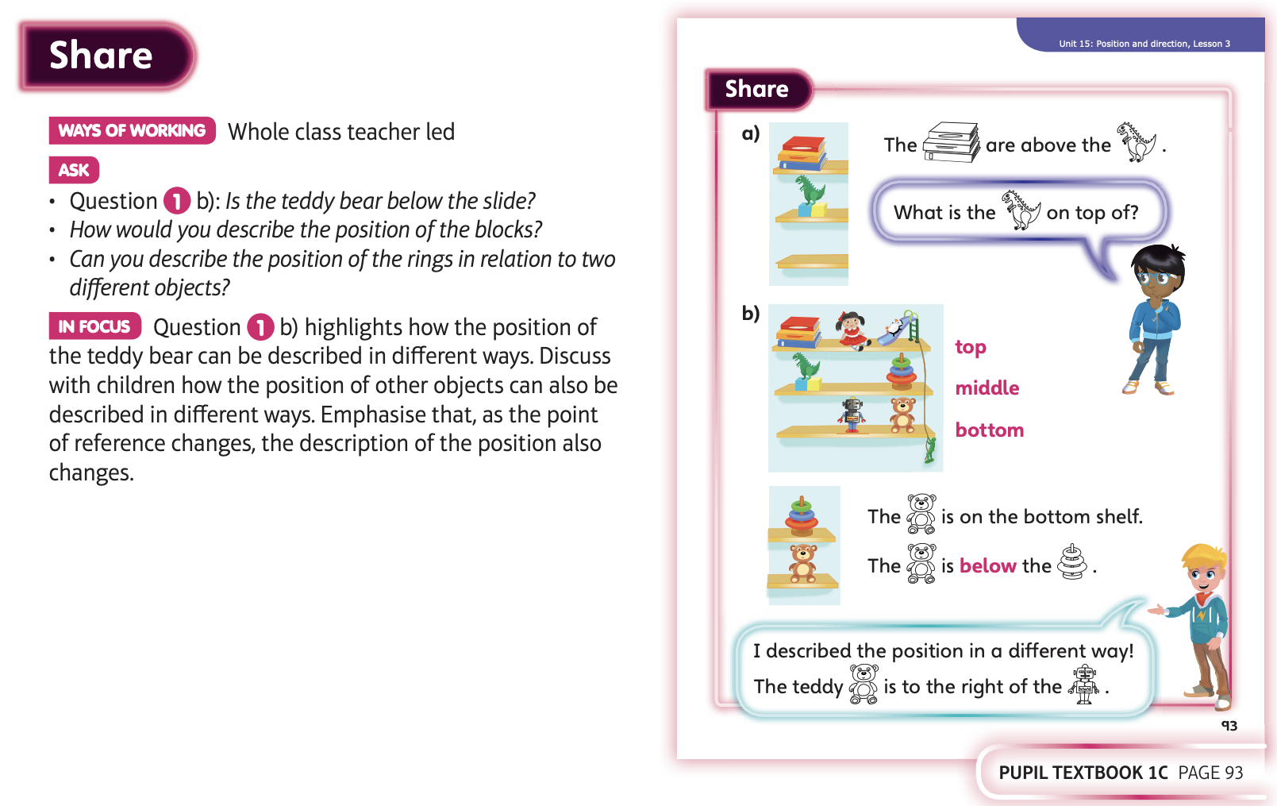
21.5.20 Have a look at these

Slide 10
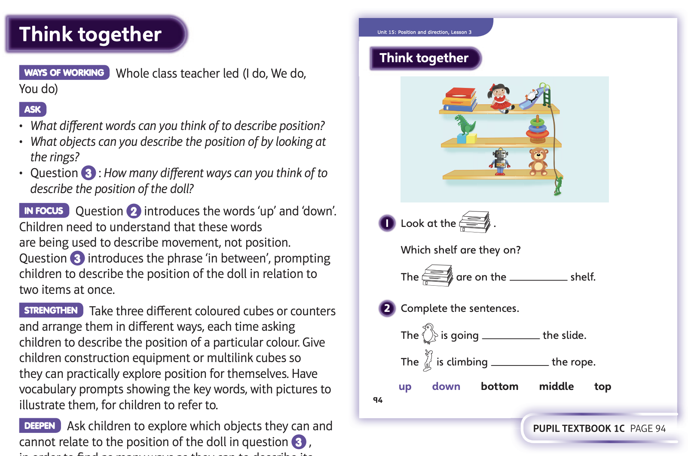
21.5.20 Have a look at these
Then complete Unit 15, lesson 3

Slide 11
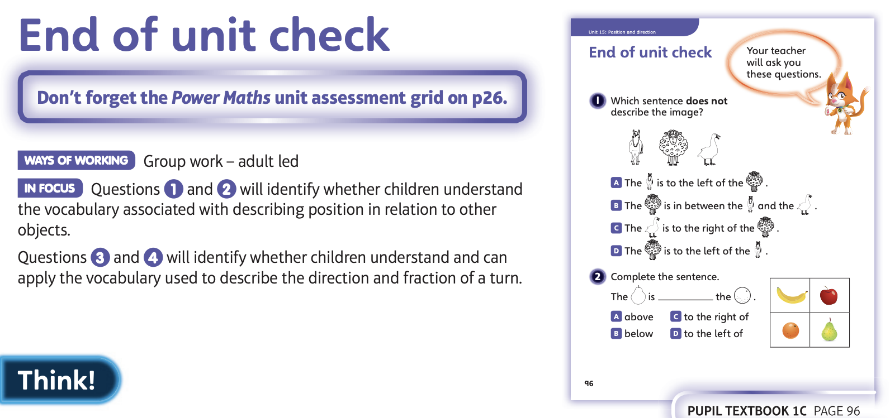
22.5.20 Have a look at these

Slide 12
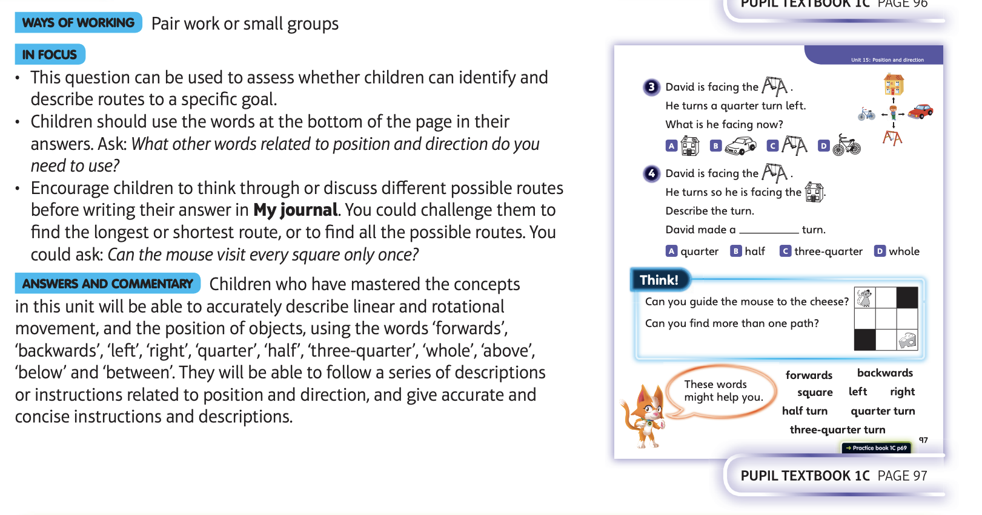
Then complete the end of unit check

