Slide 1
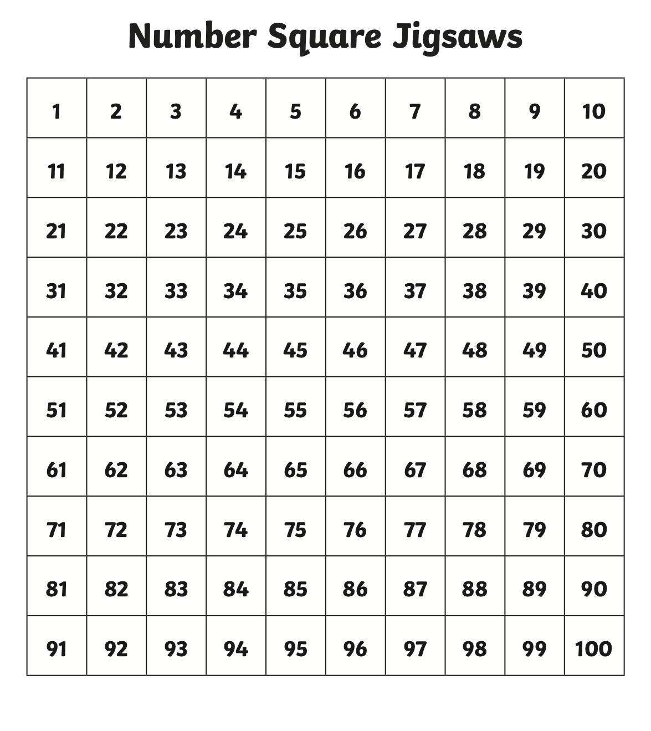
1.6.20
Can you count all the numbers from 1 to 100? Can you see any patterns through the 100 square?

Slide 2
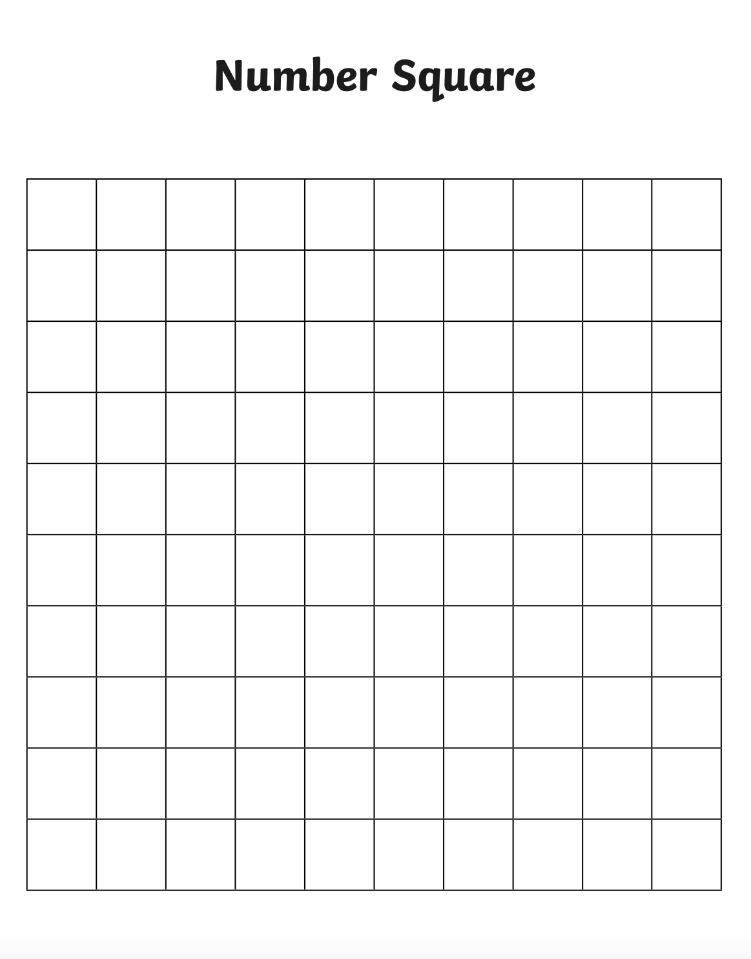
Have a go at filling in this blank 100 square. Start at 1. Can you get to 100? Do you need to look at the one on the previous page to help?
Can you write every number correctly?

Slide 3
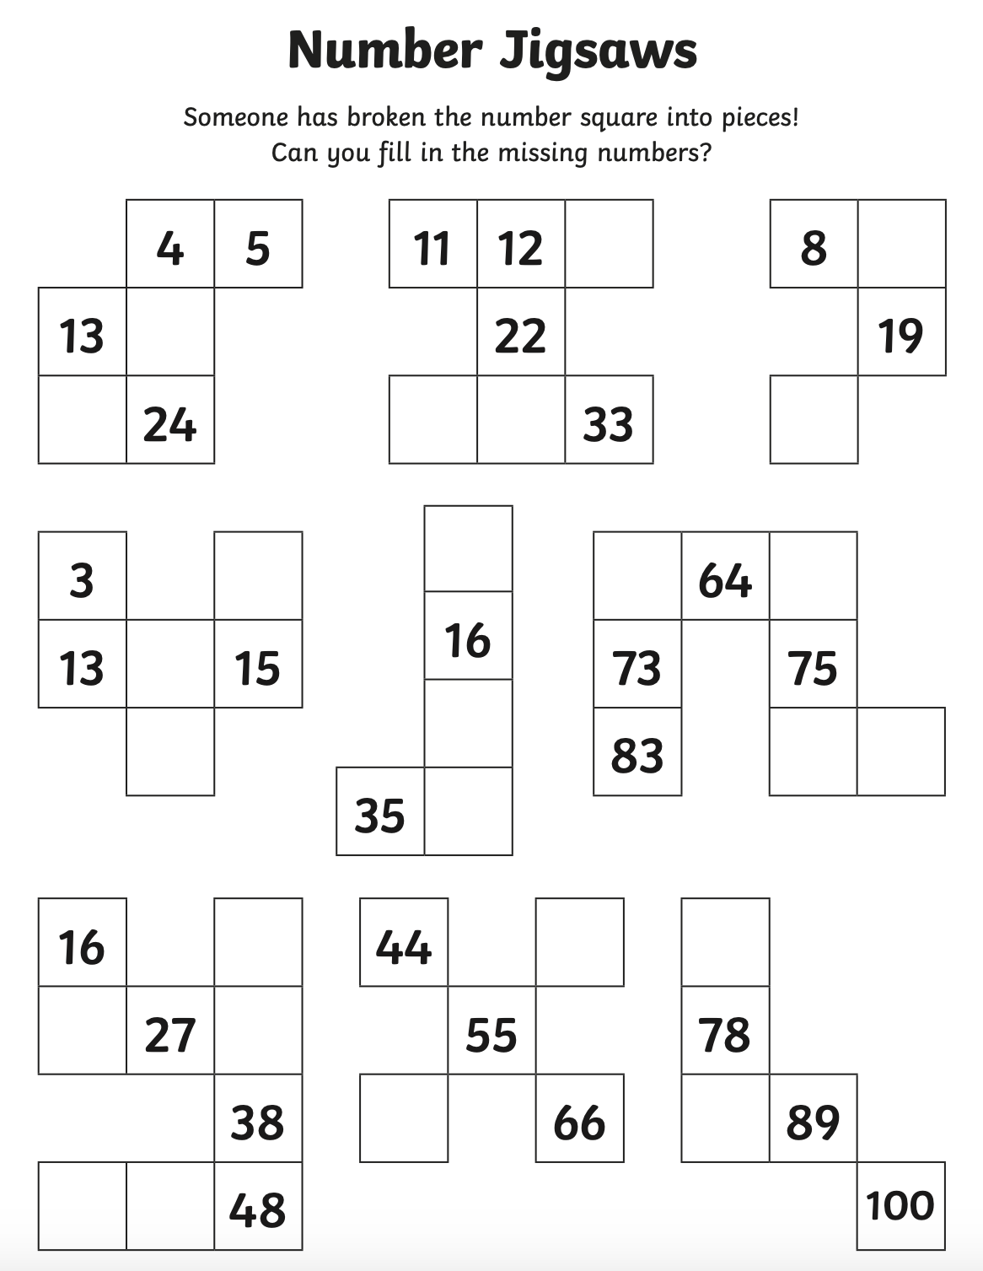
2.6.20
Use your 100 square to fill in
the missing gaps?

Slide 4
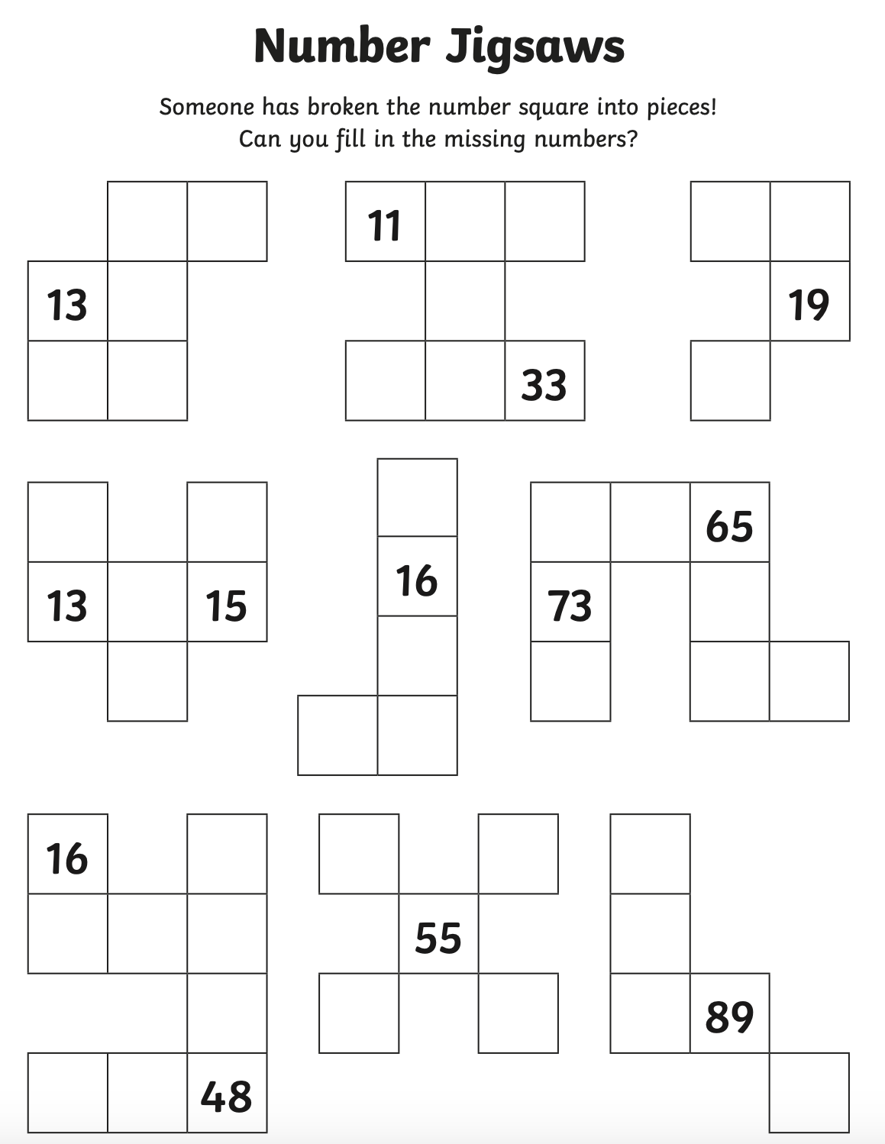
Here is a harder challenge,
if you fancy it!

Slide 5
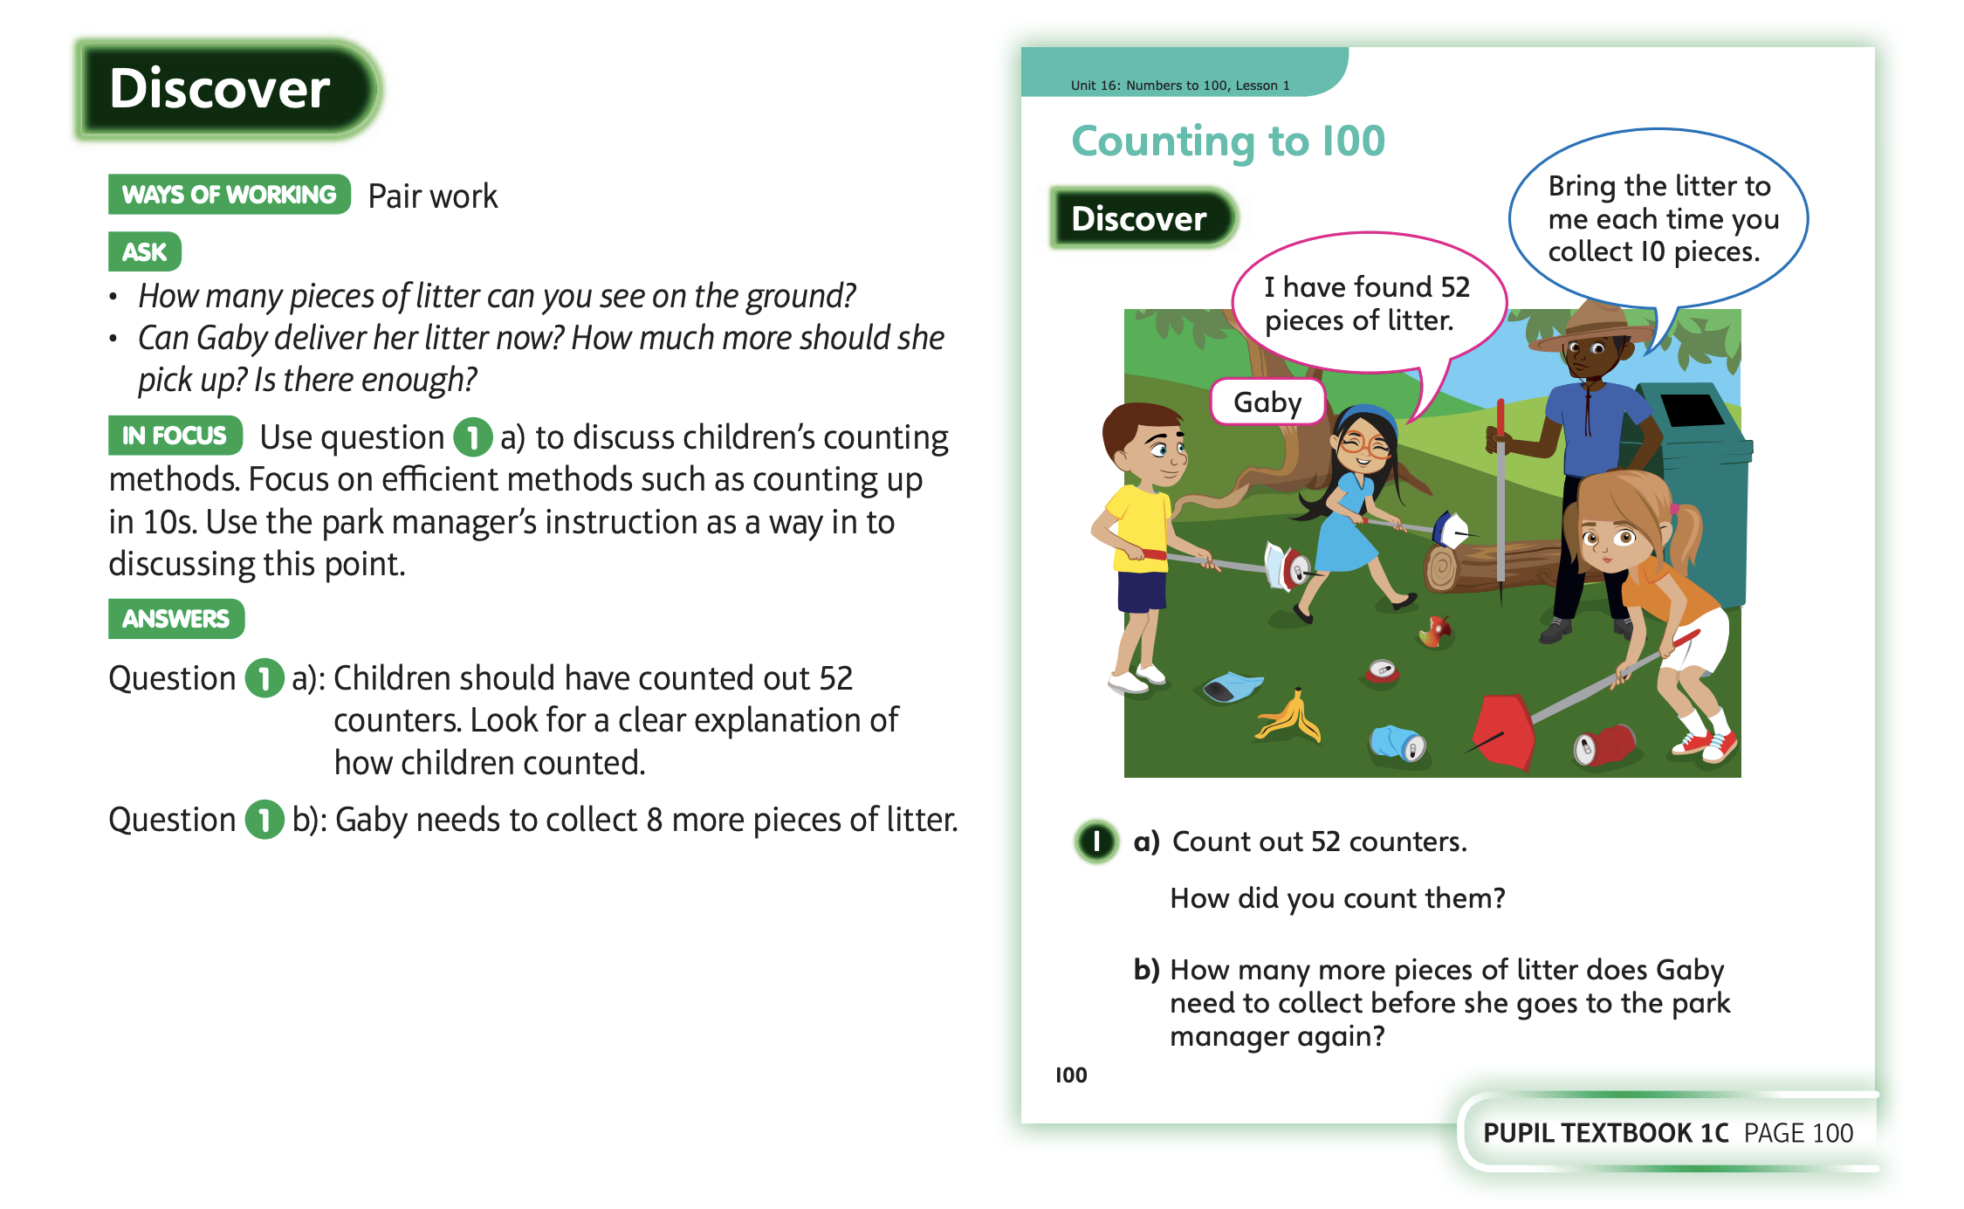
3.6.20 Have a look at these slides

Slide 6
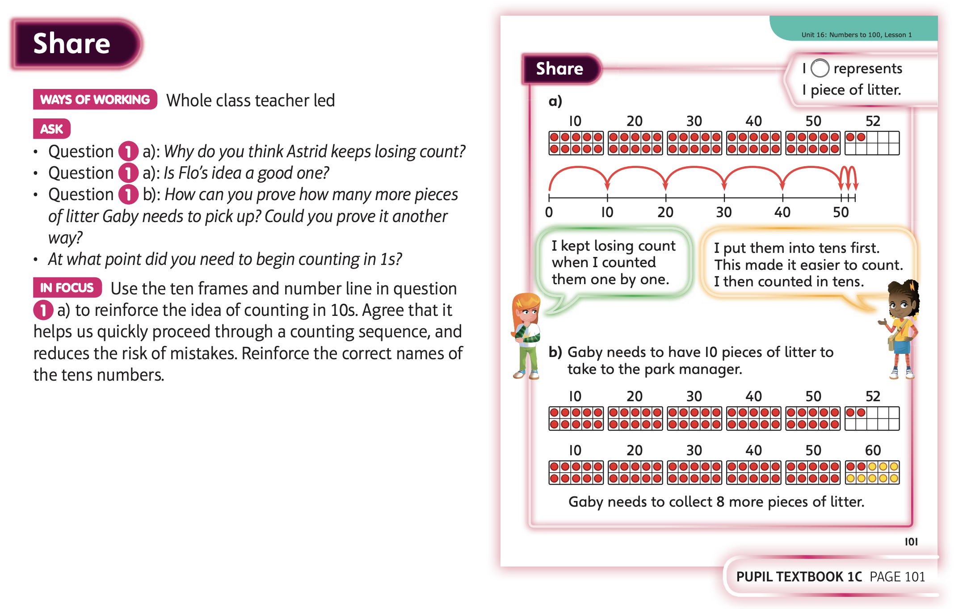

Slide 7
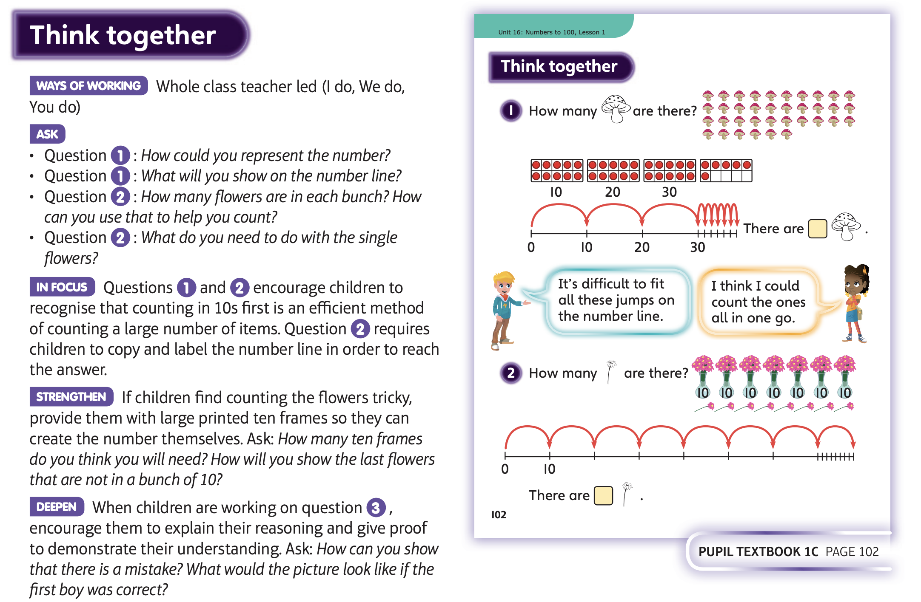
Now complete Unit 16, lesson 1

Slide 8
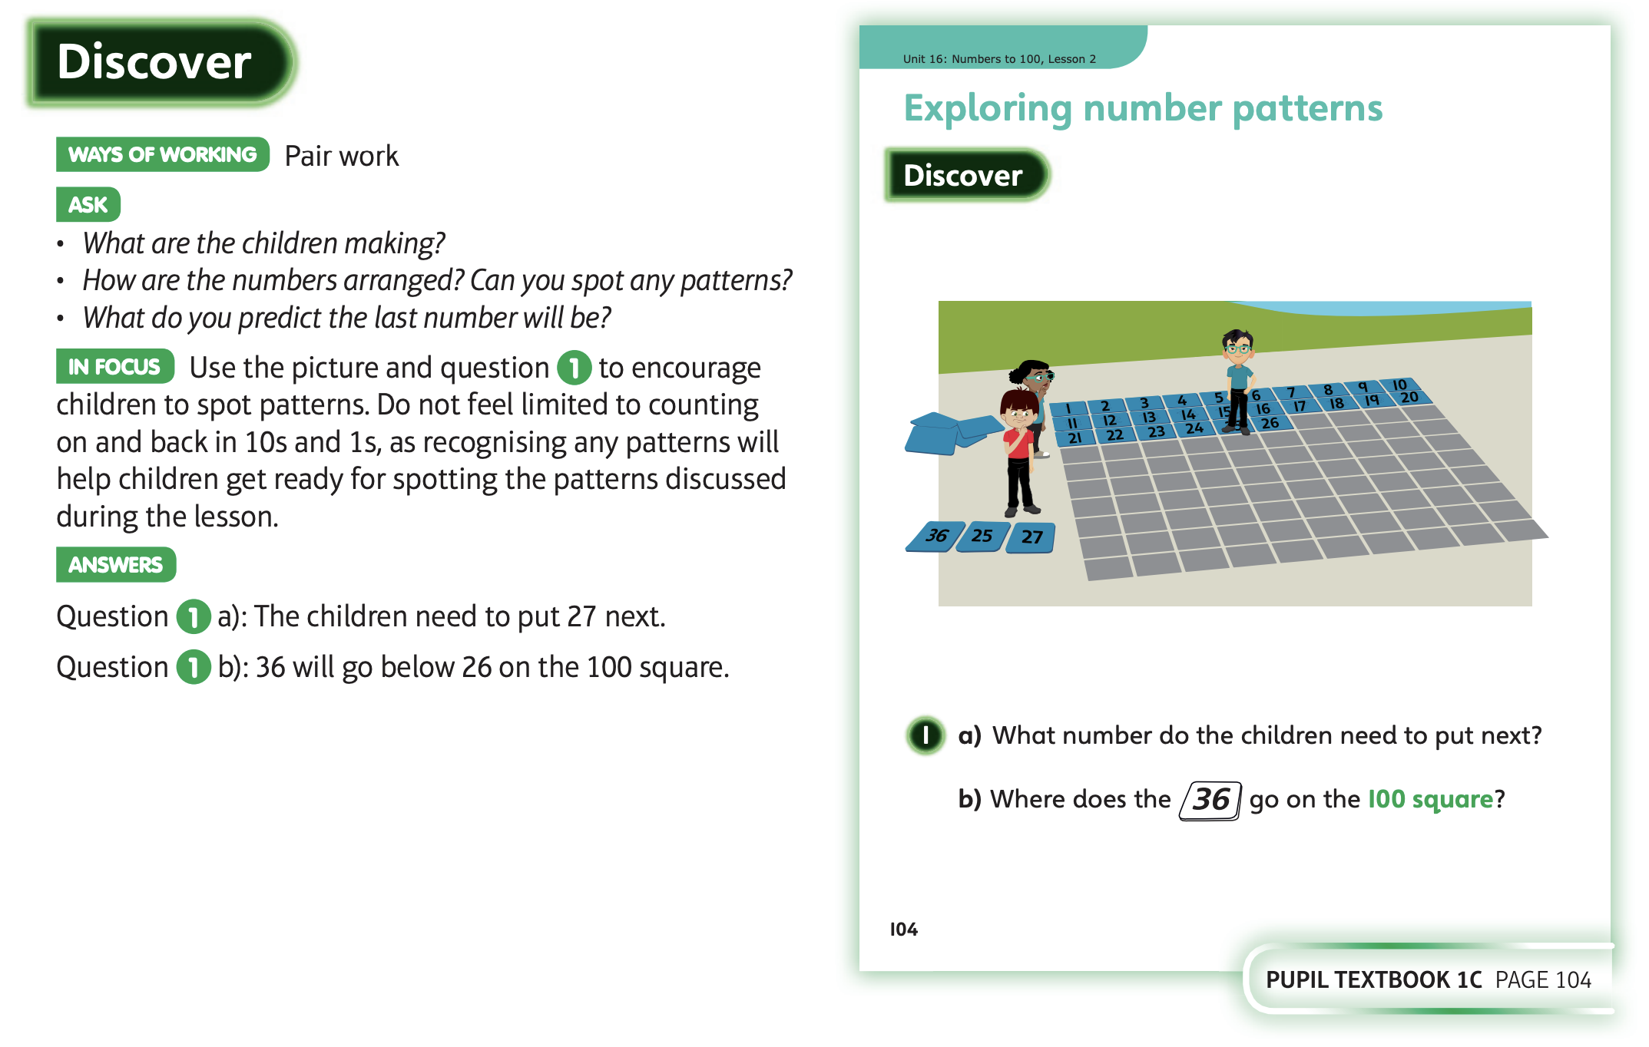
4.6.20 Have a look at these slides

Slide 9
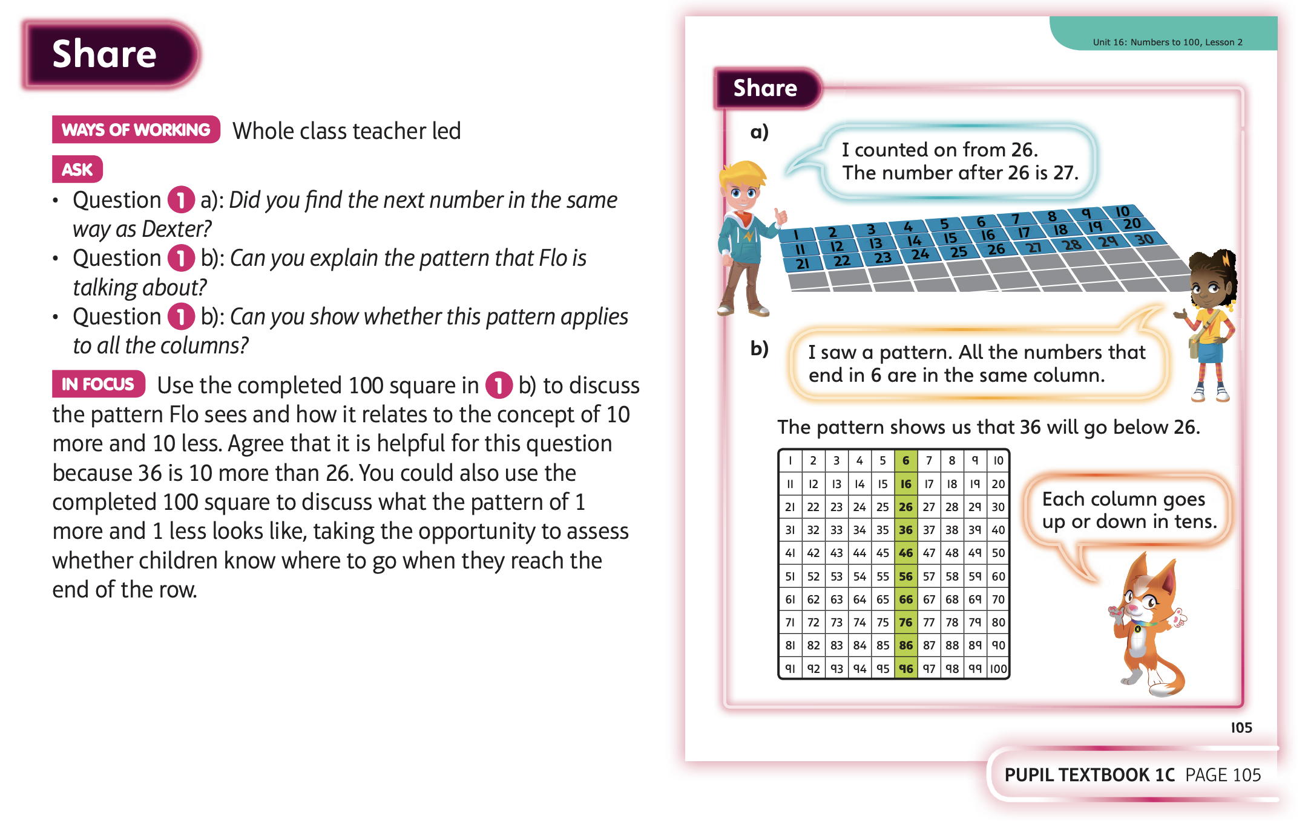

Slide 10
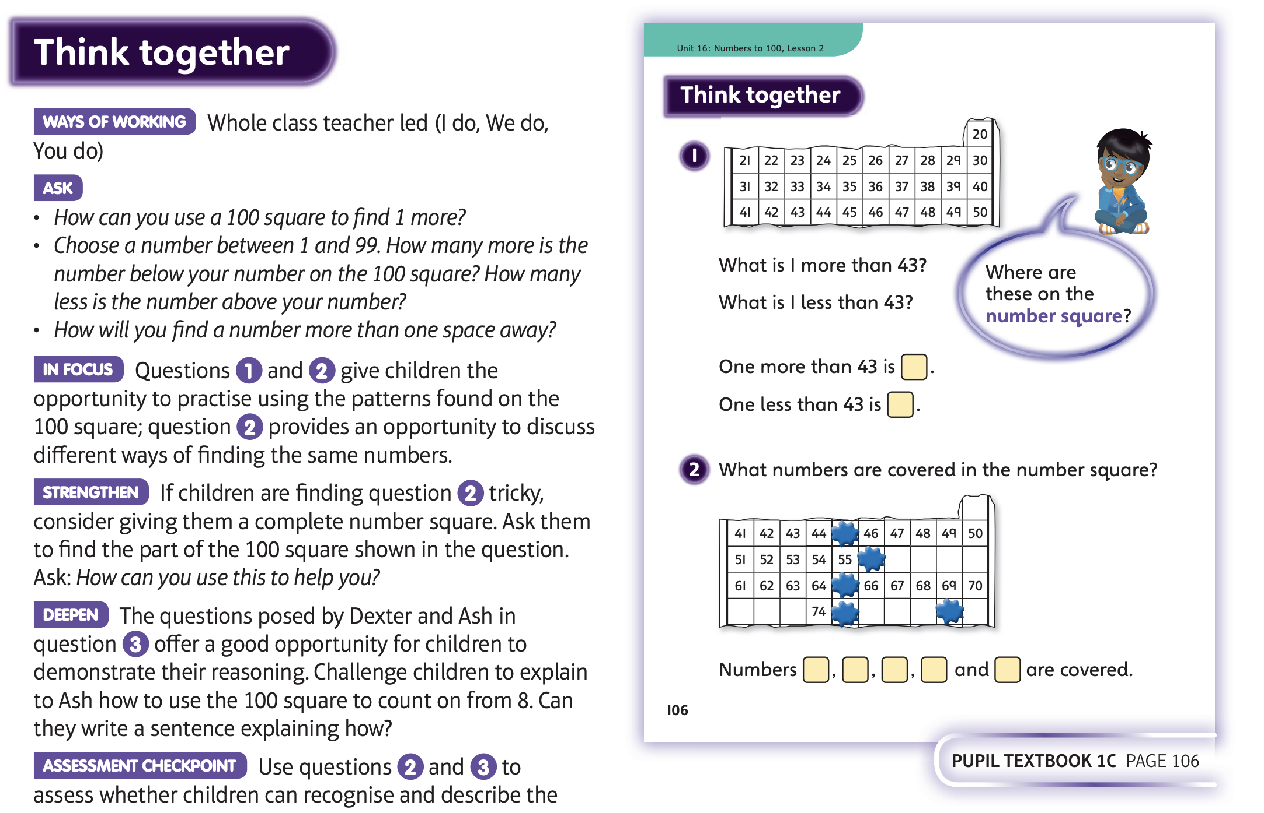

Slide 11
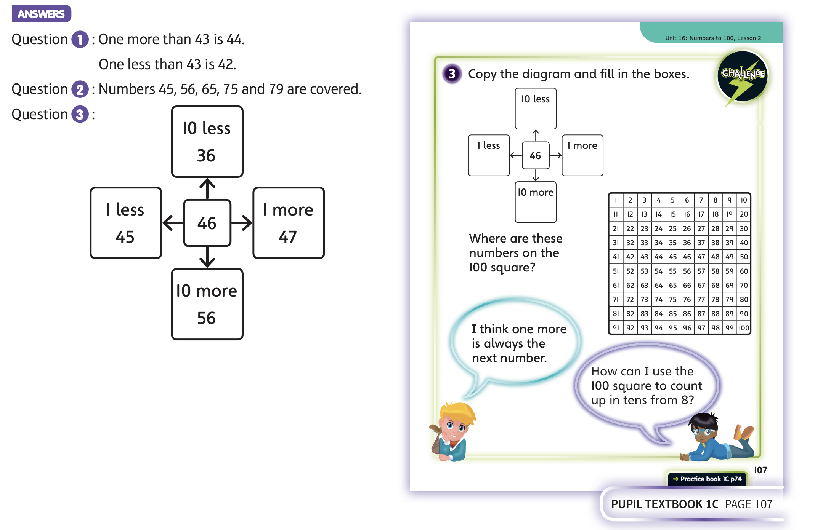
Now complete Unit 16, lesson 2

Slide 12
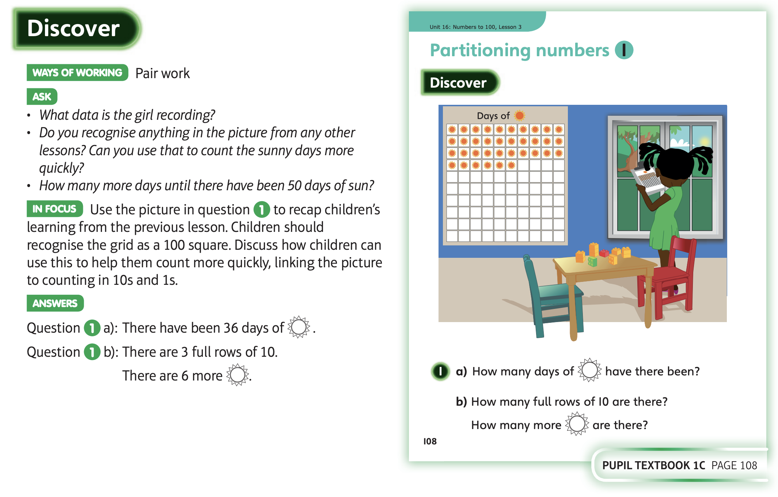
5.6.20 Have a look at these slides

Slide 13
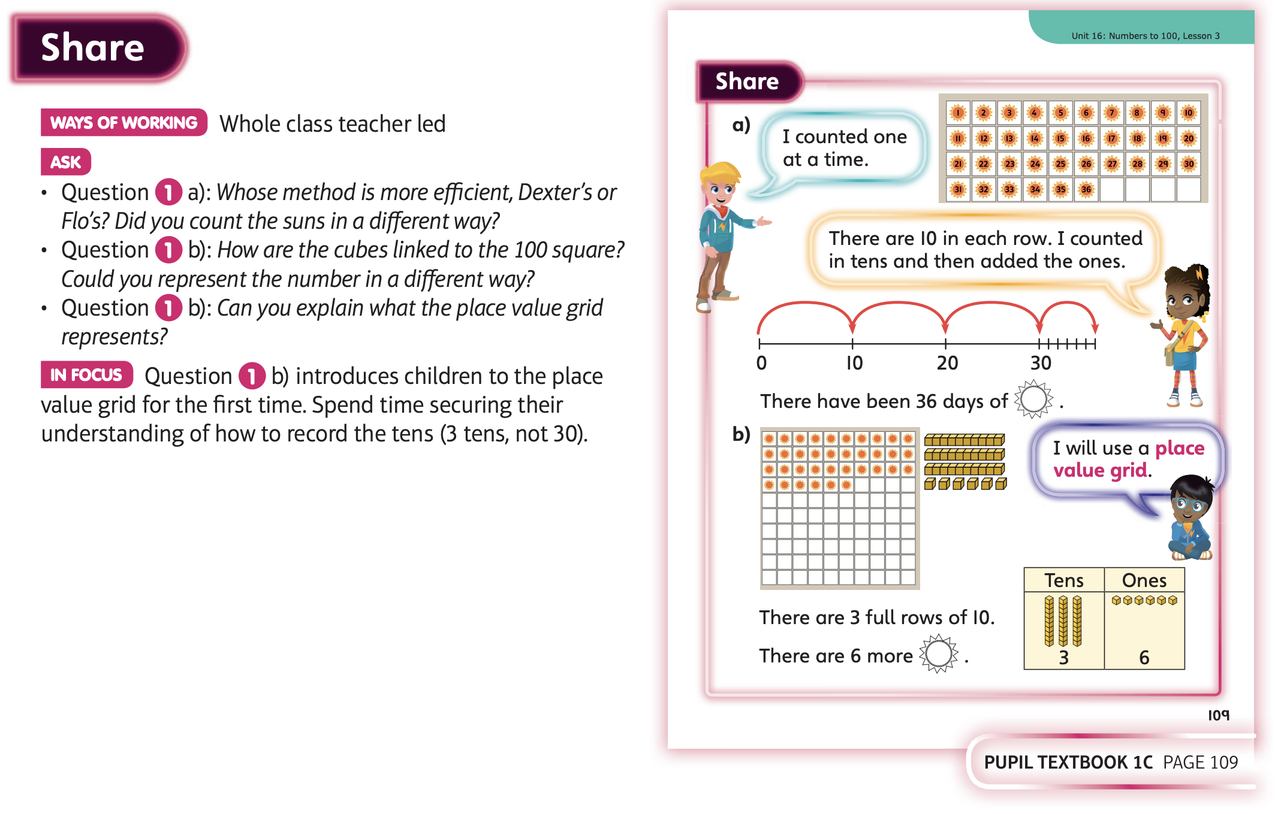

Slide 14
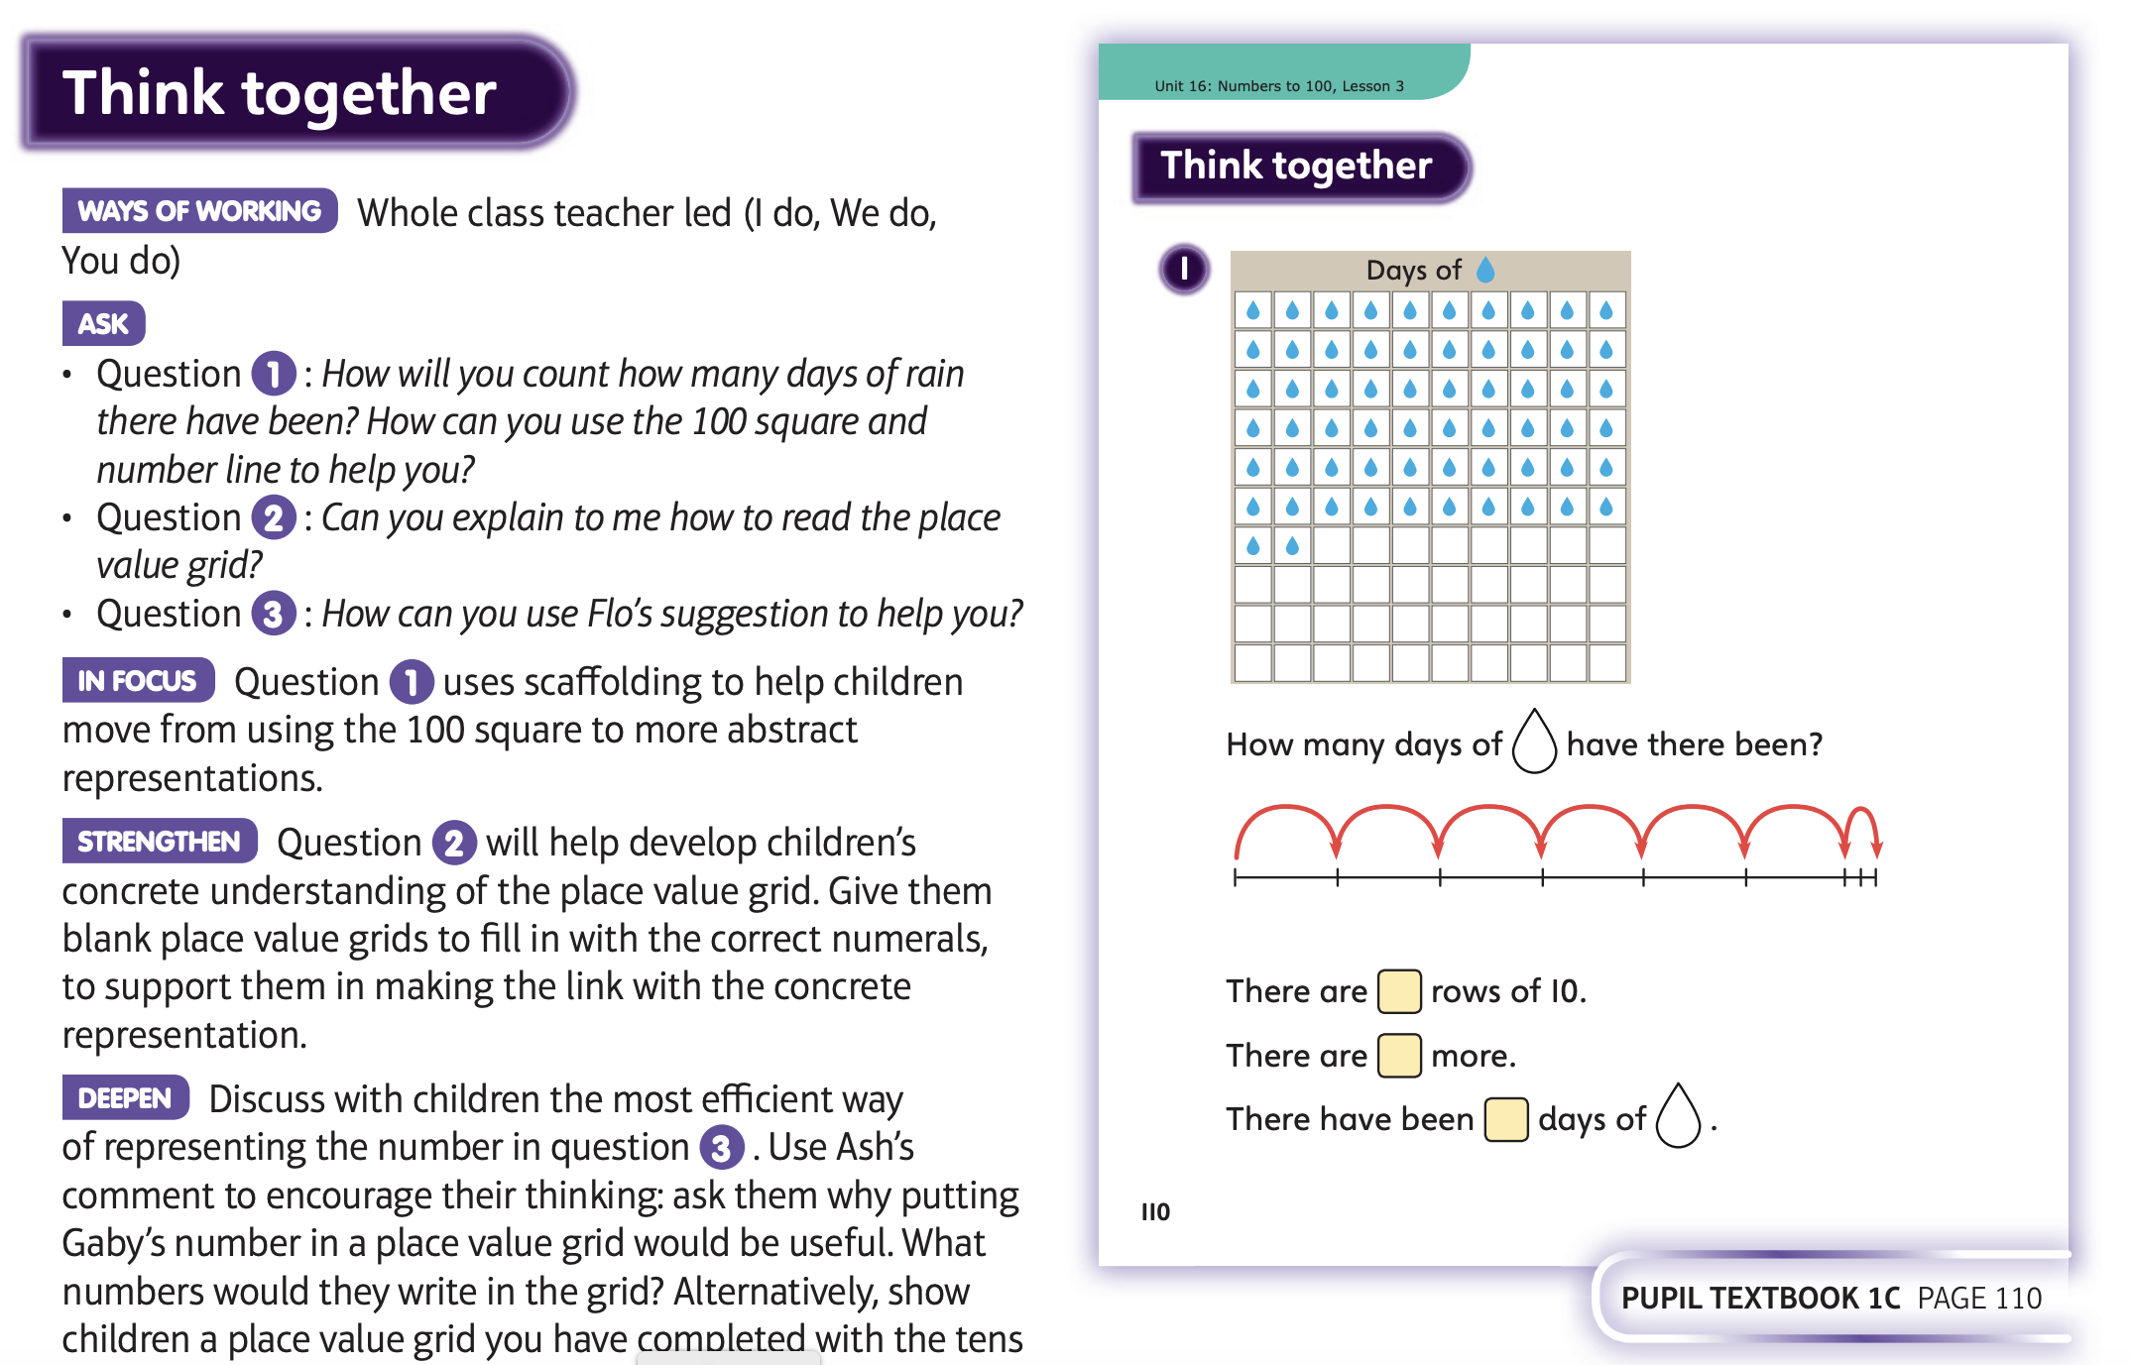

Slide 15
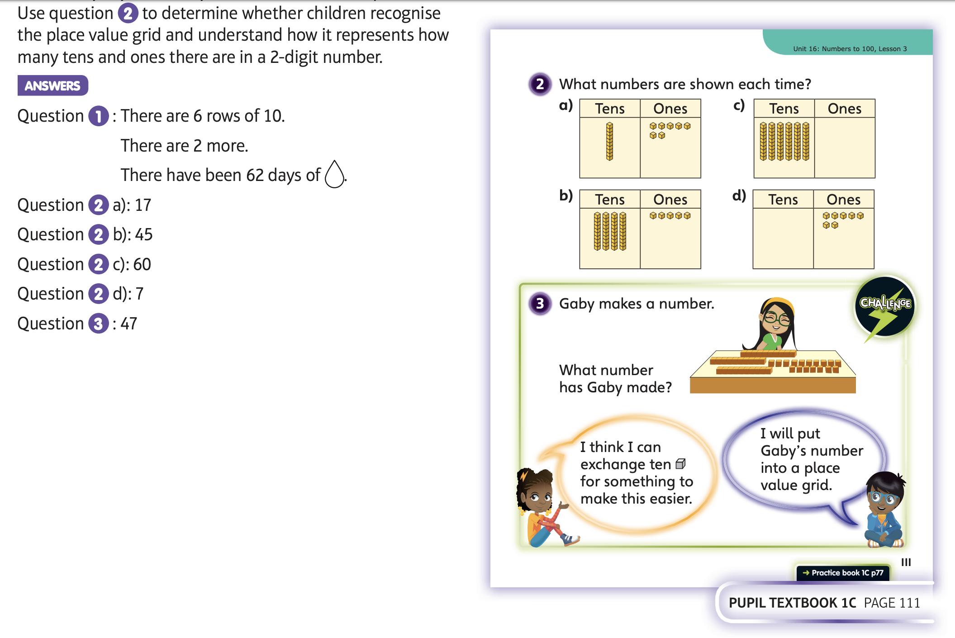
Now complete Unit 16, lesson 3

