Slide 1
Maths Year 1 Week Beginning 8.6.20
Monday and Tuesday will be two stand alone activities again so that the children coming into school on Wednesday will all be at the same starting point in their work books.

Slide 2
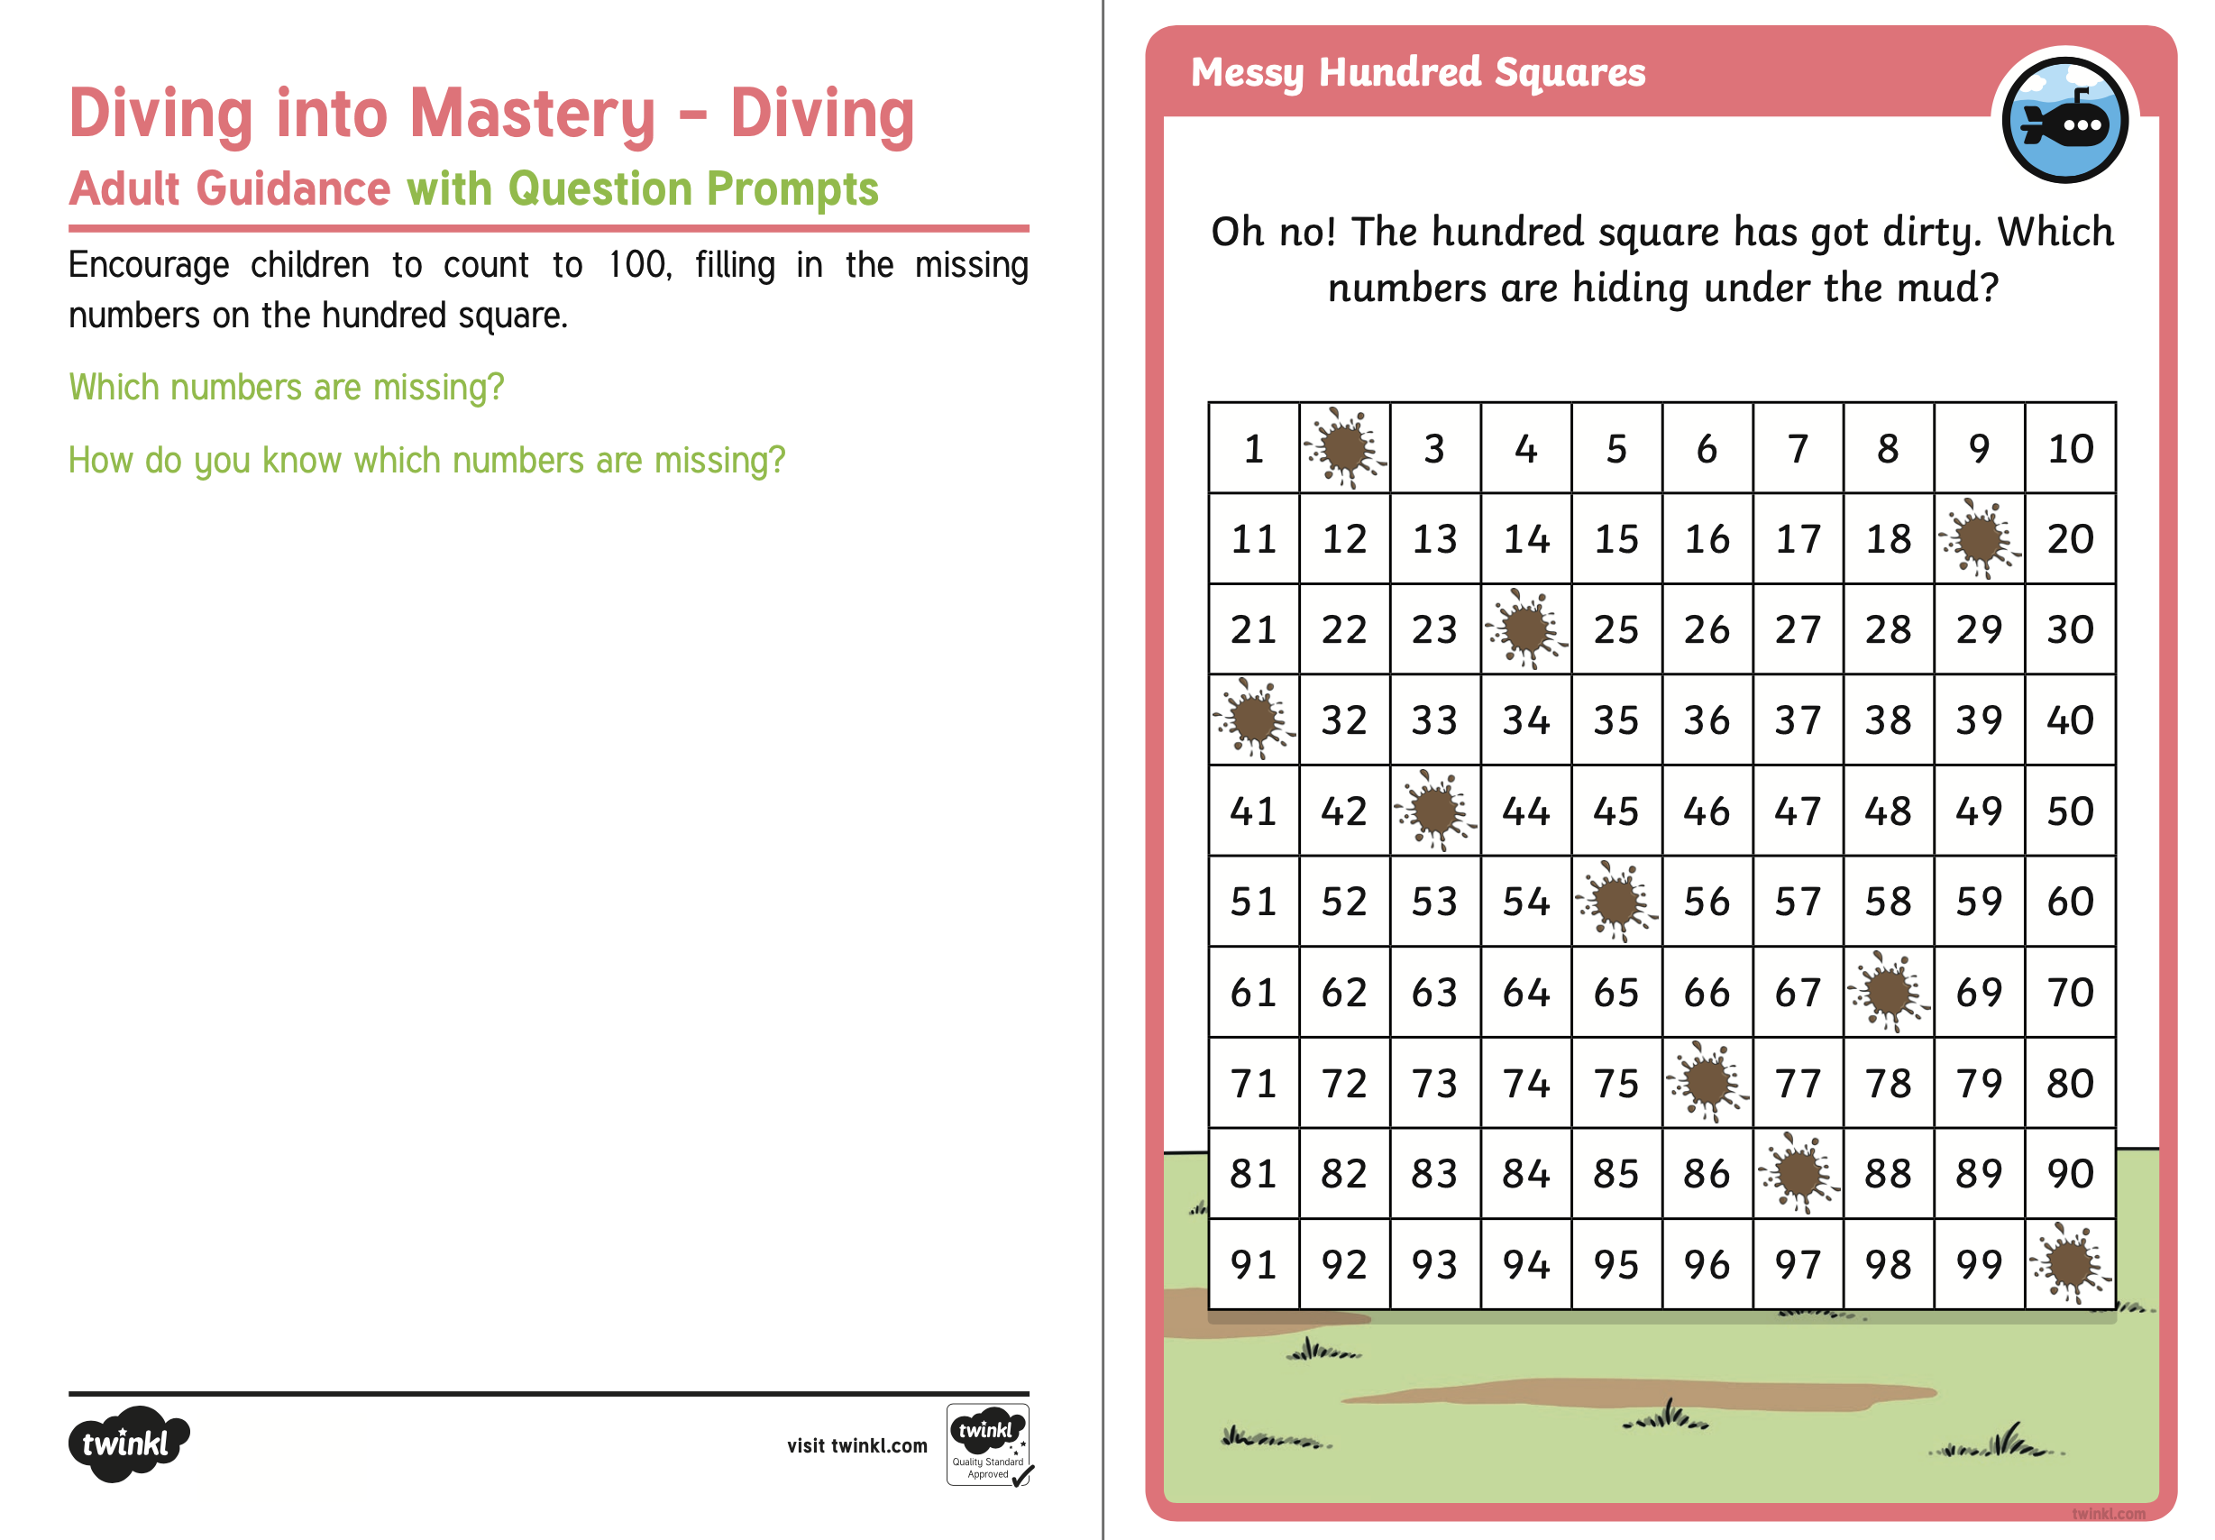
Monday 8.6.20

Slide 3
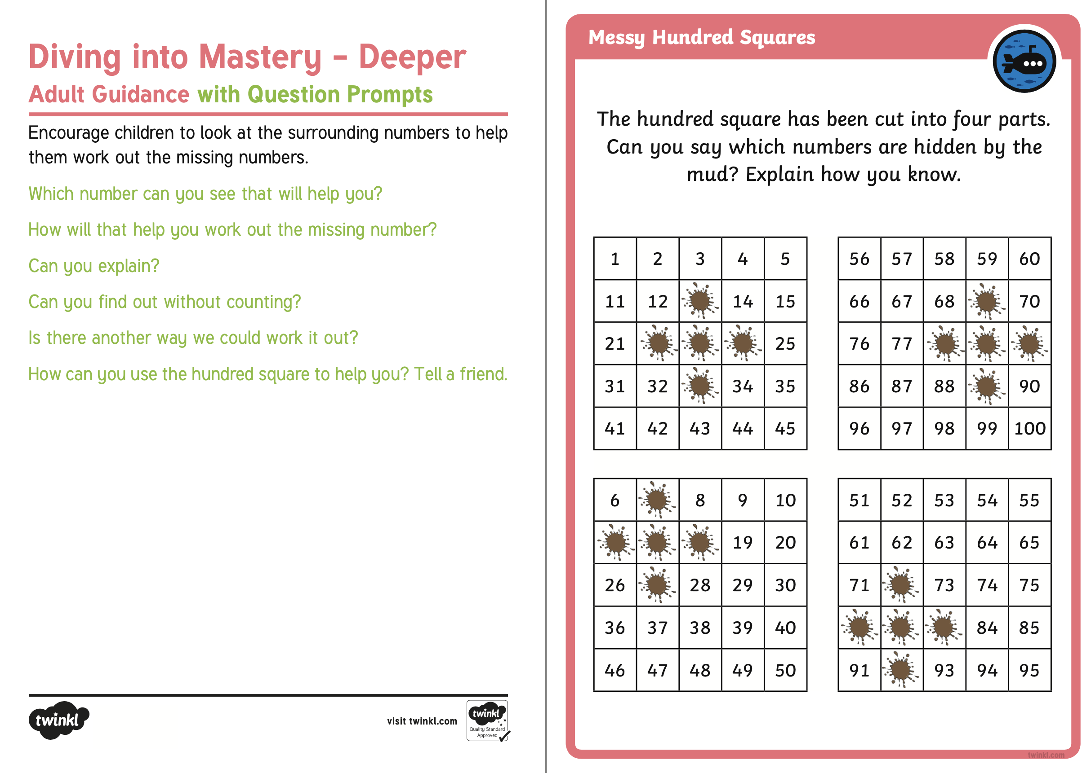

Slide 4
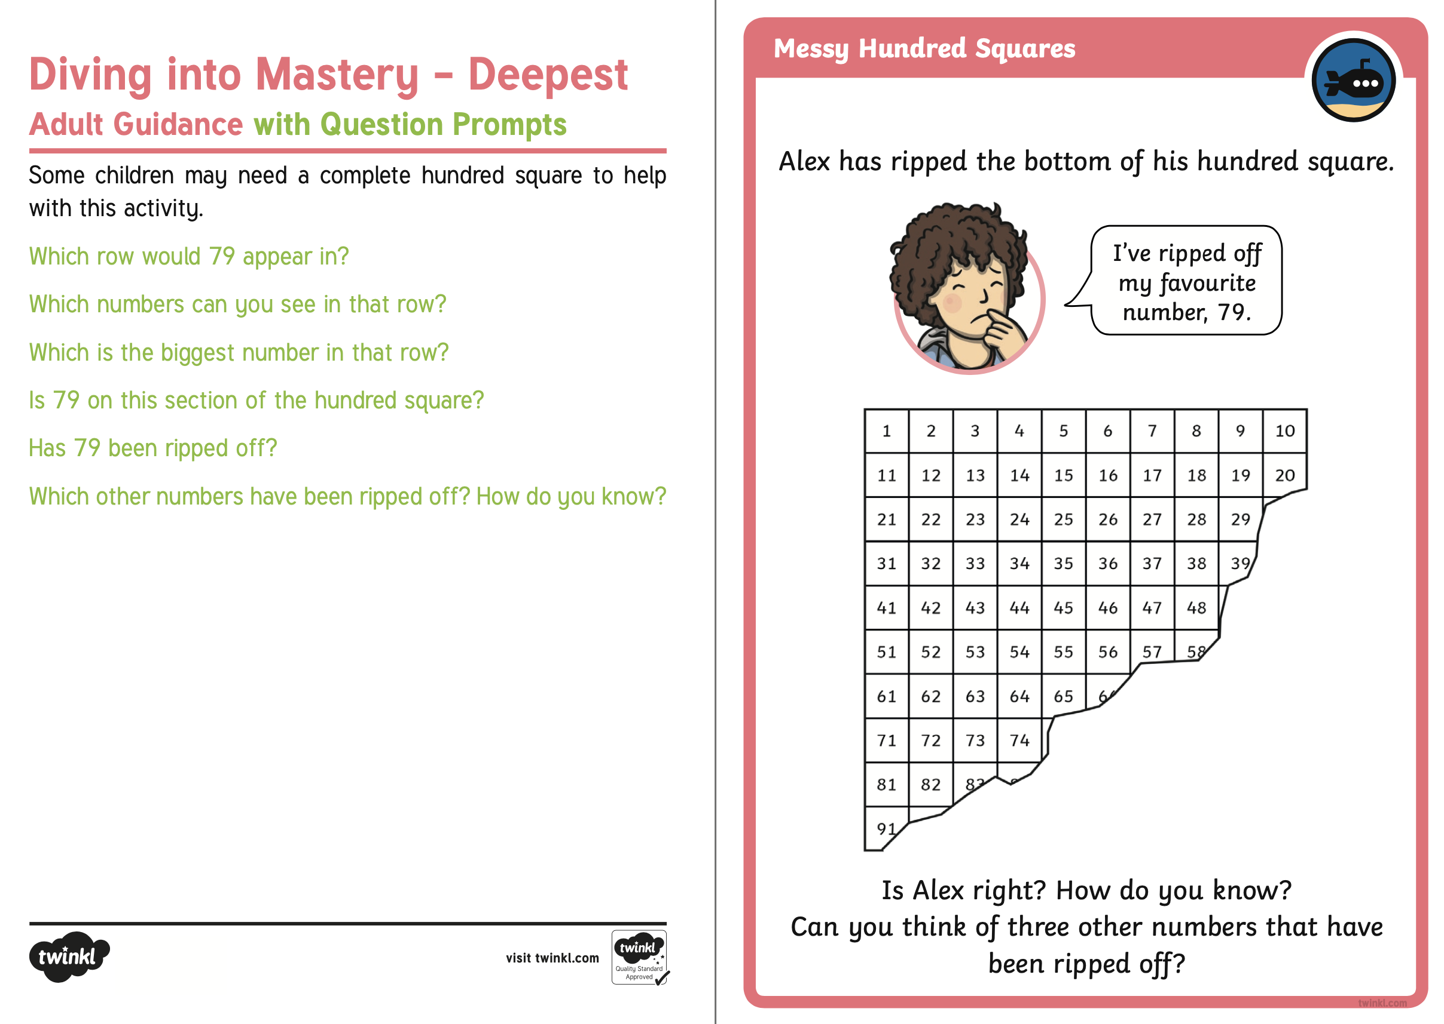

Slide 5
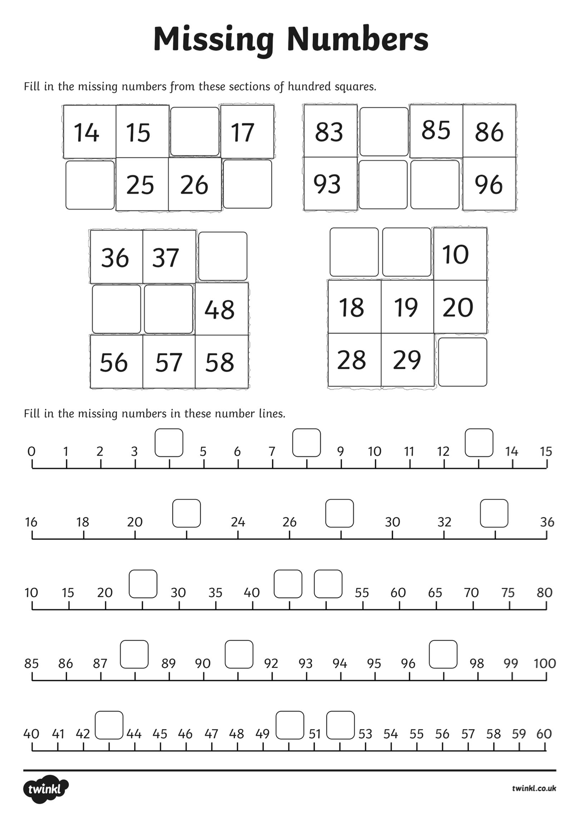
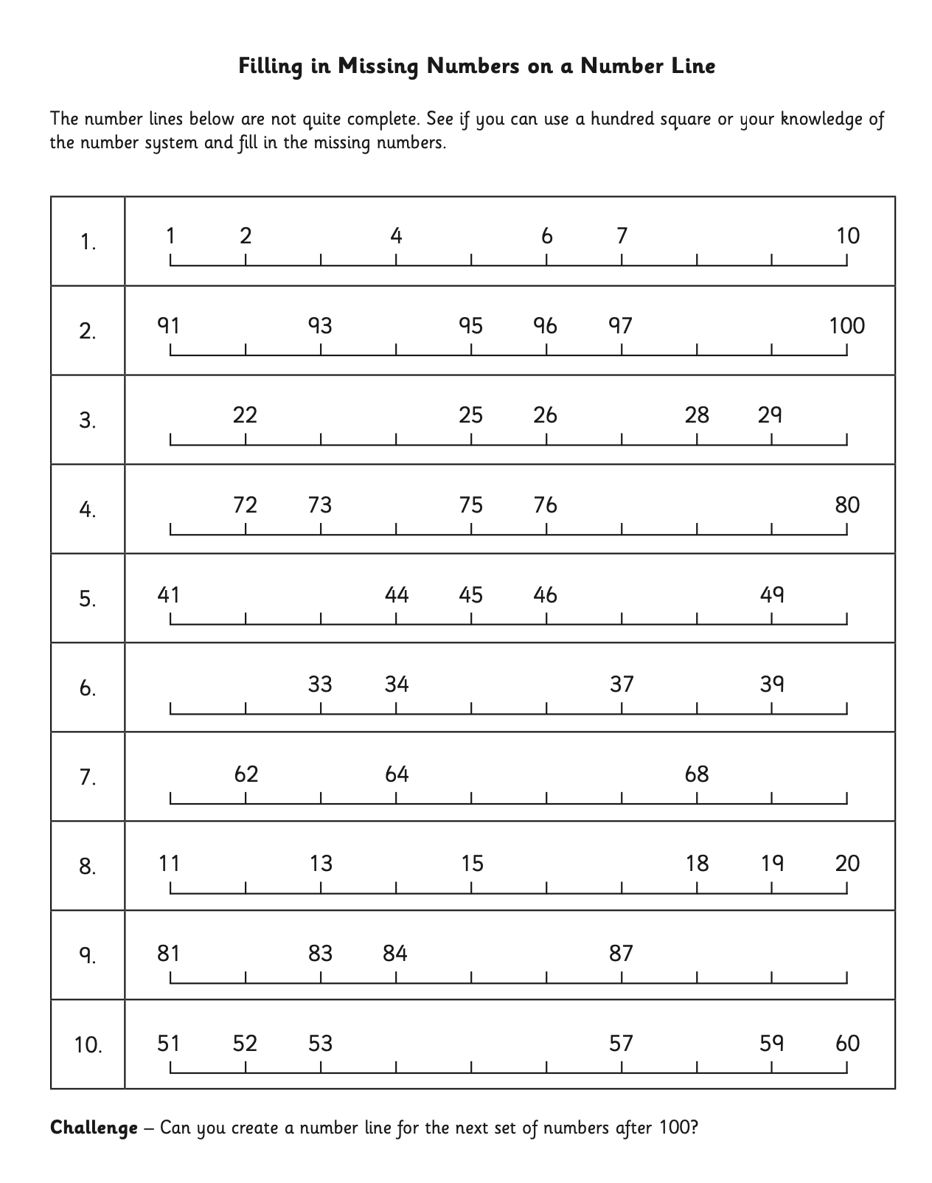
Tuesday 9.6.20

Slide 6
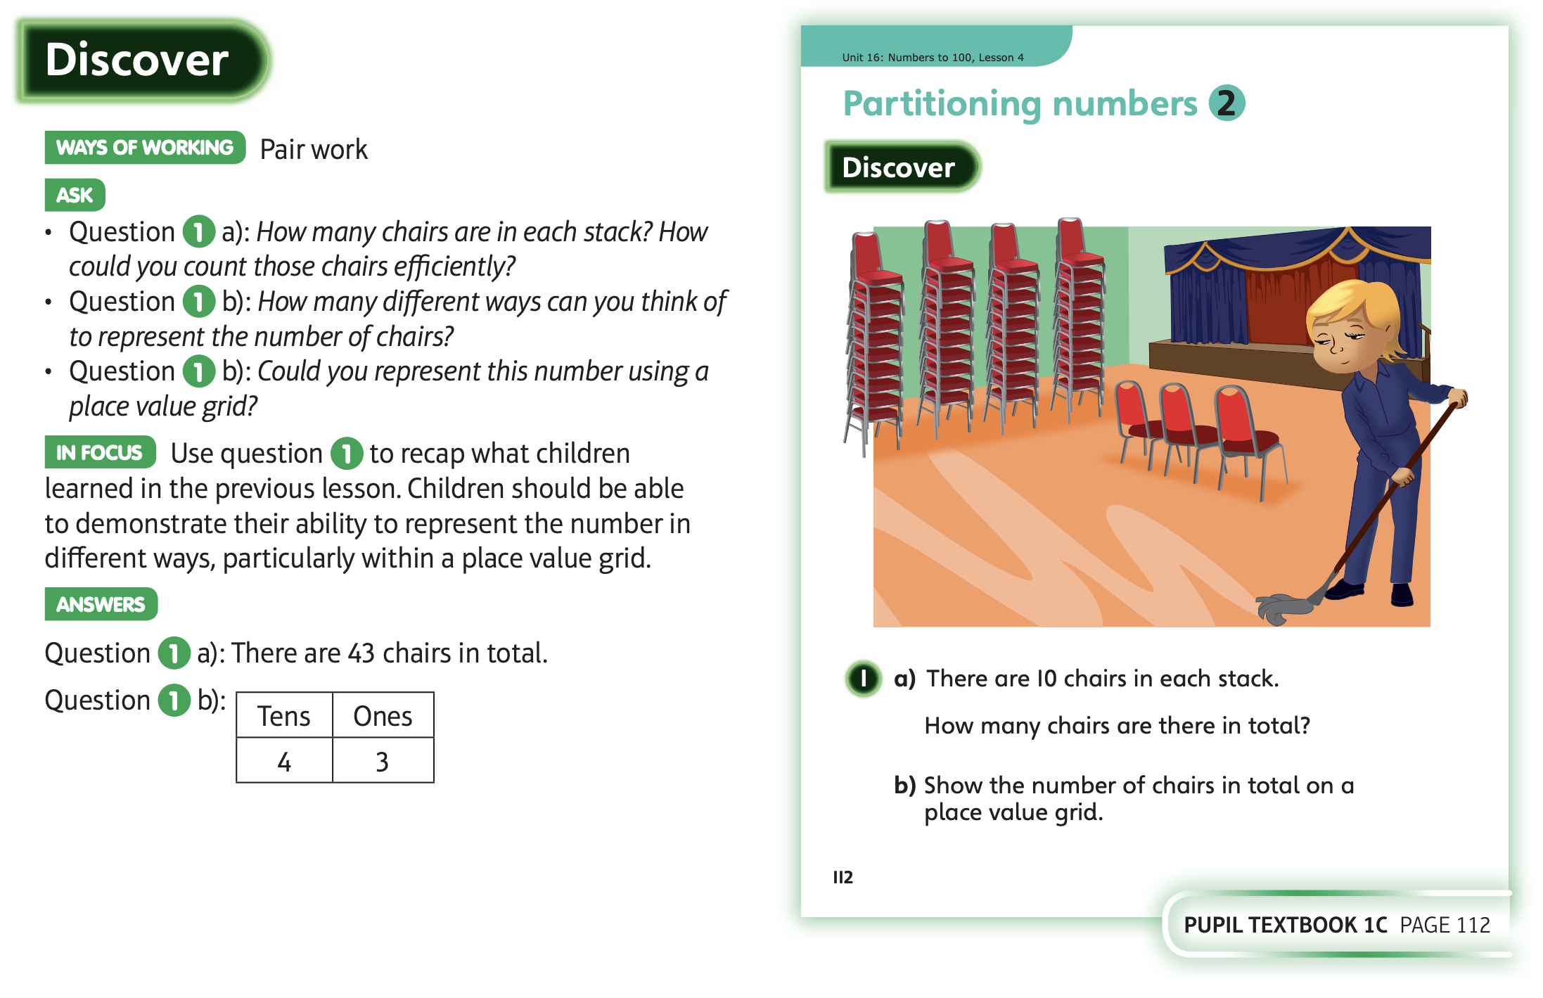
Wednesday 10.6.20

Slide 7
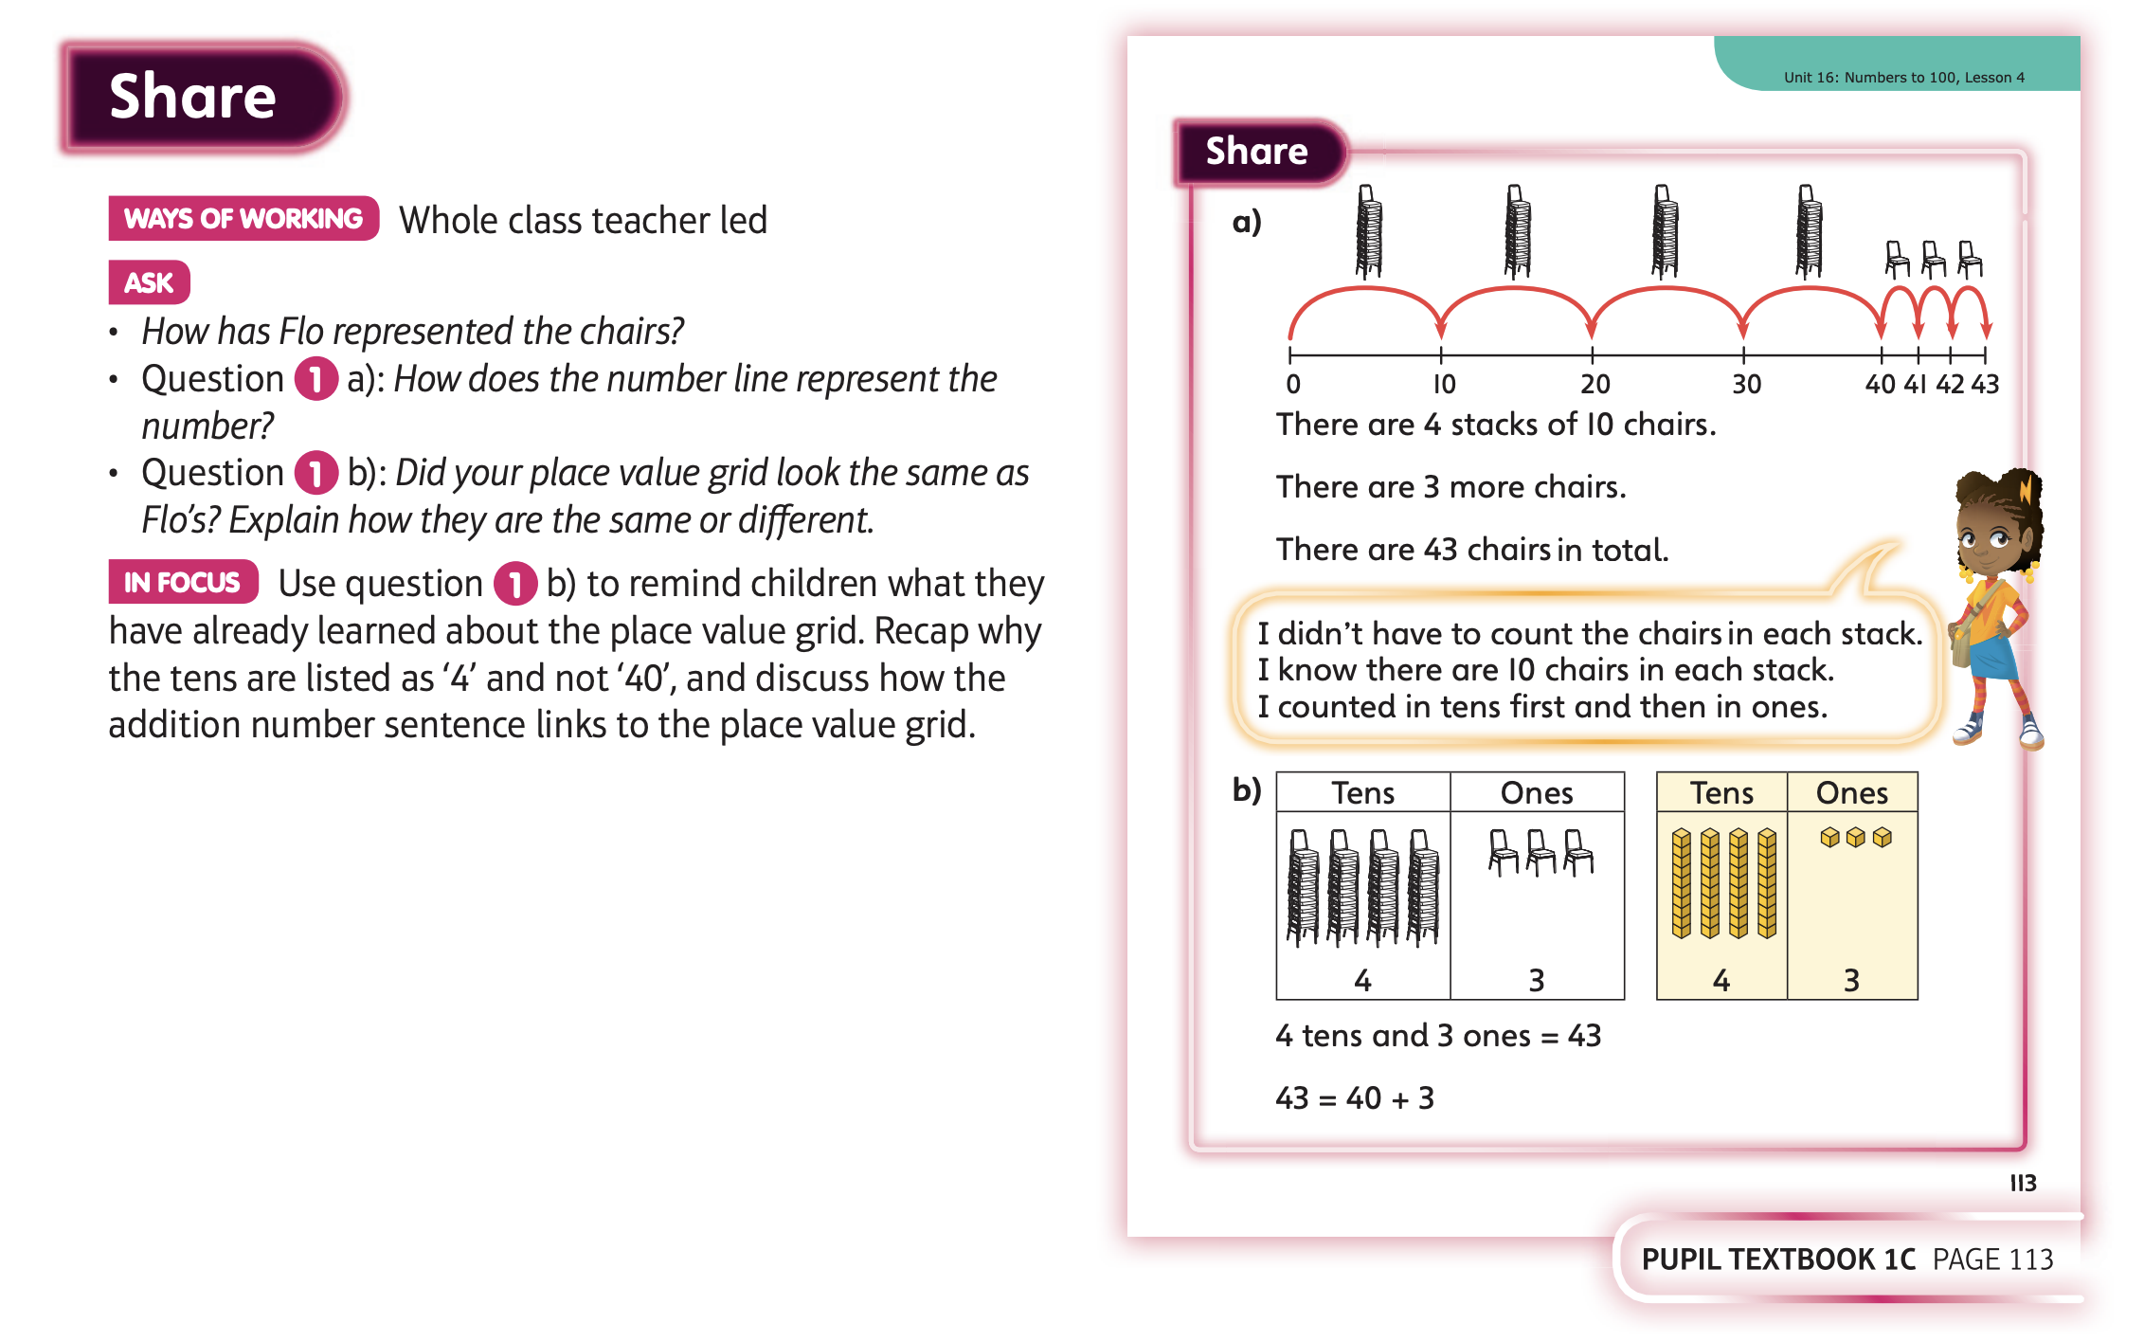

Slide 8
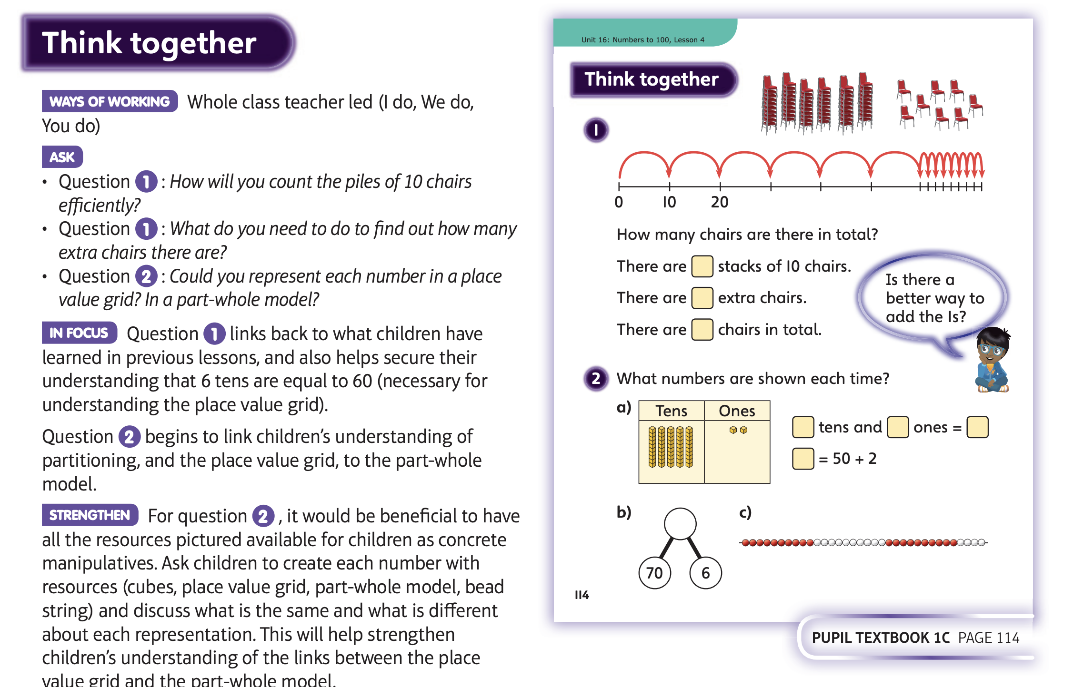

Slide 9
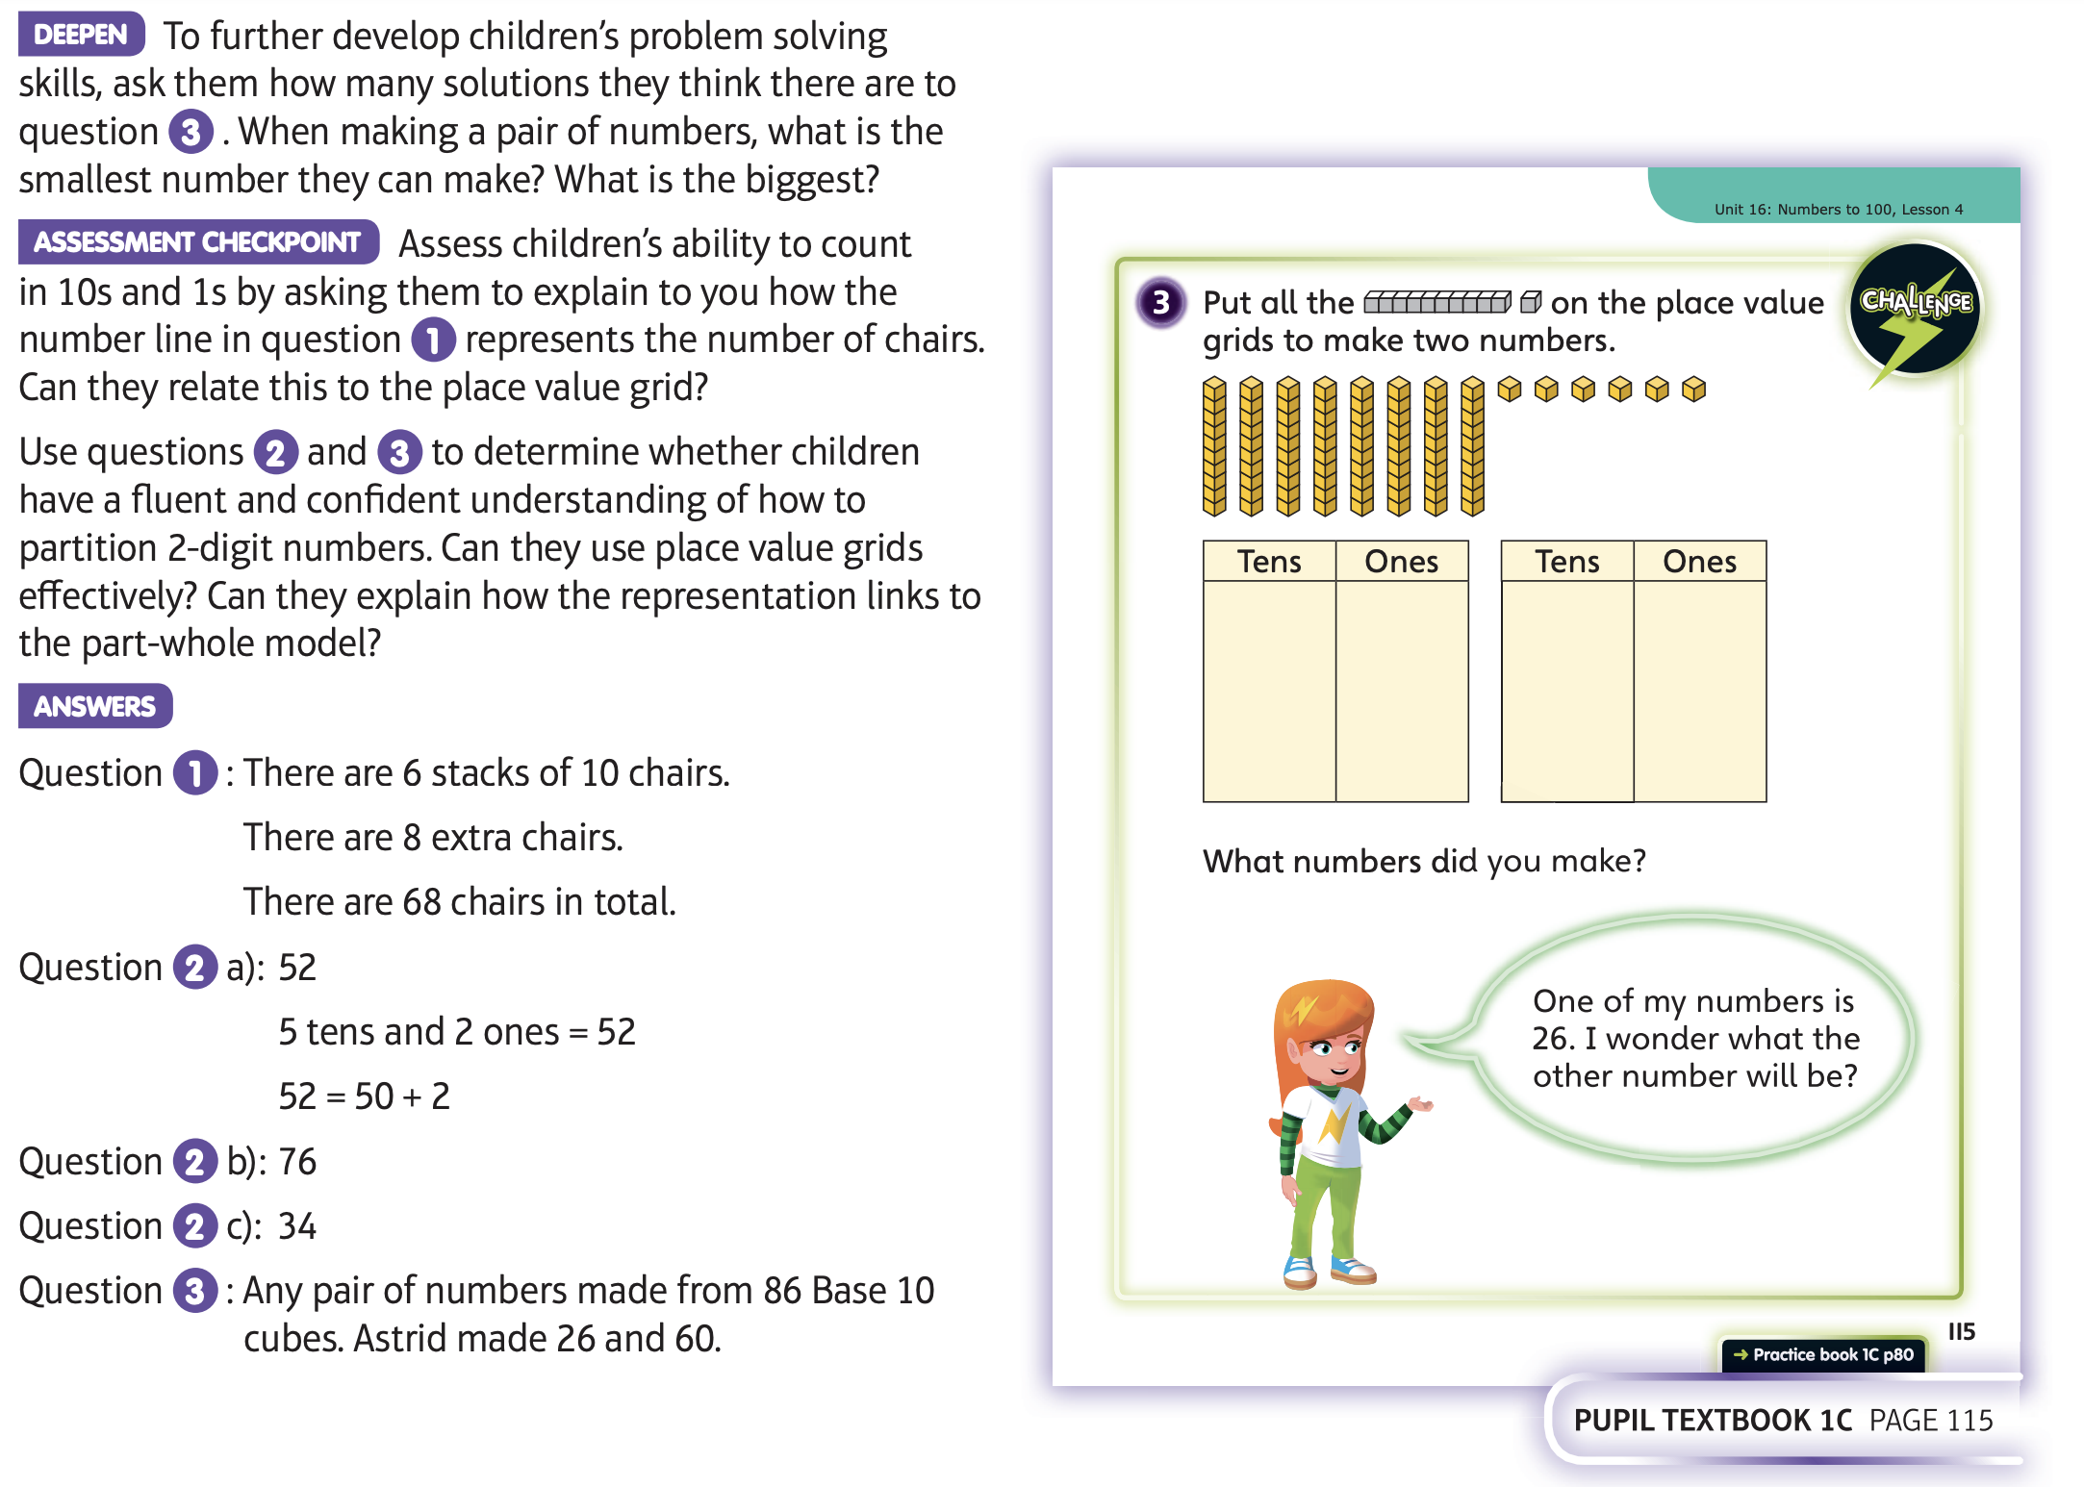
Now have a go at Unit 16 lesson 4

Slide 10
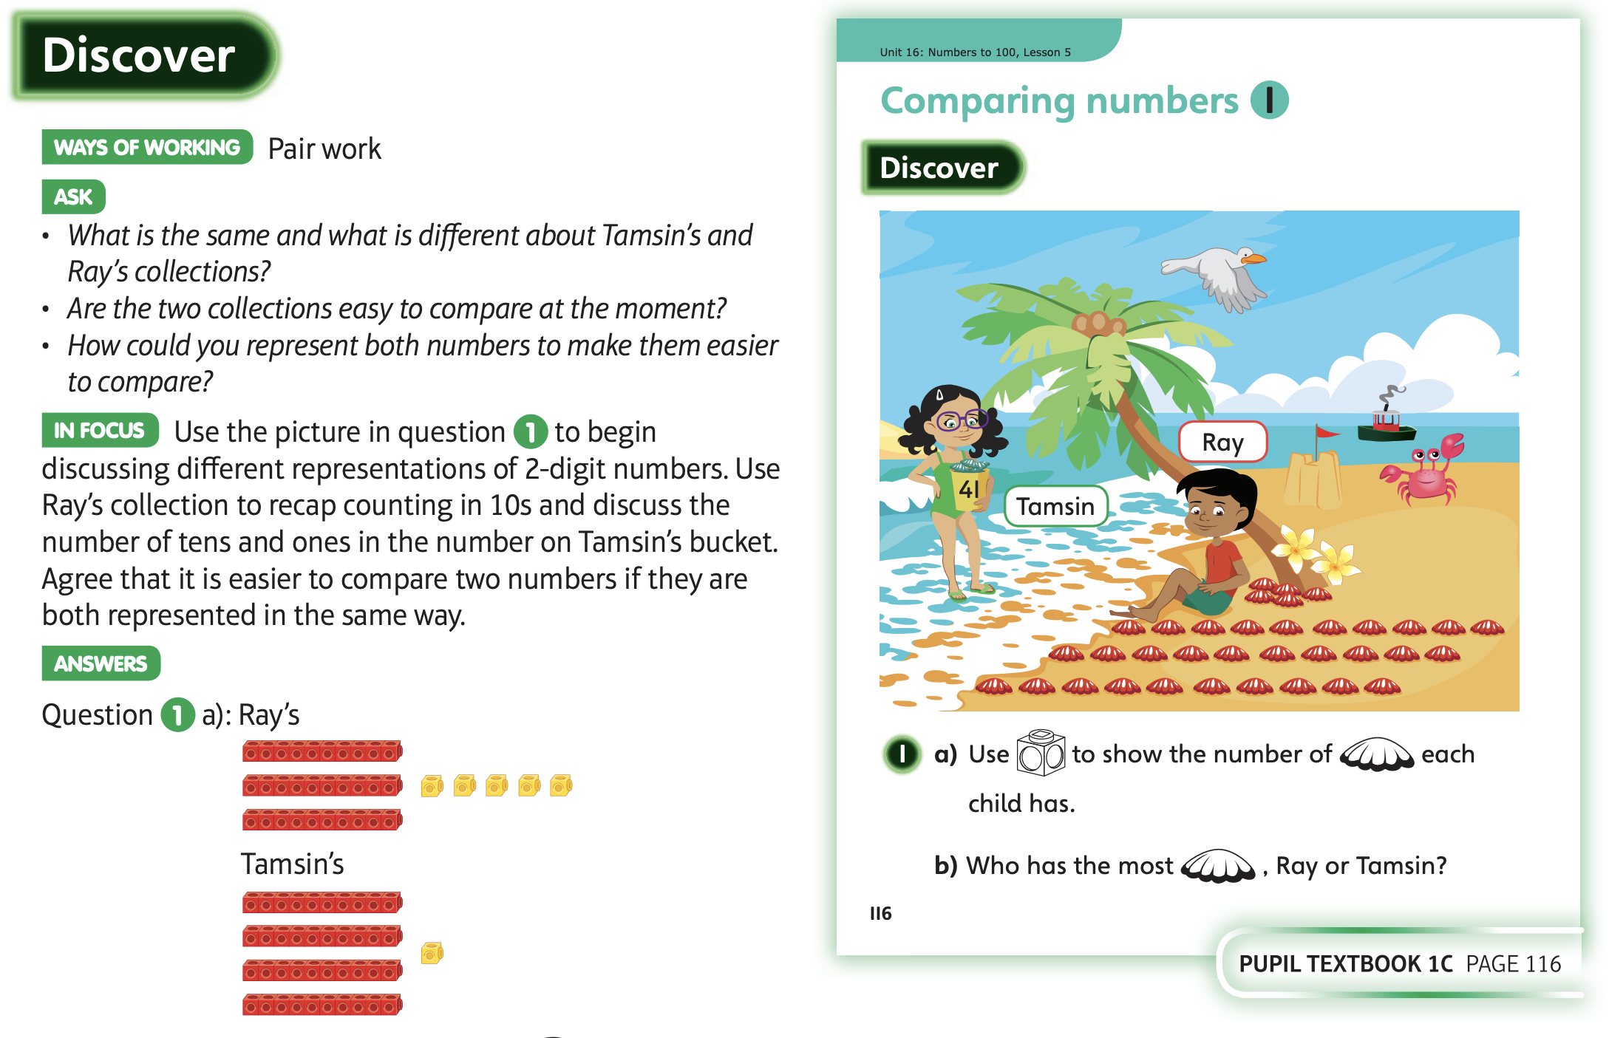
Thursday 11.6.20

Slide 11
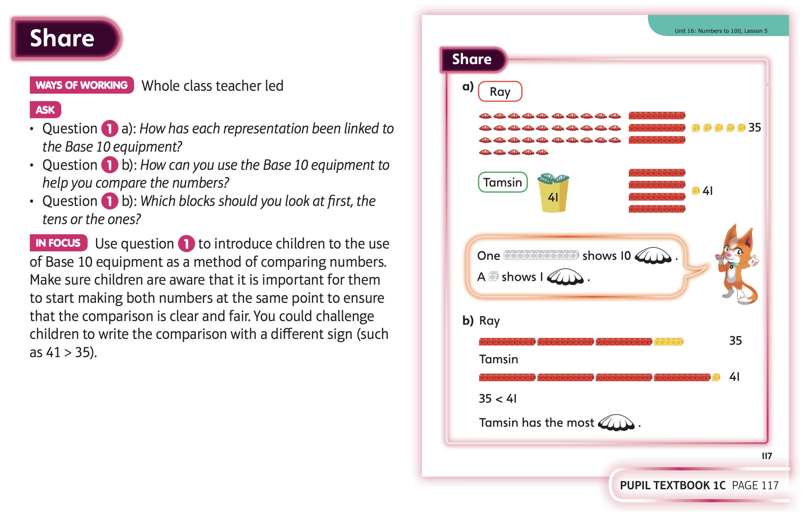

Slide 12
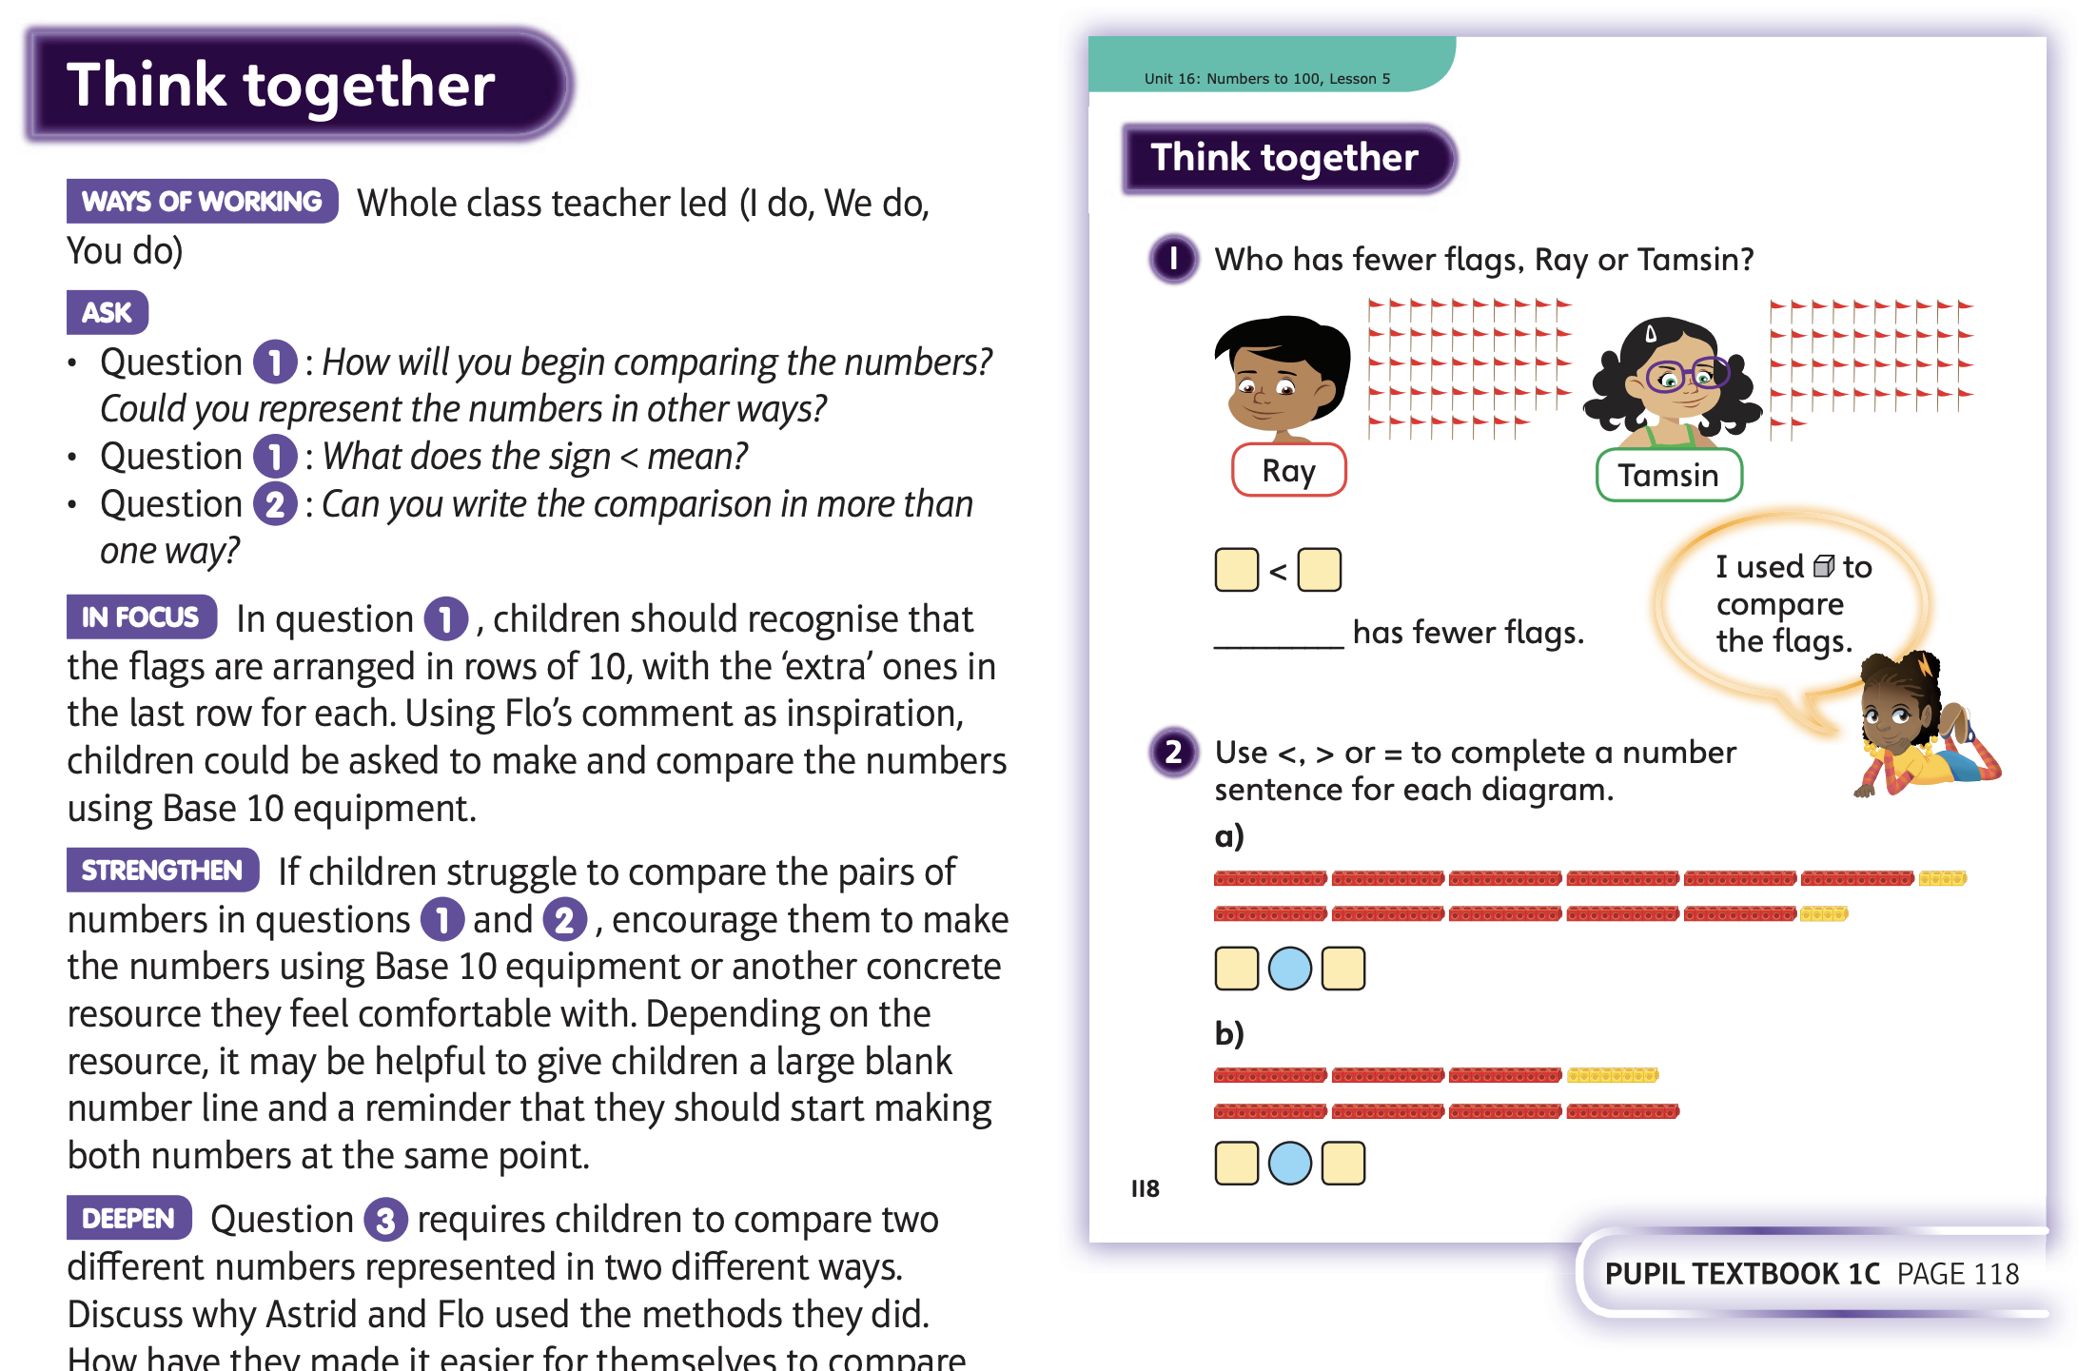

Slide 13
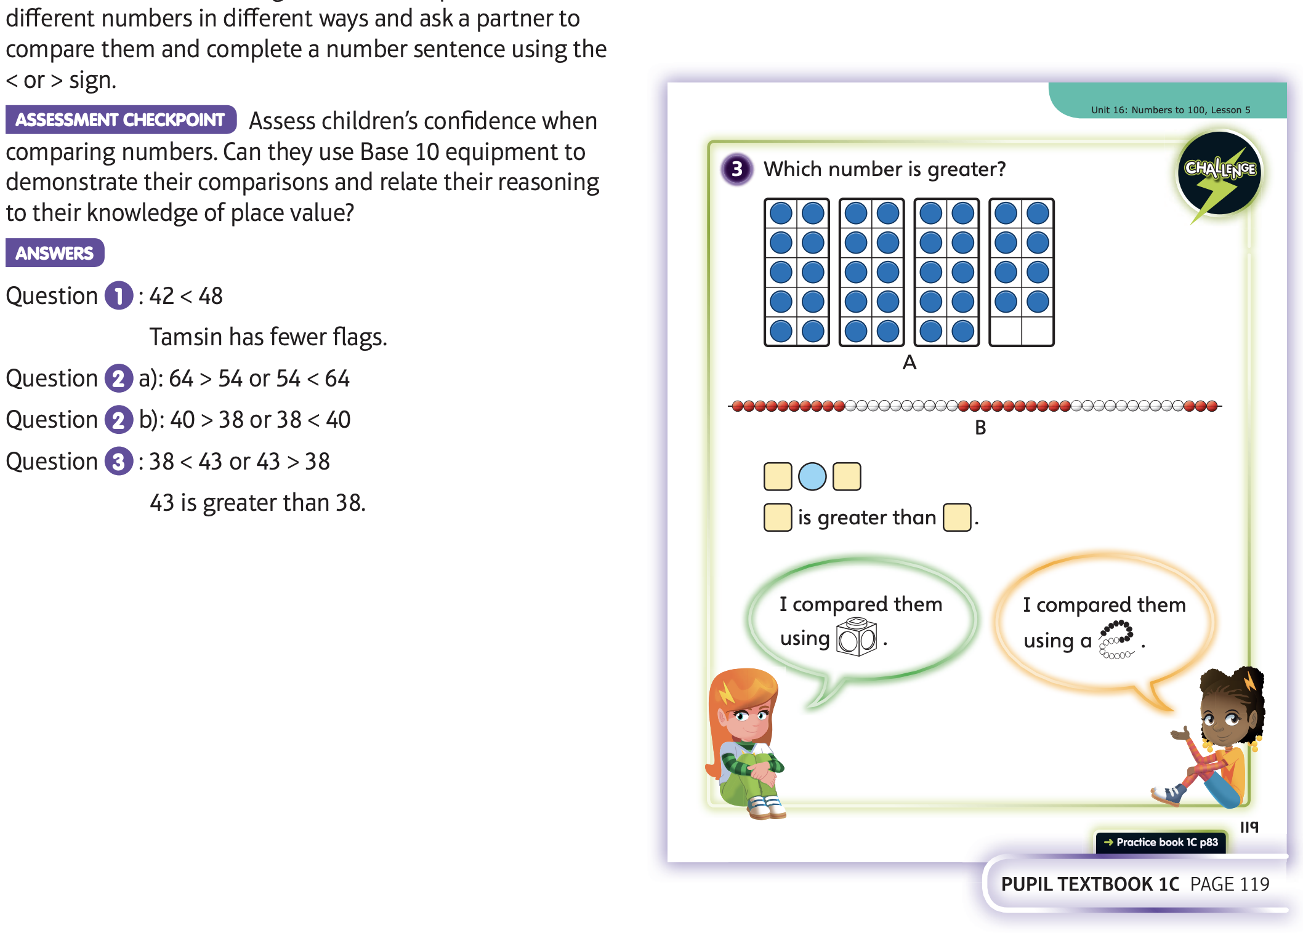
Now have a go at Unit 16 lesson 5

Slide 14
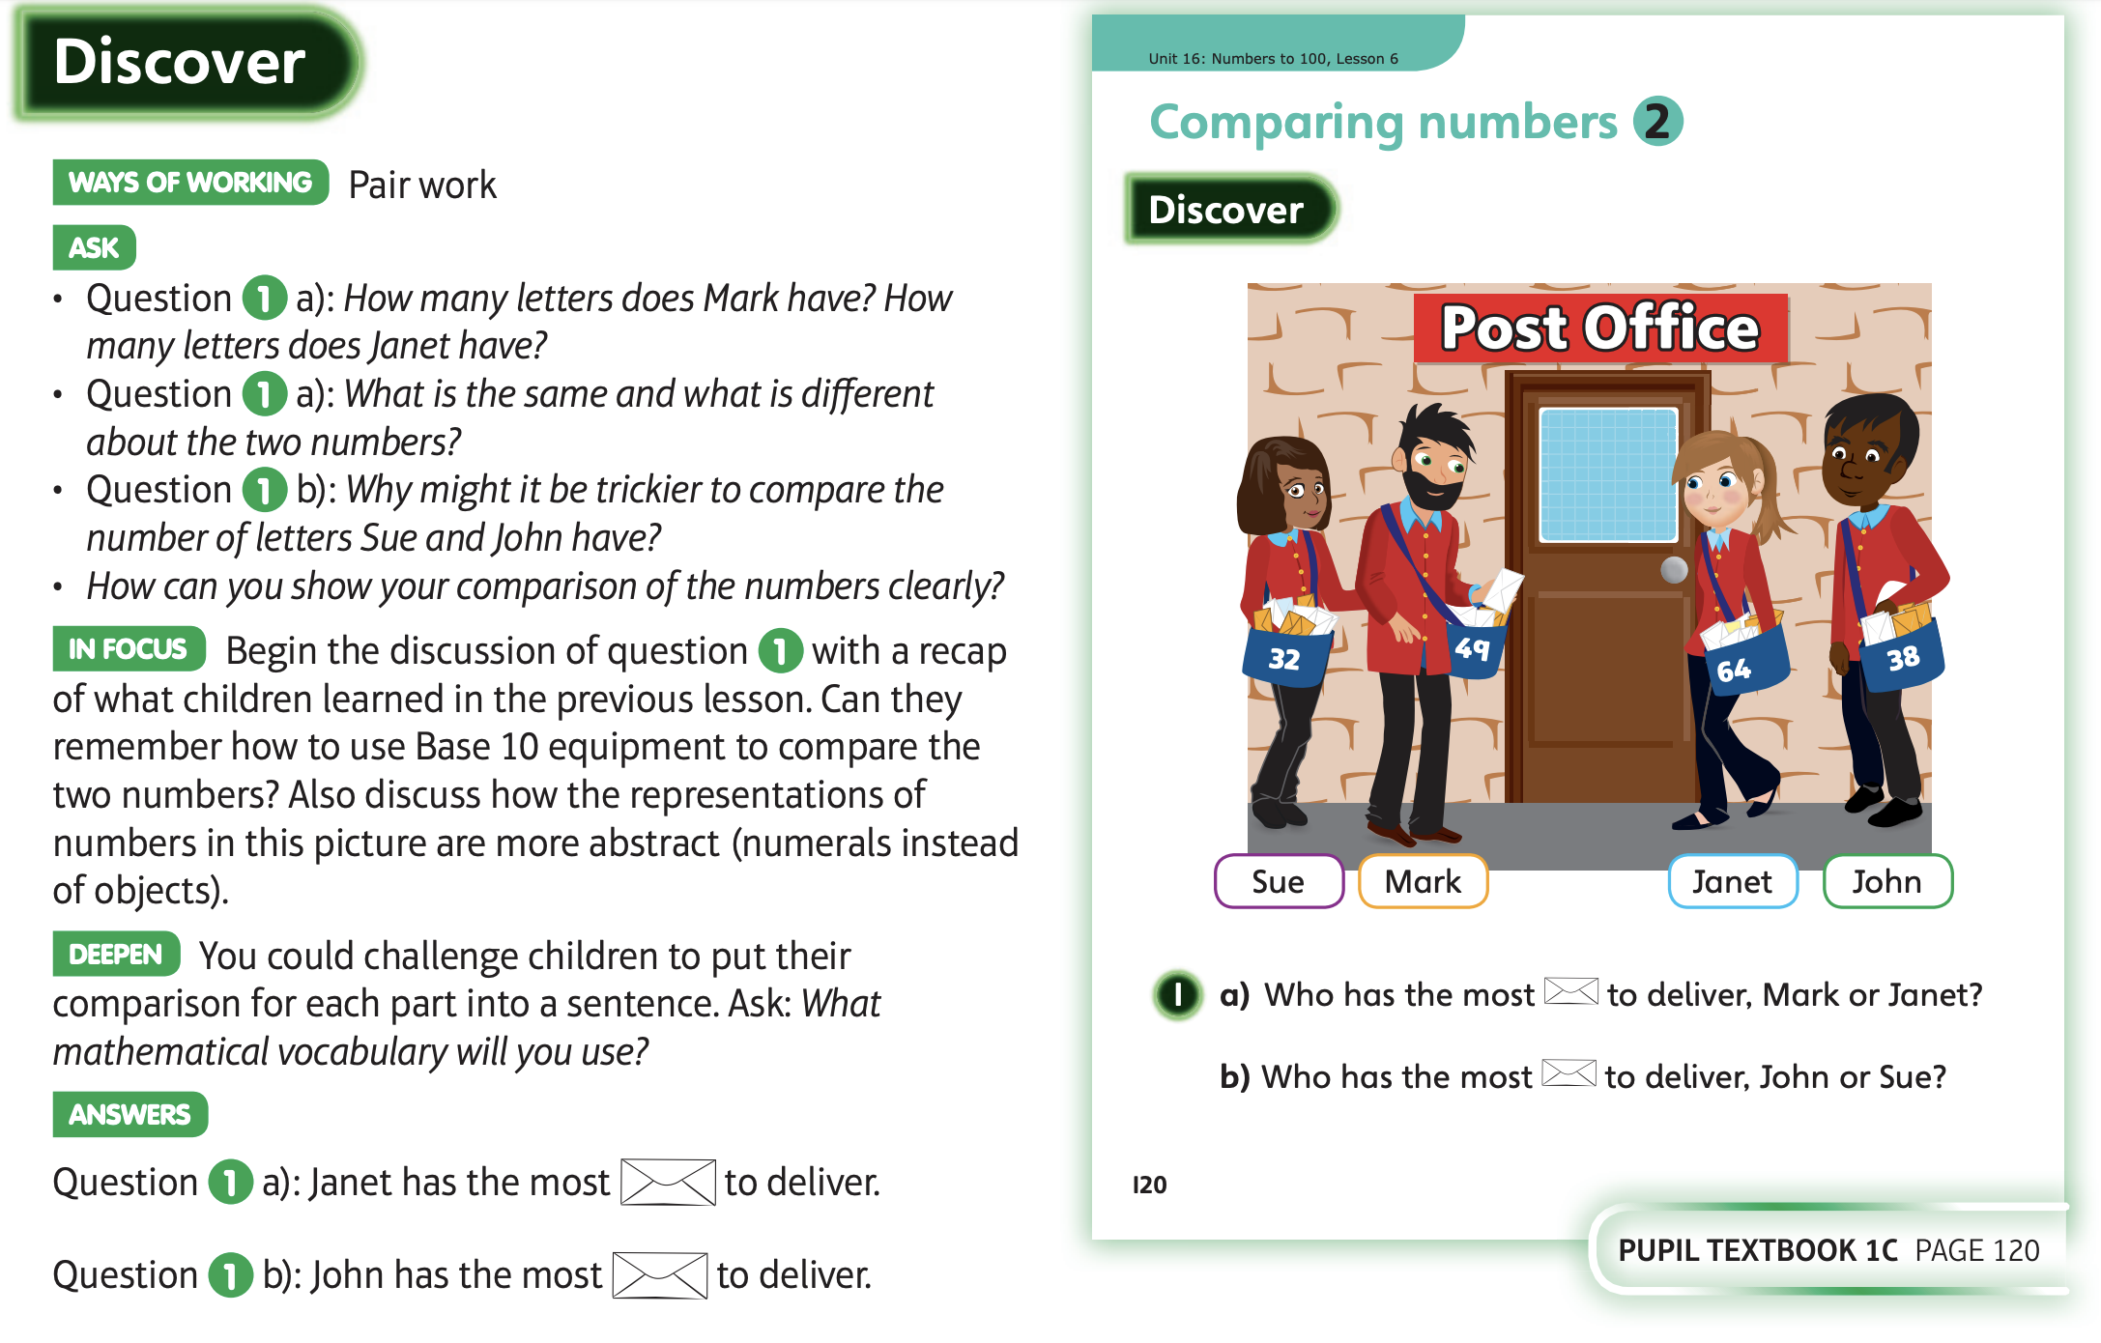
Friday 12.6.20

Slide 15
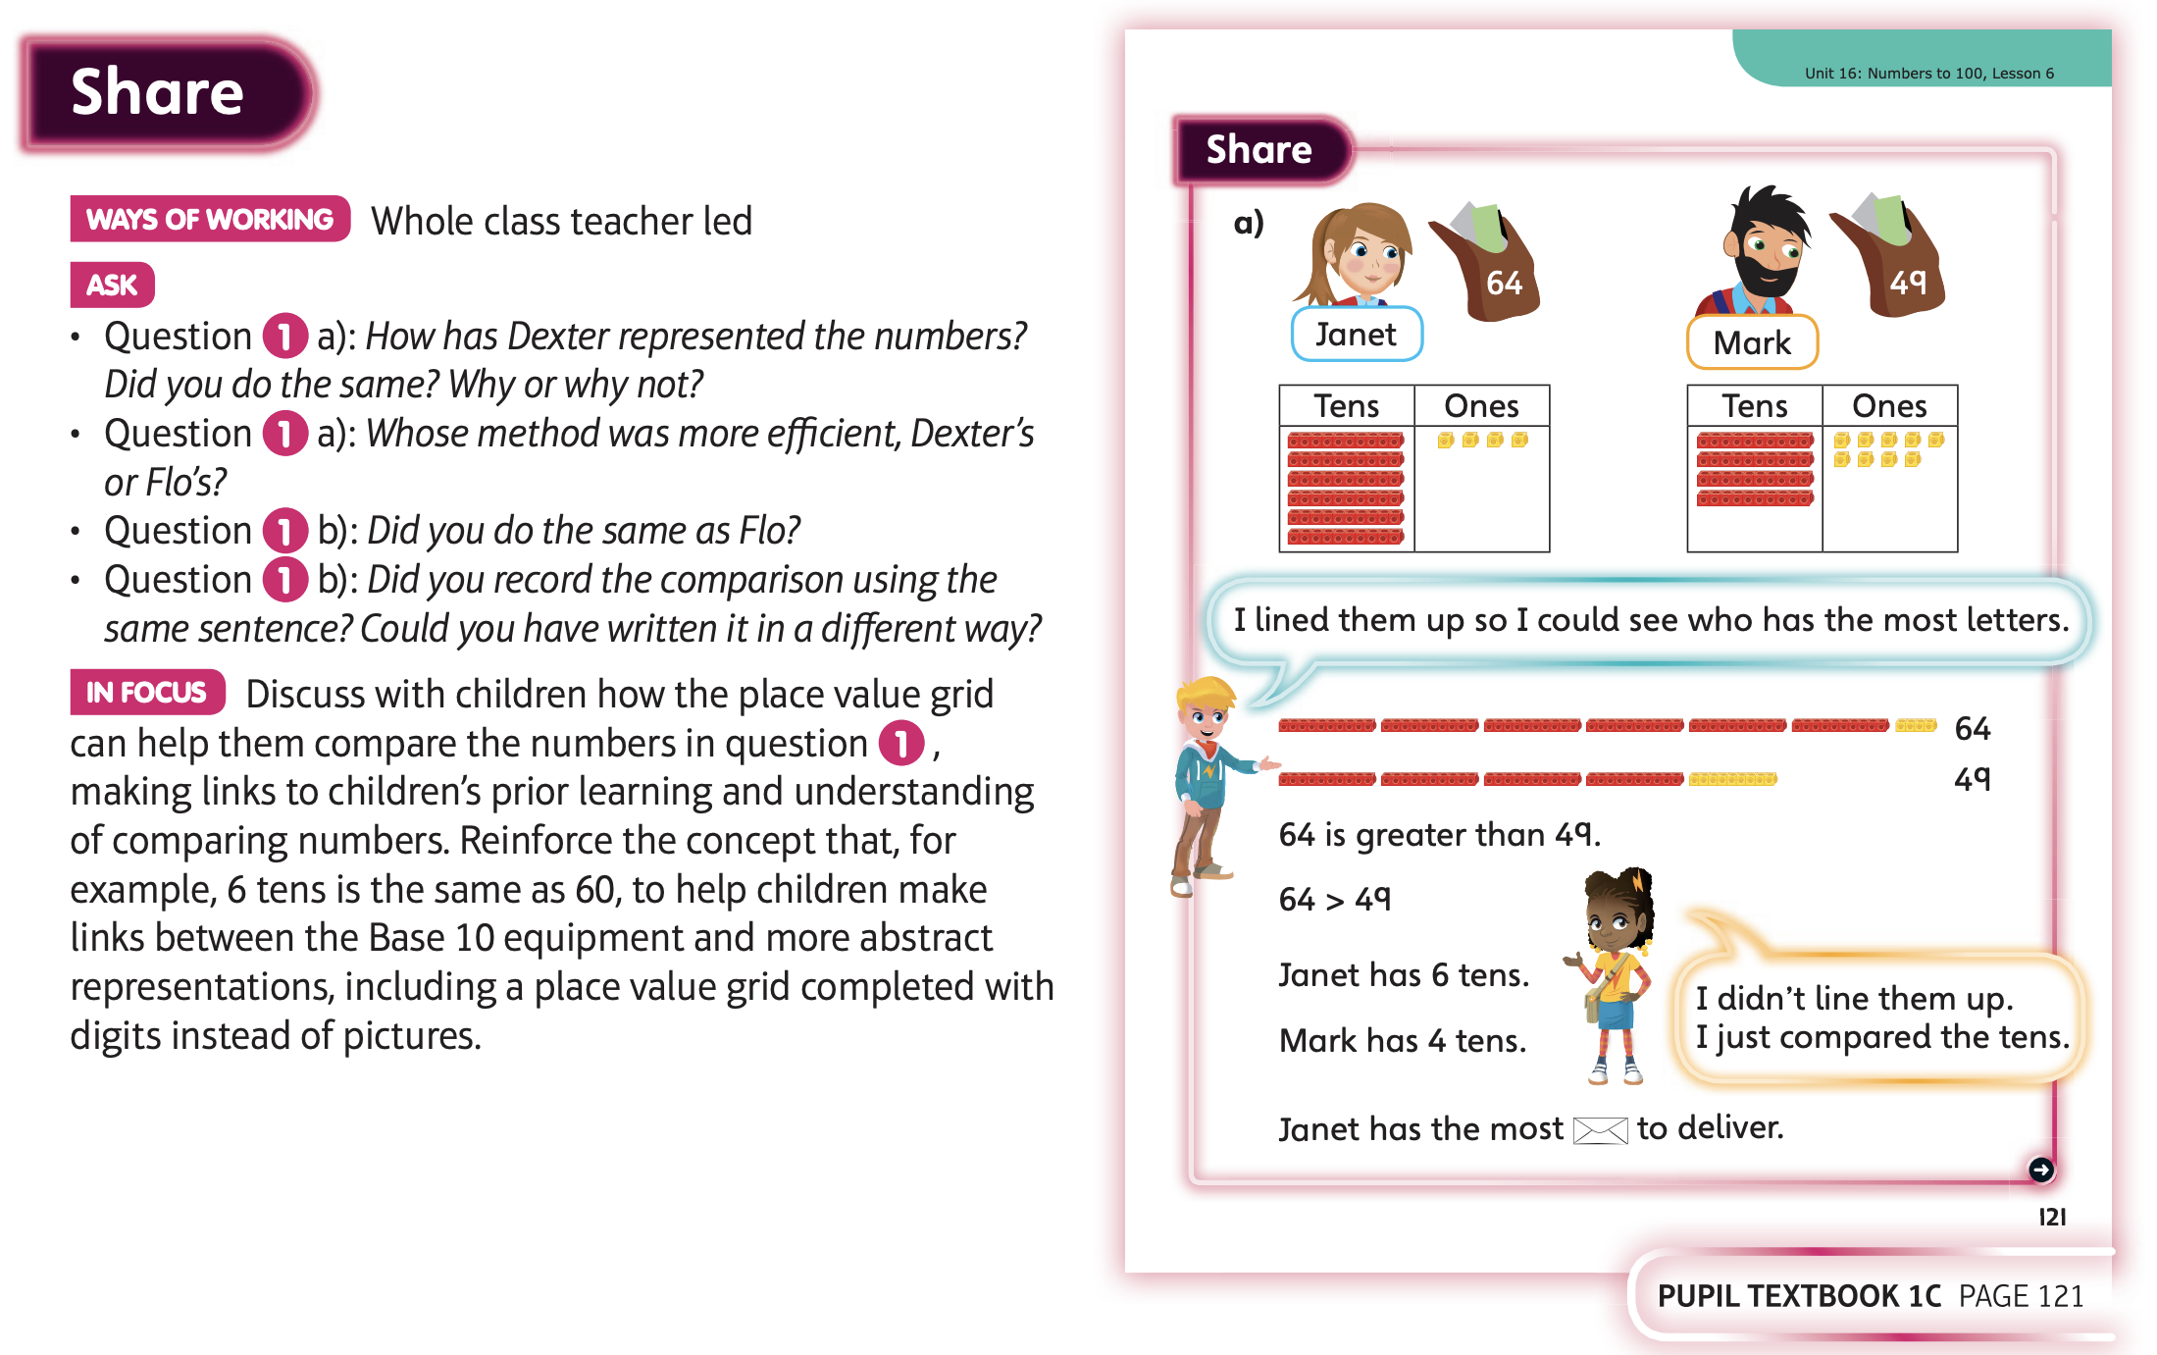

Slide 16
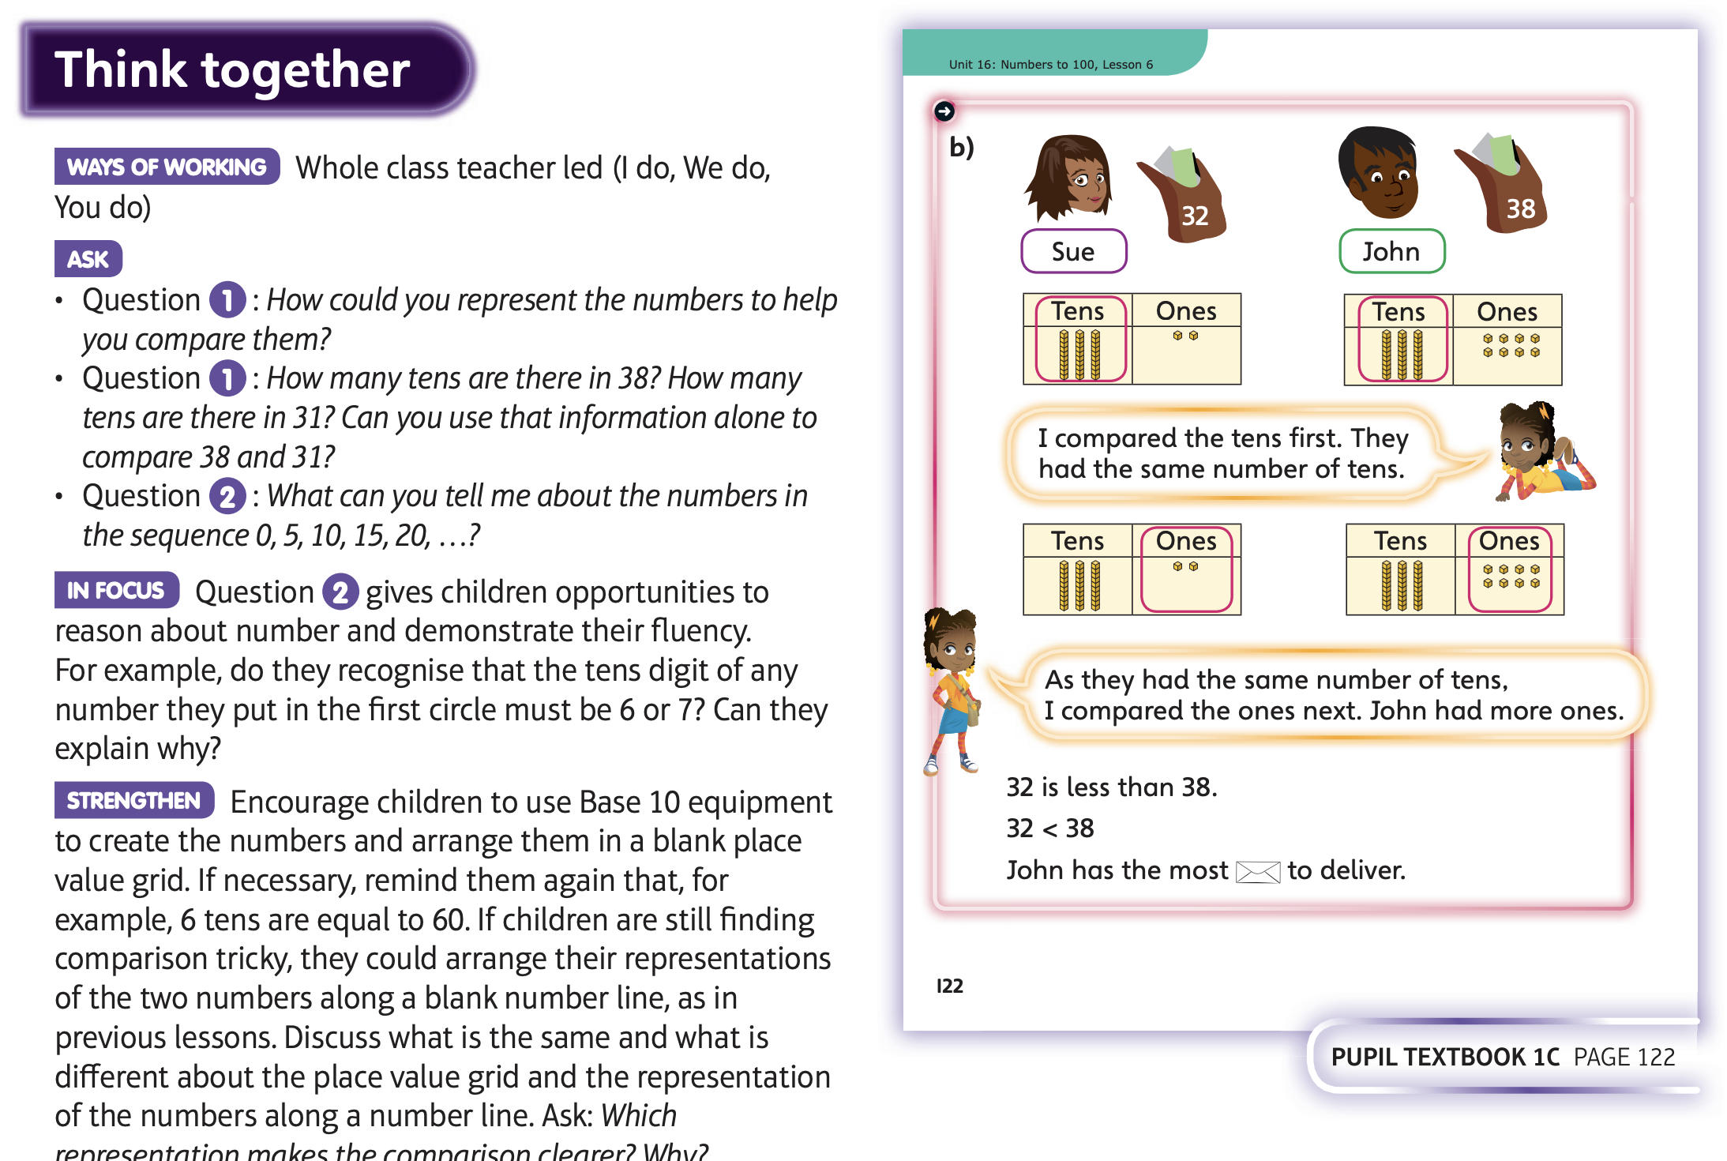

Slide 17
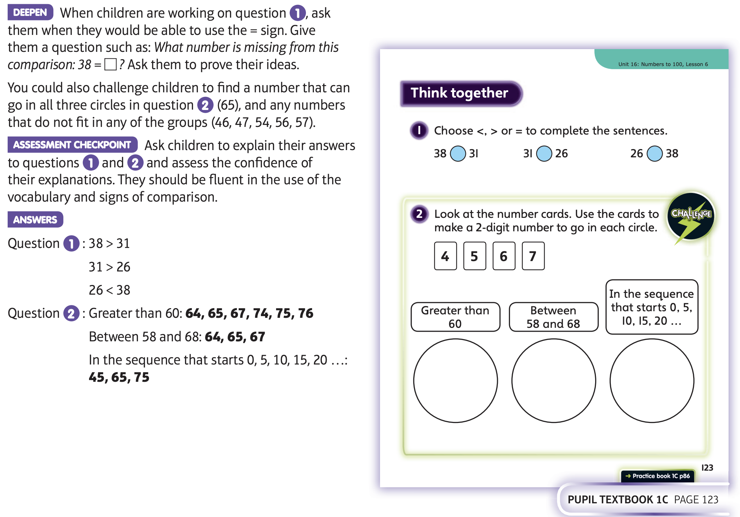
Now have a go at Unit 16 lesson 6

