Slide 1
Year 1 Maths
Week Beginning 15.6.20

Slide 2
Monday and Tuesday 15.6.20 & 16.6.20
This week in Power Maths we will be looking at ordering numbers from smallest to greatest and number bonds to 100.
Use these next two days to get really good at your number bonds to 10 - You want to be able to recall them immediately
so practice lots and get your grown ups or an older sibling to challenge you!
You will find several activities to print out in one document on our class page.
They are under the heading ‘Year 1 Maths Monday and Tuesday 15th & 16th June’. If you can’t print them out then you
could answer orally or copy them into your books.
Have a go at the two maths games I’ve put links for on the class page, or you can find them here;
https://www.ictgames.com/mobilePage/countingCaterpillar/index.html
https://www.ictgames.com/saveTheWhale/index.html

Slide 3
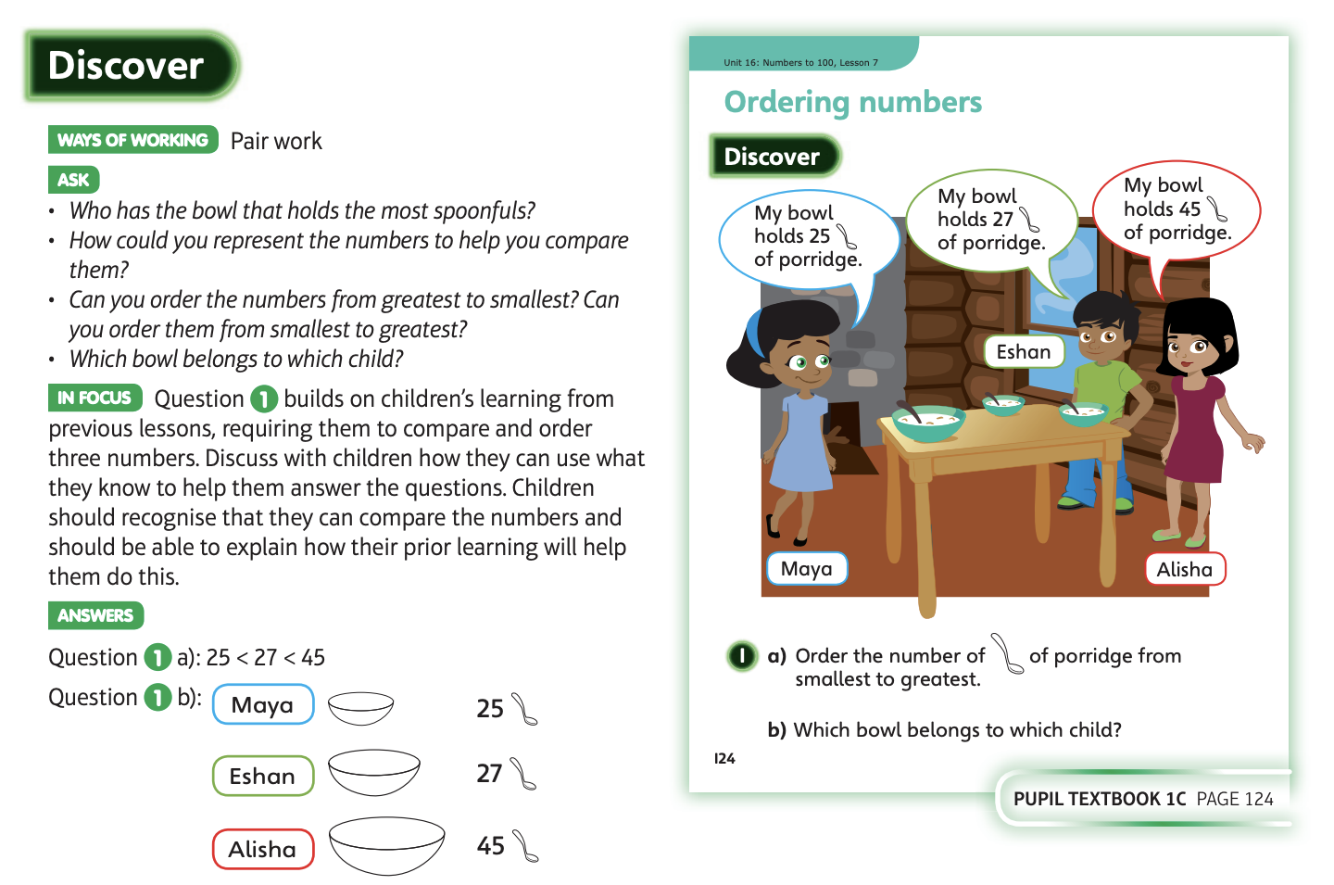
Wednesday 17.6.20

Slide 4
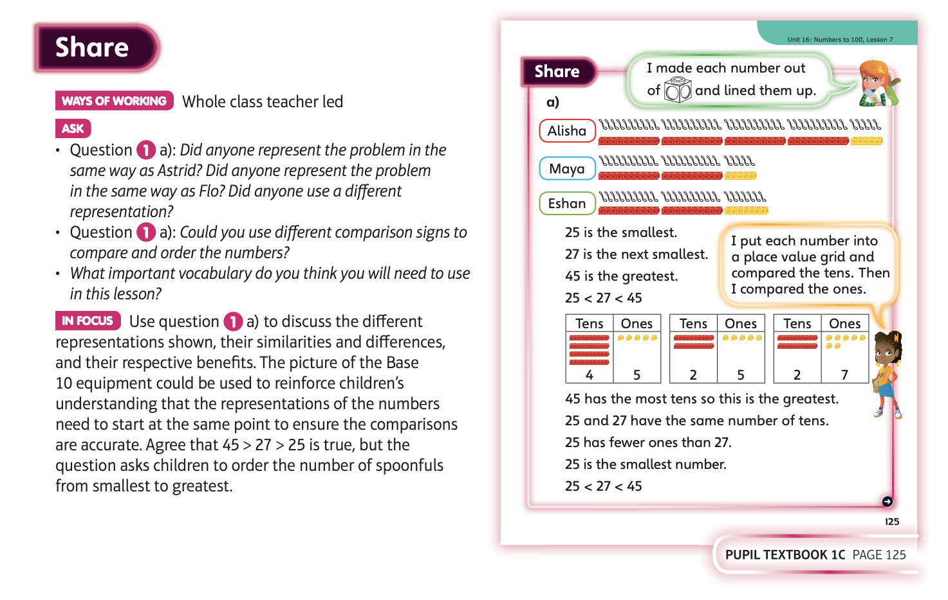

Slide 5
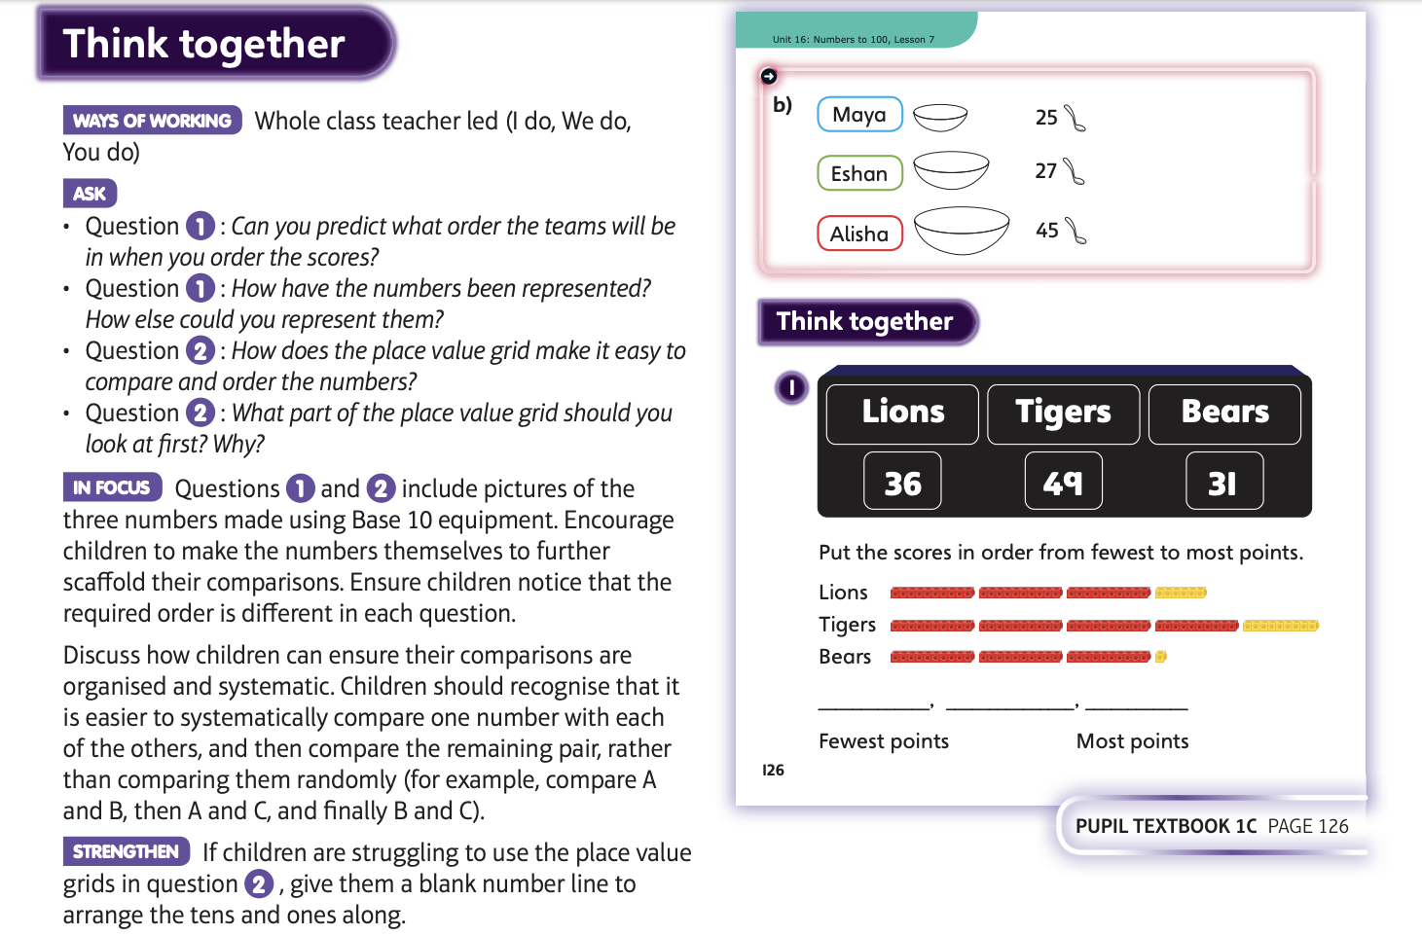

Slide 6
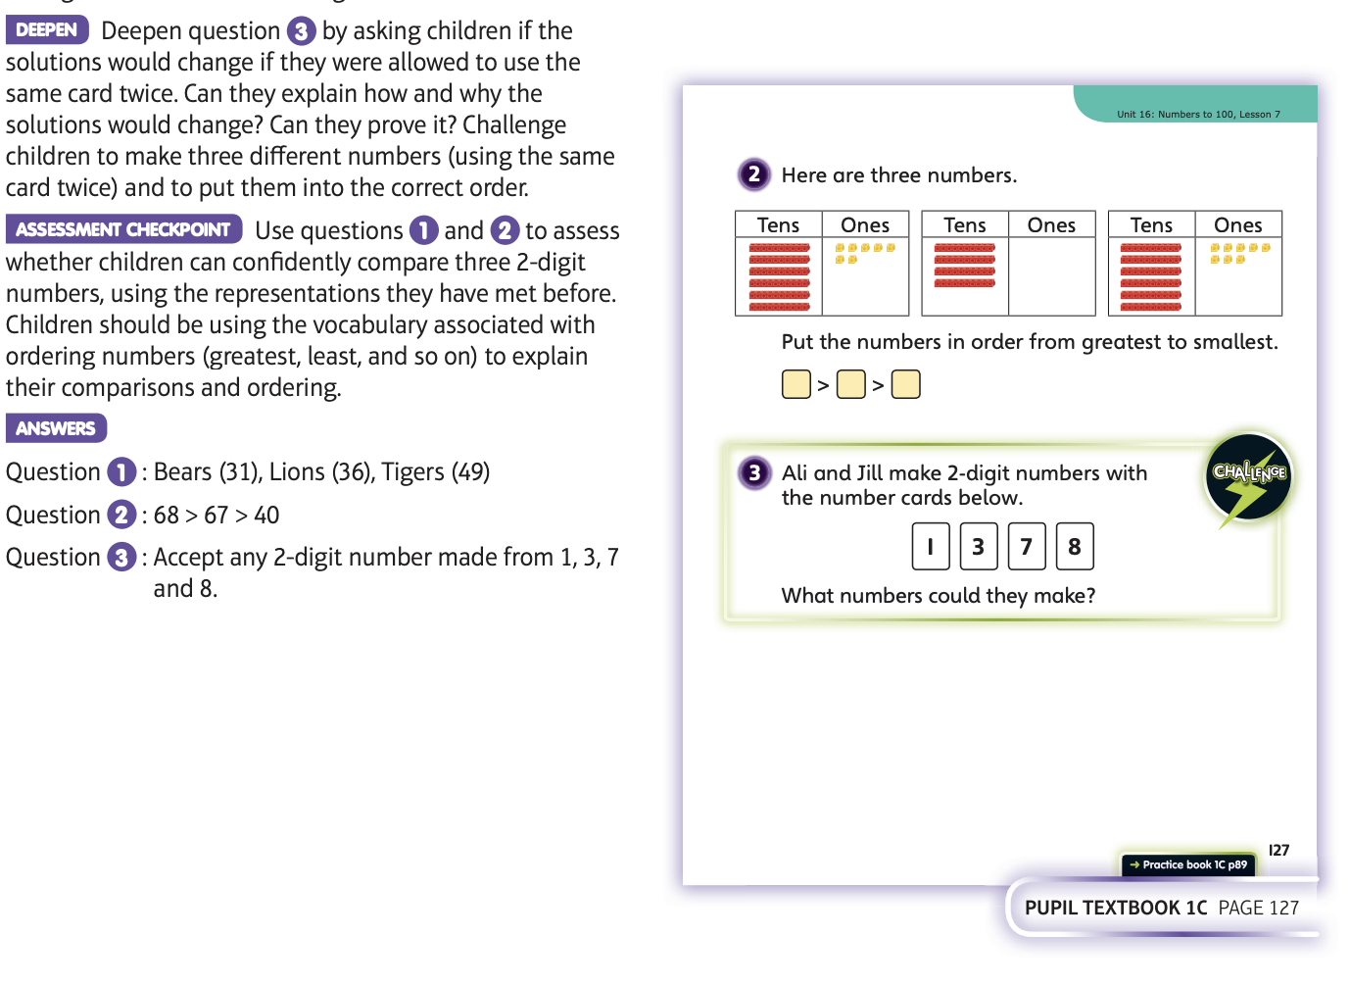
Now have a go at Unit 16 lesson 7

Slide 7
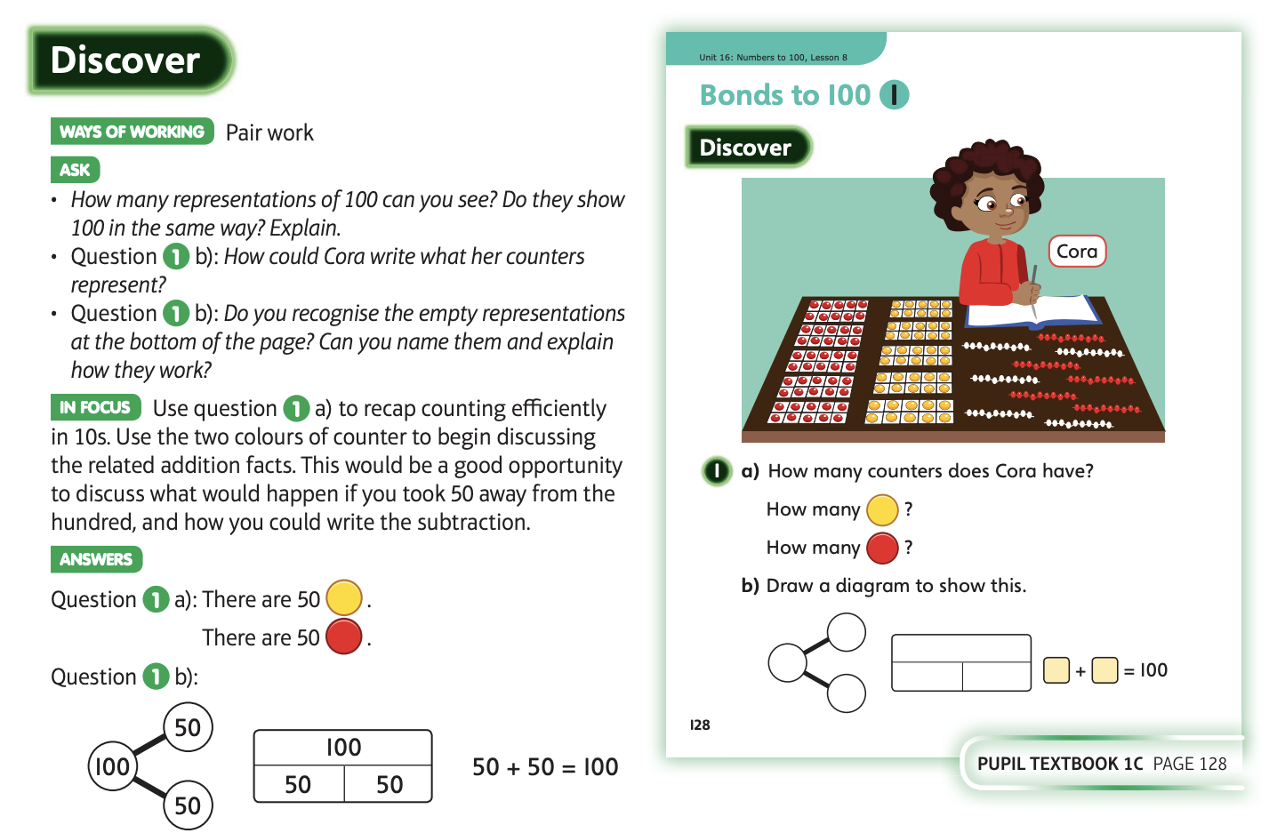
Thursday 18.6.20

Slide 8
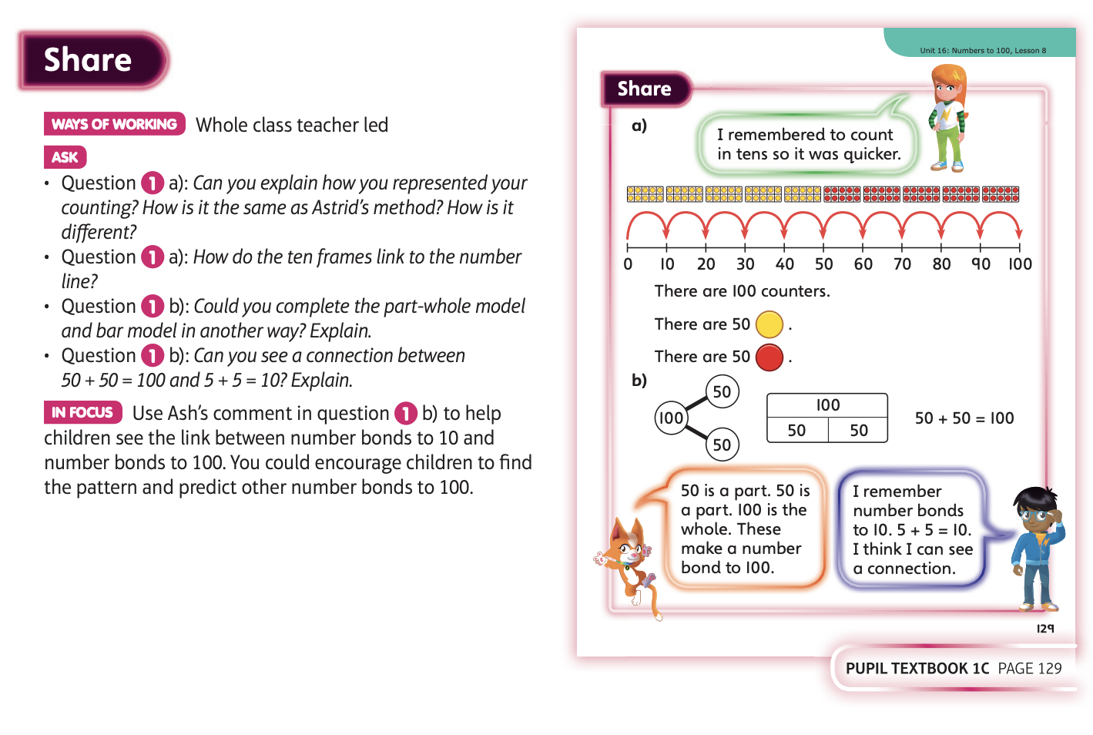

Slide 9
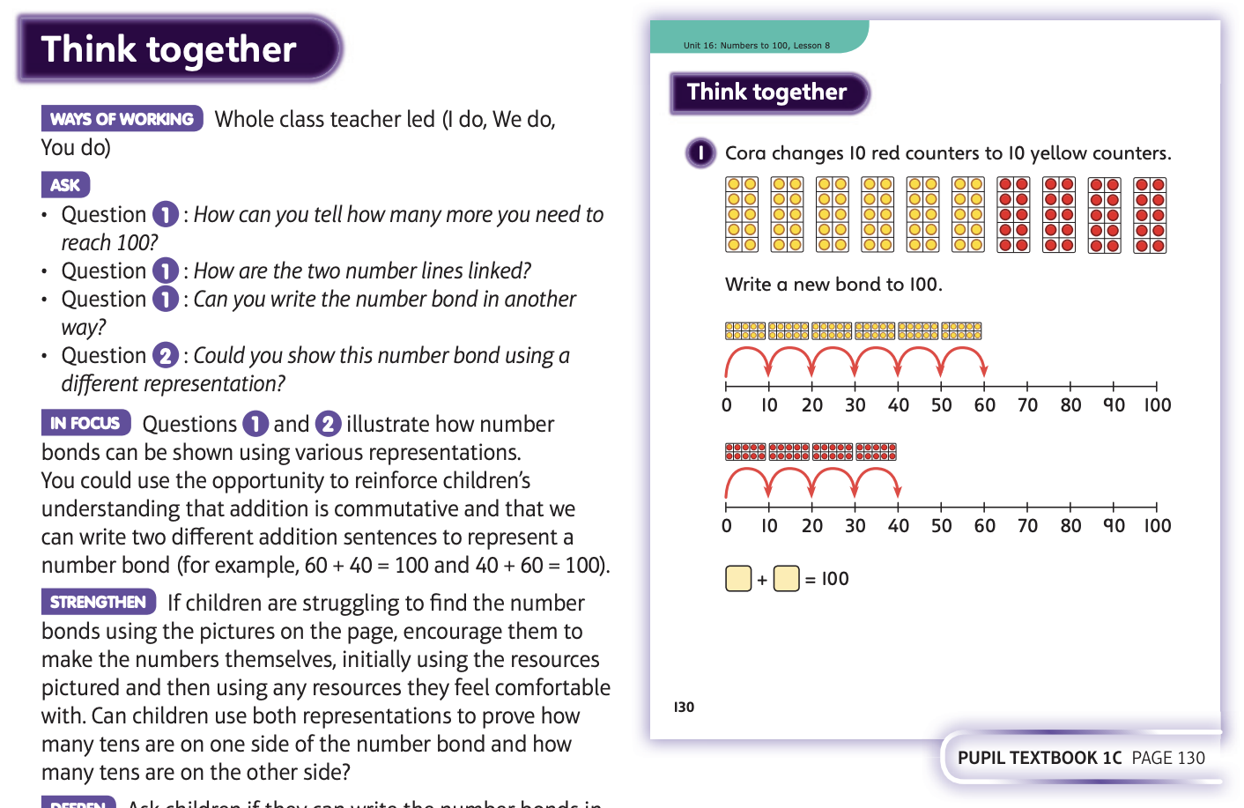

Slide 10
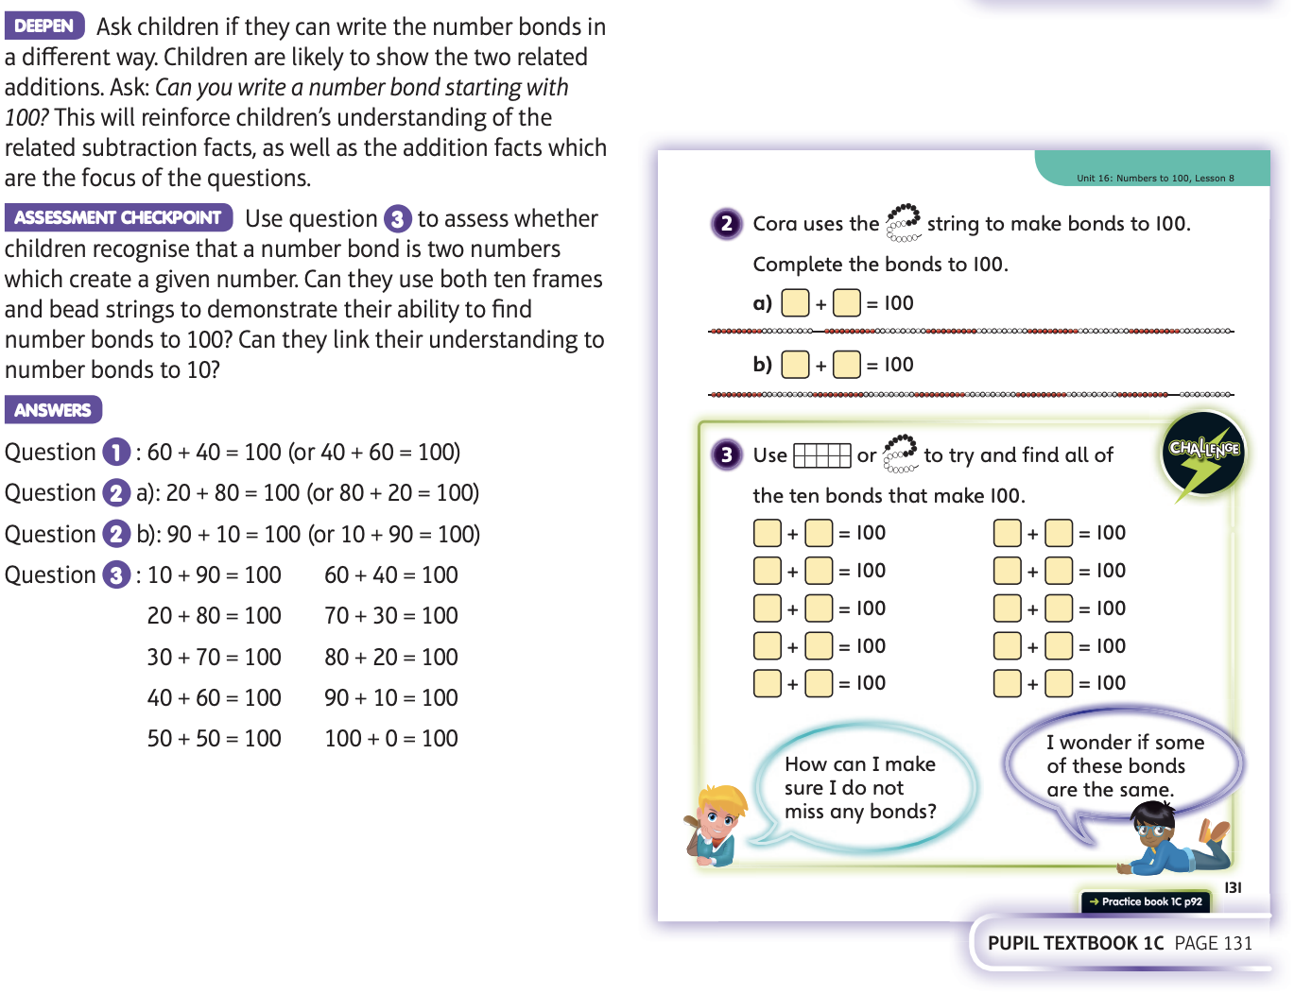
Now have a go at Unit 16 lesson 8

Slide 11
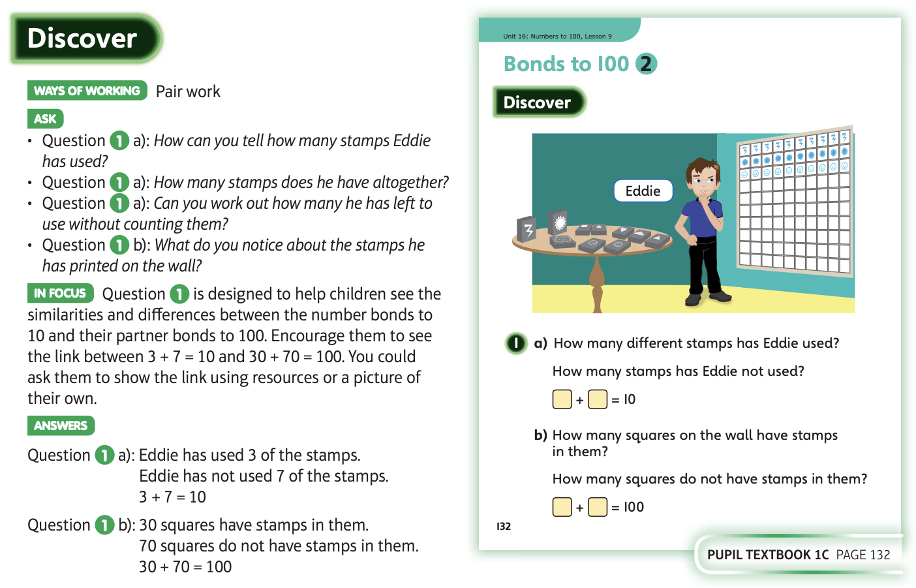
Friday 19.6.20

Slide 12
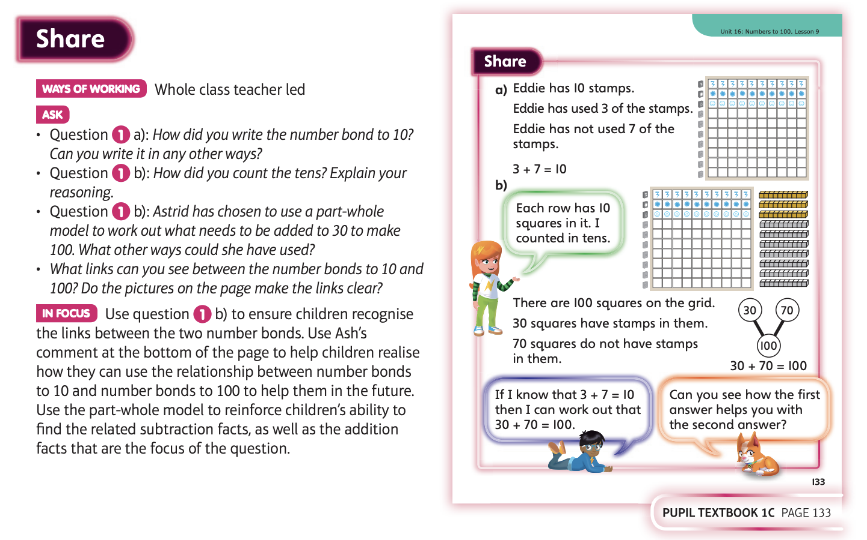

Slide 13
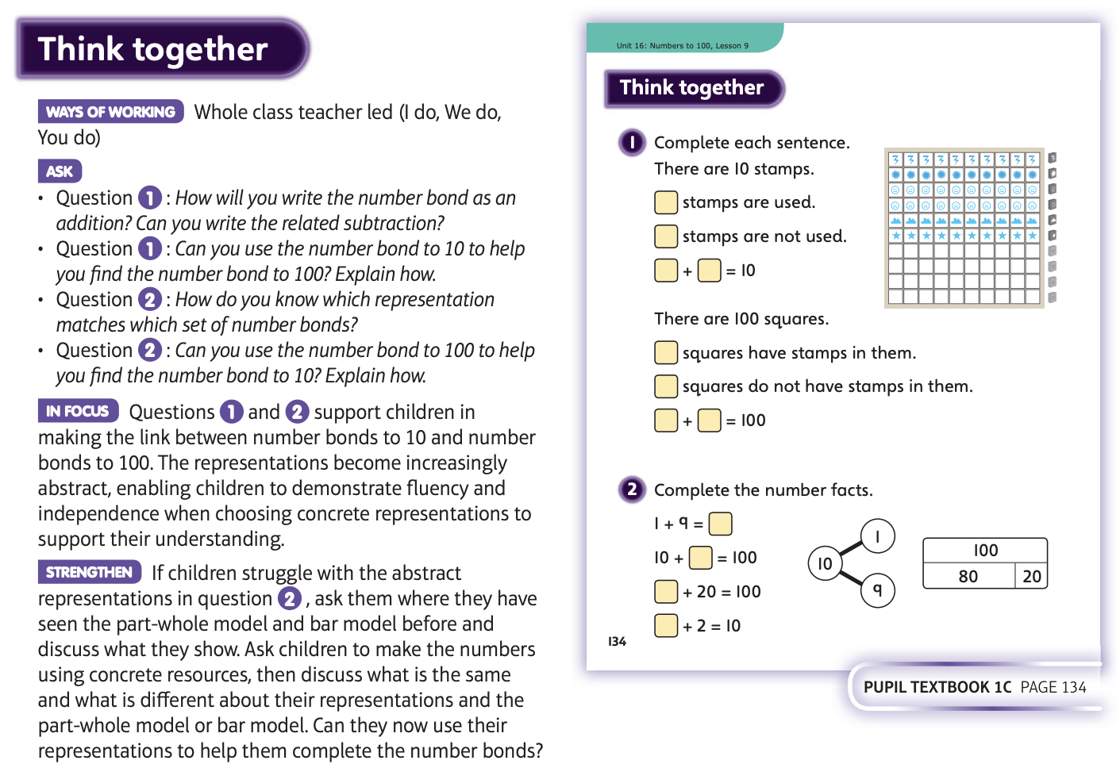

Slide 14
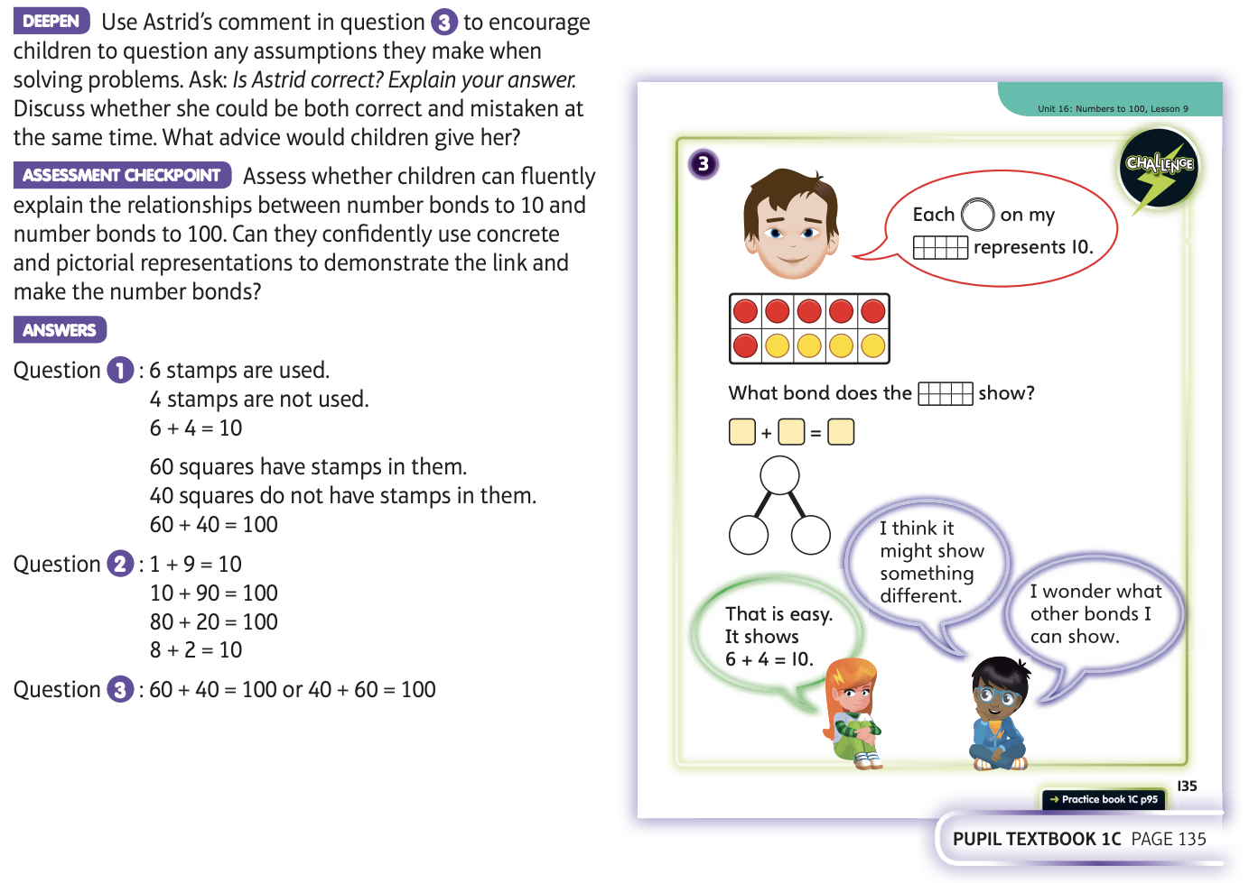
Now have a go at Unit 16 lesson 9

Slide 15
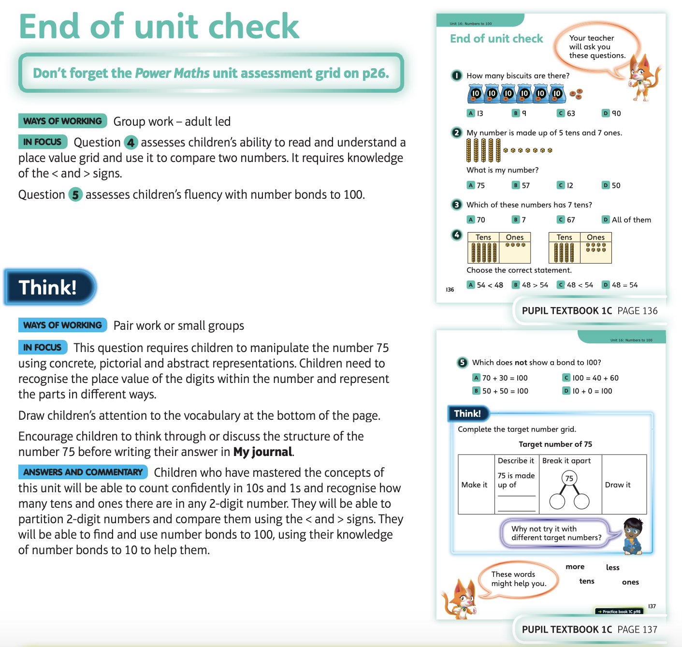
Now have a go at the end of unit check if you can

