Slide 1
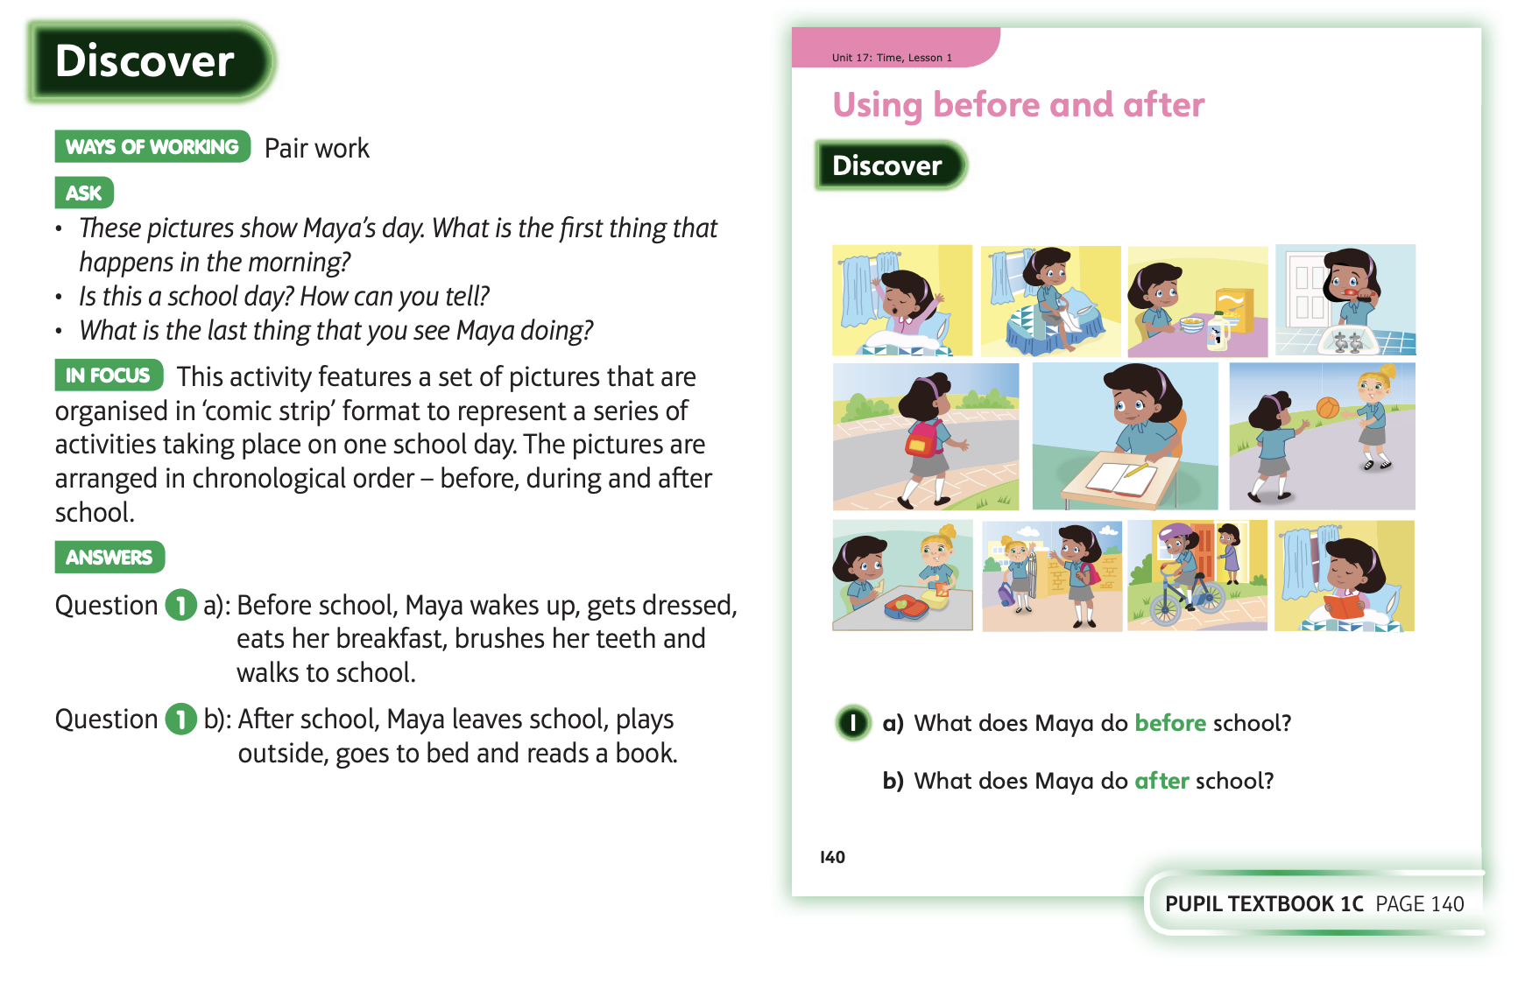
22.6.20 Have a look at these

Slide 2
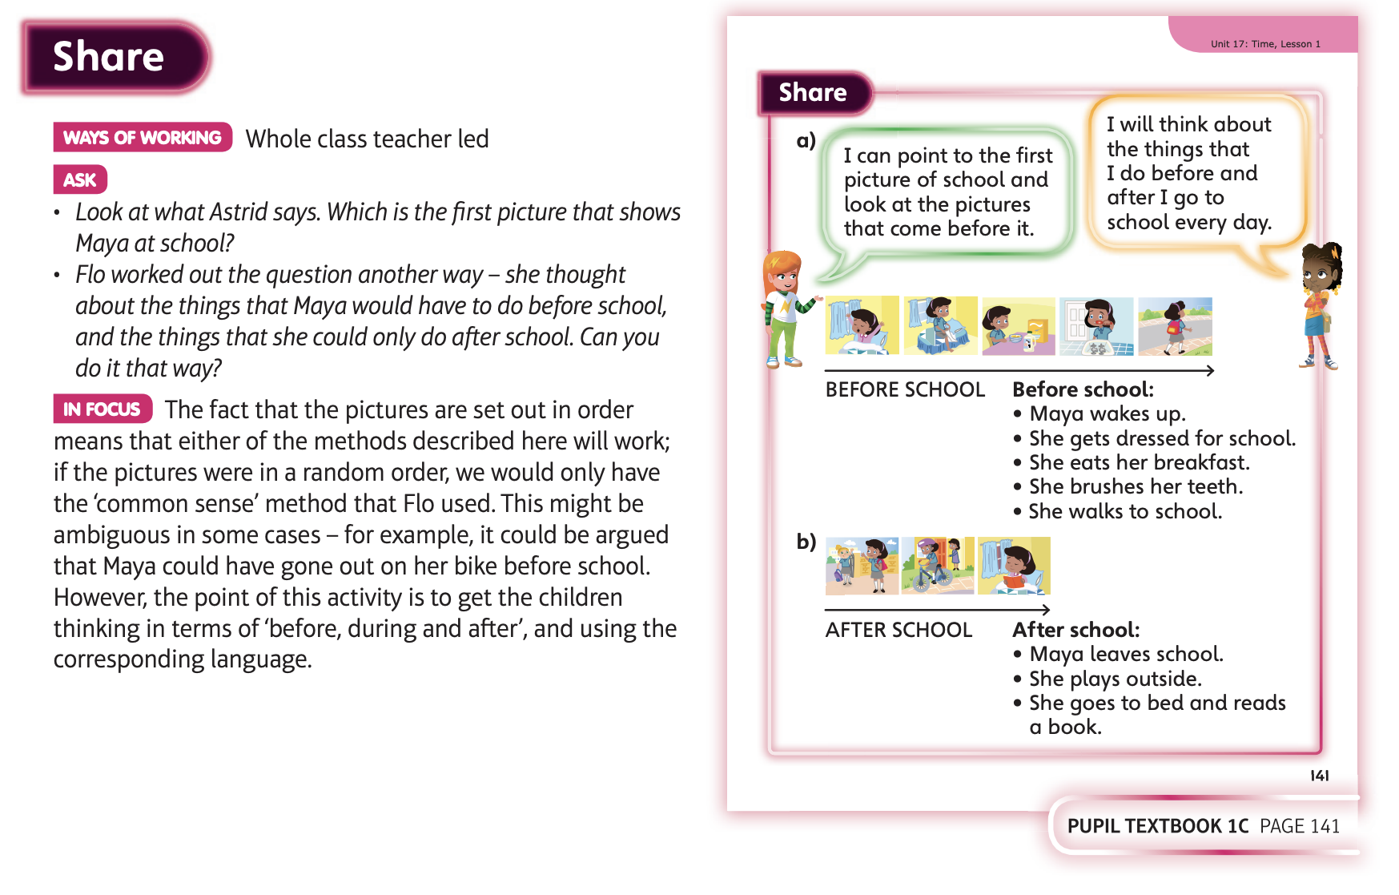

Slide 3
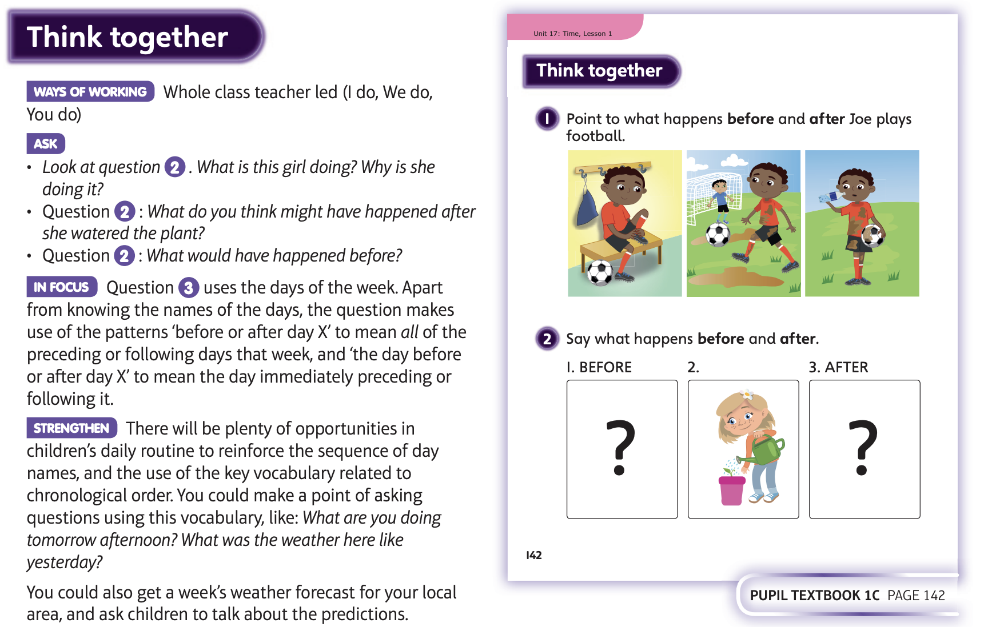

Slide 4
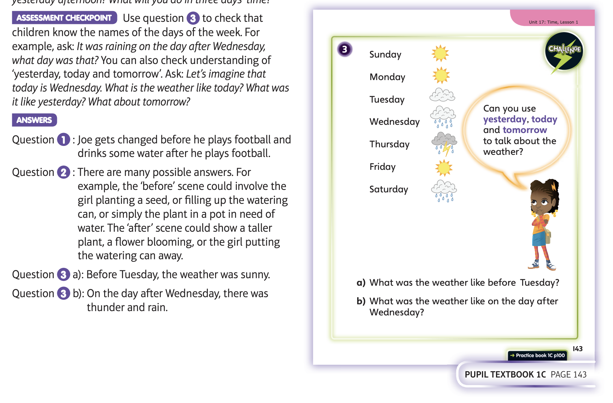
Now complete Unit 17 lesson 1 or do the following activities

Slide 5
If you come into school on a Wednesday – Friday then you can have a go at these activities;
Do you know all the days of the week?
Can you say them all in order without needing help?
Ask a grown up to challenge you – ‘What day is is today?
‘What day will it then be tomorrow?’
‘What day was it yesterday?’
Think about your day – what was your favourite part? Can you recall what you did before it? What did you do after it?
See what games you can play thinking about the days of the week and the order in which events took place. Keep using
the language of before and after.

Slide 6
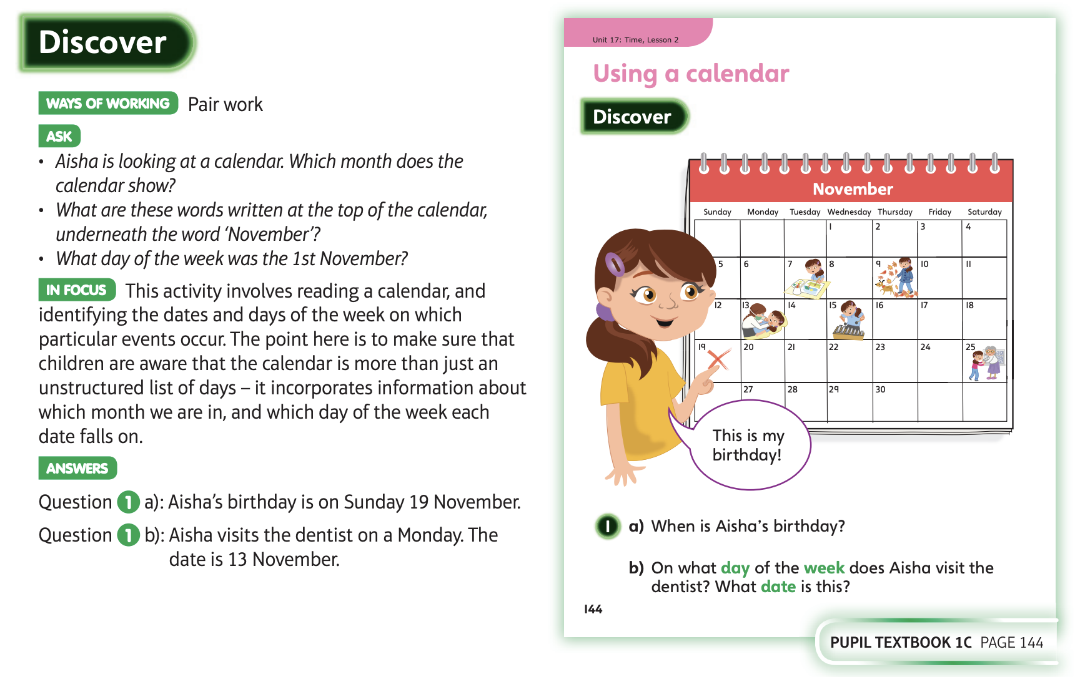
23.6.20 Have a look at these

Slide 7
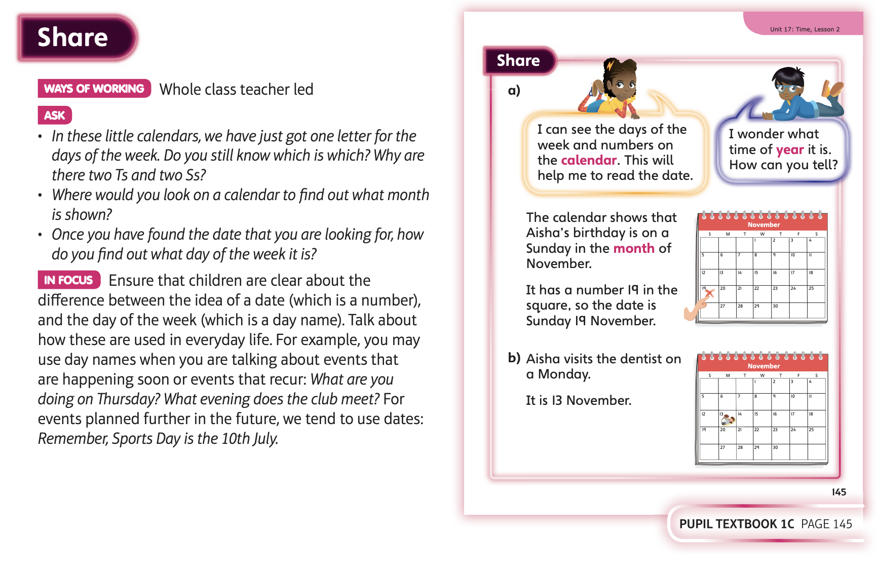

Slide 8
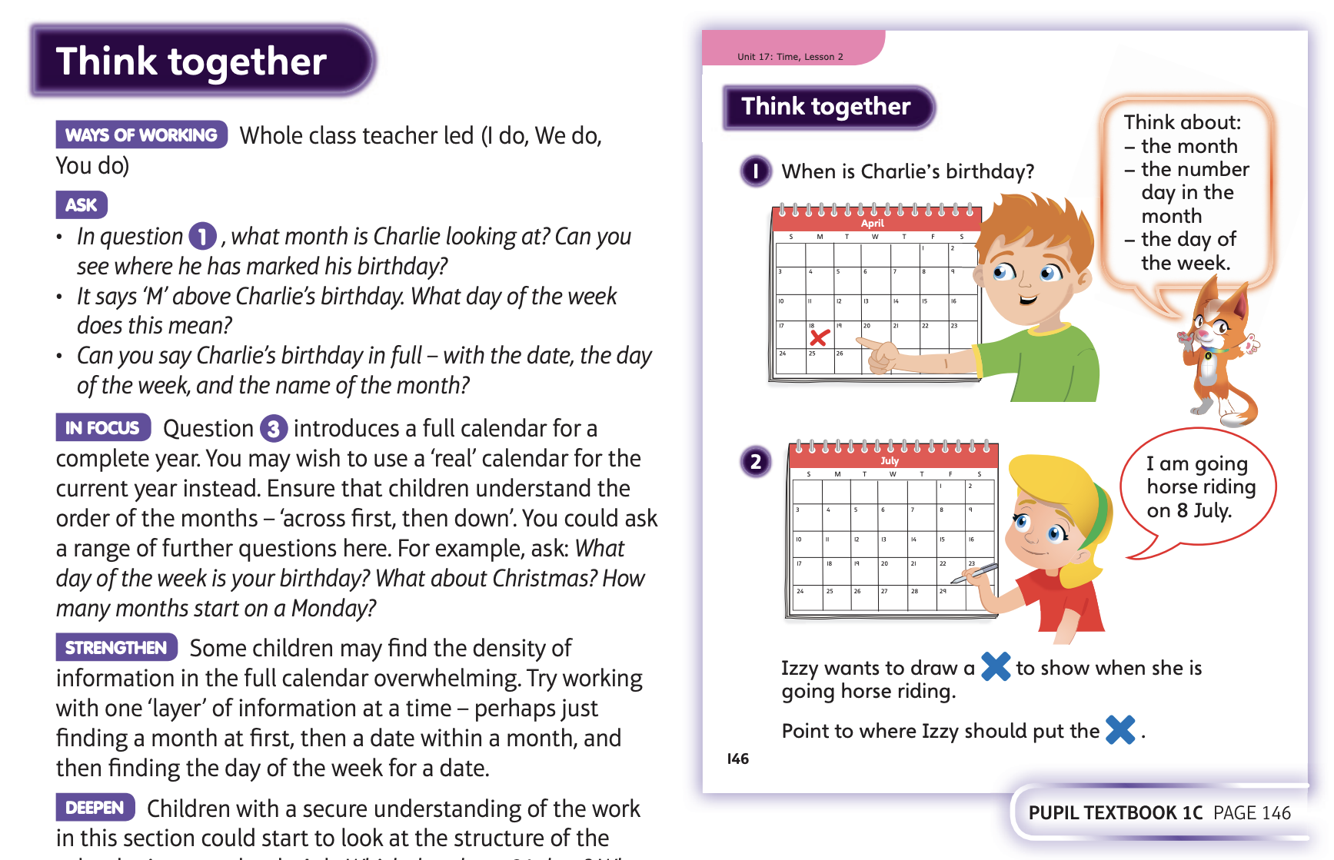

Slide 9
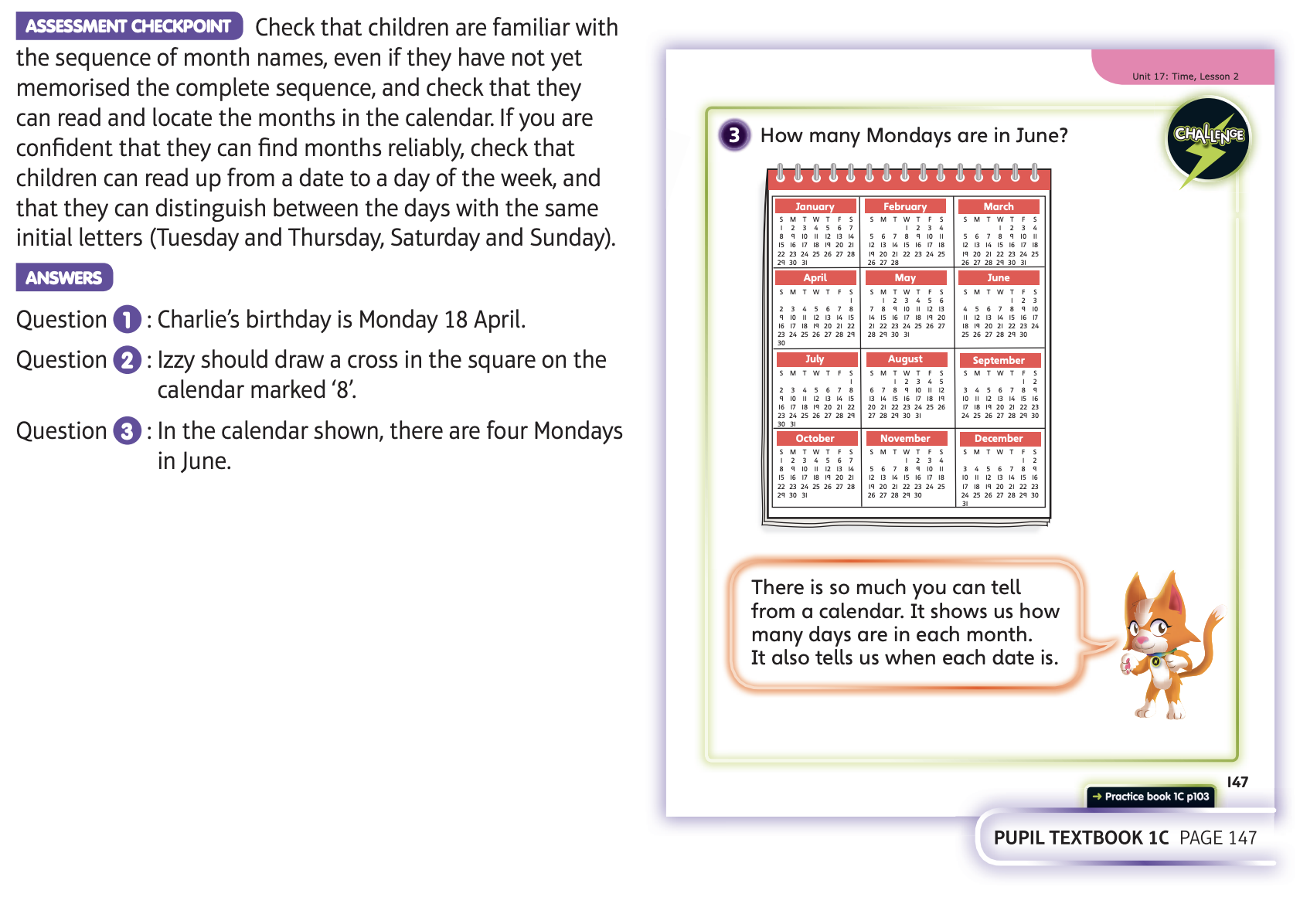
Now complete Unit 17 lesson 2 or do the following activities

Slide 10
Do you have a calendar or diary in your house? Have a look at it and see how it is laid out. Can you see that there are
12 months? Use it to help you answer these questions;
Can you name all the months of the year in order?
Pick a number and see if you can say and write the date of that number (16th October for example)
How many days are in the month of your birthday?
Can you find a month with a different number?
How many Thursdays are there in February?
How many Saturdays are there in July?
How many Mondays are there in December?
See if you can find differences and similarities between all the months of the year.

Slide 11
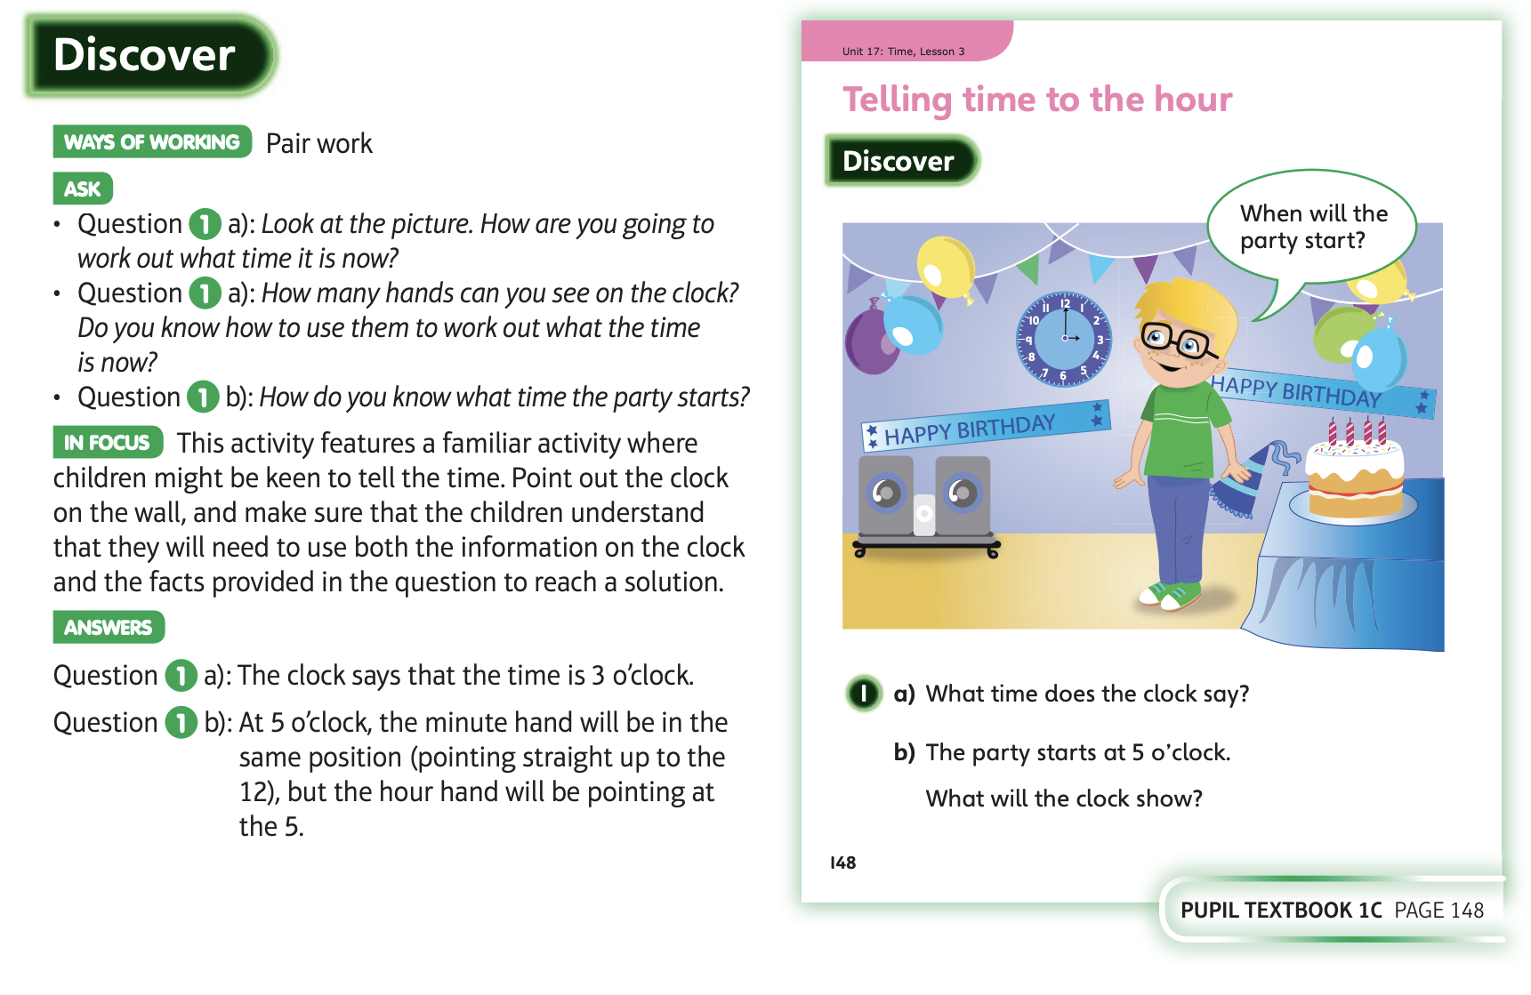
24.6.20 Have a look at these

Slide 12
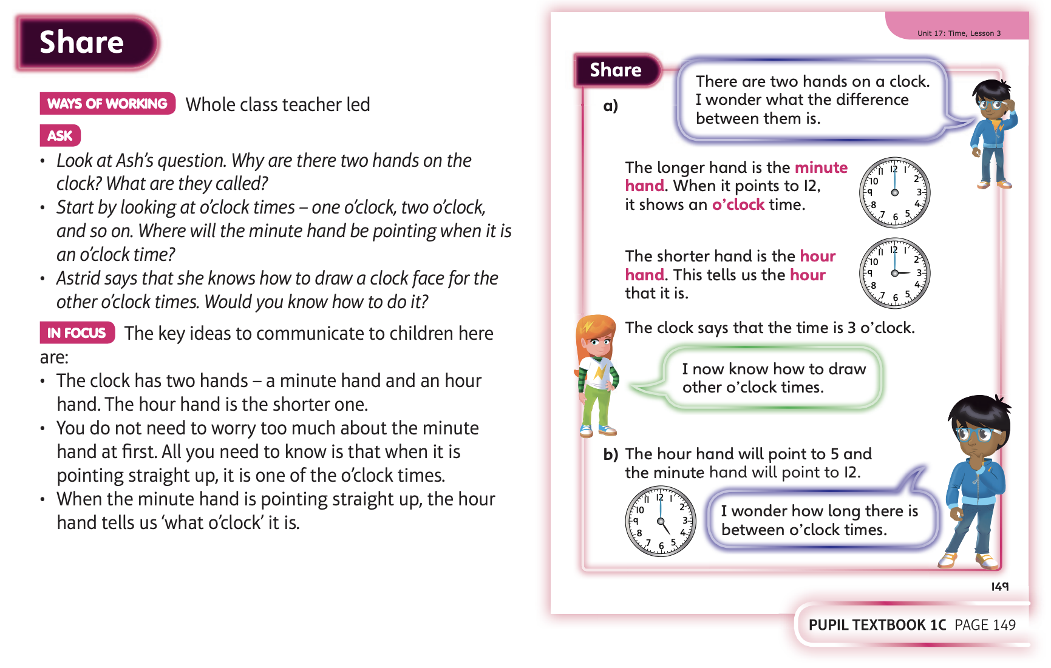

Slide 13
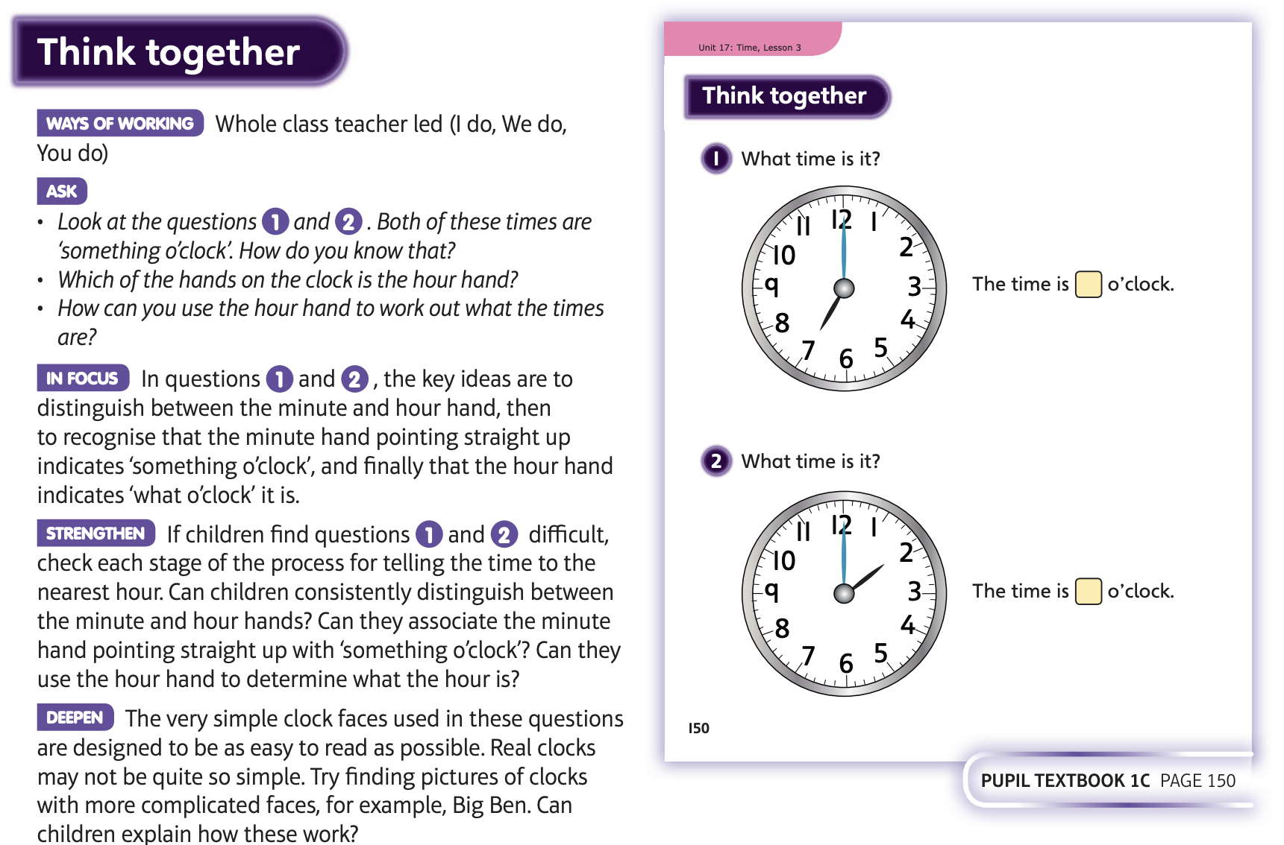

Slide 14
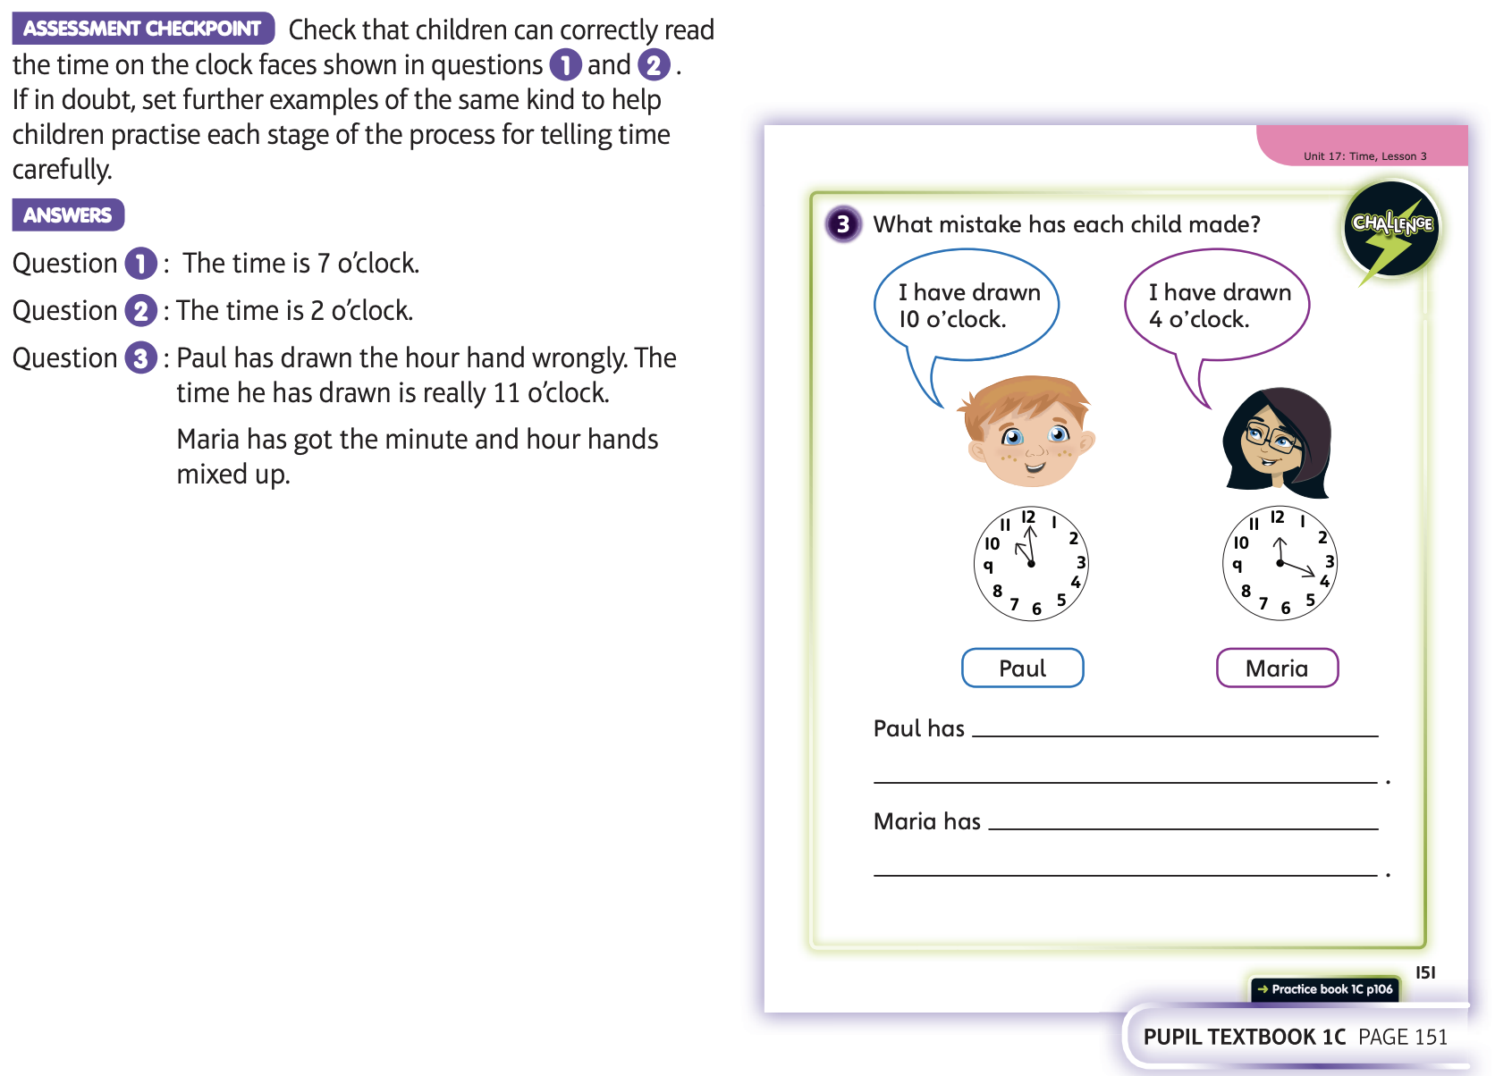
Now complete Unit 17 lesson 3

Slide 15
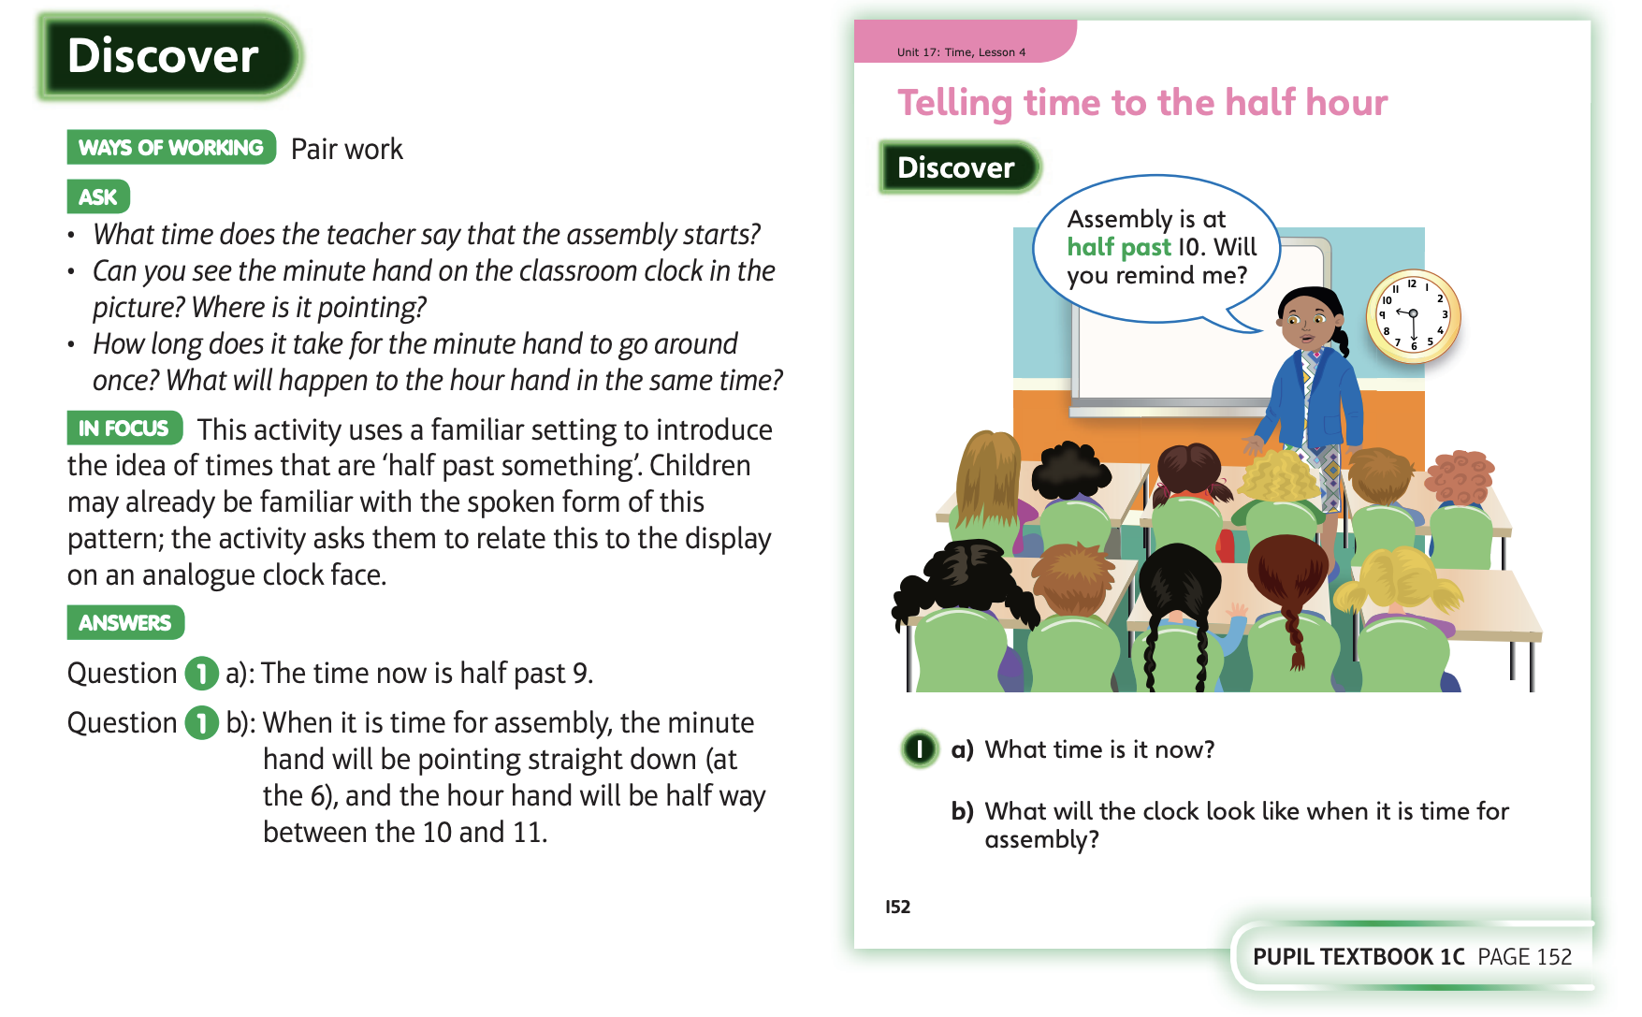
25.6.20 Have a look at these

Slide 16
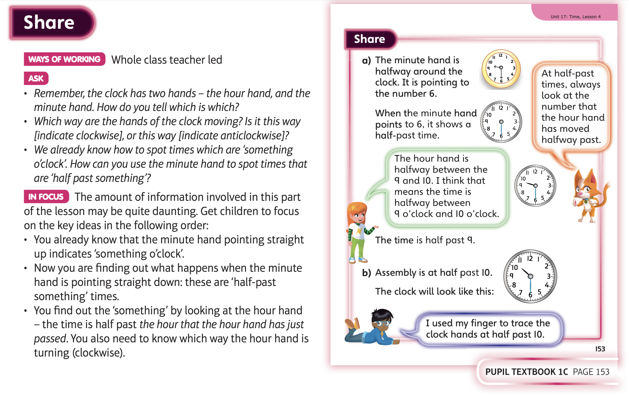

Slide 17
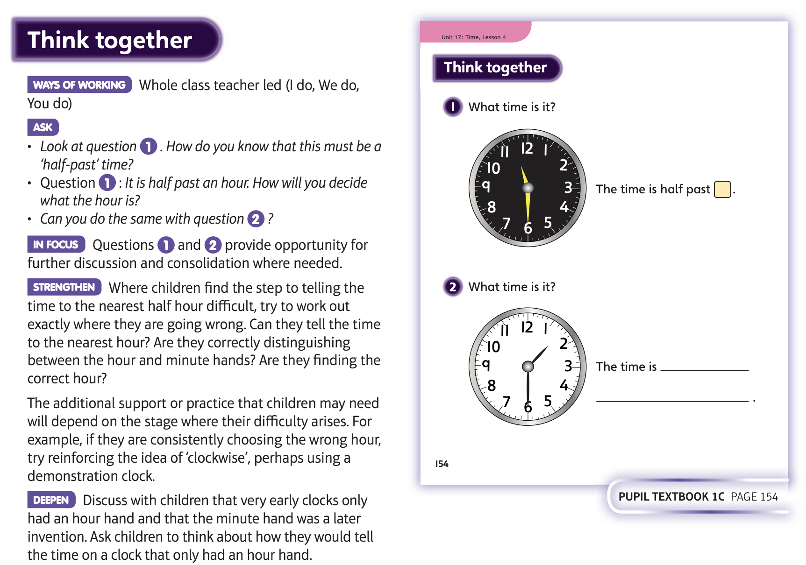

Slide 18
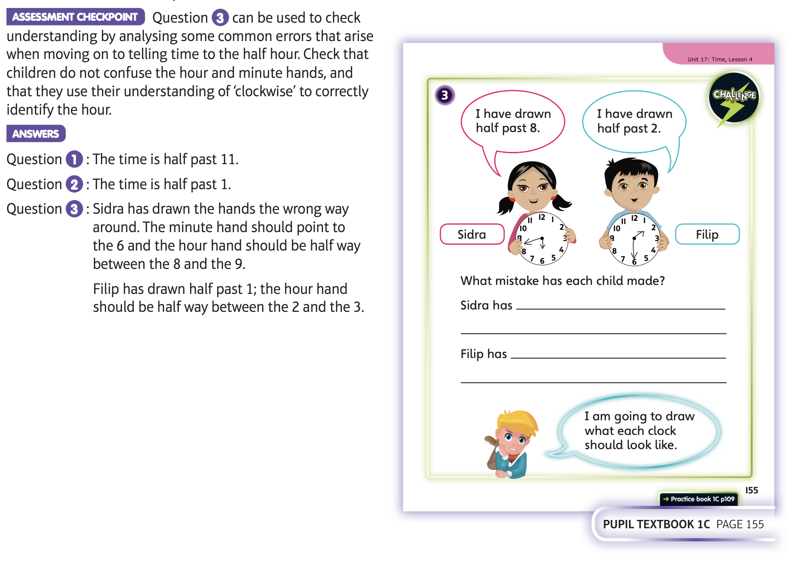
Now complete Unit 17 lesson 4

Slide 19
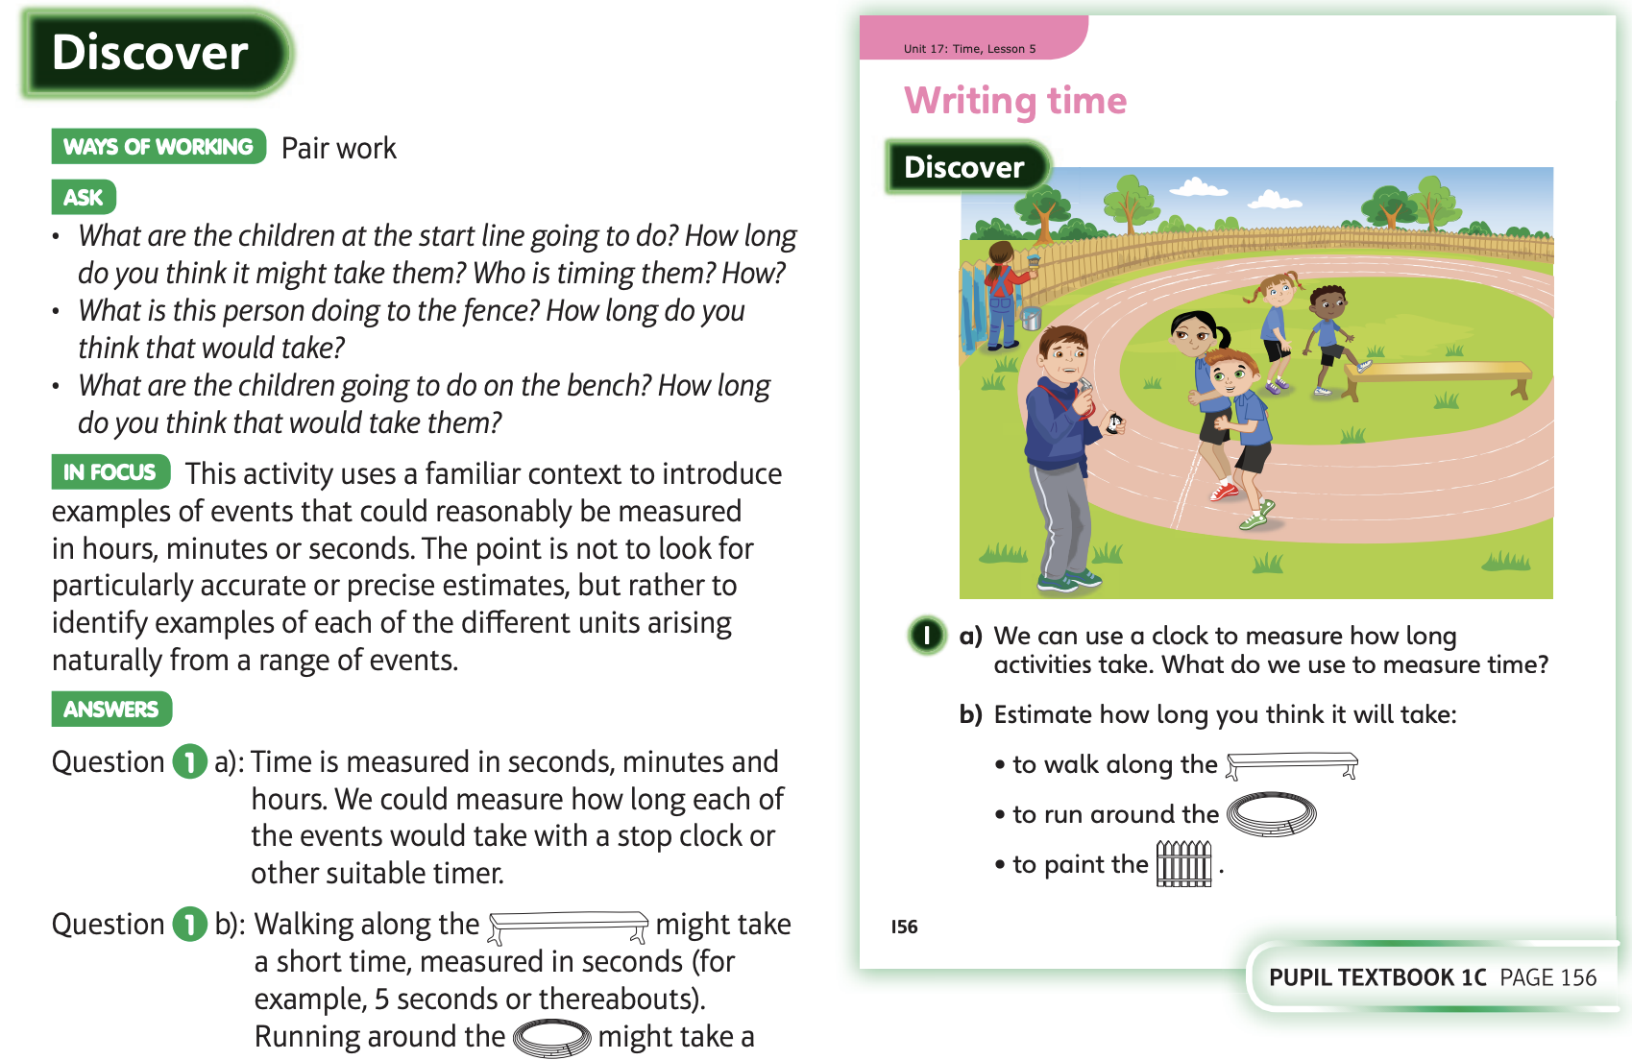
26.6.20 Have a look at these

Slide 20
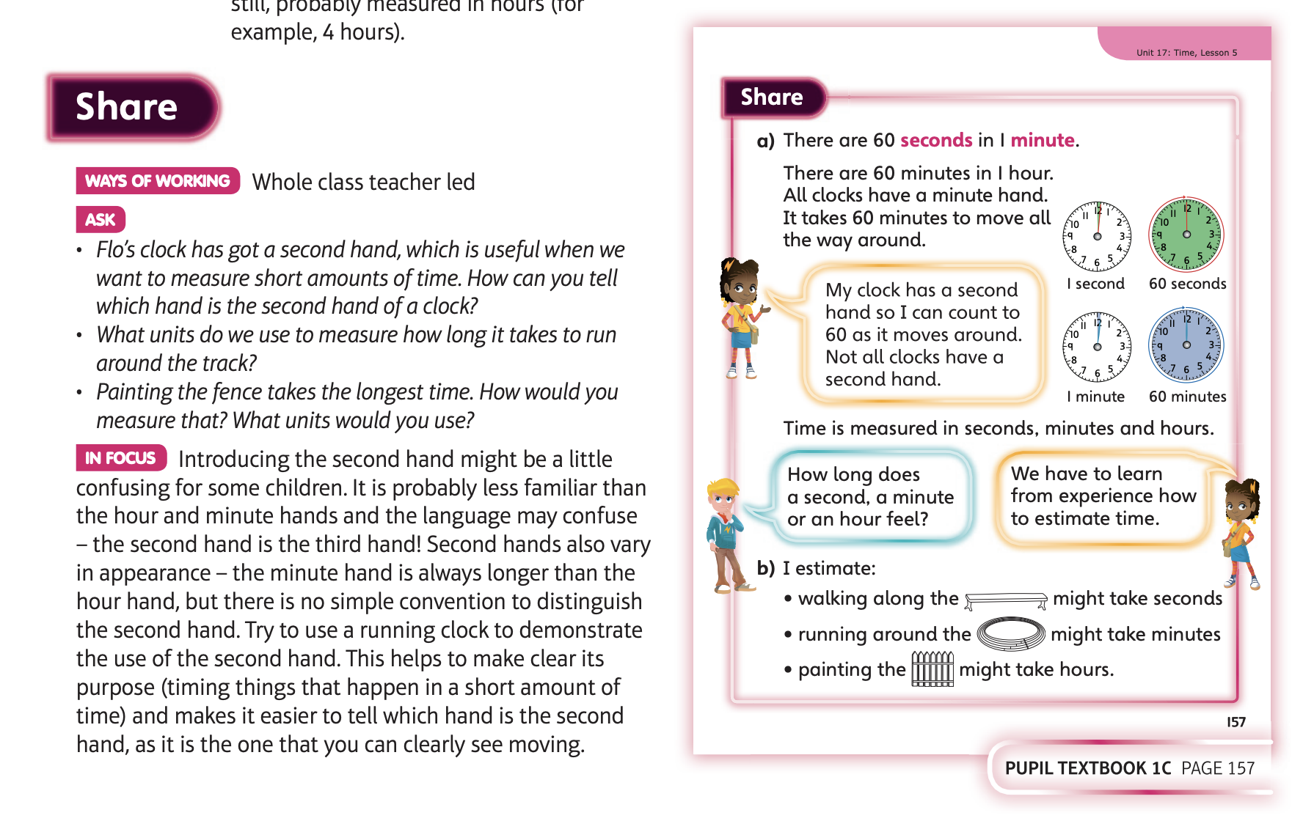

Slide 21
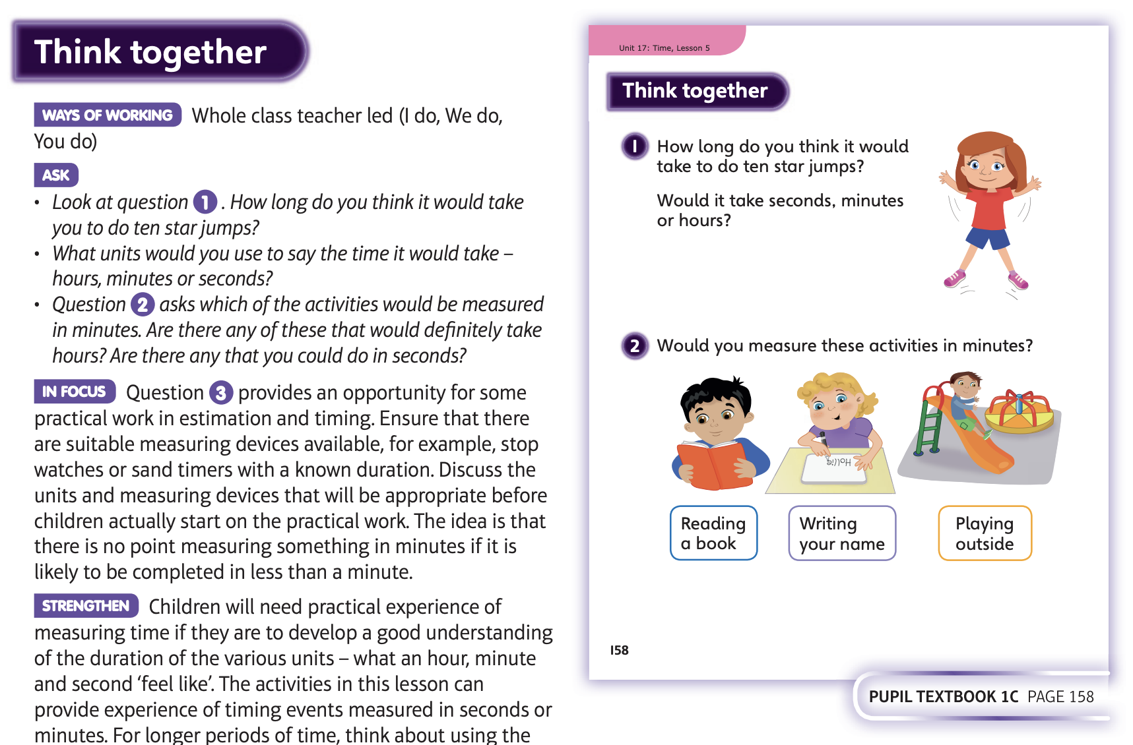

Slide 22
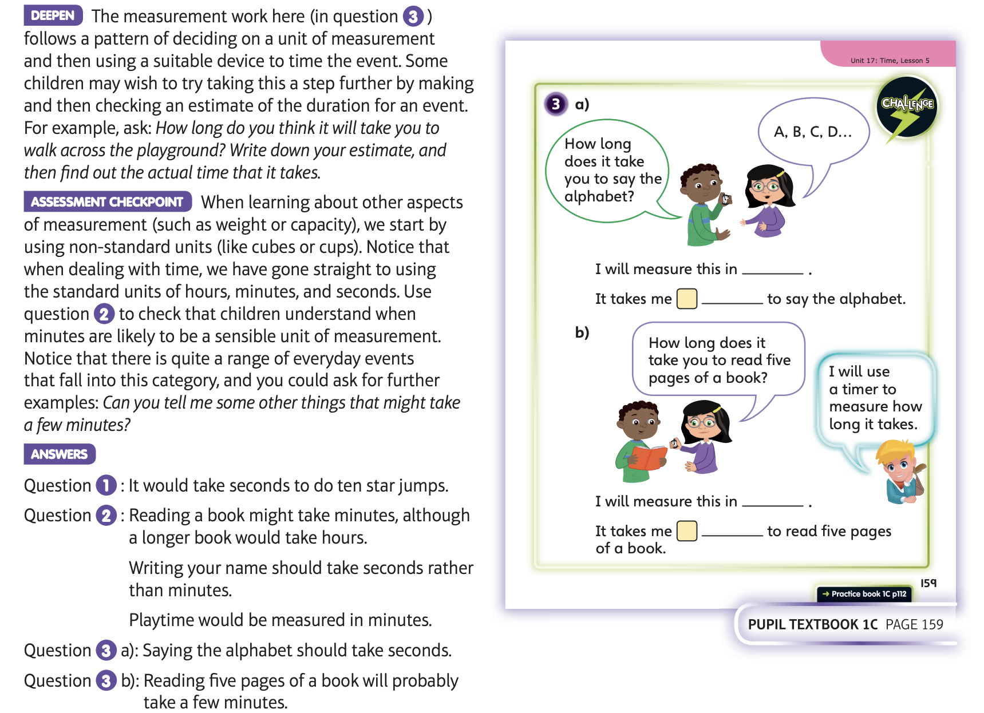
Now complete Unit 17 lesson 5

