Slide 1
Welcome to Bullfinch Class
Mrs Metcalfe – Monday, Tuesday & Wednesday
Mrs Crowe – Wednesday, Thursday & Friday
Mrs Bardsley – Monday, Tuesday, Thursday & Friday

Slide 2
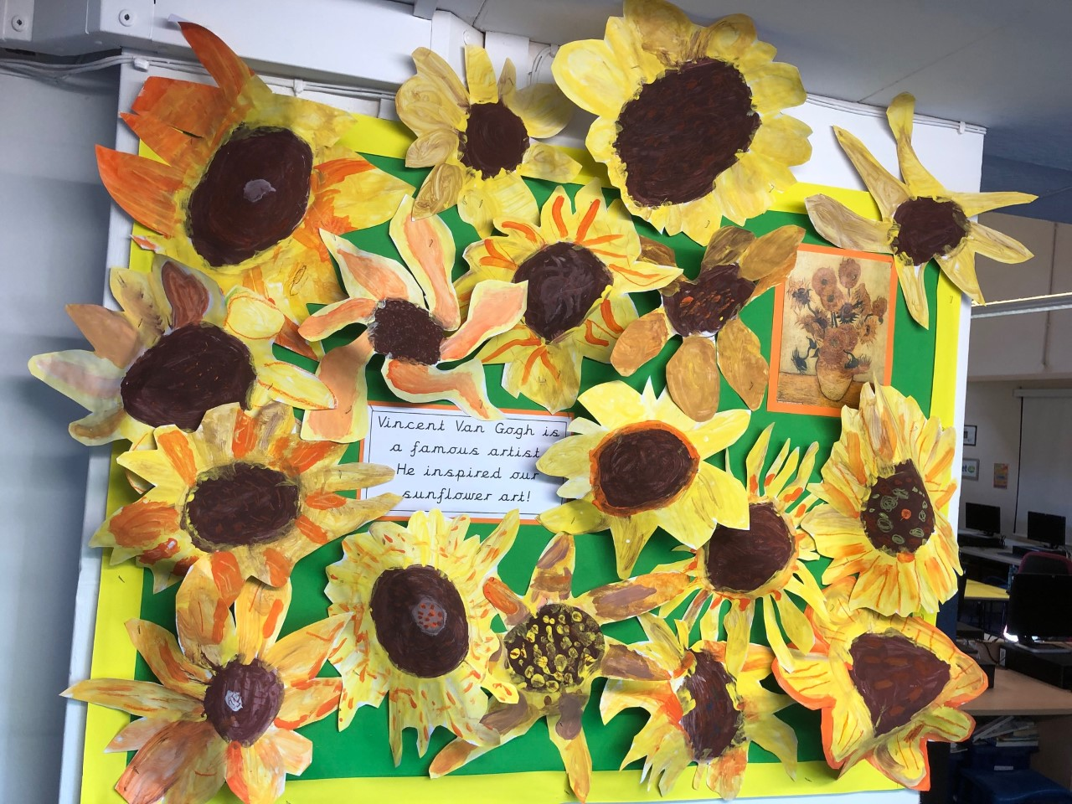
Your children have all settled in beautifully and are keen and happy throughout the day!

Slide 3
Bullfinch is currently just working as a year 2 bubble
Please can your child bring the following EVERY day;
A water bottle
A coat – we will try and work outside as much as possible!
A packed lunch (unless a school lunch has been ordered)
Everything else they need will be provided!

Slide 4
Our Curriculum
Our topic for this half term is TOYS
Lots of our learning will be linked to this.
Our main English text is
‘Lost in the toy museum’
More details about our learning for this period can be found on the website in our Bullfinch jigsaw

Slide 5
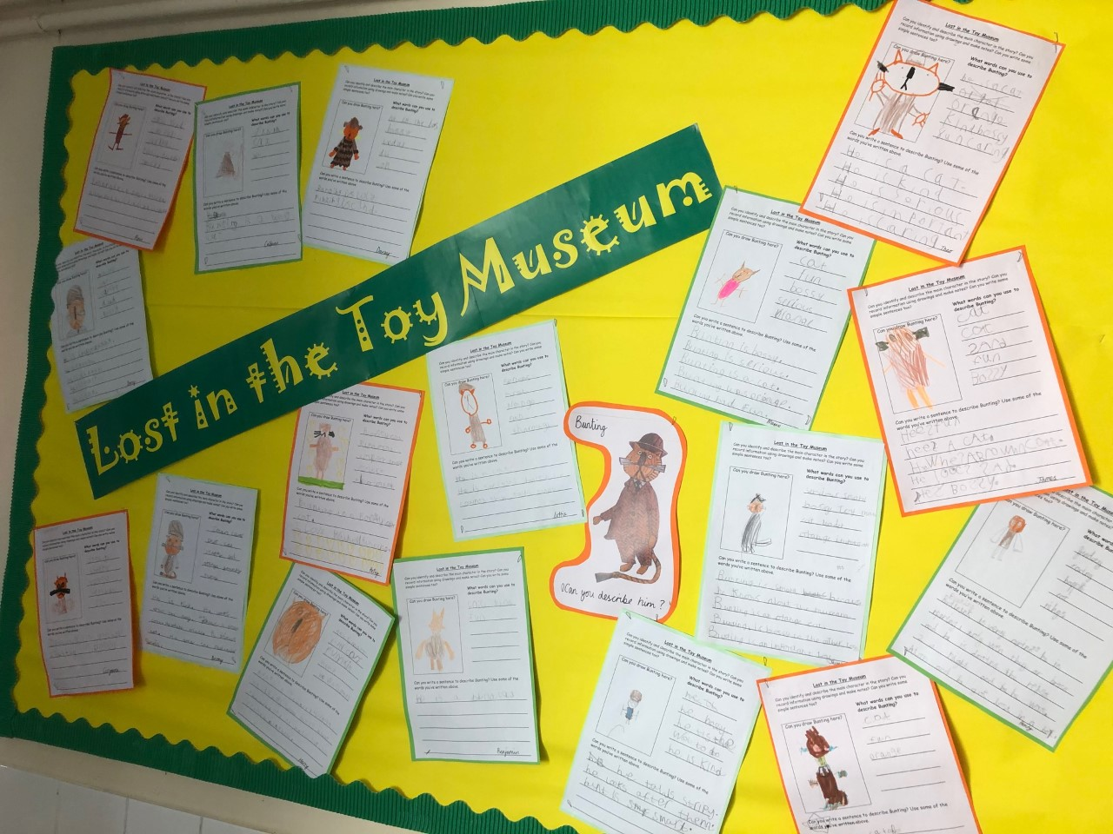

Slide 6
Home Learning
We will aim to have google classrooms up and running for the purpose of homework.
Further details will be sent regarding this.
Children will be expected to read for 10 minutes EVERY day and to learn set spellings weekly.

Slide 7
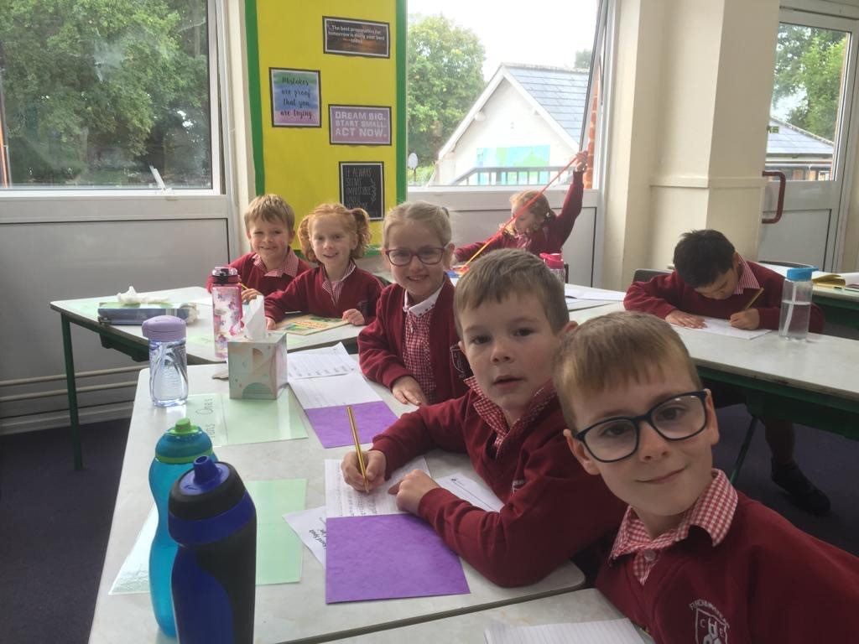
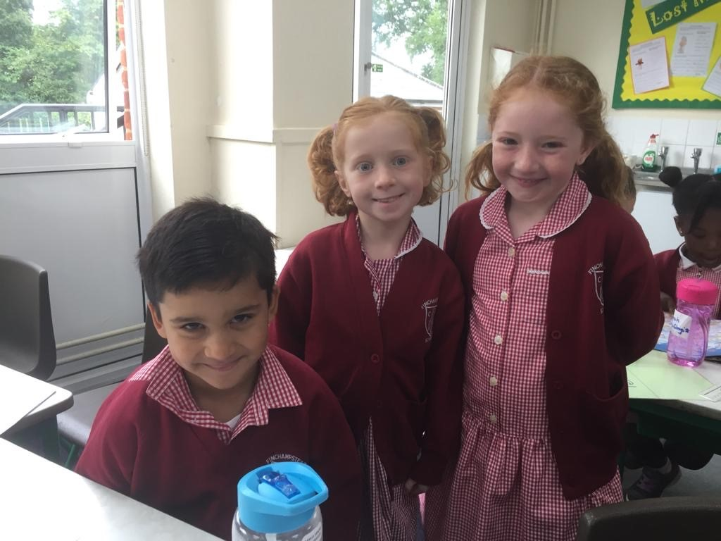
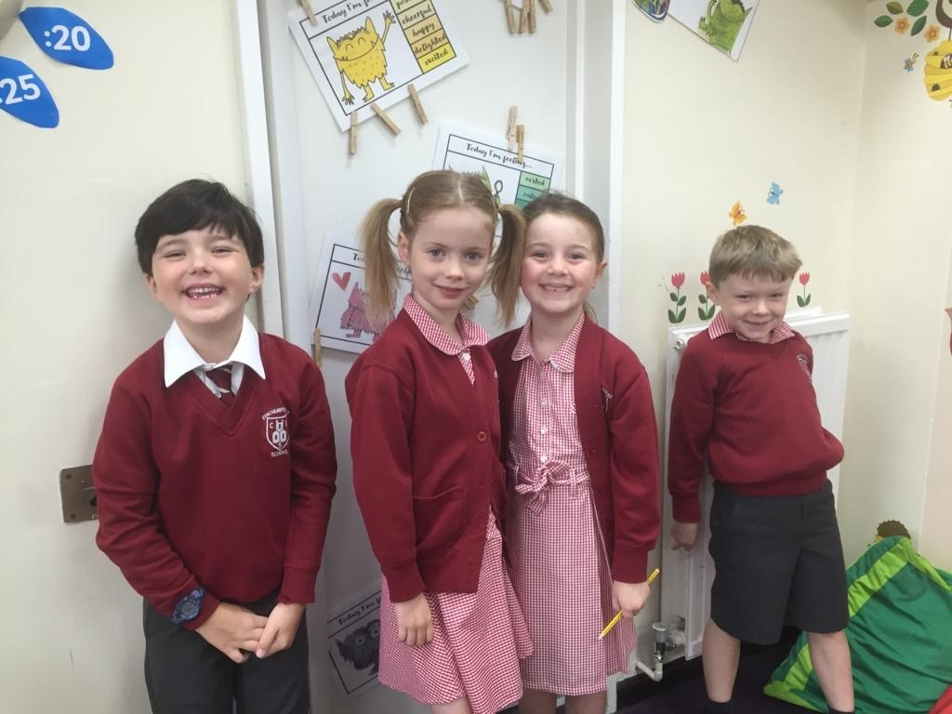
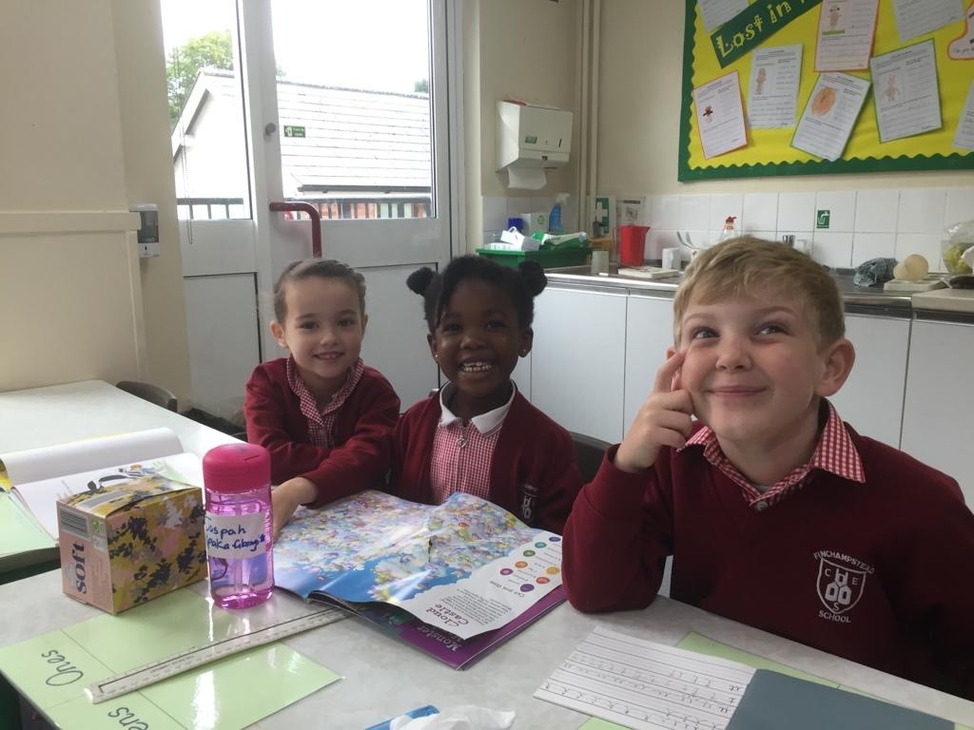

Slide 8
Reading Books at home
Your children are reading regularly through the week within school.
They should come home with a book and reading record in a named ziplock folder today.
(We don’t have the space to store the red book-bags each day that the children normally use)

Slide 9
Reading Books at home
Please read with your child each and every day for a period of about 10 minutes. We appreciate that some evenings are busier than others, but the more you read with your child, the more able a reader they will become – please find a time that works well for you all. There is no point persevering with a reading session if your child is tired, irritable and unwilling. If this happens, then you could read to them – all reading opportunities are valuable!

Slide 10
Reading Books at home/school
The book and reading record needs to come to school every day.
We will hear your children read at different points throughout the week.
Please rest assured that prior to handling your child’s reading folder and books, we will endeavour to sanitise or wash our hands. Books that are changed from each child will be put away for a period of 72 hours before being returned to the book shelves.

Slide 11
The Colour Monster
Your child may have talked to you about the book,
‘The Colour Monster’.
It’s a text we’re using in our classroom to help think about our emotions and how we are feeling. Each day we encourage the children to move their named peg onto the colour monster that they most associate with that day. We want them to know it’s ok to not always be feeling happy and full of sunshine and that we can talk through our feelings together so that we can get to feeling ‘yellow’ or ‘green’ again!

Slide 12
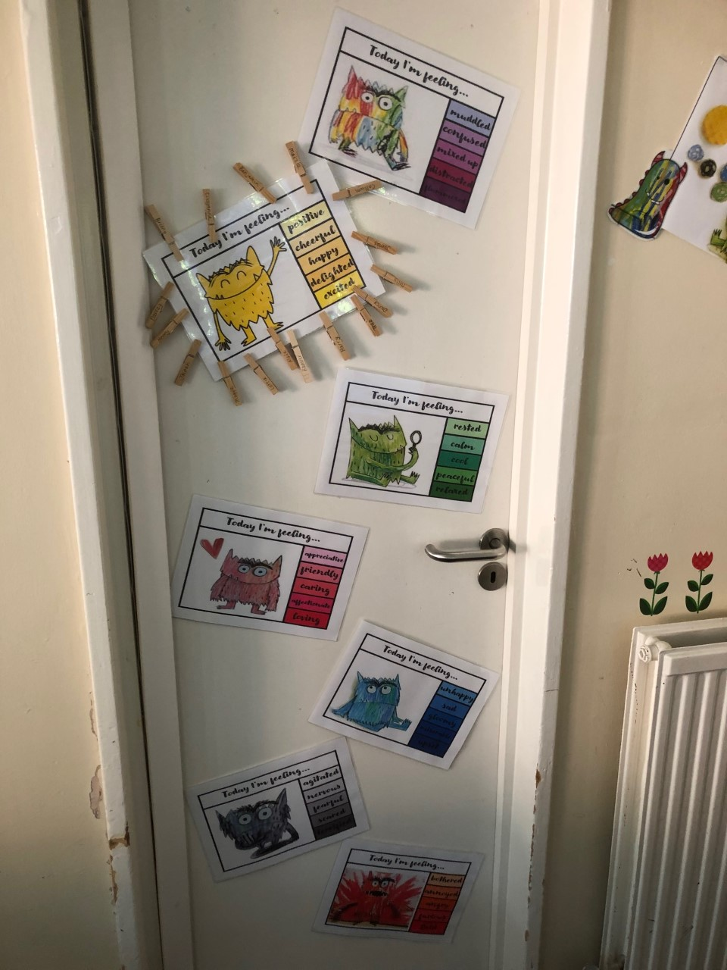
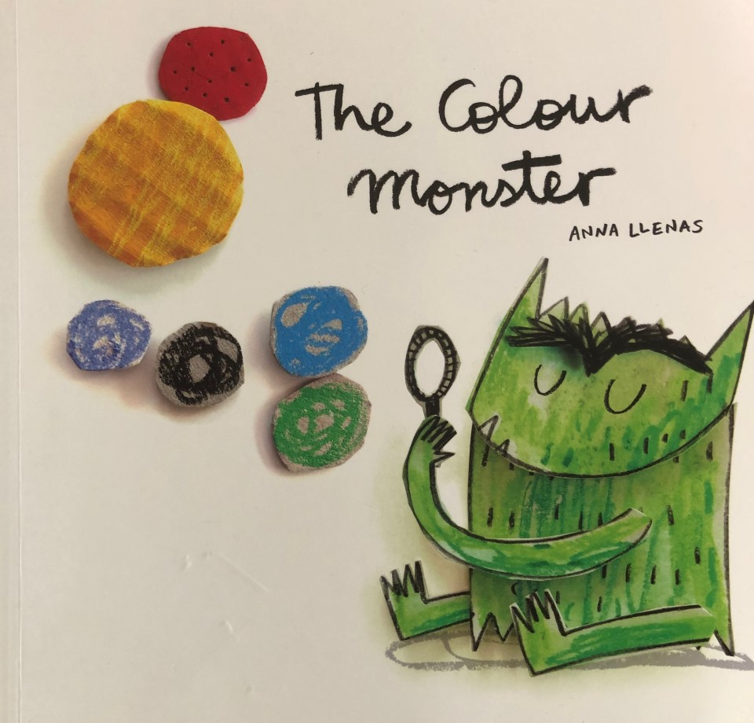

Slide 13
Any Questions…
We want your children to be happy at school
They’ve all settled in brilliantly so far but please do let us know if there are any problems.
We’re always happy to chat with you if you have any concerns. There’s always a little more time at the end of the day though if it can wait until then, alternatively please leave a message with Mrs Bardsley at the gate or phone the office.

