Slide 1
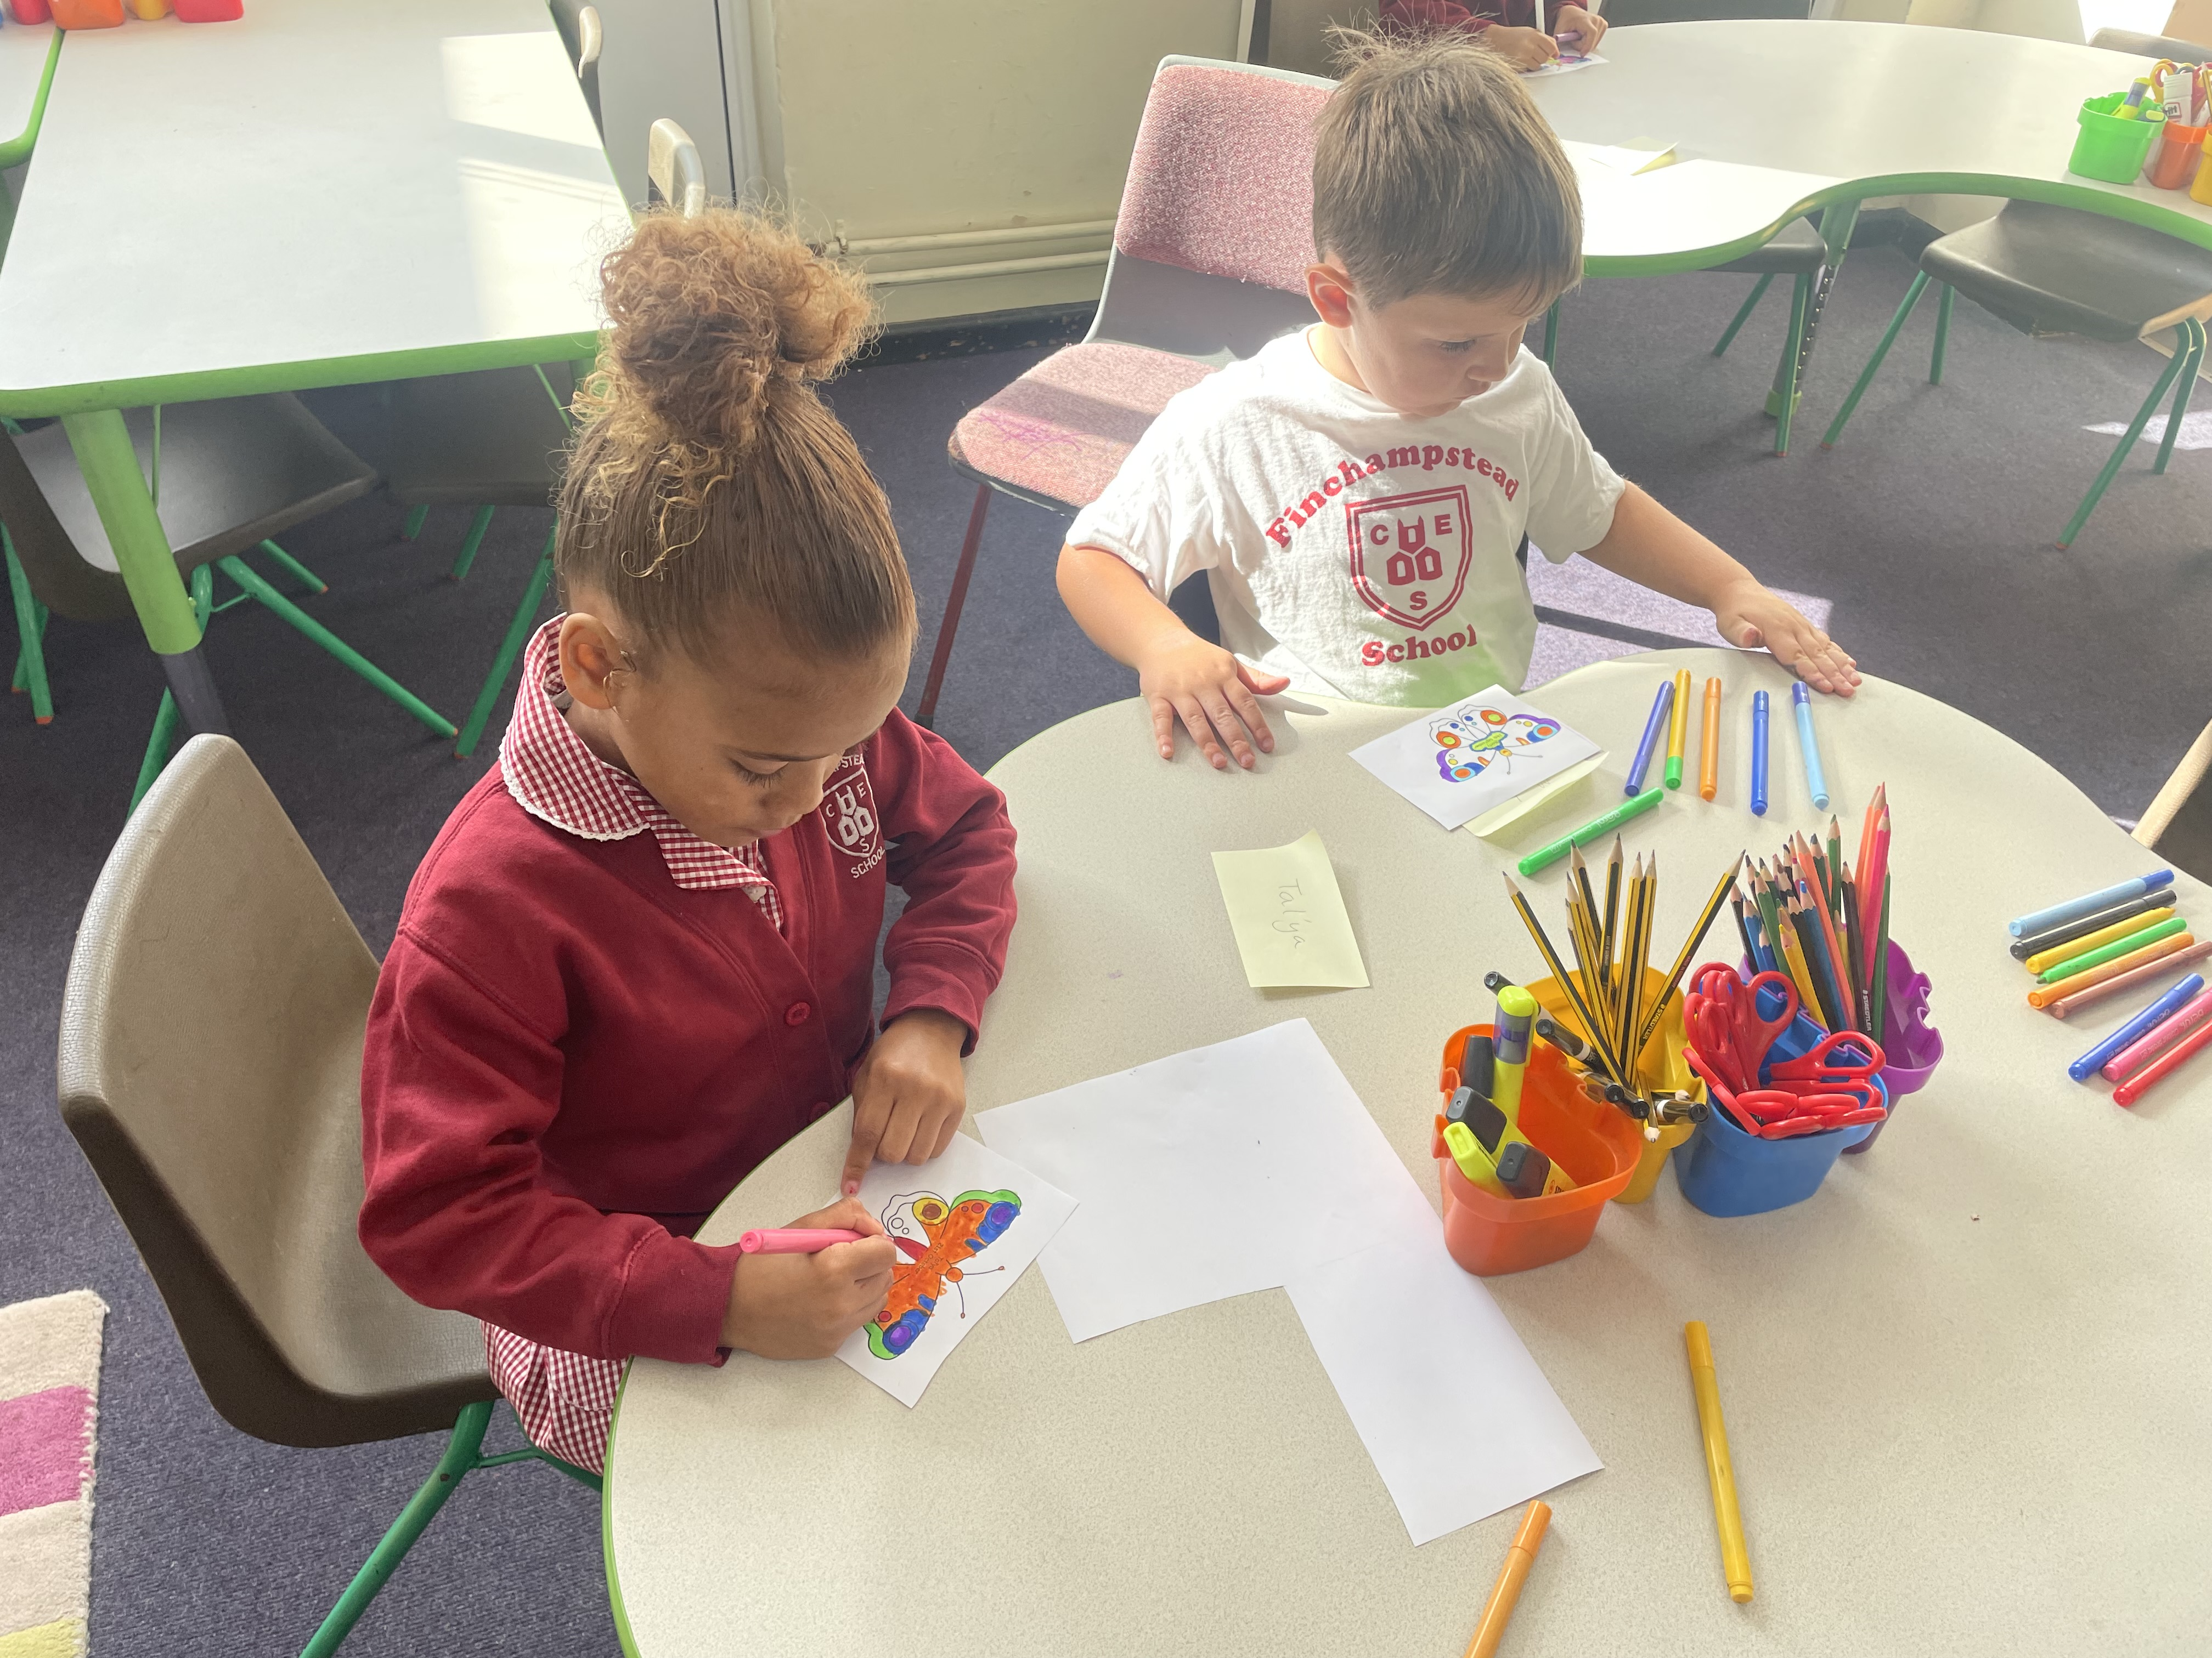
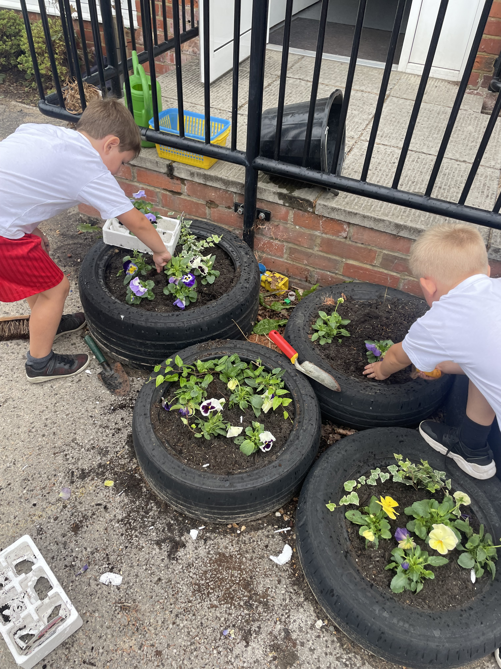
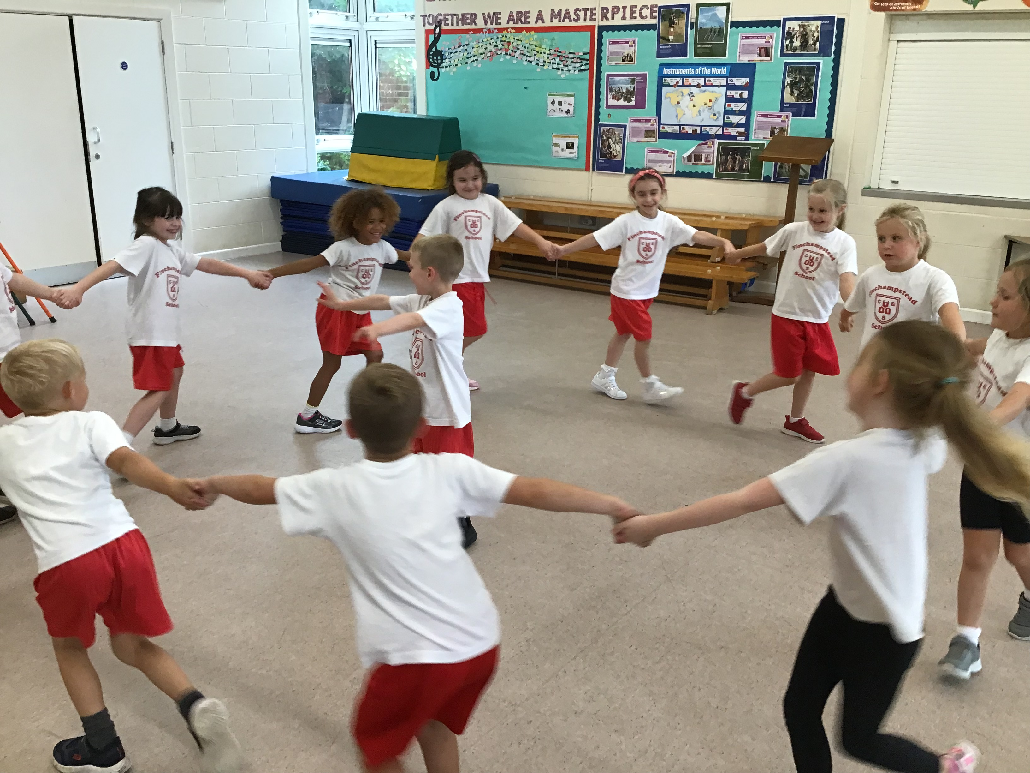
Welcome to Bullfinch

Slide 2
We are currently just a year 2 group – this will be a fluid arrangement and will change throughout the year.
Monday, Tuesday and Wednesday - Mrs Metcalfe
Thursday and Friday – Mrs Crowe
All week – Mrs Bardsley

Slide 3
What the children need every day:
A water bottle
A packed lunch or school meal (we can order in class each morning)
A snack – we do provide this, but many children prefer their own. We do ask that this is fruit or veg rather than any fruit winders etc.
A book bag with their reading record and books in.
A coat!
We have PE on a Monday and Tuesday – please come in PE kit on these days. Shoes with Velcro unless they can do their own laces!

Slide 4
Our days usually follow the same format.
8.40-8.50 – children arrive
8.50 – Register
9.00 – Assembly
9.20 – Maths
10.20 – Story time and snack
10.45 – Break
11.05 – English – Phonics/writing/reading
12.10 – Lunch
1.10 – Afternoon Curriculum
3.00 – Story
3.15 – Hometime
The children use our visual timetable to know which subjects are being taught each day. There are also plenty of learning through play opportunities each day.

Slide 5
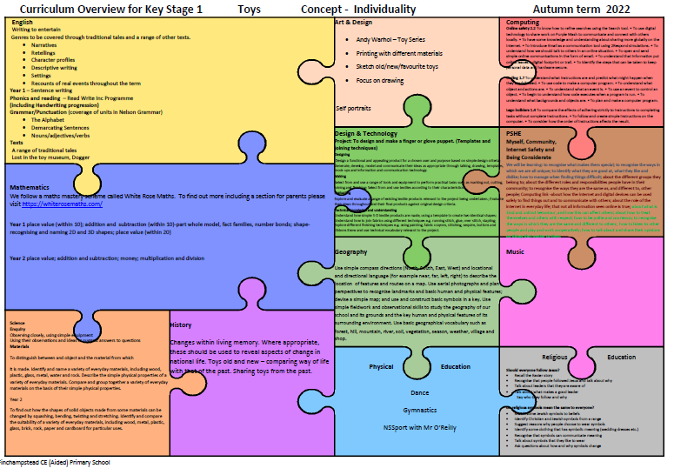
Our curriculum this term

Slide 6
Reading
Your child will read every day in school.
Books will usually come home at two points during the week.
Please try and read with and to your child every day and record this in their reading record.
We, however, will record their daily reading progress using an in house system in school.
Spellings

Slide 7
The website
https://www.finchampsteadschool.org/
Volunteers
We’d love regular and ad hoc helpers in our class!
Any Questions?

