Slide 1
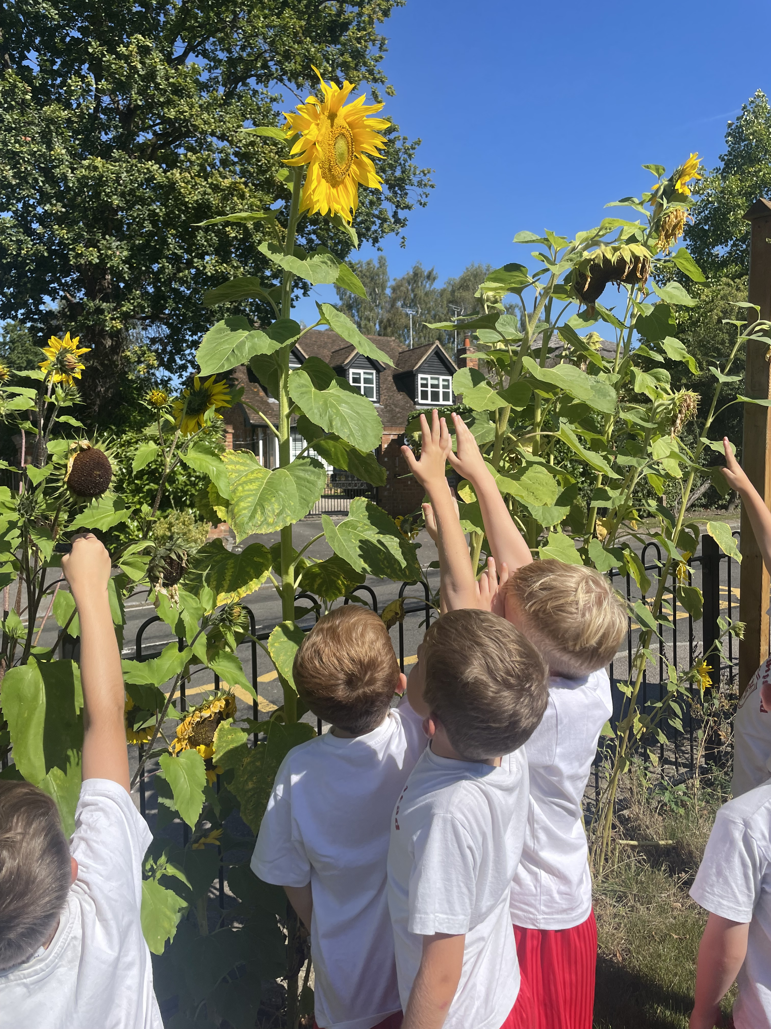
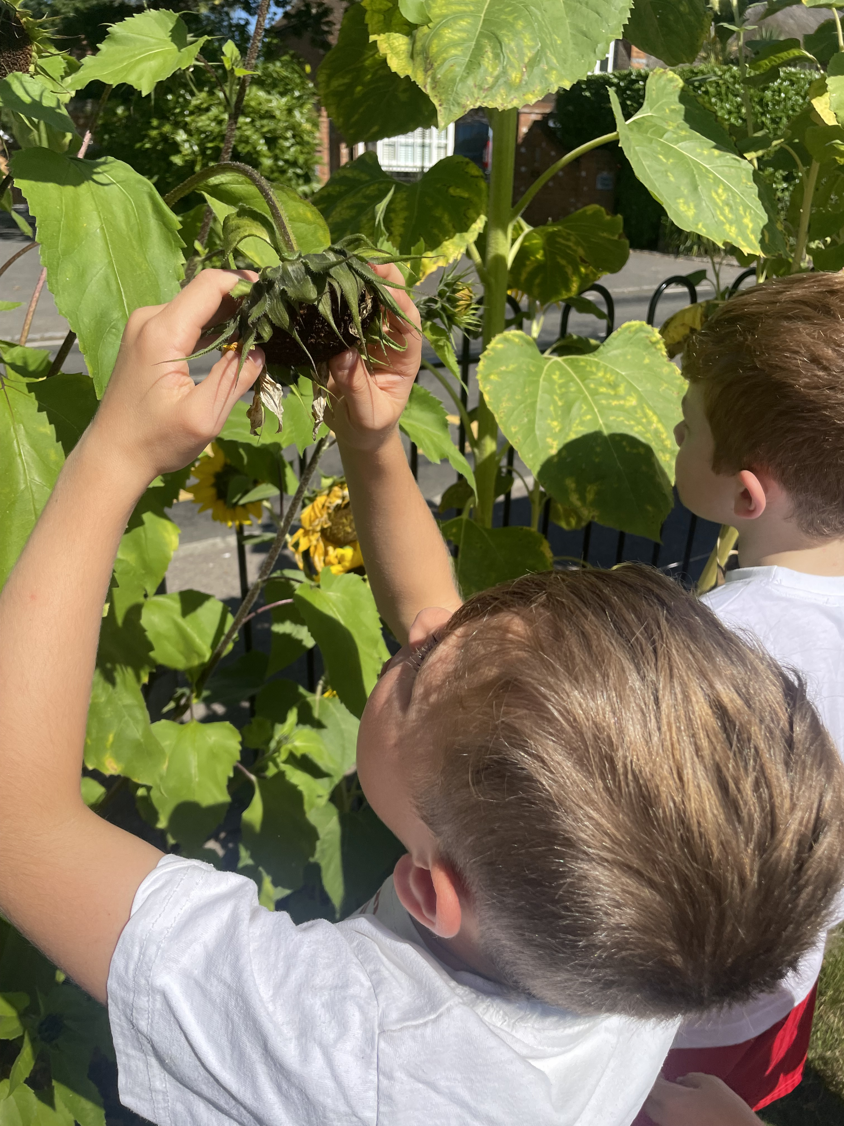
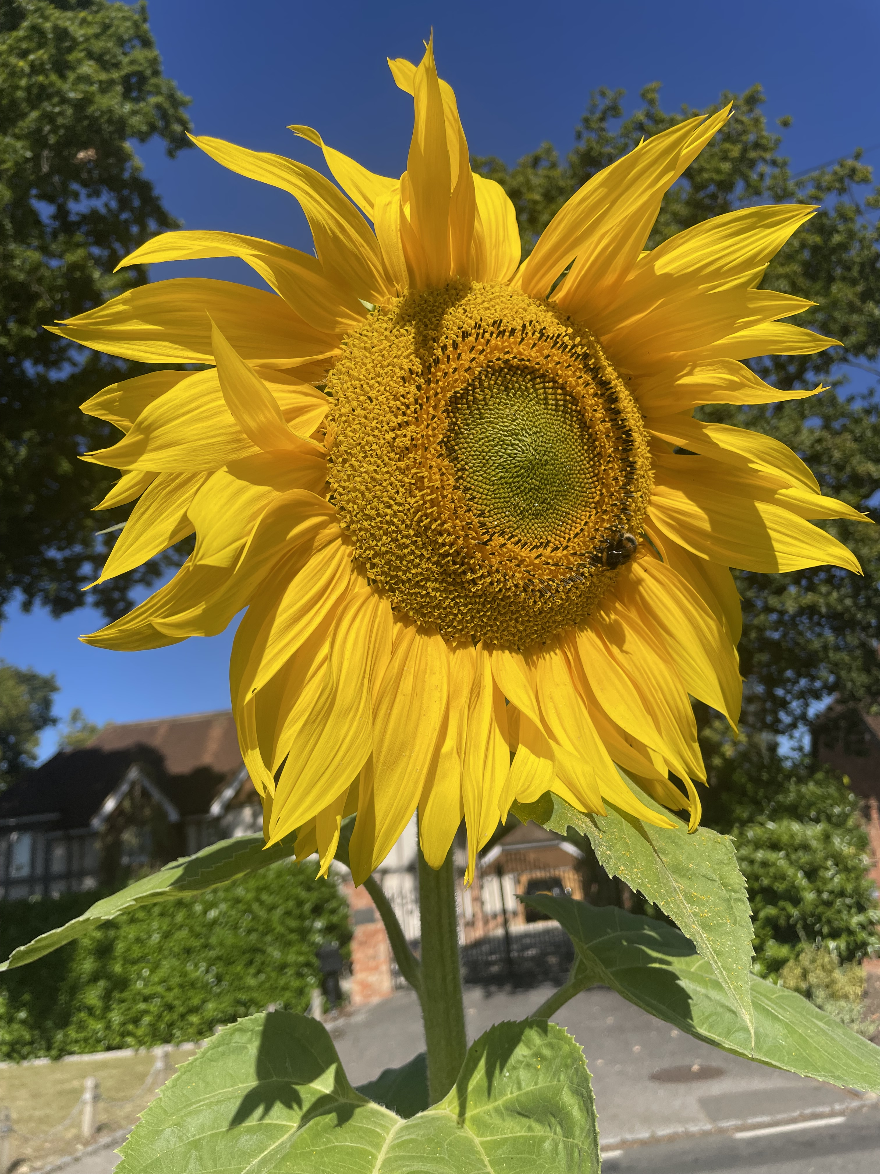
Welcome to Bullfinch

Slide 2
We are currently just a year 2 group – this will be a fluid arrangement and will change throughout the year.
Monday, Tuesday and Wednesday - Mrs Metcalfe
Thursday and Friday – Mrs Crowe
All week – Mrs Bardsley

Slide 3
What the children need every day:
A water bottle
A packed lunch or school meal ordered through the office
A snack – we do provide this, but many children prefer their own. We do ask that this is fruit or veg rather than any fruit winders etc.
A book bag with their reading record and books in.
A coat/sunhat – weather dependent!
We have PE on a Monday and Tuesday – please come in PE kit on these days. Shoes with Velcro please, unless they can do their own laces!

Slide 4
Our days usually follow the same format.
8.40-8.50 – children arrive
8.50 – Register
9.00 – Phonics and Maths/English (depending on day)
10.30 – Assembly
10.50 – break and snack
11.05 – Phonics and Maths/English (depending on day)
12.10 – Lunch
1.10 – Afternoon Curriculum
3.00 – Story
3.15 – Hometime
The children use our visual timetable to know which subjects are being taught each day. There are also plenty of learning through play opportunities each day.

Slide 5
Monday News Sharing!
We share news each Monday and give each child in the class a chance to share something from home.
It might be something interesting they have found on a nature walk, an award, a drawing or a model created at home.
We encourage toys to stay at home, unless there’s just been a birthday or a special reason for a gift.

Slide 6
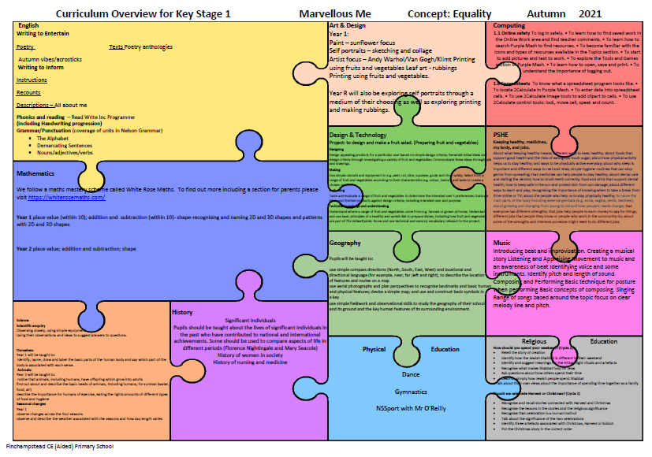
Our curriculum this term
Autumn 2023

Slide 7
Reading
Your child will read every day in school either independently, in a pair, in a group or 1:1 with an adult.
Books will usually come home at two points during the week.
Please try and read with (and to) your child every day and record this in their reading record.
Spellings
Spellings are sent home on a Friday
Tested the following Thursday

Slide 8
The website
https://www.finchampsteadschool.org/
Volunteers
We’d love regular and ad hoc helpers in our class!
Any Questions?

