Slide 1
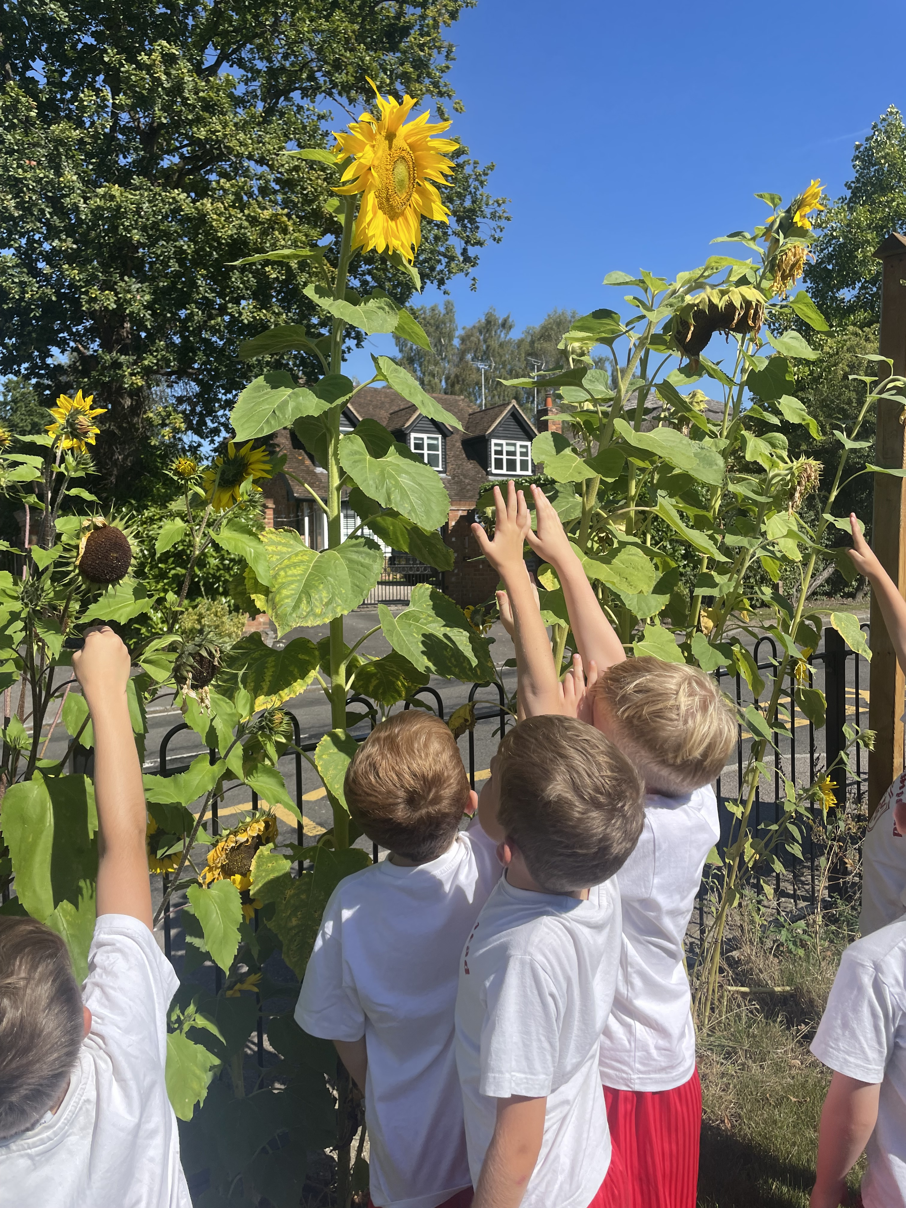
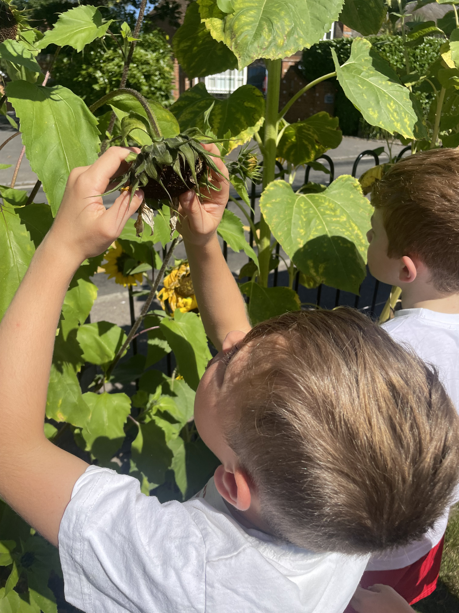
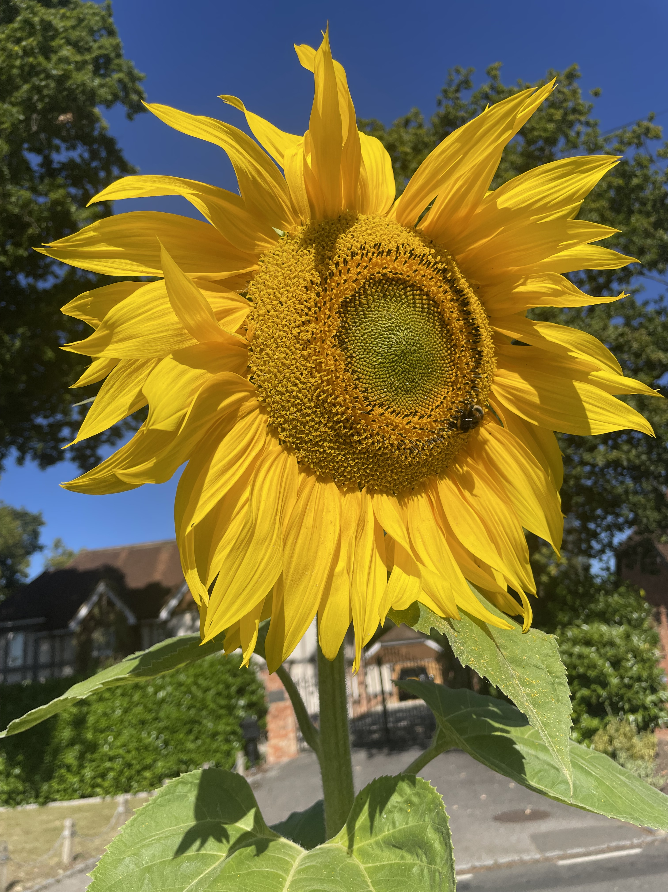
Welcome to Bullfinch

Slide 2
We have all of year 2 and some year 1 in our class – More year 1 may join us throughout the year.
Monday, Tuesday and Wednesday - Mrs Metcalfe
Thursday and Friday – Mrs Crowe
All week – Mrs Bardsley

Slide 3
What the children need every day:
A water bottle
A packed lunch or school meal ordered through the office
A snack – we do provide this, but many children prefer their own. We do ask that this is fruit or veg rather than any fruit winders etc.
A book bag with their reading record and books in.
A coat/sunhat – weather dependent!
We have PE on a Tuesday and Thursday– please come in PE kit on these days. Shoes with Velcro please, unless they can do their own laces!

Slide 4
Our days usually follow the same format.
8.40-8.50 – children arrive
8.50 – Register
9.00 – Assembly
9.25 – Phonics and English
10.50 – break and snack
11.05 – Maths
12.10 – Lunch
1.10 – Afternoon Curriculum
3.00 – Story
3.15 – Hometime
The children use our visual timetable to know which subjects are being taught each day. There are also plenty of learning through play opportunities each day.

Slide 5
Monday News Sharing!
We share news each Monday and give each child in the class a chance to share something from home.
It might be something interesting they have found on a nature walk, an award, a drawing or a model created at home.
We encourage toys to stay at home, unless there’s just been a birthday or a special reason for a gift.

Slide 6
Reading
Your child will read every day in school either independently, in a pair, in a group or 1:1 with an adult.
Books will usually come home at one or two points during the week depending on their phonic groups.
Please try and read with (and to) your child every day and record this in their reading record.
Spellings
Spellings are sent home on a Friday
Tested the following Thursday

Slide 7
The website
https://www.finchampsteadschool.org/
Volunteers
We’d love regular and ad hoc helpers in our class!
Any Questions?

