Slide 1
Chaffinch Class – Summer 2020
A collaborative project on Europe

Slide 2
Project Learning Objectives
Locate European countries on a map.
Identify human and physical characteristics of your chosen European county.
Share your learning with others when back at school.
Compare geographical similarities and differences between European countries including the United Kingdom
Notes:
Set the context of the lesson and explain lesson objectives. Explain to the children they do not have to memorise all European countries.

Slide 3
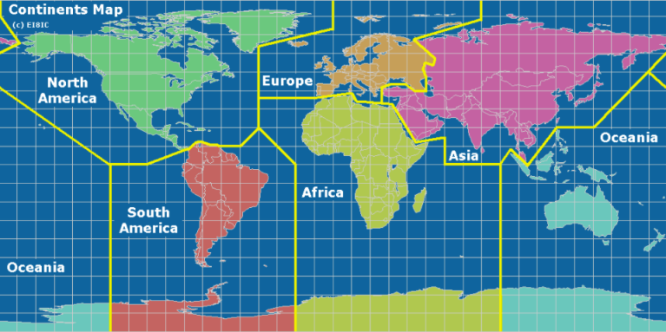
Continents
Can you name any continents ? A continent is a massive area of land that is separated from others by water or other natural features. There are seven continents on Earth and together they cover one third of the world, with the oceans covering the other two thirds.
There are SIX in total!
Notes:
Offer the opportunity for the children to contribute anything they may know. Dispel any misconceptions or confusion with countries. Reveal the six continents (EI8IC, 2015).

Slide 4


Time to Travel
Our tour of Europe…
Click on the blue writing and it will take you to a presentation on prezi. Then use the arrows at the bottom of the presentation to show famous landmarks for each country with a map pin.
Notes:
Click on the link to open the Prezi presentation. Explain that we are going to take a short tour of some of the countries in Europe. Make it clear that part of Russia is also in Europe and show them where this is on the map. If they have anything they know about the country (friends, family, general knowledge) encourage them to raise their hand and contribute as we visit them.

Slide 5
European Country project
Choose a country other than the United Kingdom from the ones we have visited: Spain, Germany, Italy, Greece, Sweden, and France.
You can use books, maps, magazines, interviews and the internet to find out the following facts….
(Don‘t worry if you cant find them all, we can search when back at school)
Notes:
We are going to carry out investigations into the countries we have ‘visited’. They can choose for themselves but cannot pick the UK-we are trying to find out about European countries we are not so familiar with. Encourage them to pick the least familiar to them.

Slide 6
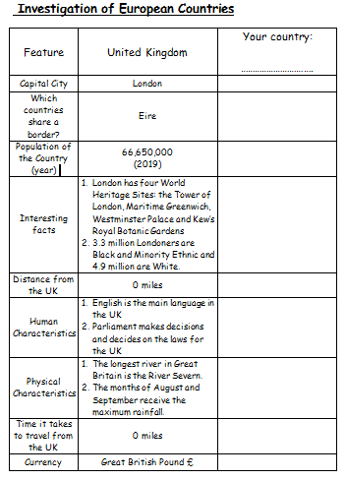
First Facts First
This worksheet is on the chaffinch page. You can either print it off or write out the facts for your country. (You don’t have to write out the UK facts too)
Notes:
The children will have a copy of the worksheet above so that they can use it as an investigation sheet. Answer any questions and give any clarification.

Slide 7

Over to you…
Types of food? landmarks?
Religion?
Famous
You have now made a page for your project.
What else will you add?
How will you organise your project?
How will you make it interesting to engage the reader?
Make it a
journey?
Write a postcard?
Chatty style?
Rivers ?
Mountains ?
Beaches? Other physical features?
Contents?
Illustrations? Index?
Glossary

