Slide 1
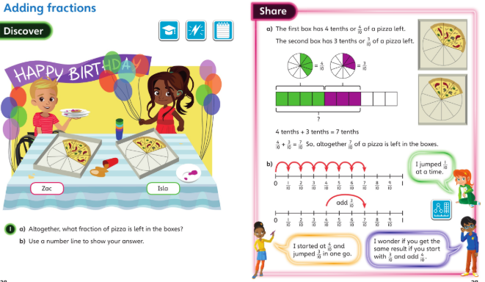
Monday 27.4.2020 Year 3 Maths Modelled examples
Discuss these pages with your carer then complete your workbook for Lesson 6.

Slide 2
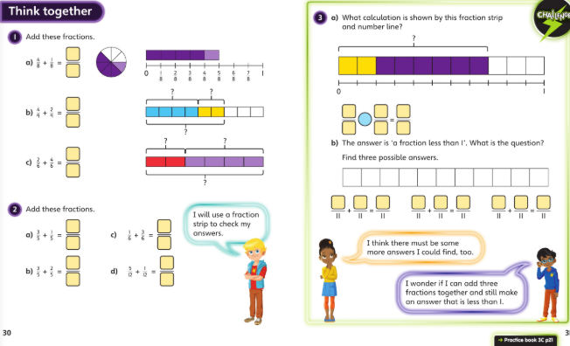
Monday 27th April 2020 -

Slide 3
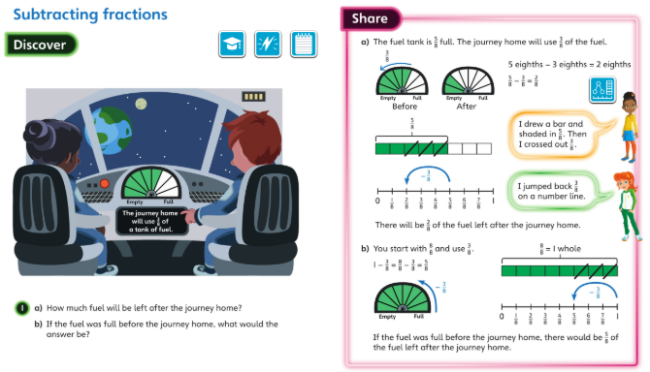
Tuesday 28.4.2020 lesson 7 Year 3 Maths Modelled examples

Slide 4
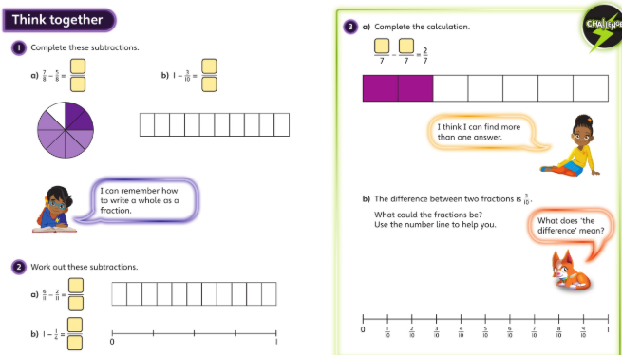
Discuss these with your carers and then complete Lesson 7 page 24 onwards

Slide 5
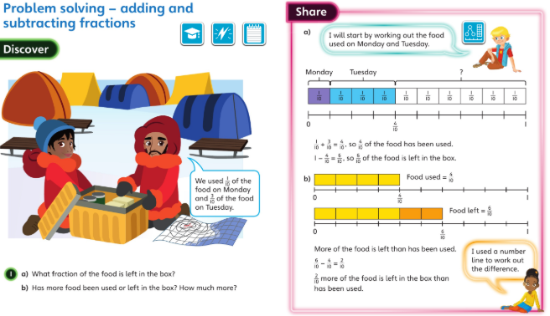
Wednesday 29 April 2020 – modelled examples lesson 8

Slide 6
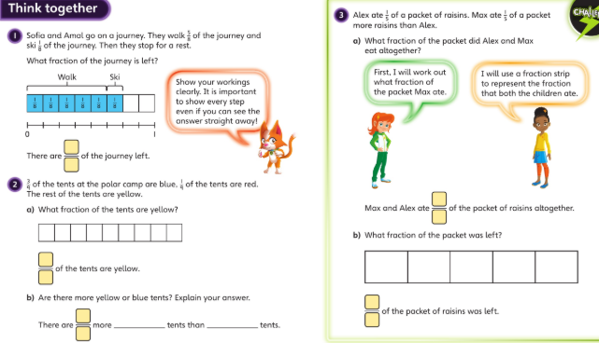
P27 in your books now …

Slide 7
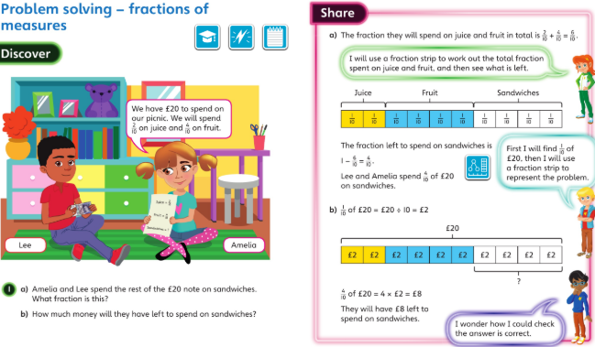
Thursday 30 April 2020 – modelled examples

Slide 8
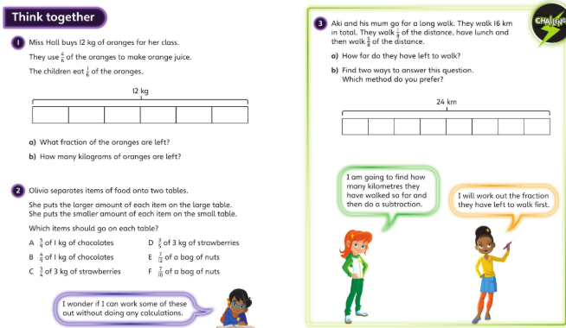
When you’ve discussed this page try the questions on lesson 9 – page 30 onwards.

Slide 9
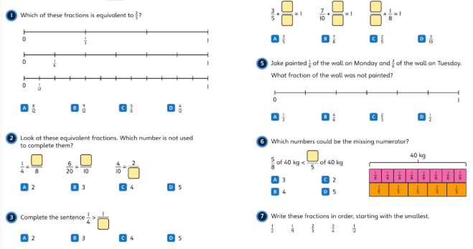
Friday 1st May 2020 – well done you’ve finished the unit on fractions. Try this check up : work this one through with someone then try the one in your book on your own. Write yourself a short SA at the end.

Slide 10
Please look over your work and check that you understand each lesson – the answers are on class page. Have your done your corrections?
Well done. Have a great weekend. x
Can you write your own question about:
Adding fractions with the same denominator?
Subtracting fractions with the same denominator?
Solving a problem with fractions?
Here’s my example…Charlie Monkey ate 3/8 of the bananas and Snowy ate 1/8. Mrs Farrell added another 2/8 to the bowl. What fraction were in the bowl now?

