Slide 1
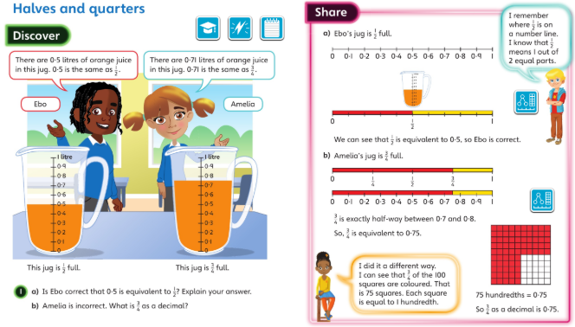
Monday 27th April 2020 – Year 4 examples: Discuss these Q’s then complete Unit 11 Lesson 6

Slide 2
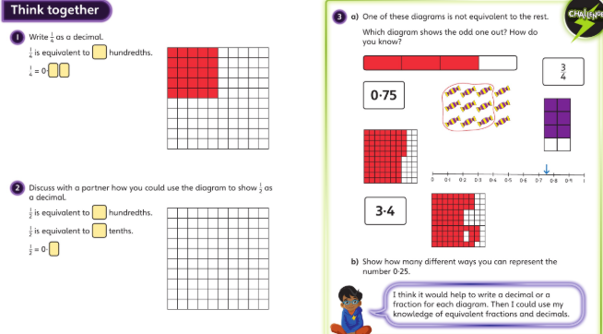
Now try your questions for L6 from page 21 of your new book.

Slide 3
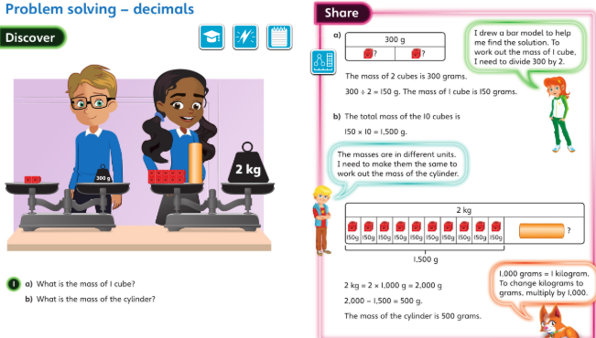
Tuesday 21.4.2020 Year 4 Maths Modelled examples

Slide 4
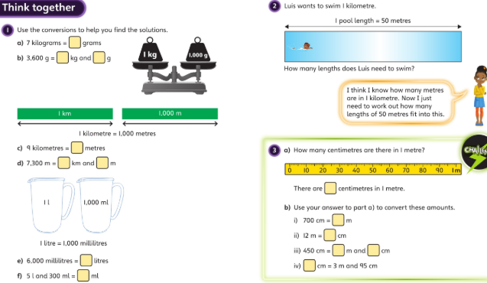
Discuss these with your carers and then complete Unit 11 Lesson 7 page 24 onwards

Slide 5
Wednesday 22nd April 2020 – strengthening our understanding
Work through the next 3 slides as today’s lesson and we will do the check up on Thursday.
Checking place value and the size of a number:
Clue: Make sure you don’t miss out the zero placeholders
Write down the number one and two hundredths as a decimal.
Write down the number one and 15 hundredths as a decimal
What is 3 and 7 hundredths as a decimal?
Can you write 3.09 in words?
Draw a place value grid and counters to show each of the above numbers.

Slide 6
Wednesday 22nd April 2020 – strengthening our understanding before a check-up
ANSWERS slide 1 Checking place value and the size of a number:
Clue: Make sure you don’t miss out the zero placeholders
Write down the number one and two hundredths as a decimal.
1.02
Write down the number one and 15 hundredths as a decimal
1.15
What is 3 and 7 hundredths as a decimal?
3.07
Can you write 3.09 in words?
Three and nine hundredths
Draw a place value grid and counters to show each of the above numbers. Eg 1 in the ones , nothing in the tenths and 2 in the hundredths column

Slide 7
Slide 2
Checking that for a number with one decimal place, the tenths digit determines what whole number the number will round to.
Do all these numbers round to 1 to the nearest whole number?
1·3, 1·4 and 1·8
Check by placing them on a number line and then decide which whole number they are closest to.
Which digit helps us to see which whole number to round to?
Can you round 1·9 4.5 and 2·2
to the nearest whole number without using a number line?
There’s a rounding game on purple mash you may enjoy…look in your to do

Slide 8
ANSWERS Slide 2
Checking that for a number with one decimal place, the tenths digit determines what whole number the number will round to.
Do all these numbers round to 1 to the nearest whole number? no
1·3, (1) 1·4 (1) and 1·8 (2)
Check by placing them on a number line and then decide which whole number they are closest to.
Which digit helps us to see which whole number to round to? tenths
Can you round 1·9 (2) 4.5 (5) and 2·2 (2)
to the nearest whole number without using a number line?

Slide 9
Wednesday 22nd April 2020 – strengthening our understanding before a check-up
SLIDE 3
When comparing decimals, always start by looking at the largest place value and then the next largest place value and so on.
1. Compare these two decimal numbers: 4·26 and 2·89
Which is greater – can you explain your reasoning? (Check children understand that ‘decimal number’ means the whole number,
not only the part after the decimal point.)
Some children may find it helpful to make the numbers with place value counters in a place value grid.
Did you notice that because there is a difference in
the greatest value column (the ones in this case), we can already decide on which number is larger and so there is no need to compare the other columns.
2, Compare these 3 decimal numbers 4.26 2.89 and 4·9 and put them in order largest to smallest.

Slide 10
Wednesday 22nd April 2020 – strengthening our understanding before a check-up
ANSWERS SLIDE 3
When comparing decimals, always start by looking at the largest place value and then the next largest place value and so on.
1. Compare these two decimal numbers: 4·26 and 2·89
Which is greater – can you explain your reasoning? 4.26 because 4 is greater than 2 so we don’t need to compare the number in the tenths and hundredths columns.
2, Compare these 3 decimal numbers 4.26 2.89 and 4·9 and put them in order largest to smallest.
4.9 4.26 and then 2.89
This time we cant just look at the ones column as two numbers start with 4 so we look at the tenths. 9 tenths is greater than 2 tenths so we know 4.9 is bigger than 4.26

Slide 11
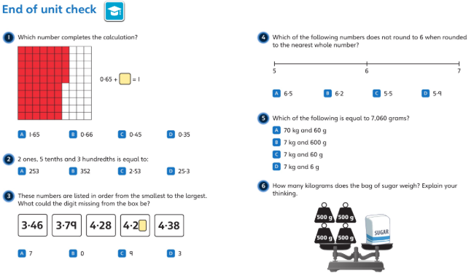
Thursday 30th April 2020 – end of unit check look at this page together then try on your own in the practice book page 27

Slide 12
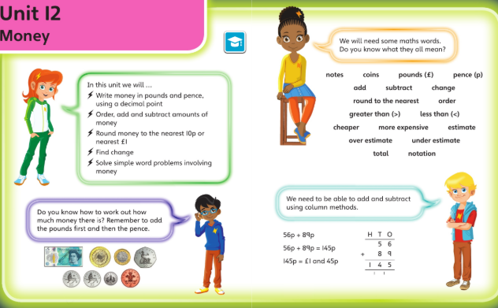
Friday 1st May 2020

Slide 13
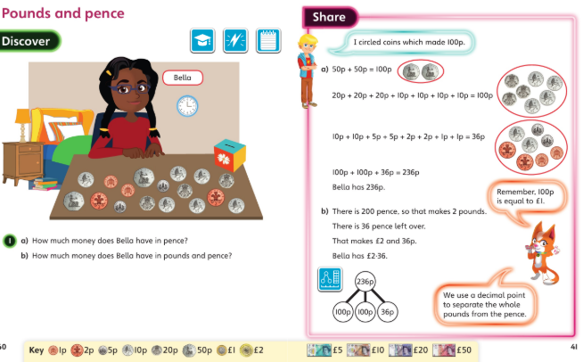
Friday 1st May 2020 talk through this work then try the first lesson on money in your book

Slide 14
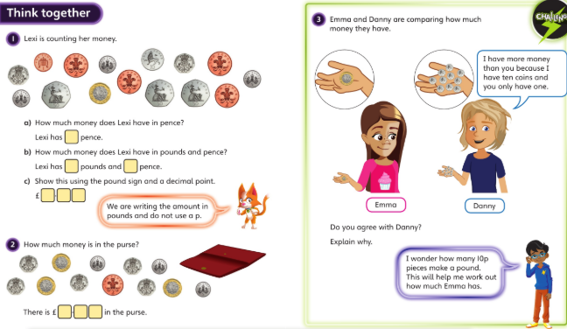
Now try Unit 12 L1page 29 onwards on your book.
Now

