Slide 1
Unit 12 – Money – Parent Notes
There are 9 lessons and 1 assessment lesson for this unit. (10 days) lesson 1 was last Friday. This week we have four lessons as Friday is a Bank Holiday
Chaffinch have already worked with money and decimals. Now we will learn how to write about money using £·p.
Children should already be confident in knowing that 100p is equal to £1 and should be able to work out how much money is shown in notes and coins.
We have also covered how to convert between pounds and pence, to round amounts to the nearest 10 and 100 and to use a variety of methods to count money.
To support learning and go deeper:
  Try to find everyday situations where you can explore the minimum number of coins needed to make particular amounts or ask how many ways they can make a given amount.
For example, find all the ways of making 50p using their times-table knowledge.
  10 lots of 5p coins (10x5) , 5 10p coins, 25 2p coins, or 4 x 5p + 3 x 10p etc

Slide 2
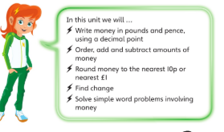
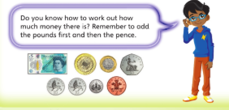
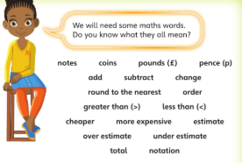
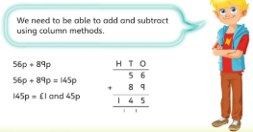

Slide 3
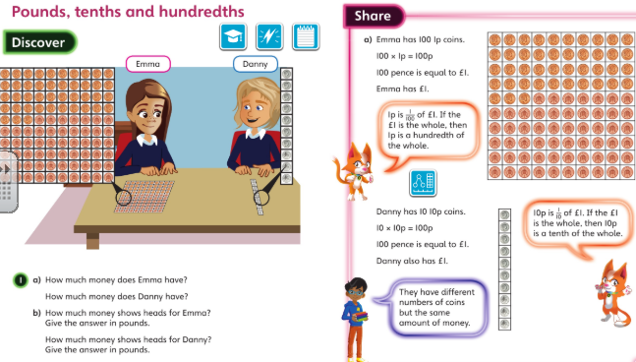
Monday 04.05.2020 Y4 examples: Discuss these Q’s then complete Unit 12 Lesson 2

Slide 4
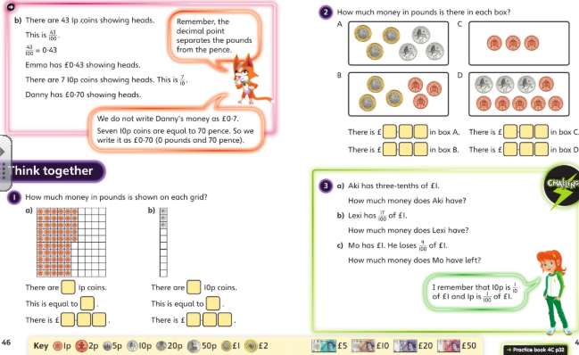
Now try your questions for L2 from page 32 of book C.

Slide 5
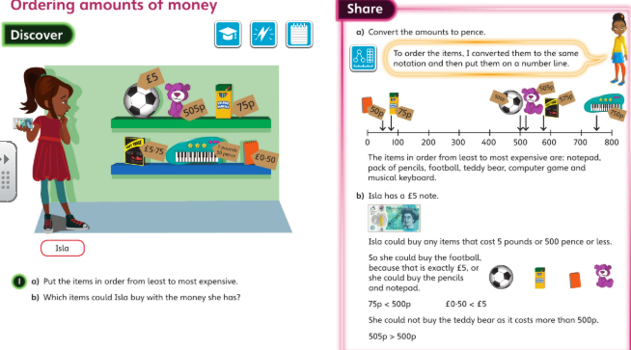
Tuesday 05.05.2020 Year 4 Maths Modelled examples

Slide 6
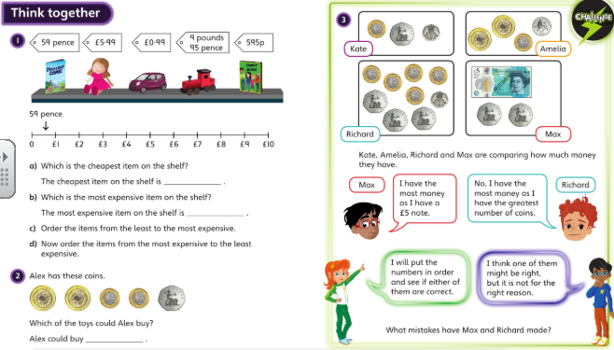
Discuss these with your carers and then complete Unit 12 Lesson 3 page 35 onwards

Slide 7
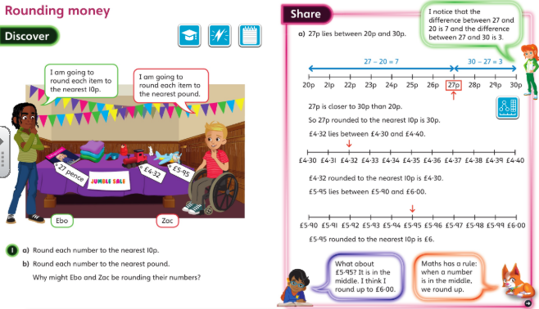
Wednesday 06.05.2020 – modelled examples

Slide 8
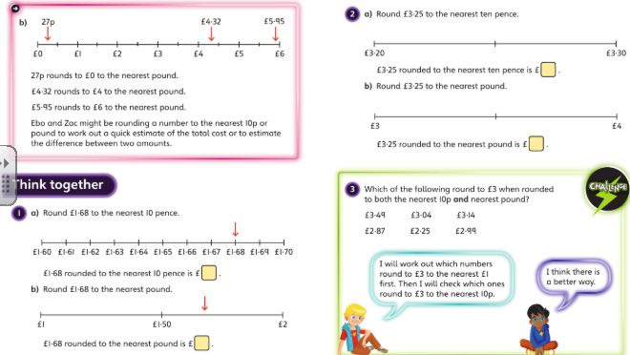
Wednesday 06.05.2020
Now try your workbook Lesson 4 page 38 onwards

Slide 9
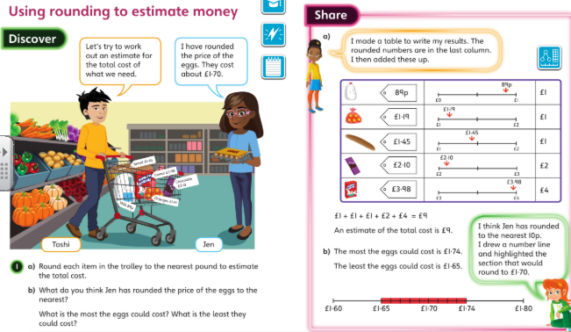
Thursday 07.05.2020 - modelled examples

Slide 10
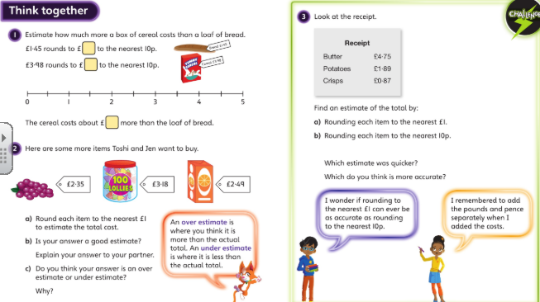
Try these examples too then do questions for L5 on page 41 onwards.

Slide 11
Friday 8st May 2020 Bank Holiday VE DAY

Slide 12
Now try Unit page onwards in your book.

