Slide 1
Unit 11 – Time – Parent Notes
There are 11 lessons and 1 assessment lesson for this unit. (12 days)
This week we have four lessons as Friday in a Bank Holiday
Time is always a difficult concept to teach as we suddenly go from counting in 10’s and multiples of 10 for place value to counting in 5’s and 12’s.
Patience and overlearning is key when learning to tell the time.
Children will begin by recapping their understanding of time from Year 2. They will develop a deeper understanding of the length of a year, a month, a day, an hour, a minute and a second, and will use this to solve problems involving reading and measuring time.
They should already know the number of minutes in an hour, and start to be able to read and write time on a clock to five minutes, know the days of the week and months of the year in order – worth checking and helping fill the gaps if you can.
Mastery Expert tip! Look for real-life learning opportunities as the unit progresses. Ask children to write their daily timetable using 12- and 24-hour time, and to ask other family members which they prefer and why. They can then discuss why they think one is more popular than the other.

Slide 2
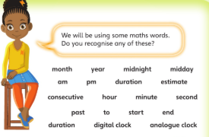
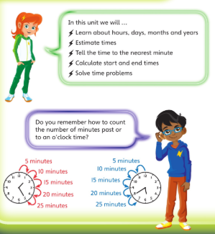
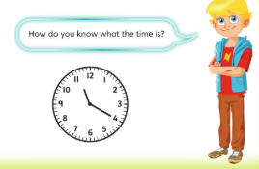
Recap your learning so far

Slide 3
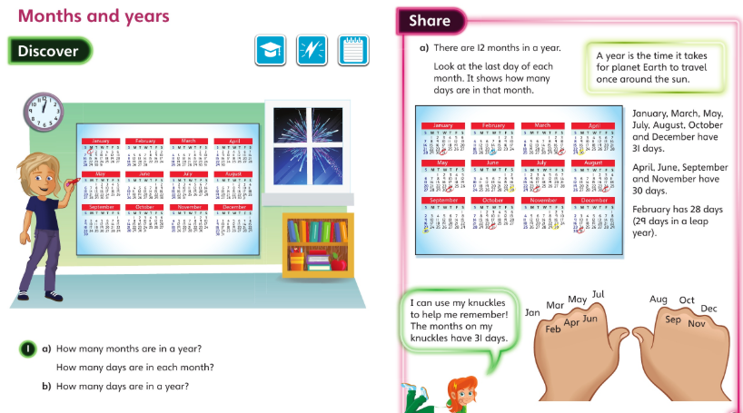
Monday 04.05.2020 Year 3 Maths Modelled examples
Discuss these pages with your carer then complete your workbook for Unit 11 Lesson 1.
If the month is ‘down a dip’ it has less days in it. Months on the knuckles always have 31 days – amazing how the world works isn’t it Chaffinch!

Slide 4
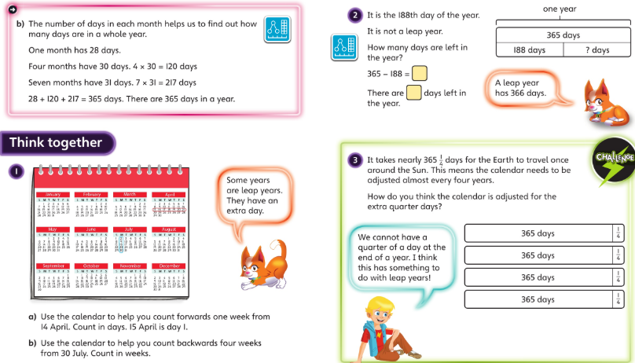
Monday 4 May 2020 - now it’s your turn for lesson 1 page 35 please

Slide 5
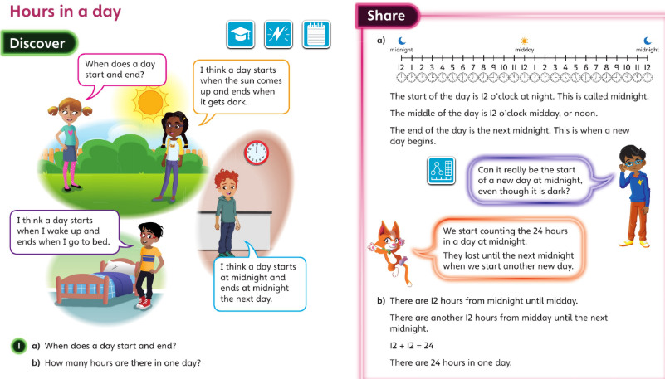
Tuesday 05.05.2020 lesson 2 Year 3 Maths Modelled examples

Slide 6
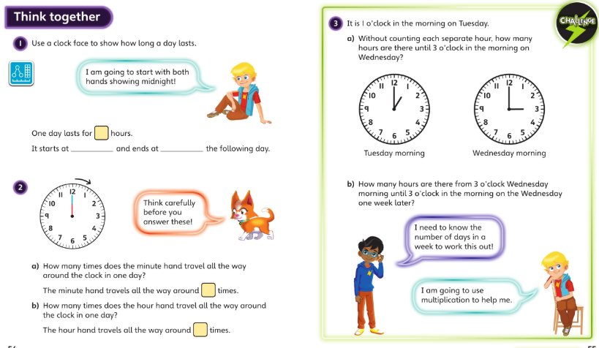
Discuss these with your carers and then complete Lesson 2 page 38 onwards

Slide 7
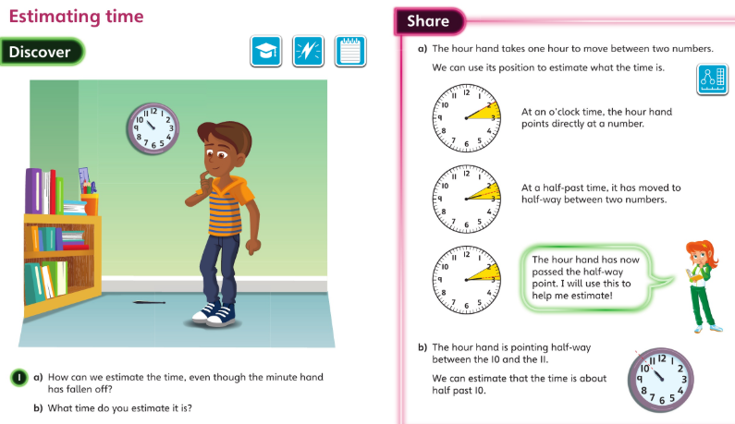
Wednesday 6 May 2020 – modelled examples lesson 3

Slide 8
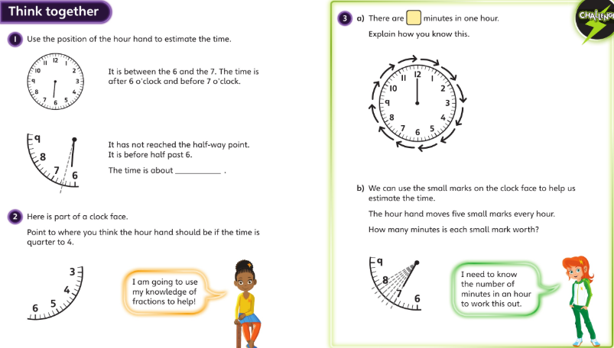
P41 in your books now …

Slide 9
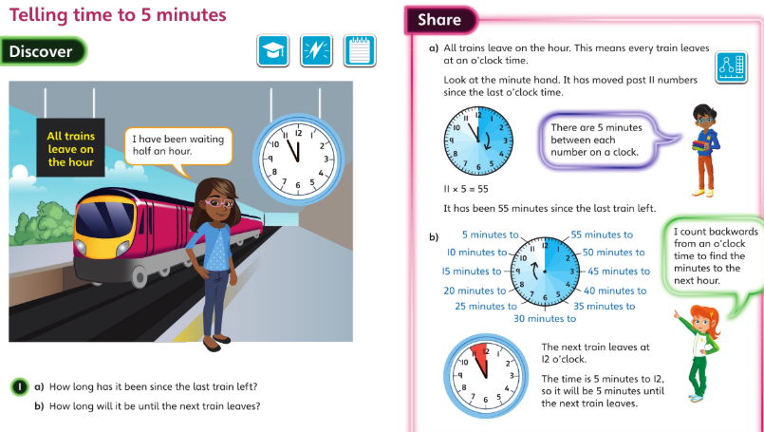
Thursday 7 May 2020 – modelled examples

Slide 10
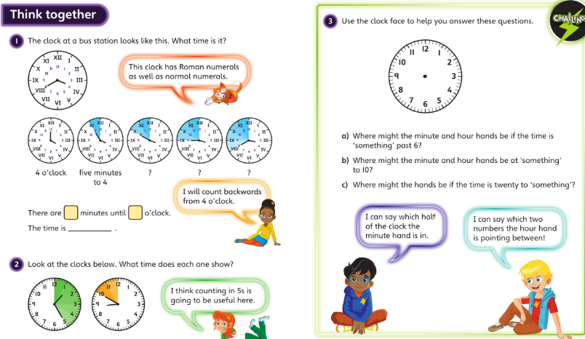
When you’ve discussed this page try the questions on lesson 4 – page 44 onwards.

Slide 11
Friday 8th May 2020 – Bank Holiday
You can still practice your x tables if you’d like some maths to do
Or practice telling the time in five minute intervals – it’s a tricky idea to master but resilience helps. Start with half past and quarter to and past then try the 5 minute intervals.

Slide 12
Please look over your work and check that you understand each lesson – the answers are on class page. Have your done your corrections?
Well done. Have a great weekend. x

