Slide 1
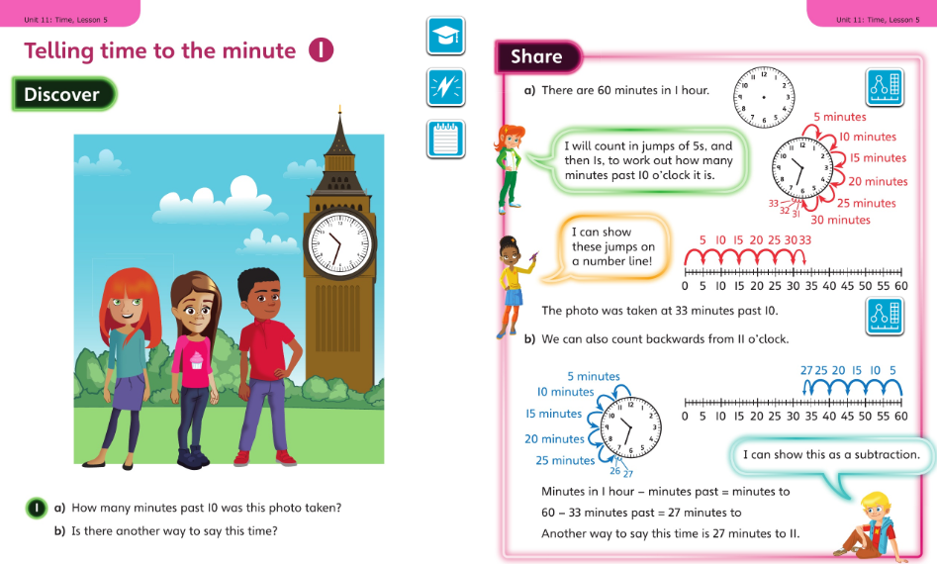
Year 3 worked examples for week commencing 11 May 2020
Monday’s slide 1:

Slide 2
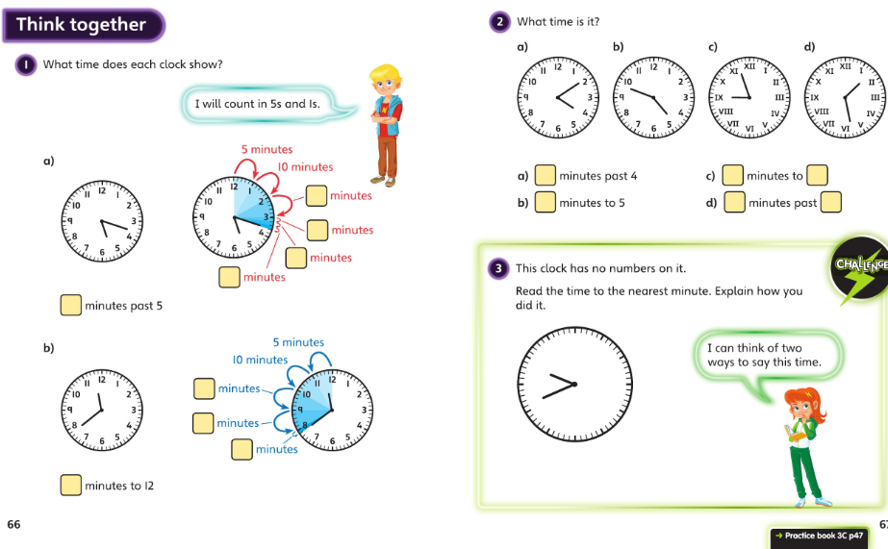
Year 3 for 11 May : slide 2 then page 47 onwards in your workbooks please

Slide 3
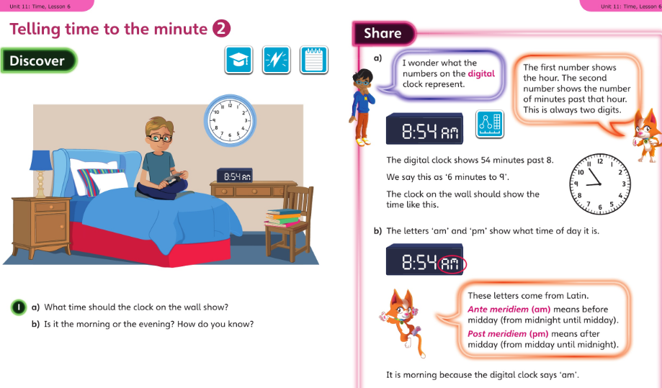
Year 3 for 12 May 2020

Slide 4
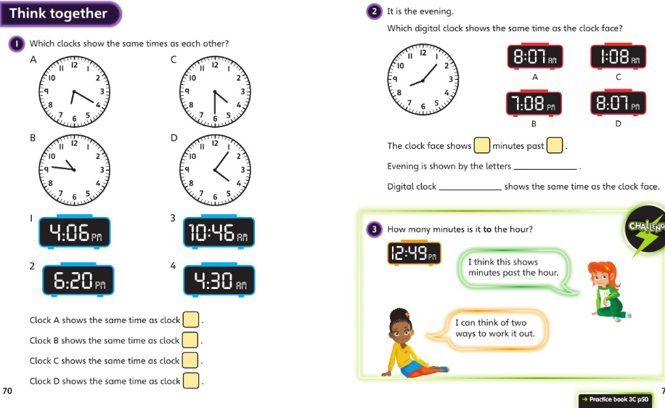
Year 3 for 12 May 2020 : slide 2 then page 50 onwards in your workbooks please

Slide 5
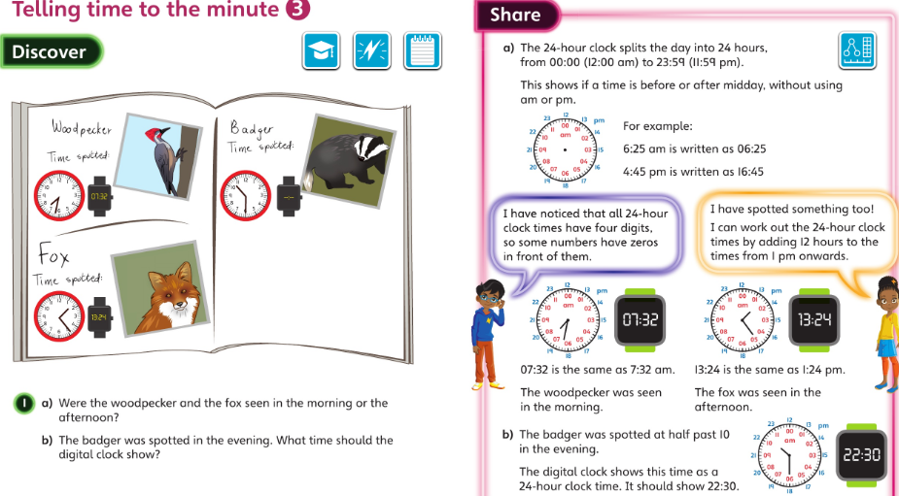
Year 3 for 13 May 2020 :

Slide 6
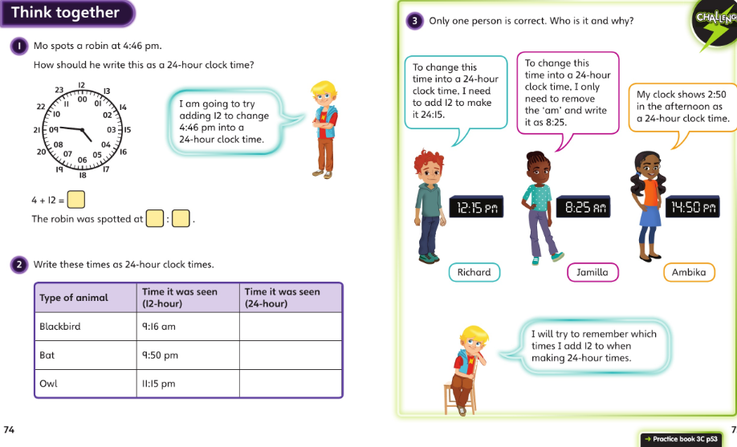
Year 3 for 13 May 2020 : slide 2 then page 53 onwards in your workbooks please

Slide 7
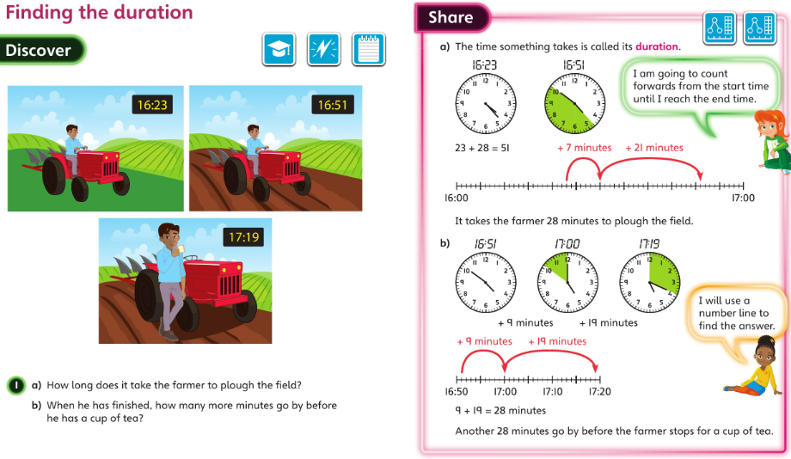
Year 3 for 14 May 2020 :

Slide 8
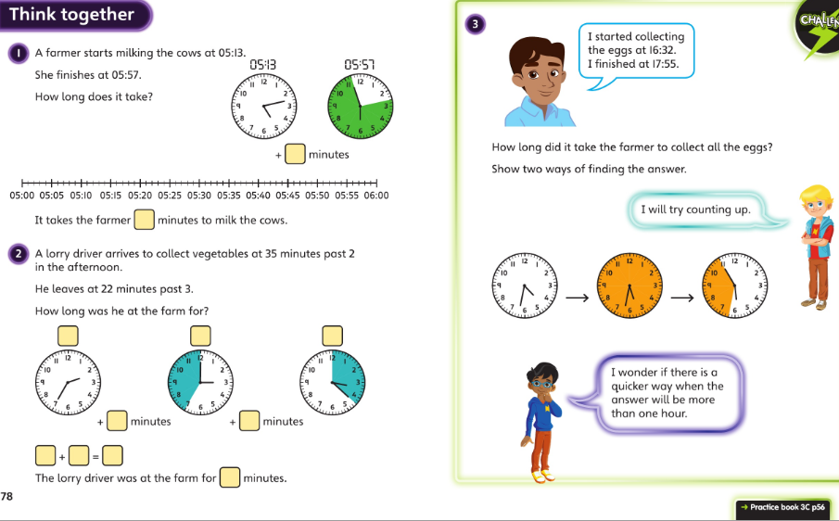
Year 3 for 14 May 2020 : slide 2 then page 56 onwards in your workbooks please

Slide 9
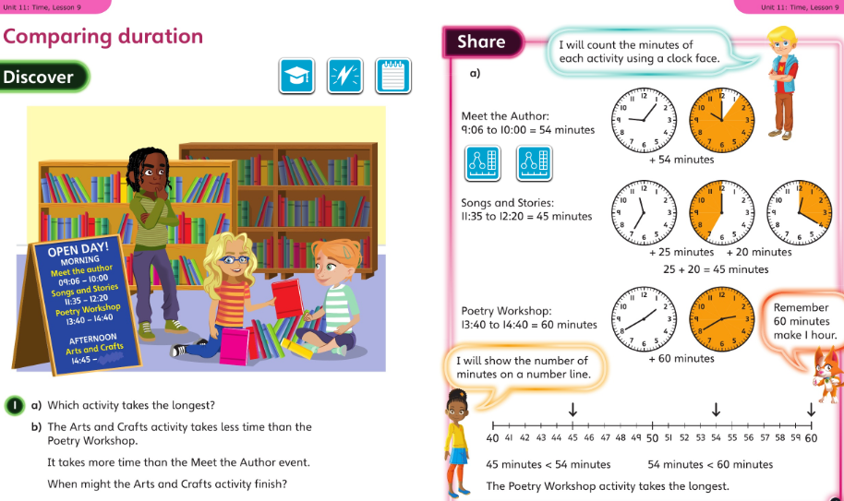
Year 3 for 15 May 2020 :

Slide 10
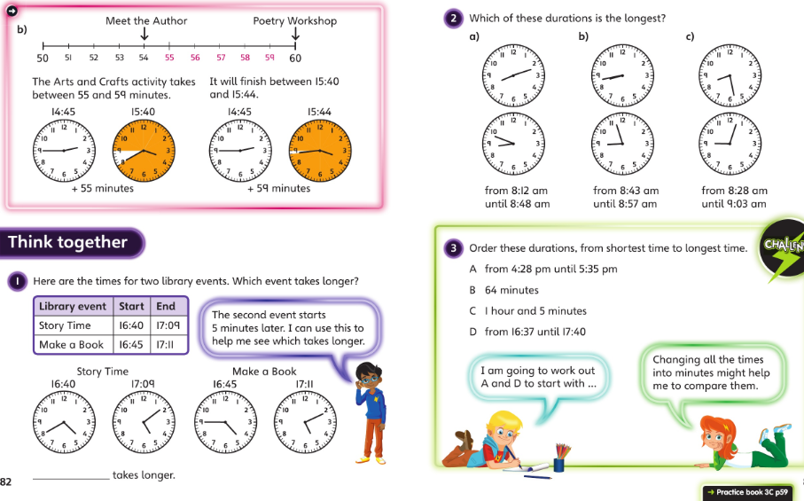
Year 3 for 15 May 2020 : slide 2 then page 59 onwards in your workbooks please

