Slide 1
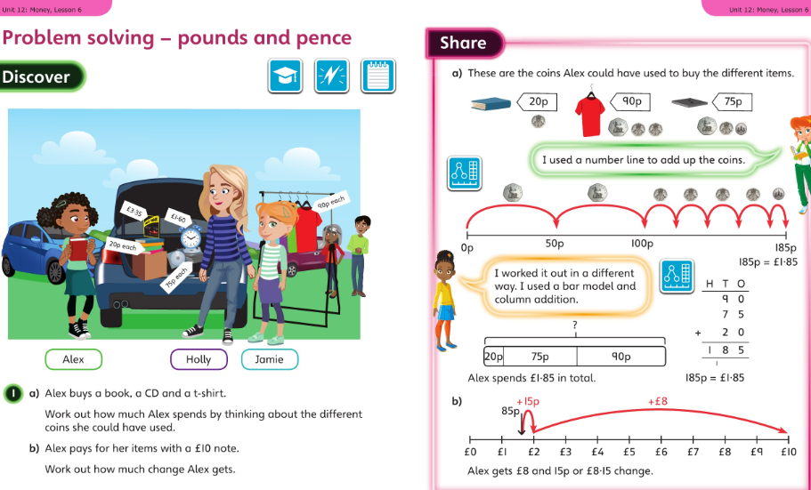
Year 4 worked examples for week commencing 11 May 2020
Monday’s slide 1:

Slide 2
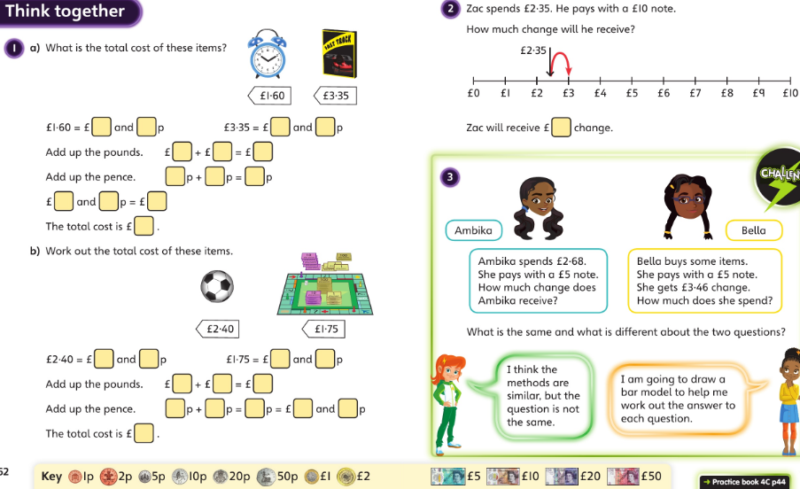
Year 4 for 11 May : slide 2 then page 44 onwards in your workbooks please

Slide 3
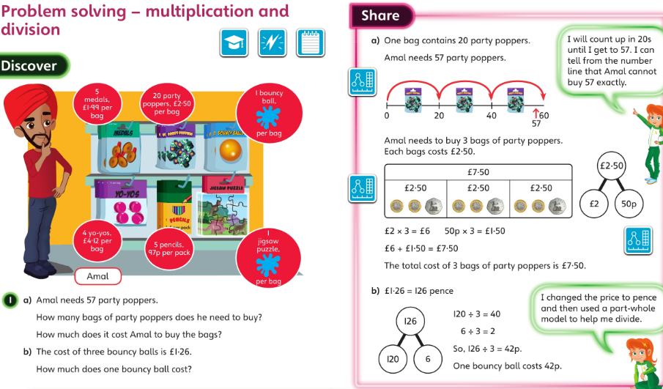
Year 4 for 12 May 2020

Slide 4
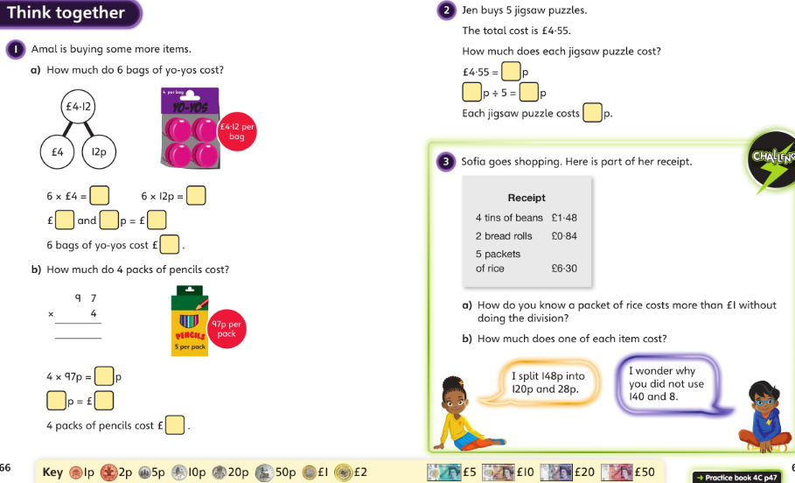
Year 4 for 12 May 2020 : slide 2 then page 47 onwards in your workbooks please

Slide 5
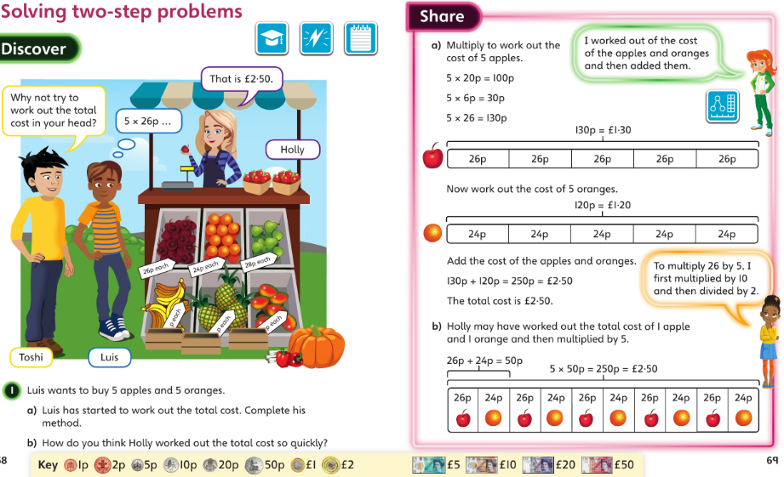
Year 4 for 13 May 2020 :

Slide 6
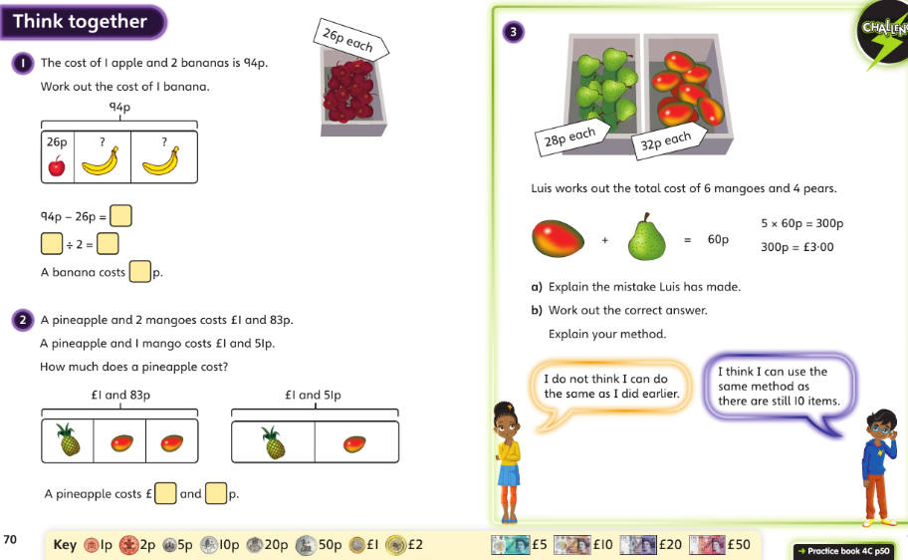
Year 4 for 13 May 2020 : slide 2 then page 50 onwards in your workbooks please

Slide 7
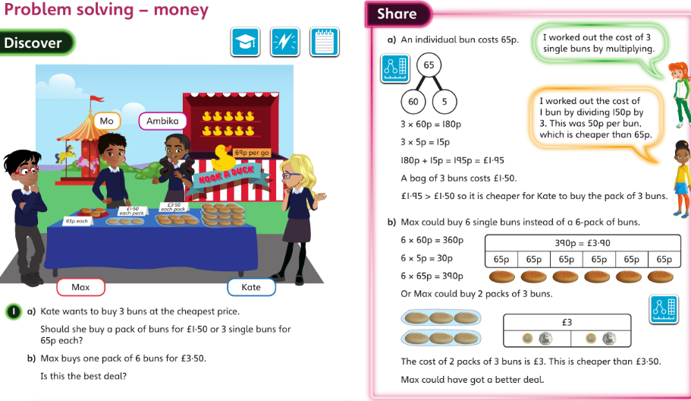
Year 4 for 14 May 2020 :

Slide 8
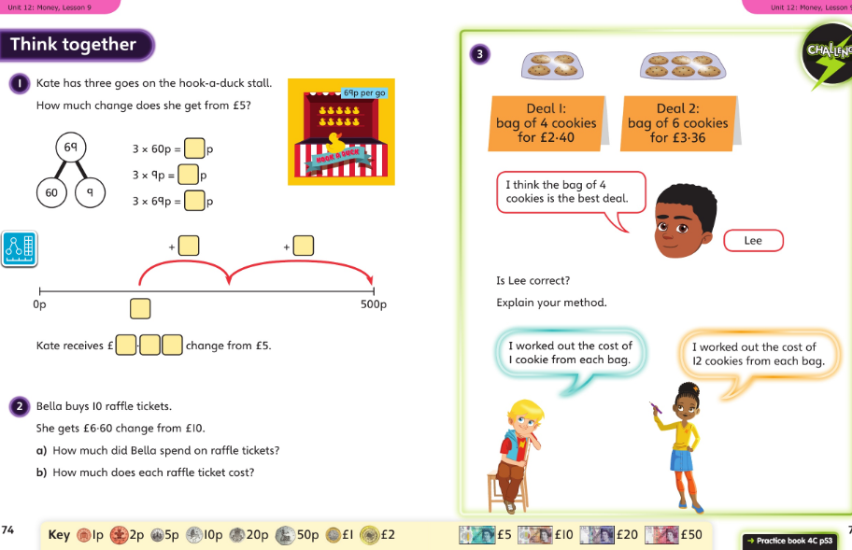
Year 4 for 14 May 2020 : slide 2 then page 53 onwards in your workbooks please

Slide 9
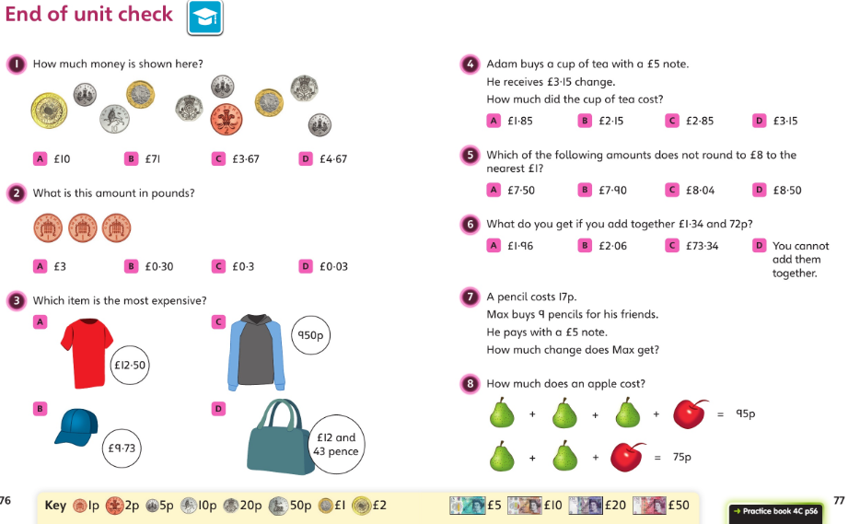
Year 4 for 15 May 2020 :

Slide 10
Year 4 for 15 May 2020 :
Please look back over this unit of work and see where you need a little extra practice.
Are you happy with all the vocabulary?
Can you write your own similar questions for each section of money? Can you answer them?
We’re moving on to TIME next week.

