Slide 1
Unit 12 – Time – Parent Notes
There are 5 lessons and 1 assessment lesson for this unit. ( covering 5 days – we will squeeze in the assessment on Friday so it doesn’t go over the half term)
Time is always a difficult concept to teach as we suddenly go from counting in 10’s and multiples of 10 for place value to counting in 5’s and 12’s.
Patience and overlearning is key when learning to tell the time. It may we worthwhile spending some time reviewing learning from Y2 an Y3 where children learn to: read and write times to the nearest minute, know the number of seconds in a minute, minutes in an hour and hours in a day, understand how to express 12-hour times digitally eg half past 3 = 3.30 and can understand the terms am and pm.
This unit will develop children’s ability to convert between units of time. eg 90 minutes = 1 and a half hours
Children will apply their knowledge of existing facts (for example, the number of minutes in an hour) when expressing a period of time using a different unit
of measurement.
Children will also be introduced to the concept of the 24-hour clock, learning to state the time as both a 12- and 24-hour clock time.
Children will solve problems using these new concepts and prior learning,

Slide 2
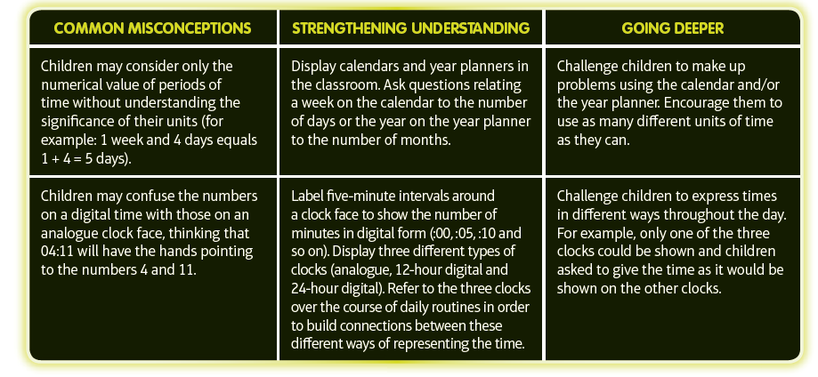
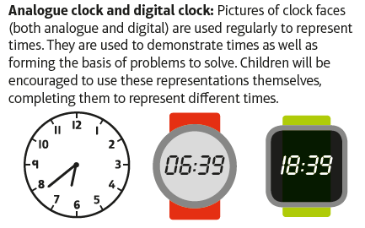
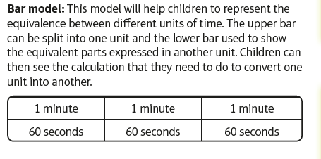
Unit 12 – Time – Parents notes 2

Slide 3
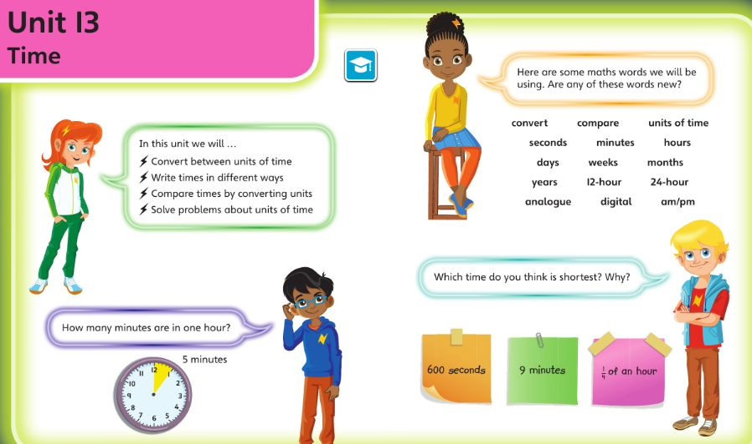
Monday 18.05.20 overview L1

Slide 4
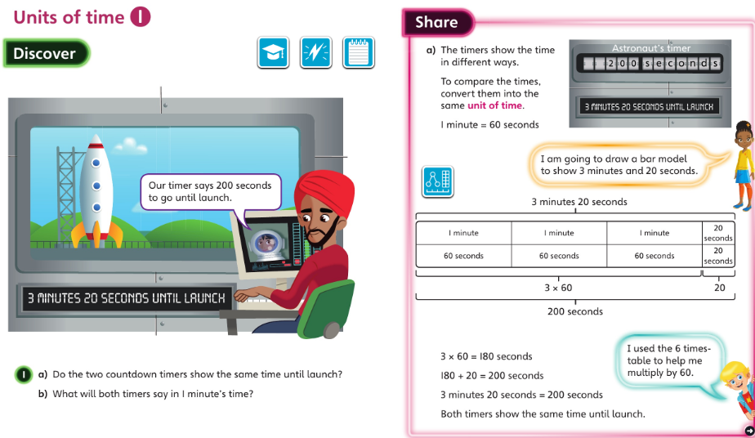
Monday 18.05.20 L1 talk together

Slide 5
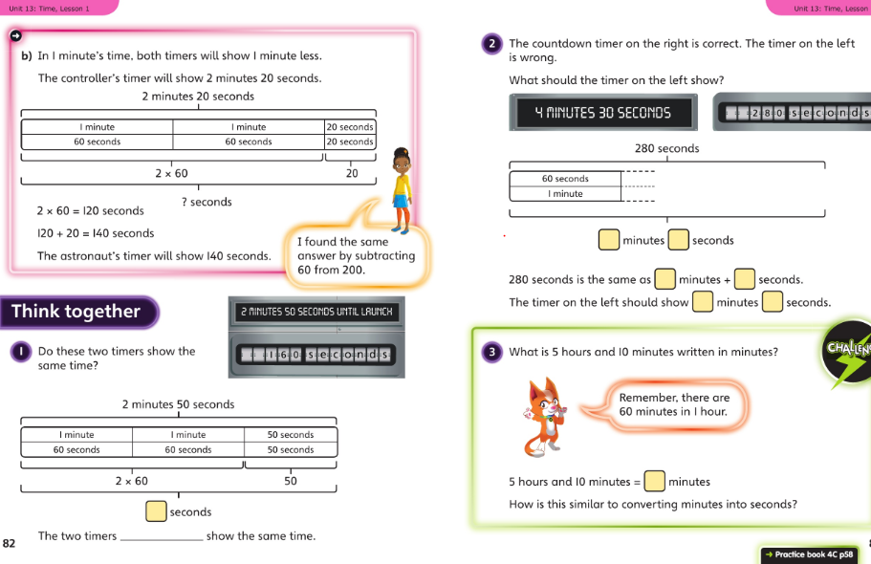
Monday 18.05.20 talk through then pg 58

Slide 6
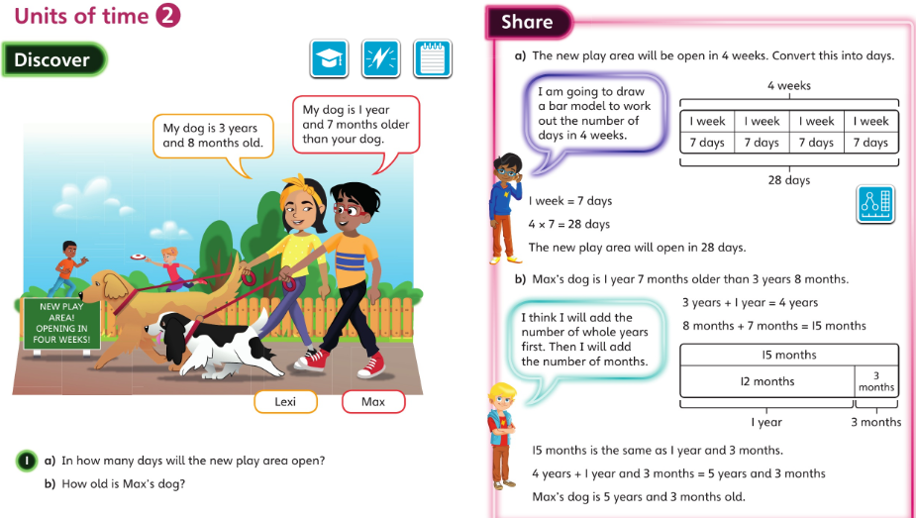
19.05.20 overview L2

Slide 7
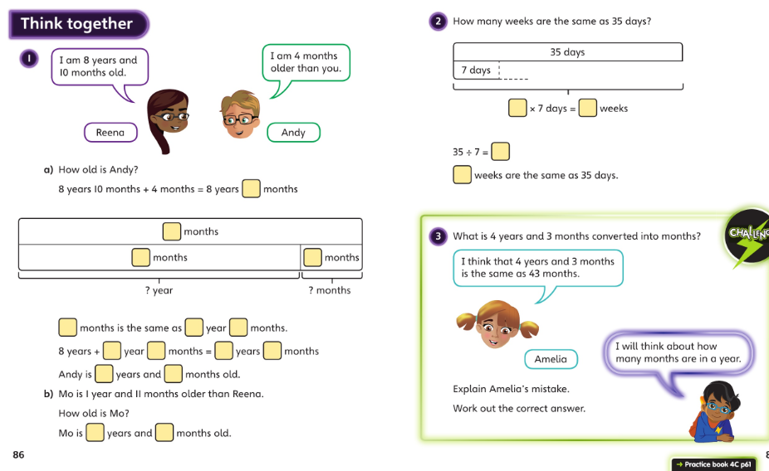
19.05.20 discuss then page 61

Slide 8
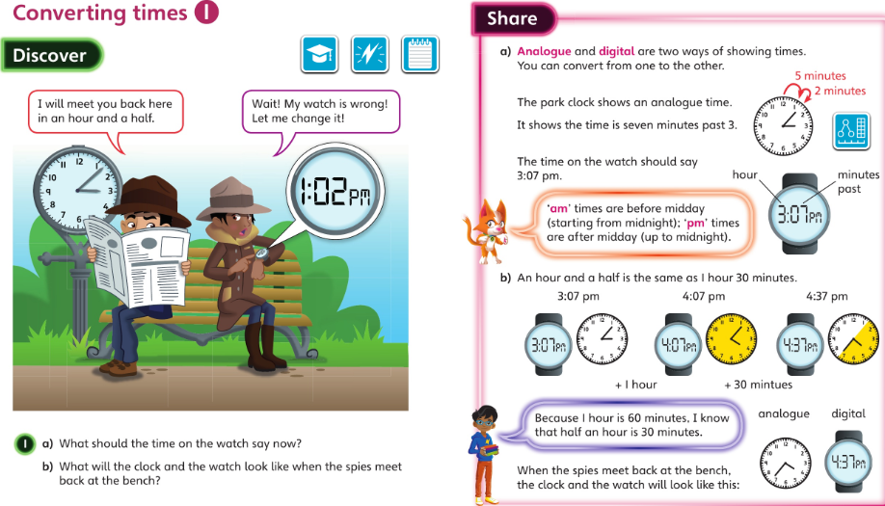
20.05.20 L3 talk through together

Slide 9
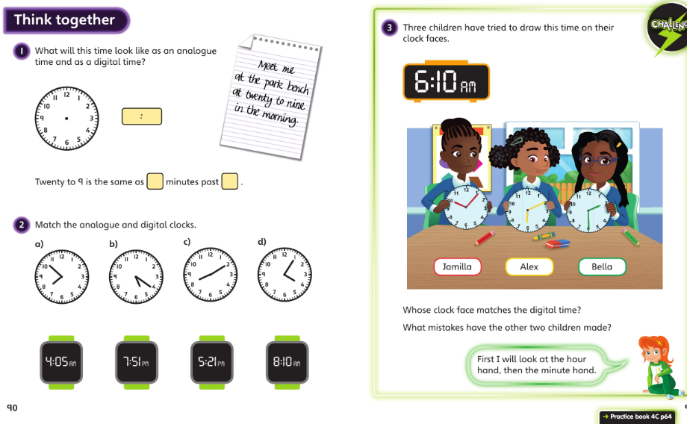
20.05.20 discuss then page 64

Slide 10
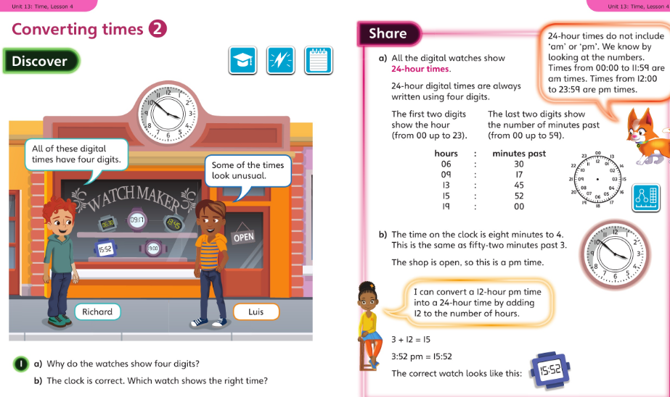
21,05,20 L4 discuss

Slide 11
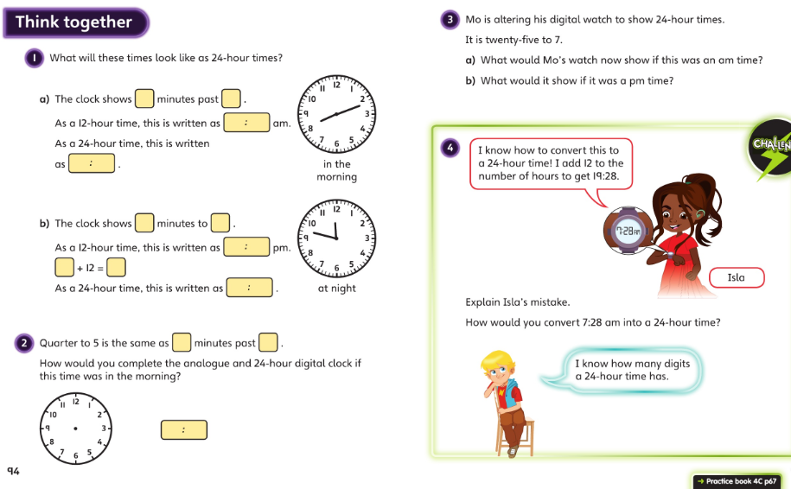
21.05.20 L4 work through then pg 67

Slide 12
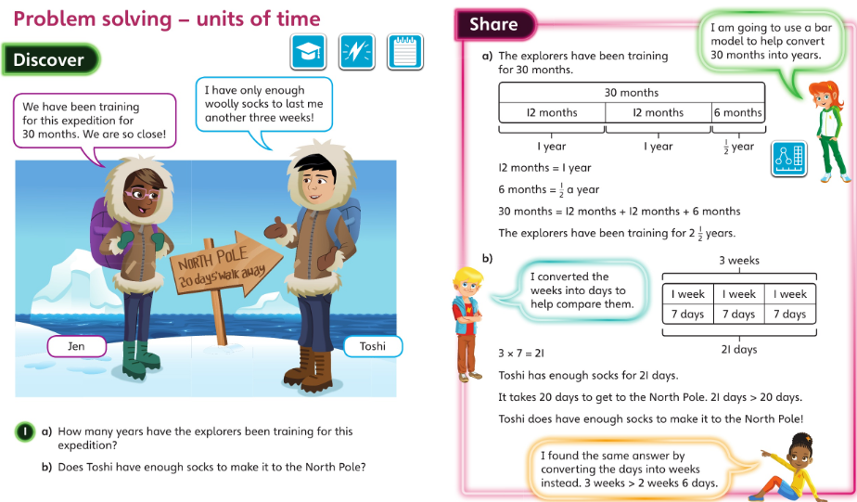
22.05.20 discuss together

Slide 13
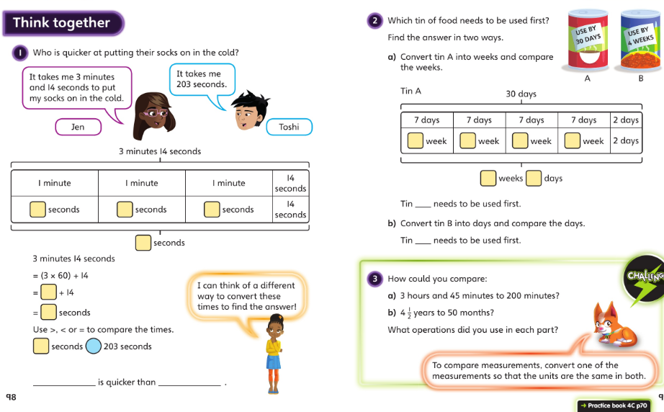
22.05.20 L5 discuss then page 70

Slide 14
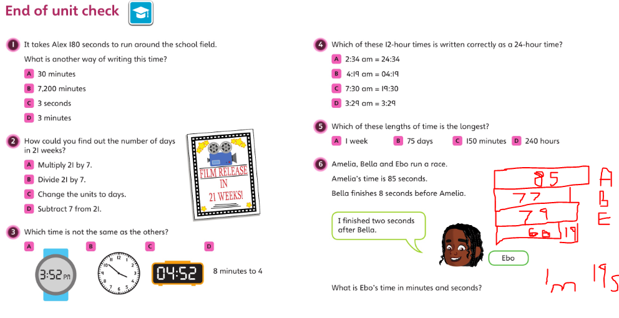
Talk through these challenges. Think about how you can use ‘jottings’ and ‘bar models’ to help you. Then complete the assessment in your book.

