Slide 1
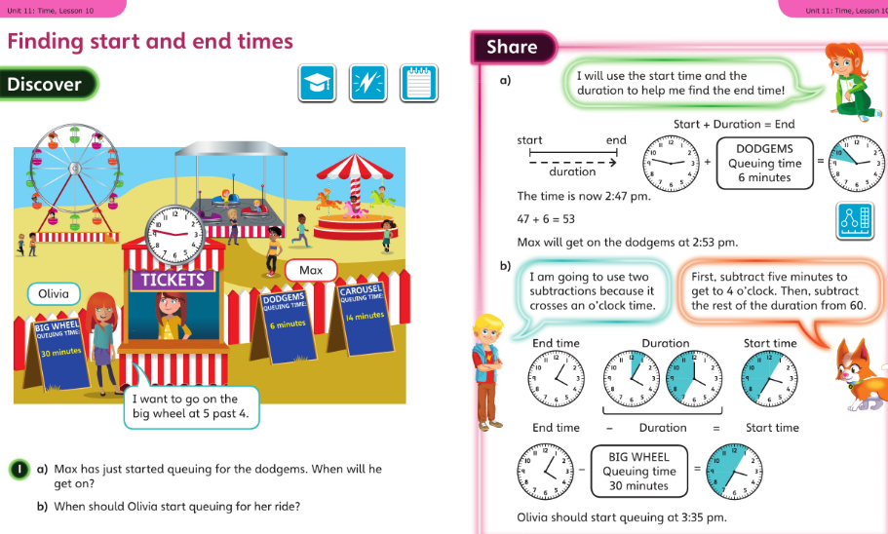
Year 3 worked examples for week commencing 18 May 2020
Monday’s slide 1:

Slide 2
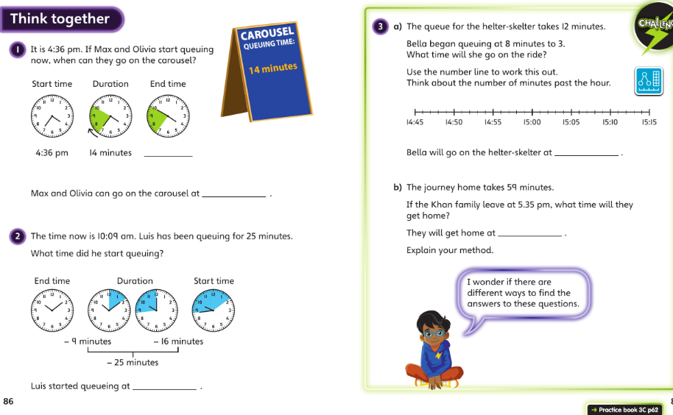
Year 3 for 18 May : slide 2 then page 62 onwards in your workbooks please

Slide 3
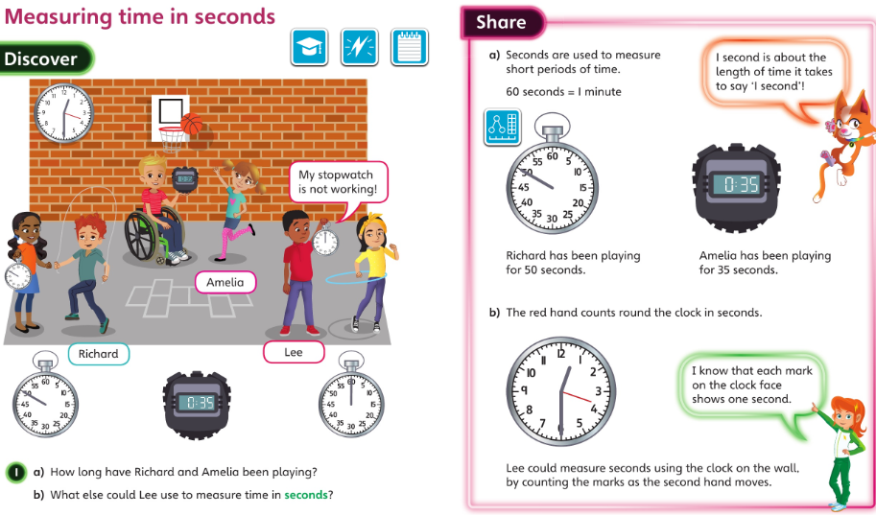
Year 3 for 19 May 2020

Slide 4
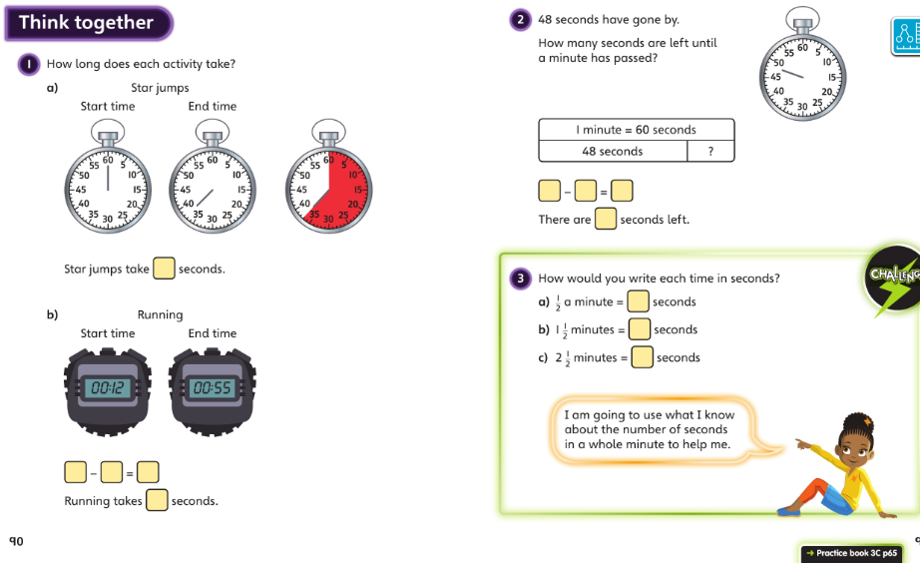
Year 3 for 19 May 2020 : slide 2 then page 65 onwards in your workbooks please

Slide 5
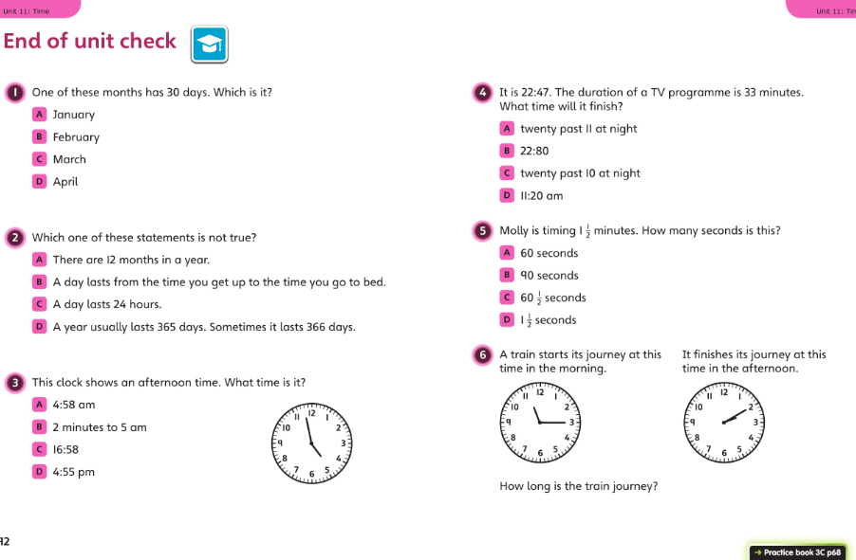
Year 3 Wednesday 20 May 2020 : work through this together then page 68 in workbooks please

Slide 6
Year 3 for Thursday 21st May 2020 and Friday 22nd May 2020
Time is difficult to learn (and to teach!)
Use your assessment from yesterday , and your work over the last couple of weeks, to think where you were challenged and use some of the extra resources in this weeks folder on the website to embed some of the ideas for today’s lesson please.
There are worksheets on telling the time and drawing hands on the clock face, games to play, or apps / website to challenge yourself on. – see next page
If you're confident with all that then please write some time duration question and answers to challenge yourself. - see next page
Which timetables help with telling the time? Are you confident with these times tables too?

Slide 7
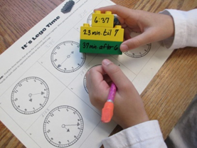
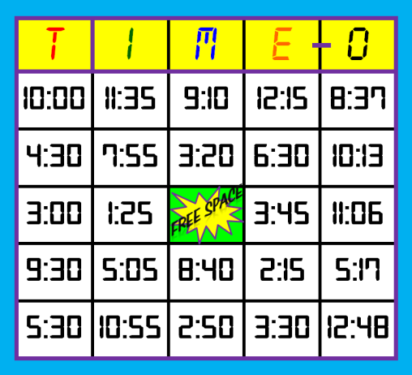
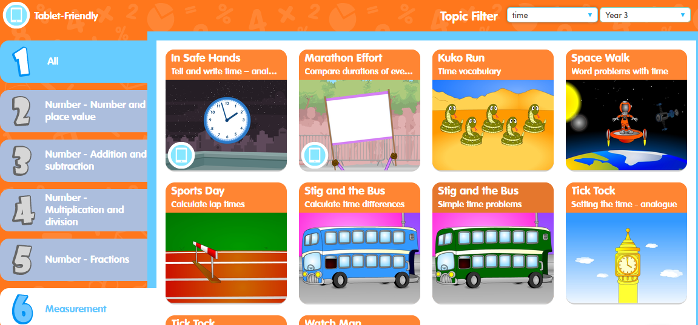
21.05.2020 Please see this weeks Chaffinch Class website for extra time resources
Education city – Year 3 Unit 6 select 6:measurement then filter on the top bar for ‘time’ and there are lots of really useful games and activities to hep ‘over learn’ the key ideas for time.

Slide 8
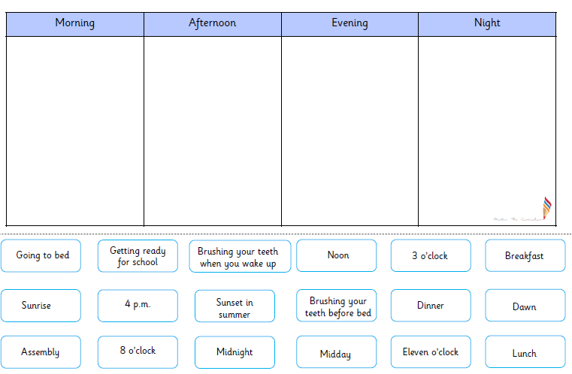
Friday 22 May 2020 – EITHER continue activity from 21st OR :
Work in your exercise book and make a table like the one below. Add each event to the correct column and add some of your own ideas – eg go for a walk, read a book.
Challenge: can you write the average duration of each activity in minutes or hours? Eg (going to bed 12 hours )

Slide 9


