Slide 1
Unit 12–Angles & Shape – Parent Notes
This unit explores the concept of right angles. Right angles are linked to the concepts of parallel, perpendicular, vertical and horizontal lines and are linked with the angle properties of 2D shapes.
Vertical and horizontal lines of symmetry are also explored and, finally, children describe and construct 3D shapes.
Angles are introduced to children as a measure of a turn, establishing that a right angle is a quarter turn, two quarter turns make a half turn, three right angles make a
three-quarter turn and four right angles make a full turn.
Children will learn that angles less than a right angle are called acute angles and angles greater than a right angle (but less than two right angles) are called obtuse angles.
Children will revise the names of 2D shapes. These include triangles (right-angled and isosceles), quadrilaterals (square, rectangle, rhombus, trapezium, parallelogram and kite) pentagons, hexagons and octagons.
Children will revise the names of 3D shapes: cube, cuboid, pyramid, prism, cylinder,
sphere and cone.
This unit will provide an important foundation for further development of the concept of geometry in later years, such as measuring and drawing angles accurately.

Slide 2
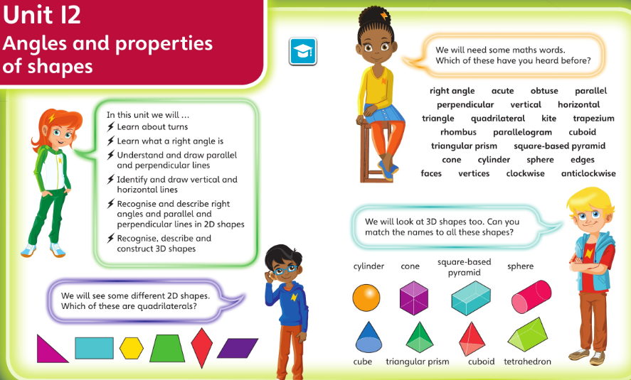
Check you’re happy with this vocabulary and these ideas before starting this unit

Slide 3
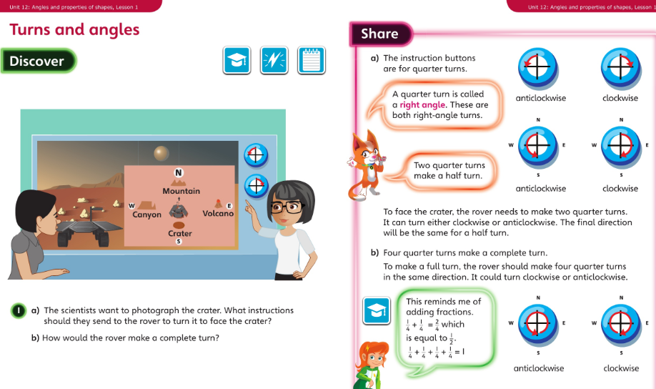
Monday 01.06.20 Overview L1

Slide 4
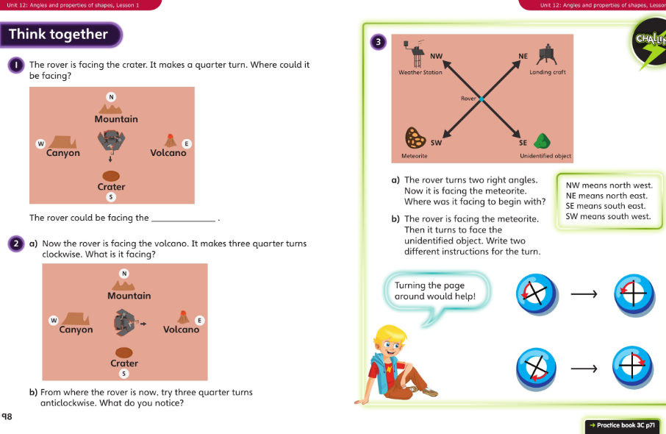
Monday talk together then pg71

Slide 5
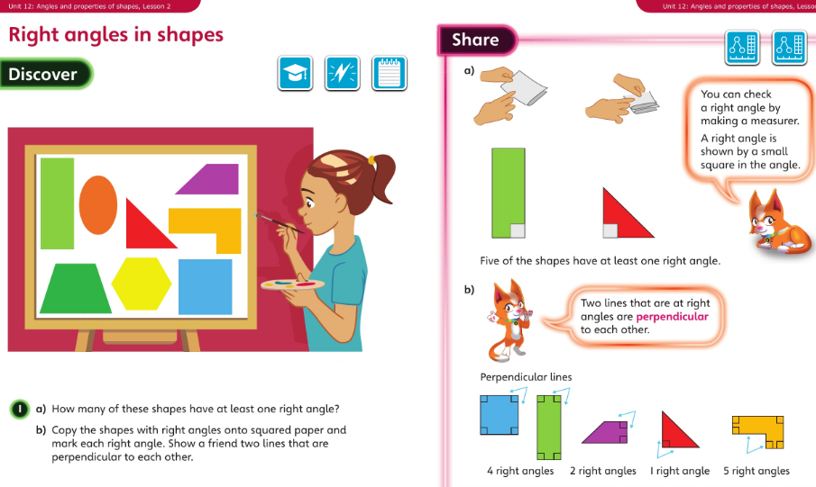
Tuesday 02.06.20 Overview L2

Slide 6
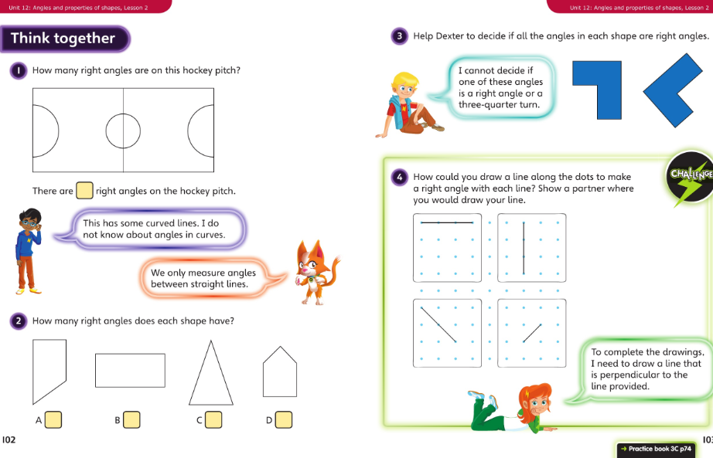
Tuesday Talk together then pg 74

Slide 7
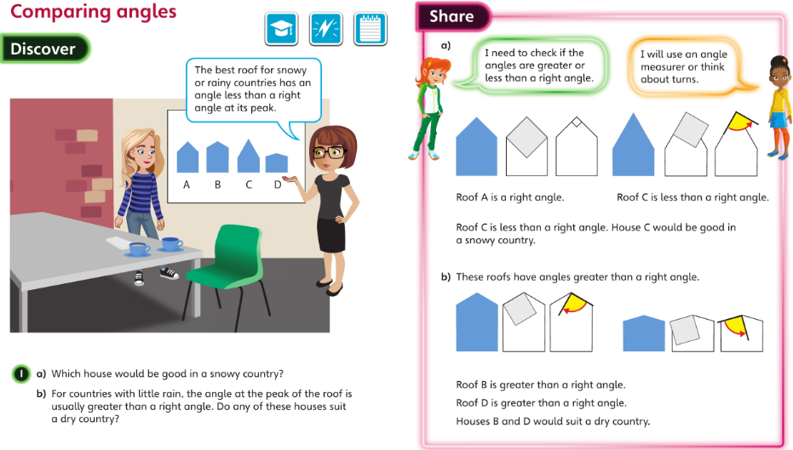
Wednesday 03.06.20 Overview L3

Slide 8
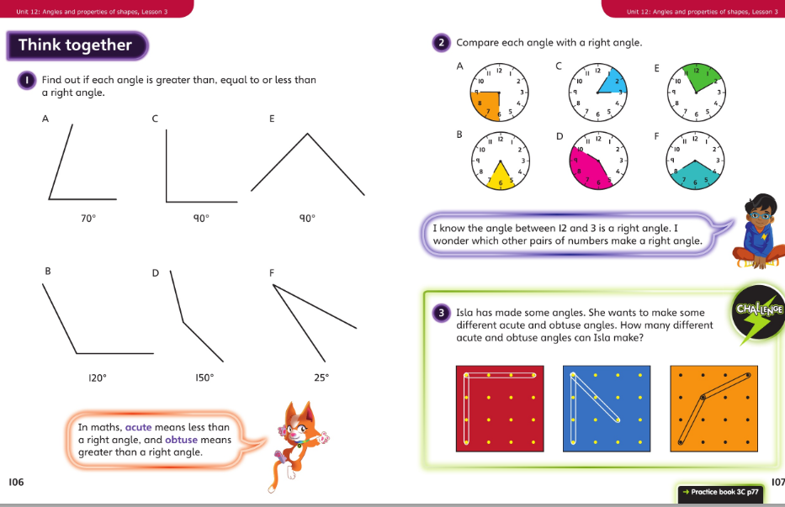
Wednesday talk together then page 77

Slide 9
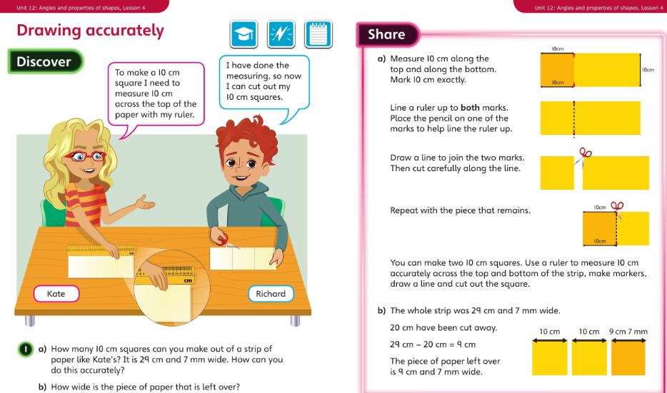
Thursday 04.06.20 Overview L4

Slide 10
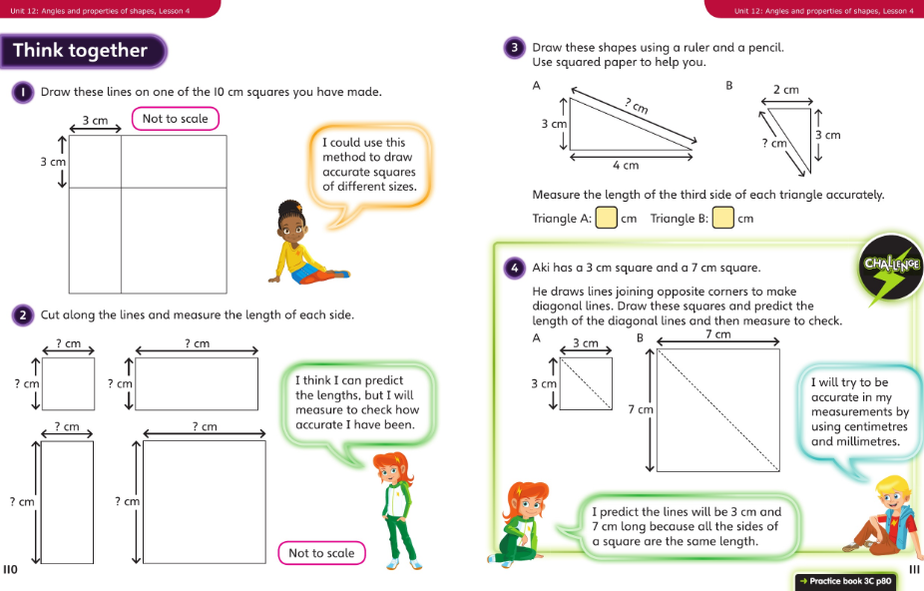
Thursday talk together then pg 80

Slide 11
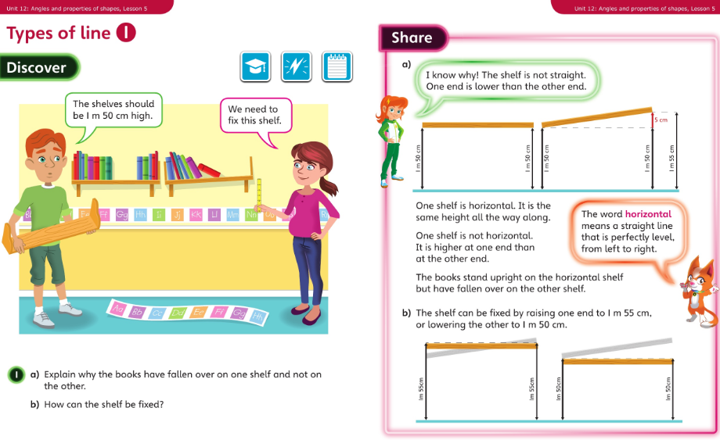
Friday 05.06.20 Overview L5

Slide 12
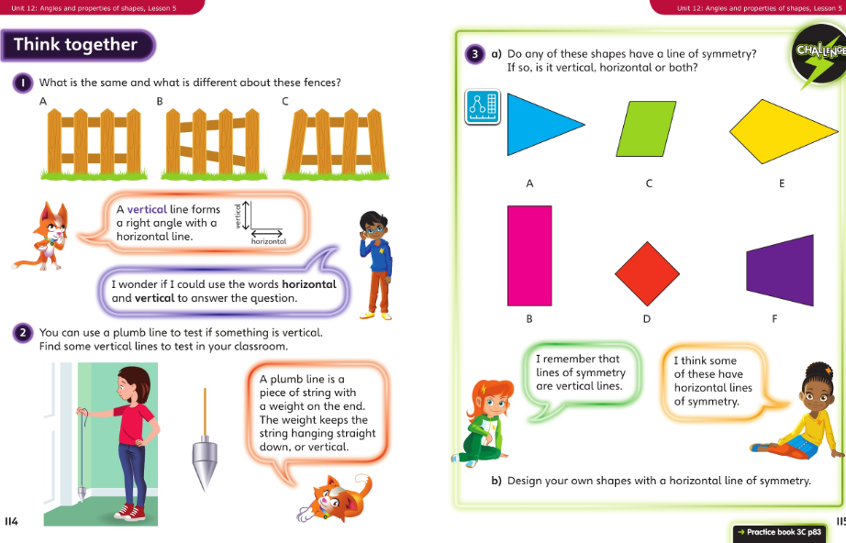
Friday talk together then pg 83

