Slide 1
Unit 14 – Statistics – Parent Notes
There are 5 lessons and 1 assessment lesson for this unit. ( we’re covering 7 days as we will add an extra day on Friday applying this maths to other curriculum areas )
In this unit we will extend our knowledge of: bar charts, tables and pictograms to interpret data
To really master this topic children will be able to read data and values from a range of bar charts and pictograms which have various scales and symbol values, including half and quarter values. Children can interpret data from tables and use this to complete charts and pictograms, as well as answer simple comparison questions.
COMMON MISCONCEPTIONS: Children may misread the scales on a bar chart, assuming that each square always stands for one. Ask: What do you notice about the scale on the vertical axis of this chart? What does it increase in? Children may also assume that each symbol in a pictogram has a value of 1. Draw children’s attention to the key on a pictogram and ask: What can you look at to identify the value of each symbol? Is this always the same for every pictogram?
Strengthen understanding of bar charts by asking children to recreate the bars using multilink cubes. This will help children compare the heights of each bar.

Slide 2
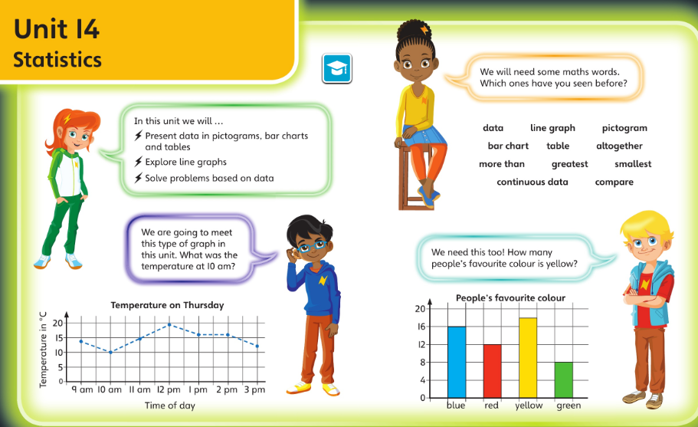
Check you’re happy with this vocabulary and these ideas before starting this unit

Slide 3
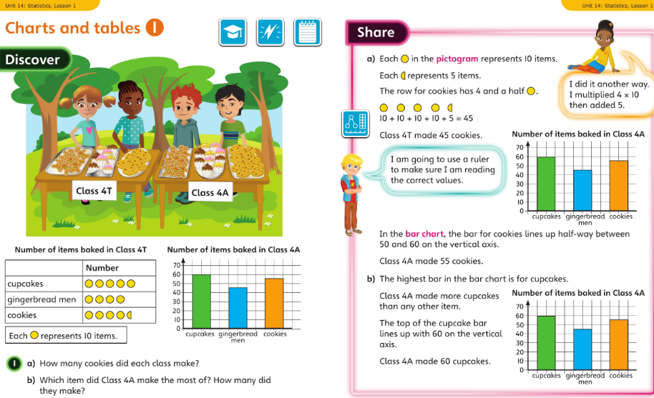
Monday 01.06.20 Overview L1

Slide 4
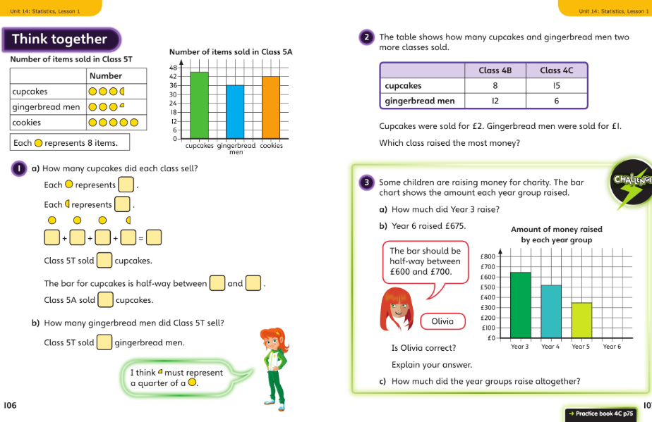
Monday talk together then pg75

Slide 5
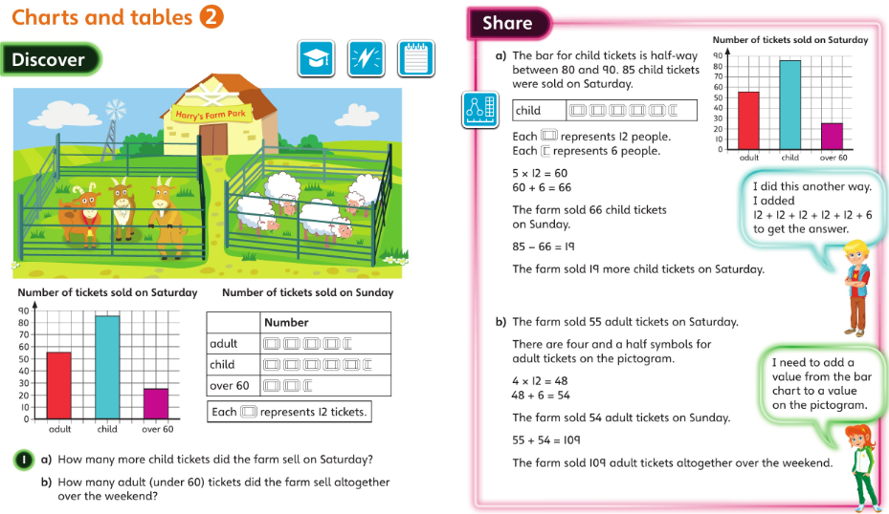
Tuesday 02.06.20 Overview L2

Slide 6
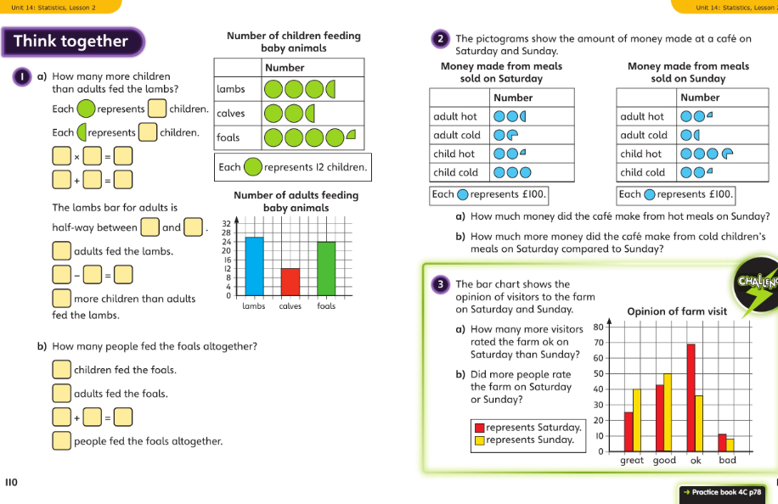
Tuesday Talk together then pg 78

Slide 7
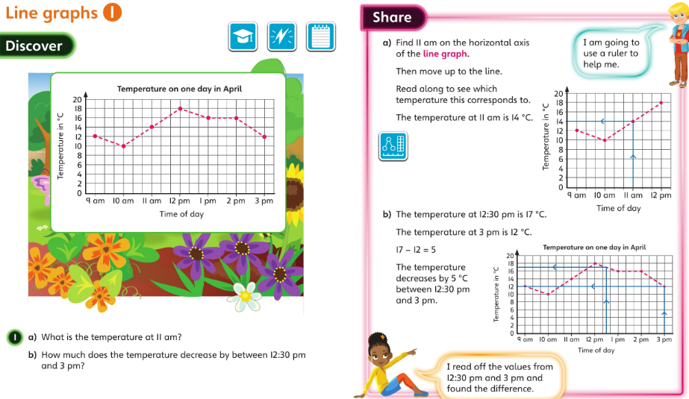
Wednesday 03.06.20 Overview L3

Slide 8
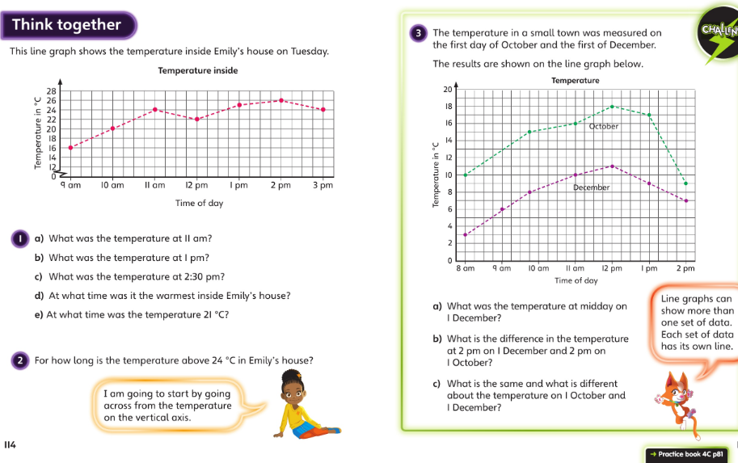
Wednesday talk together then page 81

Slide 9
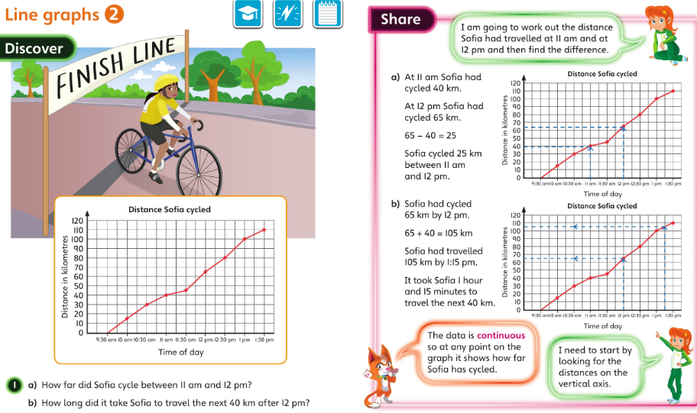
Thursday 04.06.20 Overview L4

Slide 10
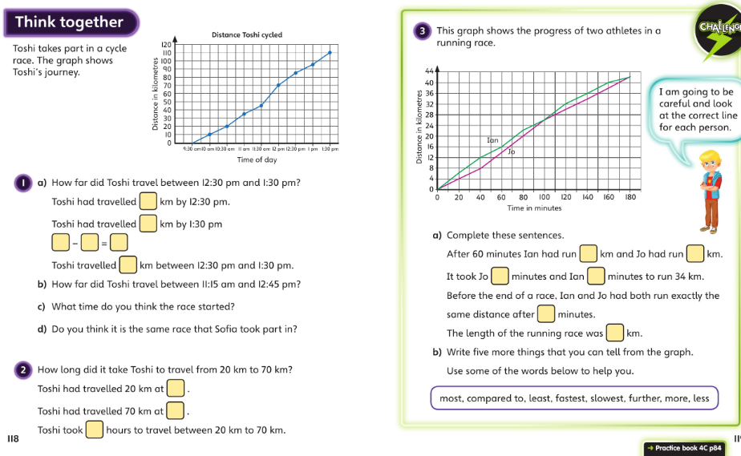
Thursday talk together then pg 84

Slide 11
Friday 05.06.20 apply your learning today
Today we would like you to draw a pictogram and a bar chart in your exercise book or on your own paper.
You can either 1: use the data below or 2: record your own data or 3: be creative and make up a data set.
If you’re recording your own data then you could choose a topic like how many star jumps each member of your family can do in one minute or how many different birds you can spot in your garden in a 30minute time slot. Be creative!
Remember to:
choose a suitable scale,
use a ruler,
label each axis and give your work a title.
It would be great to see your work - Send a photo of your finished pictogram and bar chart via the finch parents email.
Optional data:
We asked the teachers to hunt for rocks and this is what they found:
Mrs Metcalf – 7 igneous, 21 sedimentary and 35 metamorphic rocks
Mrs Vanstone – 14 igneous, 7 sedimentary and 21 metamorphic
Mrs Gan – 0 igneous, 28 sedimentary and 14 metamorphic
Mrs Dodds – 14 igneous, 21 sedimentary and 7 metamorphic
Extra challenge – How many rocks altogether? Who found the least? What else can you ask about this data?

