Slide 1
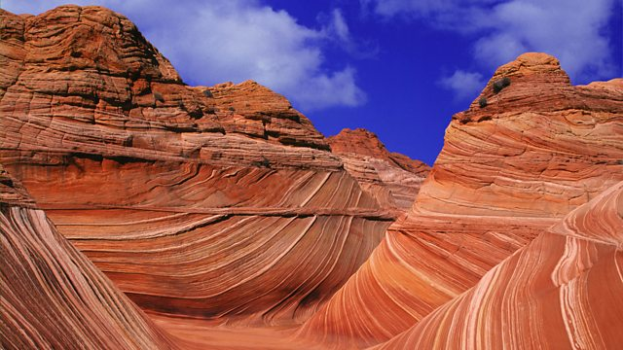
EDIBLE ROCKS
Image source: www.thewave.info

Slide 2
INTRODUCTION
In this activity you are going to:
Find out about different types of Earth rocks
Make edible models of these Earth rocks to understand how they are formed
Branding

Slide 3
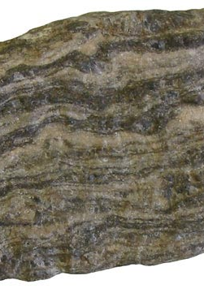
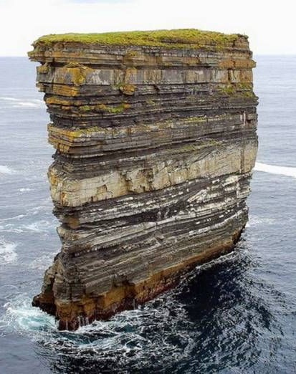
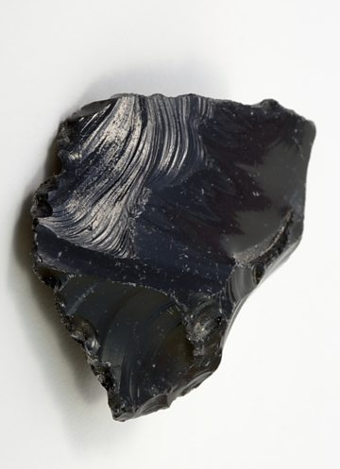
THREE TYPES OF EARTH ROCK
Metamorphic
Sedimentary
Igneous
Branding

Slide 4
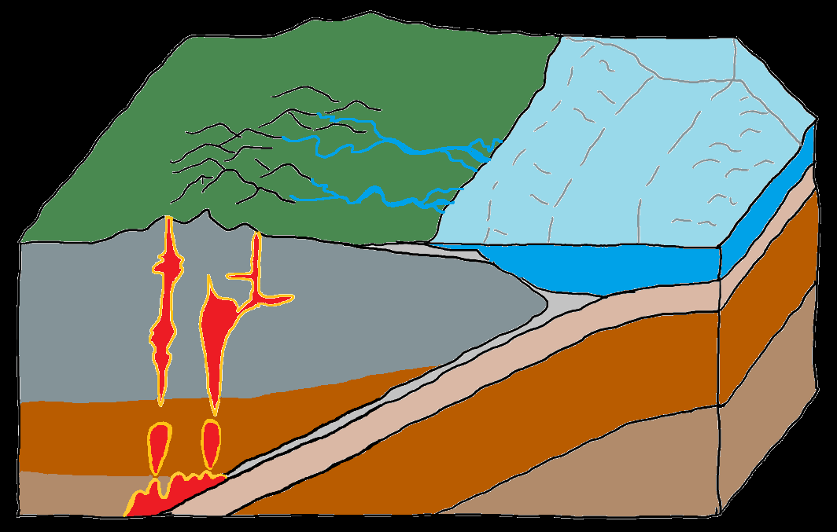
EARTH ROCKS CHANGE A LOT…
Rain and wind
Bits of rock get washed away to oceans
These layer up over time
Some erupt as volcanos
Igneous rock
Some cools inside the Earth
Sedimentary rock
Igneous rock
Melted hot rock
(Magma)
Heat and pressure under the Earth
Metamorphic rock
Branding
Notes:
And the cycle keeps on going…Moon rocks experience NO weathering and any changes to them occurs through impacts.

Slide 5


METAMORPHIC ROCK
Pressure
Heat
Branding
Notes:
Pressure squashes the rocks, like your hands will squash the icing!

Slide 6

SEDIMENTARY ROCK
Builds up in layers in water over time
Notes:
So there are no sedimentary rocks on the Moon as there is no water.

Slide 7

IGNEOUS ROCK
Rock is heated and melted
And then cools to become solid

