Slide 1
Unit 14 – Statistics – Parent Notes
There are 5 lessons and 1 assessment lesson for this unit. ( we’re covering 7 days as we will add an extra day on Friday applying this maths to other curriculum areas )
In this unit we will extend our knowledge of: bar charts, tables and pictograms to interpret data
To really master this topic children will be able to read data and values from a range of bar charts and pictograms which have various scales and symbol values, including half and quarter values. Children can interpret data from tables and use this to complete charts and pictograms, as well as answer simple comparison questions.
COMMON MISCONCEPTIONS: Children may misread the scales on a bar chart, assuming that each square always stands for one. Ask: What do you notice about the scale on the vertical axis of this chart? What does it increase in? Children may also assume that each symbol in a pictogram has a value of 1. Draw children’s attention to the key on a pictogram and ask: What can you look at to identify the value of each symbol? Is this always the same for every pictogram?
Strengthen understanding of bar charts by asking children to recreate the bars using multilink cubes. This will help children compare the heights of each bar.

Slide 2
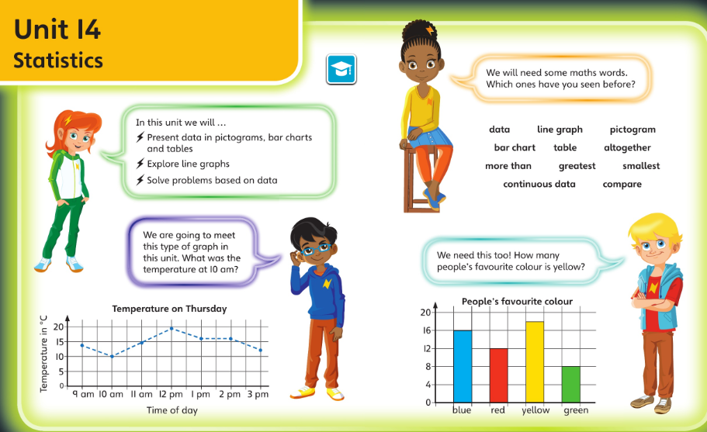
Check you’re happy with this vocabulary and these ideas before starting this unit

Slide 3
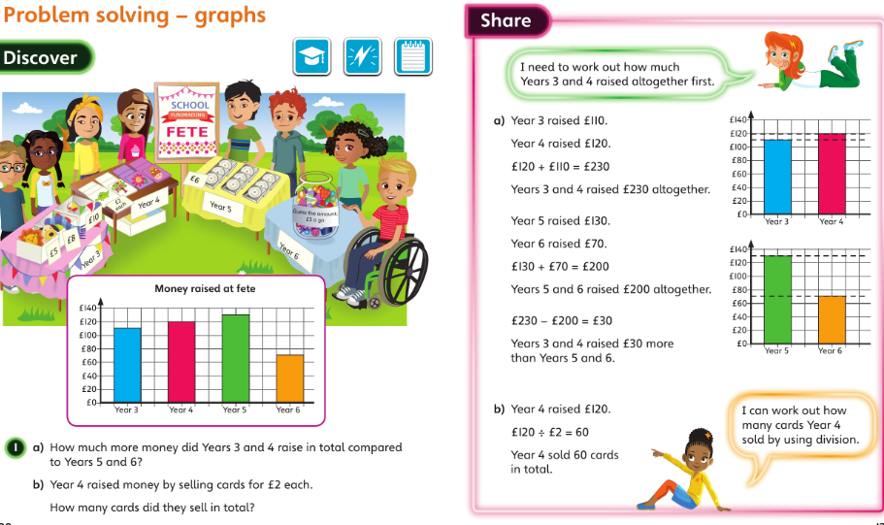
Monday 08.06.20 Overview L5

Slide 4
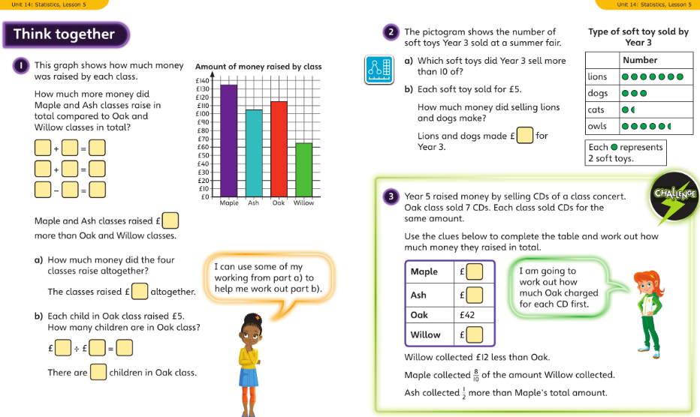
Monday talk together then pg87

Slide 5
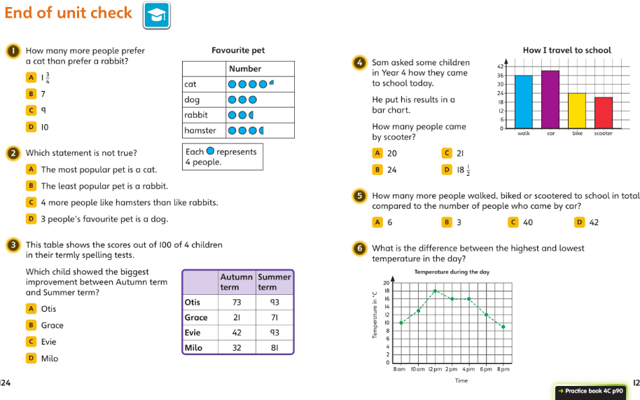
Tuesday 09.06.20 Overview – unit check

Slide 6
Parents notes - geometry
This unit develops children’s understanding of types of 2D shapes and their properties. There are 11 lessons over 13 days with extra activities added that are not in the booklet.
Children begin by learning about three types of angles: acute, obtuse and right angles.
They will use right angles as a way of recognising when angles are acute or obtuse. Children will then compare and order angles in ascending and descending order.
Children will then learn about how shapes can be regular or irregular
Children then learn about different types of triangles and different types of quadrilaterals.
Children will be encouraged to apply all they have learnt to deduce facts about shapes and solve shape based problems and puzzles.
Finally, children will develop their understanding of symmetry, both inside and outside of shapes, and will complete symmetrical shapes and patterns.

Slide 7
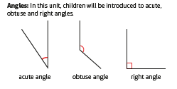
Parents notes - geometry

Slide 8
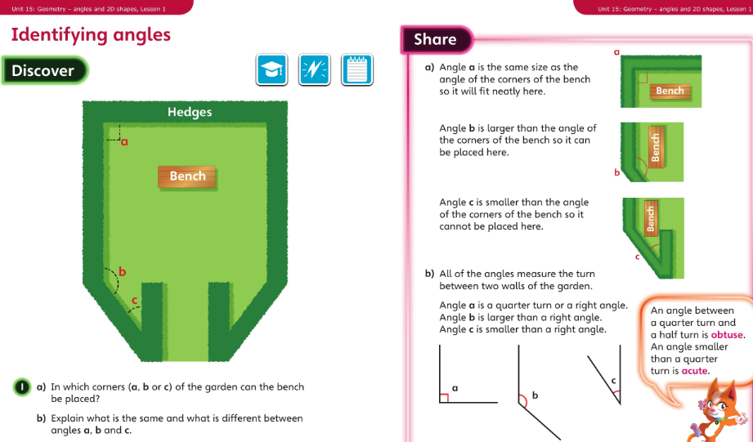
Wednesday 10.06.20 Overview L1

Slide 9
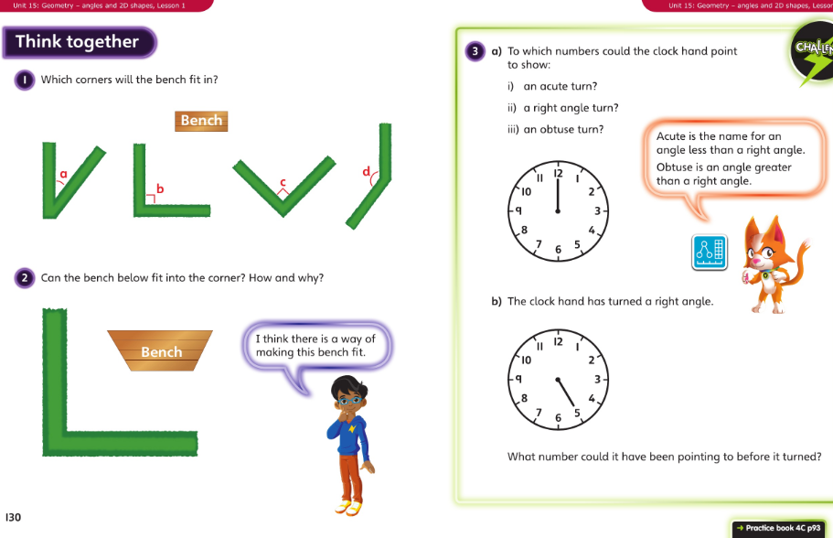
Wednesday talk together then page 93

Slide 10
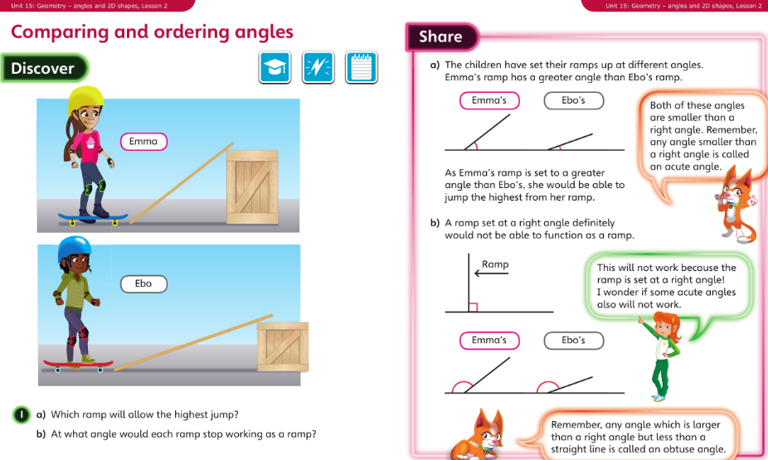
Thursday 11.06.20 Overview L2

Slide 11
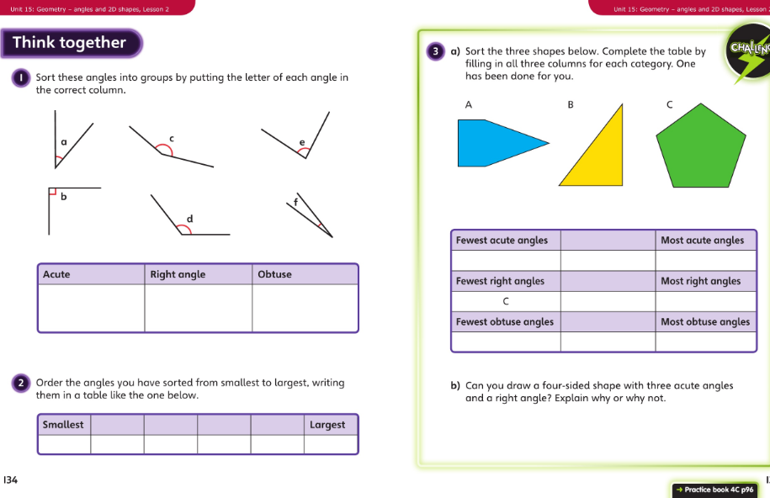
Thursday talk together then pg 96

Slide 12
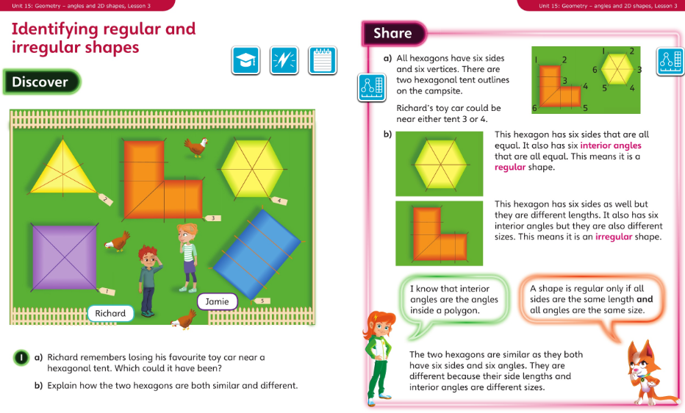
Friday 12.06.20 Overview L3

Slide 13
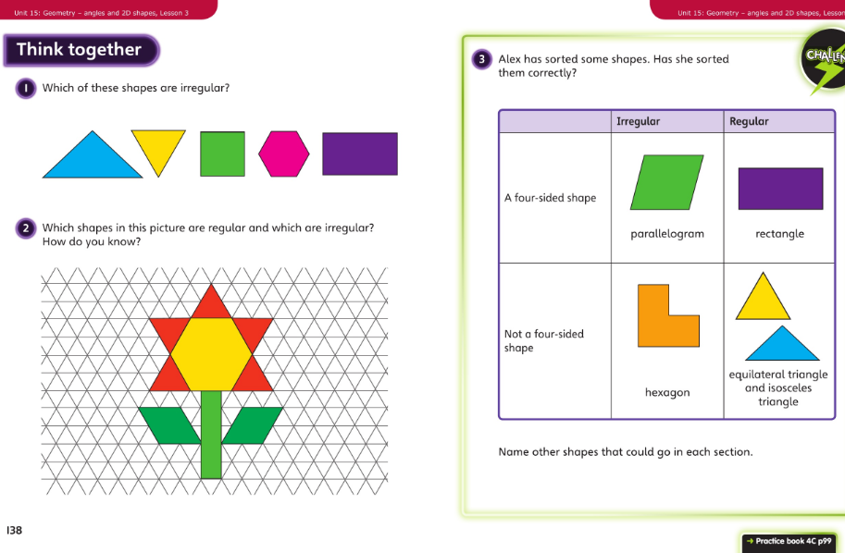
Friday talk together then pg 99

