Slide 1
Unit 12–Angles & Shape – Parent Notes
This unit explores the concept of right angles. Right angles are linked to the concepts of parallel, perpendicular, vertical and horizontal lines and are linked with the angle properties of 2D shapes.
Vertical and horizontal lines of symmetry are also explored and, finally, children describe and construct 3D shapes.
Angles are introduced to children as a measure of a turn, establishing that a right angle is a quarter turn, two quarter turns make a half turn, three right angles make a
three-quarter turn and four right angles make a full turn.
Children will learn that angles less than a right angle are called acute angles and angles greater than a right angle (but less than two right angles) are called obtuse angles.
Children will revise the names of 2D shapes. These include triangles (right-angled and isosceles), quadrilaterals (square, rectangle, rhombus, trapezium, parallelogram and kite) pentagons, hexagons and octagons.
Children will revise the names of 3D shapes: cube, cuboid, pyramid, prism, cylinder,
sphere and cone.
This unit will provide an important foundation for further development of the concept of geometry in later years, such as measuring and drawing angles accurately.

Slide 2
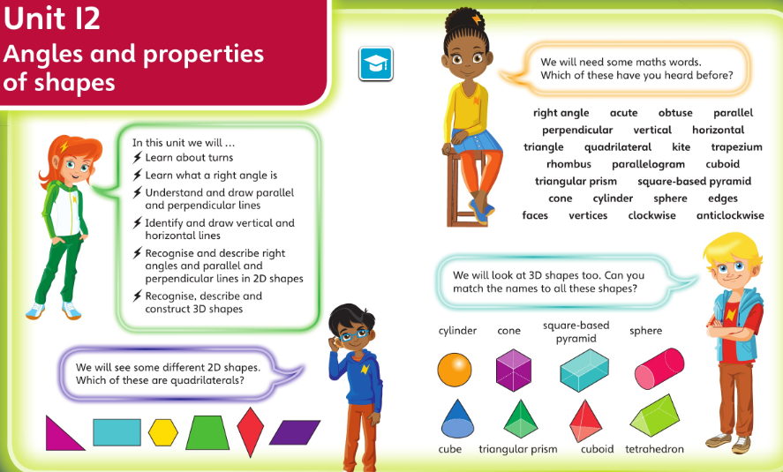
Check you’re happy with this vocabulary and these ideas before starting this unit

Slide 3
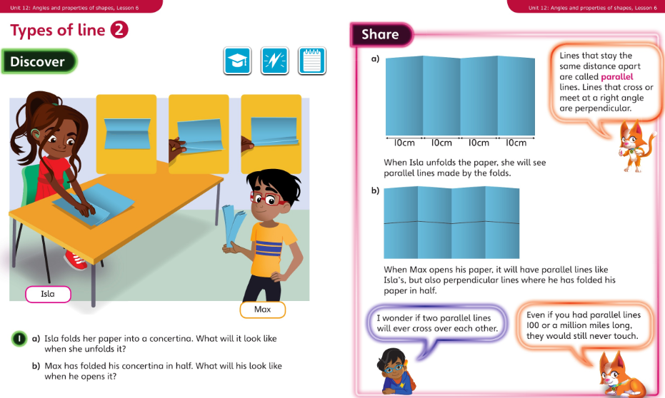
Monday 08.06.20 Overview L6

Slide 4
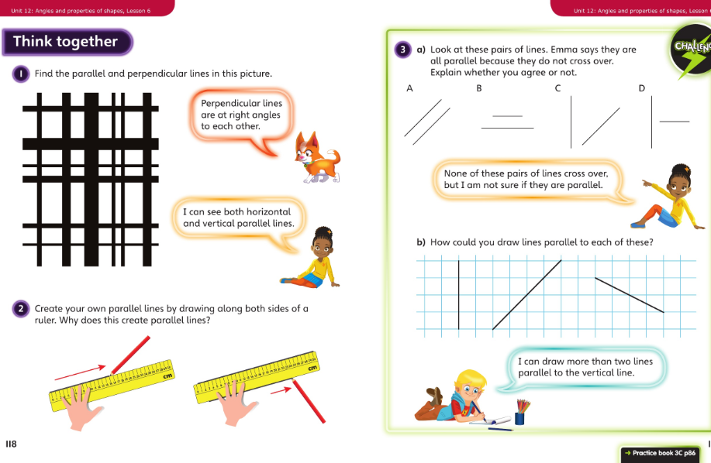
Monday talk together then pg86

Slide 5
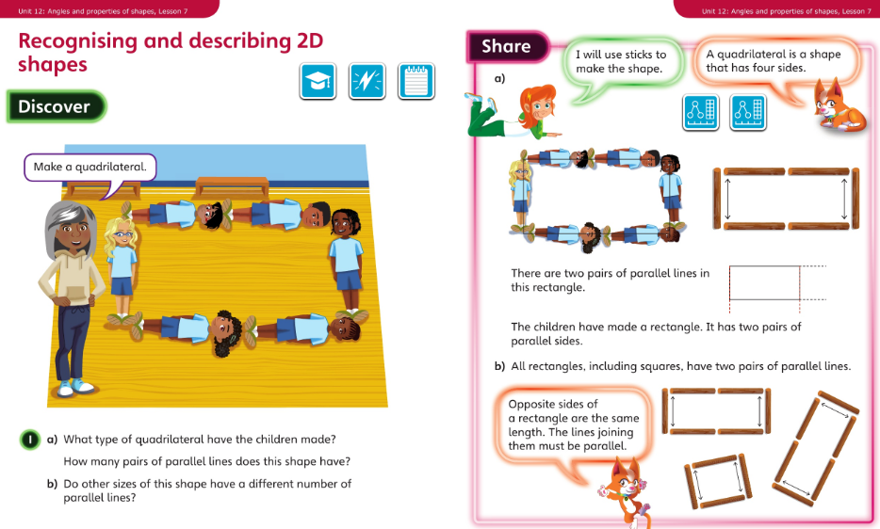
Tuesday 09.06.20 Overview L7

Slide 6
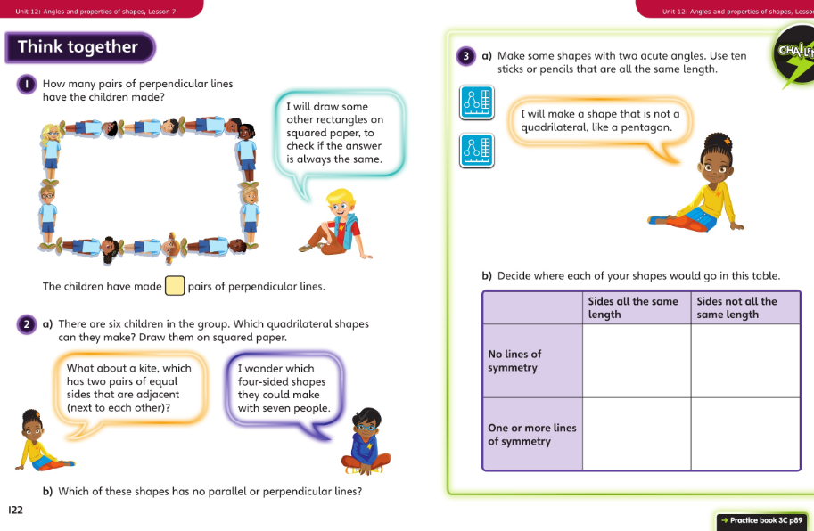
Tuesday Talk together then pg 89

Slide 7
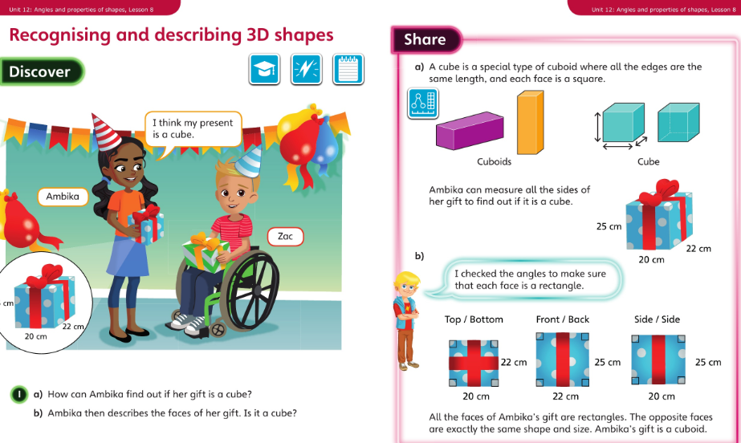
Wednesday 10.06.20 Overview L8

Slide 8
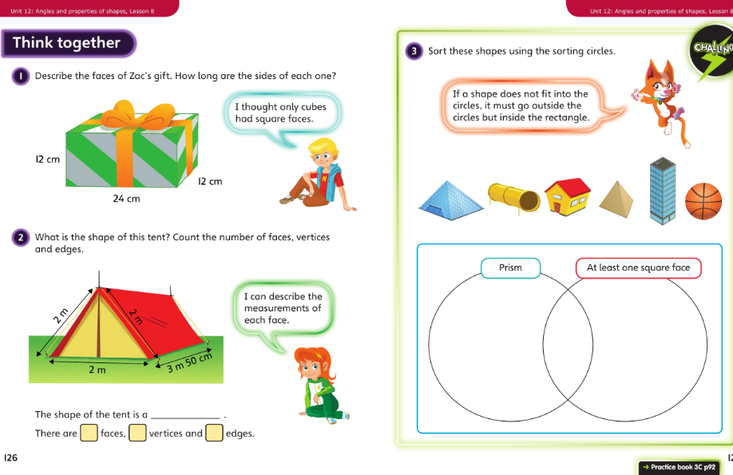
Wednesday talk together then page 92

Slide 9
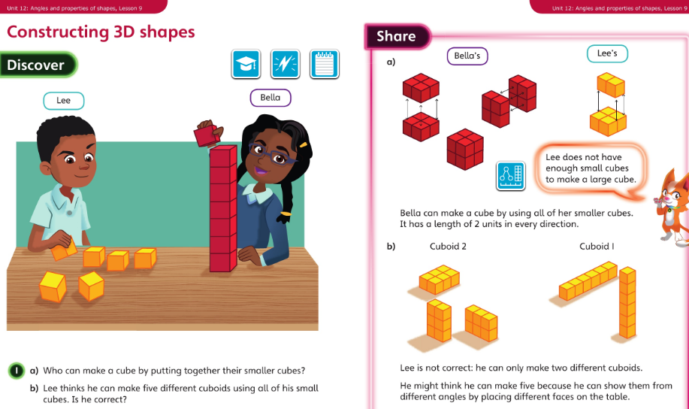
Thursday 11.06.20 Overview L9

Slide 10
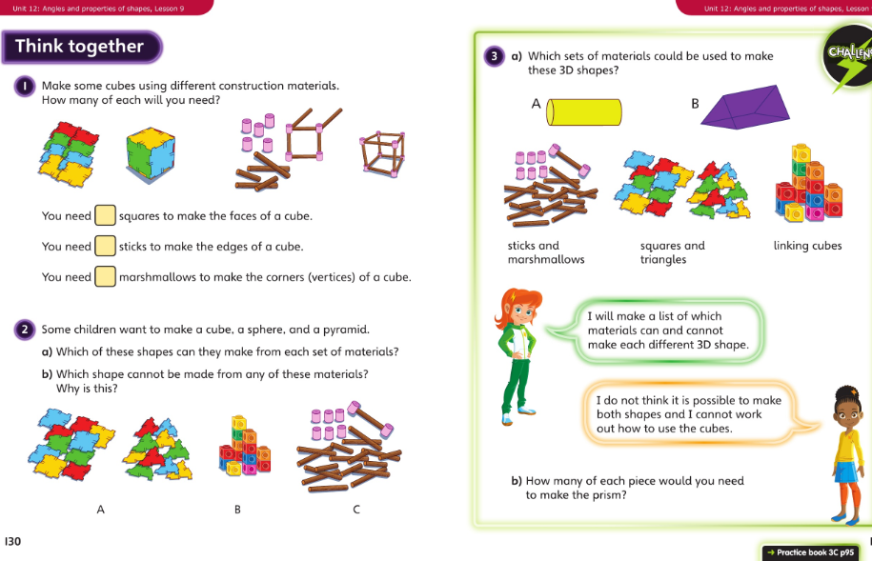
Thursday talk together then pg 95

Slide 11
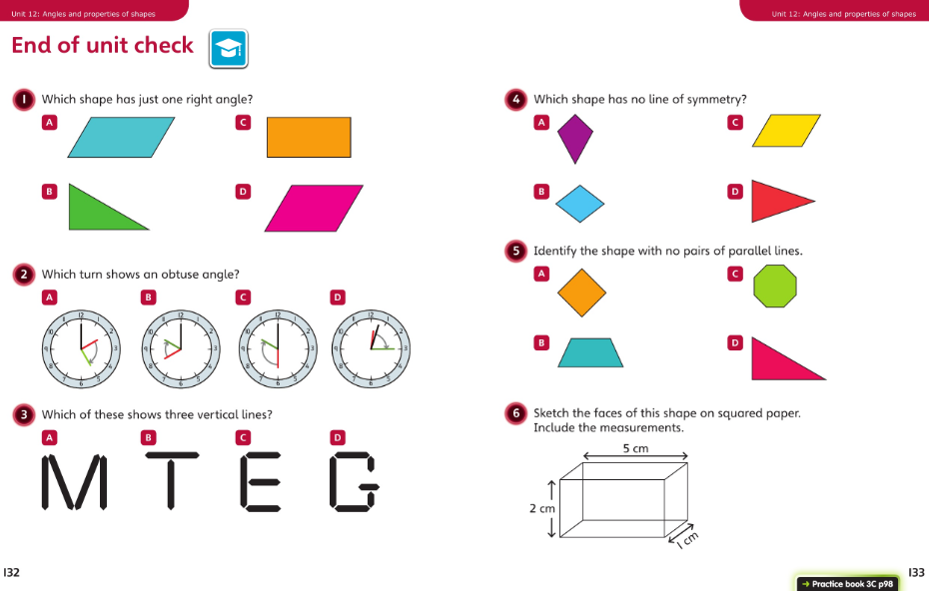
Friday 12.06.20 Overview – end of unit

Slide 12

Treasure Hunt - optional extra activity
In your garden, or a walk around your neighbourhood, can you identify and sketch each item:
A pair of horizontal lines?
A vertical line?
An object with 4 right angles?
A pentagon (extra point for this one !)
A cube?
An object with a line of symmetry?
An object with two lines of symmetry? (extra point)
A sphere?
How many did you find? There were ten points available. What questions could you ask in your own shape hunt?

