Slide 1
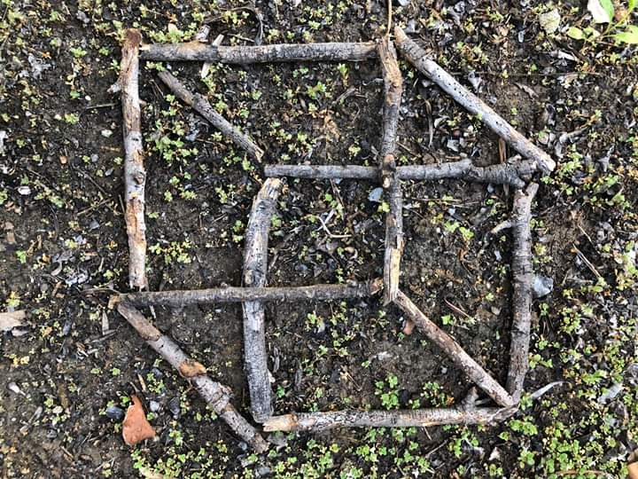
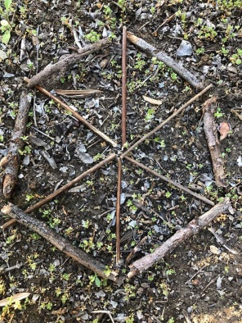
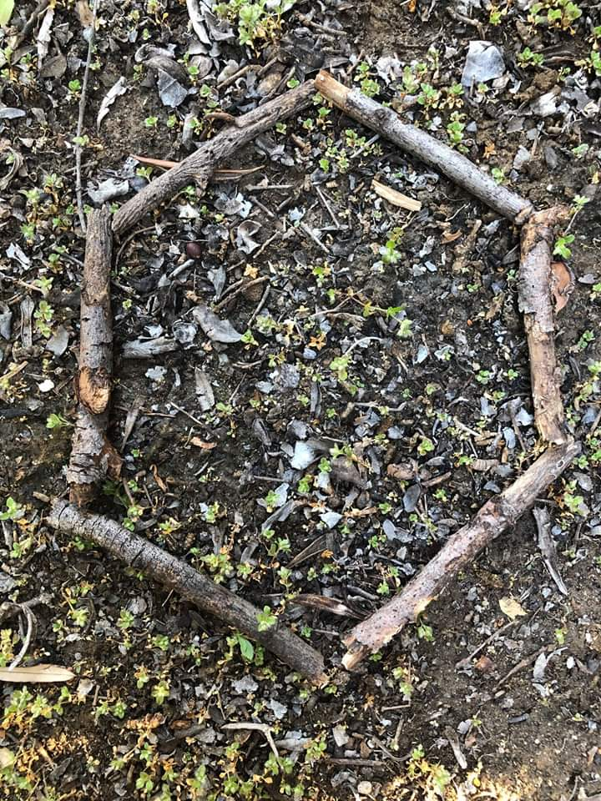
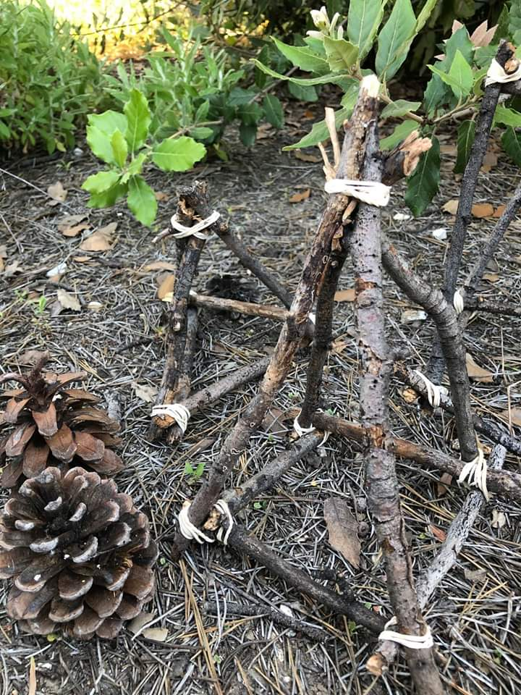
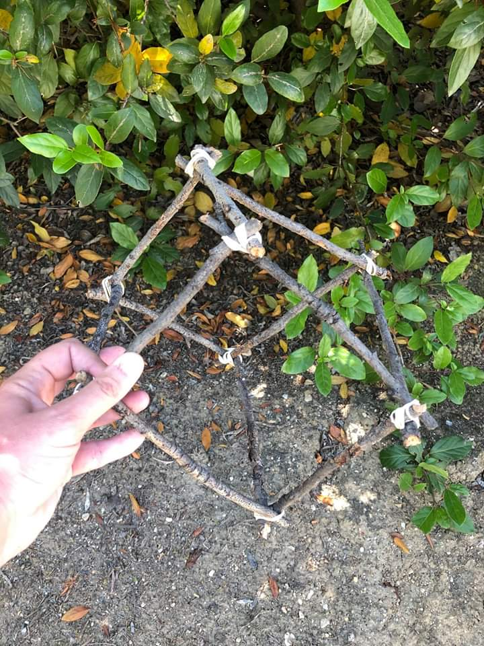
MONDAY 15th JUNE – Practical maths. This is a great way to explore shape – building spatial awareness and fine motor skills. All you need are sticks and rubber bands. First create 2d shapes with your sticks. Talk about their properties – angles, parallel or perpendicular lines, lines of symmetry etc. How many can you make? Can you name them all? Then make flat 3d shapes, then challenge yourself to make 3d models using rubber bands. Finally, use your imagination to transform your models into something new (tiny houses, space ships, boats)

Slide 2
Tuesday 16th June – Parent notes for MASS – kilograms and grams
This unit is important because it strengthens children’s knowledge of mass: an important area of learning which has many real-life applications.
First, children will learn how to measure and read a scale, focusing upon unmarked intervals.
Next, different masses will be compared and ordered.
Following this, children will learn to add and subtract different amounts, using a range of strategies.
Finally, they will apply their knowledge to real-life problems – an important skill for children to learn in life.
Before they start this unit, it is expected that children :
  can use scales to compare, estimate and measure the mass of an object
  are able to measure mass in grams and kilograms
  can count in hundreds to link grams to kilograms.

Slide 3
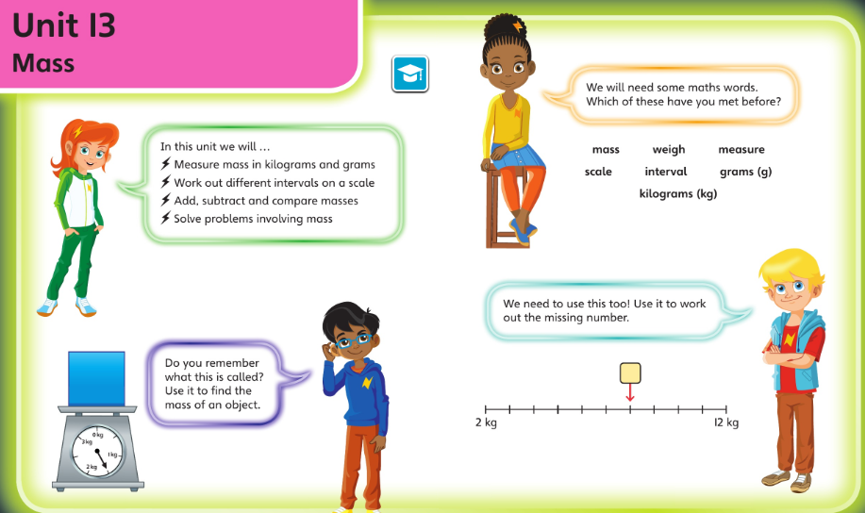
Check you’re happy with this vocabulary and these ideas before starting this unit

Slide 4
Tuesday 16th June 2020
This unit on Mass is heavily dependent on reading scales confidently.
Do you have any items with a scale at home?
Maybe kitchen weighing scales, bathroom scales, barometer, car accelerator, rev dials etc.
Talk about the scales we have and how the numbering may differ. How? Why? What else could you use a scale for.
Today’s lesson is based on reading scales – See the two different worksheets on reading scales in this week’s resources.
Print them off or write the answers in your exercise book.

Slide 5
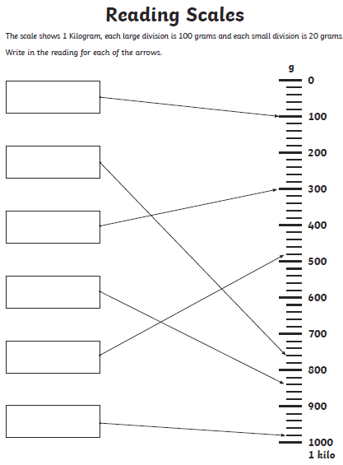
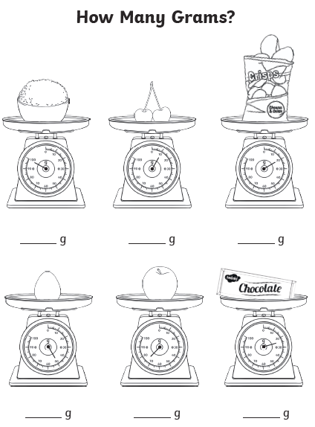
Tuesday – see sheets in class folder

Slide 6
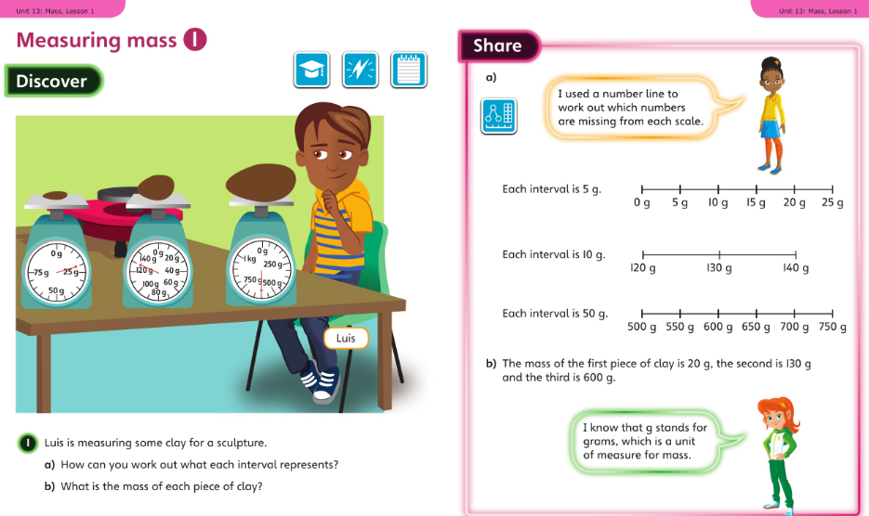
Wednesday 17.06.20 Overview L1

Slide 7
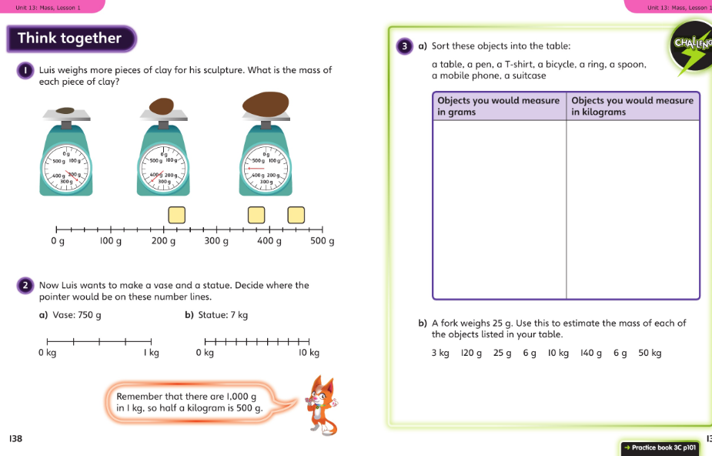
Wednesday talk together then page 101

Slide 8
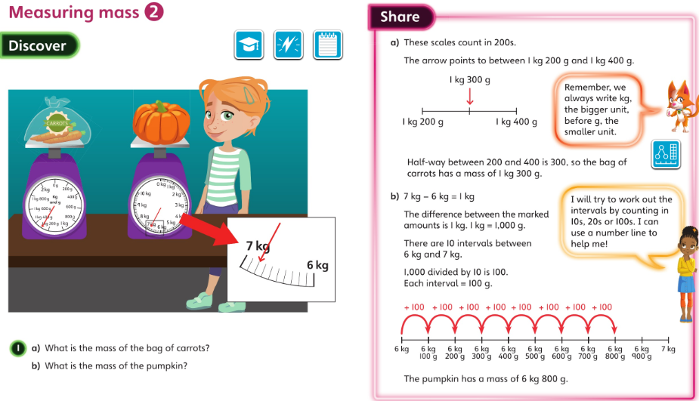
Thursday 18.06.20 Overview L2

Slide 9
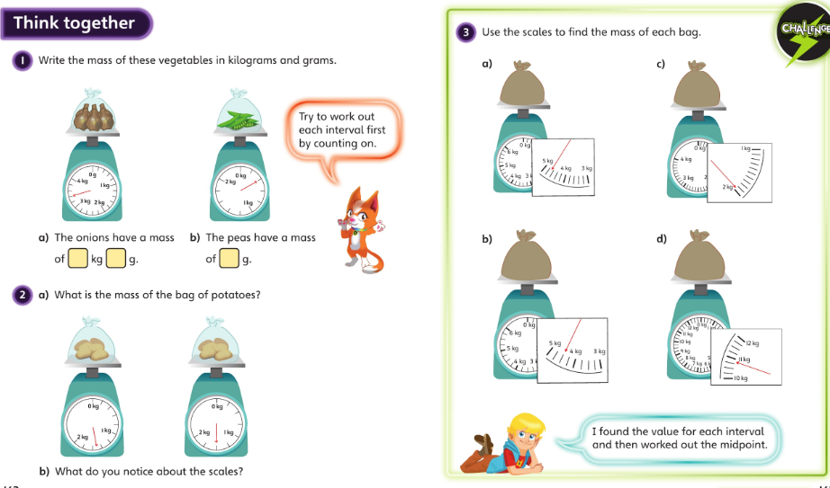
Thursday talk together then pg 104

Slide 10
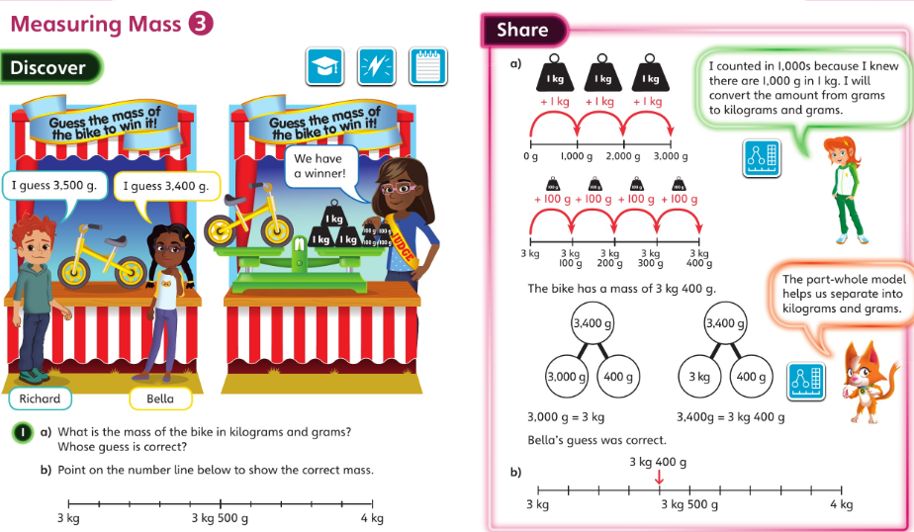
Friday 19.06.20 Overview L3

Slide 11
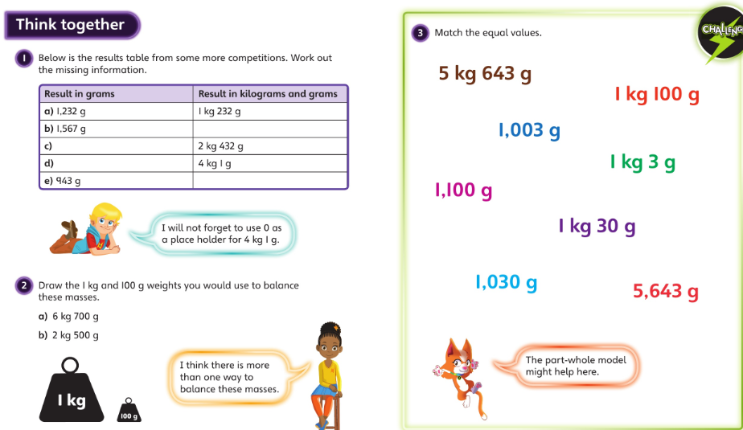
Friday – talk together then pg 107

