Slide 1
Parents notes - geometry
This unit develops children’s understanding of types of 2D shapes and their properties. There are 11 lessons over 13 days with extra activities added that are not in the booklet.
Children begin by learning about three types of angles: acute, obtuse and right angles.
They will use right angles as a way of recognising when angles are acute or obtuse. Children will then compare and order angles in ascending and descending order.
Children will then learn about how shapes can be regular or irregular
Children then learn about different types of triangles and different types of quadrilaterals.
Children will be encouraged to apply all they have learnt to deduce facts about shapes and solve shape based problems and puzzles.
Finally, children will develop their understanding of symmetry, both inside and outside of shapes, and will complete symmetrical shapes and patterns.

Slide 2
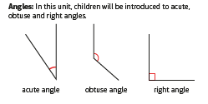
Parents notes - geometry

Slide 3
Monday 15.06.20 applied maths
Today you have two activities to choose from to apply your knowledge of angles, 2d and even 3d shapes.
You can do the treasure hunt on the next page and / or make shapes like the photos shown on the page after then talk through all the properties of the shapes to apply this unit’s vocabulary.
Please send photos of your work to us via the parents email.

Slide 4
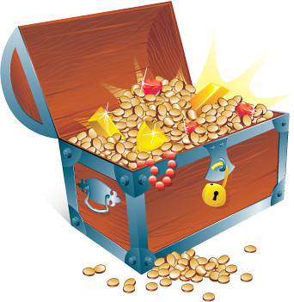
Treasure Hunt - Activity
In your garden, or a walk around your neighbourhood, can you identify and sketch/photograph each item:
A pair of parallel horizontal lines?
A pair of parallel vertical lines?
A compound object made of two different shapes? Eg a house front may be made of triangle and rectangle.
Objects with an acute, obtuse or right angle – label them
An object with at least 2 lines of symmetry?
3 different triangular shapes?
An irregular hexagon?
A regular or irregular pentagon?
Am irregular quadrilateral?
An interesting shape of your choice – tell me about it.
How many did you find? There were ten points available. What questions could you ask in your own shape hunt?

Slide 5
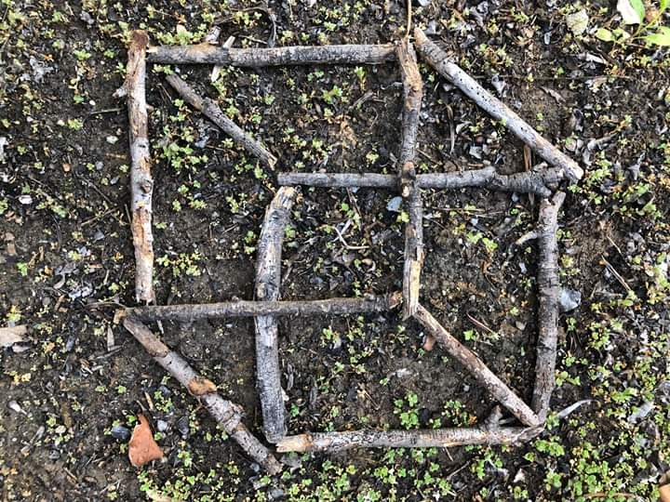
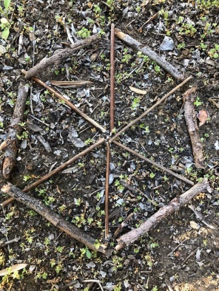
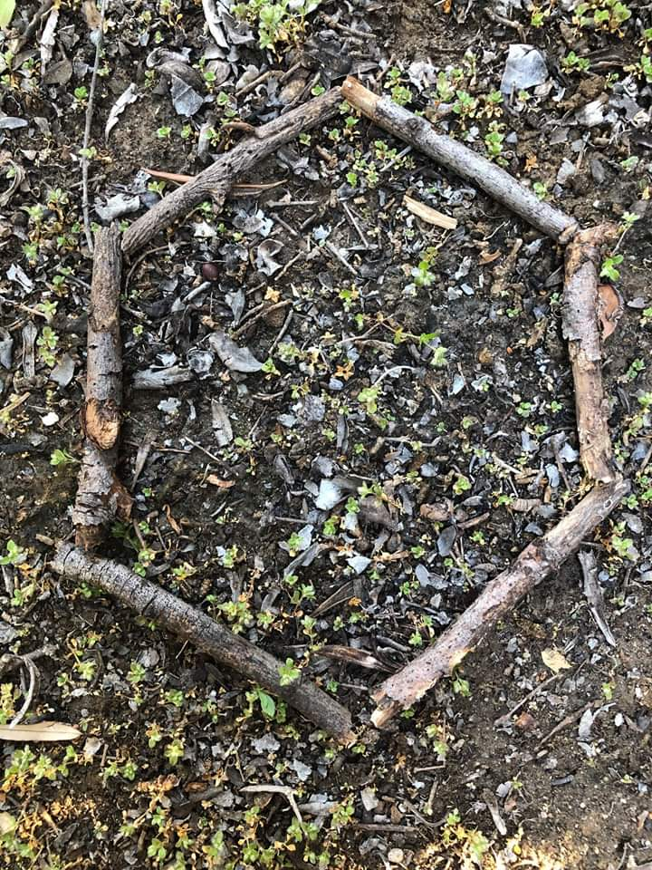
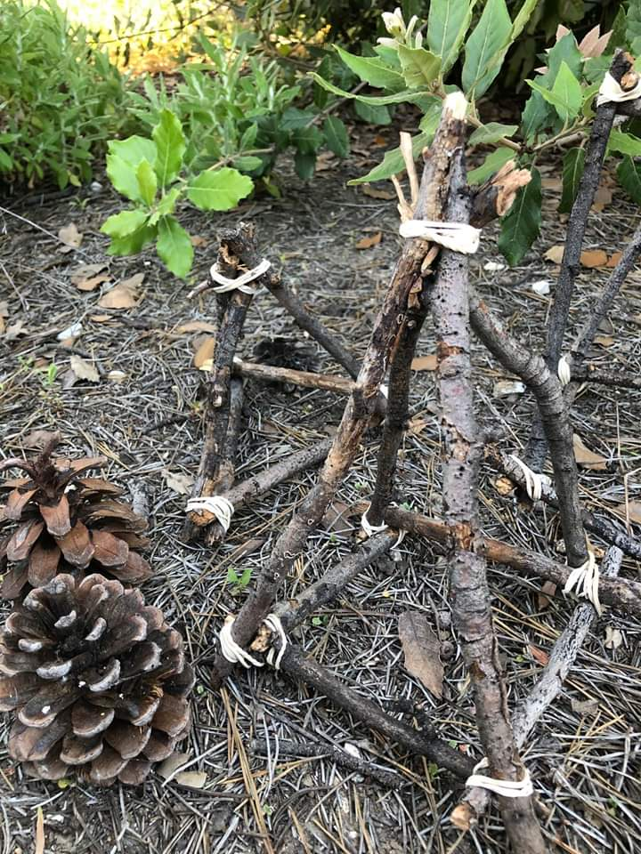
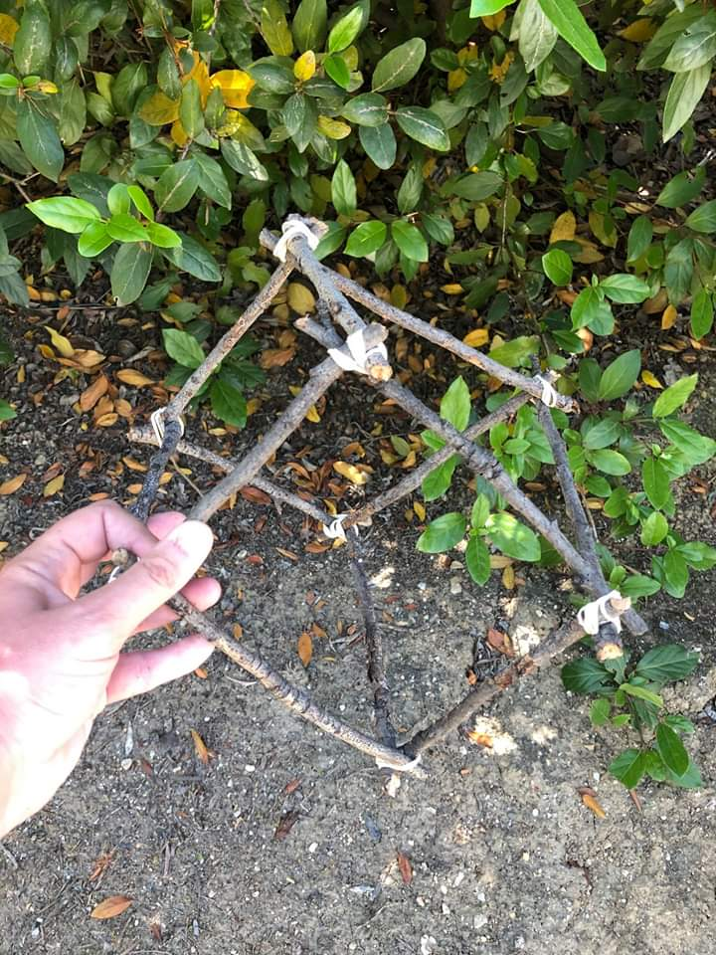
This is a great way to explore shape – building spatial awareness and fine motor skills. All you need are sticks and rubber bands. First create 2d shapes with your sticks. Talk about their properties – angles, parallel or perpendicular lines, lines of symmetry etc. How many can you make? Can you name them all? Then make flat 3d shapes, then challenge yourself to make 3d models using rubber bands. Finally, use your imagination to transform your models into something new (tiny houses, space ships, boats etc)

Slide 6
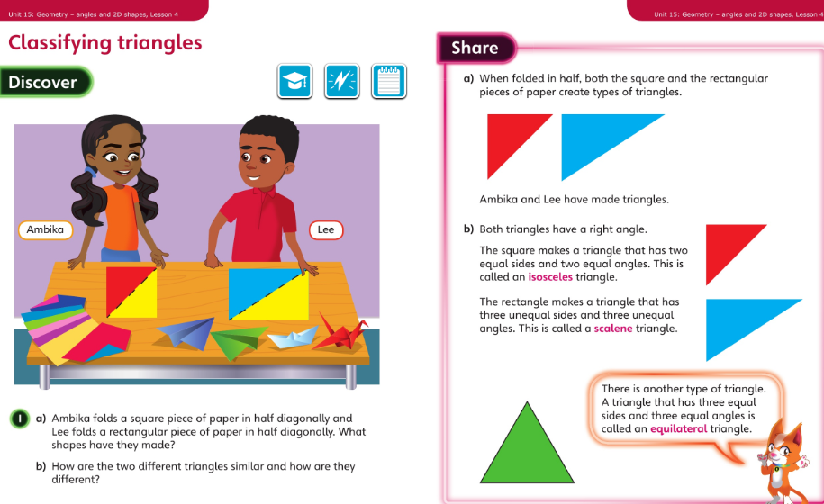
Tuesday 16.06.20 Overview lesson 4

Slide 7
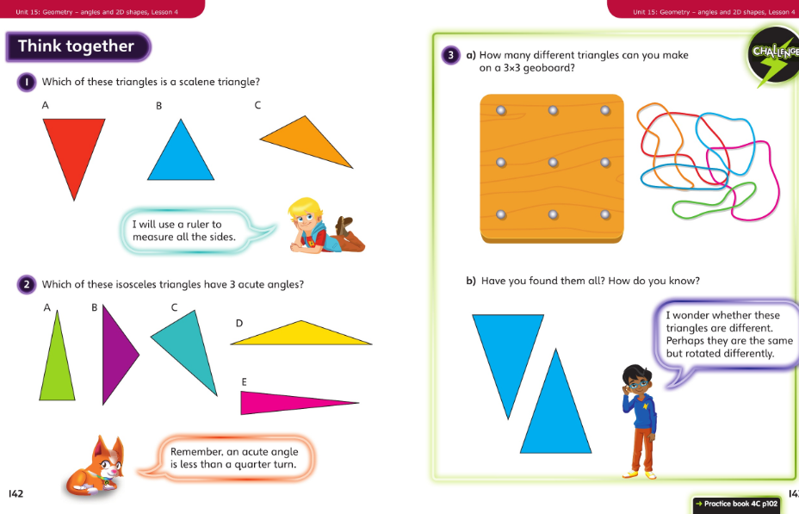
Tuesday – talk together then pg 102

Slide 8
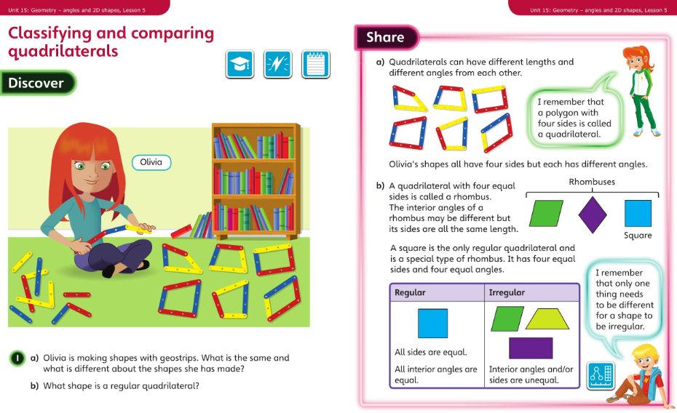
Wednesday 17.06.20 Overview L5

Slide 9
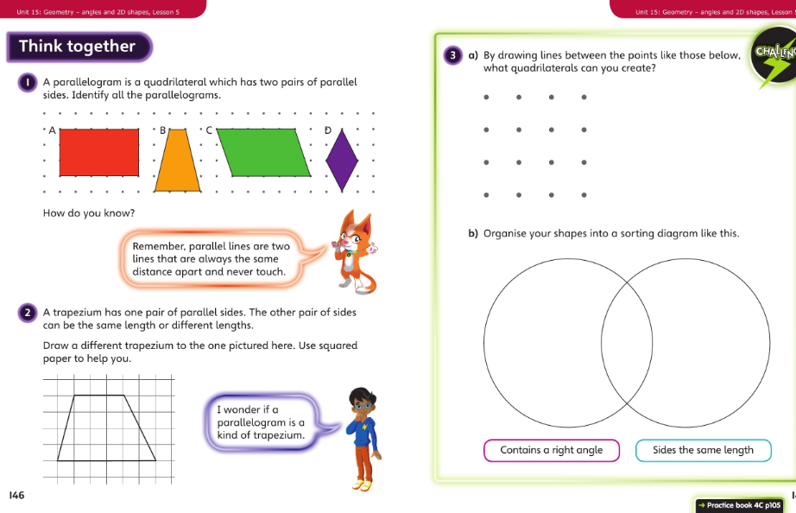
Wednesday talk together then page 105

Slide 10
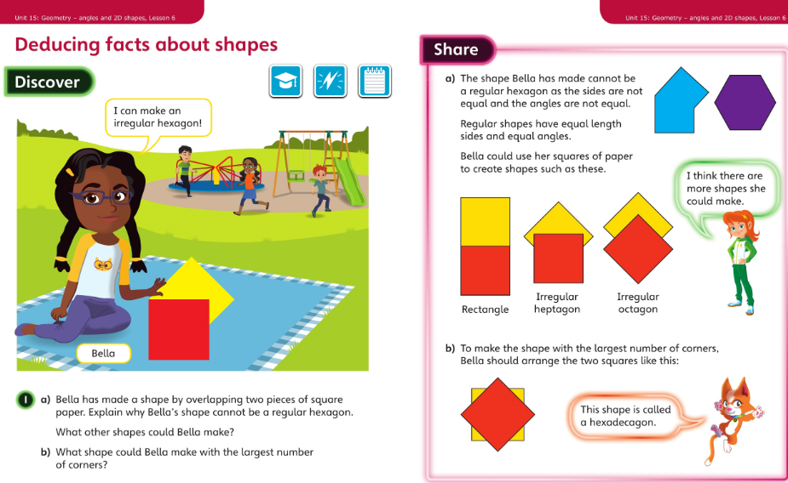
Thursday 18.06.20 Overview L6

Slide 11
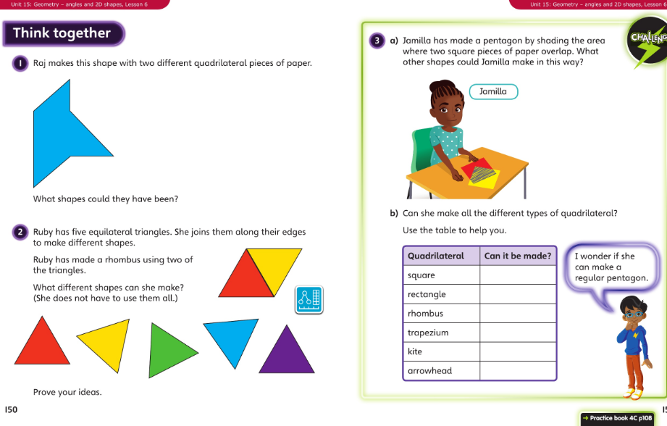
Thursday- talk together then page 108

Slide 12
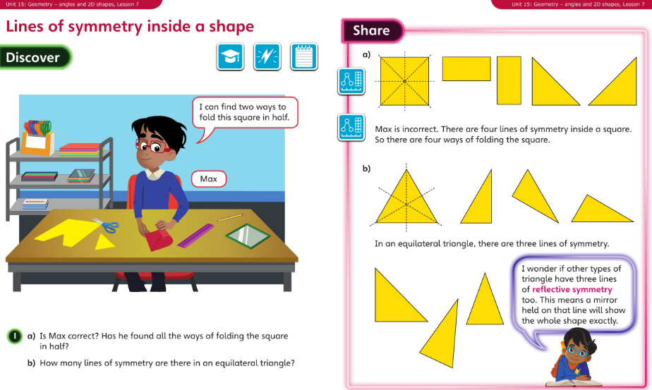
Friday 19.06.20 Overview L7

Slide 13
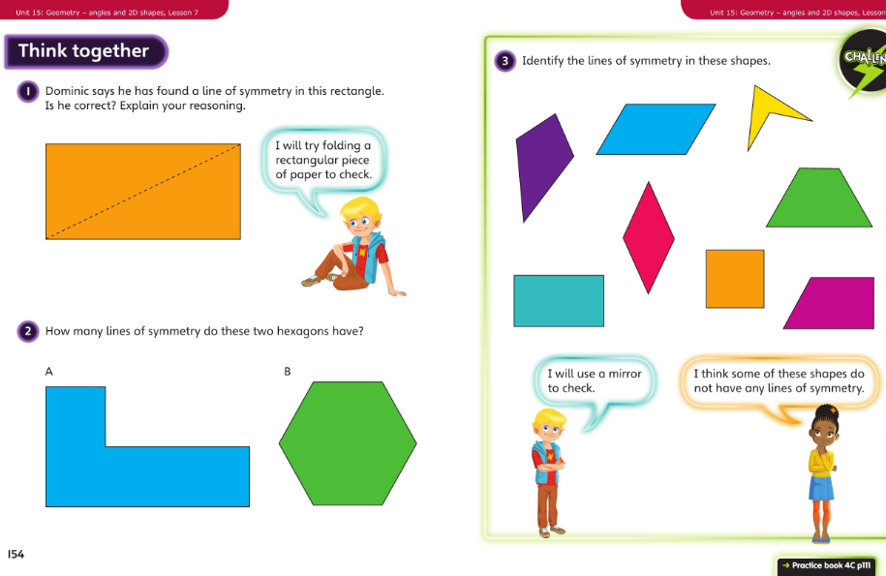
Friday talk together then pg 111

