Slide 1
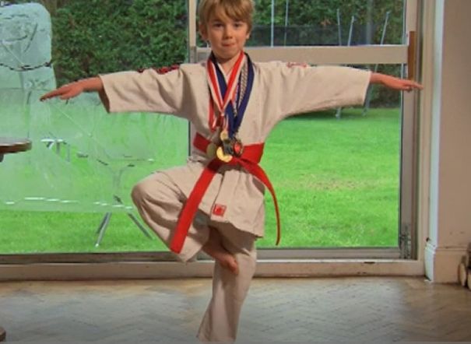
Parents notes – symmetry extra activities and videos
What makes a shape symmetrical?
https://www.bbc.co.uk/bitesize/topics/zrhp34j/articles/z8t72p3
Can you make a symmetrical piece of art? Dance?
https://www.bbc.co.uk/teach/class-clips-video/maths-ks2-finding-lines-of-symmetry/zktfgwx

Slide 2
Parents notes - geometry
This unit develops children’s understanding of types of 2D shapes and their properties. There are 11 lessons over 13 days with extra activities added that are not in the booklet.
Children begin by learning about three types of angles: acute, obtuse and right angles.
They will use right angles as a way of recognising when angles are acute or obtuse. Children will then compare and order angles in ascending and descending order.
Children will then learn about how shapes can be regular or irregular
Children then learn about different types of triangles and different types of quadrilaterals.
Children will be encouraged to apply all they have learnt to deduce facts about shapes and solve shape based problems and puzzles.
Finally, children will develop their understanding of symmetry, both inside and outside of shapes, and will complete symmetrical shapes and patterns.

Slide 3
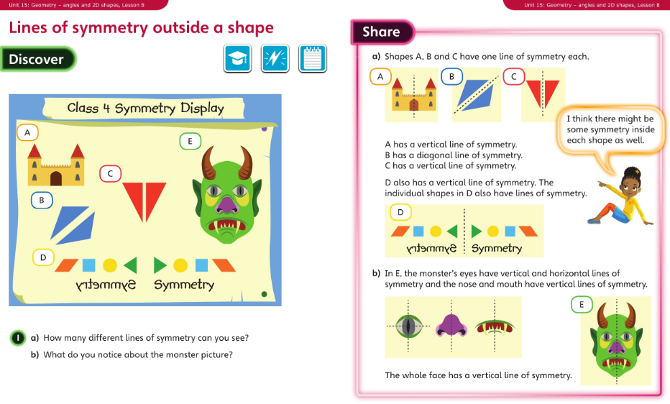
Monday 22.06.20 Overview lesson 8

Slide 4
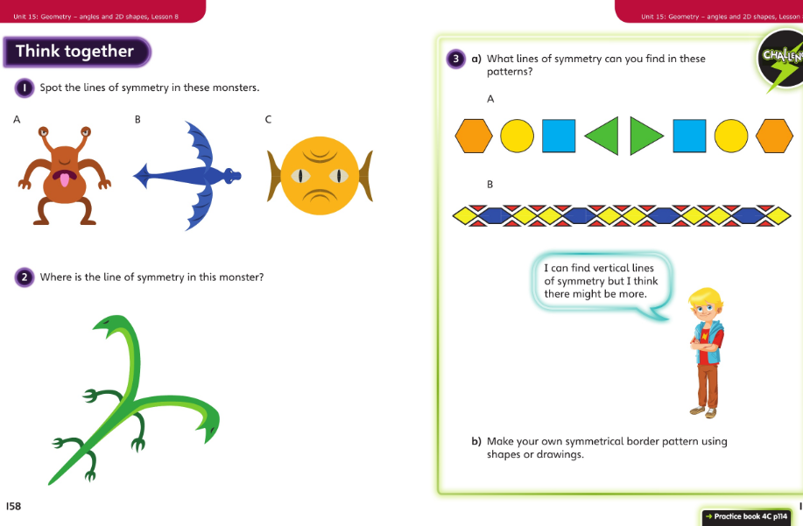
Monday – talk together then pg 114

Slide 5
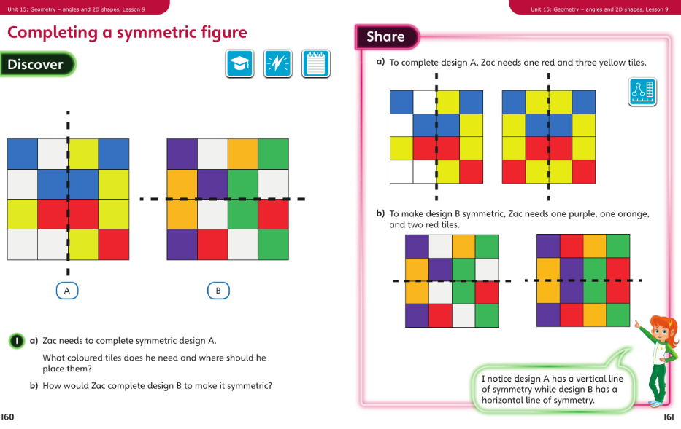
Tuesday 23.06.20 Overview lesson 9

Slide 6
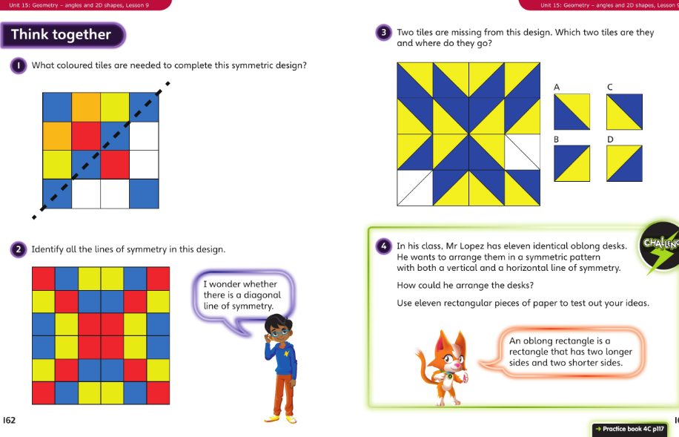
Tuesday – talk together then pg 117

Slide 7
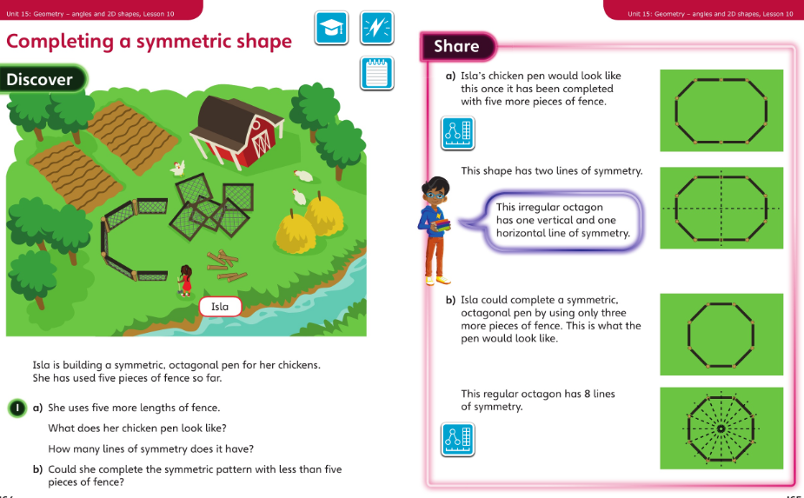
Wednesday 24.06.20 Overview L10

Slide 8
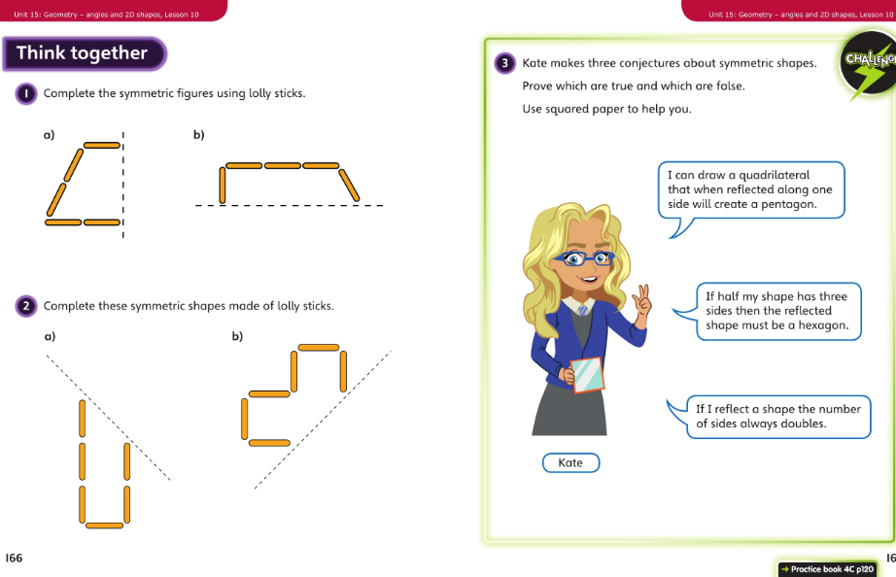
Wednesday talk together then page 120

Slide 9

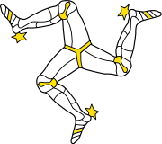
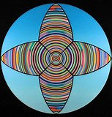
Thursday 25.06.20 – applying maths
Can you apply your learning to the world around you? Choose from these activities:
Take photographs of symmetrical objects or patterns in your garden
Draw/paint/chalk a symmetrical pattern
Cut of items with symmetry from a magazine and make a collage
Bake biscuits and add a symmetrical pattern
Look at European flags – how many have a line of symmetry?
What else can you do to discover more about symmetry?

Slide 10
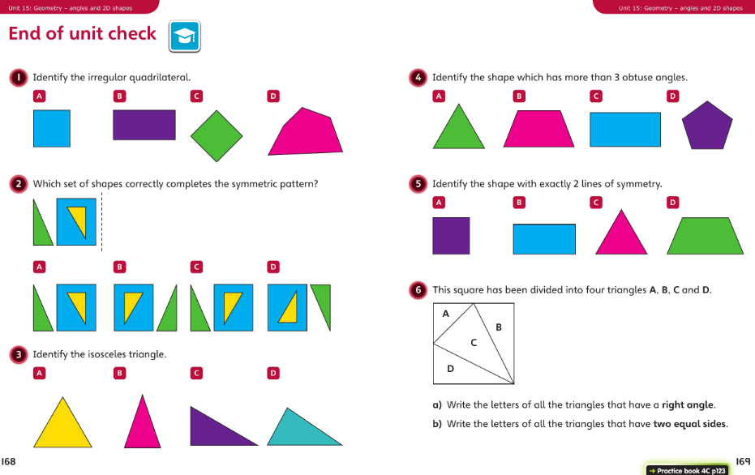
Friday 26.06.20 check-up

