Slide 1
Monday 22nd June – Parent notes 2 for MASS – kilograms and grams
This unit is important because it strengthens children’s knowledge of mass: an important area of learning which has many real-life applications.
First, children will learn how to measure and read a scale, focusing upon unmarked intervals.
Next, different masses will be compared and ordered.
Following this, children will learn to add and subtract different amounts, using a range of strategies.
Finally, they will apply their knowledge to real-life problems – an important skill for children to learn in life.
Before they start this unit, it is expected that children :
  can use scales to compare, estimate and measure the mass of an object
  are able to measure mass in grams and kilograms
  can count in hundreds to link grams to kilograms.

Slide 2
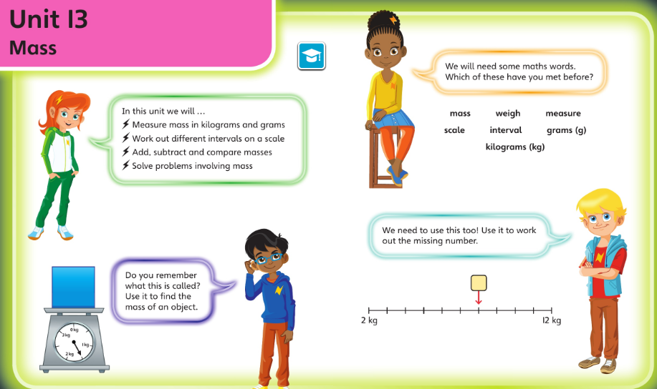
REPEAT: Check you’re happy with this vocabulary and these ideas before starting this unit

Slide 3
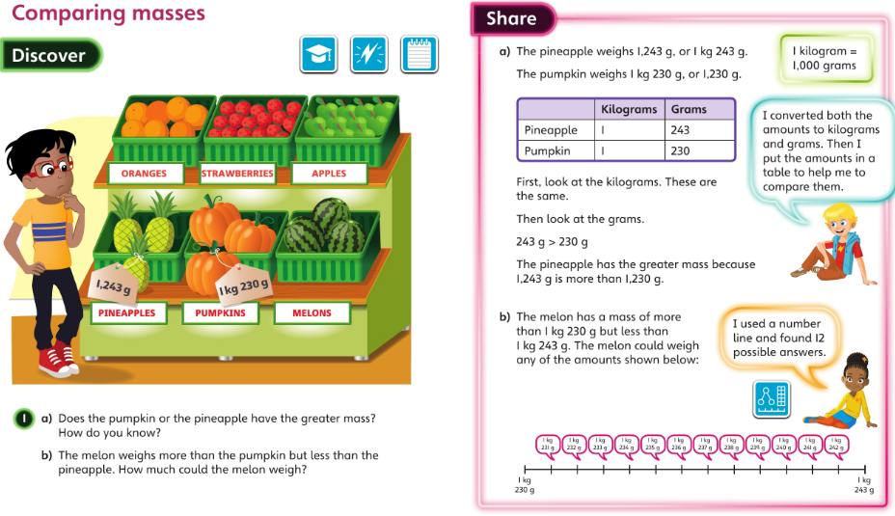
Monday 22.06.20 Overview L4

Slide 4
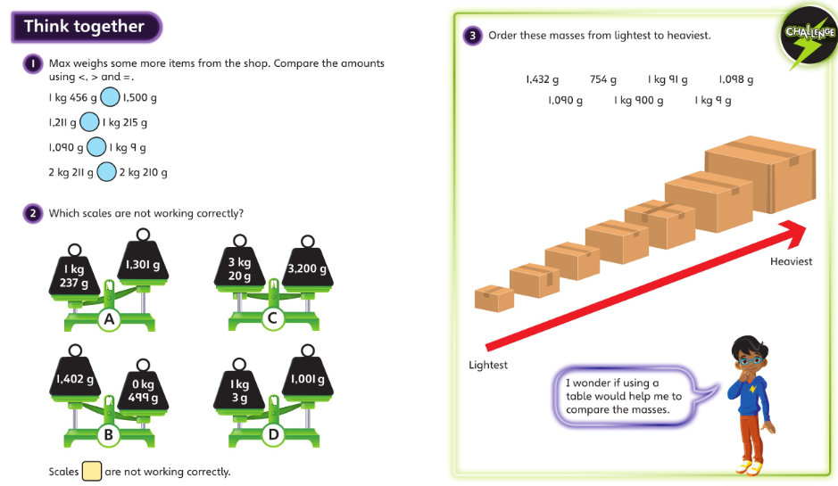
Monday talk together then page 110

Slide 5
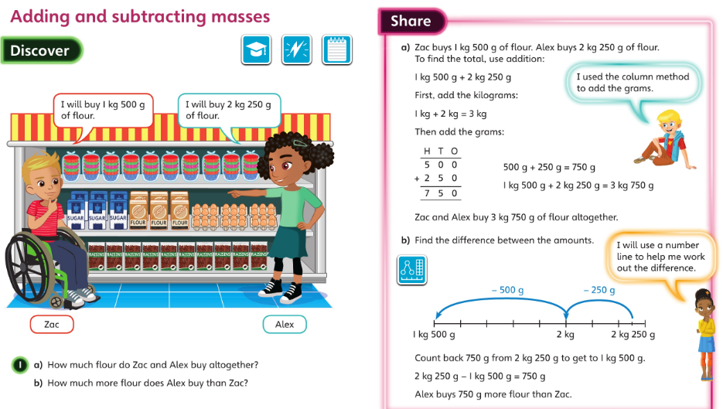
Tuesday 23.06.20 Overview L5

Slide 6
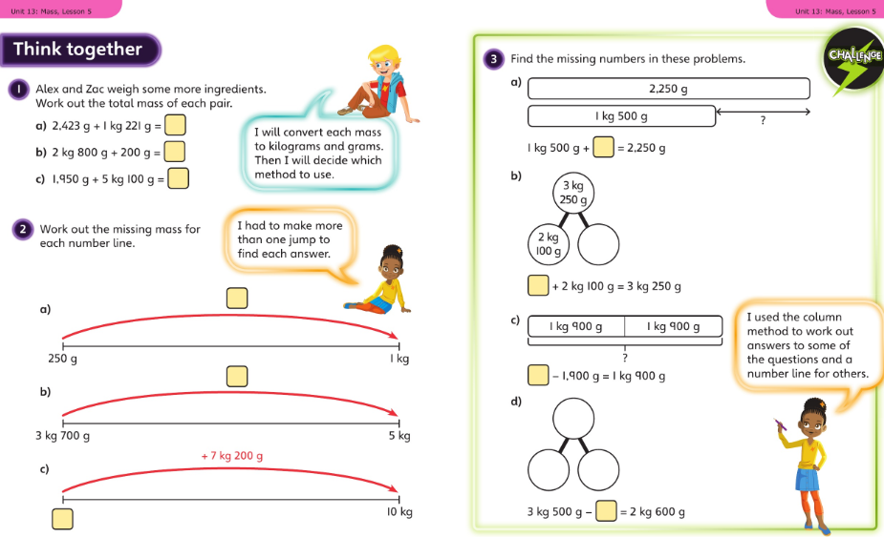
Tuesday talk together then page 113

Slide 7
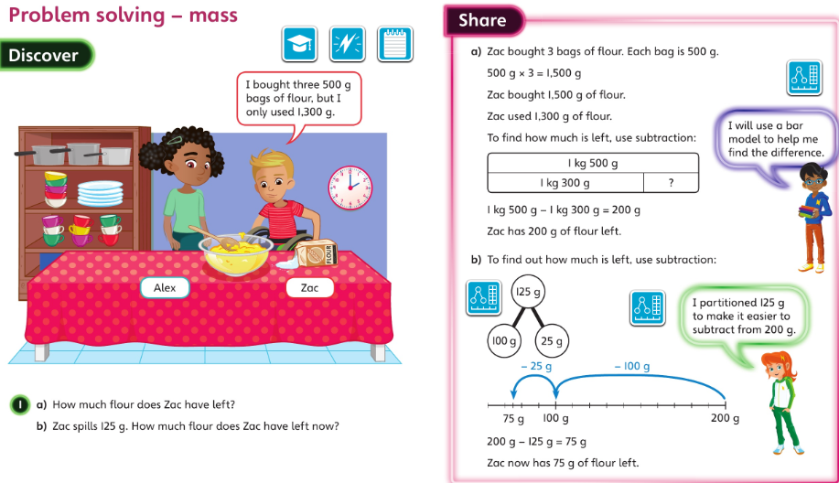
Wednesday 24.06.20 Overview L6

Slide 8
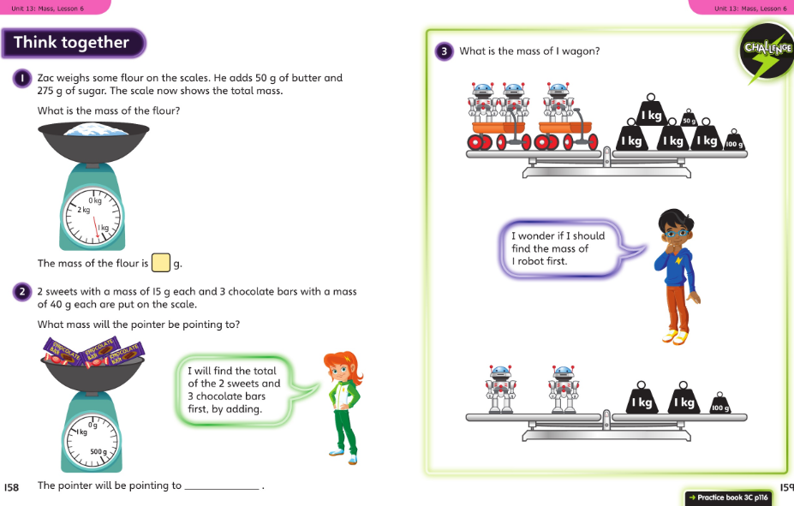
Wednesday talk together then page 116

Slide 9
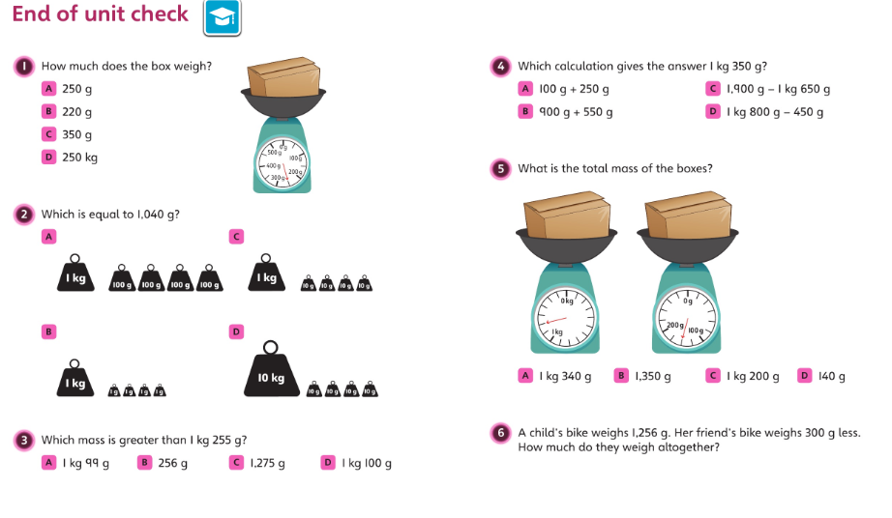
Thursday 25.06.20 end of unit

Slide 10
Thursday talk together then pg 119

Slide 11
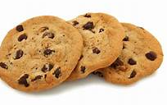

Friday 26.06.20 Overview
Using and applying maths
Can you follow a simple recipe? – weigh your ingredients to ensure you have the correct mass of each ingredient.
There are recipes for football or traffic light biscuits on the class page. Or you might have a cookery book you can use or a web recipe?
Please send me a photo of you using the scales.
What other times do you use a scale?

