Slide 1
Parents notes – END OF TERM
This is our last unit of the year.
It covers 6 lessons and 1 check-up which are all on this PowerPoint. It is up to you if you cover it all this week or take the last 2 slides into next week.
After this unit our maths will focus on general maths skills, application and times tables practice.
You may wish to look back through books B and C and revisit those areas your child found difficult.
As always please email me via finchparents if you have any specific queries or areas needing clarification when you’re revisiting topics.

Slide 2
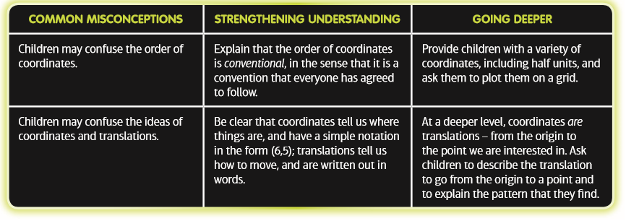
Parents notes – position and direction using co-ordinates
Coordinates use numbers to describe positions on a grid
This unit focuses on the use of coordinates to describe positions and movements, and provides a solid foundation in some key ideas that will be used in a wide variety of more advanced concepts.
This unit introduces children to coordinate grids, using them to describe positions of points and translations from one point to another.
Before they start this unit, it is expected that children: • know how to read positions on a number line (to the nearest half unit) • understand how maps and plans can be used to represent a ‘real-life’ scene • understand a range of simple ideas and vocabulary related to position and direction: for example left /right and horizontal/vertical.

Slide 3
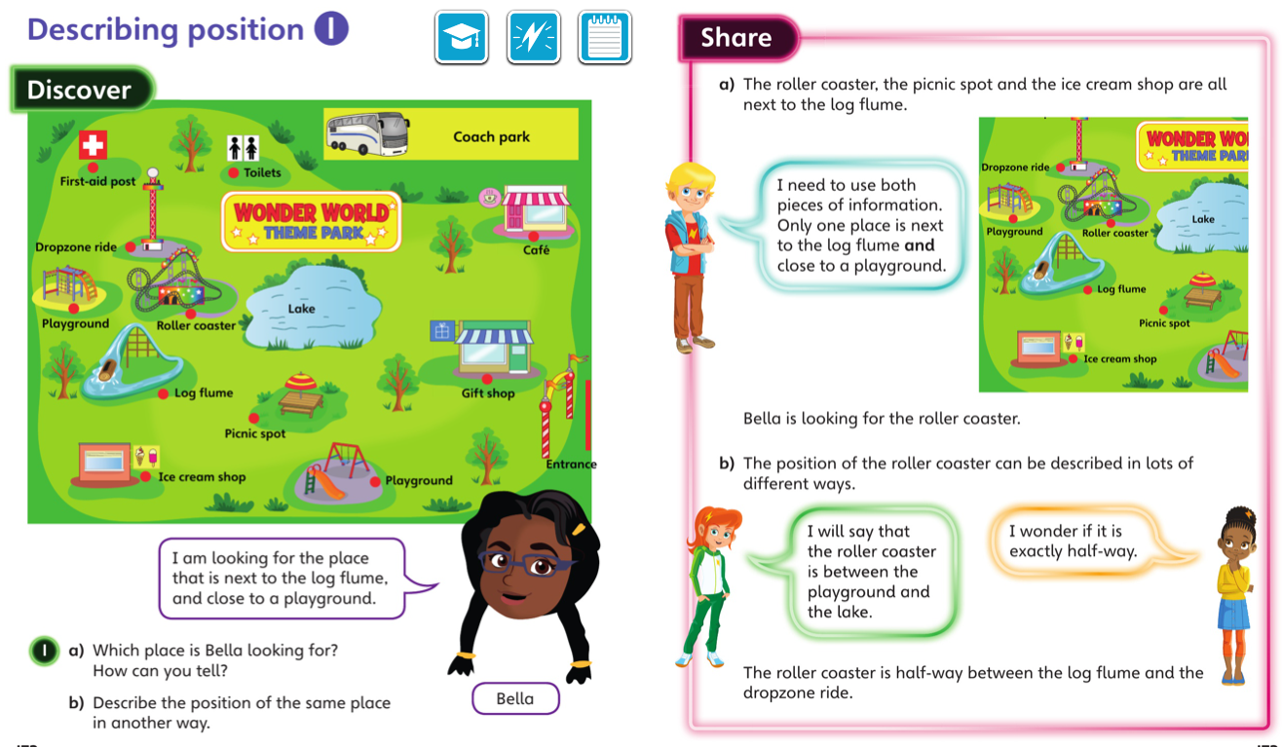
Monday 29.06.20 L1 overview

Slide 4
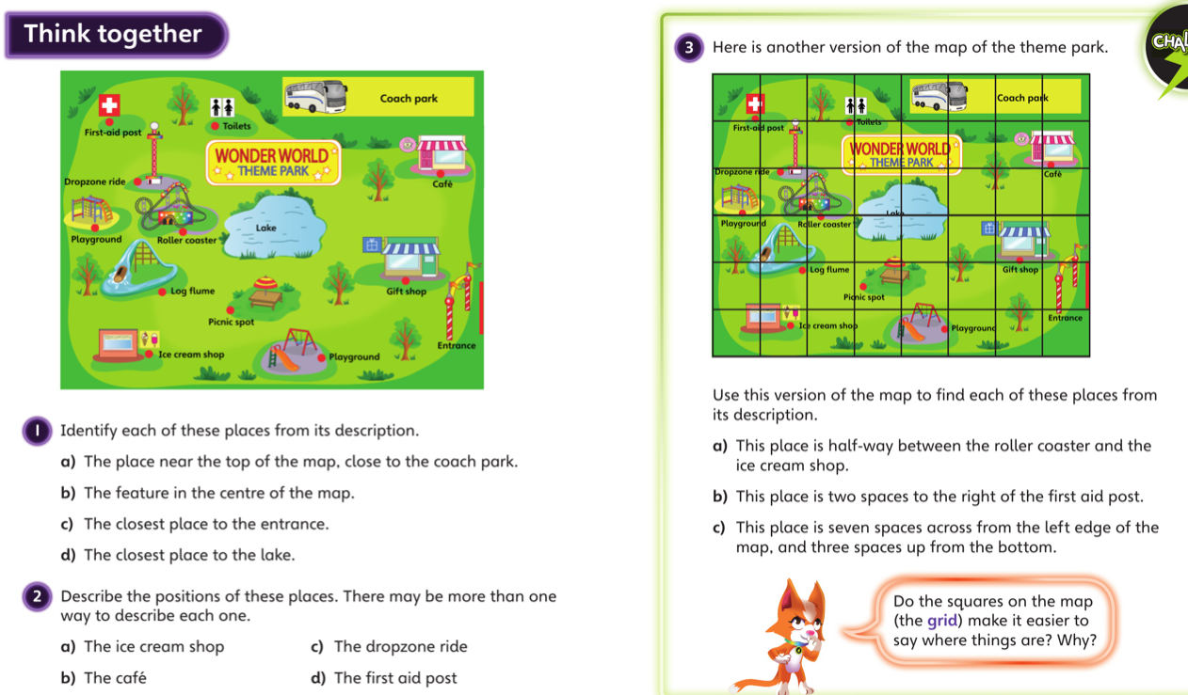
Monday – talk together then pg 126

Slide 5
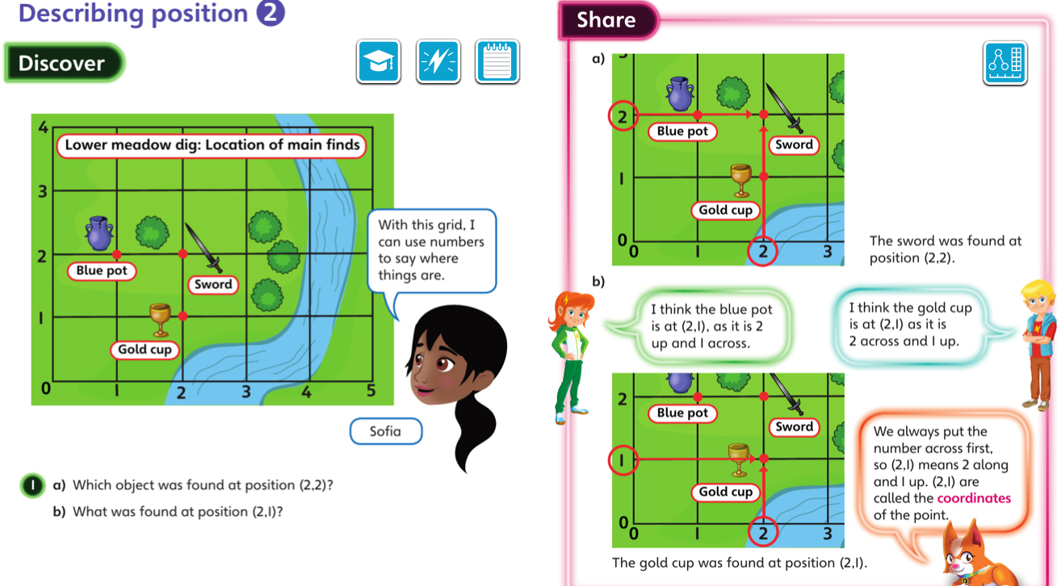
Tuesday 30.06.20 Overview lesson 2

Slide 6
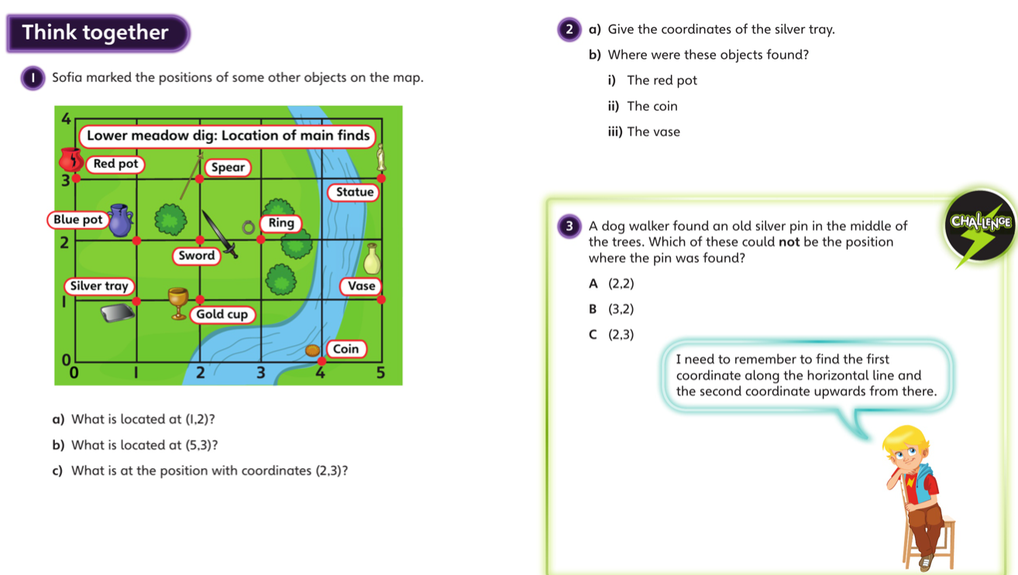
Tuesday – talk together then pg 129

Slide 7
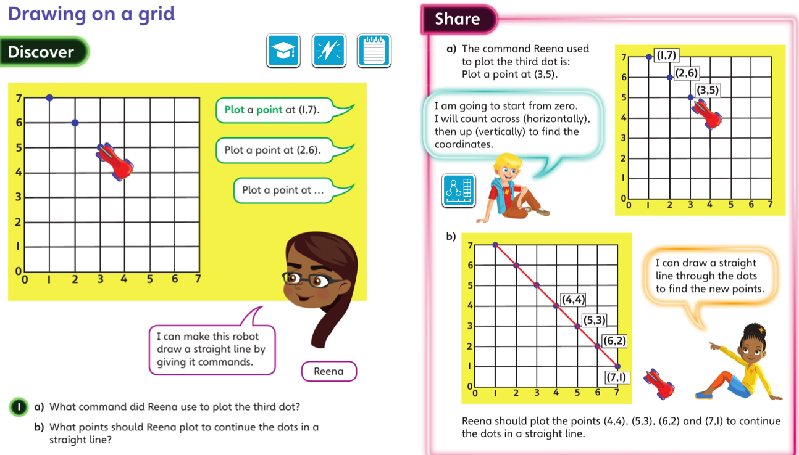
Wednesday 1.07.20 Overview L3

Slide 8
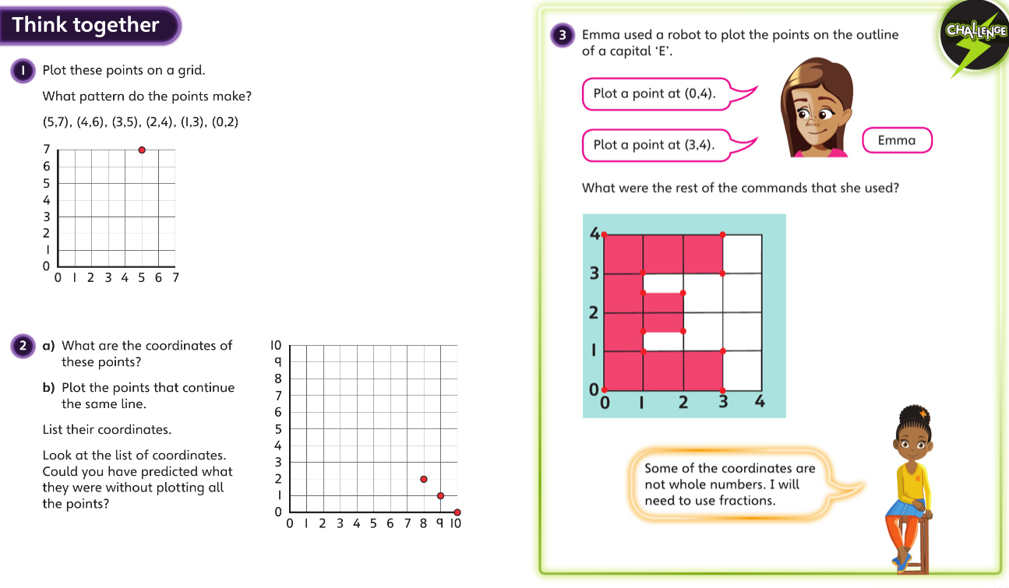
Wednesday talk together then page 131

Slide 9
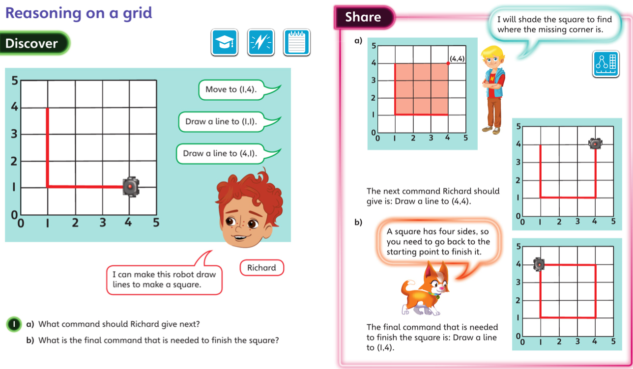
Thursday 2.07.20 Overview L4

Slide 10
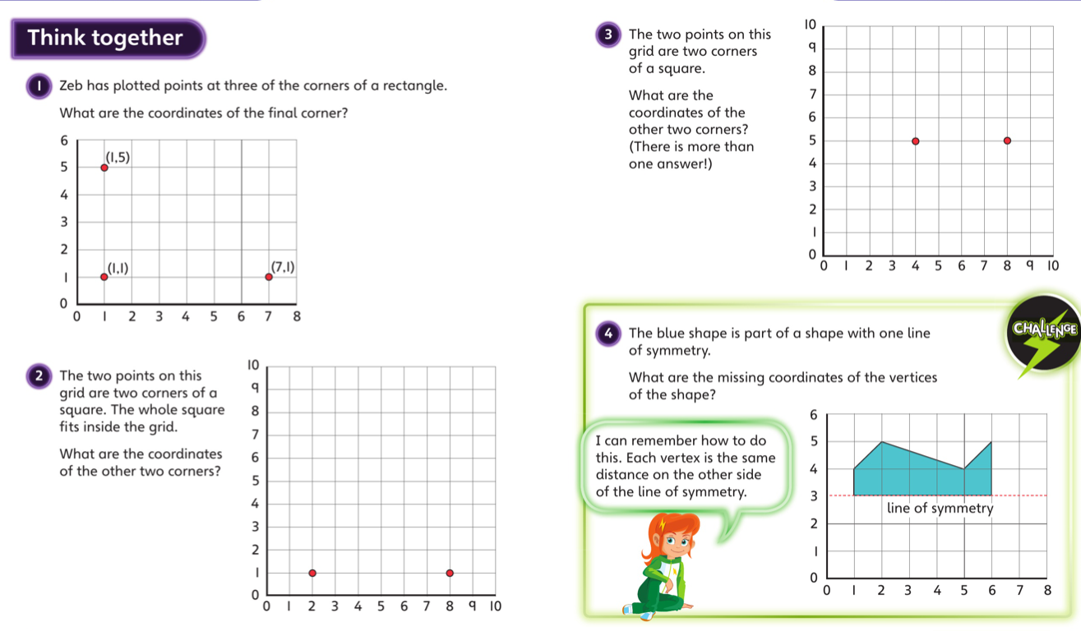
Thursday- talk together then page 134

Slide 11
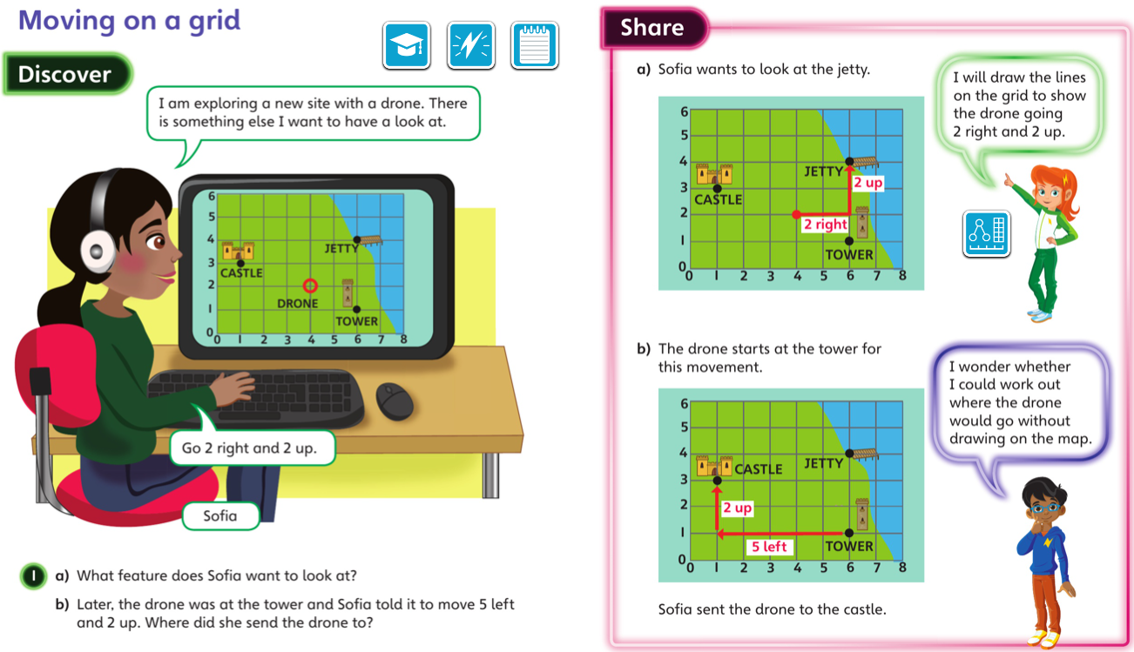
Friday 3.07.20 Overview L5

Slide 12
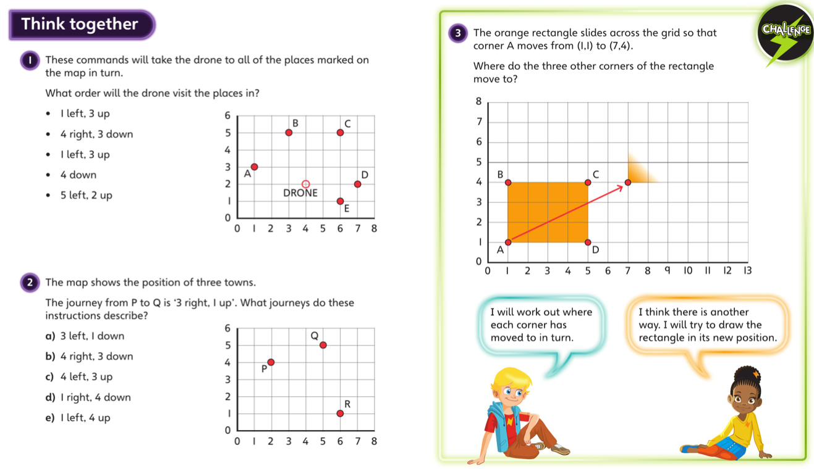
Friday talk together then pg 137

Slide 13
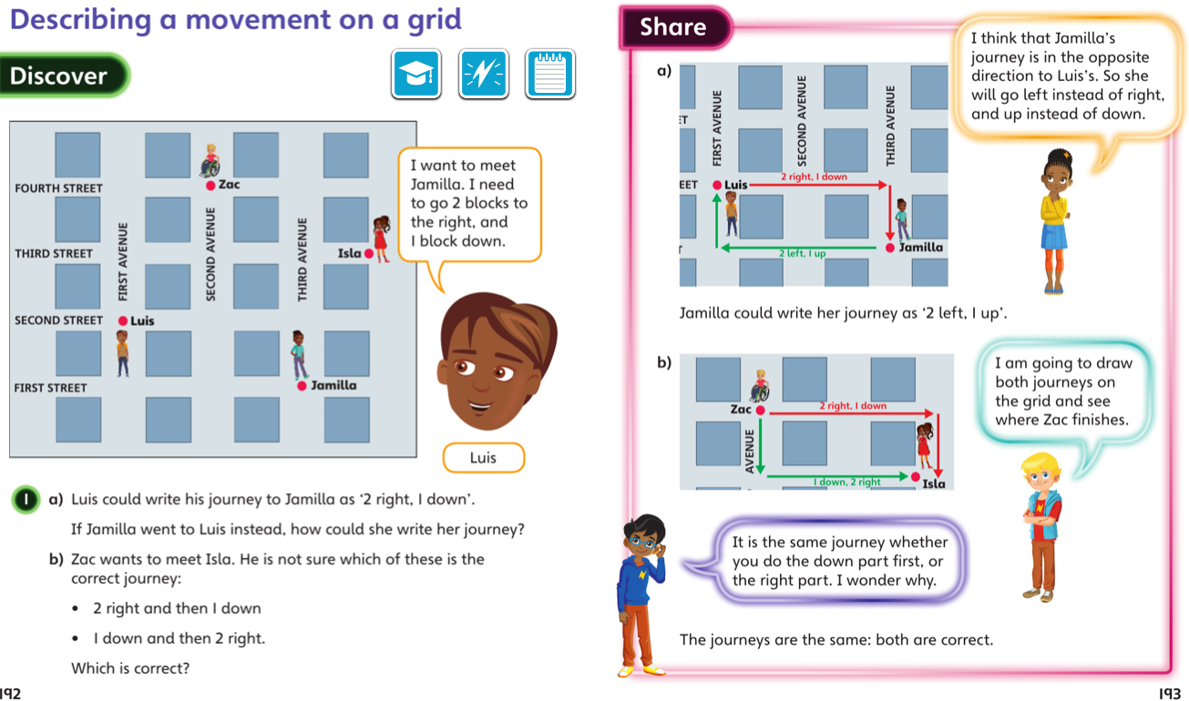
Final lesson

Slide 14
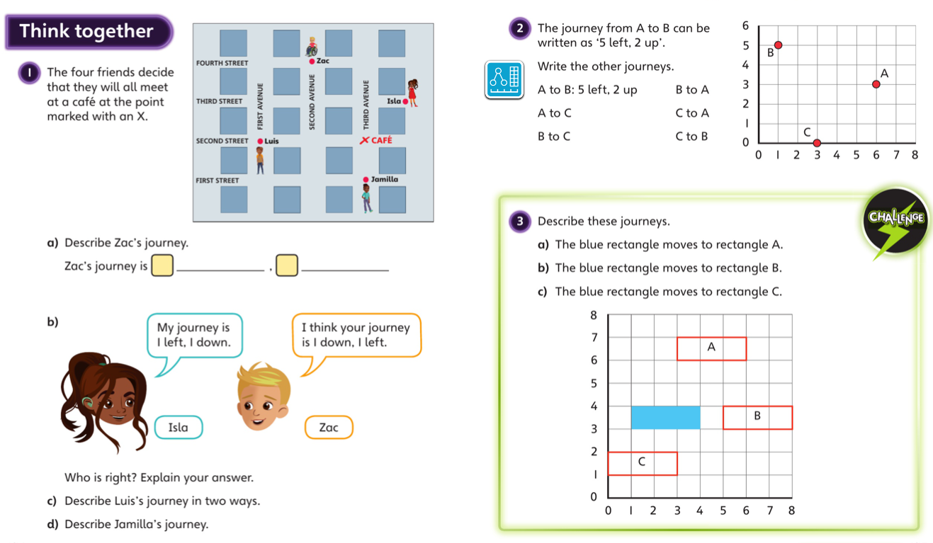

Slide 15
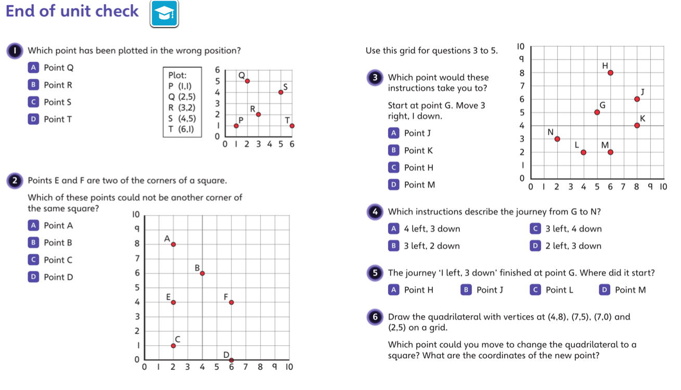
Check up

