Slide 1
Parents notes – END OF TERM
This is our last unit of the year.
It covers 6 lessons and 1 check-up which are all on this PowerPoint. It is up to you if you cover it all this week or take the last 2 slides into next week.
After this unit our maths will focus on general maths skills, application and times tables practice.
You may wish to look back through books B and C and revisit those areas your child found difficult.
As always please email me via finchparents if you have any specific queries or areas needing clarification when you’re revisiting topics.

Slide 2
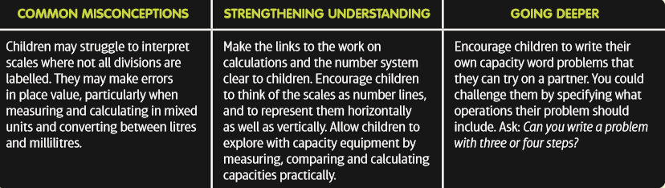
Parents notes – capacity
This unit asks children to interpret a range of scales and apply their knowledge of place value and the number system.
Children will learn to compare and order measurements, and convert between millilitres and mixed units of litres and millilitres.
They will then use knowledge of all four operations to solve problems involving capacity.
Children should already have experience in reading and interpreting a range of scales and converting between units of measure, which will help them in this unit. Before they start this unit, it is expected that children: • understand place value in 3-digit numbers • know how to add and subtract 3-digit numbers • know multiplication facts for the 2, 5 and 10 times-tables.

Slide 3
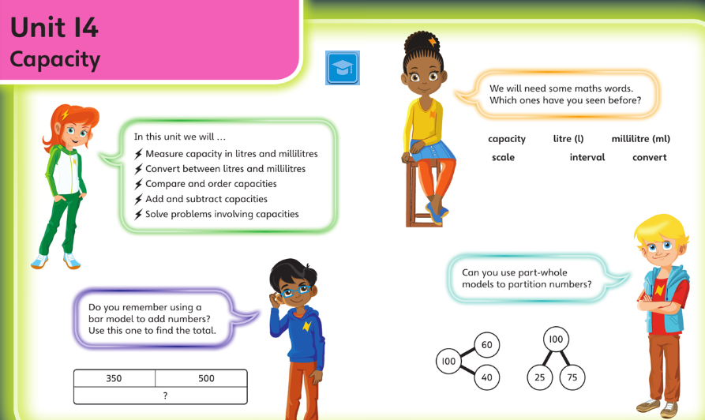
Vocabulary and key ideas

Slide 4
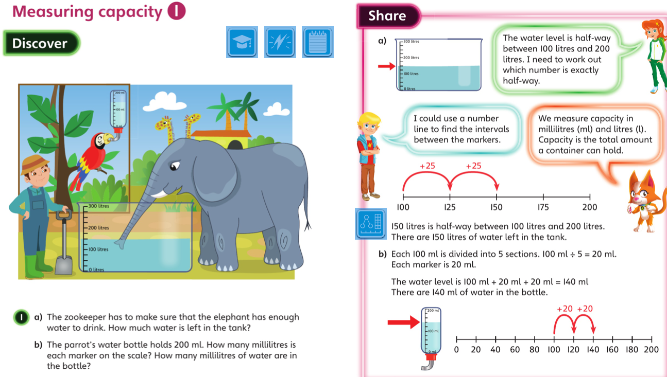
Monday 29.06.20 L1 overview

Slide 5
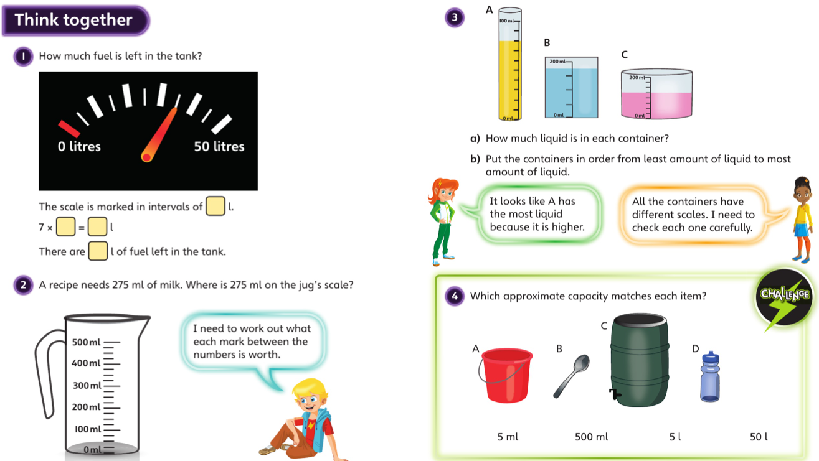
Monday – talk together then pg 121

Slide 6
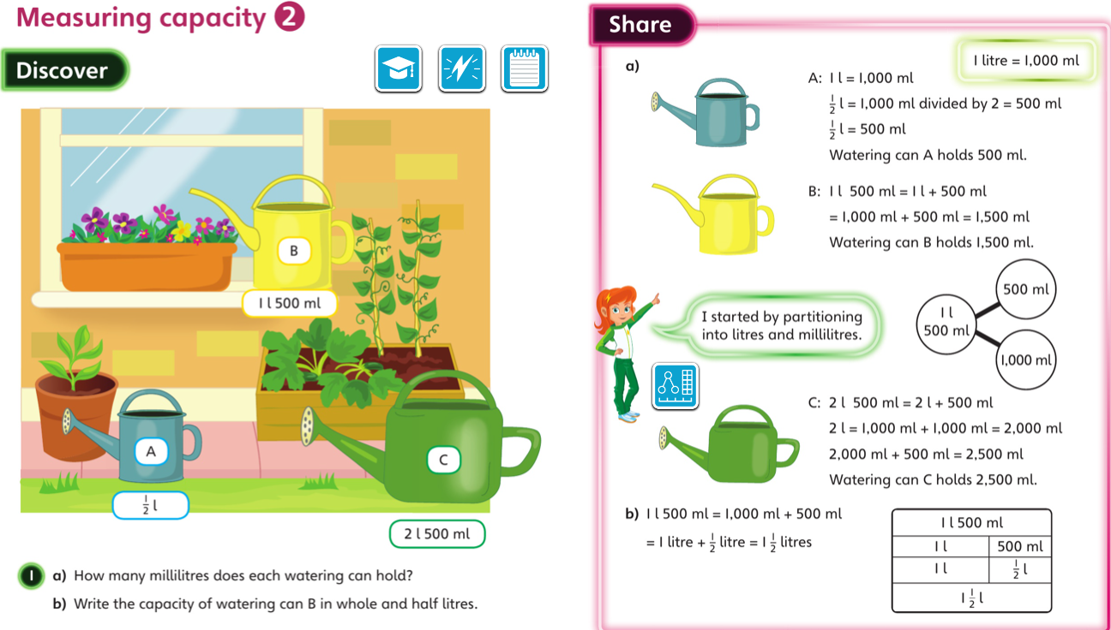
Tuesday 30.06.20 Overview lesson 2

Slide 7
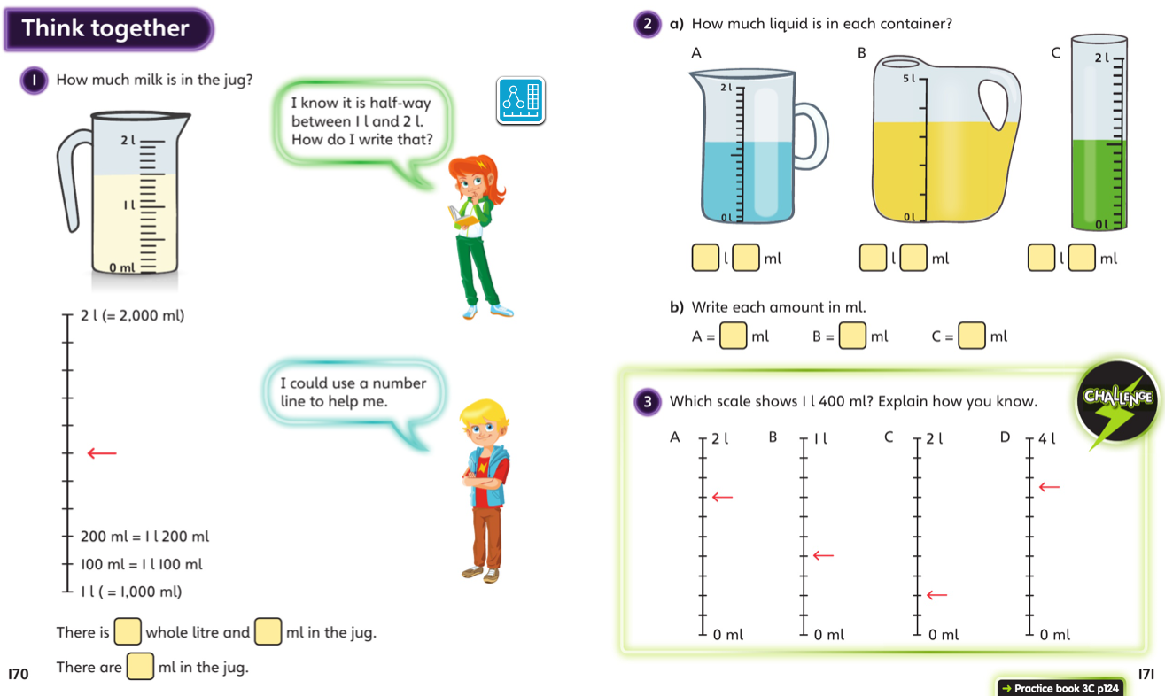
Tuesday – talk together then pg 124

Slide 8
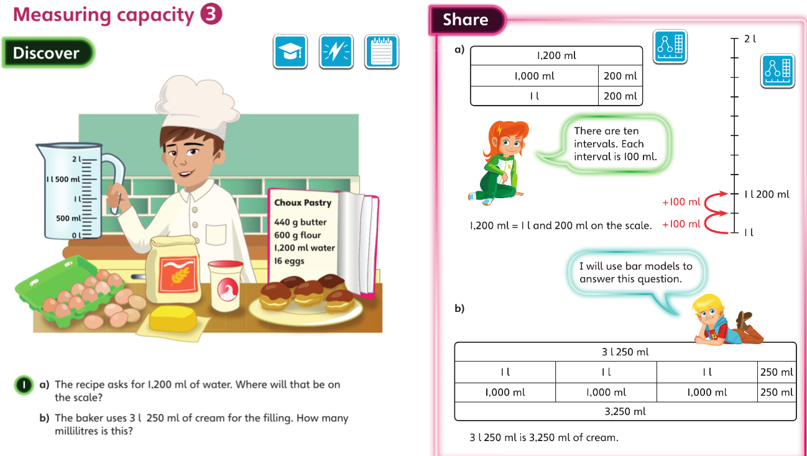
Wednesday 1.07.20 Overview L3

Slide 9
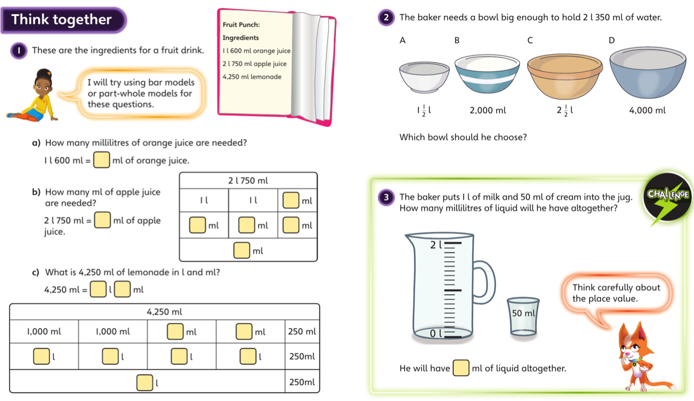
Wednesday talk together then page 127

Slide 10
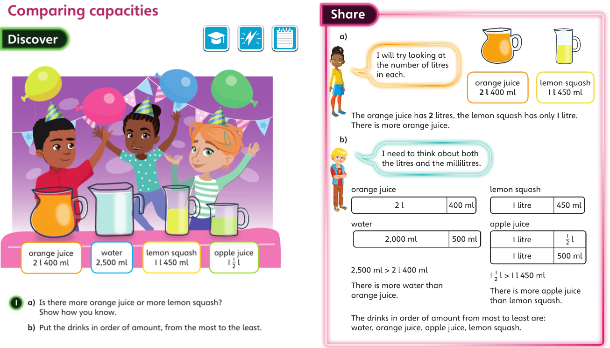
Thursday 2.07.20 Overview L4

Slide 11
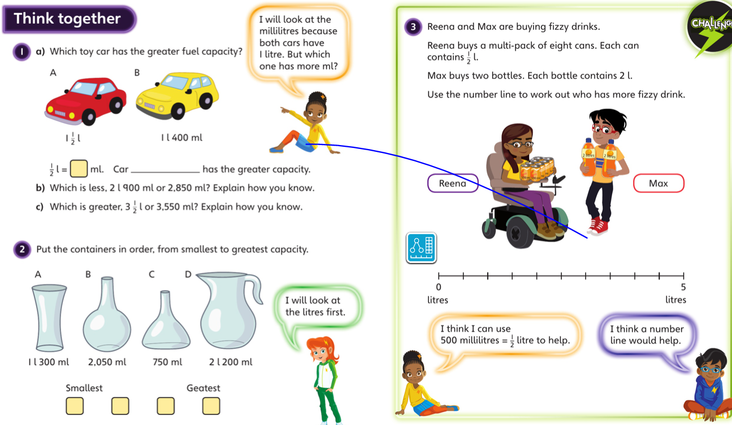
Thursday- talk together then page 130

Slide 12
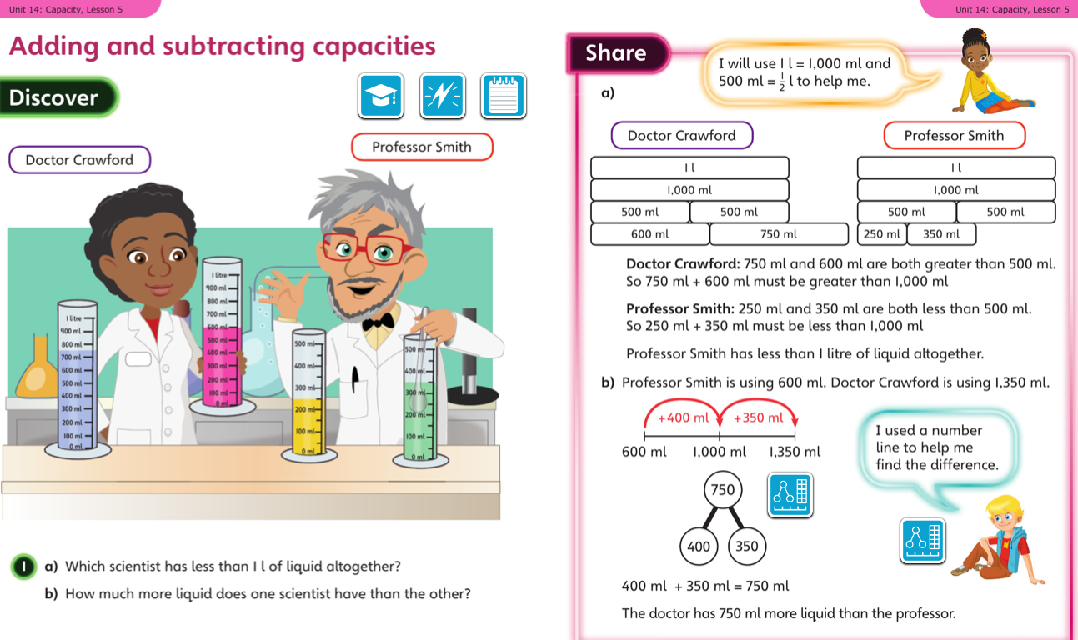
Friday 3.07.20 Overview L5

Slide 13
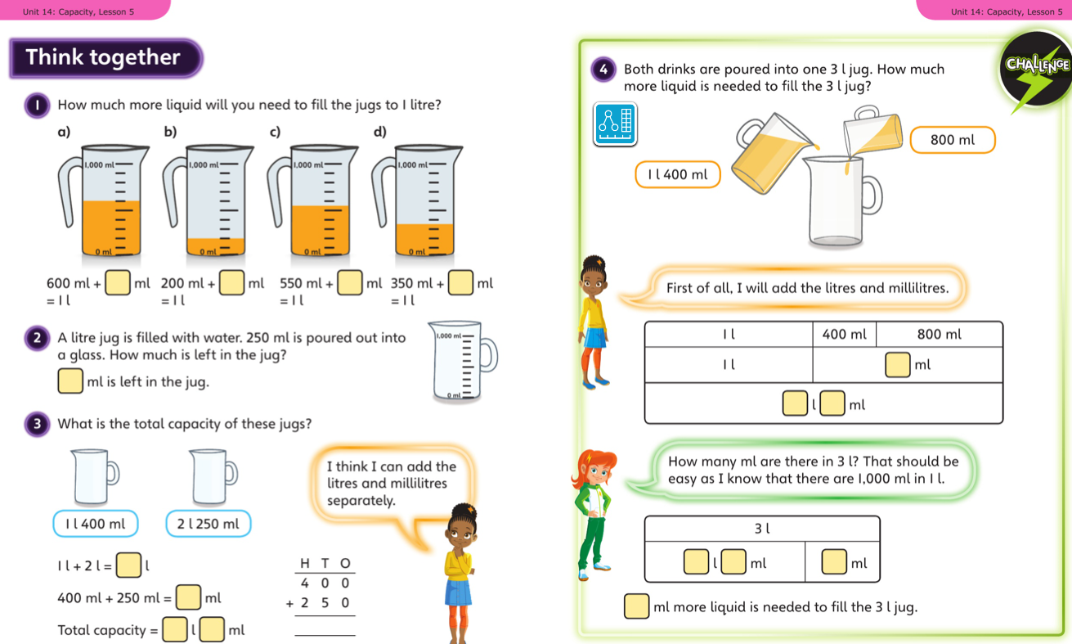
Friday talk together then pg 133

Slide 14
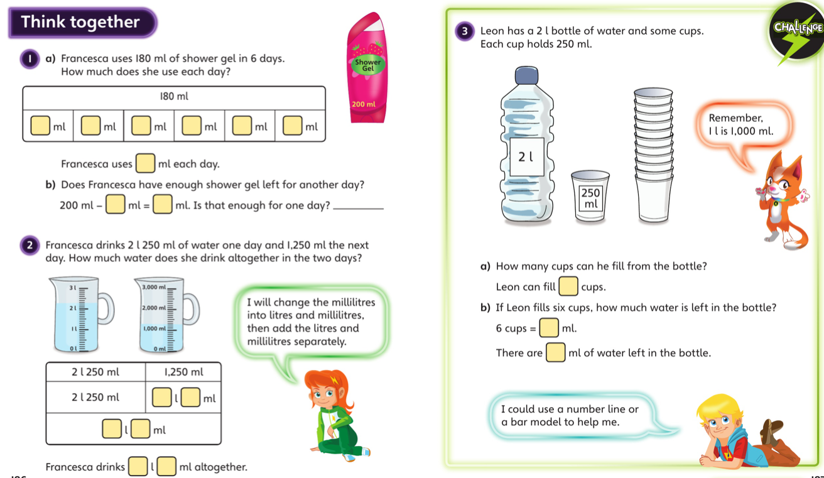
Final lesson

Slide 15


