Slide 1
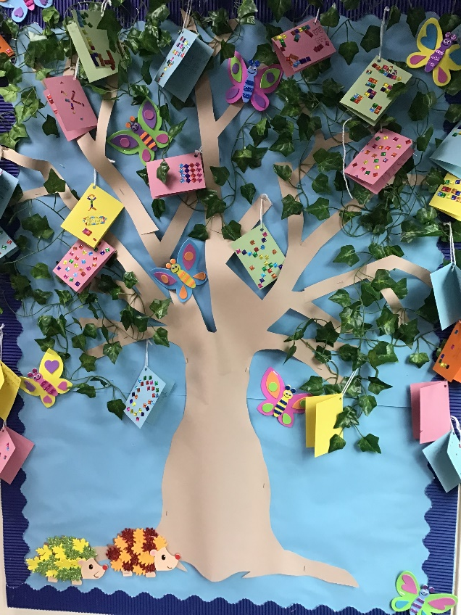
Welcome to Chaffinch Class
Year 3 and 4
Mrs Dodds : Monday – Thursday Morning
Mrs Gan : Thursday am - all day Friday
Mrs Farrell: Monday – Friday
Sports coach – Mr O’Reilly ( Wednesday)

Slide 2
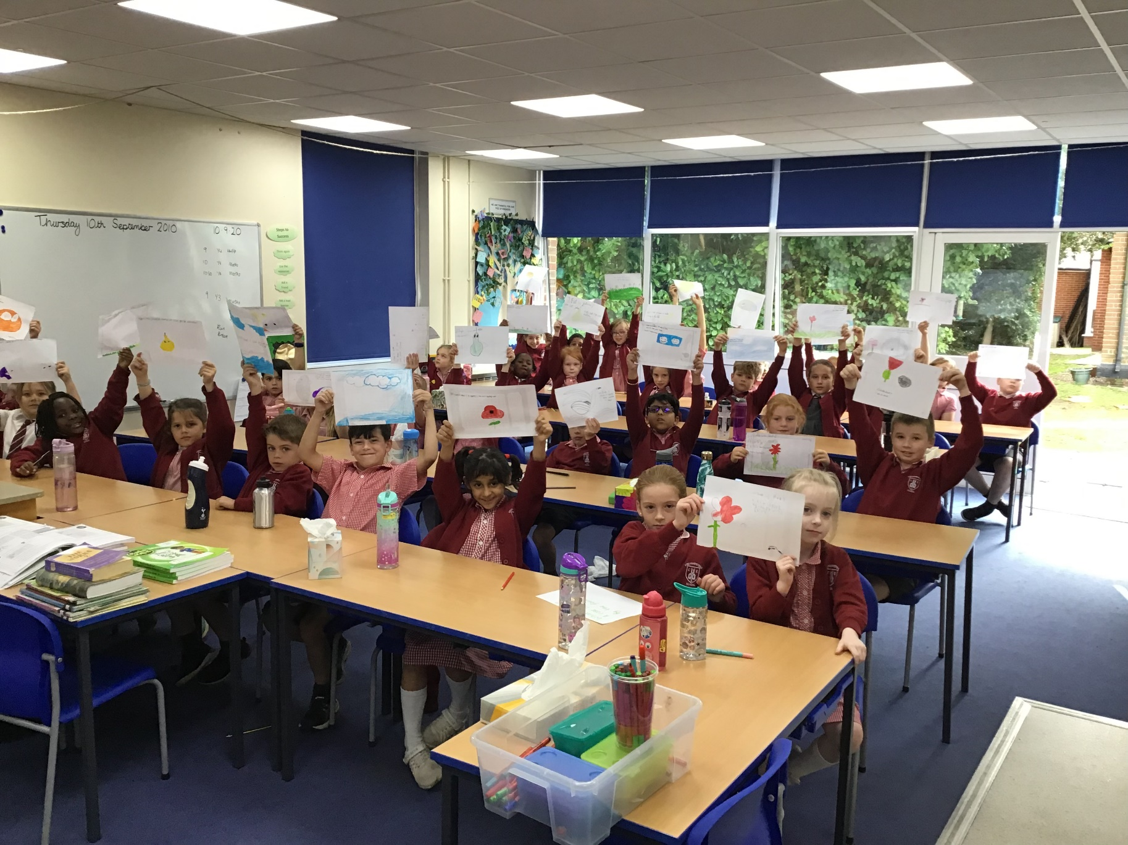

Slide 3
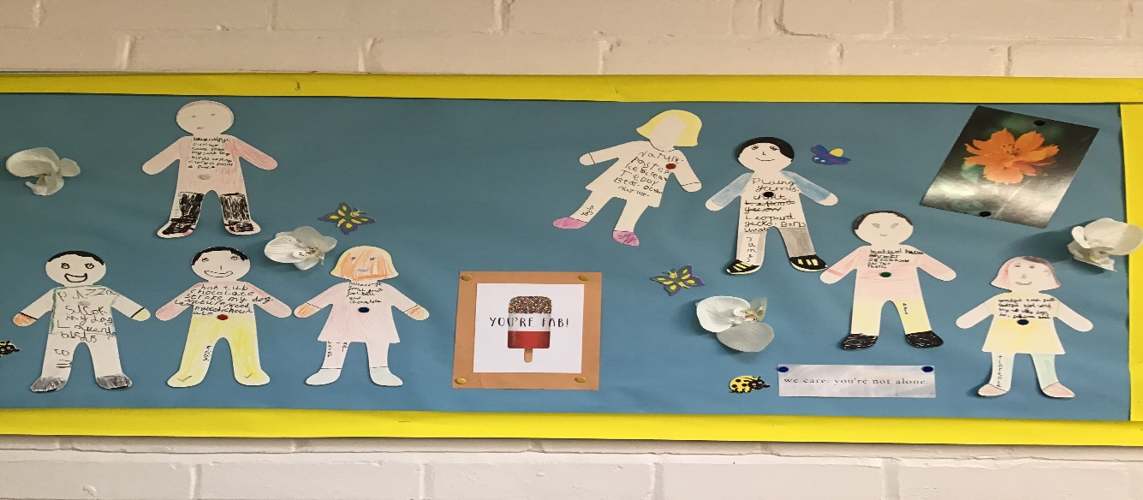
What equipment do I need?
Packed lunch if required
Small box of tissues and hand gel
Trainers every day
Jumpers and warm coat as outside doors will be open and we’ll be learning outside a lot
Water bottle with a sports lid to avoid spillages
Healthy snack – fruit or veg only please
All other equipment is provided by school this term

Slide 4
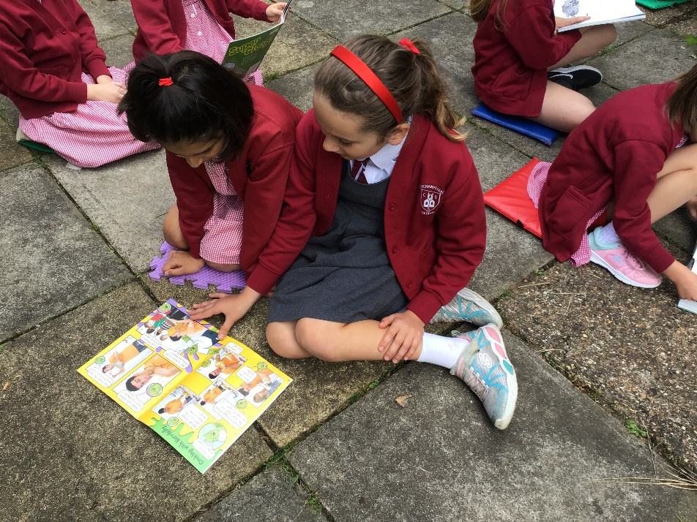
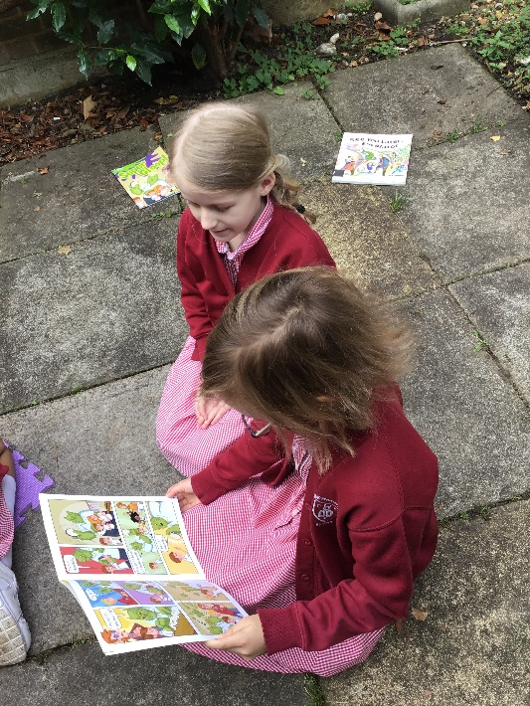
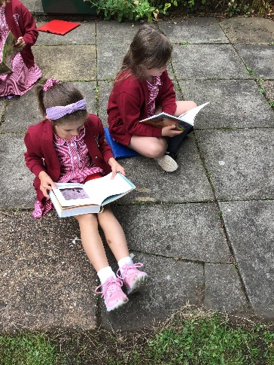
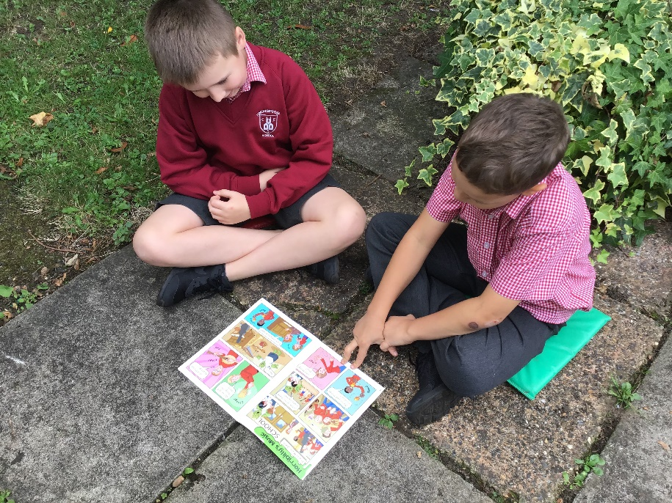
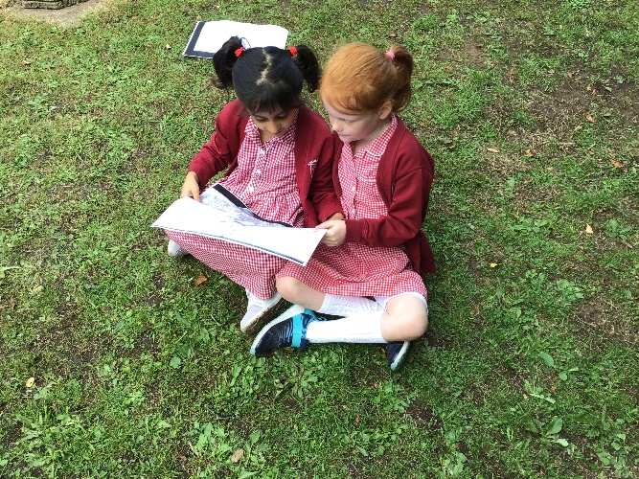

Slide 5
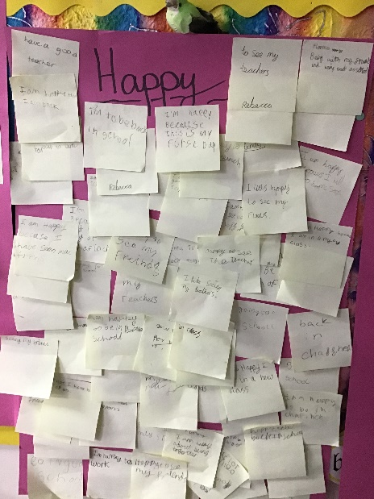
Routines
Morning Challenge and register
Maths in single year groups
Spelling / handwriting / grammar focus
Daily run
Break and Snack ( please provide fruit or veg and keep this separate to your child’s lunch)
English
Assembly
Lunchtime
Foundation subjects (science, RE, history, PE etc)
Story
Home time
Water bottles are on the table to drink as required
Toilet breaks are encouraged at break or lunchtime but children can also go at an appropriate part of the lesson
As we can no longer take messages on the door, please email the office to update the teacher on anything special for that day.

Slide 6
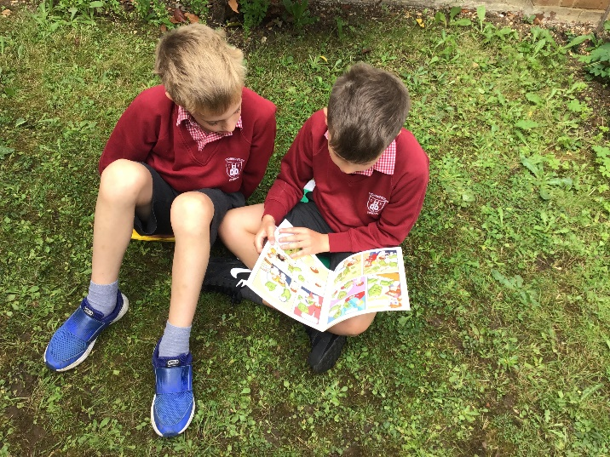
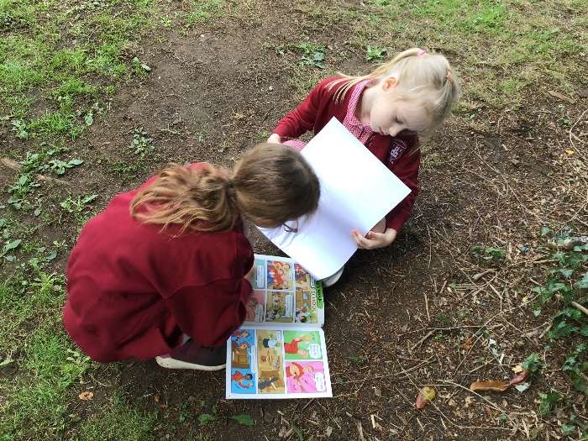
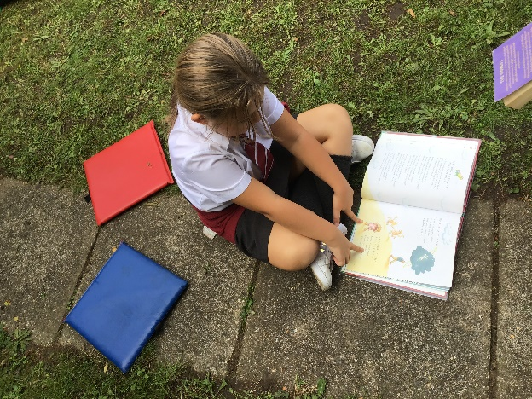
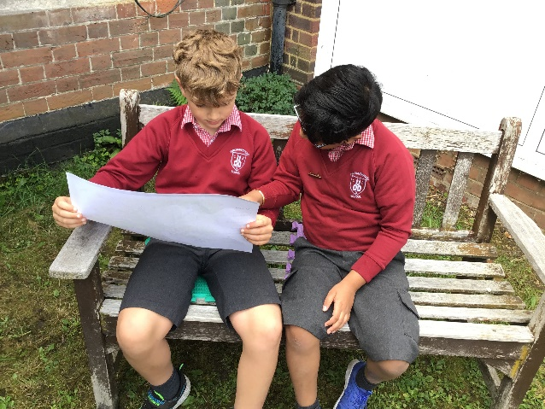
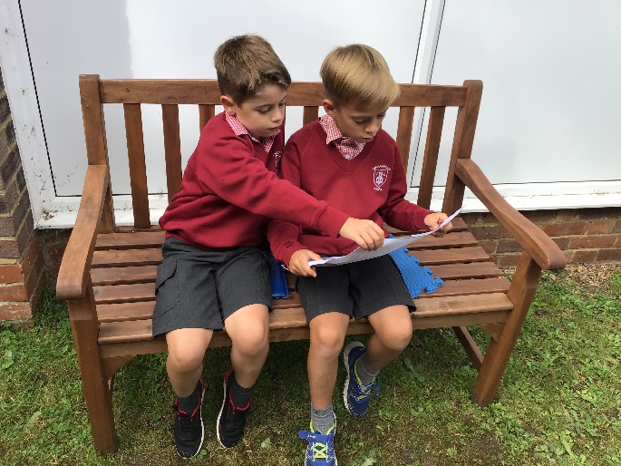
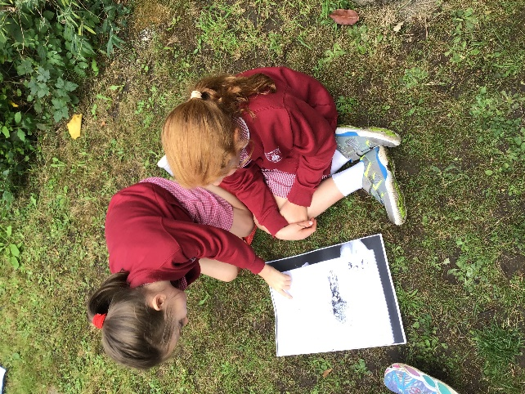
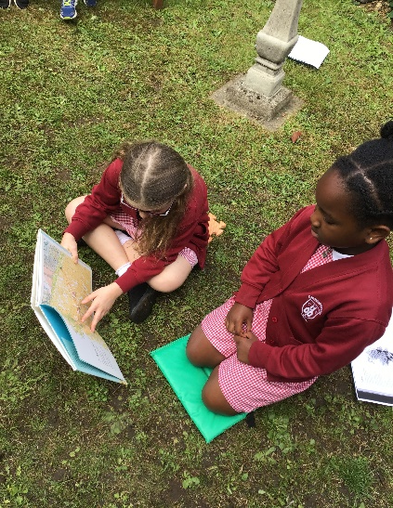

Slide 7
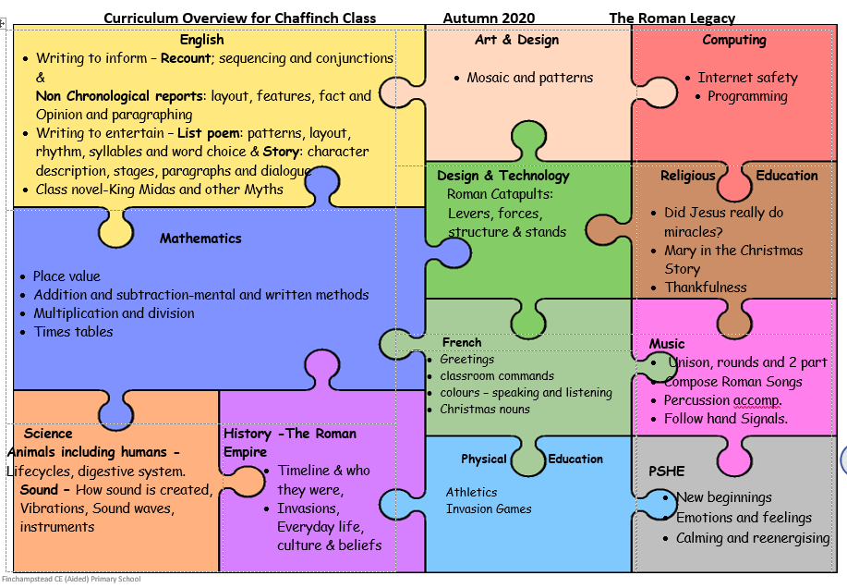
Chaffinch Curriculum

Slide 8
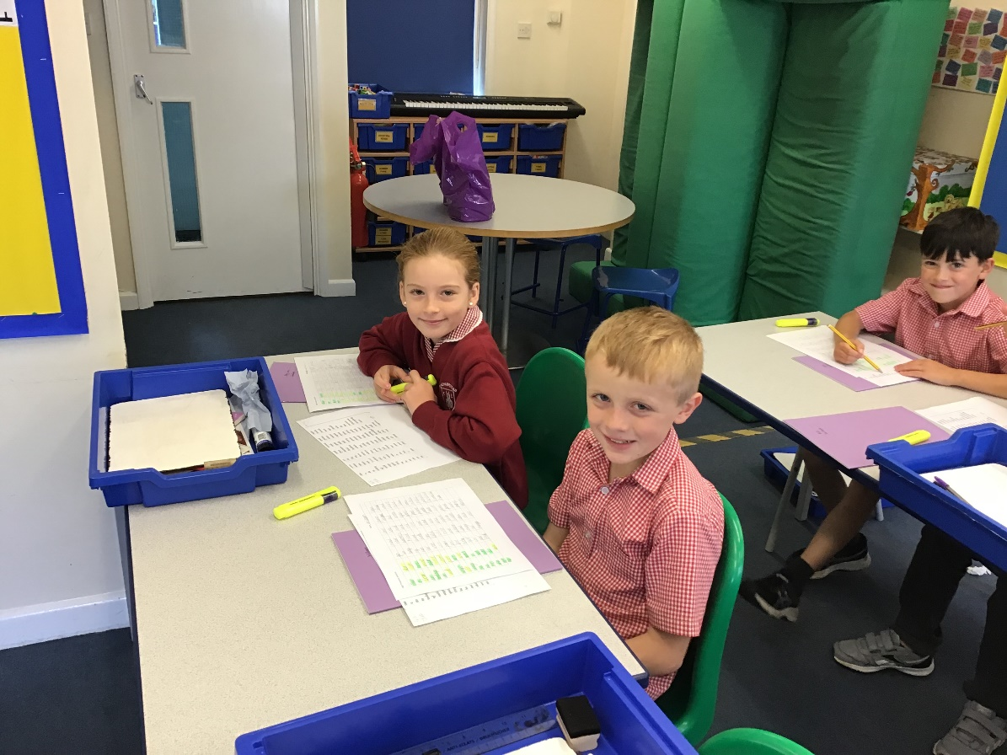
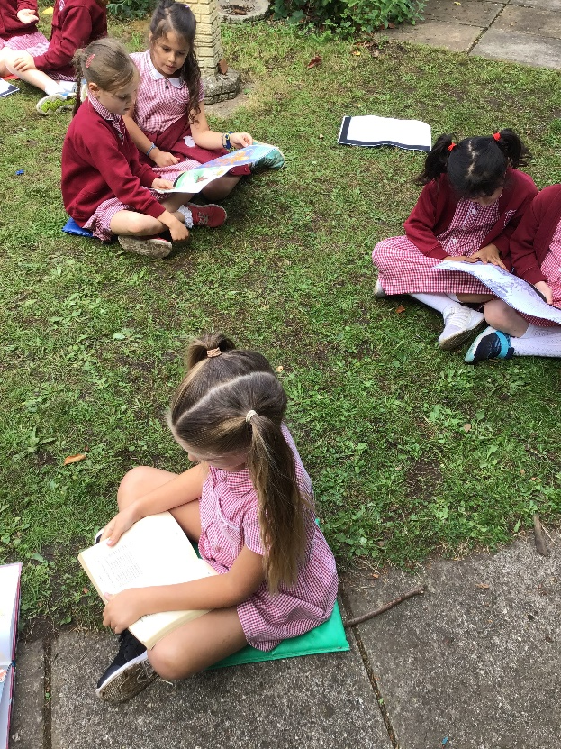
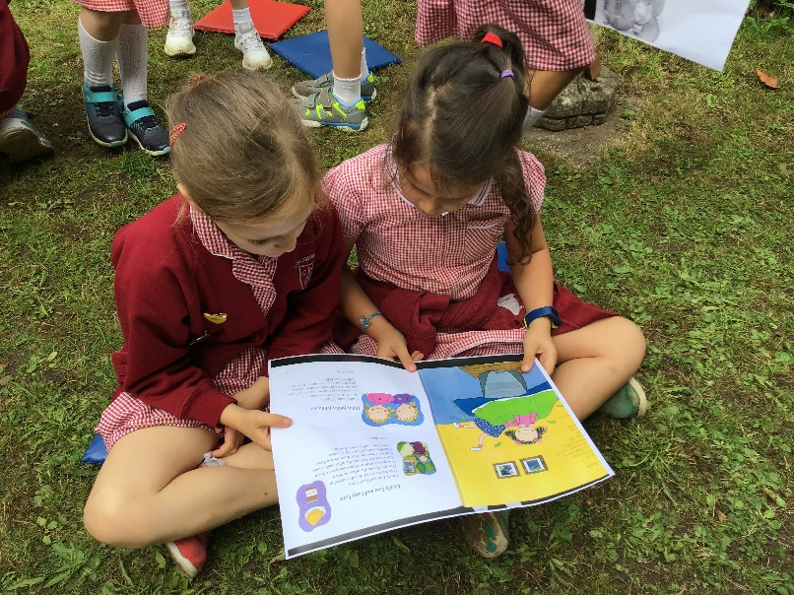
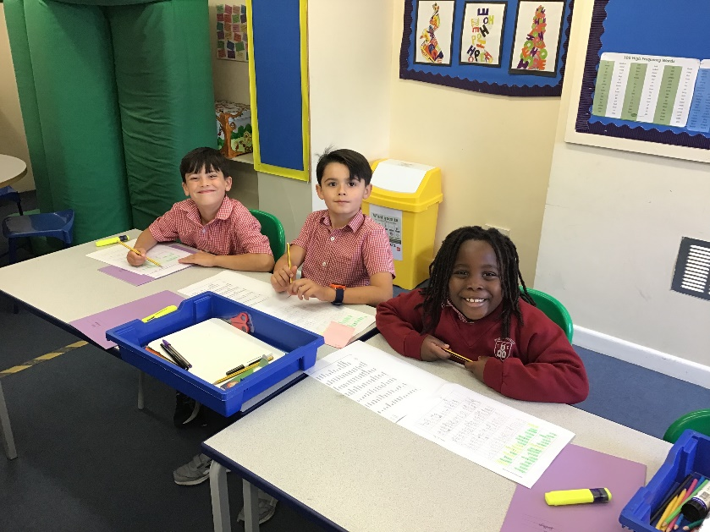

Slide 9

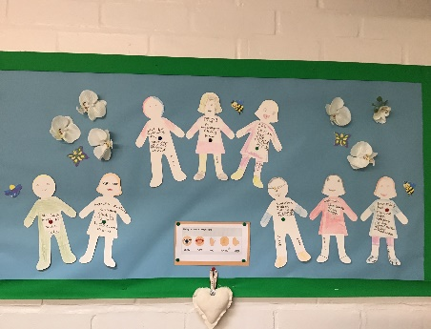
Home Learning
All homework will be set on Google Classrooms
Once completed it should be uploaded back on Google Classroom so teachers can view and comment if appropriate
Spellings – set on Mondays each week; daily practice
Timetables – regular practice on Time tables rock stars and homework
Reading:
  This is such an important skill and progress can really be accelerated by regular home reading to support our classroom learning
  Children on the reading scheme will change books on Monday’s and Thursdays ONLY. They should read daily for c 10 minutes
  Children who usually have library books should still read daily and reading will be logged on Google Classroom
  All children have a school reading book to keep in their tray to
  read at school. This is changed Tuesdays and Fridays.

Slide 10


