Slide 1
Welcome to Chaffinch Class
Year 3 and 4
Mrs Dodds : Monday – Thursday am
Mrs Gan : Thursday pm - all day Friday
Mrs Grey: Monday, Tuesday
Mrs Martinez: Wednesday
Mrs Baker: Thursday, Friday
Mrs Coulson and parental volunteers in the afternoons
Sports Coach – Mr O’Reilly ( Wednesday)

Slide 2
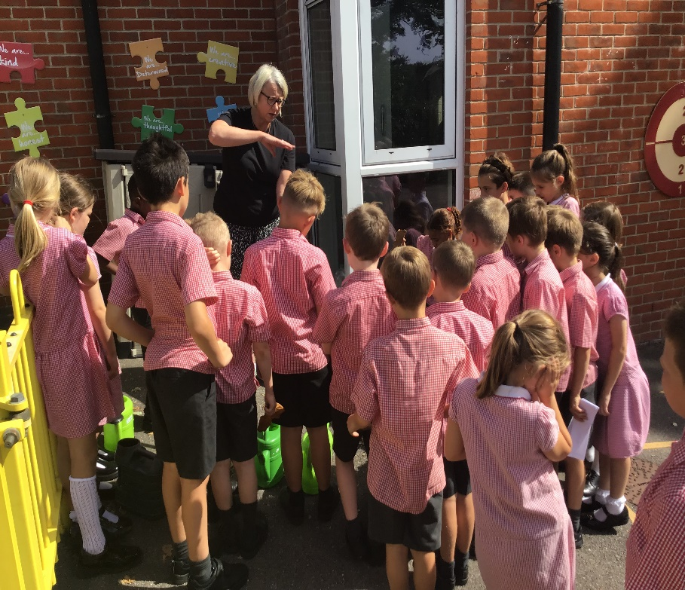
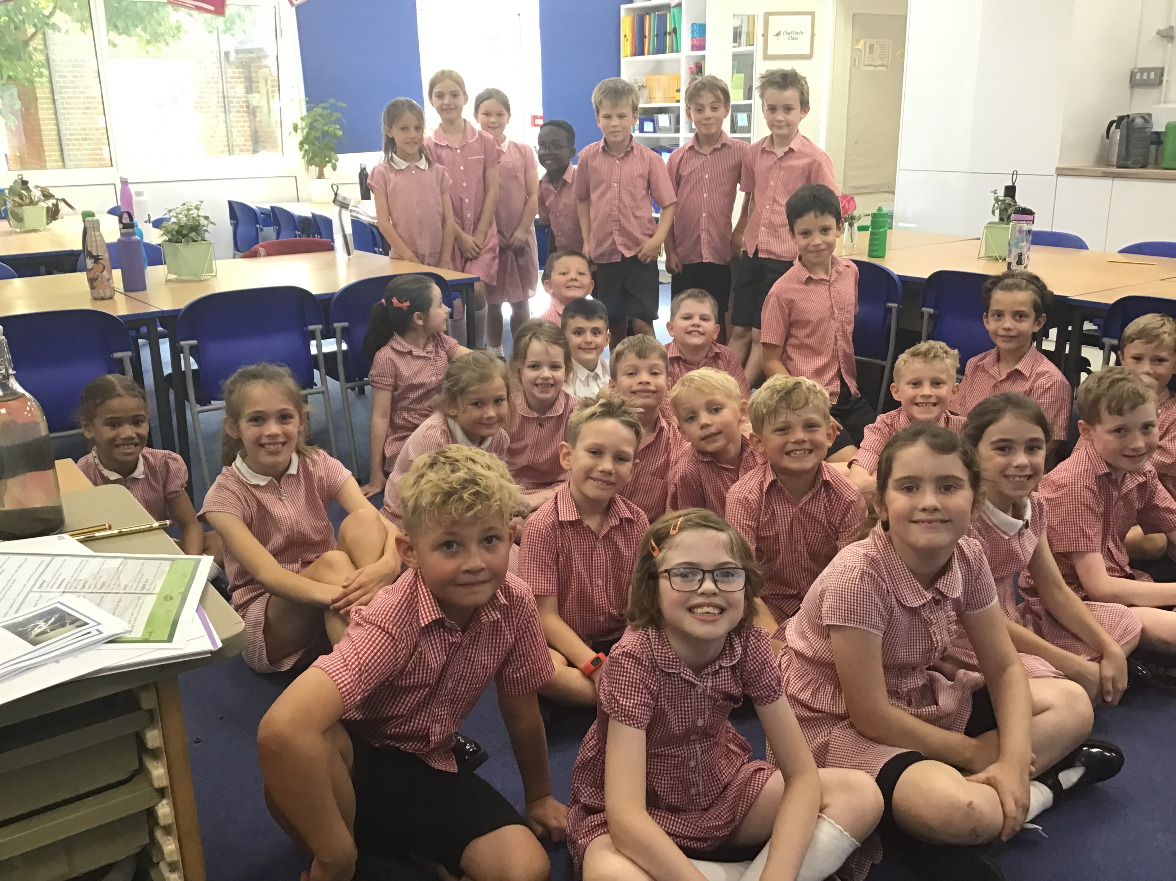
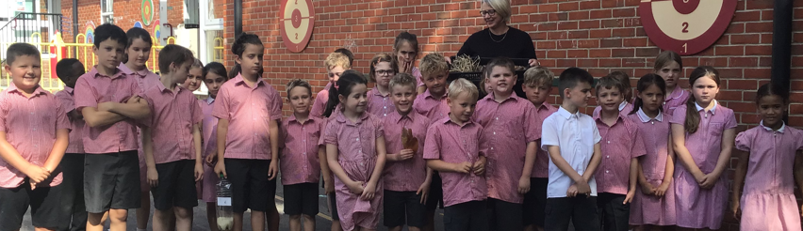
Welcome to Chaffinch

Slide 3

Who’s who?
Please come and say hello at pick up – we enjoy sharing your child's progress with you.
Mrs Dodds : Monday – Thursday am
Mrs Gan : Thursday pm - all day Friday
Mrs Grey: Monday, Tuesday
Mrs Martinez: Wednesday
Mrs Baker: Thursday, Friday
Mrs Coulson and parental volunteers in the afternoons
Sports Coach – Mr O’Reilly ( Wednesday)
Contact us:
Leave a message on the door at drop off
Email finchparents@finchampstead.wokingham.sch.uk
Call the office
Speak to us at pick up

Slide 4
Equipment
PE kit Monday, Wednesday or when advised
Art shirt or apron Fridays or when advised
Reading book and reading record every day – detailed check on Thursdays
No Pencil cases please but we would welcome donations of coloured pencils and glue sticks
Water bottle with a sports lid to avoid spillages
Healthy snack for break time – fruit or veg only please.

Slide 5
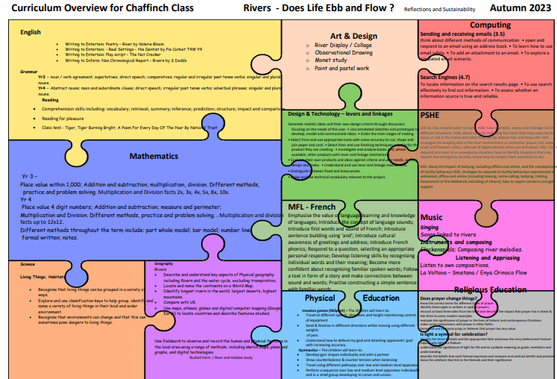
Chaffinch Curriculum and updates - see the school website
https://www.finchampsteadschool.org/class-information/
Click on the above link and then ‘termly overview’ to see the detail of each term.
Class pages are updated to show more detail and celebrate our learning.
We also post information and photographs of learning in each of the subject areas under the ‘Our Curriculum’ tag.

Slide 6
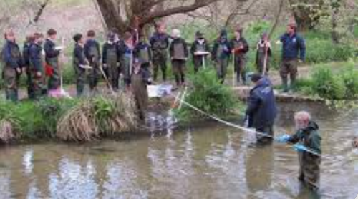
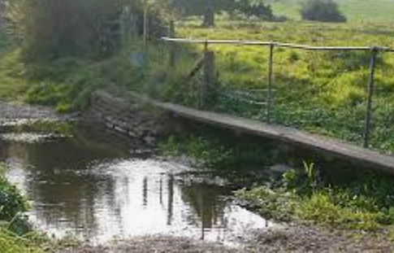
Trips and Visits
Autumn: 9th October trip to River Pang in Bradfield – a separate letter with details will follow
Spring: TBA ‘Viking Day’ in school
Summer: TBA ‘European Fair’ learning event in school

Slide 7

Can you help?
We are always looking for volunteers in Chaffinch Class. If you would be able to help with reading, trips, learning event days or other busy times please drop Mrs Dodds an email with your availability and the type of help you can offer on finchparents@finchampstead.Wokingham.sch.uk and I’ll contact you as and when we are in need

Slide 8

Home learning
Please support your child by talking about and enjoying the topics covered on the curriculum jigsaw.
Each term has an optional home learning grid to give ideas but feel free to support the subjects however you'd like to.
Weekly expectations:
  Regular reading – see later slide
  New spelling sound or pattern to learn each week – termly summary is sent home at the start of term. 2 lessons each week are dedicated to spelling practice but home learning is also important.
  Times tables mountain challenge is a weekly challenge set at the stage of each child. A weekly lesson is dedicated to spelling practice but home learning is also important – see later slide
  In Year 3, children are expected to learn the 3, 4 and 8 times table (year 2 is 2,5,10) – multiply and divide
  In year 4, the expectation is all tables up to 12 x 12 and the related division facts.

Slide 9
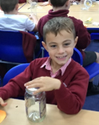
Times tables – Y4 statutory assessment
Summer 2023
Up to 12 x 12
Multiplication and division facts
  Eg 6x8=48 and 48 divided by 6=8
Accuracy and speed
Focus in school and at home
Practice ideas on school website
TTRS passwords have been sent home for regular practice please

Slide 10

Reading Challenge
AIM
To introduce children to a wide range of genre and compare and contrast the different styles.
Stages 8 – 16
Each stage includes books that cover a wide range of genres including Myths and Legends, Poetry, Comedy, Non-Fiction, Range of stories including animal, adventure, mysteries etc.

Slide 11

Reading Records
Handed in Thursday and returned Friday
Year 3
Daily reading with an adult
Recording at least 4 times in the reading record during the week.
Initially 1 recording by the reader and 3 by the parent building up to 3 recorded by the reader and 1 by the parent.
Year 4
Daily reading wirth an adult
Recording in the reading record at least 4 times in the week.
Initially twice by the child and twice by the parent building to 4 times by the child and signature by the parent.

Slide 12
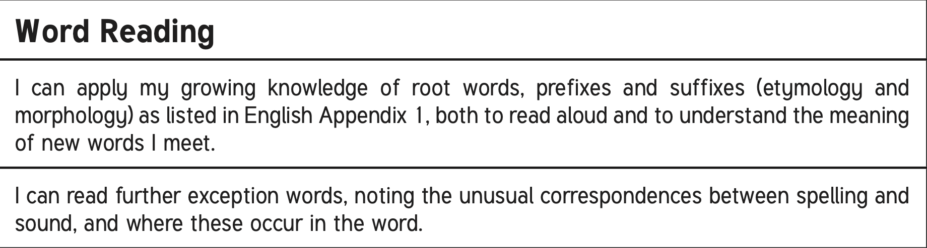

LKS2 Reading Curriculum

Slide 13
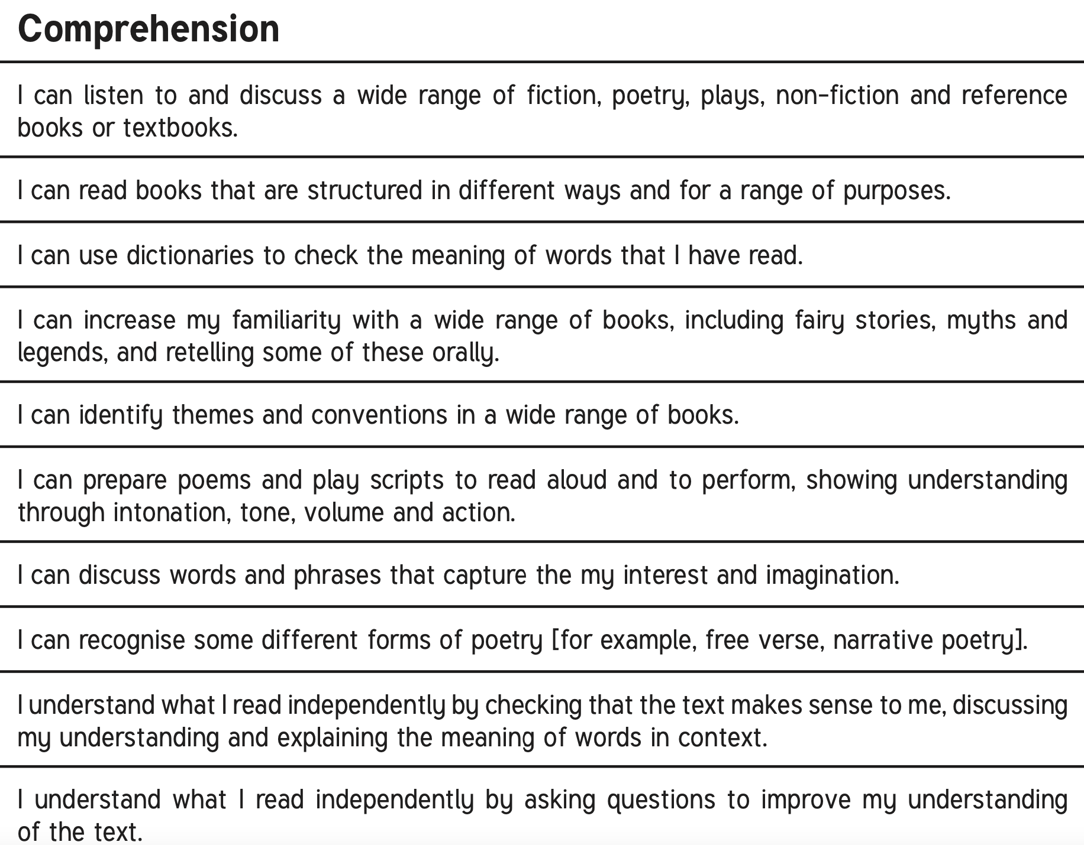
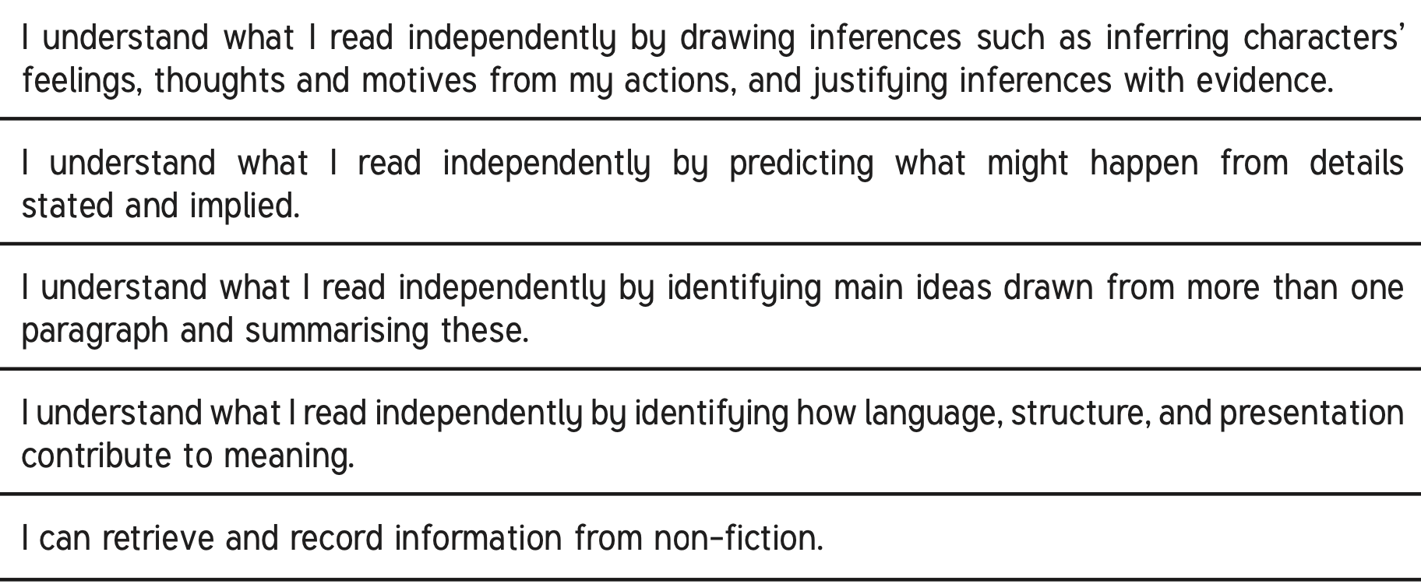

Slide 14






Read a VARIETY and have FUN!

Slide 15
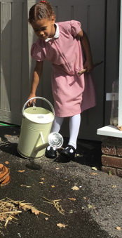
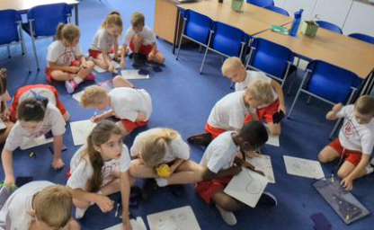
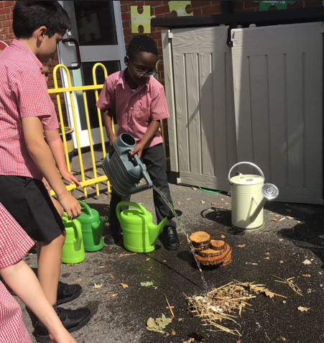
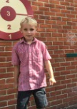
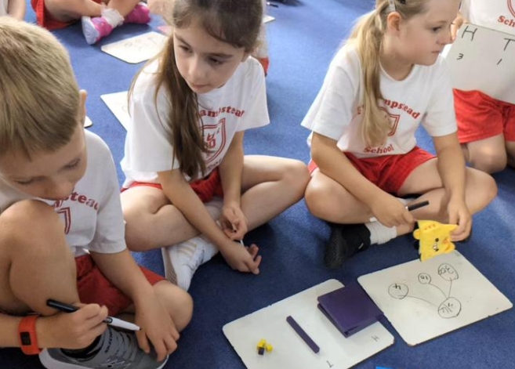
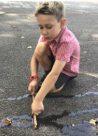
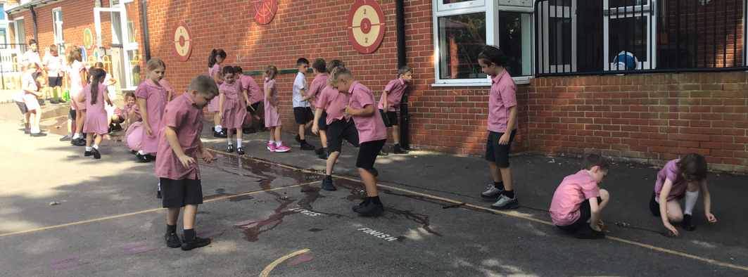
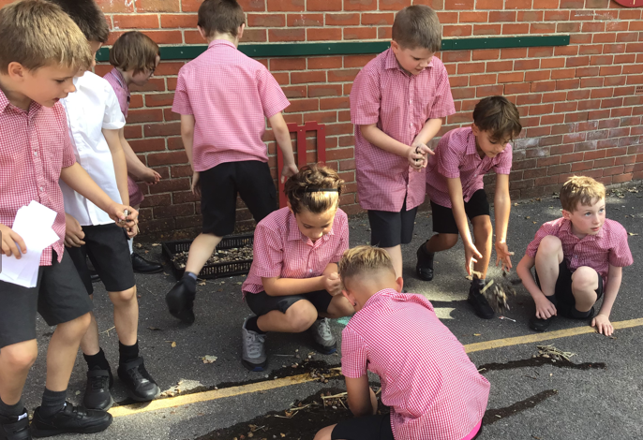
Thank you for entrusting us with your child’s learning!

