Slide 1
Welcome to Chaffinch Class
Year 3 and 4
Mrs Dodds : Monday – Thursday Morning
Mrs Gan : Thursday am - all day Friday
Mrs Ewing: Monday, Tuesday
Mrs Martinez – Wednesday
Mrs Baker – Thursday,Friday
Mrs Coulson and parental volunteers in the afternoons
Sports Coach – Mr O’Reilly ( Wednesday)

Slide 2
Equipment
PE kit Monday, Wednesday and maybe extra days
art shirt or apron Fridays or when advised
reading book and reading record every day – detailed check on Thursday
Water bottle with a sports lid to avoid spillages
Healthy snack – fruit or veg only please.

Slide 3
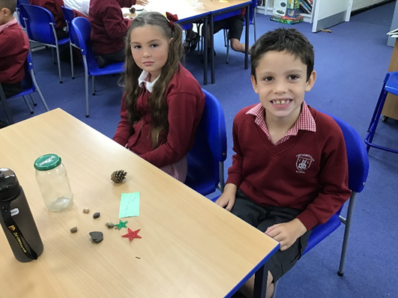
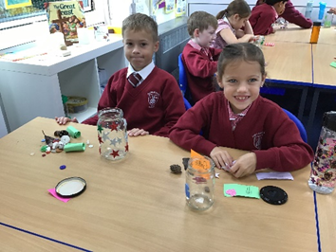
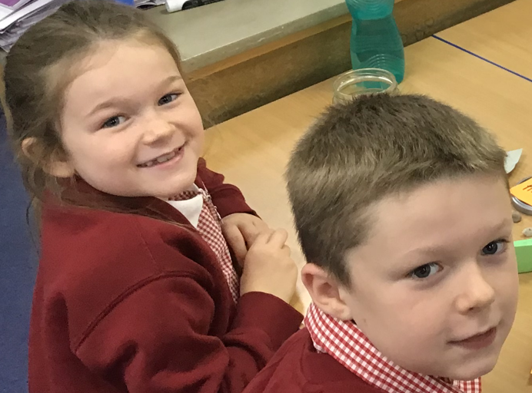
Chaffinch Curriculum and updates - school website
https://www.finchampsteadschool.org/

Slide 4
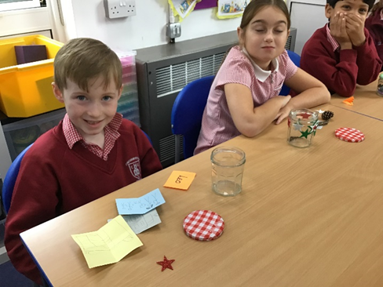
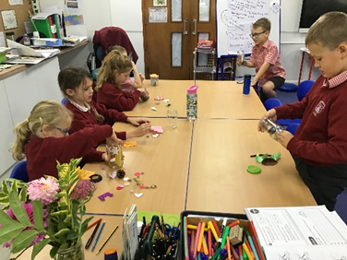
Trips and Visits
Autumn: Harvest Festival at Wellington College (car)
Spring: Parent Learning Event on Egyptians
Summer: local area visit to Moor Green Lake and / or Church and Lavender farm

Slide 5
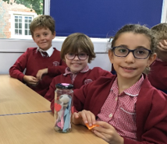
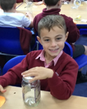
Times tables – Y4 statutory assessment
Summer 2025
Up to 12 x 12
Accuracy and speed
Focus in school and at home
Practice ideas on school website

Slide 6
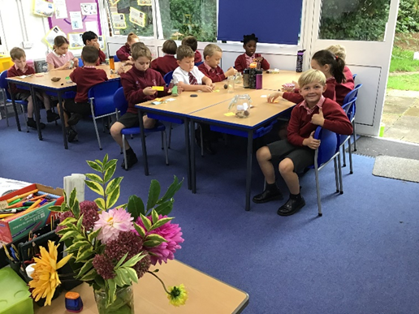
Reading Challenge
Please see separate document

