Slide 1
Chaffinch Maths Information Event
Multiplication and Division April 2025

Slide 2
Year 3 and 4
Solid grounding in x tables – understanding the multiplication and division facts
National Curriculum times tables expectations for each year group:
Year 1 Count in multiples of 2, 5 and 10. Recall and use doubles of all numbers to 10 and corresponding halves.
Year 2 Recall and use multiplication and division facts for the 2, 5 and 10 multiplication tables.
Year 3 Recall and use multiplication and division facts for the 3, 4 and 8 multiplication tables.
Year 4 Recall multiplication and division facts for all multiplication tables up to 12 x 12.
Year 5/6 Revision of all times tables and division facts up to 12 x 12.
Therefore, we would expect your child to know their 12 x 12 times tables before they leave Year 4, with Years 5 and 6 for consolidation and revision.

Slide 3
Year 3 and 4
We teach for fluency – not the same as memorizing.
Additional ways to calculate quickly if not recall automatically:
Commutativity. Commutativity is the understanding that if 7 x 5 = 35, 5 x 7 will also equal 35. If children understand this, it halves the amount of times tables they need to learn. It can also help with both the learning of trickier times tables, such as 7 and 8’s.
Using nearby facts. If children have a good understanding of multiplication as repeated addition, they can use this to quickly solve times tables they’re not sure of by ones they are. For example: 6 x 7= 42, they can quickly add seven to solve 7 x 7. If a child can do this mentally at speed, they have developed fluency.
Partitioning. Solving the 12 times tables can be difficult, especially at speed. Teaching children to split the 12s into 10s and 2s can give them a quick efficient way of solving the problems. For instance, solving 12 x 7 as (10 x 7) + (2 x 7)
Doubling and halving. Teaching children to use doubling skills can speed up these times tables. For instance, knowing that 8 x 6 is double 4 x 6 can help speed up their answer to this question.

Slide 4
Year 3 and 4
We need to know the times-tables facts so we can use them in our arithmetic and problem solving.
About 6 weeks of the Y3and 4 maths curriculum (so about half a term) is dedicated to this area but the skills are used all year.
We continue to learn and apply vocabulary such as unitizing, commutativity and partitioning.
  Unitising – counting in 10s,100s, 25s, 6s - useful to know how many eggs in 5 boxes without counting each egg.
  Commutativity – flexibility in applying known facts to calculations and problem solving. If you know 3 x 10 = 30 then you know there are 10 x 3 in 30 or 30 divided by 10 is 3.
  Partitioning – this is ‘splitting’ numbers into parts to extend skills to multiply by 2 and 3 digits.
  Example – 32 x 5 is 30 lots of 5 (or 3 tens lots of 5) plus 2 lots of 5 = 150 + 10 = 160

Slide 5
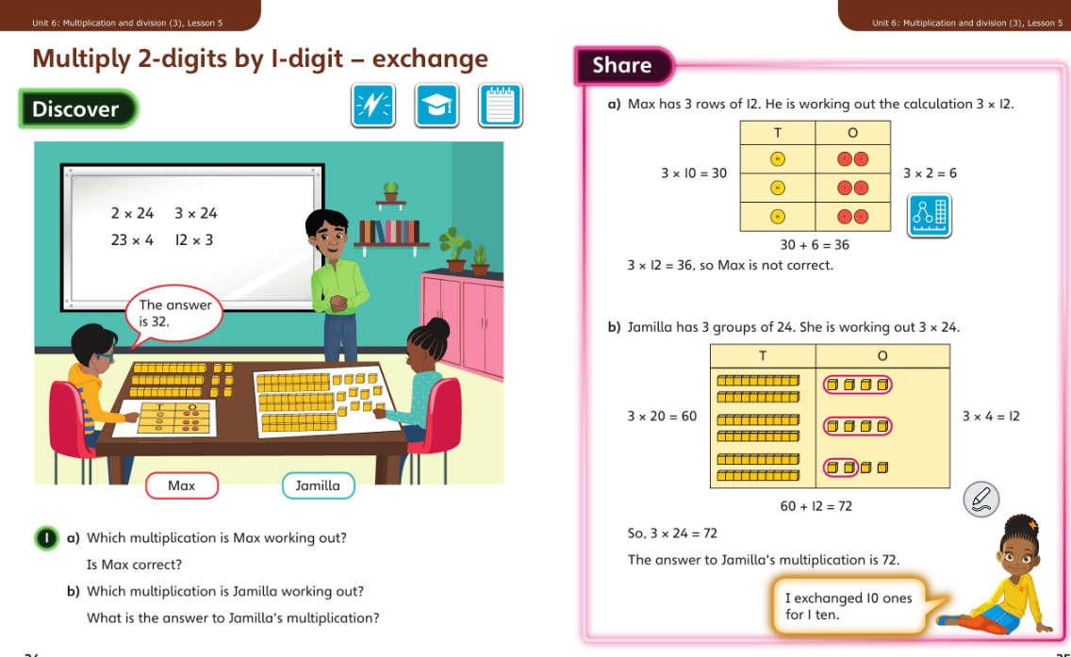

Slide 6
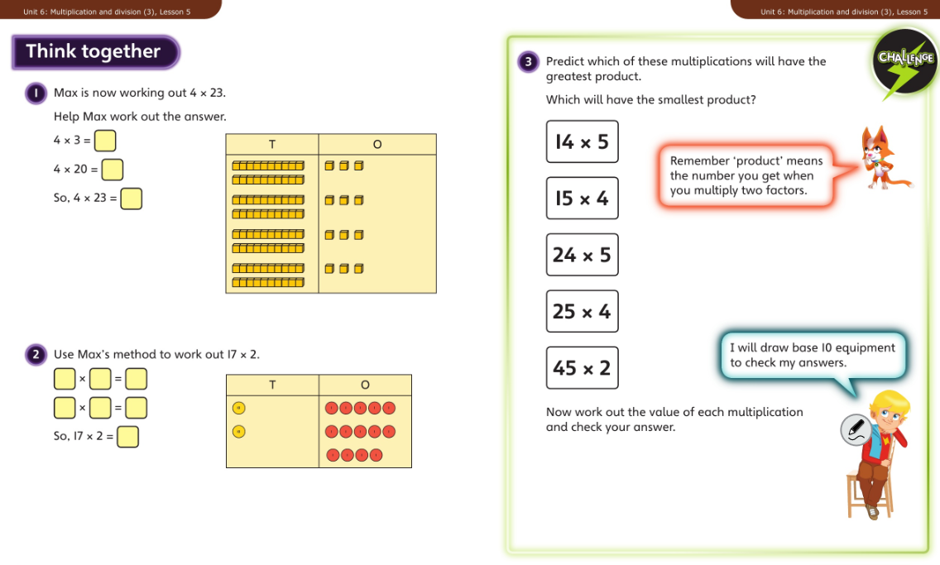

Slide 7
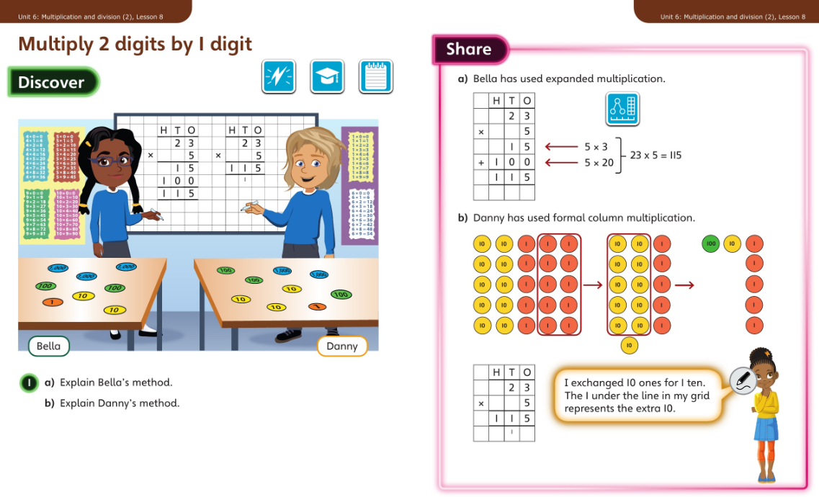

Slide 8
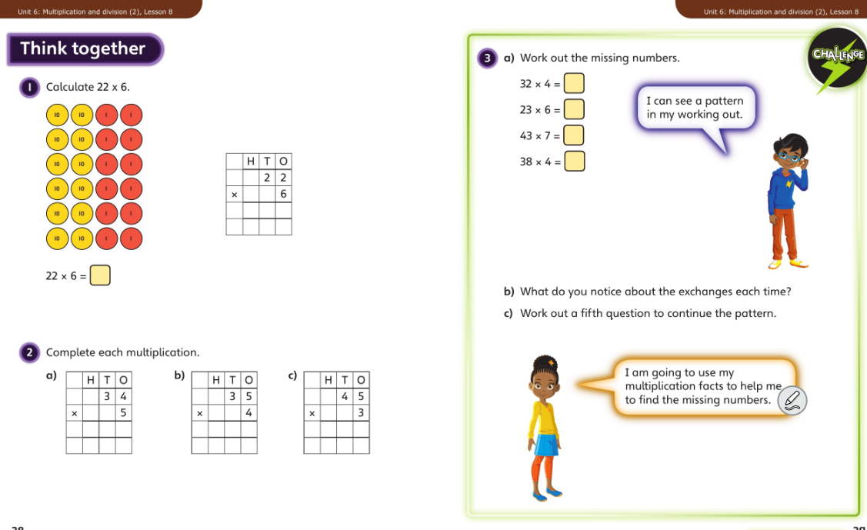

Slide 9
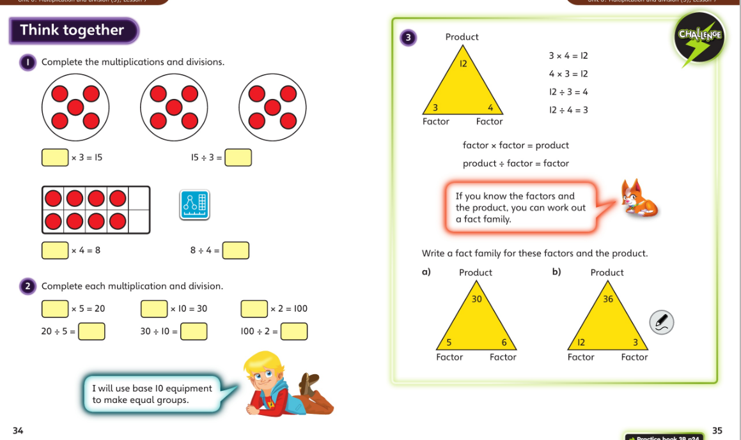

Slide 10
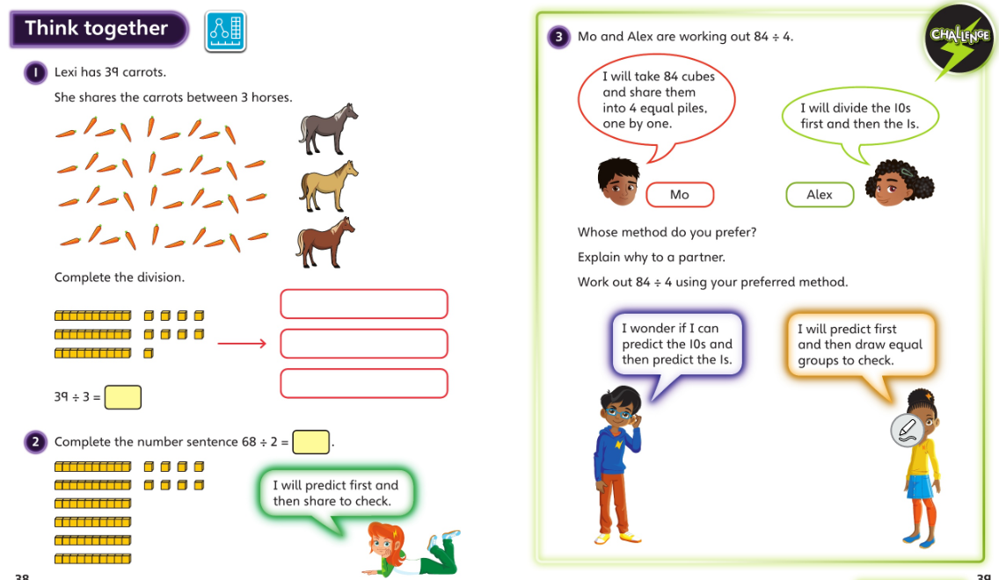

Slide 11
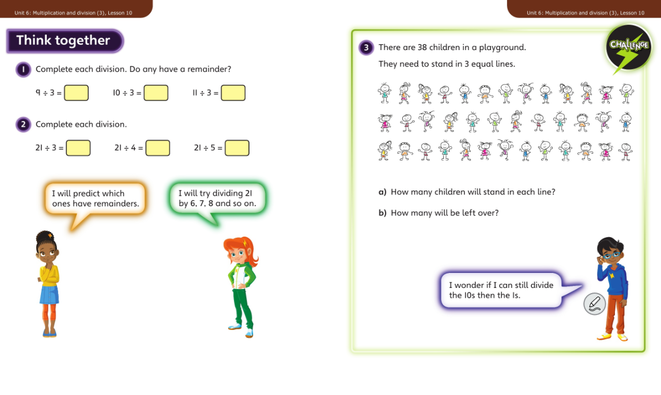

Slide 12
Summary
Can see the importance of fluency in timetables facts.
Remember the fact families help eg 3x7=7x3=21/3=21/7
Little and often practice helps.
Make it fun – it sticks
Songs, games, races, challenges, skipping, posters – all help.
Questions?

