Slide 1
Welcome to Chaffinch Class
Year 3 and 4
Mrs Dodds : Monday – Thursday Morning
Mrs Gan : Thursday am - all day Friday
Mrs Baker: Monday, Tuesday, Thursday
Mrs Martinez – Wednesday, Thursday, Friday
Mrs Coulson and parental volunteers in the afternoons
Sports Coach – Mr O’Reilly ( Wednesday)

Slide 2
Equipment
PE kit Monday, Wednesday and maybe extra days
Art shirt or apron Fridays or when advised
Reading book and reading record every day – children to hand in on Thursday
School water bottle every day
Healthy snack – fruit or veg only please.
We provide, pens, pencils etc. so there’s no need for a pencil case. We are always very thankful for class donations of glue sticks which seem to disappear!

Slide 3
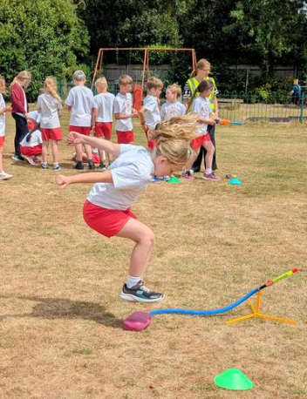
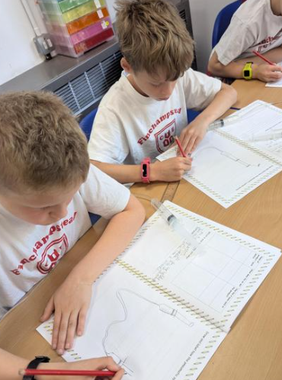
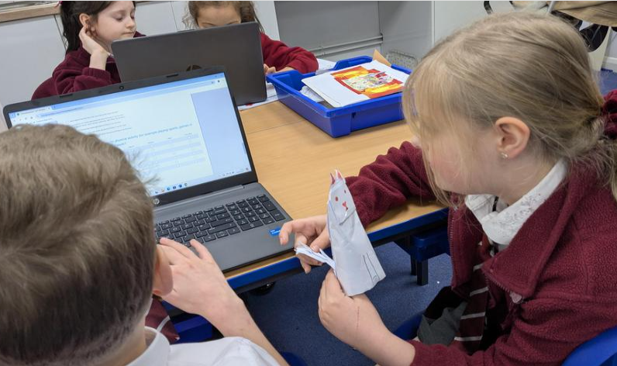
Chaffinch Curriculum and updates - school website
We often share photos of our learning and have copies of the spelling lists etc on our class page. https://www.finchampsteadschool.org/

Slide 4
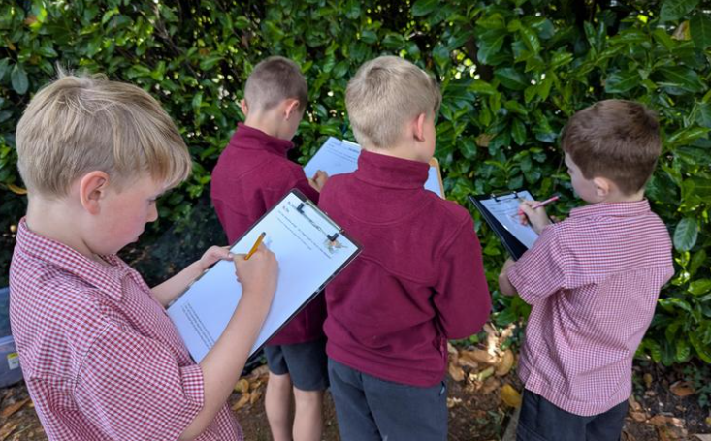
Trips and Visits
Autumn: Rushall Farm and River Pang trip to be confirmed but anticipated on 22.10.25 (coach); global explorer talk about rivers of the world and life in Papua New Guinea, November (in school);
Spring: Parent Learning Event on Vikings; Viking Day re-enactment
Summer: European convention hosted by our children
Throughout the year, we have regular stay and read registers and other opportunities to engage with your children's learning.

Slide 5
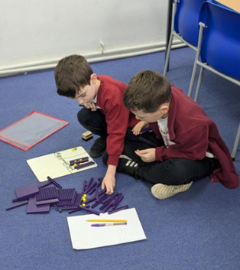
Times tables – Y4 statutory assessment
Statutory Assessment in Summer 2026
Up to 12 x 12
Accuracy and recall speed
Keyboard fluency
Focus in school and at home
Practice ideas on school website

Slide 6
Reading Challenge
Please see separate presentation

Slide 7
Home learning expectations
Children should read regularly and record in the reading record at least 4 times a week – details in the reading presentation.
Spellings are tested each Monday. The termly overview of spellings and dates is sent home at the start of term and available on the class page.
Multiplication regular practice – ideas and links etc. are on the class page.
We also set optional challenges to engage children in the term's learning and extend their interest.

