Slide 1
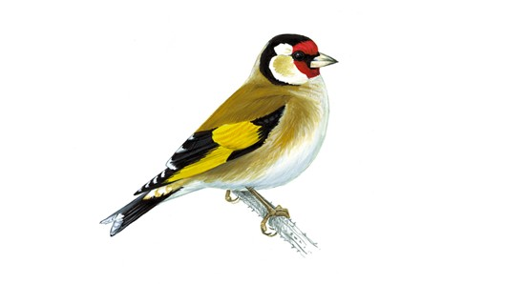
Welcome to Goldfinch Class
Year 5 and 6
Adults working with Goldfinch class:
Mrs Wirth - Monday – Thursday Morning
Mrs Coulson- Thursday afternoon
Mrs Gan - Friday
Mrs Williams - Monday – Friday
Sports coach – Mr O’Reilly ( Wednesday)
Music teacher – Mrs Gan ( Thursday)

Slide 2
Equipment
To help the children to be ready for their learning, it would be really useful if they have the following equipment in school every day :
PE kit every day, (especially Wednesdays and Thursdays),
art shirt or apron,
reading books,
reading records ( needed for Fridays –filled in by the children)
small pencil case which will fit comfortable in the children’s trays. This should contain HB and colour pencils, rubber and sharpener, a ruler, small glue stick. A clear protractor and a compass would also be really helpful.
Children who have a KS2 Intermediate or Master handwriter certificates may use a fountain pen or handwriting pen – with black ink - but not a biro.
Please remember to provide a sports lid only water bottle too (containing water rather than juice which can be sticky if it spills).

Slide 3

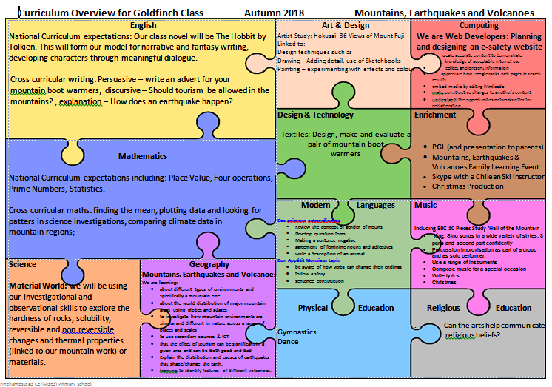
Goldfinch Curriculum

Slide 4
Goldfinch Home Learning
English and maths set on Thursday( for next Thursday)
Spelling/word activities set on Thursday( for next Thursday)
Times tables should be practiced daily.
Reading record books should be updated regularly and brought to school every day together with a reading book. They will be needed for reading sessions on a Friday when reading tasks will be set.
A sheet of questions you could choose from, to discuss texts with your child, will be stuck in the front of their reading record book.

Slide 5
Year 5/6 Home Learning Expectations
Monday | Tuesday | Wednesday | Thursday | Weekend
Reading At least 15 minutes reading including pupil comments. | Reading At least 15 minutes reading including pupil comments. | Reading At least 15 minutes reading including pupil comments. | Reading At least 15 minutes reading including pupil comments. | Reading At least 15 minutes reading including pupil comments.
Times tables facts At least 5 minutes | Times tables facts At least 5 minutes | Times tables facts At least 5 minutes | Times tables facts At least 5 minutes | Times tables facts At least 5 minutes
Spelling !0 minutes daily practice in journals | Spelling !0 minutes daily practice in journals | Spelling !0 minutes daily practice in journals | Spelling !0 minutes daily practice in journals | Spelling !0 minutes daily practice in journals
 |  |  | Spelling journal due in school. Maths and English weekly home learning tasks due to be checked. New home learning tasks set.

Slide 6
PGL
Year 6 will be going the PGL for the week on Monday 8th October.
There will be a meeting for year 6 parents and Y6 children at 3.30pm on Wednesday 26th October. This will be in Goldfinch class and siblings can be supervised in the suite during the meeting.
We will talk through the PGL information pack and have a Q&A session.

