Slide 1
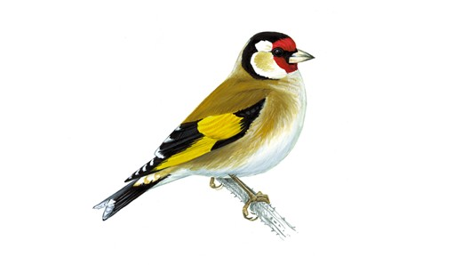
Welcome to Goldfinch Class
Year 5 and 6
Adults working with Goldfinch class:
Mrs Wirth : Monday – Thursday Morning
Mrs Stangroom : Thursday afternoon
And Friday
Mrs Williams - Monday – Thursday
Mrs Beakhouse - Friday
Sports coach – Mr O’Reilly ( Wednesday)
Music teacher – Mrs Gan ( Thursday)

Slide 2
Equipment
To help the children to be ready for their learning, it would be really useful if they have the following equipment in school every day :
PE kit every day, (especially Wednesdays and Thursdays),
art shirt or apron ( to be kept in PE bag),
reading books,
reading records ( needed for Fridays –completed in by the children)
small pencil case which will fit comfortably in the children’s trays. This should contain HB and colour pencils, rubber and sharpener, a ruler and small glue stick. A clear protractor, scissors and a compass would also be really helpful.
Children who have a KS2 Intermediate or Master handwriter certificates may use a fountain pen or handwriting pen – with black ink - but not a biro.
Please remember to provide a water bottle with a sports lid to avoid spillages too (containing water , not juice, which can be sticky if it spills).

Slide 3

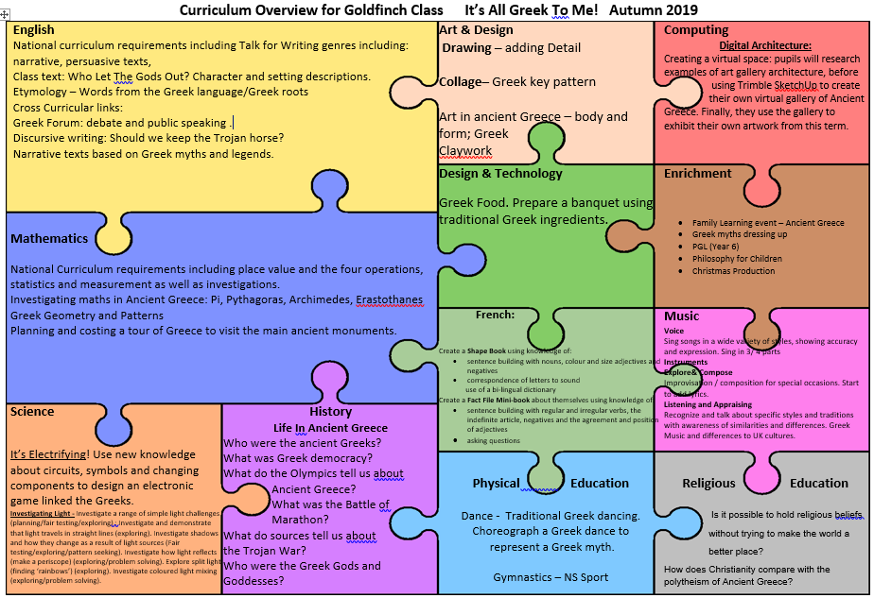
Goldfinch Curriculum

Slide 4
Goldfinch Home Learning
English and maths revision tasks will be set on Thursday( for next Thursday)
Spelling/word activities set on Thursday( for next Thursday): The children should practice every day – little and often is best for long term memory. Use a different spelling strategy each day.
Times tables should be practiced daily. The following website is helpful and can be used on PCs or tablets ( phones are a little too small): https://mathsframe.co.uk/en/resources/resource/477/Multiplication-Tables-Check
Reading record books should be updated regularly and brought to school every day together with a reading book. They will be needed for reading sessions on a Friday when they will be checked.
A sheet of questions you could choose from, to discuss texts with your child, will be stuck in the front of the reading record book. These discussions will support your child when they make comments in their reading record books.
NB: A family learning event has been planned for Thursday 14th November from 2-3pm. The theme will be Ancient Greece.

Slide 5
Year 5/6 Home Learning Expectations
Monday | Tuesday | Wednesday | Thursday | Weekend
Reading At least 15 minutes reading including pupil comments. | Reading At least 15 minutes reading including pupil comments. | Reading At least 15 minutes reading including pupil comments. | Reading At least 15 minutes reading including pupil comments. | Reading At least 15 minutes reading including pupil comments.
Times tables facts At least 5 minutes | Times tables facts At least 5 minutes | Times tables facts At least 5 minutes | Times tables facts At least 5 minutes | Times tables facts At least 5 minutes
Spelling !0 minutes daily practice in journals | Spelling !0 minutes daily practice in journals | Spelling !0 minutes daily practice in journals | Spelling !0 minutes daily practice in journals | Spelling !0 minutes daily practice in journals
 |  |  | Spelling journal due in school. Maths and English weekly home learning tasks due to be checked. New home learning tasks set. | Reading records to be checked on Fridays.

Slide 6
PGL
Year 6 will be going the PGL for the week on Monday 21st October.
There will be a meeting for year 6 parents and Y6 children at 3.30pm on Wednesday 25th September. This will be in Goldfinch class (siblings can be supervised in the suite during the meeting.)
We will talk through the PGL information pack and have a Q&A session.

