Slide 1
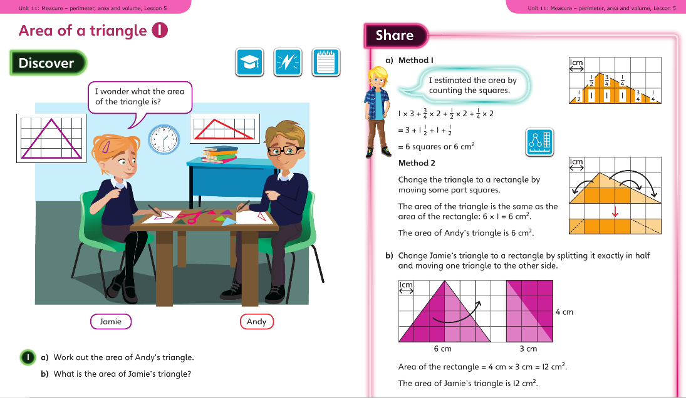
Monday 23.3.2020 Year 6 Modelled example
Now complete Year 6 Unit 11 Measure Lesson 5 in your books

Slide 2
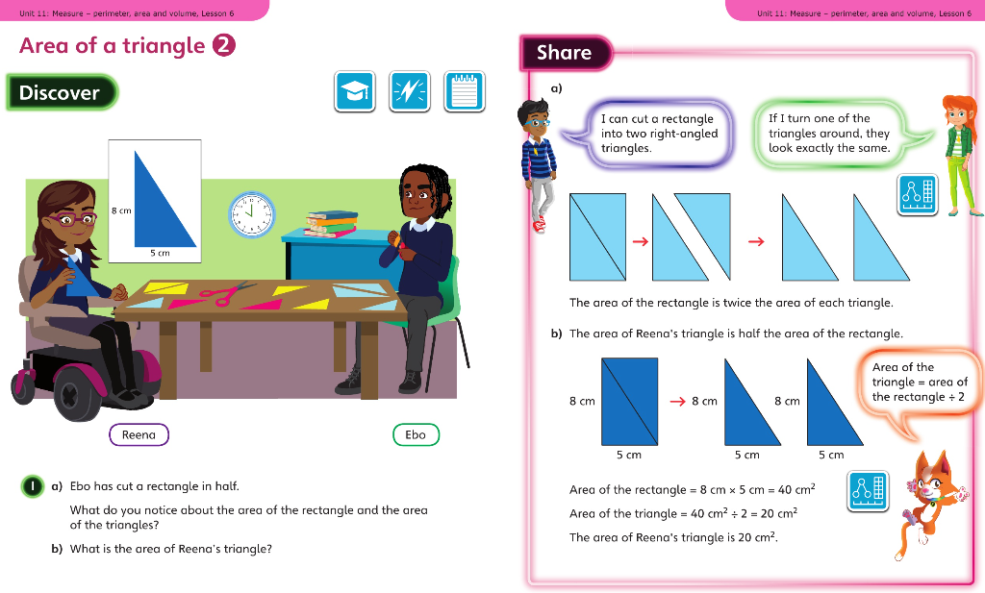
Tuesday 24.3.2020 Y6 Modelled Example Unit 11 Lesson 6

Slide 3
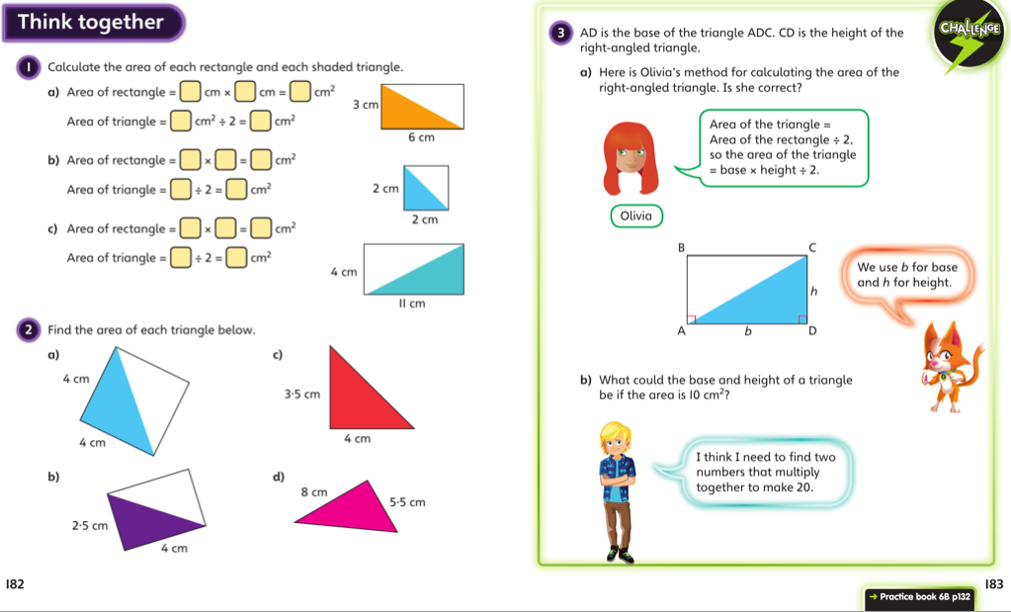
Discuss with your carer and then complete the lesson in your book

Slide 4
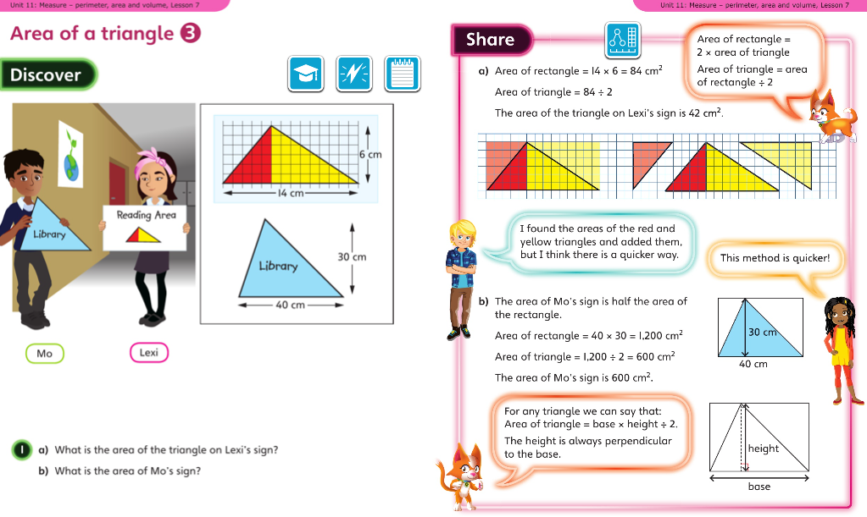
Wednesday 25.3.2020 Year 6 Modelled Example Unit 11 Lesson 7

Slide 5
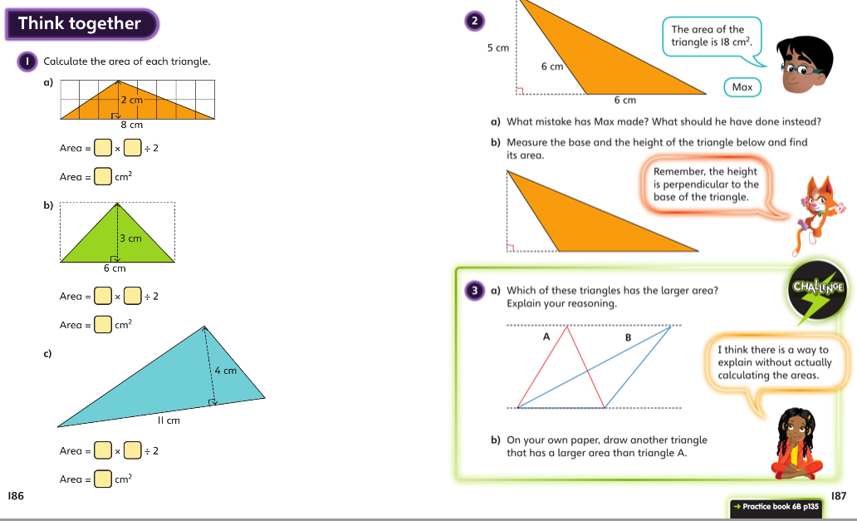
Discuss with your carer and then complete the lesson in your book

Slide 6
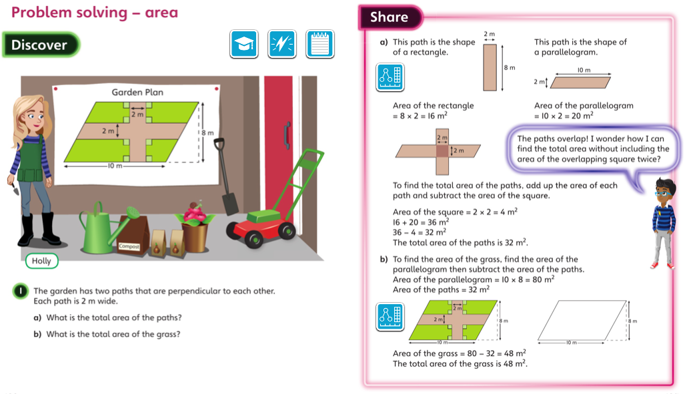
Thursday 26.3.2020 Year 6 Modelled Example Unit 11 Lesson 8

Slide 7
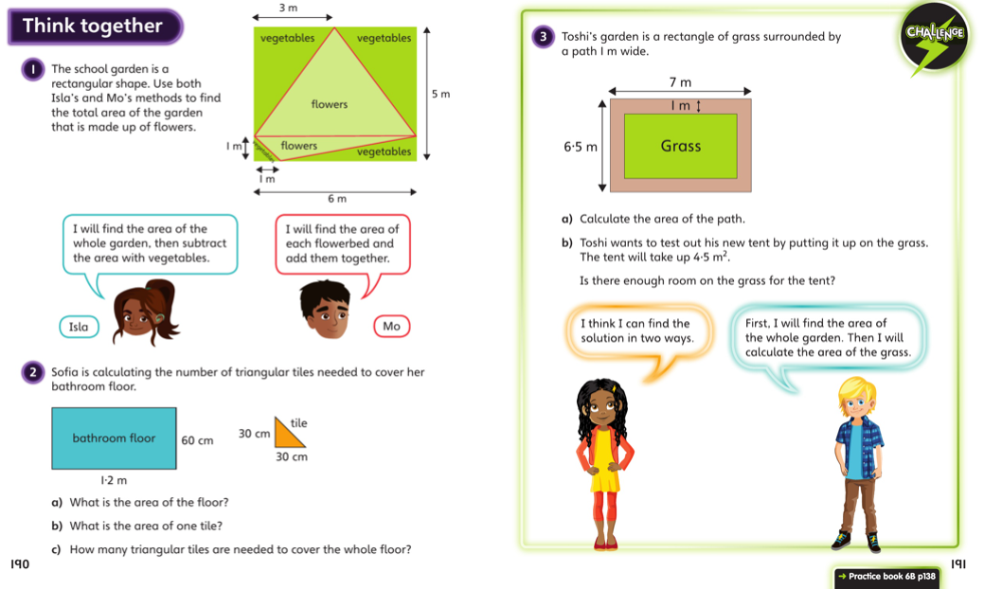
Discuss with your carer and then complete the lesson in your book

Slide 8
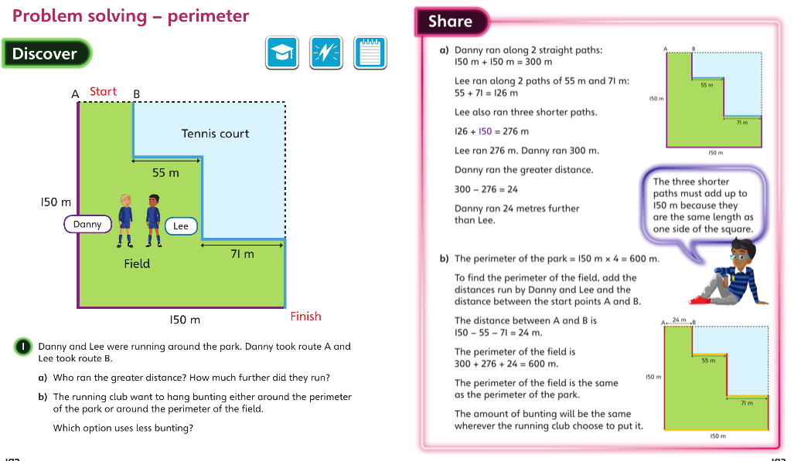
Friday 27.3.2020 Year 6 Modelled Example Unit 11 Lesson 9

Slide 9
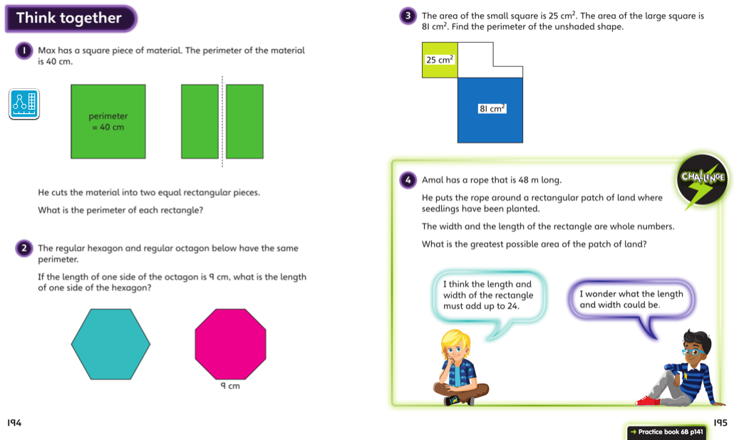
Discuss with your carer and then complete the lesson in your book

