Slide 1
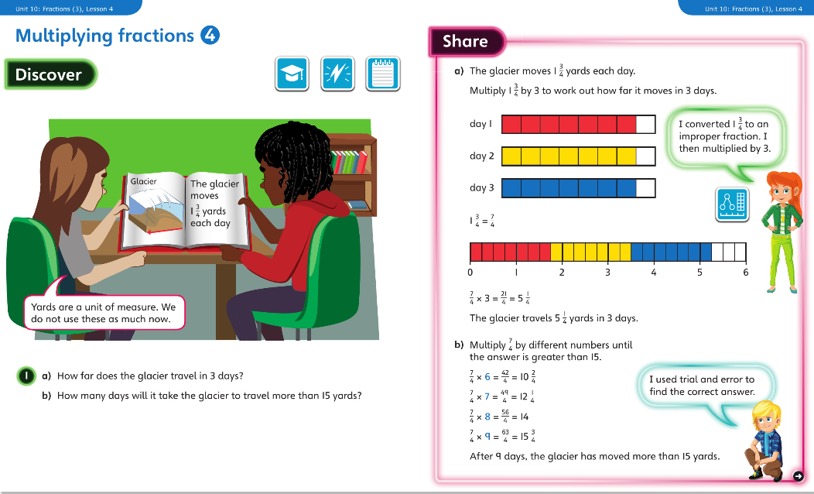
Monday 23.3.2020 Year 5 Modelled example Unit 10 Lesson 4

Slide 2
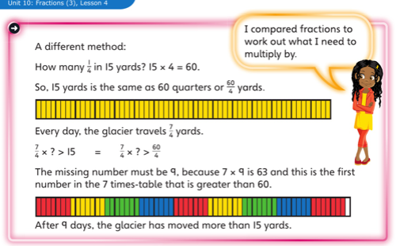
Now complete Year 5 Unit 10 Fractions Lesson 4 in your books

Slide 3
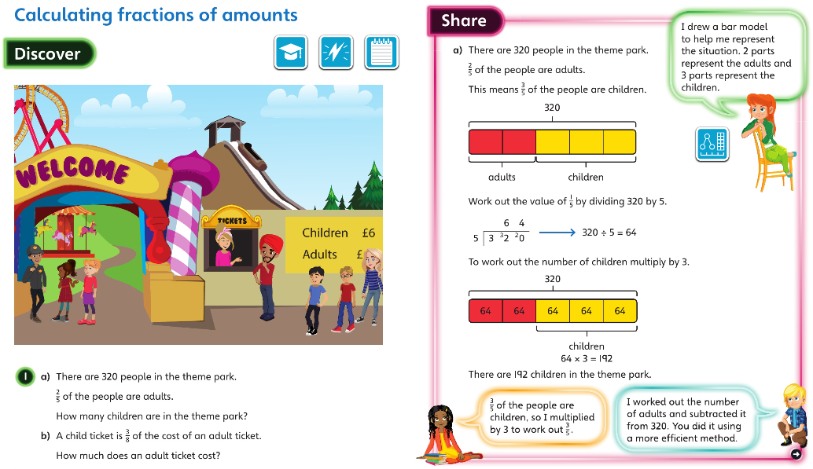
Tuesday 24.3.2020 Y5 Modelled examples Unit 10 lesson 5

Slide 4
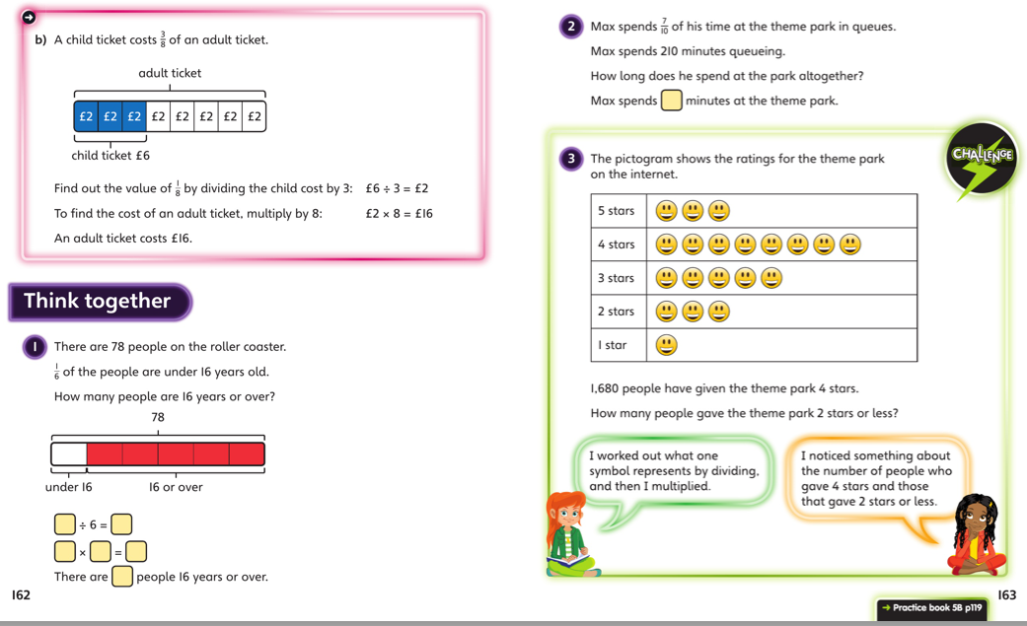
Discuss with your carers and then work independently in your maths books.

Slide 5
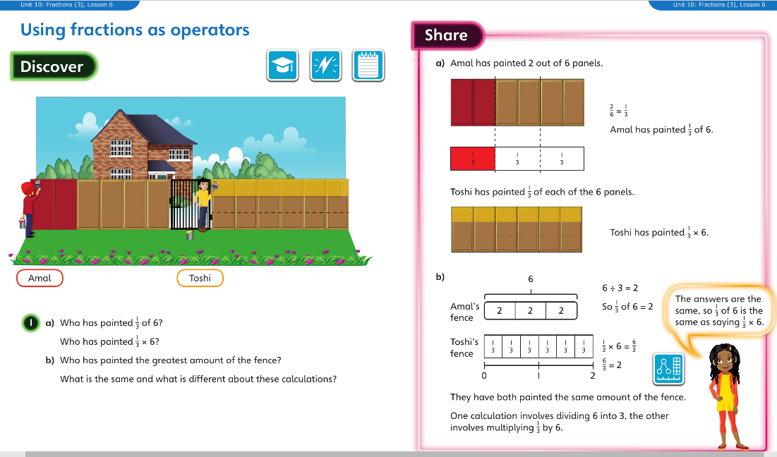
Wednesday 25.3.2020 Year 5 Modelled Examples Unit 10 Lesson 6

Slide 6
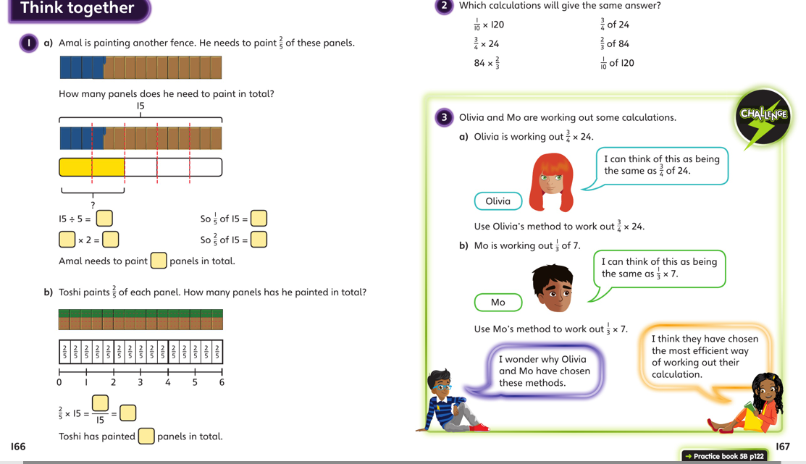
Discuss with your carers and then work independently in your maths books.

Slide 7
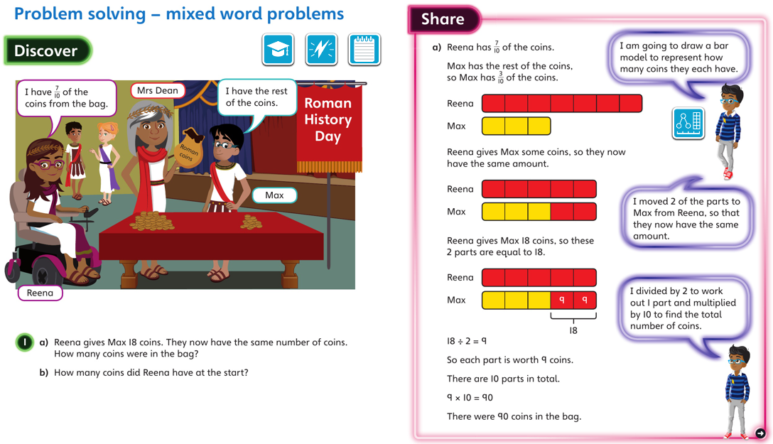
Thursday 26.3.2020 Year 5 Modelled Examples Unit 10 Lesson 7

Slide 8
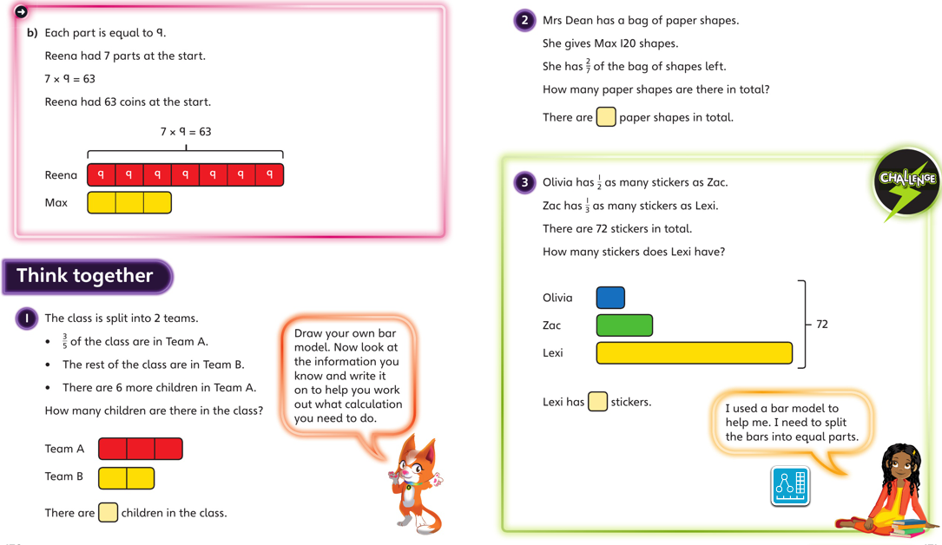
Discuss with your carers and then work independently in your maths books.

Slide 9
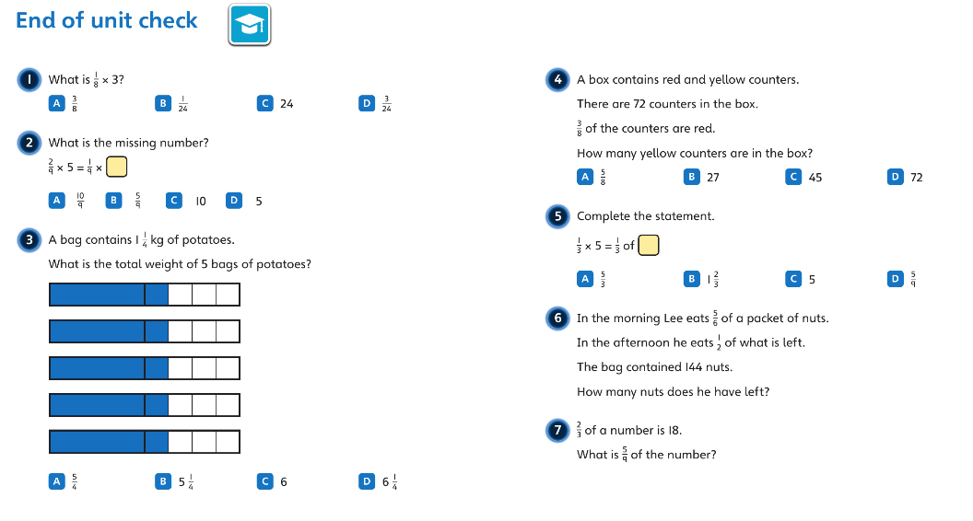
Friday27.3.2020 Year 5 Modelled Examples Unit 10 End Of Unit Check
Discuss with your carers then complete the activities in your maths book

