Slide 1
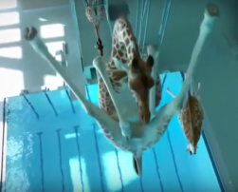
Thursday English Task
Interesting Times
_______________________
______________________
________________________________________________________________________________________________________________________________________________________________________________________________________________________________________________________________________________________________________________________________________________________________________________________________________________________________________________________________________________________________________________________
________________________________________________________________________________________________________________________________________________________________________________________________________________________________________________________________________________________________________________________________________________________________________________________________________________________________________________________________________________________________________________________________________________________________________________________________________________________________________________________________________________________________________________________________________________________________________________________________________________________________________________________________________________________________________________________________________________________________________________________________________________________________________________
____________________________________________________________________________________________________________________________________________________________________________________________________________________________________________________________________________________________________________________________________________________________________________________________________________________________________________________________________________________________________________________________________________________________________________________________________________________________________________________________________________________________________________________________________________________________________________________
______________________________________________________________________________________________________________________________________________________________________________________________________________________________________________________________________________________________________

Slide 2
Headline – short, punchy, alliteration, play on words (pun)
Quotes – reported or direct speech
Introductory statement – who,what,when,where,why,how
Facts (it is certain) and opinions (many believe)
Formal tone
Third Person
Chronological order
Mainly past tense
Conclusion

