Slide 1
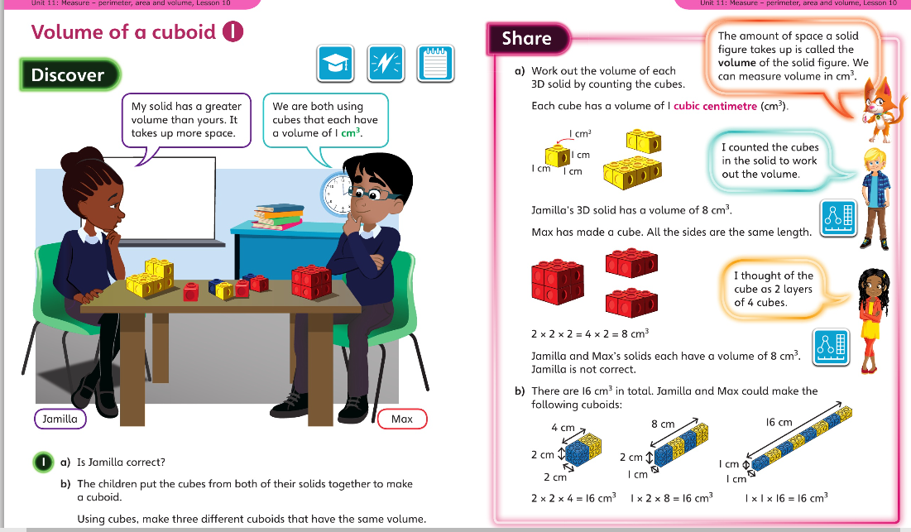
Monday 30.3.2020 Year 6 Modelled example Unit 11 Lesson 10

Slide 2
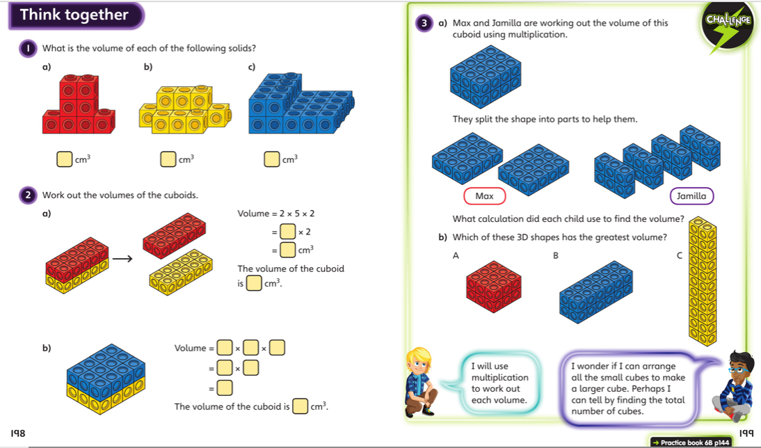
Discuss with your carer and then complete the lesson in your book
Now complete Year 6 Unit 11 Lesson 10 in your books

Slide 3
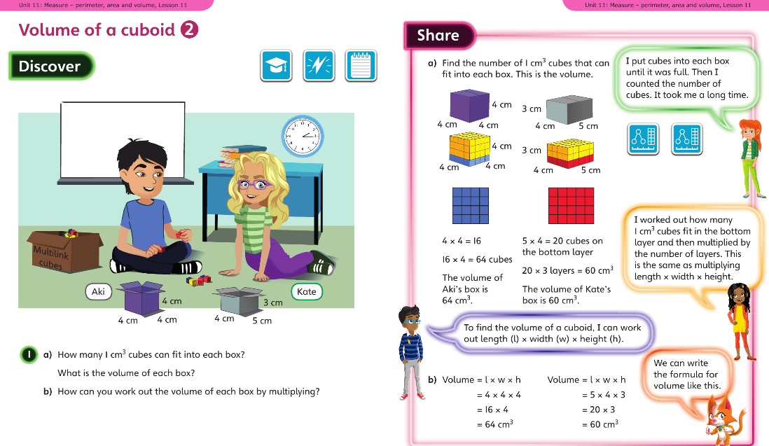
Tuesday 31.3.2020 Y6 Modelled Example Unit 11 Lesson 11

Slide 4
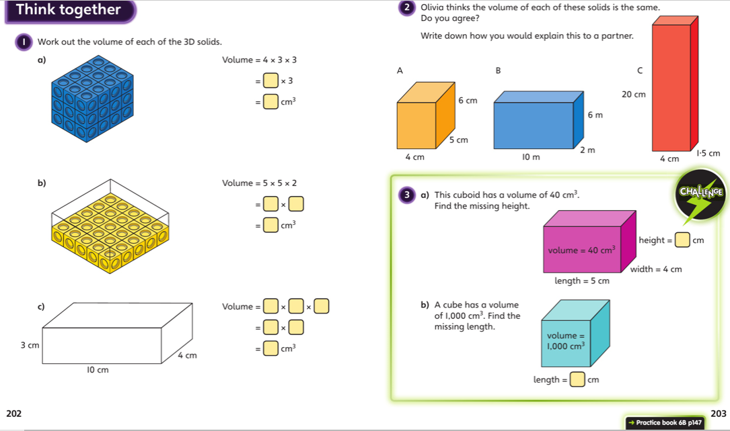
Discuss with your carer and then complete the lesson in your book

Slide 5
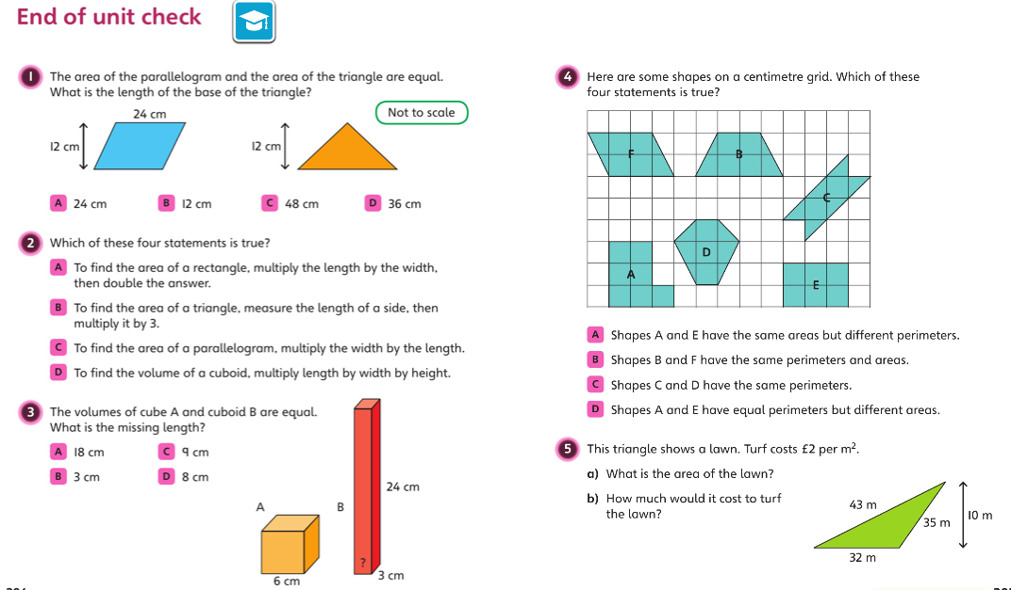
Wednesday 1.4.2020 Y6 Modelled Example Unit 11 End of Unit check
Discuss your strategies for solving these problems then go to p150 in your books.

Slide 6
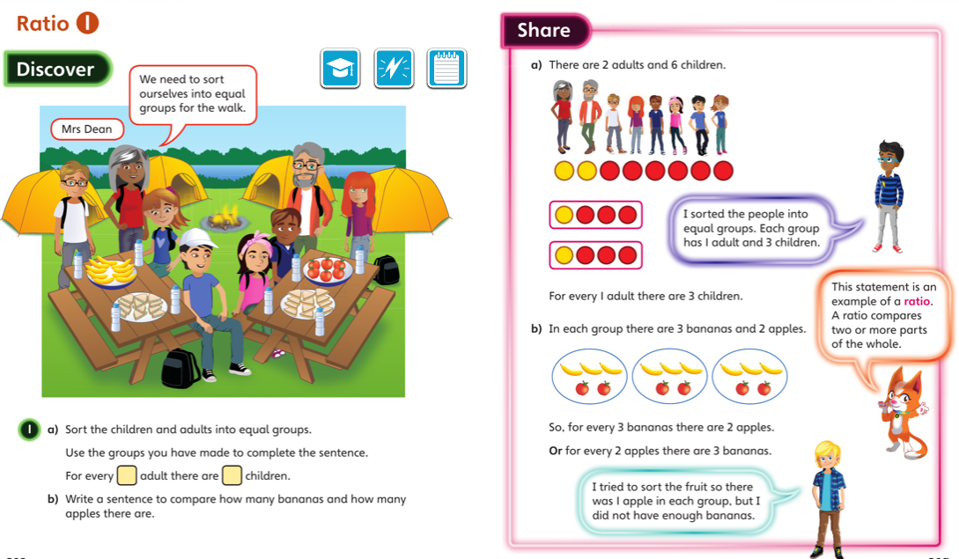
Thursday 2.4.2020 Y6 Modelled Example Unit 12 Lesson 1
You may also wish to visit https://whiterosemaths.com/homelearning/year-6/ Week 1 Lesson 1 for a virtual lesson.

Slide 7
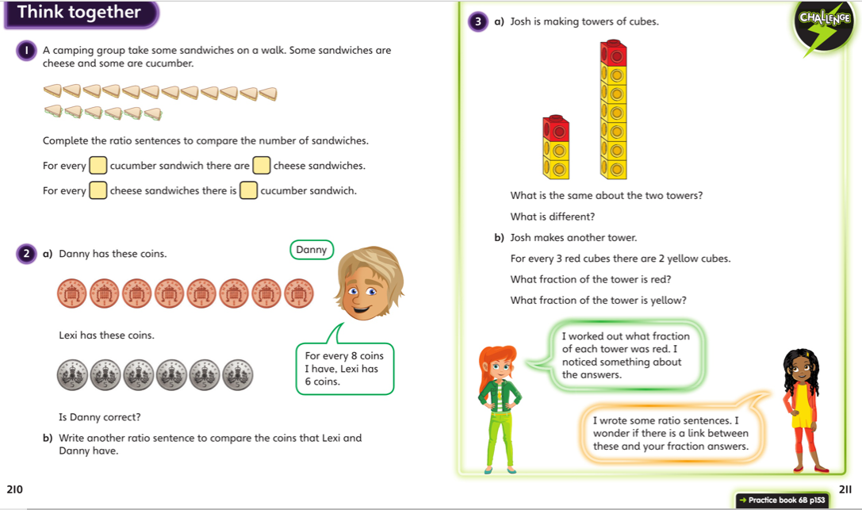
Discuss with your carer and then complete the lesson in your book

Slide 8
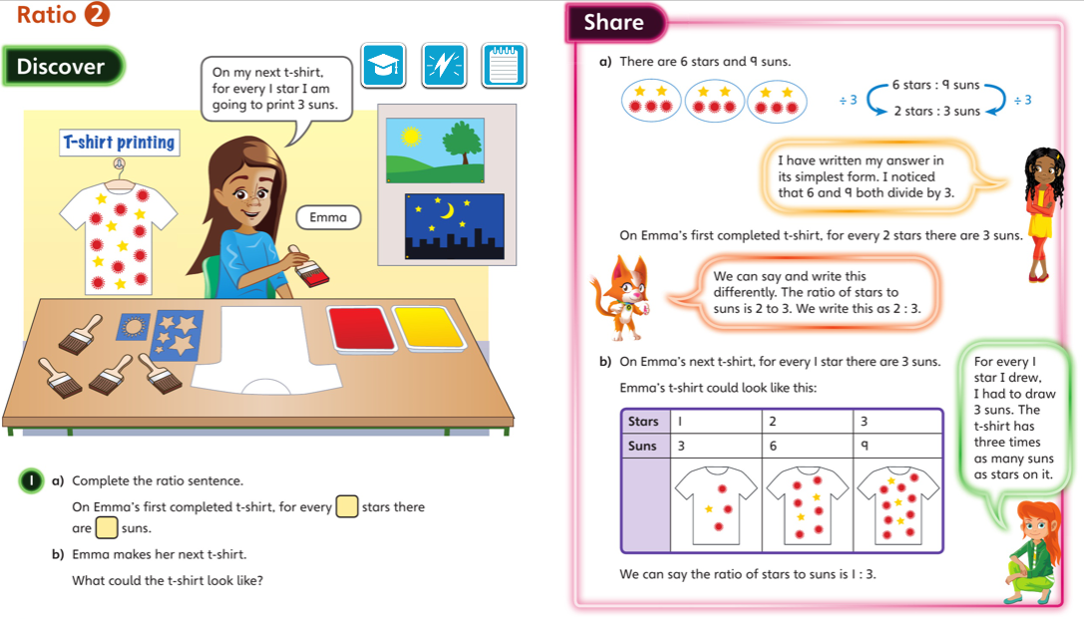
Friday 3.4.2020 Y6 Modelled Example Unit 12 Lesson 2
You may also wish to visit https://whiterosemaths.com/homelearning/year-6/ Week 1 Lesson 2 and 3 for a virtual lesson.

Slide 9
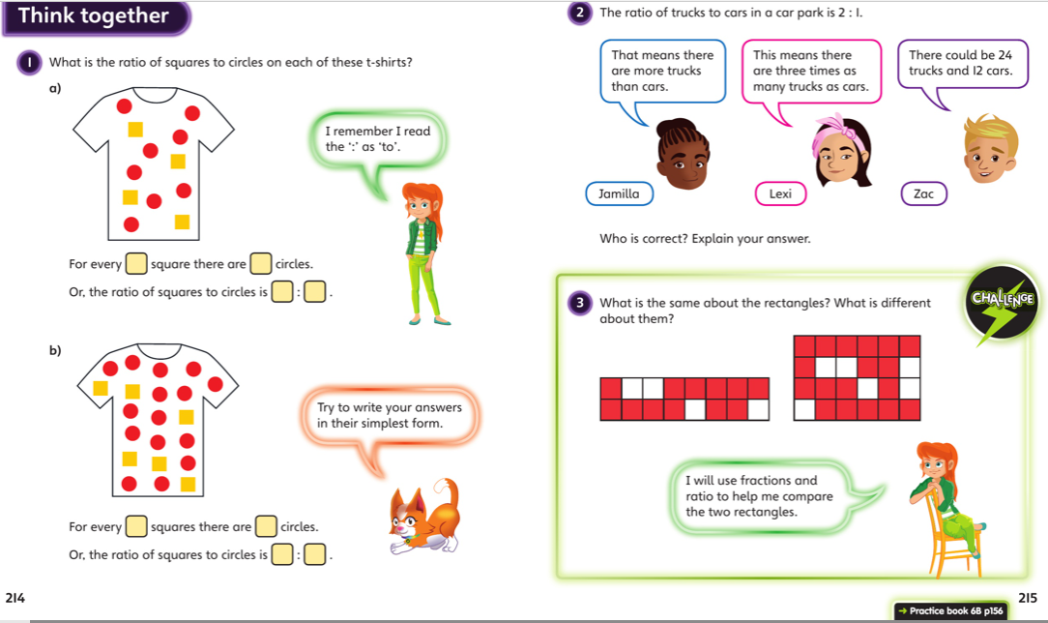
Discuss with your carer and then complete the lesson in your book

