Slide 1
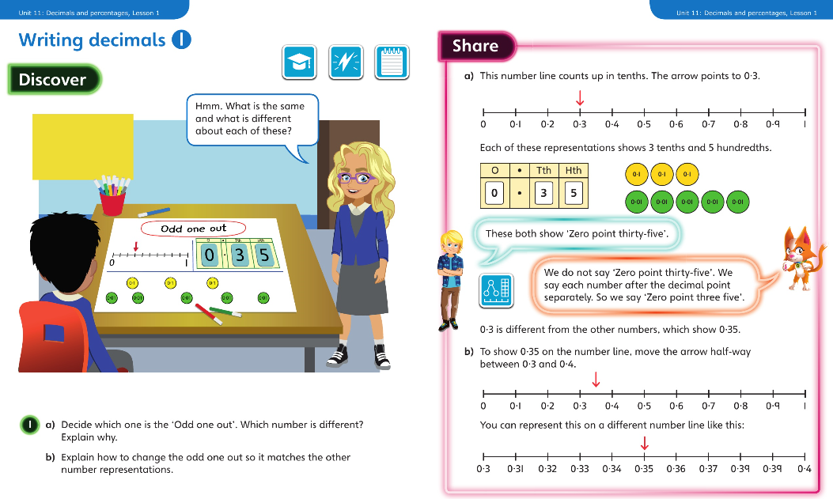
Monday 30.3.2020 Year 5 Modelled example Unit 11 Lesson 1
You may also wish to visit https://whiterosemaths.com/homelearning/year-5/ Week 1 Lesson 1 for a virtual lesson.

Slide 2
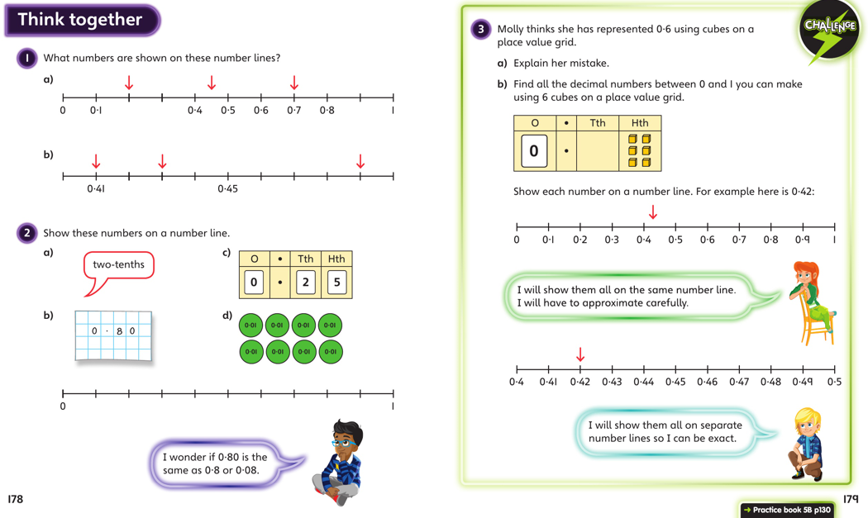
Discuss with your carers and then work independently in your maths books.
Now complete Year 5 Unit 11 Lesson 1 in your books

Slide 3
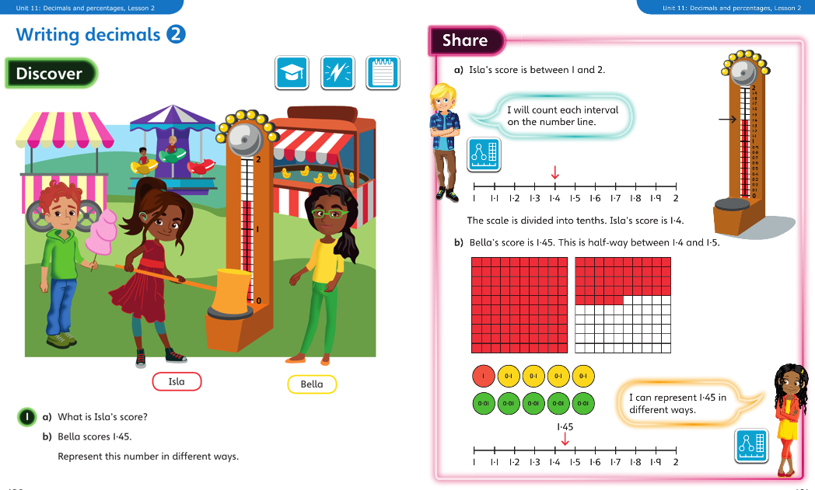
Tuesday 31.3.2020 Y5 Modelled examples Unit 11 lesson 2

Slide 4
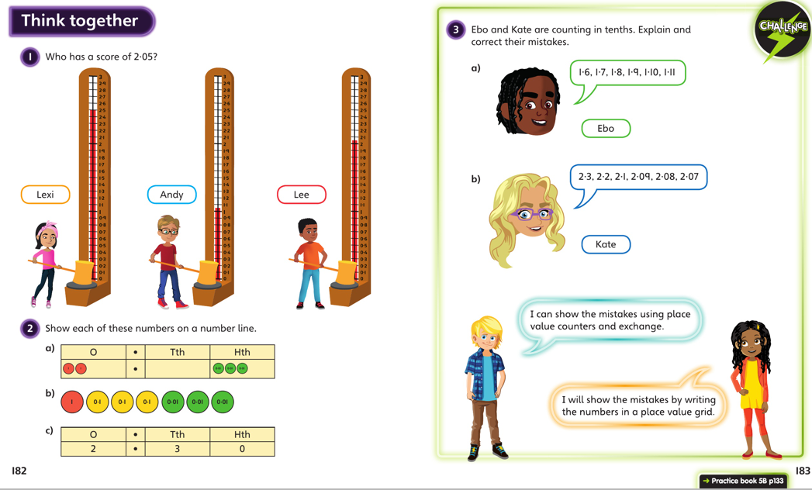
Discuss with your carers and then work independently in your maths books.

Slide 5
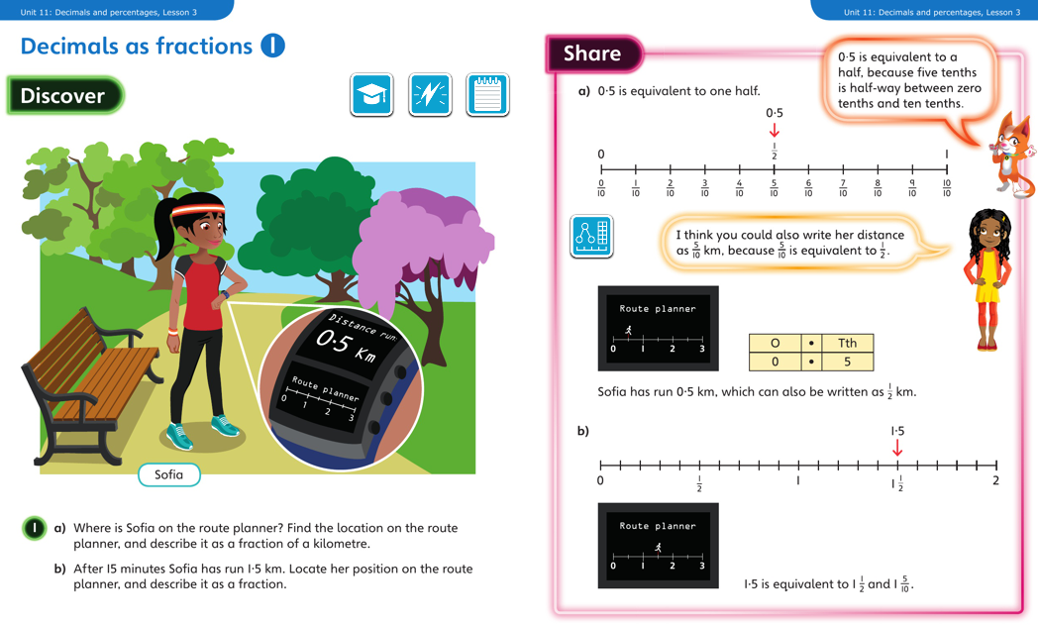
Wednesday 1.4.2020 Year 5 Modelled Examples Unit 11 Lesson 3
You may also wish to visit https://whiterosemaths.com/homelearning/year-5/ Week 1 Lesson 2 for a virtual lesson.

Slide 6
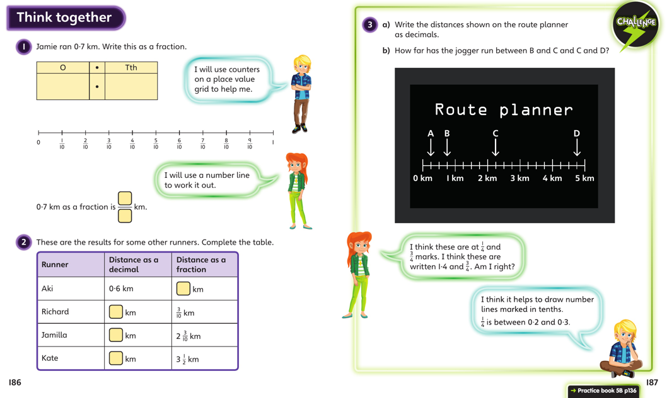
Discuss with your carers and then work independently in your maths books.

Slide 7
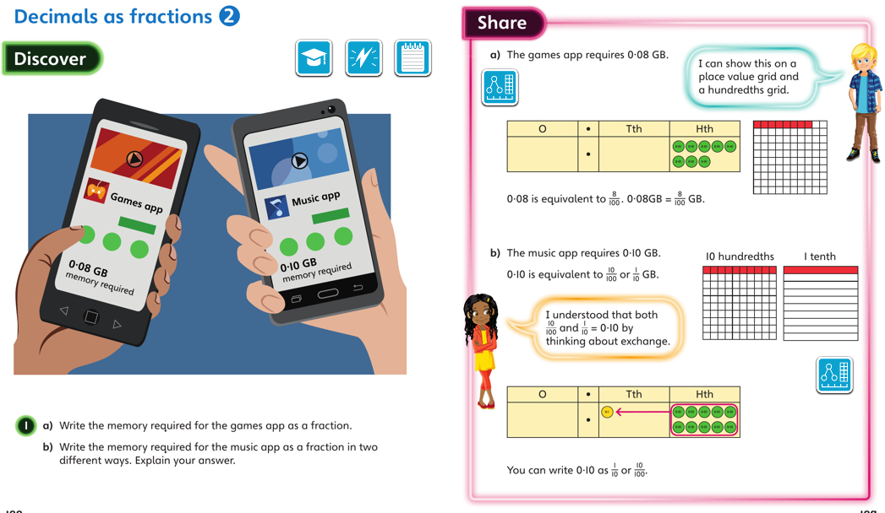
Thursday 2.4.2020 Year 5 Modelled Examples Unit 11 Lesson 4
You may also wish to visit https://whiterosemaths.com/homelearning/year-5/ Week 1 Lesson 3 for a virtual lesson.

Slide 8
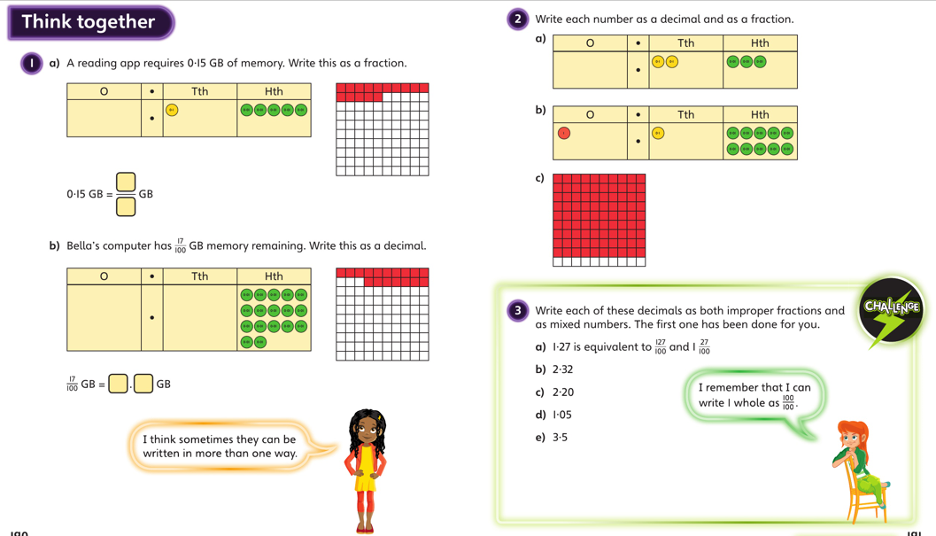
Discuss with your carers and then work independently in your maths books.

Slide 9
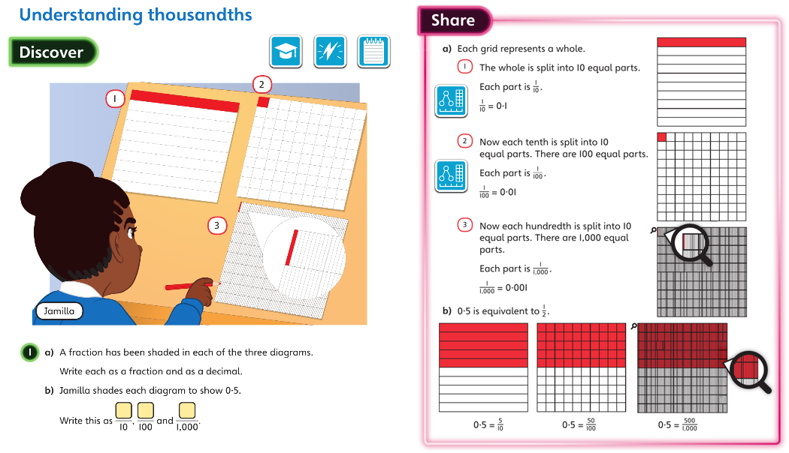
Friday 3.4.2020 Year 5 Modelled Examples Unit 11 Lesson 5
You may also wish to visit https://whiterosemaths.com/homelearning/year-5/ Week 1 Lesson 4 and 5 for a virtual lesson.

Slide 10
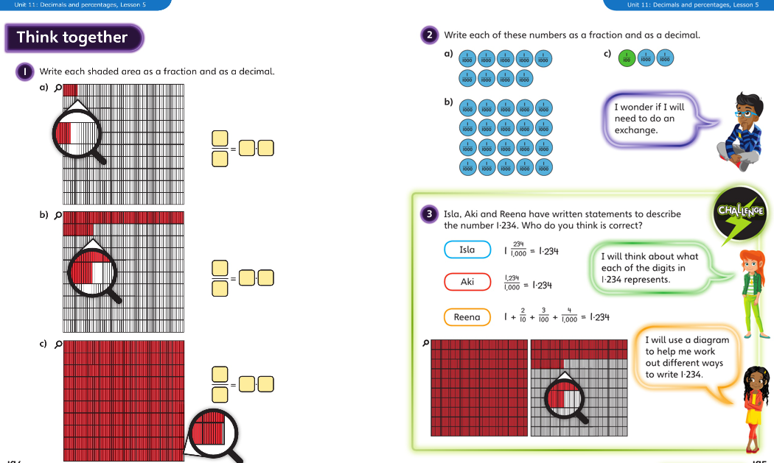
Discuss with your carers then complete the activities in your maths book

