Slide 1
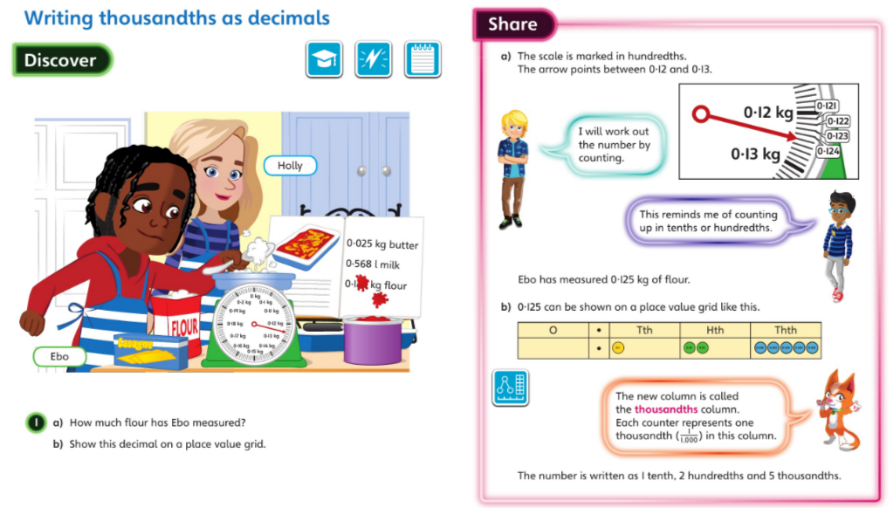
Monday 20.4.2020 Year 5 Modelled example Unit 11 Lesson 6
You may also wish to visit https://whiterosemaths.com/homelearning/year-5/ Spring Week 1 Lesson 5 - Thousandths as decimals for a virtual lesson.

Slide 2
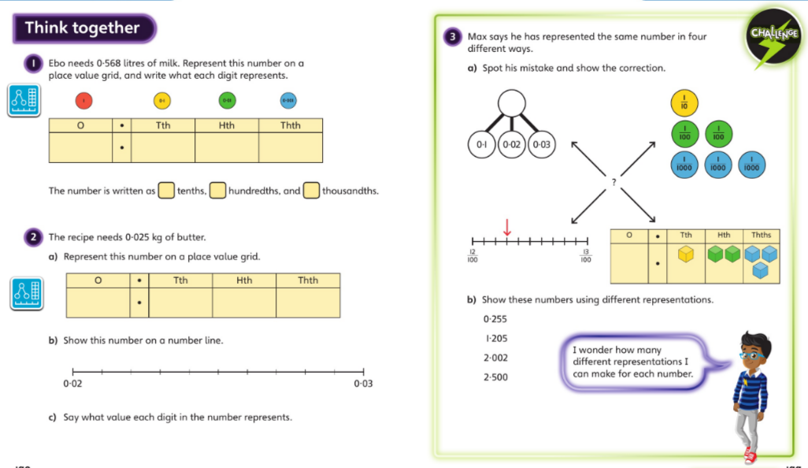
Discuss with your carers and then work independently in your maths books.
Now complete Year 5 Unit 11 Lesson 6 in your books

Slide 3
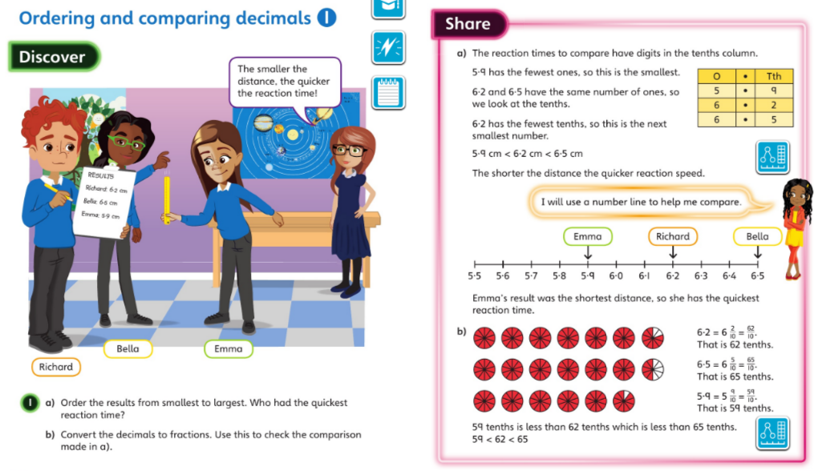
Tuesday 21.4.2020 Y5 Modelled examples Unit 11 lesson 7
You may also wish to visit https://whiterosemaths.com/homelearning/year-5/ Spring Week 2 Lesson 2 - Order and compare decimals for a virtual lesson.

Slide 4
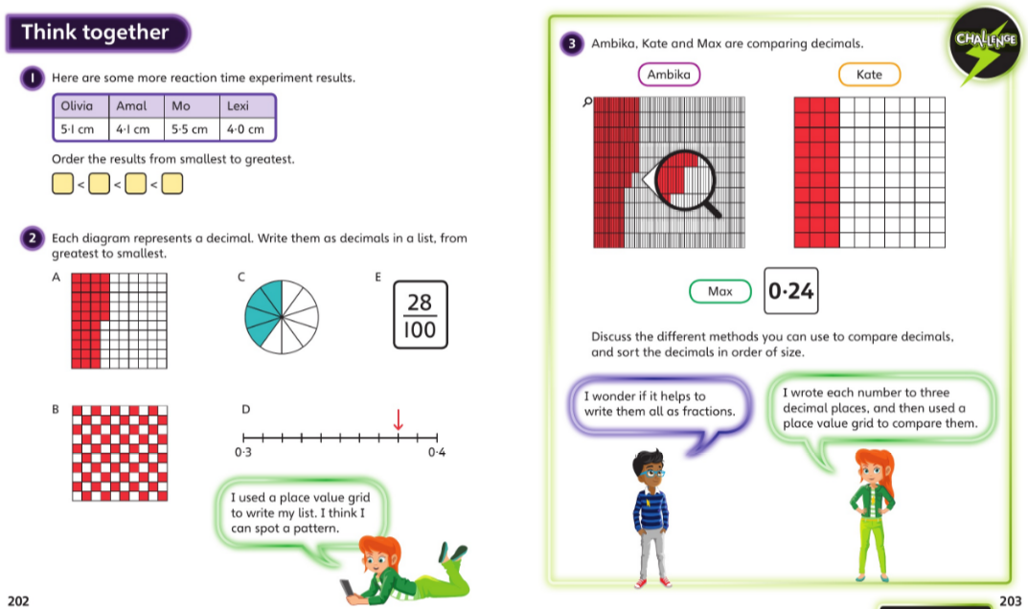
Discuss with your carers and then work independently in your maths books.

Slide 5
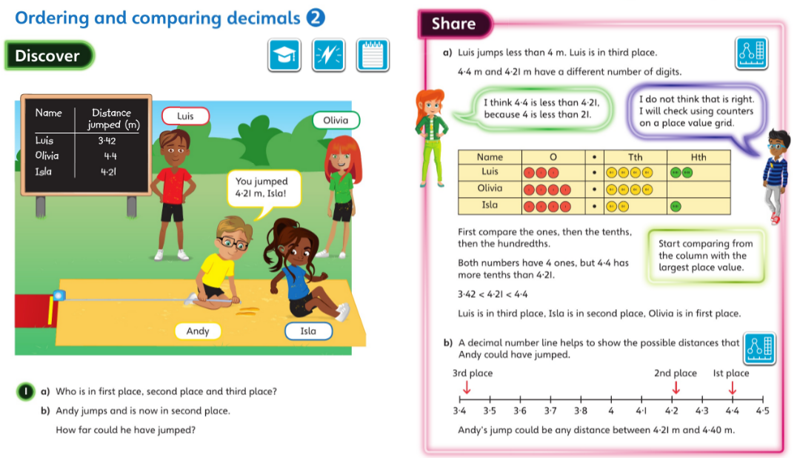
Wednesday 22.4.2020 Year 5 Modelled Examples Unit 11 Lesson 8

Slide 6
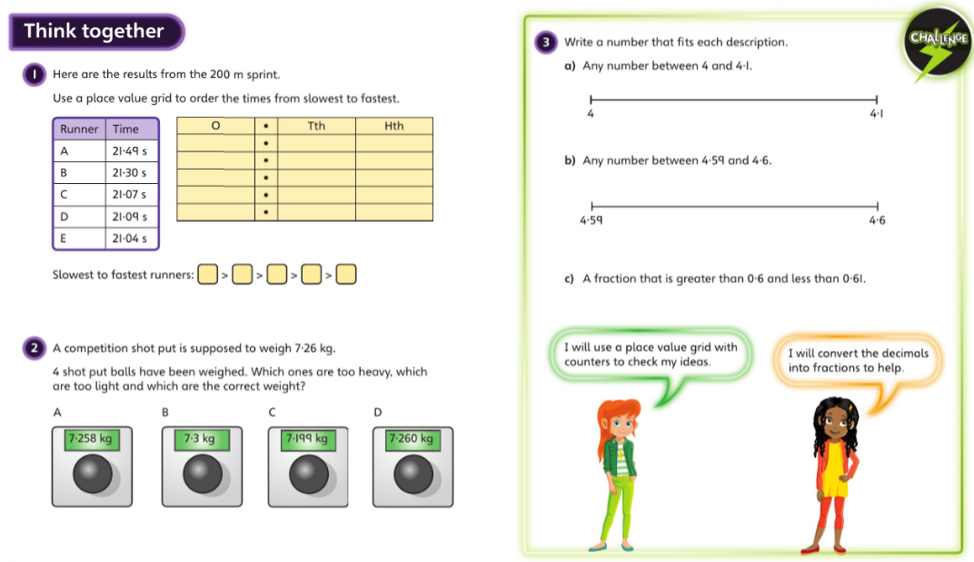
Discuss with your carers and then work independently in your maths books.

Slide 7
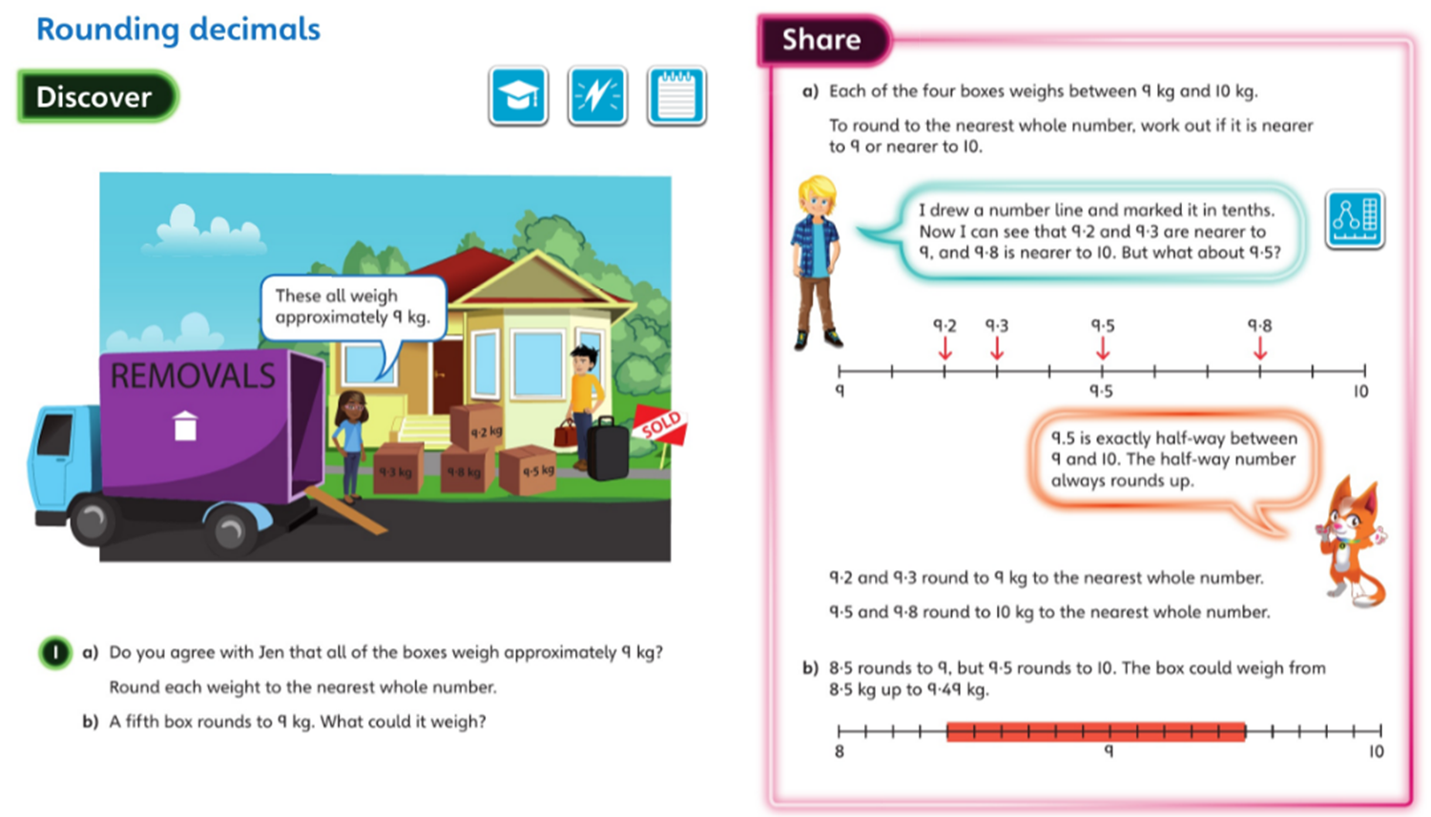
Thursday 23.4.2020 Year 5 Modelled Examples Unit 11 Lesson 9
You may also wish to visit https://whiterosemaths.com/homelearning/year-5/ Spring Week 2 Lesson 1 - Rounding decimals for a virtual lesson.

Slide 8
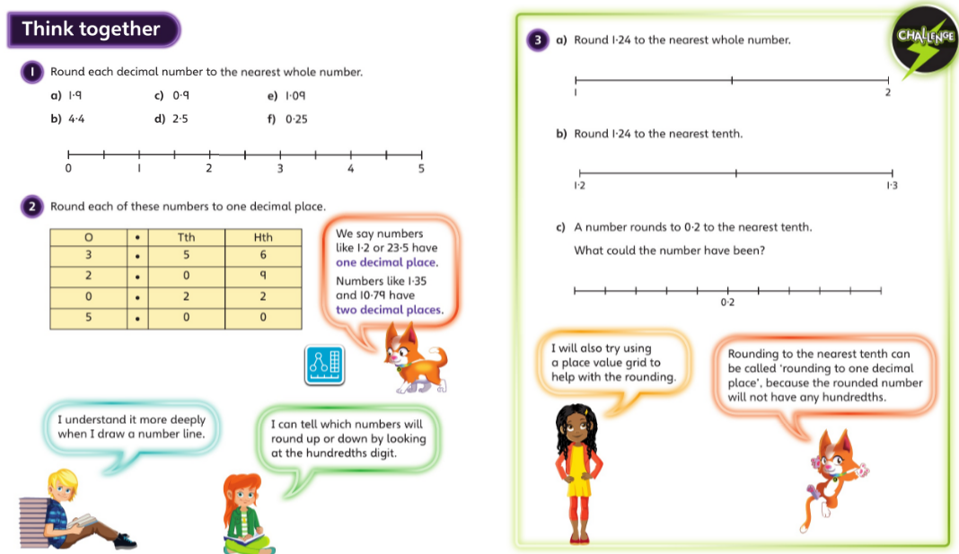
Discuss with your carers and then work independently in your maths books.

Slide 9
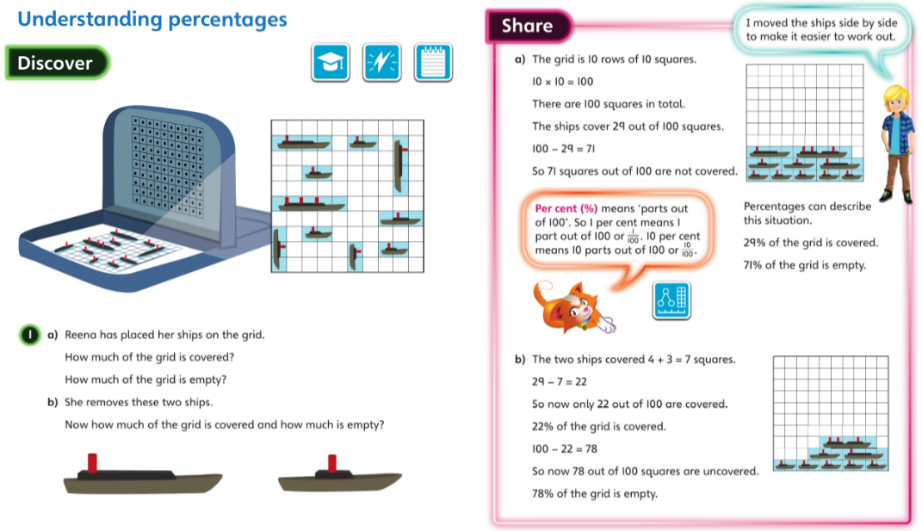
Friday 24.4.2020 Year 5 Modelled Examples Unit 11 Lesson 10
You may also wish to visit https://whiterosemaths.com/homelearning/year-5/ Spring Week 2 Lesson 3 - Understand percentages for a virtual lesson.

Slide 10
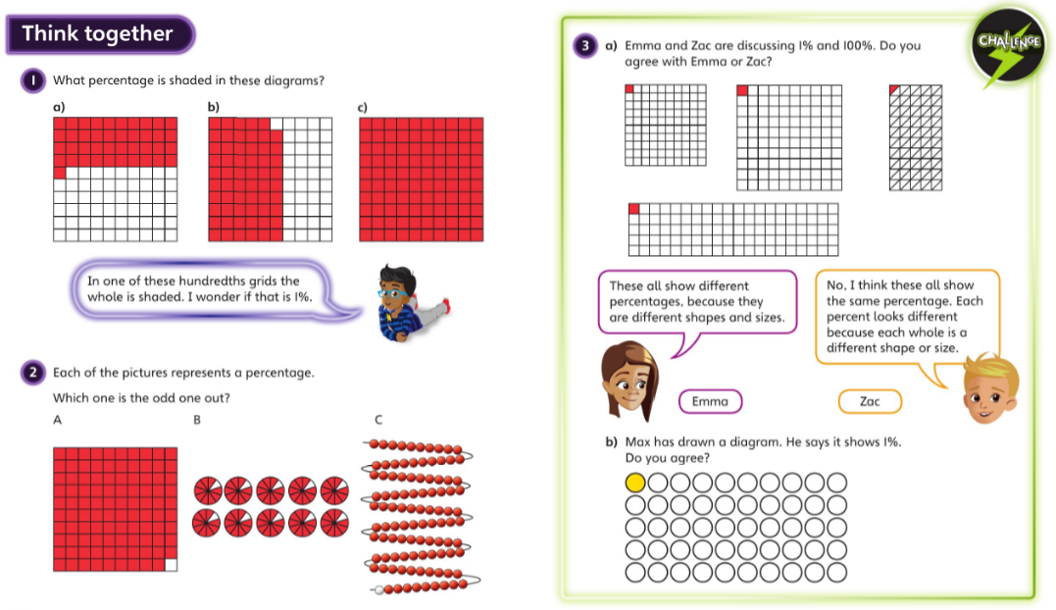
Discuss with your carers then complete the activities in your maths book

