Slide 1
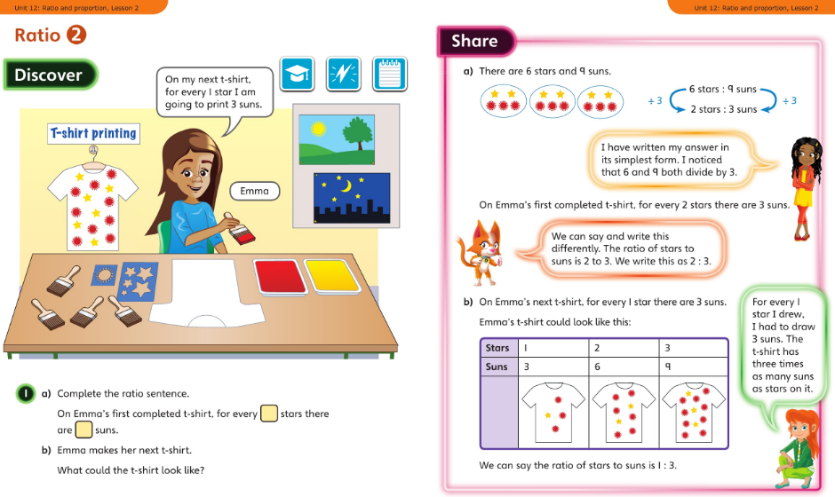
Monday 20.4.2020 Year 6 Modelled example Unit 12 Lesson 2
You may also wish to visit https://whiterosemaths.com/homelearning/year-6/ Week 1 Lesson 3 - Introducing the ratio symbol for a virtual lesson.

Slide 2
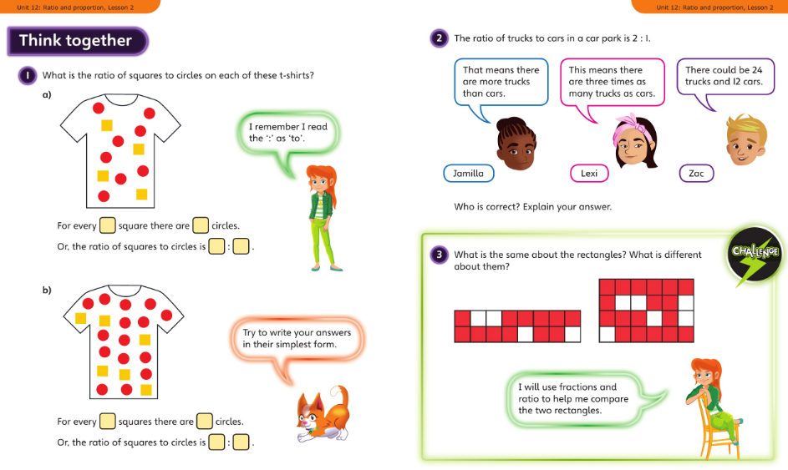
Discuss with your carer and then complete the lesson in your book

Slide 3
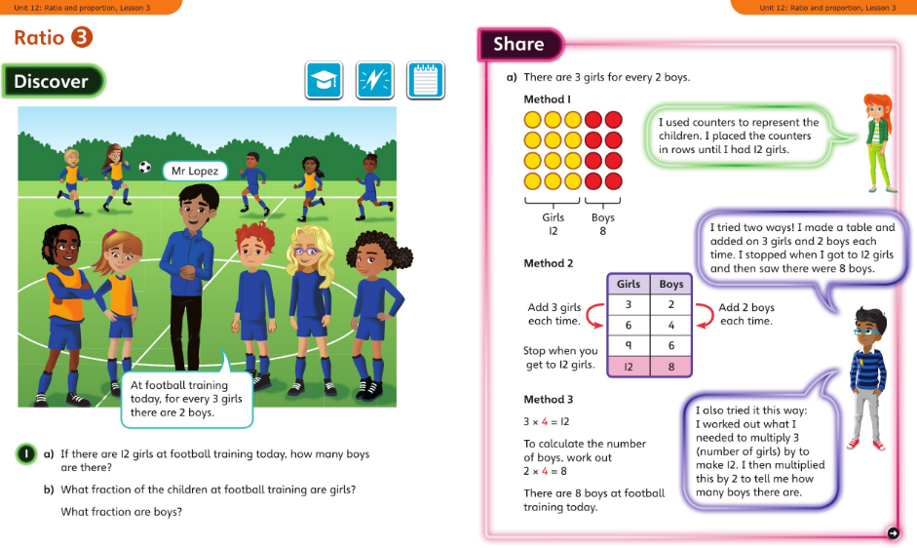
Tuesday 21.4.2020 Y6 Modelled Example Unit 12 Lesson 3
You may also wish to visit https://whiterosemaths.com/homelearning/year-6/ Week 1 Lesson 4 - Calculating ratio for a virtual lesson.

Slide 4
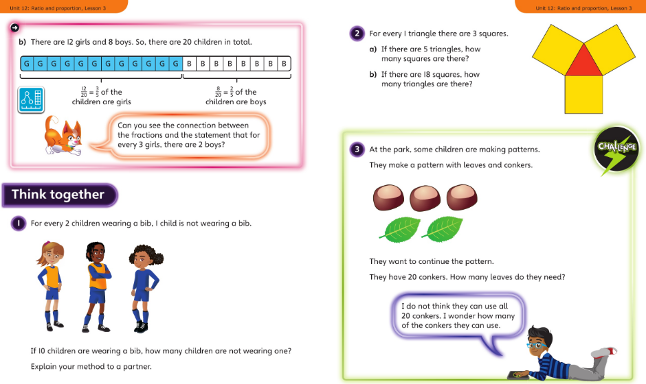
Discuss with your carer and then complete the lesson in your book

Slide 5
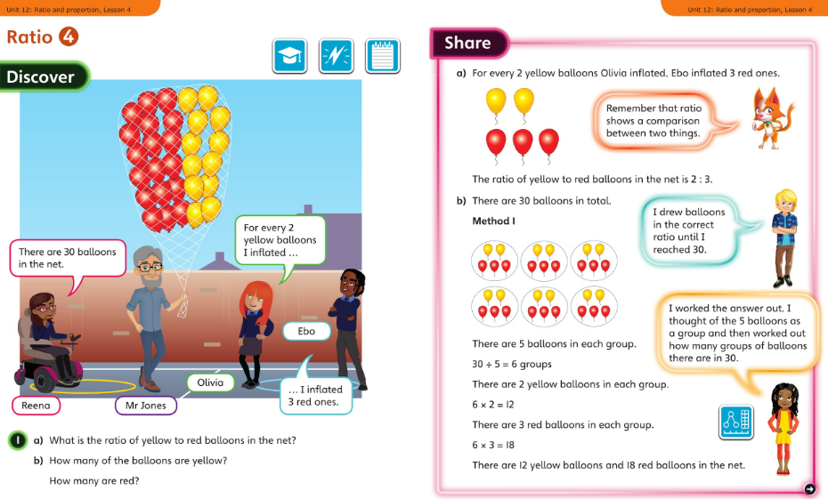
Wednesday 22.4.2020 Y6 Modelled Example Unit 12 Lesson 4

Slide 6
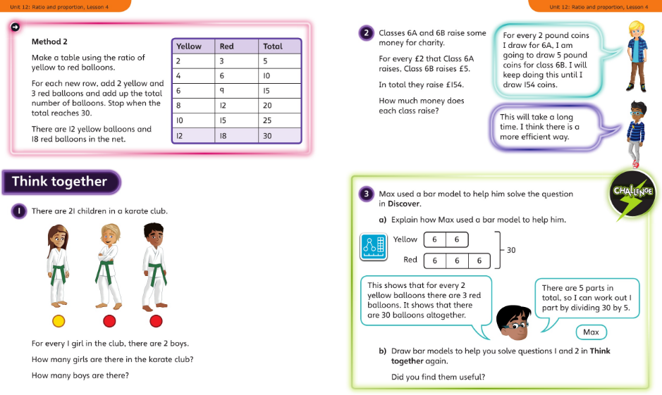

Slide 7
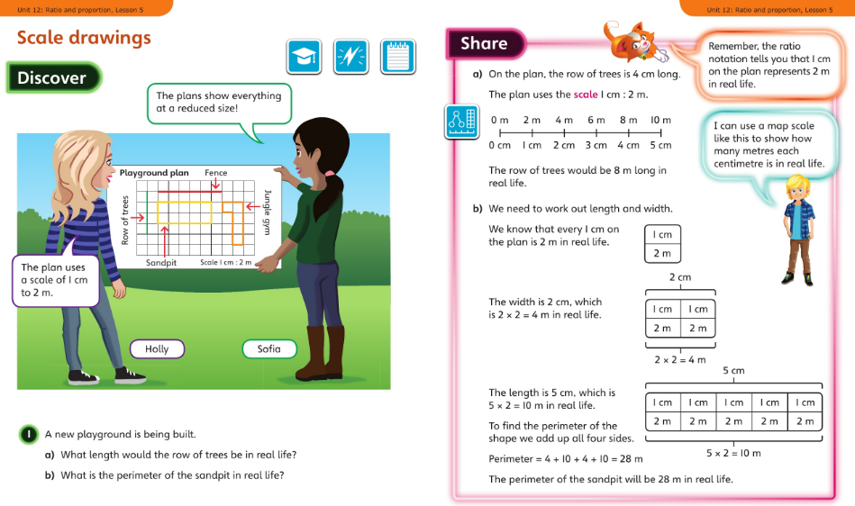
Thursday 23.4.2020 Y6 Modelled Example Unit 12 Lesson 5

Slide 8
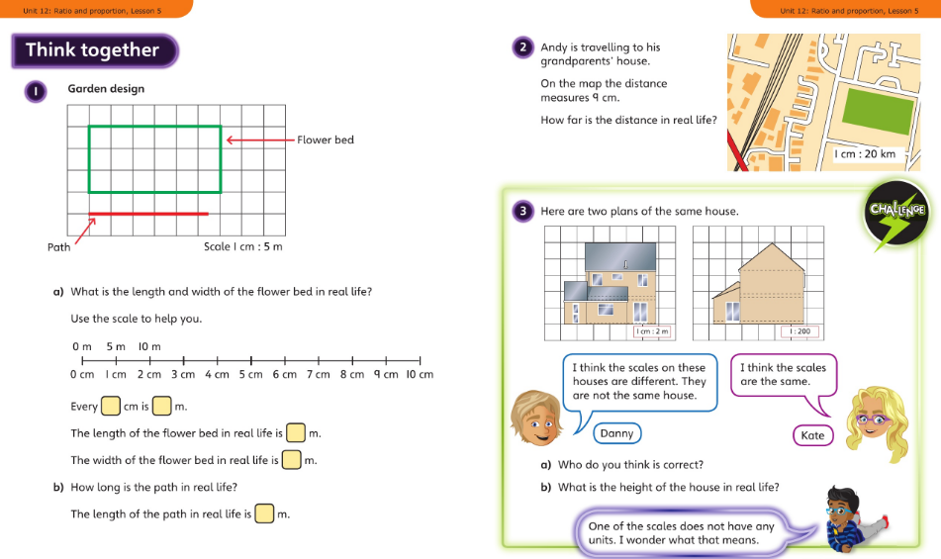
Discuss with your carer and then complete the lesson in your book

Slide 9
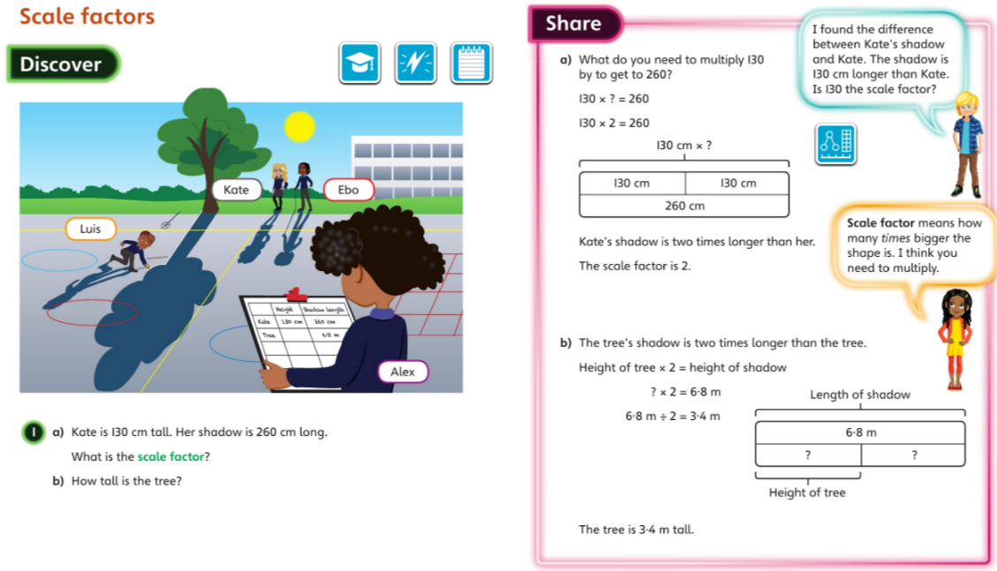
Friday 3.4.2020 Y6 Modelled Example Unit 12 Lesson 6
You may also wish to visit https://whiterosemaths.com/homelearning/year-6/ Week 1 Lesson 5 - Using scale factors for a virtual lesson.

Slide 10
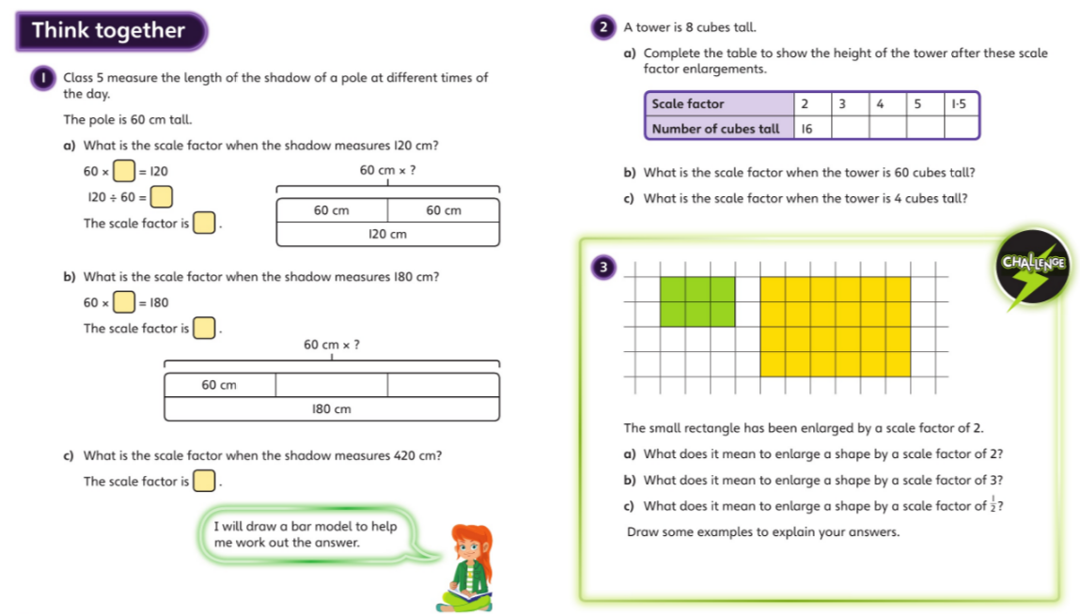
Discuss with your carer and then complete the lesson in your book

