Slide 2
Aim
I can recognise and manage uncomfortable feelings.
Success Criteria
I am able to describe and discuss a range of emotions.
I understand how our feelings can impact on our thoughts and actions.
I can suggest strategies to cope with uncomfortable or unpleasant emotions.
This resource is fully in line with the Learning Outcomes and Core Themes outlined in the PSHE Association.

Slide 3
The Big Questions

Slide 4

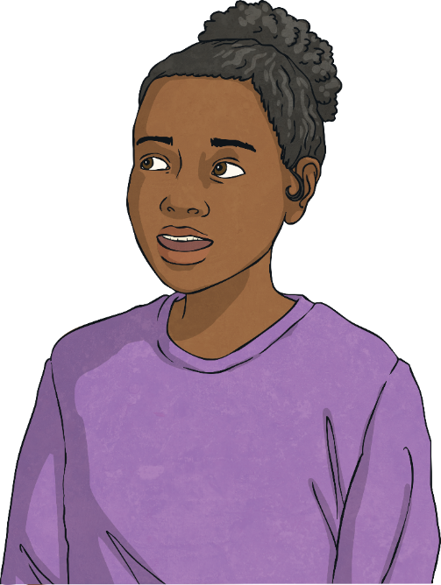
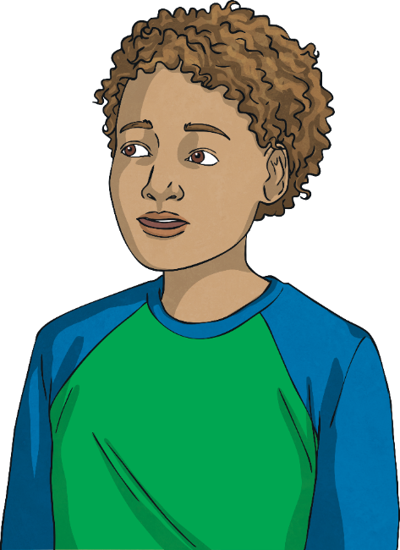
What can we do to manage uncomfortable feelings?
How do uncomfortable feelings affect our thoughts and actions?

Slide 5
Reconnecting

Slide 6

When Did You Last Feel…
Let’s think about our emotions and try to recall a time when we recently felt the different feelings below. When each emotion pops up, jot down a time you can remember feeling like this and what caused that emotion.
nervous
angry
guilty
not good enough
upset
embarrassed
lonely
frustrated
anxious
jealous

Slide 7
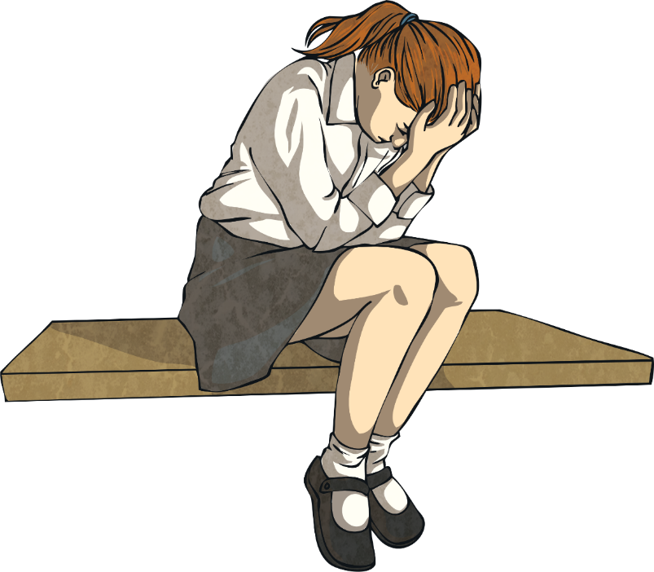
When Did You Last Feel…
We all experience these uncomfortable or unpleasant emotions sometimes and different things trigger these feelings in different people. What makes one person anxious might be no problem for someone else and something that angers one individual simply might not bother another.
It is important to remember that what others feel and experience is real to them, just as our emotions are real to us. And, although the triggers might be different, the feelings can be very similar.

Slide 8
Exploring

Slide 9
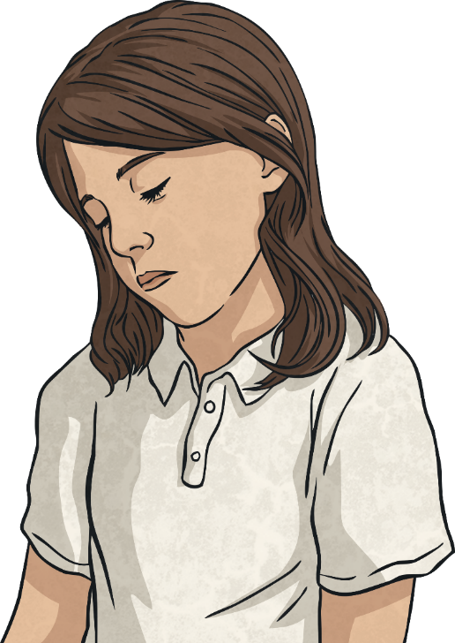
What Is Mental Wellbeing?
Mental wellbeing refers to our feelings and thoughts. Our feelings and thoughts are our mind's way of letting us figure out what is going on in our lives and how to react or respond.
Feeling uncomfortable or unpleasant emotions from time to time is normal. However, if we are experiencing negative feelings often, or we are worried about our negative feelings, it can be a sign that we need help with our mental wellbeing.

Slide 10
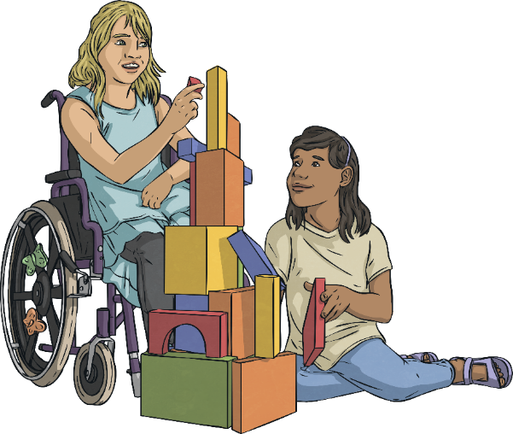
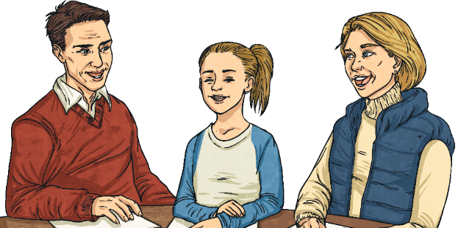
What Is Mental Wellbeing?
If we are feeling particularly low, anxious, lonely or isolated, it means we are experiencing poor mental wellbeing and we need to seek support.
Who could you turn to for support with your mental health and wellbeing?
If someone we know doesn't seem to be coping well or doesn't seem to be their normal self, then we might need to seek support on their behalf.

Slide 11
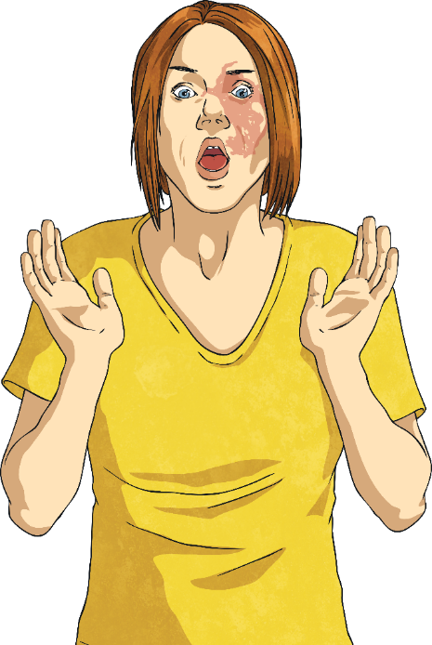
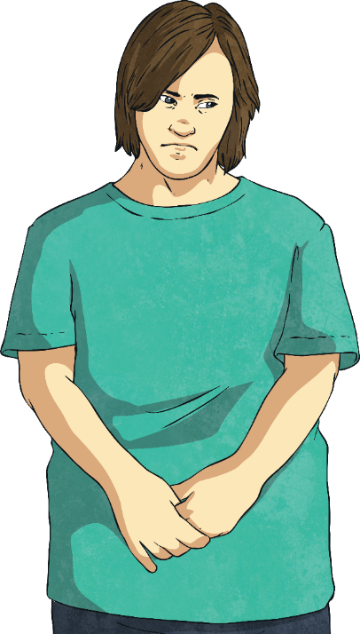
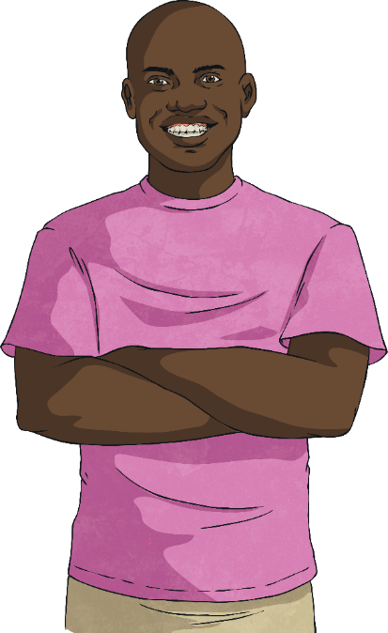
What Is Mental Wellbeing?
One thing we can all do to improve our mental wellbeing is become familiar with different feelings and emotions and learn to describe them. This can help when getting help to support positive mental health.

Slide 12
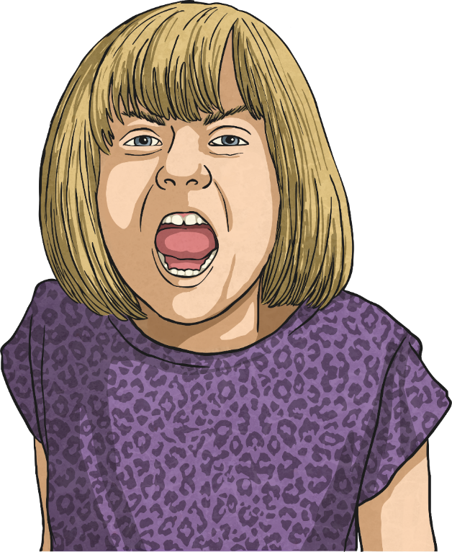
Recognising and Describing Our Feelings
Experiencing the feelings we have discussed can be very unpleasant and even a little frightening, especially if they are emotions we do not have much experience of.
However, we can become better at coping with these uncomfortable emotions, if we try to better understand them.

Slide 13
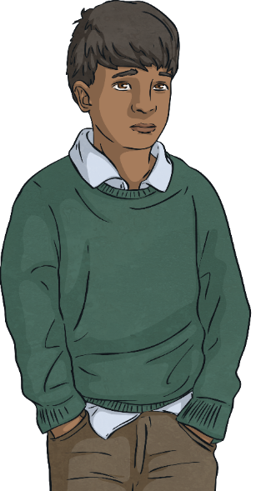
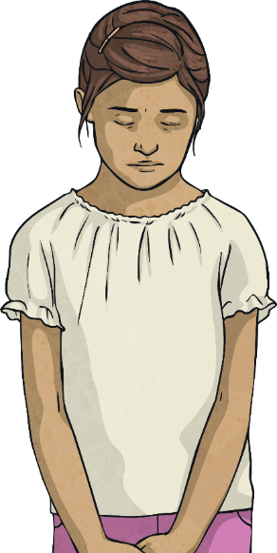
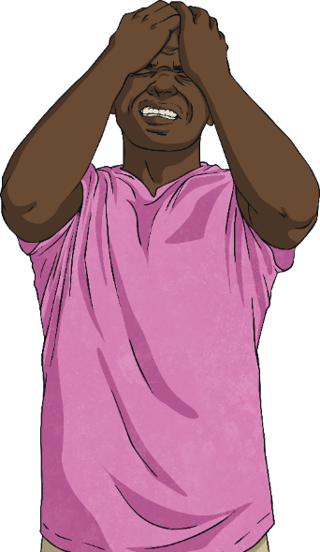
Recognising and Describing Our Feelings
Let’s explore some of those emotions mentioned earlier in more depth.
Talk to your family and try to answer the following questions:
What does sadness feel like?
How do you feel inside when
you are nervous?
What kinds of thoughts go through your mind when you feel embarrassed?
Whereabouts in your body do you
feel anger?

Slide 14
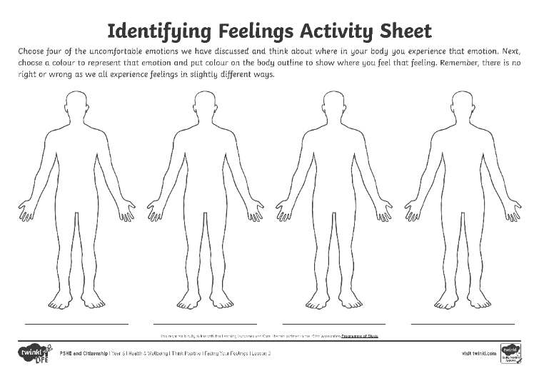
Recognising and Describing Our Feelings
Sometimes it can be useful to identify an emotion you are experiencing and label it in some way. Some people like to do this using colours.
Using the Identifying Feelings Activity Sheet, choose four different uncomfortable emotions and colour areas of the body that you feel these feelings, in the colour you associate with that emotion.
The colours we link to emotions, and where we feel these emotions in our bodies, might be different for everyone – there is no right or wrong here!

Slide 15
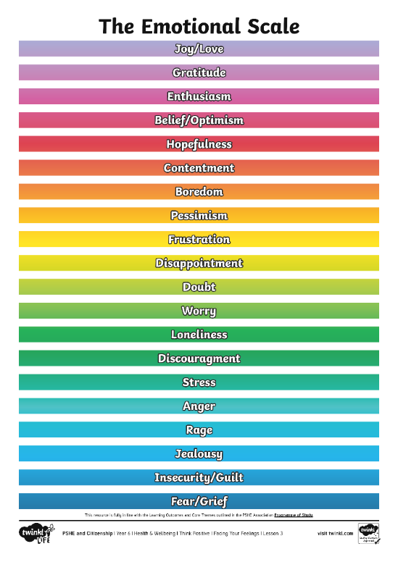
Recognising and Describing Our Feelings
Another thing that can be useful to do, in terms of understanding our feelings, is to rate the emotion, asking ourselves how serious or intense the emotion is.
We can do this by using a scale like this…

Slide 16
Recognising and Describing Our Feelings
So, we are learning to pay attention to our feelings, recognise how they feel in our bodies and even place them on a scale.
Now take a look at the following statement and take a few moments to think about it…
‘If feelings and emotions are inside us, they cannot have an impact on our actions, nor on anyone else.’
Do you agree or disagree with this statement?
Can you explain why you agree or disagree?

Slide 17
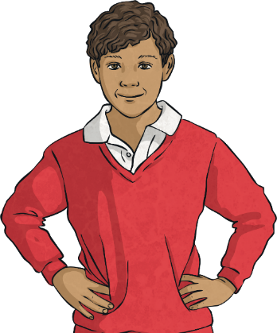
Understanding the Impact of Our Feelings
Some of you might have said that the way we feel can affect our actions – and our thoughts. Our thoughts, feelings and actions are all linked to one another.
Thoughts
Consolidating
Reflecting
Feelings
Behaviours

Slide 18
Consolidating

Slide 19
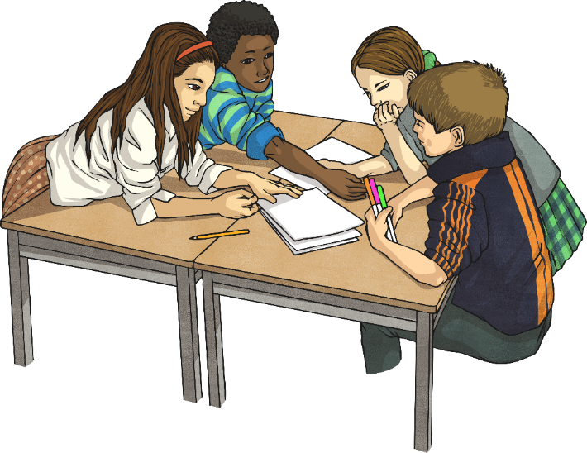
The Emotional Scale
You are now going to try an activity in your groups. Use the Emotions Scenario Cards to pick a scenario. Share it with your family, then discuss where you think that scenario should be on The Emotional Scale. Remember, there is no right or wrong and all individuals feel emotions differently. Try to come to an agreement as a family, listening to all members’ contributions.
Then, as a family, discuss what the child in the scenario might think and how they might act, as a result of experiencing that emotion..

Slide 20
Reflecting

Slide 21
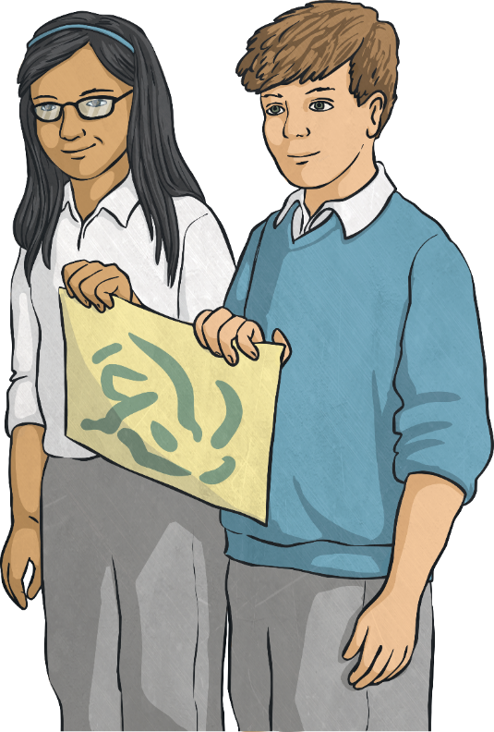
Managing Our Feelings
The more we experience different emotions, the more we learn how to deal with them.
Different people like to use different strategies to help manage their feelings.
Talk to your family about any strategies you use, or have heard about, to help manage uncomfortable emotions.

Slide 22
Managing Our Feelings
Let’s think about some of your ideas about how to deal with uncomfortable feelings.
Did you think of any of these?
Talk to someone about how you are feeling.
Count to ten and focus on your breathing.
Take some time out, away from the current situation.
Write your feelings down.
Listen to music or spend time with a pet.

Slide 23
The Big Questions

Slide 24
What can we do to manage uncomfortable feelings?
How do uncomfortable feelings affect our thoughts and actions?

Slide 25
Aim
I can recognise and manage uncomfortable feelings.
Success Criteria
I am able to describe and discuss a range of emotions.
I understand how our feelings can impact on our thoughts and actions.
I can suggest strategies to cope with uncomfortable or unpleasant emotions.

